Slide 1


Subbies
COMPLIANCE BUILDS PROGRESS
CONTRACTOR ONBOARDING & COMPLIANCE
Stop chasing subcontractors for expired documents.
Collect, review and track your contractors' compliance documents. One secure link. No contractor logins.

Slide 2
01 THE PROBLEM
Chasing paperwork is a job on its own
WHERE IT LIVES TODAY
Insurance certificates, licences and workers comp arrive by email, text and photo. Someone files them somewhere. Nobody is sure which copy is current.
DOCUMENT
WHERE IT IS
CURRENT?
Public liability
Concreter
An email from March
Unsure
Workers' comp
Scaffolder
A shared spreadsheet
Unsure
It costs an afternoon every time you chase one down.
Trade licence
Electrician
A photo on someone's phone
Unsure
White card
Labourer
A folder in the site office
Unsure

Slide 3
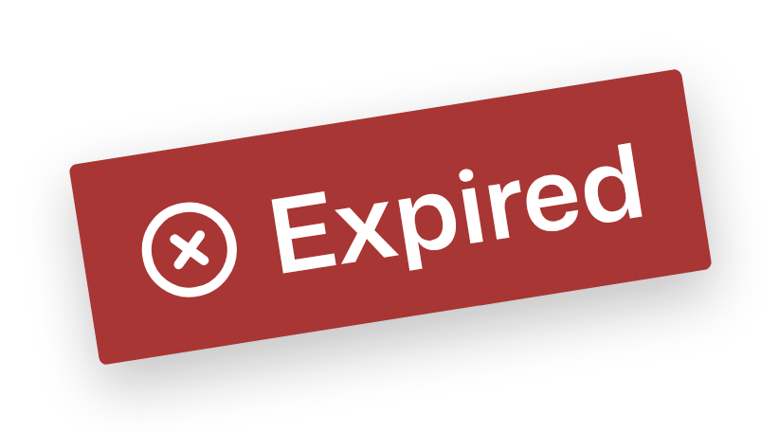
02 THE HIDDEN PROBLEM
EXAMPLE DATA
Approved once. Expired next year.
Insurance, licences and workers comp all carry expiry dates, and each one restarts the chase. A lapse stays invisible right up until it isn't.
CERTIFICATE OF CURRENCY
Public liability insurance
Insured
Concreting Co.
Collected
→
Approved
→
Expires
→
Chase again
Policy
PL-000000
Expiry
20 Oct 2026
Then it starts over, for every contractor you use.

Slide 4
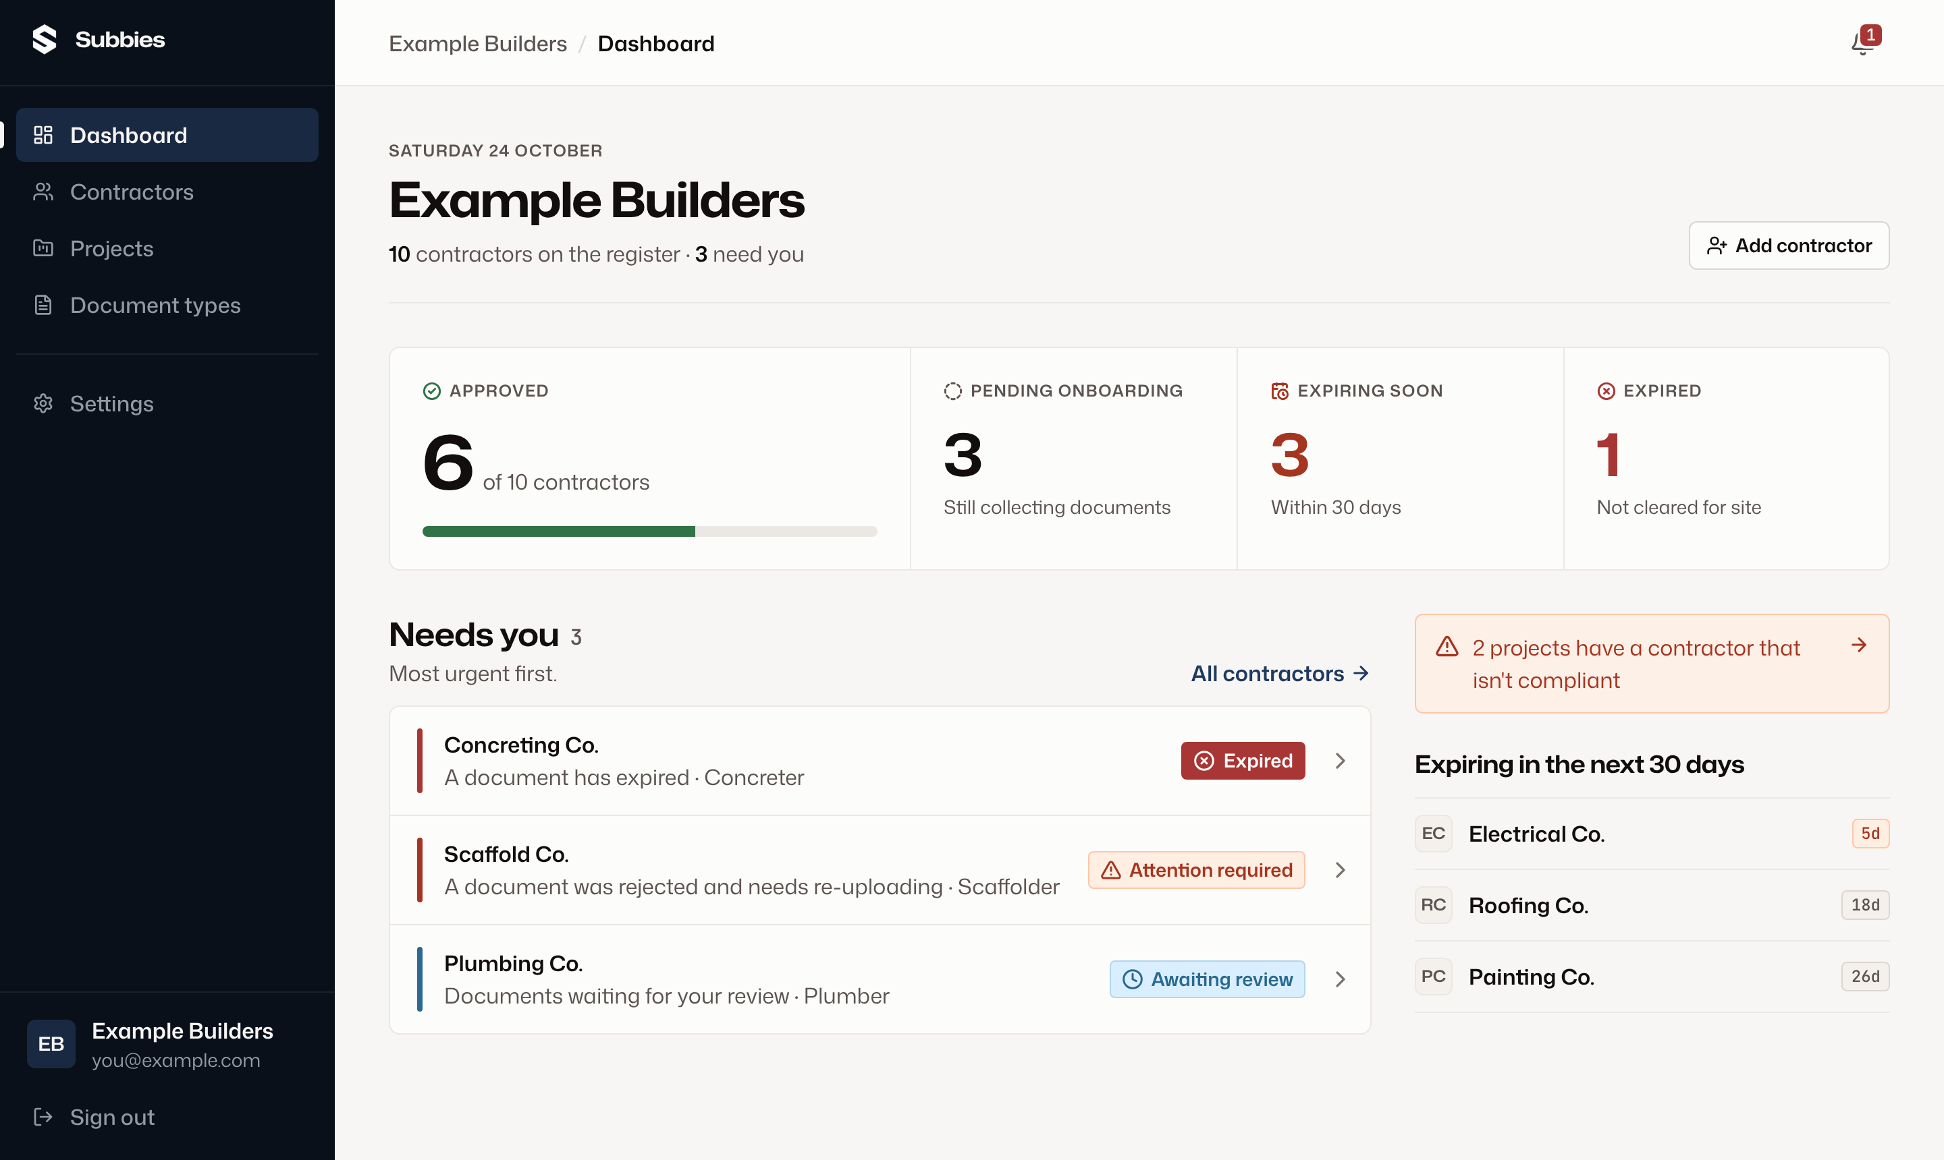
03 MEET SUBBIES
EXAMPLE DATA
Know who's cleared for site
Subbies collects your contractors' compliance documents through one secure link, puts them in one place for review, and reminds everyone before anything expires.
CONTRACTOR LOGINS
None. One link.
ACCEPTED FILES
PDF, JPG, PNG, HEIC
EXPIRY REMINDERS
On your schedule

Slide 5

04 HOW IT WORKS
From request to cleared for site
01 Onboard
02 Collect
03 Review
04 Track
YOU
Add a contractor and tick the documents you need
Approve with an expiry date, or reject with a reason
See who's cleared and what's expiring
SUBBIES
Emails them a secure upload link
Tells you when files arrive
Emails the rejection reason back
Reminds them before expiry and alerts you if it lapses
CONTRACTOR
Opens the link on their phone, uploads, submits
Re-uploads anything that was rejected
Uploads the renewal on the same link
No contractor account at any step. The link is unique to them and needs no password.

Slide 6
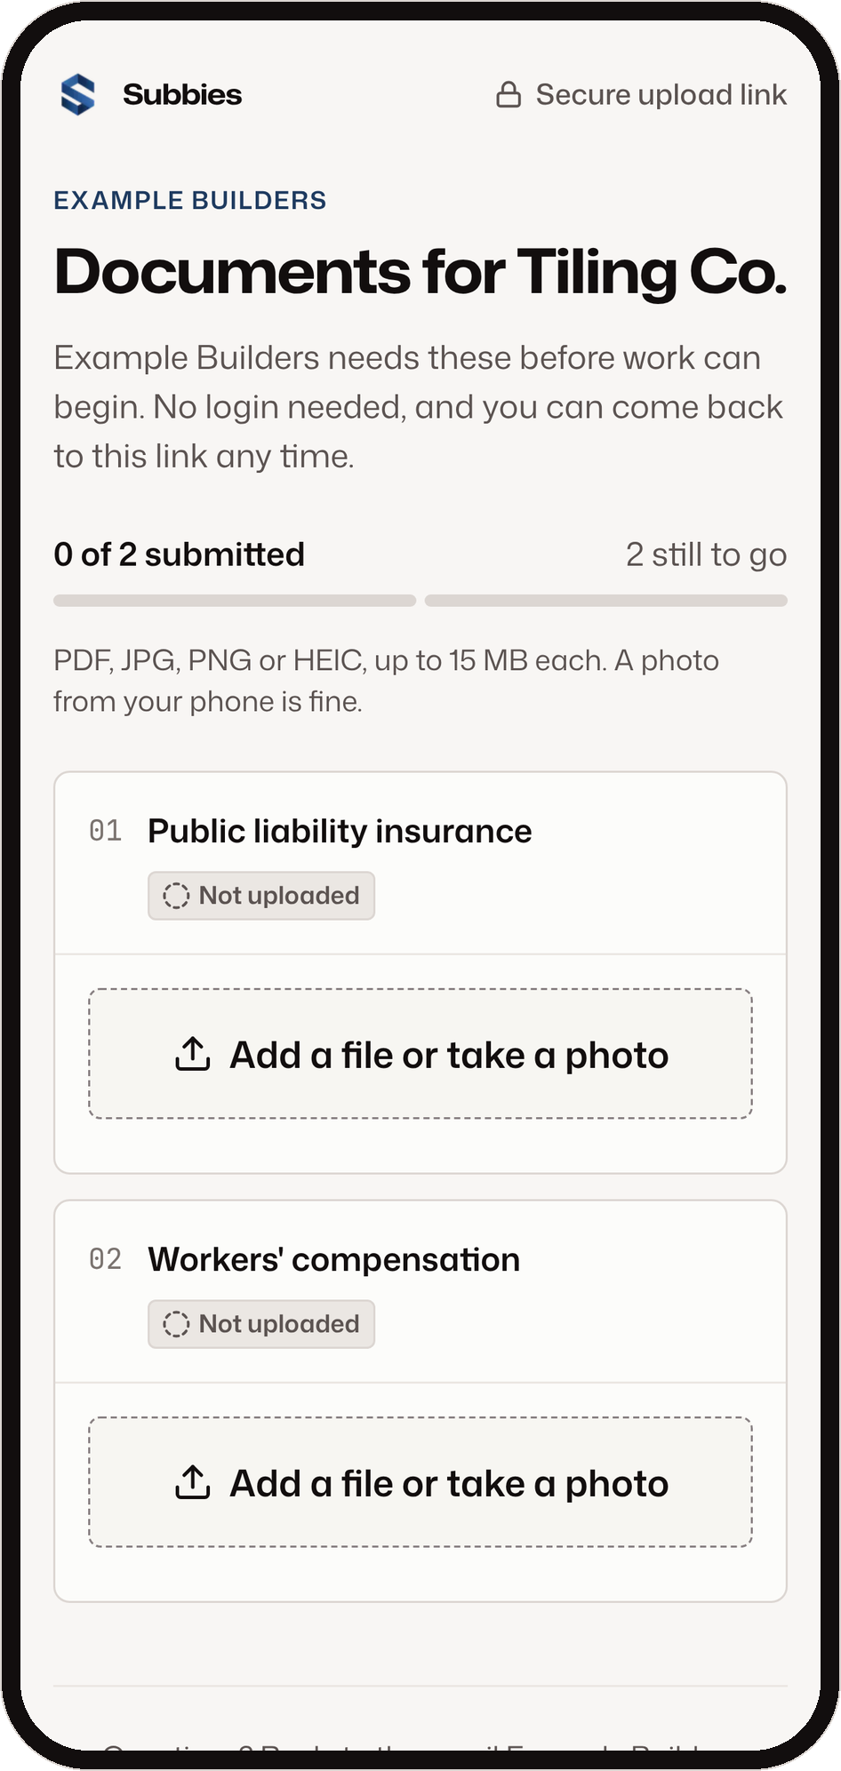
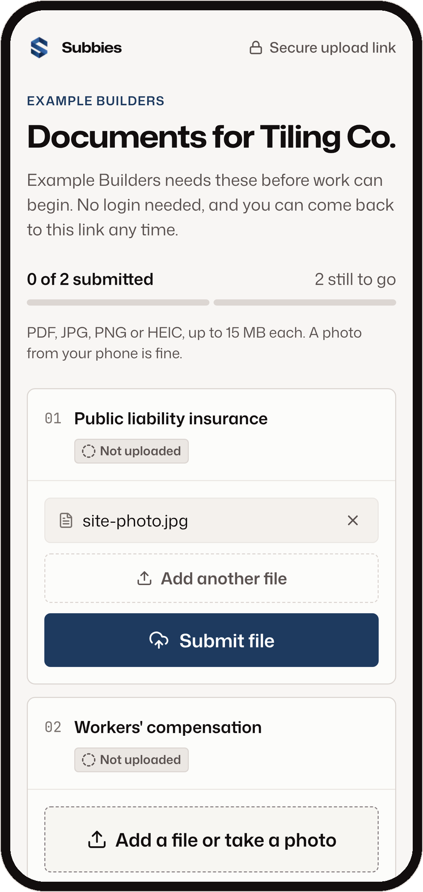
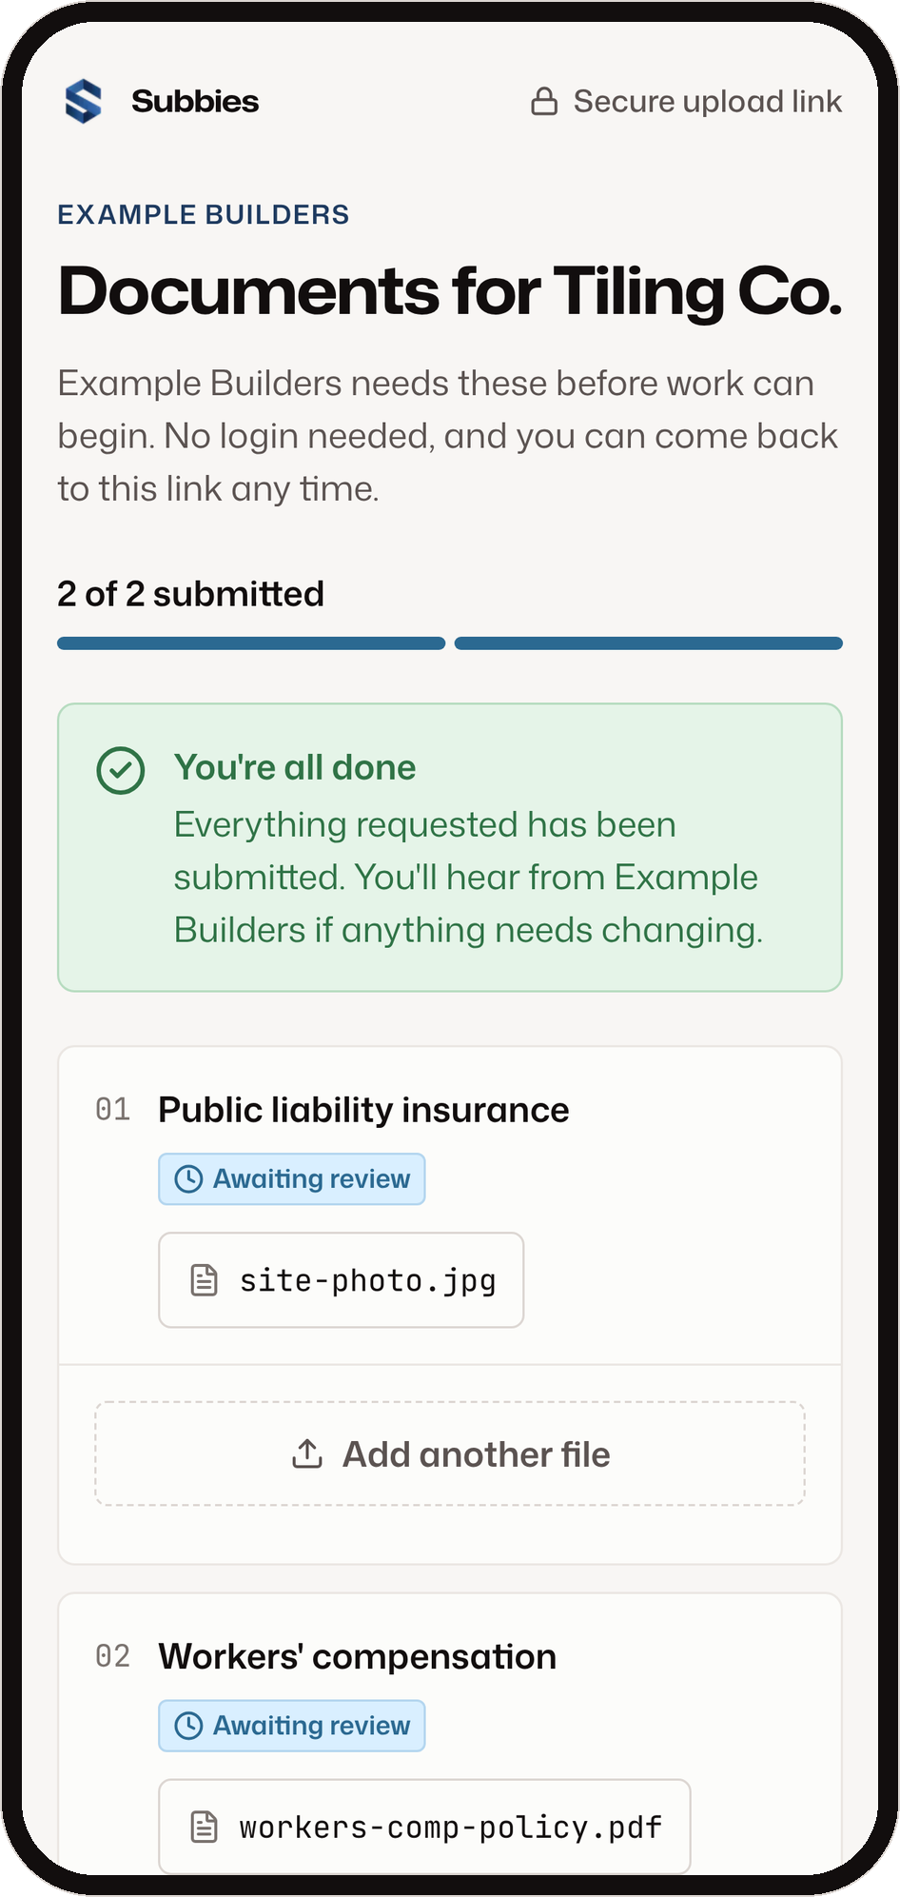
05 FOR THE CONTRACTOR
EXAMPLE DATA
No account. No password. Just a link.
They get a plain email from your business, open the link on their phone, and send what's asked for.
01
02
03
01 Open the link
02 Add a file or take a photo
03 Submit. Done.
PDF, JPG, PNG or HEIC, up to 15 MB each. The same link still works when a document renews.

Slide 7
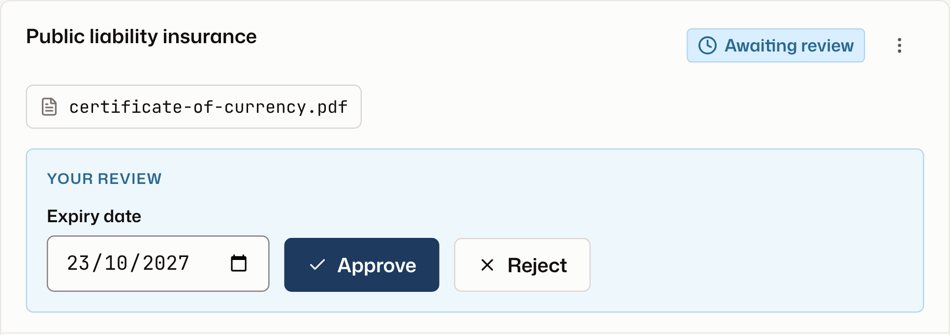

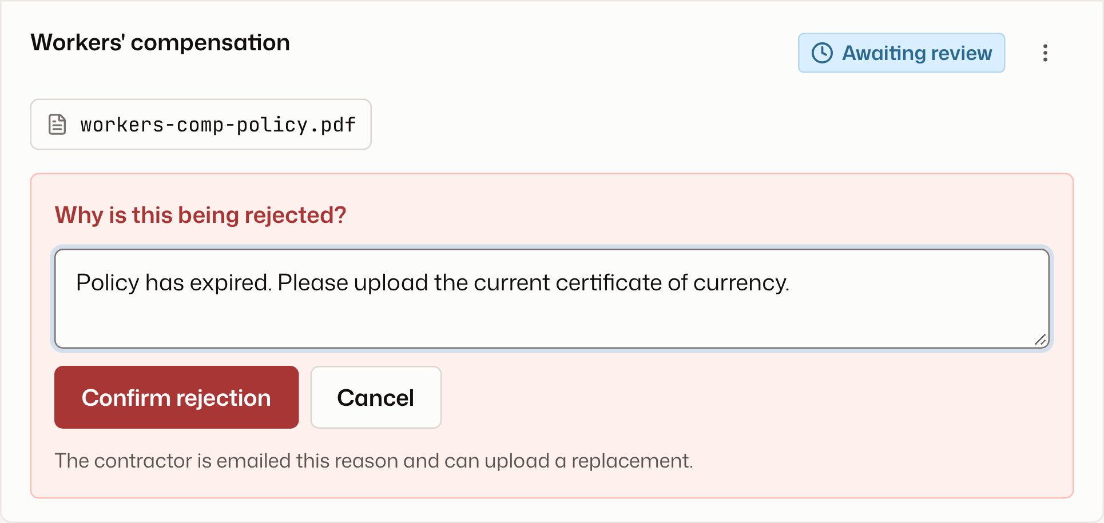
06 FOR YOUR BUSINESS
EXAMPLE DATA
Every document checked before it counts
Open each file, set its expiry date and approve it. Or reject it with a reason, and Subbies emails that reason to the contractor.
Expiry date prefilled from the document type
OR
Files open through short-lived secure links
Ask for an updated copy while the current one stays valid

Slide 8
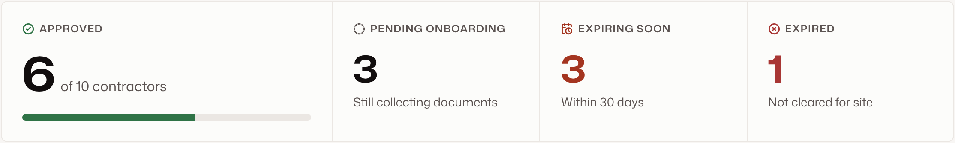

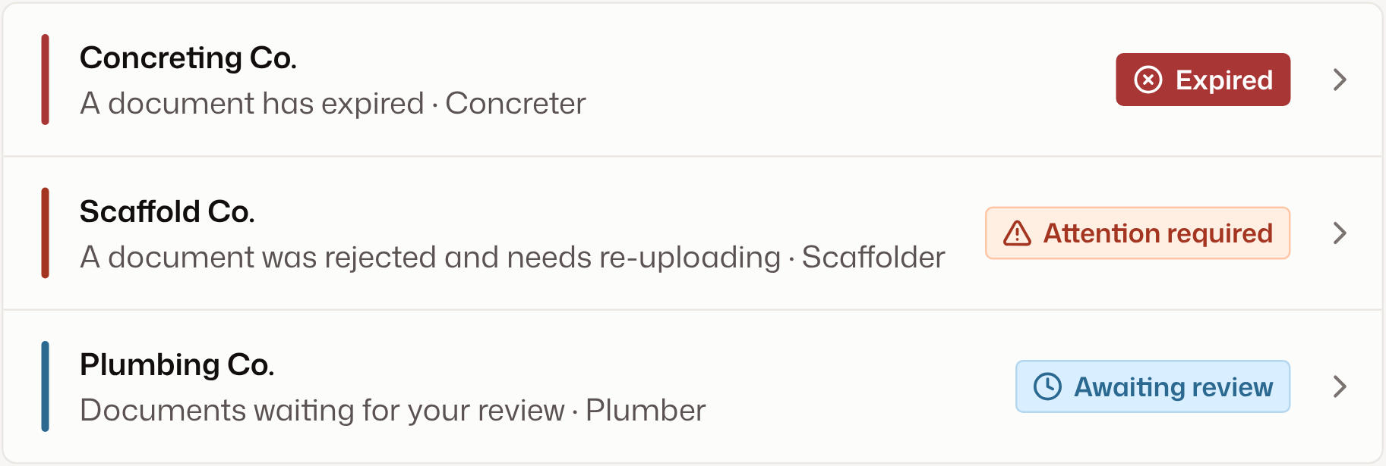




07 THE DASHBOARD
EXAMPLE DATA
What needs you, worst first
Expired first, then rejected, then waiting for review. Everything expiring in the next 30 days sits alongside.
EVERY STATUS, IN PLAIN WORDS
Approved
Every document approved and current
Awaiting review
Files are in and waiting on you
Attention required
A document was rejected
Pending onboarding
Still collecting documents
Expired
Not cleared for site

Slide 9
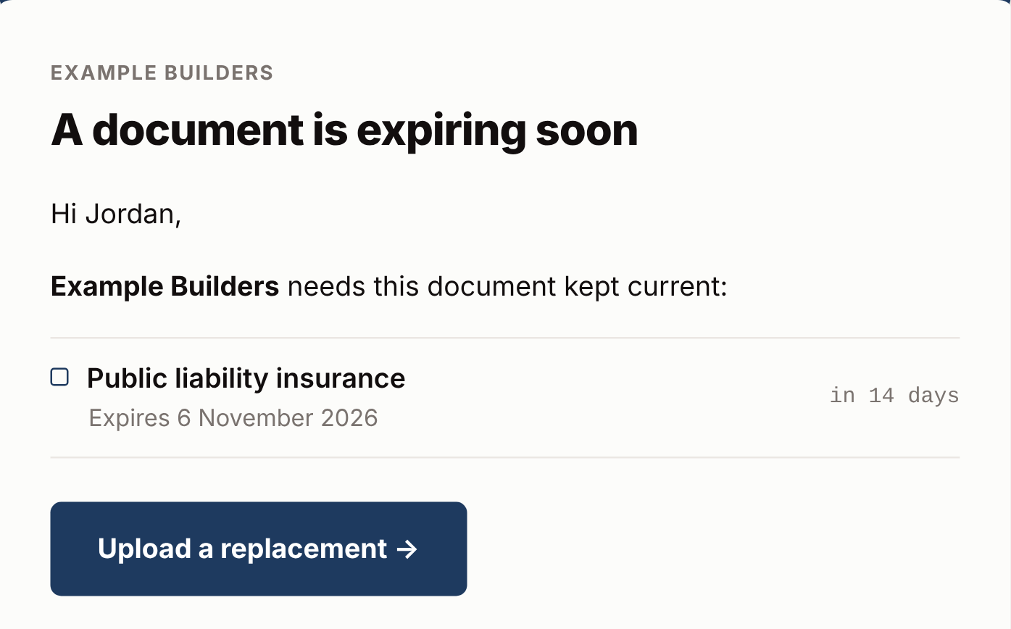
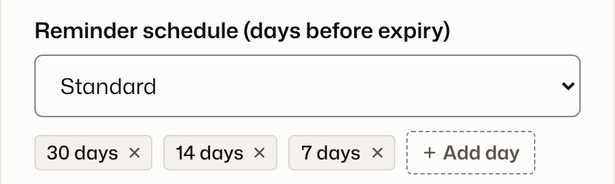
08 ONGOING COMPLIANCE
EXAMPLE DATA
Reminders go out before anything lapses
Choose a reminder schedule for each document type. Subbies emails the contractor ahead of expiry, and alerts you once something lapses.
YOUR SCHEDULE, PER DOCUMENT TYPE
THE EMAIL THE CONTRACTOR GETS
Approved
30 days
14 days
7 days
Lapsed
Expiry date set
Contractor emailed
Contractor emailed
Contractor emailed
You're alerted

Slide 10
09 WHAT IT DOES
Built around the compliance workflow
01
02
03
04
Onboard
Collect
Review
Track
Add contractors with trade, ABN and contact
Mobile-first upload page
Files open through short-lived secure links
Reminder schedule per document type
Choose the documents each one owes you
Several files per document, or a photo
Approve with an expiry date
Alert email once something lapses
Define your own document types
PDF, JPG, PNG and HEIC
Reject with a reason, emailed
Dashboard of what needs you
One secure link, emailed for you
Notified when files arrive
Request an updated copy any time
One-click resend of requests
AROUND IT
Compliance per project
Activity history
Private notes
Document history
In-app notifications

Slide 11
10 WHY SUBBIES
A focused tool that does one job well
01
02
Focused
Easy for contractors
One question: which contractors are compliant. Not job management, accounting or a CRM.
No app, no account, no password. A link and a phone is all they need.
03
04
Built around compliance
Sits alongside your tools
Status, expiry dates and reminders are the product itself, not a bolt-on module.
Keep the accounting and job software you already use. Subbies works next to it.

Slide 12
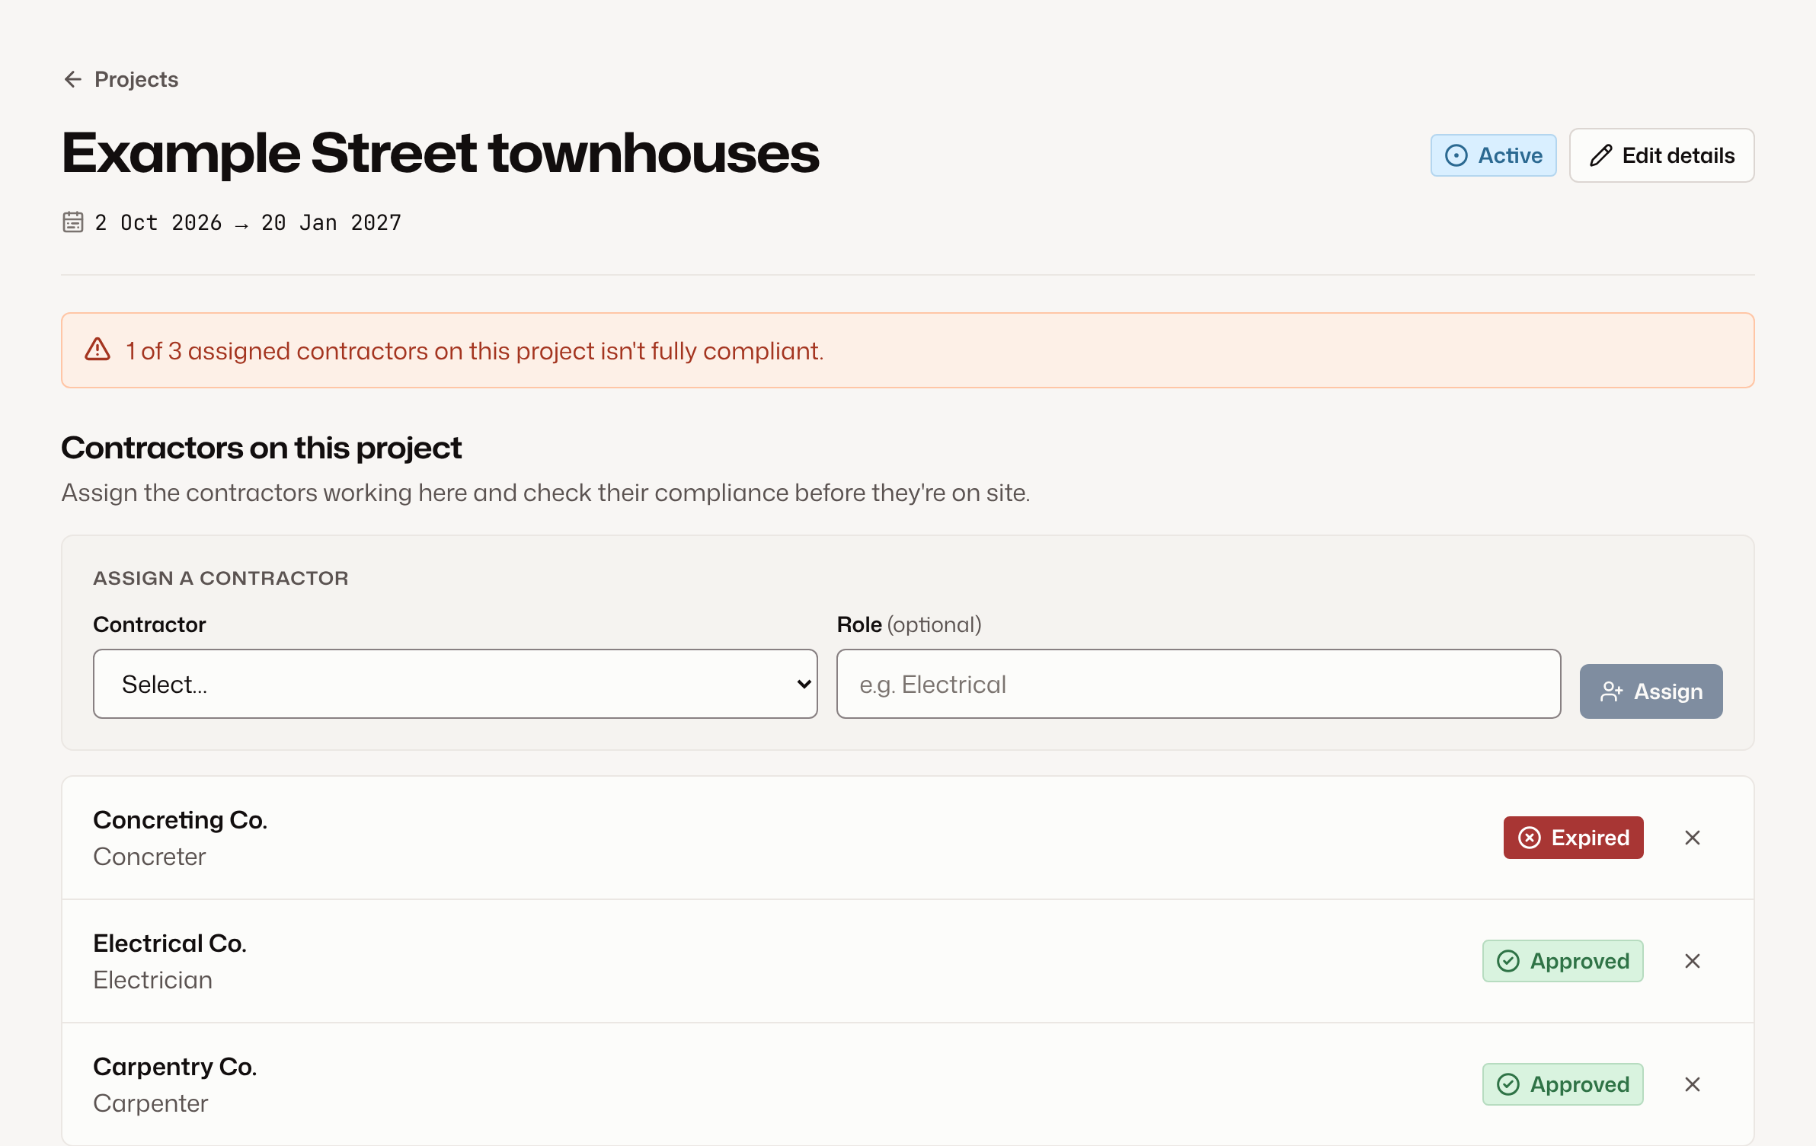
11 WHO IT'S FOR
EXAMPLE DATA
For anyone who relies on subbies
01
Builders and construction companies
Running jobs with a changing crew of trades
02
Trade businesses
Trades who subcontract part of the work
03
Property maintenance and facilities teams
Sending contractors to sites you're responsible for
04
Anyone managing external contractors
RUNNING JOBS? COMPLIANCE SHOWS PER PROJECT
If their paperwork has to be current, Subbies fits

Slide 13

Subbies
COMPLIANCE BUILDS PROGRESS
Stop chasing paperwork.
Know who's cleared for site.
Start a 7-day free trial
subbies-hazel.vercel.app
Plans from A$19 a month. Card required, nothing charged for 7 days.

