Slide 1
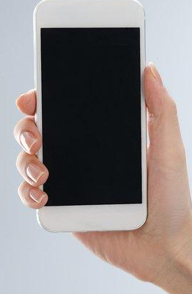
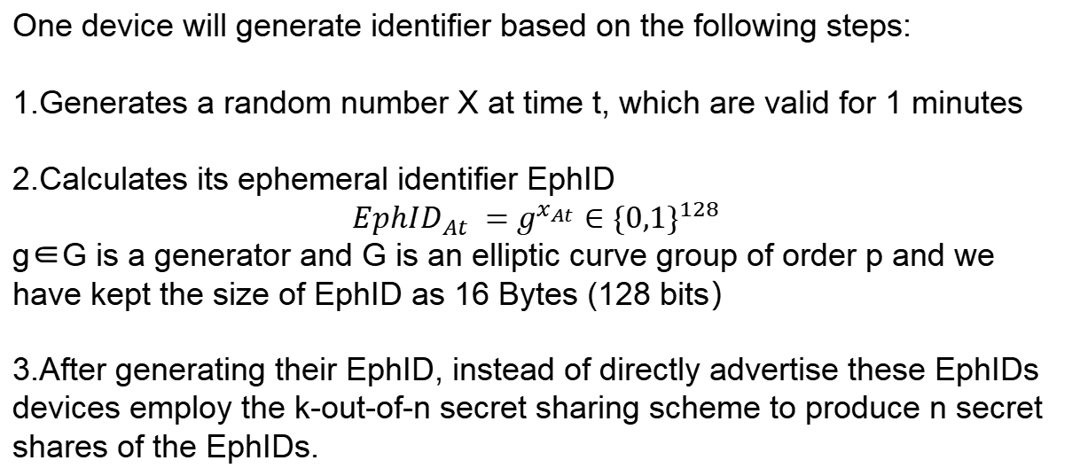
Generate identifier
Devices in DIMY protocol will periodically generate random ephemeral identifiers, which will be used to record the encounter of two devices.
One device will generate identifier based on the following steps:
1.Generates a random number X at time t, which are valid for 1 minutes
2.Calculates its ephemeral identifier EphID
$${EphID}_{At} =g^{x_{At}}∈{\{0,1\}}^{128}$$
g∈G is a generator and G is an elliptic curve group of order p and we have kept the size of EphID as 16 Bytes (128 bits）
3.After generating their EphID, instead of directly advertise these EphIDs devices employ the k-out-of-n secret sharing scheme to produce n secret shares of the EphIDs.

Slide 2
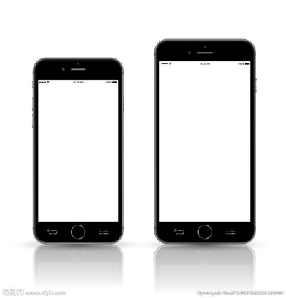
Regenerate identifier
Another phase of a secret sharing scheme is reconstruction, which means to reconstruct the identifier.
1. There is a unique player called the dealer who share the parts of the secret S
2. The dealer creates n shares of the secret S(S1,S2,...,Sn) and sends every player a share (say Si to player Pi) of the secret S
3. Once a receiver has collected any k out of n shares, it reconstructs the identifier.

