Slide 1

A COVID tracing system using DIMY Protocol
Group ID:
SIYING CHEN zID
JIAWEI GAO z5242283
ZHOU YUNTAO ZID

Slide 2
DIMY is a secure protocol that implements the privacy sharing mechanism in both client-end and the server-end which can be leveraged for contact tracing!
The DIMY protocol-based contact tracing system has three mean components: A PRIVACY Generating component, A privacy SHARING component and a privacy storage component.

Slide 3
PRIVACY GENERATION COMPONENT
Location: This component resides on the client-side as it the main approach to representing a client uniquely.
Description: periodically generate ephemeral identifiers as our private secret. This ephemeral ID represents the different devices or the owner of the device in the context of real life.
Implementation: A random number generator + Diffie-Hellman key exchange algorithm (Finite cyclic groups will be used for choosing a base),
Advantages: A good mechanism for key distribution. And a good approach to represent close contact.

Slide 4
PRIVACY SHARING COMPONENT
Location: The privacy sharing component resides on the client-side as well.
Description: This component coordinates with the privacy generating component providing an approach to represent groups of people who had close contact with each other.
Implementation: The Shamir Secret Sharing algorithm is used. This is also known as “k-out-of-n sharing “. Where the secret (here is the client’s ephemeral ID) is divide into n parts in total and the only way for the other client to reconstruct the ephemeral ID is to obtain at least K parts.
Advantages: Securely share the secret in an insecure context. Prevent a replay attack. To achieve integrity, the hash value of the secret can be shared as well.

Slide 5
PRIVACY STORAGE COMPONENT
Location: This component resides on both the client-side and the server-side.
Description: Providing an approach to efficiently and rapidly trace the contact, maintain fast and efficient storage, as well as the query mechanism.
Implementation: A special data structure called Bloom Filter is being used to implement this component. The combined Bloom filter data structure can be used for keeping record on the server or performing fast query lookup on the sever.
Advantages: A low overhead as well as efficient storage mechanism with fast lookup property.

Slide 6
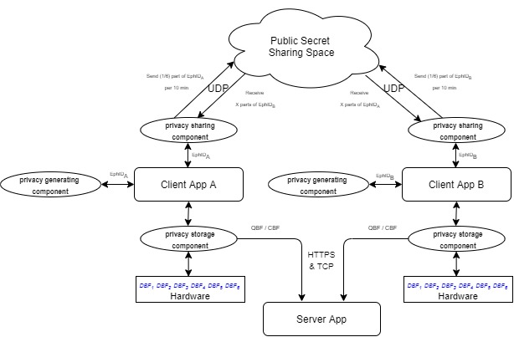
Tracing System Architecture
The figure on the right shows the architecture of the entire tracing system.
The client apps communicate with other client apps using UDP protocol. The privacy generating and sharing components are used for generating and sharing the ID of the client.
The privacy storage component handles the ID storage of those clients who had close contact with the current client. The data will be stored in a Bloom Filter data structure for easily uploading to or querying the server.
The server app maintains the CBF data uploaded by the client and handles the query request from the client. The communication between Client and Server is based on HTTPS on top of TCP protocol.

