Slide 1
Note: Scope of This Demonstration
The Full Output: The "Visually" model is designed to generate a dual output: a Scientific Visualization alongside a Textual Explanation that interprets the visual for the user.
The Presentation Focus: For this presentation, we have intentionally omitted the text explanations from the slides.
Reasoning: Large Language Models (LLMs) are already proven at generating text. The primary challenge—and the core innovation of this project—is the Visual Engine. We isolated the visuals here to strictly audit the model's ability to generate accurate, mathematical, and structural diagrams solely from natural language prompts.

Slide 2
PHYSICS

Slide 3
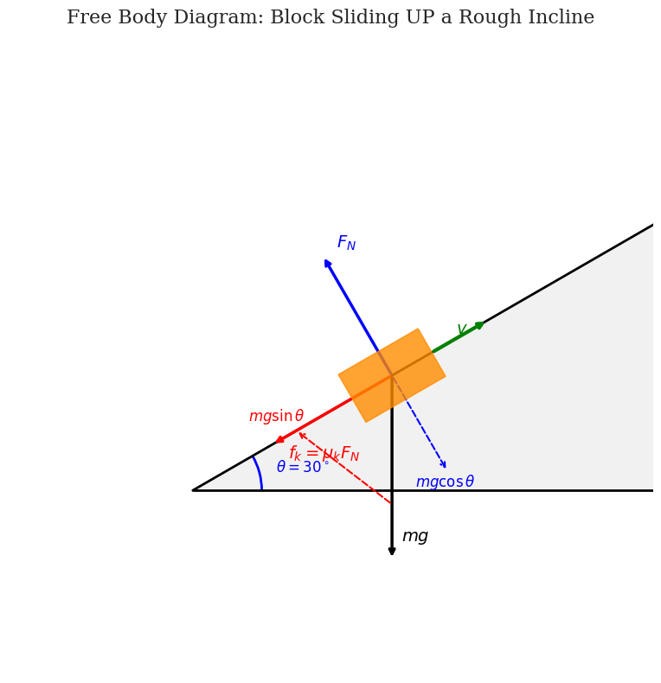
User Query: Draw a free body diagram for a block sliding UP a rough incline angled at 30 degrees. Include Kinetic Friction, Normal Force, and Gravity components
Model Response:
This Free Body Diagram illustrates the forces acting on a block moving up a 30-degree incline. The kinetic friction force and the gravitational component ($mg \sin \theta$) both act down the slope, opposing the upward velocity, while the normal force balances the perpendicular gravitational component ($mg \cos \theta$).

Slide 4
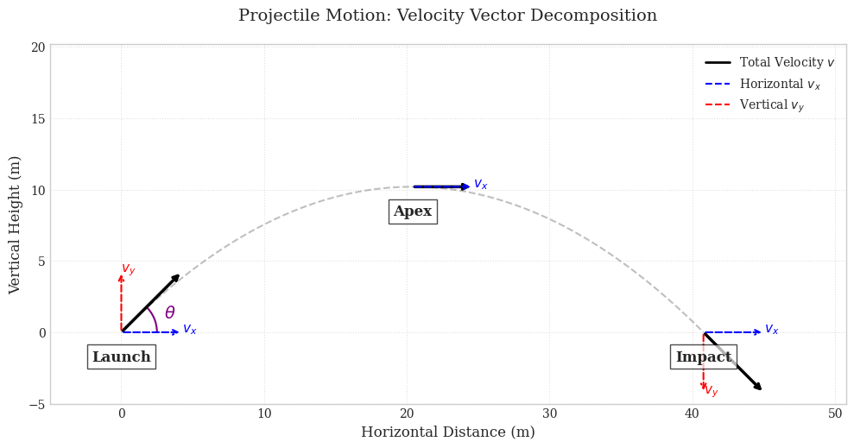
User Query: Visualize the velocity vectors of a projectile at launch, at the very top of its arc, and just before hitting the ground. Decompose the vectors into horizontal (vx) and vertical (vy) components
Model Response:
This visualization illustrates the kinematic principle that horizontal velocity remains constant in ideal projectile motion, while vertical velocity varies linearly due to gravitational acceleration. The decomposition highlights that at the apex, the vertical velocity component is zero, leaving only the horizontal component.

Slide 5
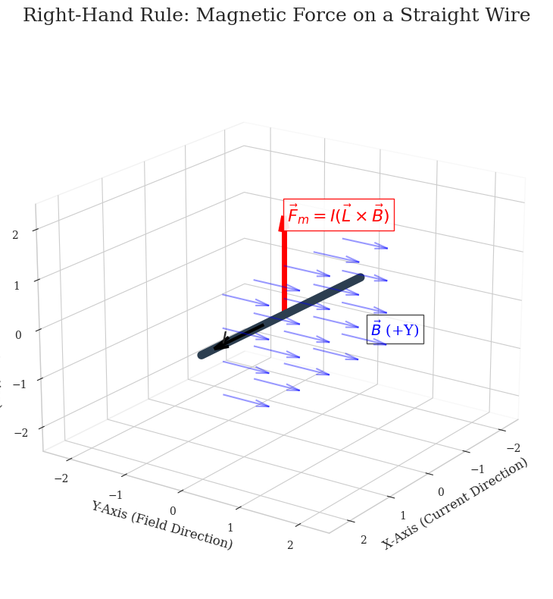
User Query: Visualize a straight wire carrying current flowing along the +X axis, sitting in a magnetic field pointing along the +Y axis. Show the direction of the resulting Magnetic Force.
Model Response:
This visualization illustrates the Lorentz force law for a current-carrying conductor in a uniform magnetic field. By placing the current along the x-axis and the magnetic field along the y-axis, the cross product result (I L x B) yields a force vector pointing strictly in the positive z-direction according to the right-hand rule.

Slide 6
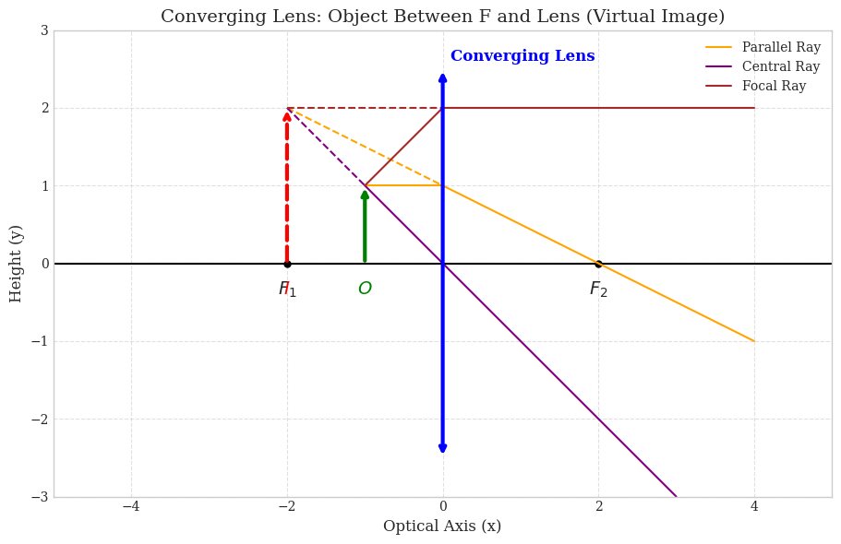
User Query: Draw a ray diagram for a converging lens where the object is placed between the focal point and the lens. Show the formation of the image.
Model Response:
This diagram illustrates the formation of a virtual image using a converging lens. When an object is placed within the focal length, the refracted rays diverge on the exit side; their backward projections intersect to form an upright, magnified, and virtual image on the same side as the object.

Slide 7
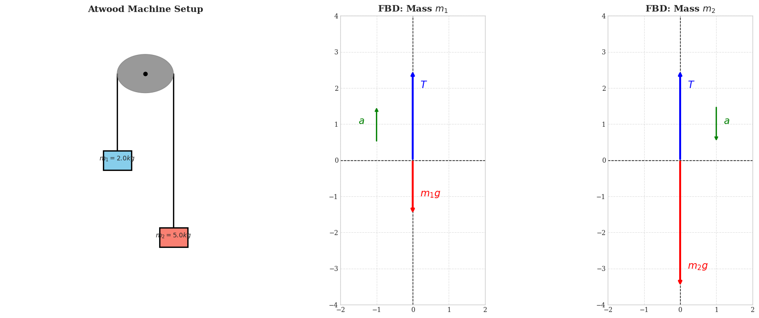
User Query: Draw a ray diagram for a converging lens where the object is placed between the focal point and the lens. Show the formation of the image.
Model Response: This visualization presents the Atwood Machine setup alongside the individual Free Body Diagrams (FBD) for both masses. The FBDs highlight how tension (T) acts upwards for both, while gravity pulls downwards according to their respective masses, resulting in a coupled acceleration system.

Slide 8
MATH

Slide 9
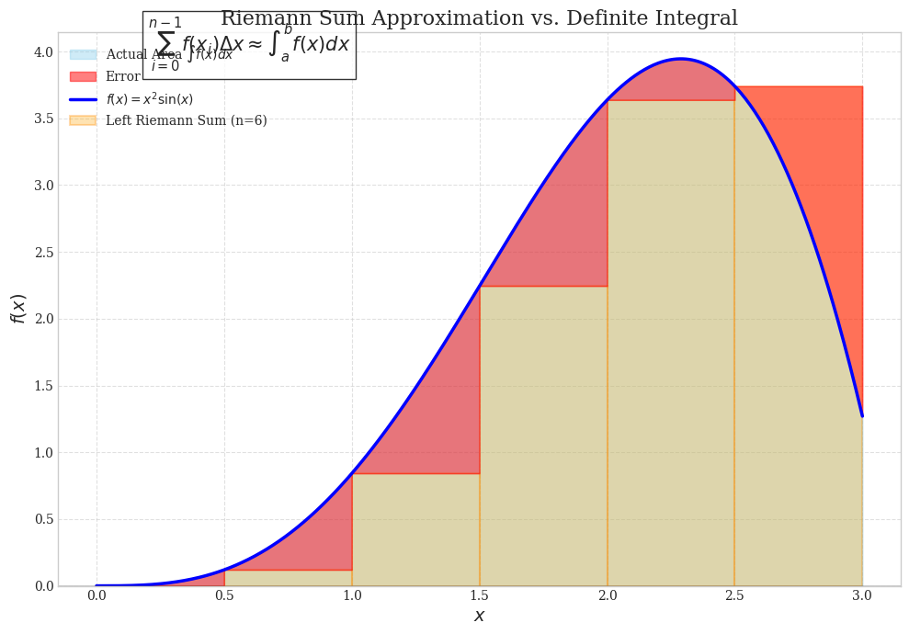
User Query: Visualize the concept of a Riemann Sum approximation compared to the actual Definite Integral.
1. Plot the function f(x) = x^2 * sin(x) from x = 0 to x = 3.
2. Show the "Left Endpoint" Riemann Sum using n=6 rectangles.
3. Shade the actual area under the curve in a semi-transparent color behind the rectangles.
4. Highlight the "error" regions (where rectangles stick out or miss the curve).

Slide 10
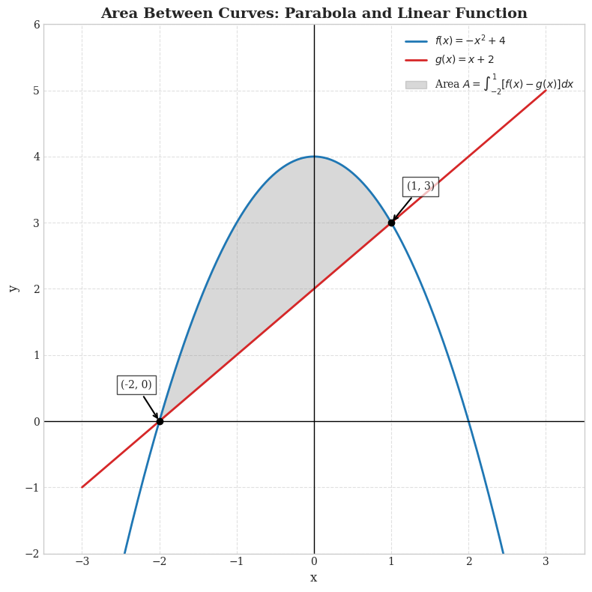
User Query: Visualize the bounded region between two functions to represent the Area Between Curves.
1. Function 1: f(x) = -x^2 + 4 (A downward parabola).
2. Function 2: g(x) = x + 2 (A straight line).
3. Find the visual intersection points.
4. Shade ONLY the enclosed region trapped between the parabola and the line.
5. Add annotations pointing to the intersection points with their approximate (x,y) coordinates.

Slide 11
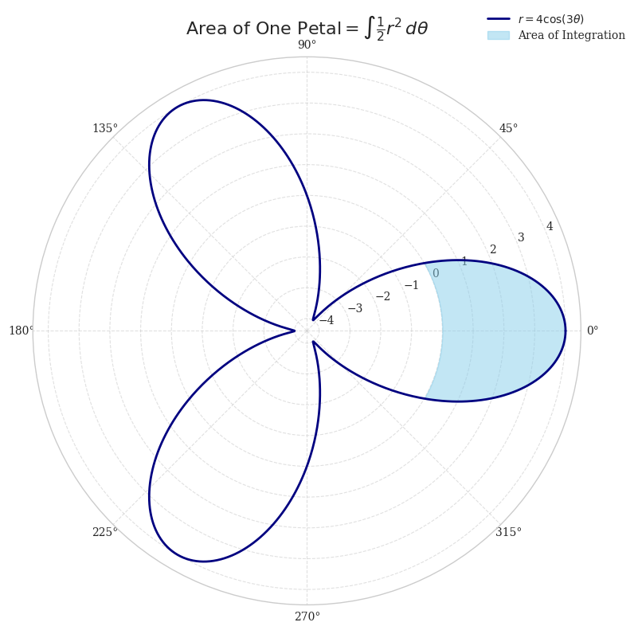
Visualize the area of a specific petal in a Polar Coordinate system.
1. Plot the Polar Rose curve: r = 4 * cos(3 * theta).
2. The plot must use a Polar projection (circular grid).
3. Shade exactly ONE petal of the rose (for example, the petal along the positive x-axis).
4. Label the plot "Area of One Petal = Integral of 0.5 * r^2 d_theta".

Slide 12
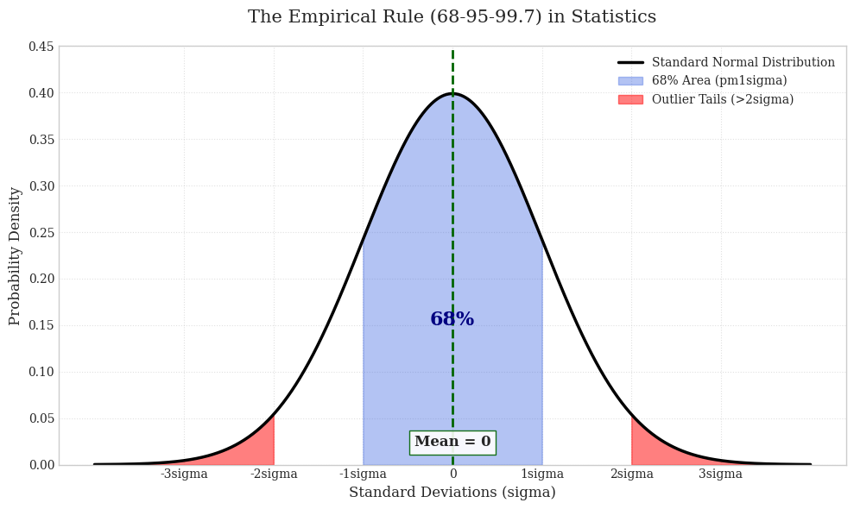
Visualize the "68-95-99.7 Rule" on a Standard Normal Distribution curve.
1. Plot a standard Bell Curve (mean=0, std=1).
2. Shade the region representing the probability of being within 1 Standard Deviation (-1 to +1 sigma) in Blue.
3. Shade the tails beyond 2 Standard Deviations in Red.
4. Annotate the Blue region with "68%" and the center line as "Mean = 0".

Slide 13
GEOMETRIC REASONING, Fixing Lazy Prompt

Slide 14
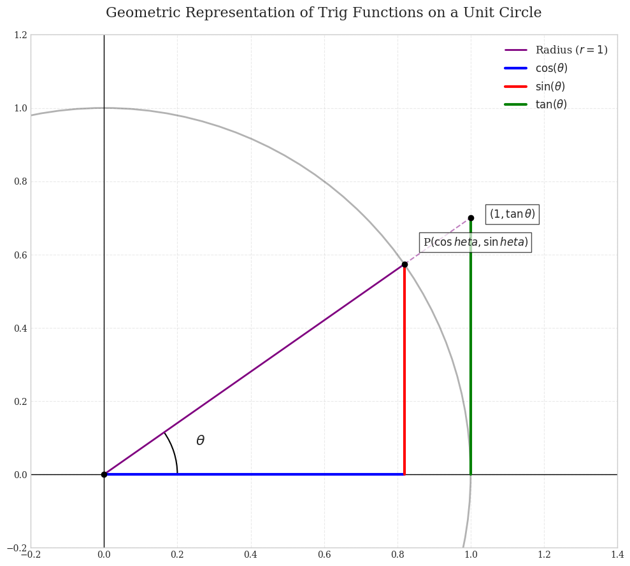
show me sin cos and tan on a unit circle diagram

Slide 15
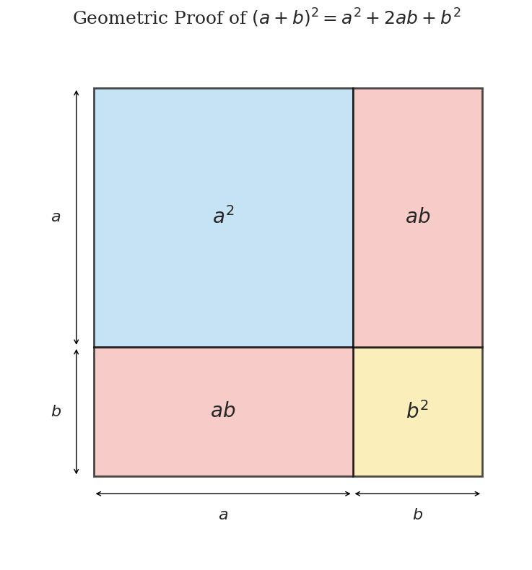
visual proof of (a+b)^2

Slide 16
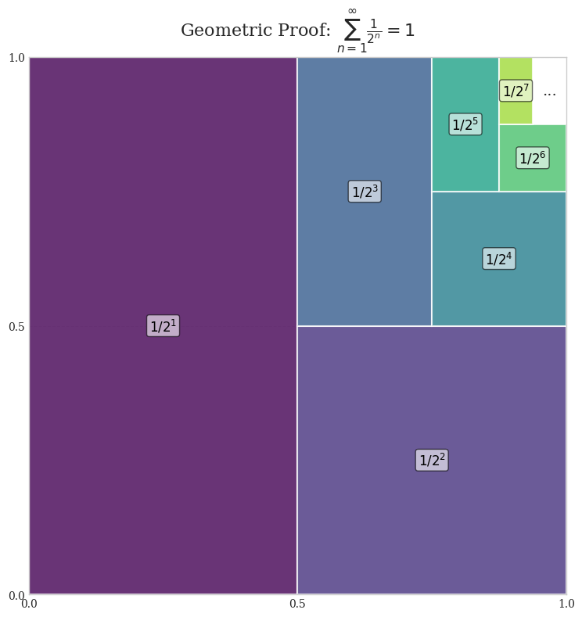
visualize the infinite series 1/2 + 1/4 + 1/8 + ... using a square

Slide 17
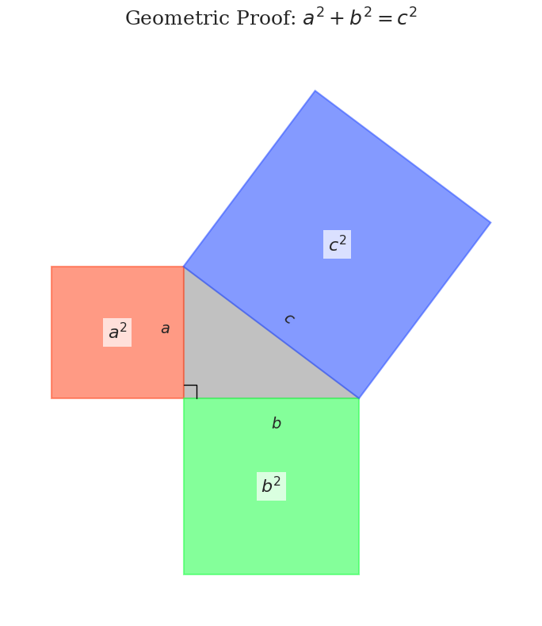
draw the pythagorean theorem with squares attached to each side of the triangle

Slide 18
CHARTS

Slide 19
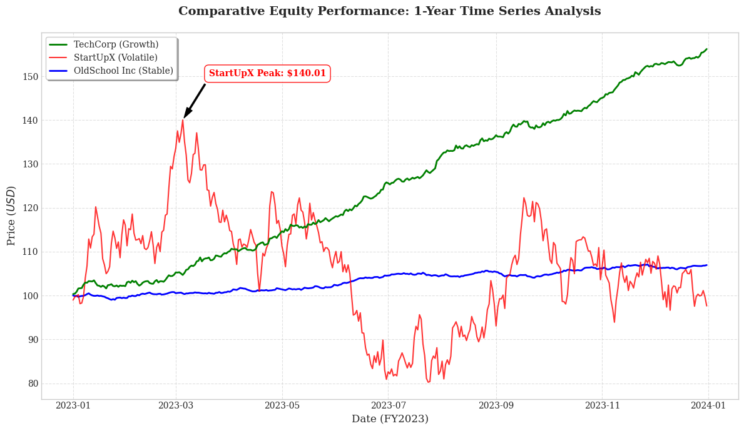
Visualize the stock price performance of three tech companies over a year.
1. Generate synthetic daily data for "TechCorp" (steady growth), "StartUpX" (volatile), and "OldSchool Inc" (flat).
2. Plot them on a single Line Chart with dates on the X-axis.
3. Use distinct colors (Green, Red, Blue) and add a legend.
4. Highlight the "Max Price" point for StartUpX with a specific annotation.

Slide 20
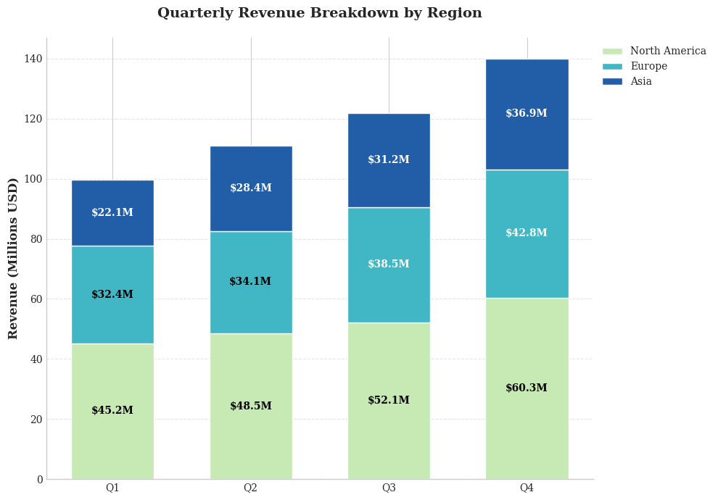
Visualize the quarterly revenue breakdown of a company by region.
1. Create a Stacked Bar Chart for Q1, Q2, Q3, and Q4.
2. Each bar should be split into "North America", "Europe", and "Asia".
3. Use a cool color palette (Blues/Teals).
4. Add data labels inside the segments showing the specific revenue values.

Slide 21
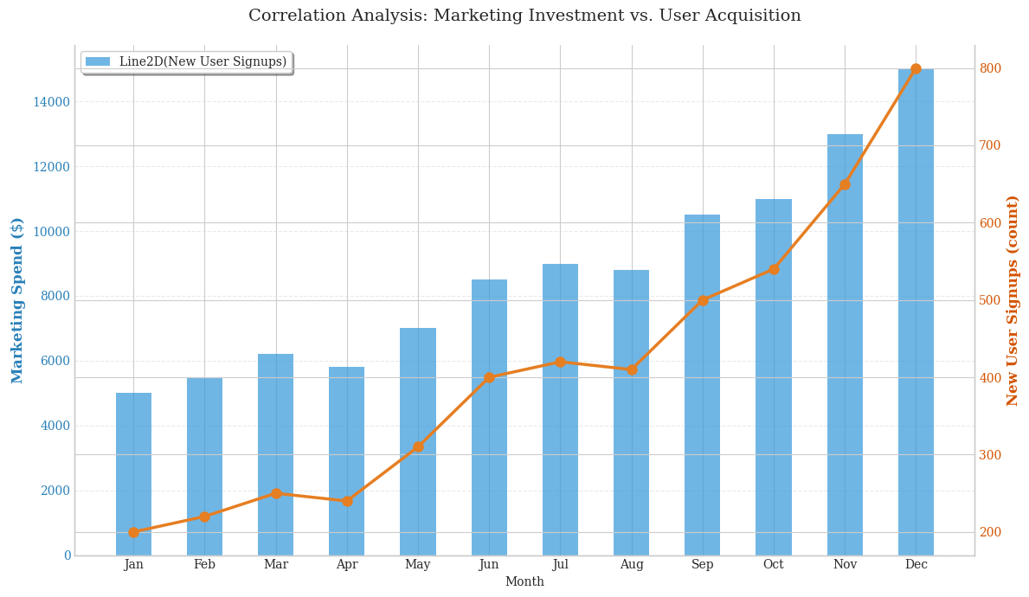
Visualize the relationship between Marketing Spend and New User Signups.
1. Bar Chart: Monthly Marketing Spend ($) on the left Y-axis.
2. Line Chart: Monthly New Users (count) on the right Y-axis.
3. Show data for 12 months.
4. Clearly label both Y-axes so the viewer knows which scale belongs to which metric.

Slide 22
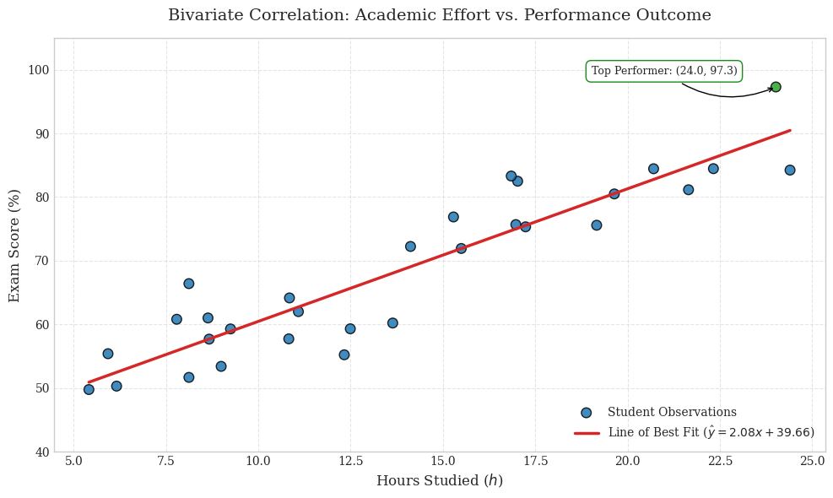
Visualize the correlation between "Hours Studied" and "Exam Score" for a class of 30 students.
1. Generate random scatter data (positive correlation).
2. Plot the individual student data points.
3. Calculate and draw the "Line of Best Fit" (Linear Regression) in red.
4. Color code the points: Green for scores > 90, Blue for the rest.

Slide 23
ARCHITECTURE DIAGRAMS AND FLOWCHARTS

Slide 24
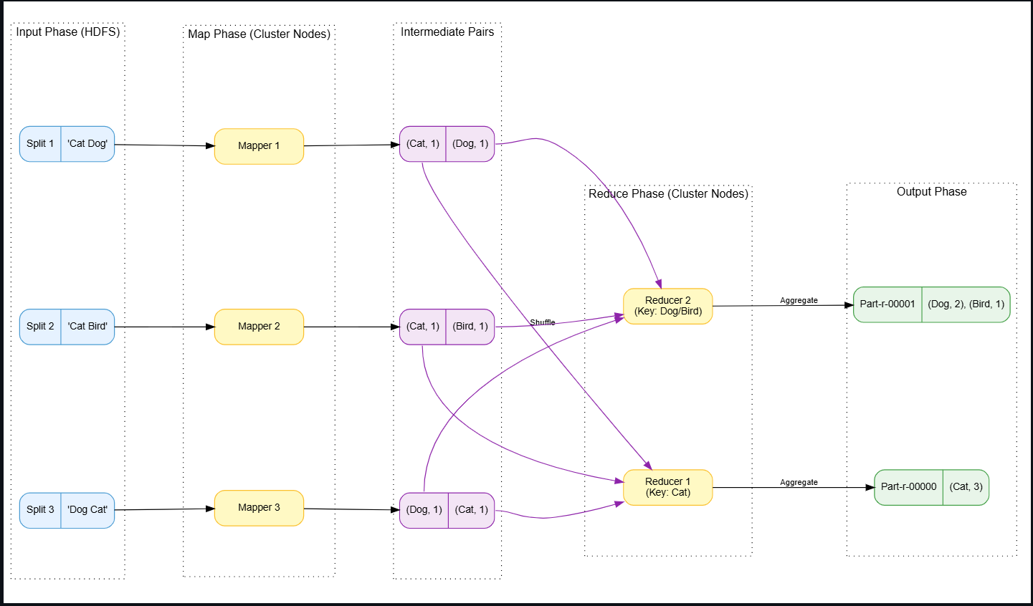
Map Reduce: Word Count example diagram

Slide 25
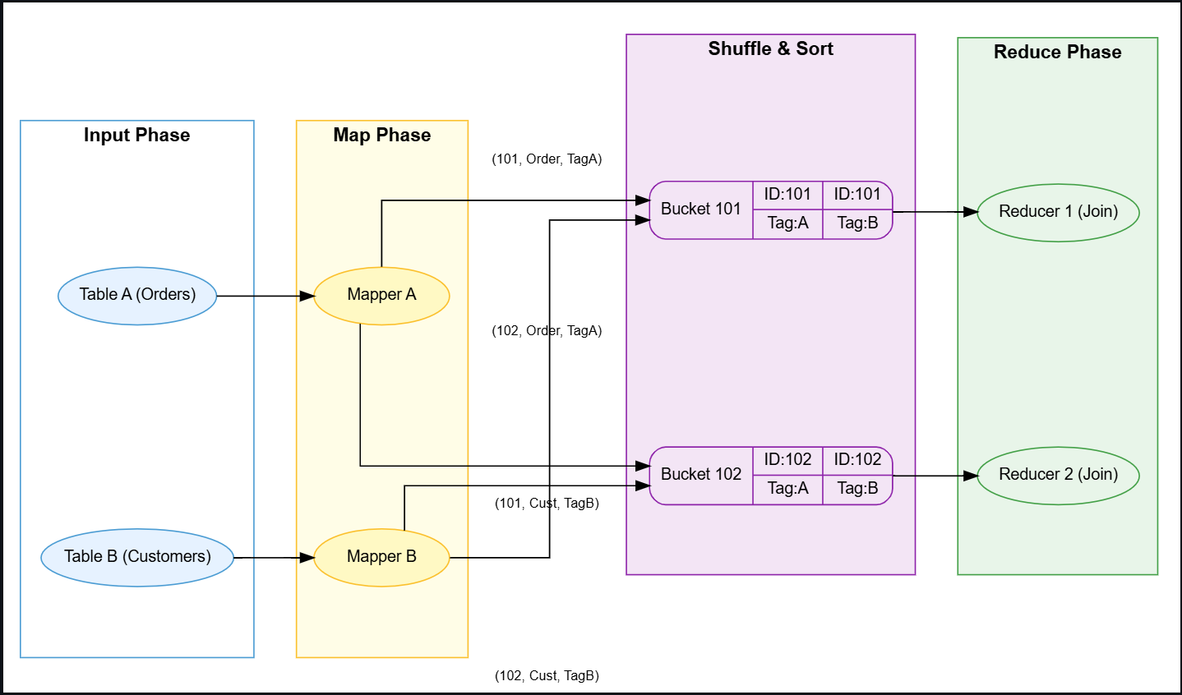
Map Reduce: Reduce Side Join example diagram

Slide 26
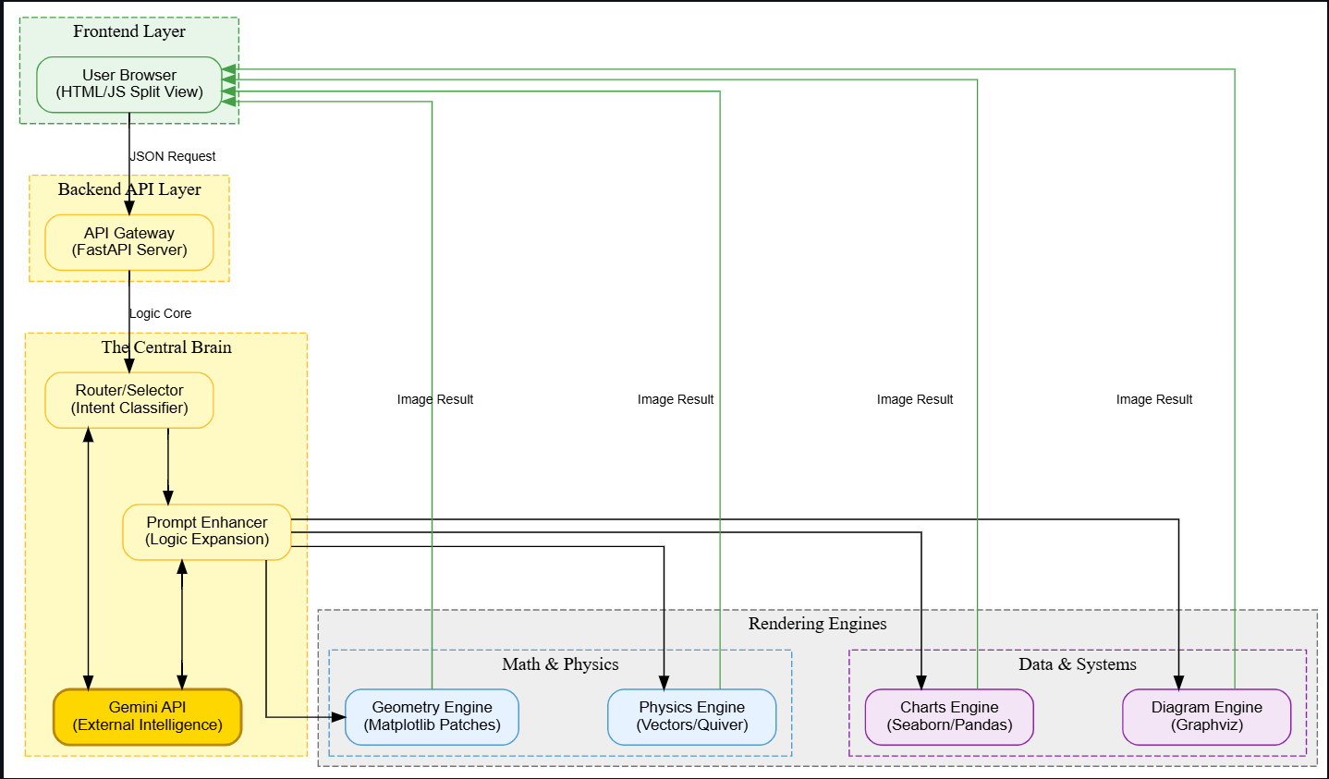
Architecture Diagram for “Visual Learning”

Slide 27
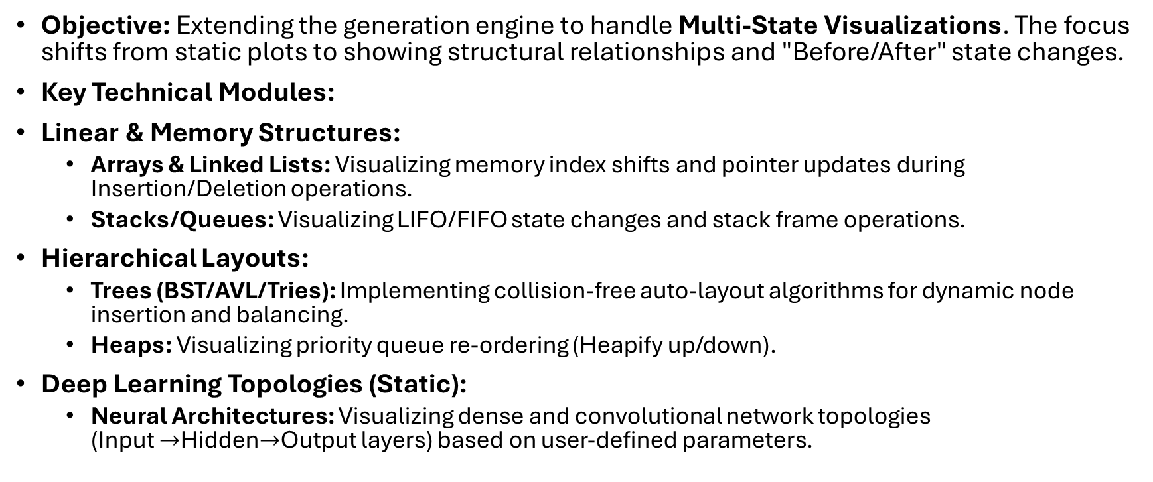
What's Next - Phase 5 (Complex Data Structures)
Objective: Extending the generation engine to handle Multi-State Visualizations. The focus shifts from static plots to showing structural relationships and "Before/After" state changes.
Key Technical Modules:
Linear & Memory Structures:
Arrays & Linked Lists: Visualizing memory index shifts and pointer updates during Insertion/Deletion operations.
Stacks/Queues: Visualizing LIFO/FIFO state changes and stack frame operations.
Hierarchical Layouts:
Trees (BST/AVL/Tries): Implementing collision-free auto-layout algorithms for dynamic node insertion and balancing.
Heaps: Visualizing priority queue re-ordering (Heapify up/down).
Deep Learning Topologies (Static):
Neural Architectures: Visualizing dense and convolutional network topologies (Input $→$Hidden$→$Output layers) based on user-defined parameters.

Slide 28
What's Next - Phase 6 (Algorithms & Animation)
Objective: Introducing Time & Motion. Visualizing the execution flow of an algorithm step-by-step using frame-by-frame generation or client-side animation libraries.
Key Technical Modules:
Sorting & Searching:
Visualizers: Visualizing comparison logic (Merge/Quick Sort) and search space reduction (Binary Search) in real-time.
Graph Traversals:
Pathfinding: Visualizing the "frontier" expansion in grid-based algorithms (Dijkstra/A*).
Game Theory: Visualizing decision tree exploration and pruning (Minimax & Alpha-Beta).
Neural Network Dynamics:
Feed Forward: Visualizing signal propagation and activation functions.
Backpropagation: Visualizing the mathematical Gradient Descent, error calculation, and weight updates.

Slide 29
Roadmap & Resource Allocation
Current Status:
Backend Core: Validated (Visual Generation Engine is functional).
Infrastructure: Server-side testing complete; Structured Output logic proven.
Effort Breakdown (Total Estimate: ~300 Hours):
1. Frontend Architecture & Client Integration (60 Hours)
Developing the User Interface (React/Next.js) to replace current server-side testing.
Building the rendering engine to display dynamic SVGs/Canvas elements alongside text explanations.
Implementing State Management for user sessions and history.
2. Phase 5 Implementation: Data Structures Engine (80 Hours)
Engineering backend logic for Multi-State Visualizations (Snapshots).
Implementing coordinate geometry logic for collision-free Tree/Graph layouts.
Developing visual schemas for Neural Network topologies.
3. Phase 6 Implementation: Animation & Algorithms (110 Hours)
The Core Challenge: Developing the frame-by-frame generation logic for algorithms.
Implementing "Step-by-Step" flow for Sorting and Pathfinding.
Visualizing complex mathematical flows (Backpropagation/Gradient Descent).
4. Quality Assurance & Optimization (50 Hours)
Edge-case testing (e.g., Unbalanced trees, complex graph cycles).
Latency optimization and Prompt Tuning for consistent output formats.
Total Projected Effort: 300 Development Hours

