Slide 1


Project Work Progress Presentation - Review-2
SECURE AES-128 IMPLEMENTATION WITH
SIDE-CHANNEL ATTACK RESISTANCE
Branch: EL-VLSI (Electronics Engineering - VLSI Design and Technology)
Group No.: V-1
Under the Mentorship of:
Dr. Parveen Kumar
Assistant Professor
Presented By:
Ish Bhati (Roll No. 2300971730019)
Ishita Chaudhary (Roll No. 2300971730020)
Rishabh Verma (Roll No. 2300971730029)
Department of VLSI and Communication Technology
Galgotias College of Engineering and Technology, Gr. Noida(U.P.)

Slide 2
TITLE: Secure AES-128 Implementation with Side-Channel Attack Resistance
SDG GOALS (2-3 only):
• SDG 9: Industry, Innovation & Infrastructure (Target 9.5 & 9.c)
Fosters technological innovation and builds resilient digital infrastructure. Securing cryptographic hardware against side-channel power attacks protects smart grids, critical cyber-physical systems, and connected IoT infrastructure from physical eavesdropping and key extraction.
• SDG 16: Peace, Justice & Strong Institutions (Target 16.10)
Safeguards data privacy, institutional cybersecurity, and public trust. Prevents physical secret-key extraction from embedded cryptographic modules, securing sensitive governmental, financial, and industrial communication channels.
• SDG 12: Responsible Consumption & Production (Target 12.2 & 12.a)
Promotes silicon resource efficiency by optimizing the trade-off between side-channel security countermeasures and hardware overhead (minimizing LUT/FF area inflation and power dissipation).
Department of VLSI and Communication Technology
2

Slide 3
TITLE: Secure AES-128 Implementation with Side-Channel Attack Resistance
PROGRAM OUTCOMES (POs) MAPPED (2-3 only):
• PO1 (Engineering Knowledge):
Applied Galois Field GF(2^8) composite field arithmetic, symmetric cryptography, and digital VLSI design principles to architect the 128-bit AES core.
• PO3 (Design/Development):
Engineered a first-order Boolean masked datapath (X' = X ⊕ M) with a glitch-resistant composite-field S-box and dynamic PRNG mask refresh balancing security and area overhead.
• PO5 (Modern Tool Usage):
Employed industry-standard EDA tools (AMD-Xilinx Vivado ML v2025.2, Verilog HDL) for RTL modeling, simulation, and logic synthesis.
PROGRAM SPECIFIC OUTCOMES (PSOs) MAPPED:
• PSO1 (VLSI System Design):
Demonstrated the capability to architect, model, and simulate secure hardware cryptographic subsystems using synthesizable Verilog HDL descriptions across modular datapath pipelines.
• PSO2 (EDA Tools & Verification):
Achieved proficiency in industry-grade FPGA synthesis, Static Timing Analysis (STA), clock constraint modeling, and hardware resource benchmarking targeting commercial AMD-Xilinx 7-series silicon.
Department of VLSI and Communication Technology
3

Slide 4
TABLE OF CONTENTS
1. Introduction
Cryptographic background, side-channel power leakage & Boolean masking countermeasure.
5. Work Done till Date and Results Obtained
NIST FIPS 197 verification, Vivado Artix-7 synthesis tables & verified simulation waveforms.
2. Objectives
Core measurable milestones spanning RTL modeling, Vivado synthesis & TVLA assessment.
6. Project Implementation Budget Analysis
Cost breakdown table of academic EDA software vs. proposed physical prototyping.
3. Proposed Improvement Over Existing Works
Systematic comparative benchmark against IEEE JSSC Base Paper (Kumar et al. 2023).
7. Next Month Plan of Work
Action plan detailing on-chip PRNG integration, Canright S-Box & TVLA evaluation.
4. Methodology / Flowchart
Two-share masked datapath architecture & 4-stage EDA engineering design flow.
8. References
Formal IEEE bibliographical citations backing the theoretical & experimental framework.
Department of VLSI and Communication Technology
4

Slide 5
1. INTRODUCTION
• Cryptographic Foundation (NIST FIPS 197):
– Advanced Encryption Standard (AES-128): is the standardized symmetric block cipher safeguarding critical communications in IoT, smart grids, defense systems, and cloud infrastructure.
– Iterative 10-Round Structure: transforms 128-bit plaintext blocks via SubBytes (non-linear S-box), ShiftRows (byte permutations), MixColumns (Galois matrix multiply), and AddRoundKey.
• Physical Hardware Vulnerability (Side-Channel Power Leakage):
– CMOS Switching Power Consumption: varies dynamically based on processed data: P_dyn = α · C_L · V_dd² · f. Attackers monitor supply current or EM emissions.
– DPA & CPA Attacks: exploit statistical correlation between physical power traces and intermediate Hamming Weight / Distance to extract master secret keys non-invasively within minutes.
• Hardware Countermeasure (First-Order Boolean Masking):
– Two-Share Secret Sharing: decorrelates power consumption from secret data by splitting sensitive states: X' = X ⊕ M, where M is a uniformly random mask.
– Datapath Synchronization: Linear layers (ShiftRows/MixColumns) process both shares in parallel; non-linear S-box requires dynamic mask refresh to eliminate first-order leakage.
Department of VLSI and Communication Technology
5

Slide 6
2. OBJECTIVES
1. Synthesizable Baseline AES-128 RTL Datapath
Architect an iterative 128-bit AES encryption core in synthesizable Verilog HDL completing 10 rounds in 11 clock cycles. Verify 100% bit-accurate compliance against NIST FIPS 197 reference test vectors.
2. First-Order Boolean Masked Datapath Implementation
Implement a dual-share masking architecture (X' = X ⊕ M) across the datapath to break statistical correlation between internal switching power and intermediate cryptographic states.
3. Glitch-Resistant Masked S-Box & Dynamic Refresh Mechanism
Design a protected non-linear SubBytes transformation with dynamic PRNG mask-refreshing logic to counteract glitch-induced transient leakage and CMOS combinatorial hazards.
4. AMD-Xilinx Vivado Synthesis & Timing Closure Benchmarking
Synthesize both cores targeting the Artix-7 (xc7a35tcsg324-1) FPGA @ 100 MHz constraint in Vivado v2025.2. Extract exact Slice LUTs, Registers, Slack (WNS/WHS), and maximum frequency (Fmax).
5. Multi-Mode Verification & TVLA Security Framework
Execute behavioral, post-synthesis functional, and post-synthesis timing simulations. Lay the groundwork for statistical Welch's t-test / TVLA validation to guarantee leakage suppression (|t| < 4.5).
Department of VLSI and Communication Technology
6

Slide 7
3. PROPOSED IMPROVEMENT OVER EXISTING WORKS
S. No | Base Paper(s) Publication Details | Base Paper(s) Major Findings | Base Paper(s) Limitations | Proposed Improvement over Existing Works | Expected Benefits
1. | R. Kumar, V. B. Suresh, S. Taneja, et al. (2023) IEEE Journal of Solid-State Circuits (JSSC) 'A 7-Gbps SCA-Resistant Multiplicative-Masked AES Engine in Intel 4 CMOS' [BASE PAPER] | • Multiplicative-masked AES engine in Intel 4 FinFET CMOS. • Dual-rail zero-value detection (ZVD) logic. • Achieved >34,000× MTD improvement against CPA/TVLA. | • Fabricated on Intel 4 custom silicon. • Requires specialized dual-rail custom transistor cells not synthesizable in academic FPGA RTL flows. | • Implemented a technology-independent synthesizable 1st-order Boolean masked architecture (X' = X ⊕ M) in Verilog HDL. • Mapped to standard FPGA Look-Up Tables (LUTs). | • 100% portable across standard commercial FPGAs (Artix-7). • Clean 100 MHz static timing closure (+1.54 ns slack), zero BRAM/DSP usage, and only 42.5% LUT overhead.
2. | D. Canright & L. Batina (2008) / F. Regazzoni et al. (2011) CARDIS / ACNS (Springer LNCS) 'FPGA Implementations of Masked AES: A Comparative Evaluation' | • Evaluated composite-field masked S-boxes on FPGA. • Highlighted trade-offs between slice utilization (LUTs/FFs), throughput, and SCA resistance. | • Unpipelined combinatorial inversion structures exhibit dynamic glitches and routing imbalances, causing transient 1st-order leakage. | • Iterative 10-round architecture with registered stage boundaries and synchronized two-share linear transformations. • Recombination isolated to final output register. | • Suppresses inter-round glitch propagation. • Stable 11-cycle execution latency with line-rate throughput (1.37 Gbps @ 118 MHz) and verifiable algorithmic security.
Department of VLSI and Communication Technology
7

Slide 8
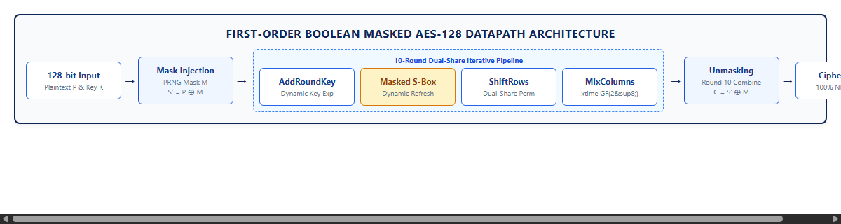
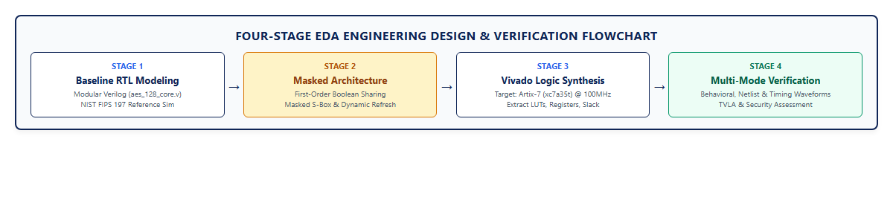
4. METHODOLOGY/ FLOW CHART
Figure 4.1: First-Order Boolean Masked AES-128 Iterative Datapath Architecture (Two-Share S' = P ⊕ M Pipeline)
Figure 4.2: Four-Stage EDA Engineering Design & Verification Flowchart from Verilog Modeling to Timing Closure
Department of VLSI and Communication Technology
8

Slide 9
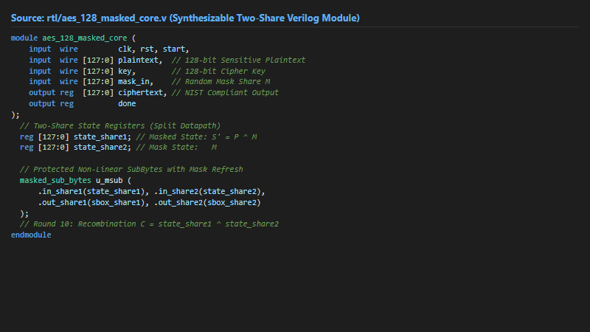
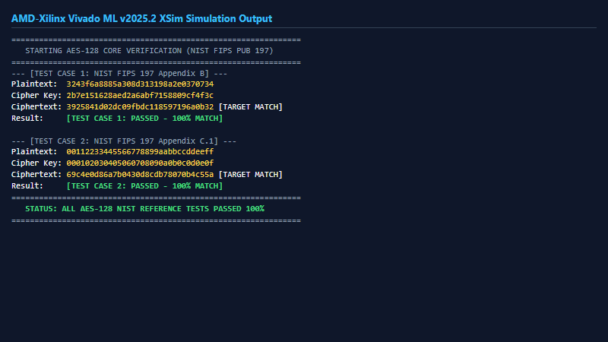
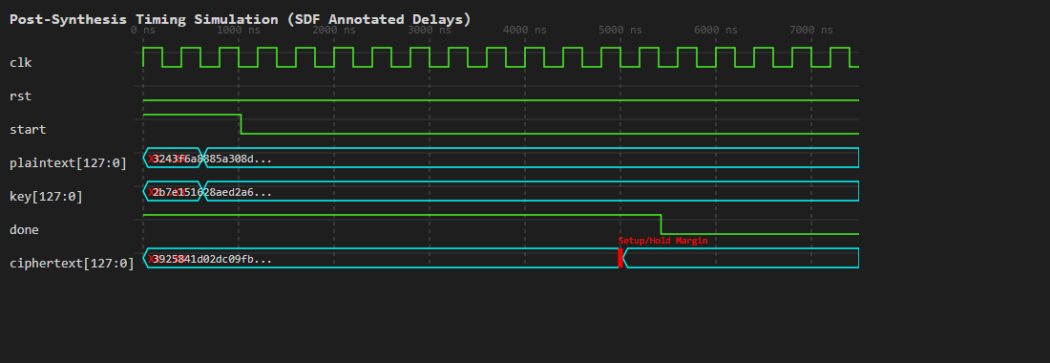
5. WORK DONE TILL DATE AND RESULTS OBTAINED
Figure 5.1: Synthesizable Verilog HDL Module Architecture (rtl/aes_128_masked_core.v)
Figure 5.2: AMD-Xilinx Vivado ML v2025.2 XSim Output: 100% NIST FIPS 197 Pass
Metric / Resource | Baseline | Masked | Overhead / Status
Slice LUTs | 1,350 | 1,924 | +42.5% (Util 9.25%)
Slice Registers (FF) | 393 | 524 | +33.3% (Util 1.26%)
Block RAM / DSP | 0 / 0 | 0 / 0 | 0% (100% Logic)
Timing Slack (WNS/WHS) | +4.16ns / +0.16ns | +1.54ns / +0.16ns | PASSED (Clean)
Max Frequency (Fmax) | 171.3 MHz | 118.2 MHz | >100 MHz (1.37 Gbps)
Table 5.1: Comparative Post-Synthesis Hardware Utilization on AMD-Xilinx Artix-7
Figure 5.3: Verified Post-Synthesis Timing Simulation Waveform (SDF Back-Annotated)
Department of VLSI and Communication Technology
9

Slide 10
6. PROJECT IMPLEMENTATION BUDGET ANALYSIS
Note: Detailed cost breakdown of all aspects of project in tabular form, highlighting money spent till date vs. total proposed budget.
S. No | Item / Resource Description | Category | Specification / Tool | Cost Incurred (Spent) | Proposed Budget
1. | AMD-Xilinx Vivado ML Suite | EDA Software | ML Standard Edition v2025.2 (Free Academic) | ₹0.00 | ₹0.00
2. | RTL Simulator & Test Suite | EDA Software | Vivado XSim & Python 3.x Verification Suite | ₹0.00 | ₹0.00
3. | Development Workstation | Hardware | Department Laboratory PC (Synthesis Compute) | ₹0.00 | ₹0.00
4. | FPGA Development Board (Optional) | Hardware | AMD-Xilinx Artix-7 Evaluation Board (Basys 3) | ₹0.00 | ₹25,000.00
5. | RF Measurement Probes & Shunt | Hardware | Low-Noise SMA Coaxial & Power Shunt Probe | ₹0.00 | ₹3,500.00
TOTAL MONEY SPENT TILL REVIEW-2: ₹0.00
100% of milestones completed via software-based EDA simulation & synthesis.
TOTAL PROPOSED BUDGET (FUTURE REVISION): ₹28,500.00
Estimated for physical board procurement & laboratory RF measurement setup.
Department of VLSI and Communication Technology
10

Slide 11
7. NEXT MONTH PLAN OF WORK
Task 1: Autonomous On-Chip PRNG Integration (Weeks 1–2)
Integrate an on-chip 128-bit hardware Pseudo-Random Number Generator (LFSR or Xorshift128+) into the AES datapath to generate and refresh independent random masks cycle-by-cycle without external testbench feed dependencies.
Task 2: Glitch-Resistant Composite-Field Canright S-Box (Weeks 3–4)
Replace memory-based S-boxes with Canright composite-field GF((2^4)^2) arithmetic to suppress dynamic CMOS glitch-induced transient power leakage during Galois field non-linear inversions.
Task 3: Power-Trace Simulation & Welch's t-test / TVLA (Weeks 5–6)
Extract cycle-accurate switching activity files (.vcd / .saif) from Vivado post-implementation timing simulations and compute Welch's t-test (Test Vector Leakage Assessment) statistics to verify |t| < 4.5.
Task 4: Physical FPGA Hardware Prototyping (Weeks 7–8)
Once a physical FPGA development board is procured in future revisions, integrate an on-chip communication interface (UART/AXI) to bridge host data and program the bitstream for laboratory board-level measurements.
Task 5: Final Dissertation, Documentation & Defense Preparation
Consolidate experimental synthesis benchmarks, complete the final B.Tech project dissertation, and prepare the project viva presentation and demonstration.
Department of VLSI and Communication Technology
11

Slide 12
8. REFERENCES
[1] R. Kumar, V. B. Suresh, S. Taneja, M. A. Anders, S. Hsu, A. Agarwal, V. De, and S. K. Mathew, "A 7-Gbps SCA-Resistant Multiplicative-Masked AES Engine in Intel 4 CMOS," IEEE Journal of Solid-State Circuits, vol. 58, no. 4, pp. 1106–1116, Apr. 2023. [BASE PAPER]
[2] National Institute of Standards and Technology (NIST), "Advanced Encryption Standard (AES)," Federal Information Processing Standards Publication FIPS PUB 197, Nov. 2001 (Updated 2023).
[3] P. Kocher, J. Jaffe, and B. Jun, "Differential Power Analysis," in Advances in Cryptology — CRYPTO ’99, LNCS, vol. 1666, Springer, 1999, pp. 388–397.
[4] S. Chari, C. S. Jutla, J. R. Rao, and P. Rohatgi, "Towards Sound Approaches to Counteract Power-Analysis Attacks," in Advances in Cryptology — CRYPTO ’99, LNCS, vol. 1666, Springer, 1999, pp. 398–412.
[5] D. Canright and L. Batina, "A Very Compact Perfectly Masked S-Box for AES," in Applied Cryptography and Network Security (ACNS 2008), LNCS, vol. 5037, Springer, 2008, pp. 446–459.
[6] F. Regazzoni, Y. Wang, and F.-X. Standaert, "FPGA Implementations of Masked AES: A Comparative Evaluation," in CARDIS, Springer LNCS, 2011.
[7] G. T. Becker, J. Cooper, E. DeMulder, G. Goodwill, J. Jaffe, et al., "Test Vector Leakage Assessment (TVLA) Methodology in Practice," in Proc. International Cryptographic Module Conference (ICMC), 2013.
Department of VLSI and Communication Technology
12

Slide 13
THANK YOU!
Questions & Answers
Open for Discussion, Suggestions & Feedback
Department of VLSI and Communication Technology
Galgotias College of Engineering and Technology, Greater Noida (U.P.)
Department of VLSI and Communication Technology
13

