Slide 1
Hybrid Quantum–Classical Neural Networks for Tuberculosis Detection from Chest X-rays
B.Tech. Mini Project, Computer Science & Engineering
Presented by
Under the guidance of
Saksham Tiwari (20233243)
Prajjwal Singh (20233213)
Madipelli Rithvik (20233176)
Sanchari Ray (20233250)
Dr. Rajitha B.
Department of CSE
MNNIT Allahabad, Prayagraj
Notes:
Good morning. We are Saksham, Prajjwal, Rithvik and Sanchari, and our project was guided by Dr. Rajitha B. We tried to find out whether adding a small quantum circuit to a normal deep-learning model helps it detect tuberculosis in chest X-rays.

Slide 2
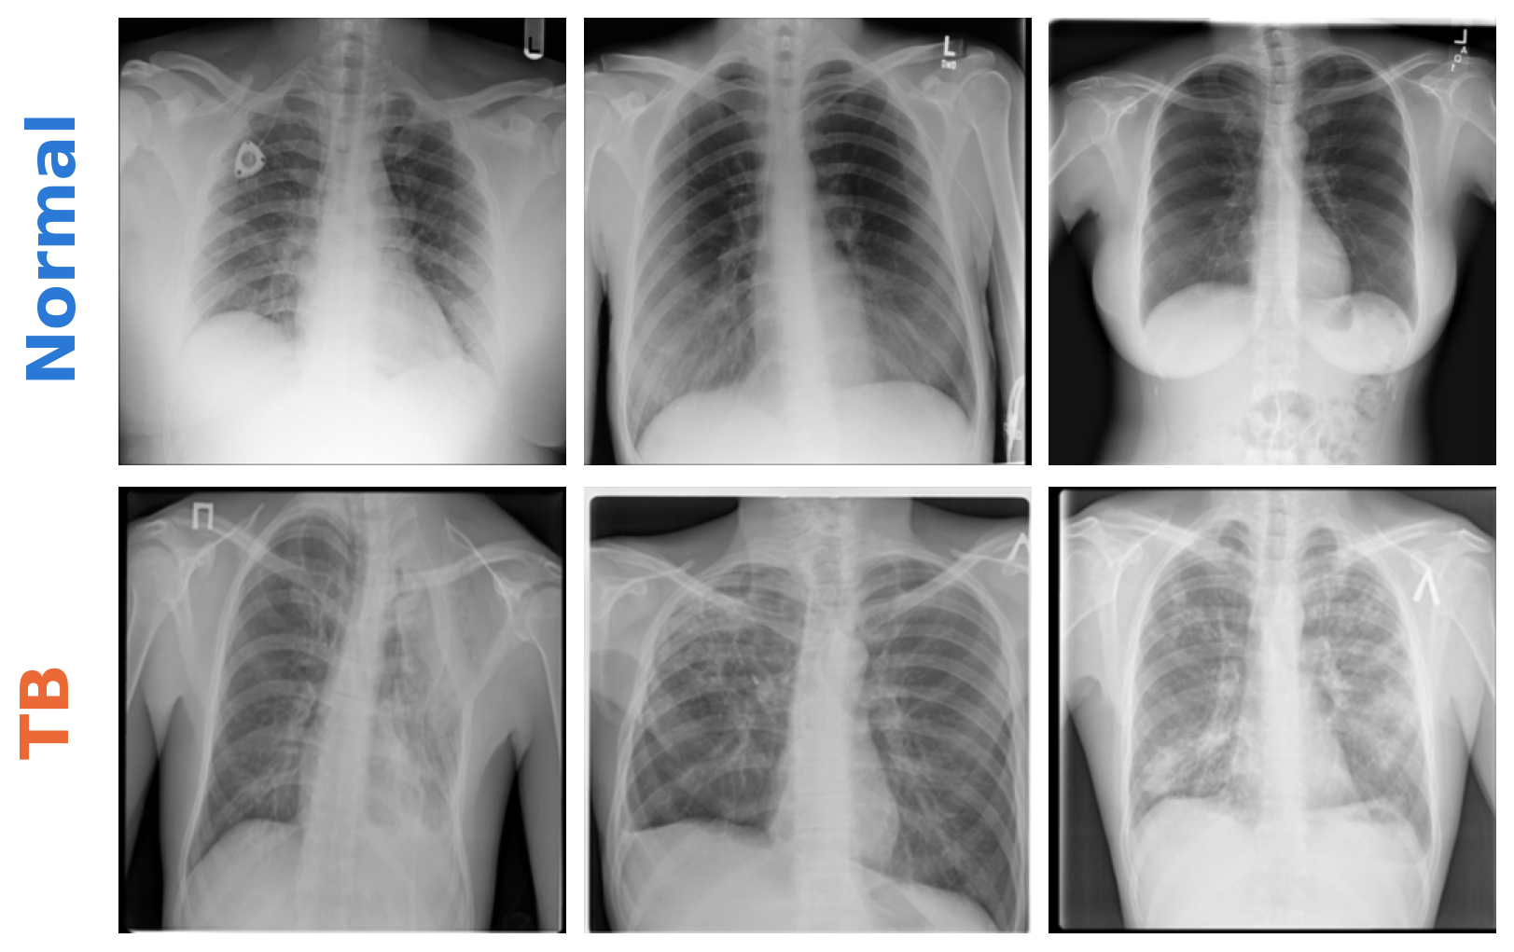
Why tuberculosis screening matters
• TB kills about 1.25 million people a year
• India has the largest number of cases
• Chest X-rays are cheap and quick
• But every X-ray needs an expert to read it
• Software can sort out the likely TB cases first
Saksham Tiwari | Prajjwal Singh | Madipelli Rithvik | Sanchari Ray · Guide: Dr. Rajitha B.
2 / 20
Notes:
TB is still the biggest killer among single infectious diseases. India has the most cases. A chest X-ray is a cheap way to screen people, but someone trained has to read every image, and there are not enough radiologists. Software that flags likely TB cases can help, and the WHO already recommends it. On the right you can see how similar normal and TB X-rays can look.

Slide 3
What we wanted to find out
Does adding a small quantum circuit to a CNN help it detect TB?
Does it matter if the circuit goes at the end or at the start?
Our short answer
• Quantum circuit at the end: a small gain (about 0.7%), too small to be sure it is real
• Quantum circuit at the start: 4 times fewer parameters, but simple image shrinking does the same
• The quantum circuits still work with noise, as on real quantum computers
Saksham Tiwari | Prajjwal Singh | Madipelli Rithvik | Sanchari Ray · Guide: Dr. Rajitha B.
3 / 20
Notes:
Many papers say a quantum model did better, but they compare it with a classical model that is different in size, and they train it only once. So we asked a fair question: if we add a small quantum circuit to a CNN, does it really help? And does it matter where we put it? Here is our answer in short. The quantum part at the end of the CNN helped a little, but the difference is too small to be sure. The quantum part at the start saved parameters, but a simple classical trick did the same.

Slide 4
Quantum computing basics
The building blocks
How a quantum circuit learns
• Qubit: can be 0, 1, or a mix of both
• Rotation gate: turns a qubit by an angle
• CNOT gate: links two qubits (entanglement)
• Measuring gives 0 or 1, so we repeat and average
• n qubits hold 2ⁿ numbers
• Put the input numbers in as angles
• Apply rotations with trainable angles
• Measure and use the result
• Train the angles like normal weights
• Real quantum computers are small and noisy
Saksham Tiwari | Prajjwal Singh | Madipelli Rithvik | Sanchari Ray · Guide: Dr. Rajitha B.
4 / 20
Notes:
A normal bit is 0 or 1. A qubit can be a mix of both. We change qubits with rotation gates and link them together with a CNOT gate; this linking is called entanglement. When we measure, we get a 0 or a 1, so we repeat the circuit many times and take the average. In a quantum neural network the rotation angles are the weights, and we train them just like normal weights. Today's quantum computers are small and noisy, so only small circuits are practical.

Slide 5
Our dataset
• TB Chest X-ray Database (Kaggle)
• 3,500 normal and 700 TB images
• Always saying 'normal' already gives 83%
so we also use F1 score and recall
• Images shrunk to 64 × 64 pixels, grayscale
• Same 630 test images for every model
Part | Normal | TB | Total
Training | 2,450 | 490 | 2,940
Validation | 525 | 105 | 630
Testing | 525 | 105 | 630
Total | 3,500 | 700 | 4,200
Saksham Tiwari | Prajjwal Singh | Madipelli Rithvik | Sanchari Ray · Guide: Dr. Rajitha B.
5 / 20
Notes:
We used a public Kaggle dataset with 4,200 chest X-rays: 3,500 normal and 700 with TB. Because there are five normal images for every TB image, a model that always says normal would already be 83 percent accurate, so we also look at F1 score and recall. We made the images black and white and shrank them to 64 by 64 pixels so that the quantum simulation runs on a laptop. Every model is tested on the same 630 images.

Slide 6
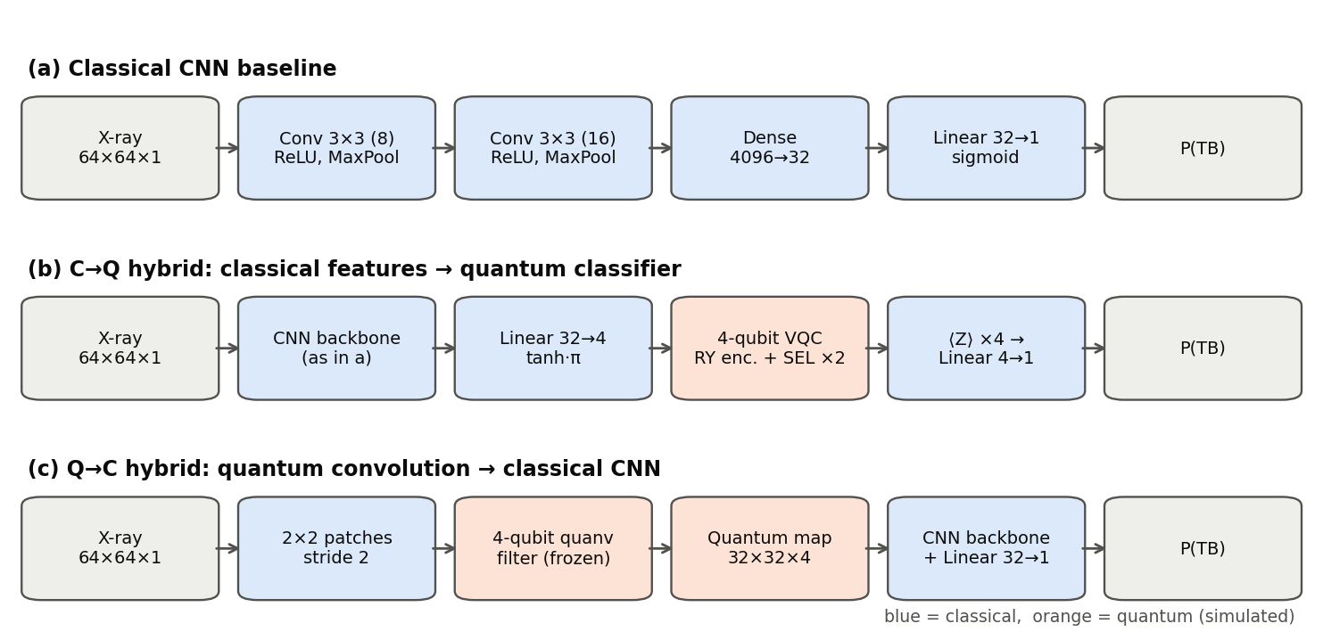
The three models we compared
Blue = normal (classical) parts, orange = quantum parts
Saksham Tiwari | Prajjwal Singh | Madipelli Rithvik | Sanchari Ray · Guide: Dr. Rajitha B.
6 / 20
Notes:
We compared three models. The first is a small normal CNN. The second keeps the same CNN but replaces its last layer with a 4-qubit quantum circuit. The third puts a quantum filter at the start, which looks at small 2 by 2 pieces of the image, and then uses a CNN. Blue parts are classical and orange parts are quantum.

Slide 7
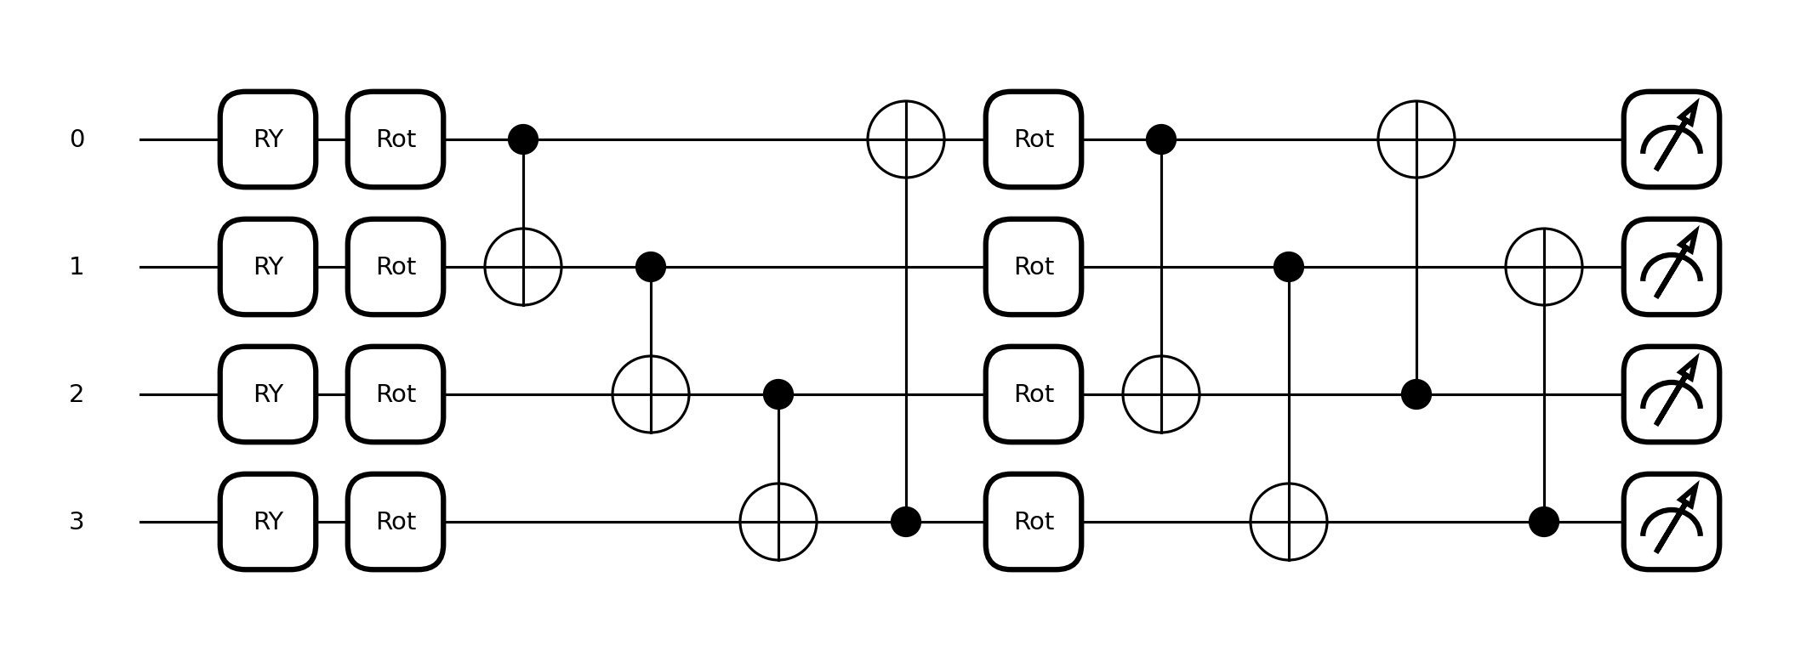
Model 2: CNN + quantum classifier
• CNN turns the X-ray into 32 numbers
• Shrunk to 4 numbers, one per qubit
• 2 layers of trainable rotations
only 24 trainable angles
• Measure, then output P(TB)
• Same size as the normal CNN
Saksham Tiwari | Prajjwal Singh | Madipelli Rithvik | Sanchari Ray · Guide: Dr. Rajitha B.
7 / 20
Notes:
Here the CNN first turns the X-ray into 32 numbers. We shrink these to 4 numbers and put each one into a qubit as a rotation angle. Then two layers of trainable rotations and CNOT gates mix the qubits. We measure each qubit and a last small layer gives the probability of TB. The quantum part has only 24 trainable angles, and the whole model is almost the same size as the normal CNN.

Slide 8
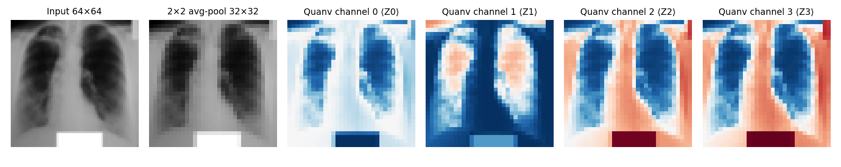
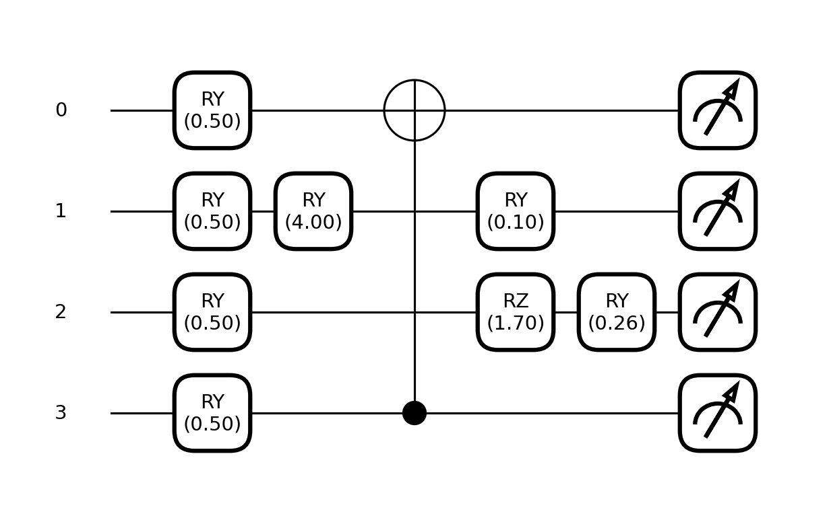
Model 3: quantum filter + CNN
• Looks at every 2 × 2 block of pixels
• 4 pixels → 4 qubits → random circuit → 4 outputs
• 1,024 circuits per X-ray, computed once
• Half-size images → 4× fewer parameters
Saksham Tiwari | Prajjwal Singh | Madipelli Rithvik | Sanchari Ray · Guide: Dr. Rajitha B.
8 / 20
Notes:
In this model the quantum circuit comes first. It looks at every 2 by 2 block of pixels, puts the 4 pixels into 4 qubits, runs a fixed random circuit and measures, giving 4 new images. That is 1,024 circuits per X-ray, so we computed them once and saved them. The new images are half the size, so the CNN after it needs about 4 times fewer parameters. You can see the 4 quantum output images here; the white box at the bottom is a marker on the original X-ray.

Slide 9
How we made the comparison fair
Classical twins
Training and testing
• Quantum classifier vs a classical layer of the same size
• Quantum filter vs three classical filters:
random, average pooling, learned
• Same data, same settings for all
• No extra tuning for any model
• Adam optimiser, 15 epochs
• Each model trained 3 times
• Laptop CPU, no GPU
• McNemar test: is a difference real?
• Over 150 training runs in total
Saksham Tiwari | Prajjwal Singh | Madipelli Rithvik | Sanchari Ray · Guide: Dr. Rajitha B.
9 / 20
Notes:
To know if the quantum part really helps, each quantum model gets a classical twin that is the same in every way except the quantum circuit. For the quantum classifier, the twin uses a small classical layer of the same size. For the quantum filter we tried three classical filters: a random one, simple average pooling, and a learned one. All models were trained the same way, three times each with different random seeds, and we used a statistical test to check if differences are real.

Slide 10
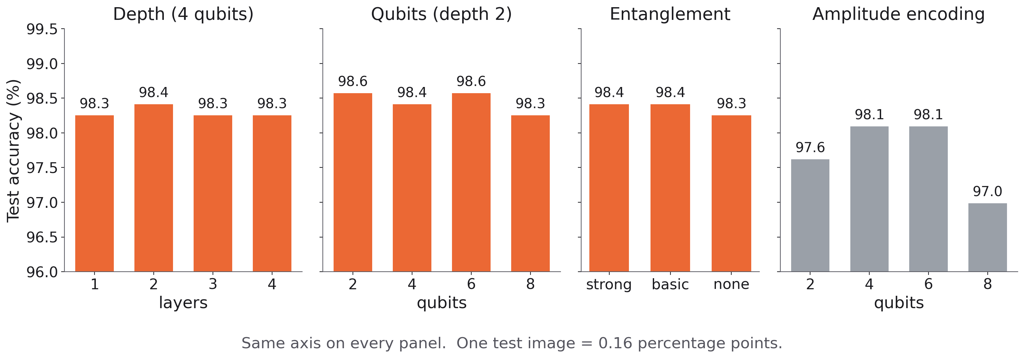
Result 1: circuit settings hardly matter
Most settings differ by only 1 or 2 test images. Angle input works best.
Saksham Tiwari | Prajjwal Singh | Madipelli Rithvik | Sanchari Ray · Guide: Dr. Rajitha B.
10 / 20
Notes:
First we changed one thing in the quantum circuit at a time: the number of layers, the number of qubits, the type of linking between qubits, and the way the input is loaded. All bars use the same scale. Most settings land between 98.3 and 98.6 percent, which is a difference of just two test images. The only clear result is that loading the input as angles works better than the other method, called amplitude encoding.

Slide 11
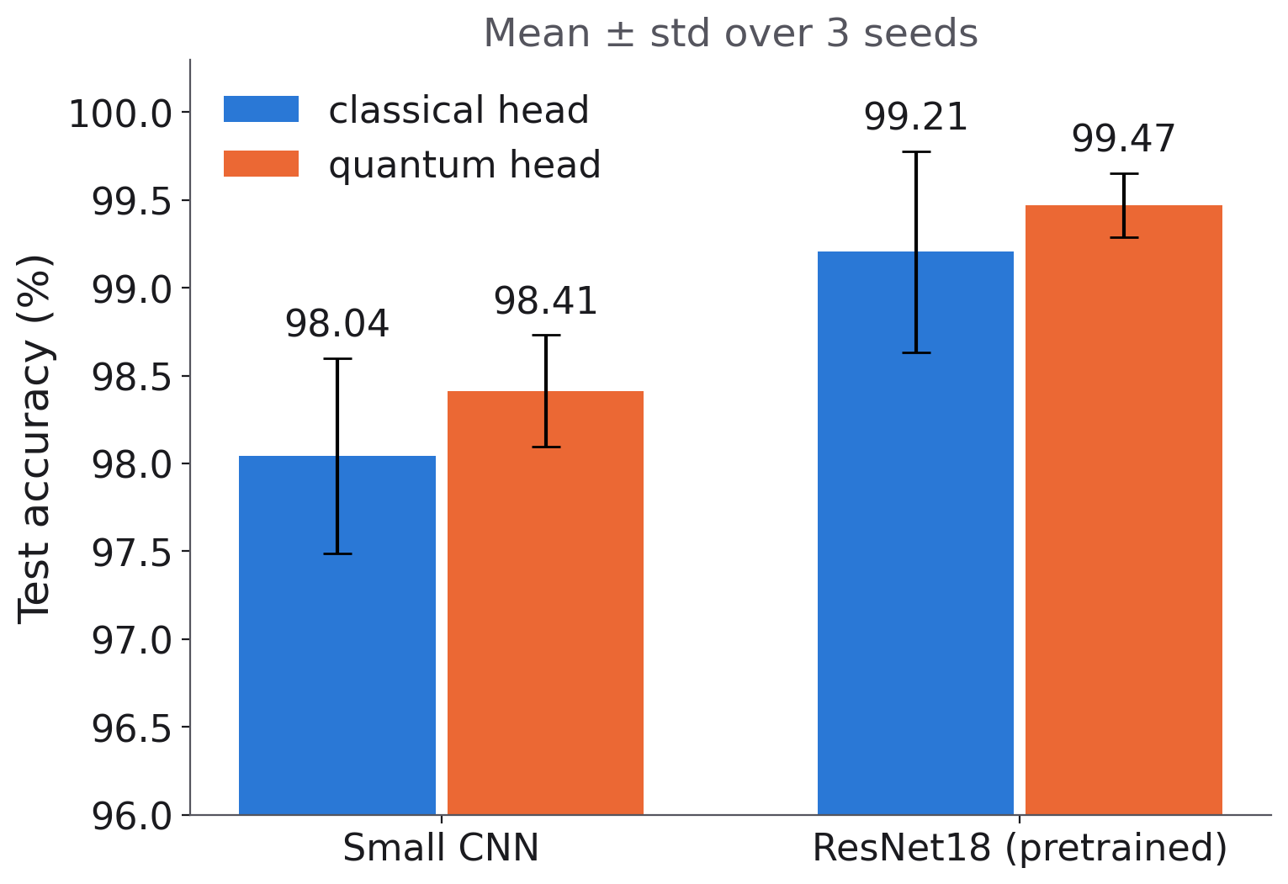
Result 2: a better CNN matters more than the quantum part
• Quantum head: +0.37% on the small CNN
• Quantum head: +0.26% on ResNet18
• Bigger CNN: +1.16%
• Best model: ResNet18 + quantum head, 99.47%
Saksham Tiwari | Prajjwal Singh | Madipelli Rithvik | Sanchari Ray · Guide: Dr. Rajitha B.
11 / 20
Notes:
Next we tried the quantum classifier on two CNNs: our small CNN and a big pretrained one called ResNet18. With both, the quantum head was a little better on average and more stable. But switching to the bigger CNN helped about three times more than switching to the quantum head.

Slide 12
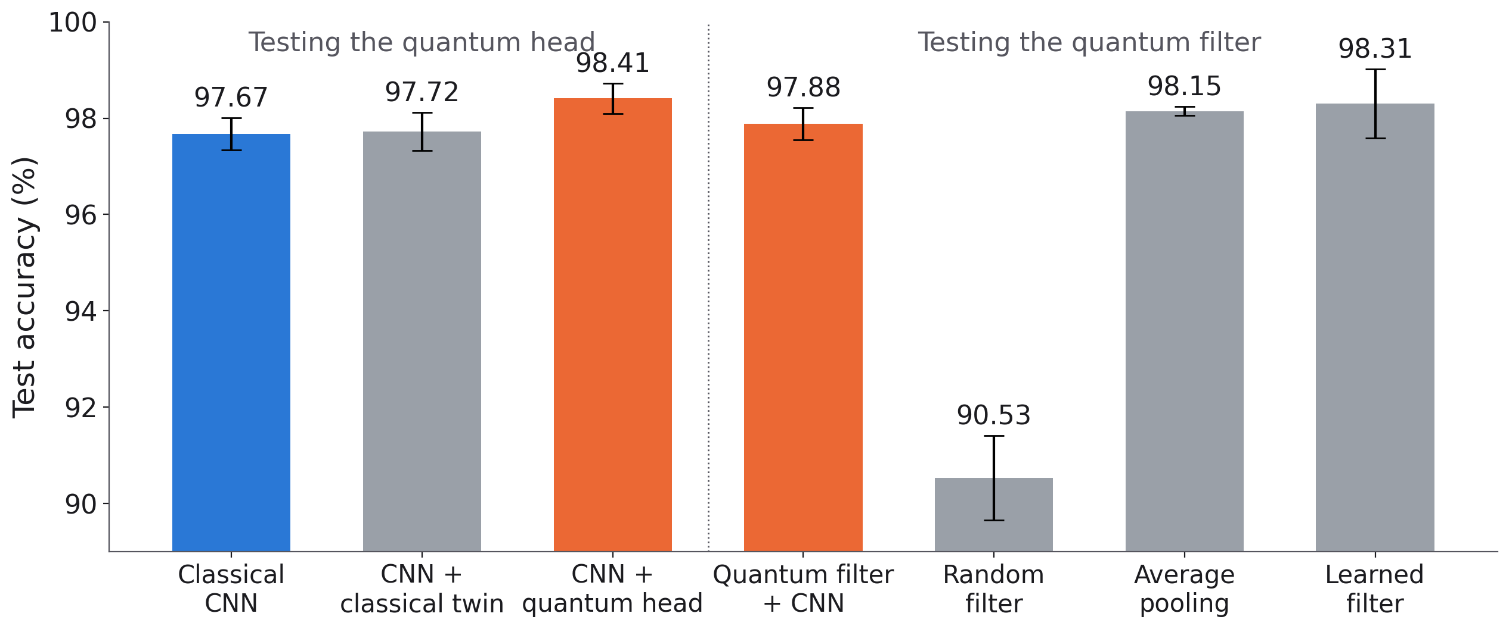
Result 3: quantum models against their classical twins
Quantum head: +0.7% over its twin. Quantum filter: same as average pooling.
Saksham Tiwari | Prajjwal Singh | Madipelli Rithvik | Sanchari Ray · Guide: Dr. Rajitha B.
12 / 20
Notes:
This is our main result. On the left, the CNN with a quantum head got 98.41 percent, about 0.7 points better than its classical twin, and it was ahead in all three runs. On the right, the quantum filter model matched the normal CNN with 4 times fewer parameters. But simple average pooling and a learned classical filter did just as well. The random filter did badly because it destroys image detail.

Slide 13
Result 4: is the difference real?
Comparison | Run 1 | Run 2 | Run 3 | Real difference?
Quantum head vs classical twin | 0.092 | 0.146 | 1.000 | No
Quantum head vs normal CNN | 0.424 | 0.227 | 0.267 | No
Quantum filter vs random filter | <0.001 | <0.001 | <0.001 | Yes
Quantum filter vs average pooling | 1.000 | 0.344 | 0.791 | No
Quantum filter vs learned filter | 1.000 | 1.000 | 0.057 | No
p-value below 0.05 means the difference is probably real.
The quantum head's small gain could be due to chance.
Saksham Tiwari | Prajjwal Singh | Madipelli Rithvik | Sanchari Ray · Guide: Dr. Rajitha B.
13 / 20
Notes:
We used McNemar's test, which looks at the test images where two models disagree. A p-value below 0.05 means the difference is probably real. For the quantum head, the p-values were 0.09, 0.15 and 1.0, so we cannot be sure the gain is real; the two models disagree on only a few images. The quantum filter is clearly better than the random filter, but not better than average pooling or the learned filter.

Slide 14
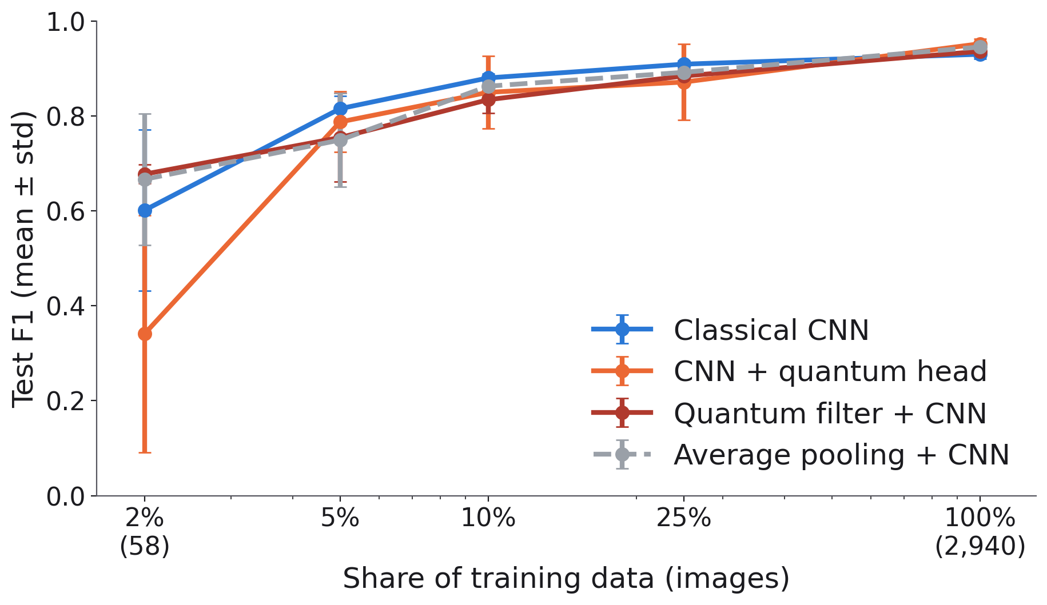
Result 5: training with very little data
• With 58 images, quantum filter and average pooling do best
• Quantum head ranks images best (AUC 0.927)
but its 0.5 cut-off is off
• With more data, the normal CNN is as good
Saksham Tiwari | Prajjwal Singh | Madipelli Rithvik | Sanchari Ray · Guide: Dr. Rajitha B.
14 / 20
Notes:
We also trained with only 2 to 25 percent of the data. With just 58 images, the quantum filter model and average pooling did best, again pointing to image shrinking. The quantum head did badly on F1 at 2 percent, but it was the best at ranking images, with an AUC of 0.927; its problem is only the 0.5 cut-off. With 5 percent or more, the normal CNN was as good or better.

Slide 15
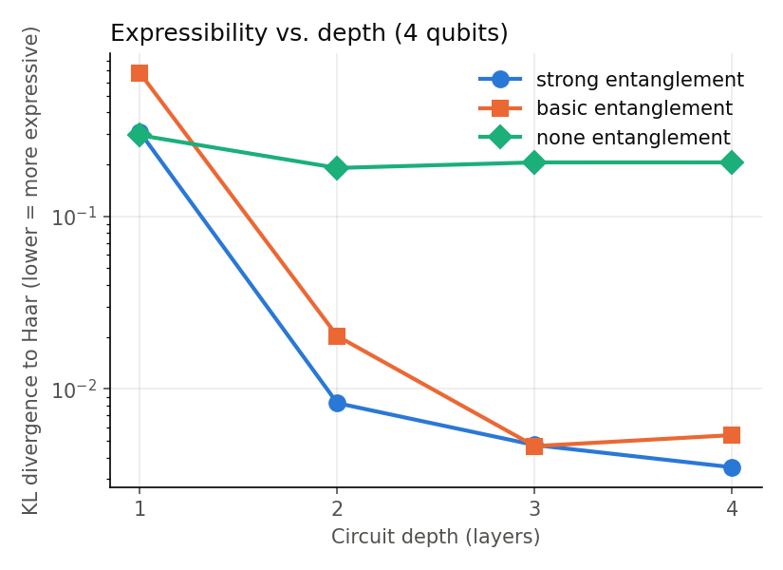
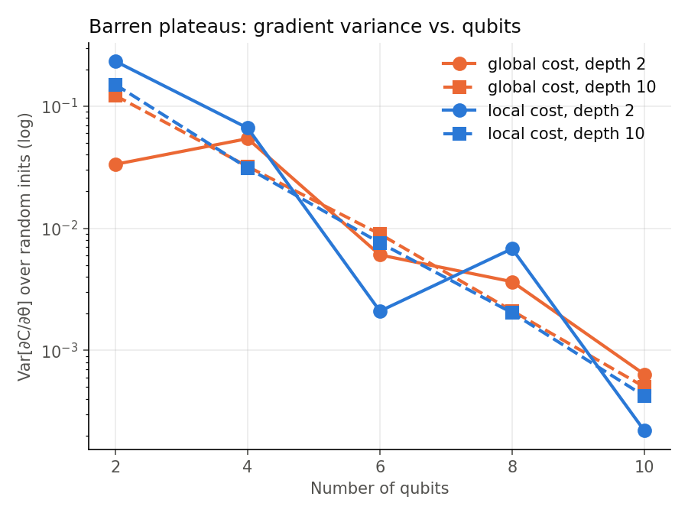
Result 6: looking inside the quantum circuit
Entanglement makes the circuit
much richer, but accuracy stays the same
Each extra qubit halves the gradient,
so small circuits train best
Saksham Tiwari | Prajjwal Singh | Madipelli Rithvik | Sanchari Ray · Guide: Dr. Rajitha B.
15 / 20
Notes:
We also studied the circuit itself. Left: with entanglement the circuit can produce a much richer set of quantum states, 20 to 60 times richer than without it. But the accuracy was the same, so our task does not need this extra power. Right: as we add qubits, the training signal, the gradient, gets about half as big for each extra qubit. This is called a barren plateau and it is why we kept the circuit small.

Slide 16
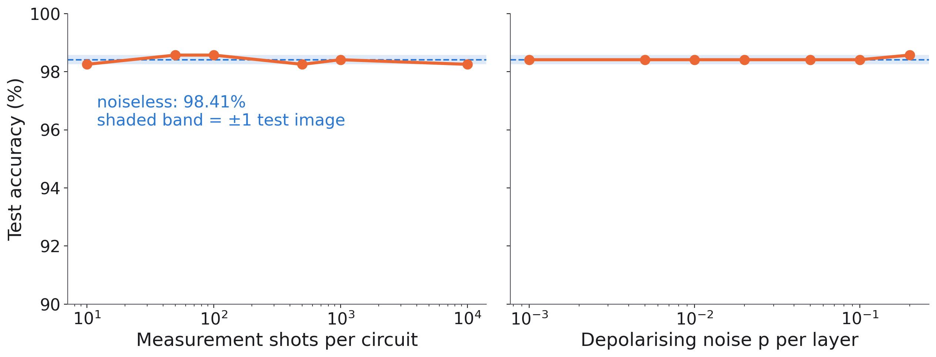
Result 7: it still works with noise
With only 10 measurements or strong noise, accuracy changes by at most 1 image.
Saksham Tiwari | Prajjwal Singh | Madipelli Rithvik | Sanchari Ray · Guide: Dr. Rajitha B.
16 / 20
Notes:
Real quantum computers are noisy and can only run a circuit a limited number of times. So we tested our trained model with only 10 measurements per circuit, and with strong noise added. The accuracy stayed within one test image of 98.41 percent in every case. This means the model should also work on today's quantum hardware.

Slide 17
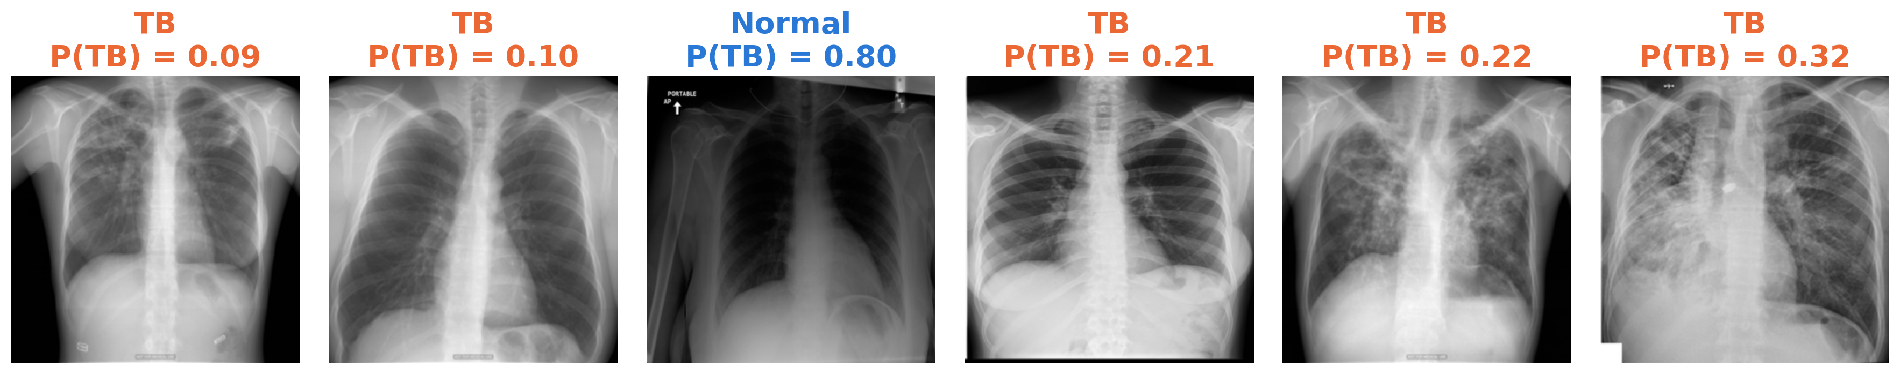
Which X-rays did the model get wrong?
• 10 mistakes out of 630: 7 missed TB, 3 false alarms
• Only 22 images were wrong for any of our 4 main models
• Text and markers on X-rays may confuse the model
Saksham Tiwari | Prajjwal Singh | Madipelli Rithvik | Sanchari Ray · Guide: Dr. Rajitha B.
17 / 20
Notes:
These are the mistakes our CNN with a quantum head was most sure about. Most of its mistakes are missed TB cases, which is the more dangerous kind of mistake. One normal X-ray was called TB; it is a portable X-ray with text on it, which suggests the model may partly learn where an image came from, not only the disease.

Slide 18
Conclusion and future work
What we found
What comes next
• Quantum head: small gain (+0.7%), not proven
• Quantum filter: saving comes from shrinking
• Small circuits train well
• Still works well with noise
• No clear quantum advantage yet
• Run on a real quantum computer
• Bigger images, X-rays from other hospitals
• Train the quantum filter
• Show which part of the X-ray the model uses
Saksham Tiwari | Prajjwal Singh | Madipelli Rithvik | Sanchari Ray · Guide: Dr. Rajitha B.
18 / 20
Notes:
To sum up: a quantum classifier can replace a normal layer and gives a small gain, but we cannot prove it is real. The quantum filter's saving comes from shrinking the image. Small circuits train well and handle noise. Our main limits are that we only simulated the quantum computer, used small images and one dataset. Next, we would like to run the model on a real quantum computer, use bigger images, test on X-rays from other hospitals, and train the quantum filter.

Slide 19

References
• WHO, Global Tuberculosis Report, 2024
• Rahman et al., TB detection using chest X-ray with deep learning, IEEE Access, 2020
• He et al., Deep residual learning for image recognition, CVPR, 2016
• Preskill, Quantum computing in the NISQ era and beyond, Quantum, 2018
• Mari et al., Transfer learning in hybrid classical-quantum neural networks, Quantum, 2020
• Henderson et al., Quanvolutional neural networks, Quantum Machine Intelligence, 2020
• McClean et al., Barren plateaus in quantum neural network training, Nature Comm., 2018
• Sim et al., Expressibility and entangling capability of PQCs, Adv. Quantum Tech., 2019
Our code:
github.com/realsaksham/Mini-project-7th-sem
Saksham Tiwari | Prajjwal Singh | Madipelli Rithvik | Sanchari Ray · Guide: Dr. Rajitha B.
19 / 20
Notes:
These are our main references. The full list is in the report. The QR code opens our code.

Slide 20
Thank you
Questions?
Saksham Tiwari (20233243)
Prajjwal Singh (20233213)
Madipelli Rithvik (20233176)
Sanchari Ray (20233250)
Guide: Dr. Rajitha B.
Notes:
Thank you for listening. We are happy to answer questions.
Likely questions:
Why 64 x 64 images? The quantum filter needs 1,024 circuits per image at 64 x 64; at 224 x 224 it would be about 12 times more, too slow on a laptop. All models use the same size, so it is fair.
Why do the CNN numbers differ between slides 11 and 12? Slide 11 keeps the last training epoch; slide 12 keeps the epoch with the lowest validation loss. The quantum head got 98.41% in both.
Why 2 circuit layers when 1 layer had the best validation score? 2 is our default in every experiment, and all depths are within one test image of each other.
Could the model learn where the image came from? Yes, possibly: normal and TB images partly come from different hospitals and have different markers. This affects all models equally.
Why McNemar per run? All models are tested on the same images, so a paired test fits, and each run is a different trained model.
Why is the random filter so bad? Its tanh saturates and turns pixels almost black or white, so image detail is lost.

