Slide 1
DATA VISUALIZATION
Project 4 — Optional Mastery Phase
E-Commerce Orders Dataset · 2023–2025 · DecodeLabs Batch 2026

Slide 2
Executive Snapshot — 1,200 Orders, $1.26M Revenue
1,200
$1.26M
$1,054
41.4%
Total Orders
Total Revenue
Avg Order Value
Cancel + Return
Situation: Stable revenue base with healthy AOV. Complication: Nearly half of demand never becomes fulfilled revenue.
SCR Framework · Situation → Complication → Resolution

Slide 3
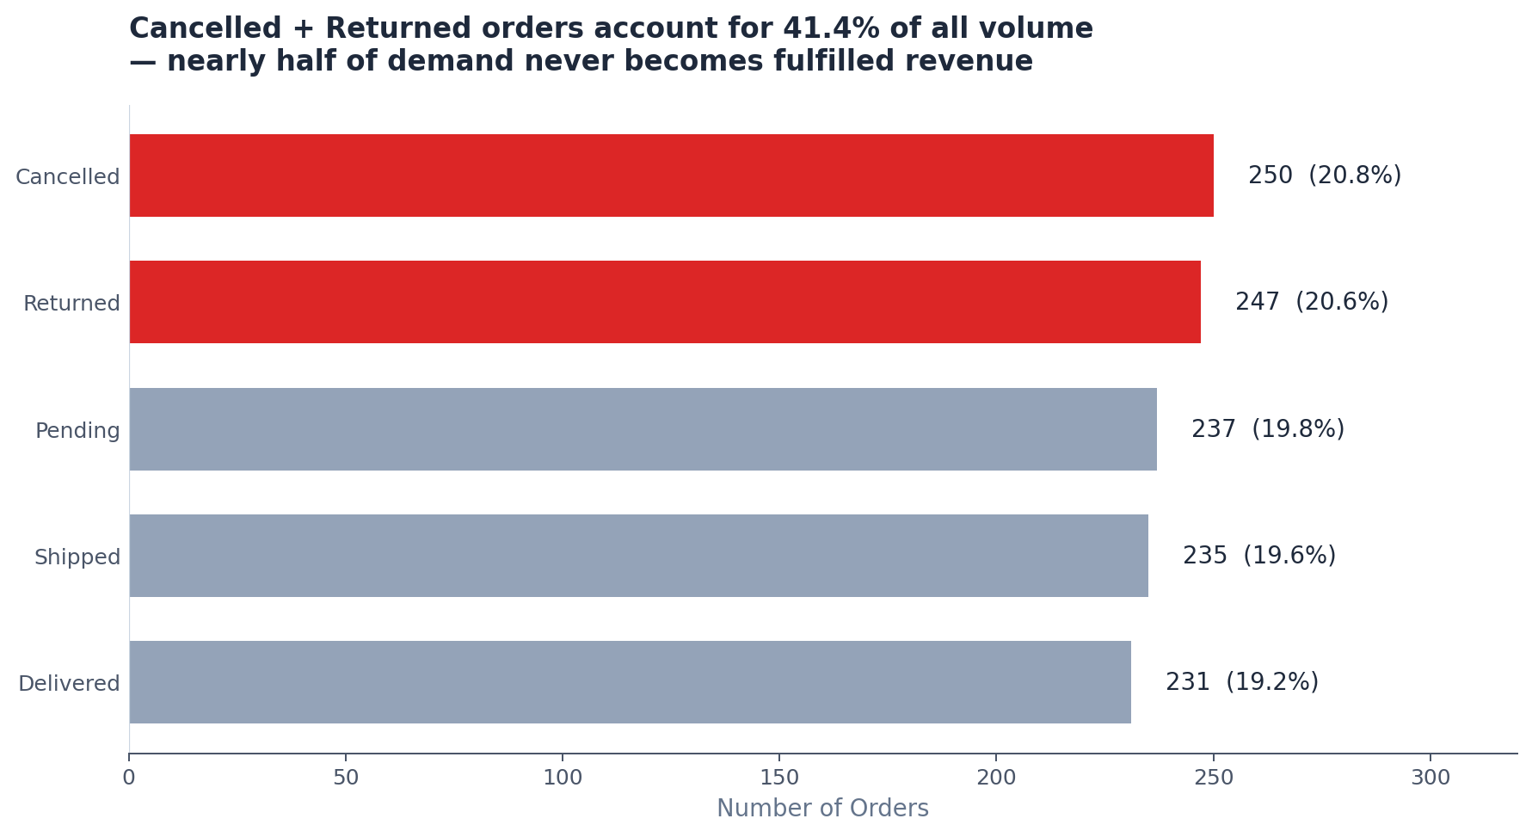
Cancelled + Returned orders account for 41.4% of all volume
Nearly half of demand never becomes fulfilled revenue — the single largest operational red flag

Slide 4
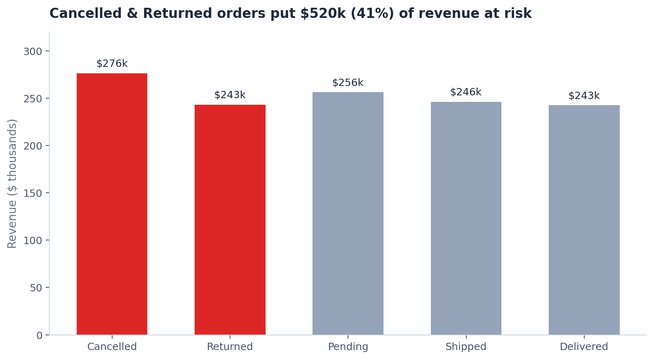
Cancelled & Returned orders put $520k (41%) of revenue at risk
High-value orders are also leaking into Cancelled/Returned status, compounding the impact

Slide 5
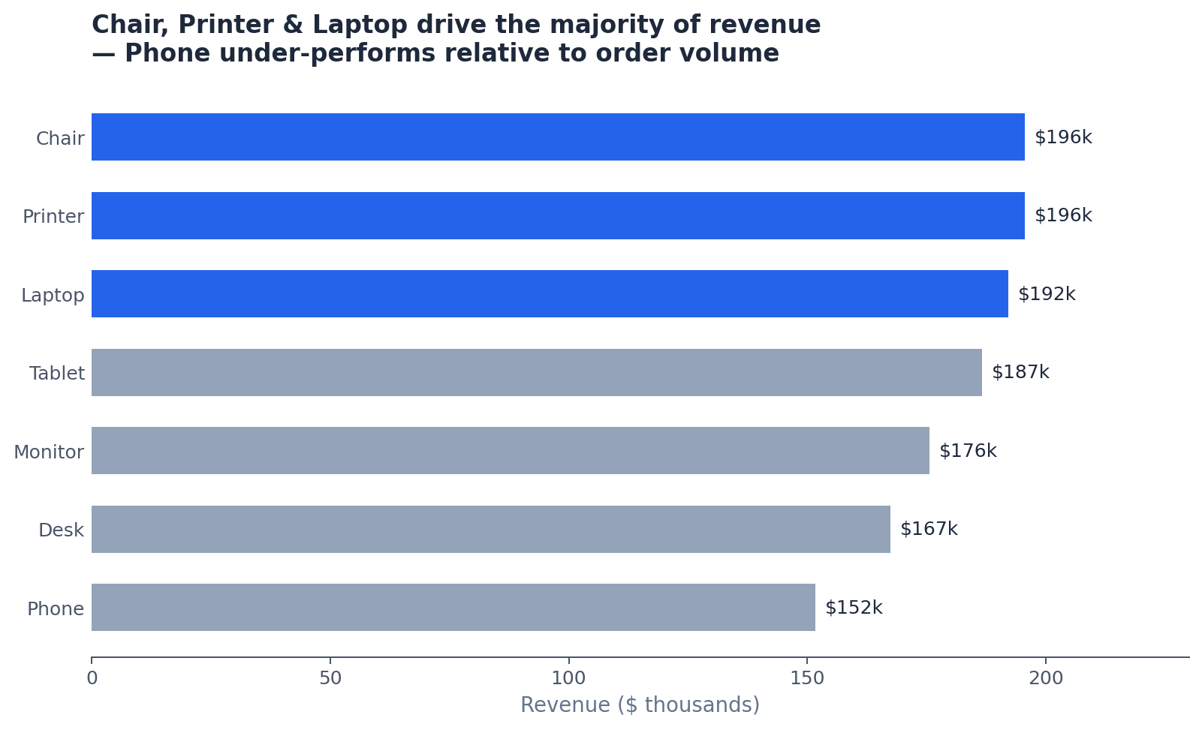
Chair, Printer & Laptop drive the majority of revenue
Phone under-performs relative to order volume — review pricing and promotion strategy

Slide 6
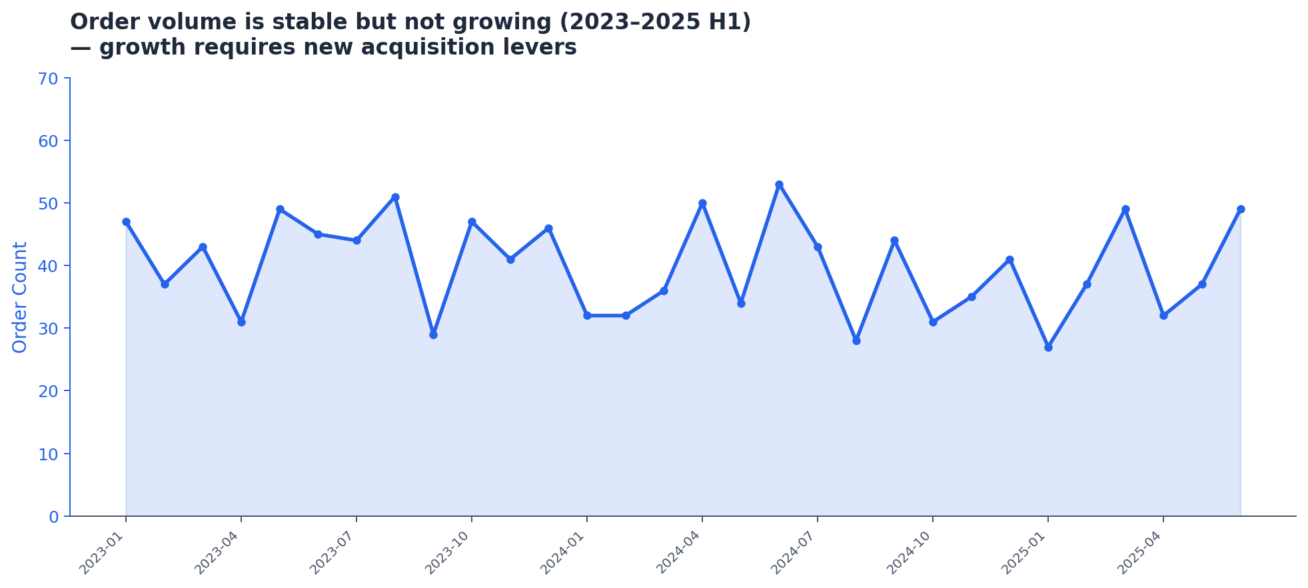
Order volume is stable but not growing (2023–2025 H1)
Growth requires new acquisition levers beyond the current channel mix

Slide 7
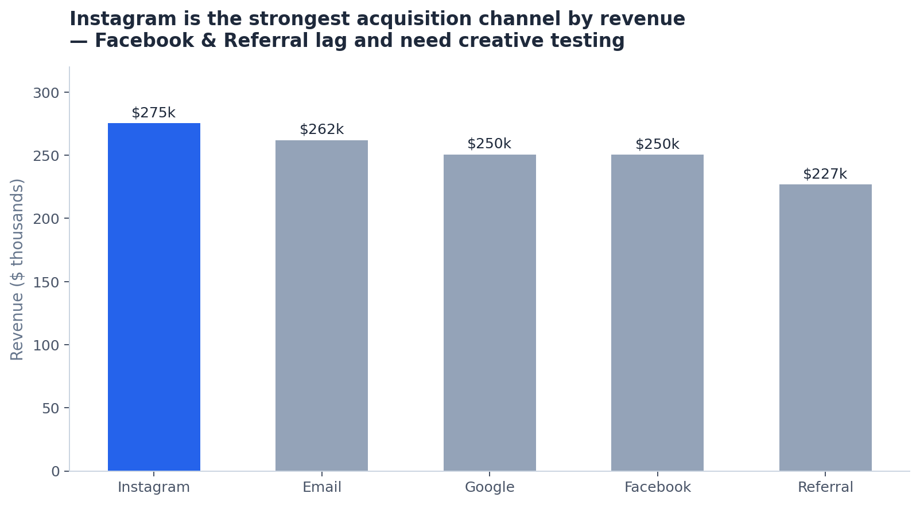
Instagram is the strongest acquisition channel by revenue
Facebook & Referral lag — prioritize creative testing and budget reallocation

Slide 8
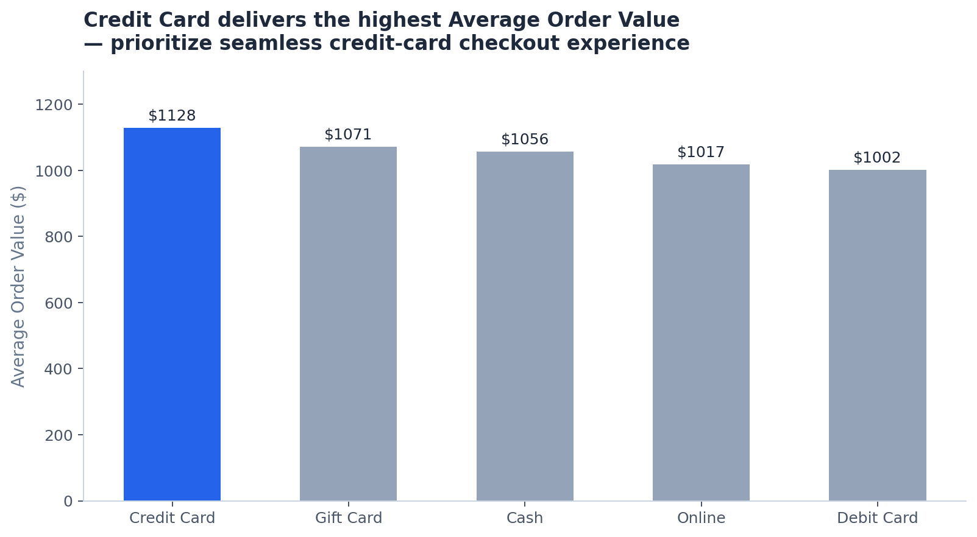
Credit Card delivers the highest Average Order Value
Prioritize a seamless credit-card checkout experience to protect and grow AOV

Slide 9
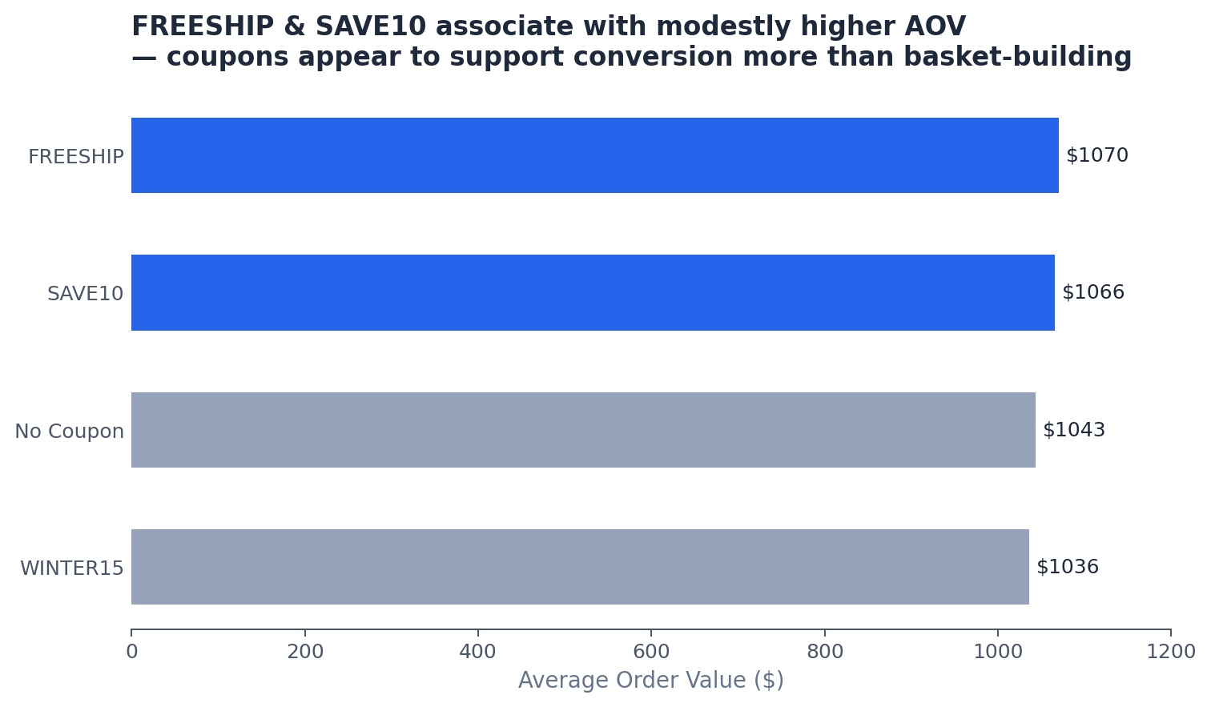
FREESHIP & SAVE10 associate with modestly higher AOV
Coupons appear to support conversion more than basket-building — test free-shipping thresholds

Slide 10
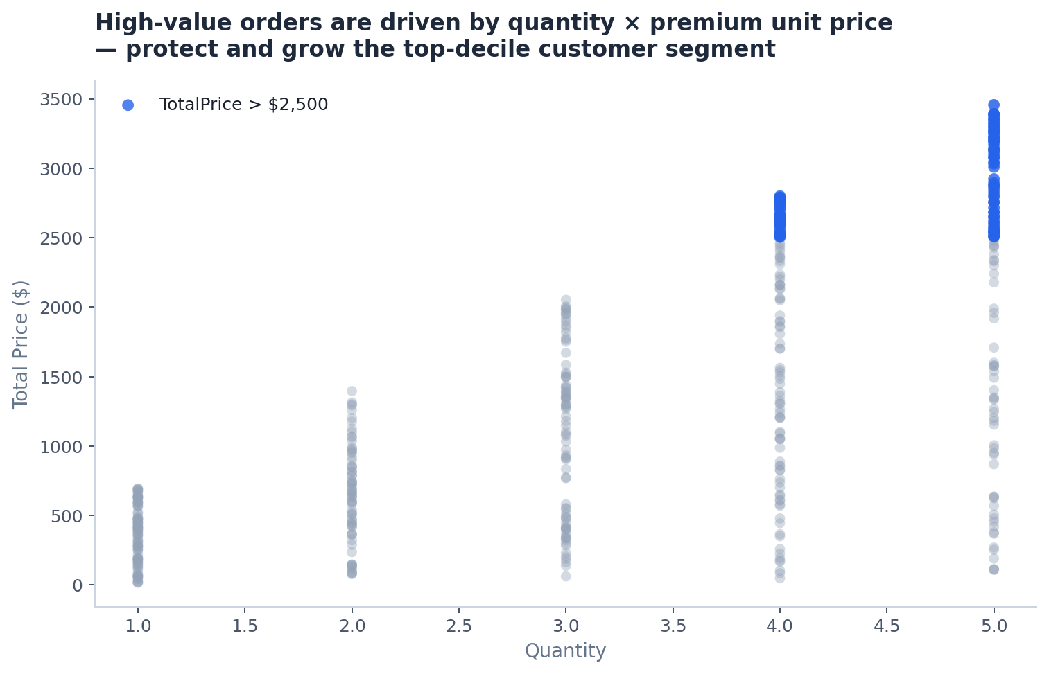
High-value orders are driven by quantity × premium unit price
Protect and grow the top-decile customer segment — several high-value orders already appear in Cancelled/Returned

Slide 11
Resolution — What We Should Do Next
01
Attack the 41% fulfilment failure rate
Root-cause Cancelled + Returned by Product × Payment × Referral. Target a 15-point reduction within two quarters (~$190k+ annualised recovery).
02
Protect high-value customers
Identify the top-decile TotalPrice cohort and design a VIP retention programme before more high-value orders leak.
03
Double-down on Instagram + Credit Card
Increase Instagram acquisition investment. Optimise checkout for Credit Card (highest AOV).
04
Review Phone category & coupon strategy
Test pricing/promotion for Phone. Replace blanket free shipping with threshold-based offers to protect margin.

Slide 12
Closing Narrative (SCR)
Situation: Stable $1.26M order book with healthy AOV.
Complication: 41% of orders (and revenue) are cancelled or returned; growth has stalled.
Resolution: Fix fulfilment leakage first, protect high-value customers, and scale the strongest channels.
DecodeLabs · Project 4 · Batch 2026

