Slide 1
Why RNN
ANN
All inputs are independent
Tabular data
No order of features
Tasks such as text, stock prices, weather,time series
— the order and context matter
I love to cook
The stock market rose today
The river bank was calm
He went to the bank to deposit money

Slide 2



Problem with Standard Neural Network
Variable input length.
Review:
Sequential inputs.
Opposite meaning sentences having same set of words with different order

Slide 3
What is an RNN?
Definition:
Recurrent Neural Networks (RNNs) are a type of neural network designed to process sequential data by maintaining a memory of previous inputs.
Key Features:
Handles time-series data and sequences.
Maintains a hidden state to capture context.
Applications:
Language modeling, speech recognition, time-series prediction.

Slide 4
RNN Architecture
Core Components:
Input Layer: Accepts sequential data
Hidden Layer: Maintains a state that evolves over time
Output Layer: Produces predictions or sequences
Recurrent Nature:
RNNs have loops — output from the previous step feeds back as input to the next step.
Outputs and hidden states are influenced by both current and past inputs.

Slide 5
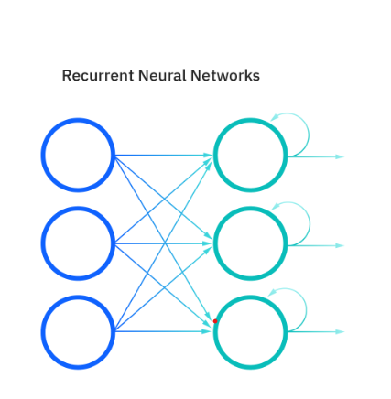
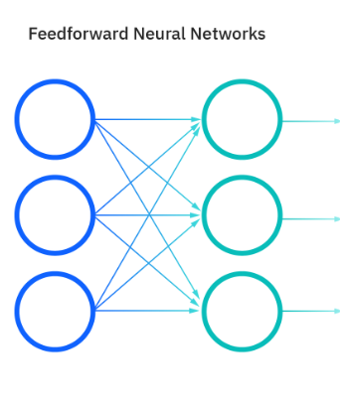

Slide 6
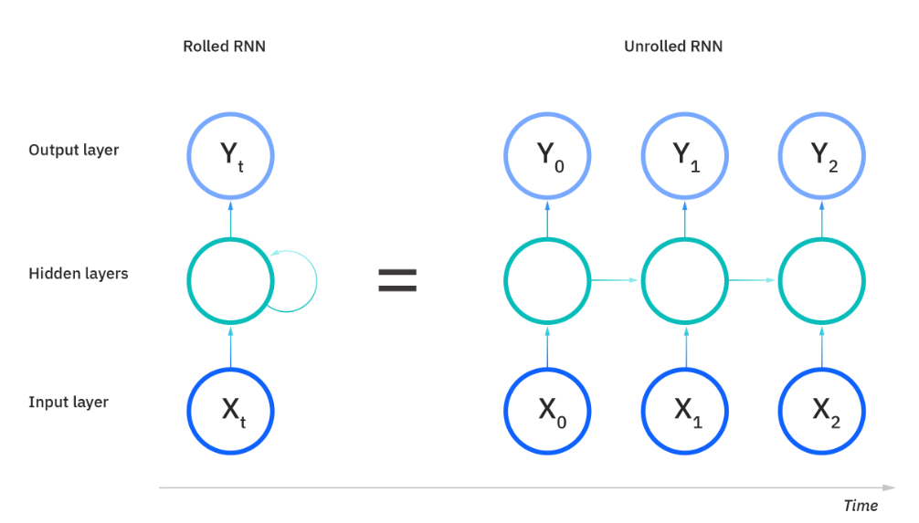
Notes:
Rolled RNN(Compact) is represented as a single block with a loop inside it showing the recurrent nature of the RNN. At all the time steps weights of the recurrent neuron would be the same since its a single neuron now. So a recurrent neuron stores the state of a previous input and combines with the current input thereby preserving some relationship of the current input with the previous input.
Unrolled RNN: how network processes sequential data by stretching out the loop across multiple time steps(t-1,t,t+1), showing each stage explicitly. It shows how the hidden state passes from one time step to the next, making it easier to understand training,

Slide 7
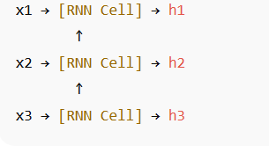
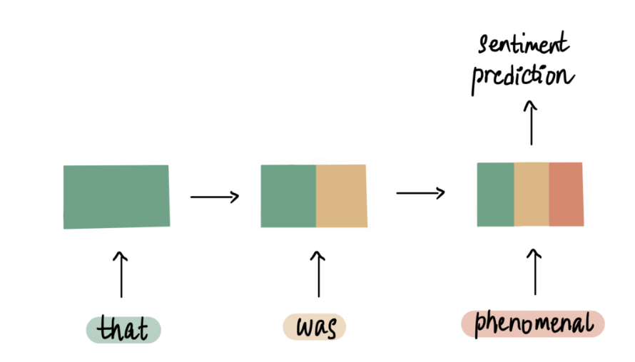
Recurrent :process a dynamic number of inputs sequentially.
x1
x2
x3

Slide 8
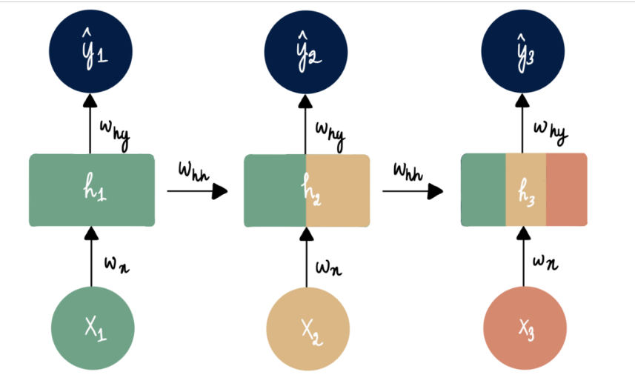
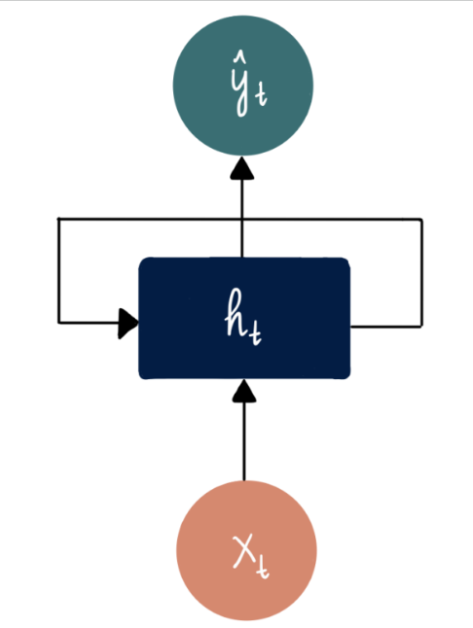
Recurrent feeding of the output
from the hidden layer
back into itself
Each stage of the process involves an input, x_{i}, that travels through the hidden layer to generate an output, h_{t}
This output then either moves into the hidden layer of the next neural network or it results in a sentiment prediction, depicted as y^
Each stage incorporates weight and bias terms which are constant in model

Slide 9
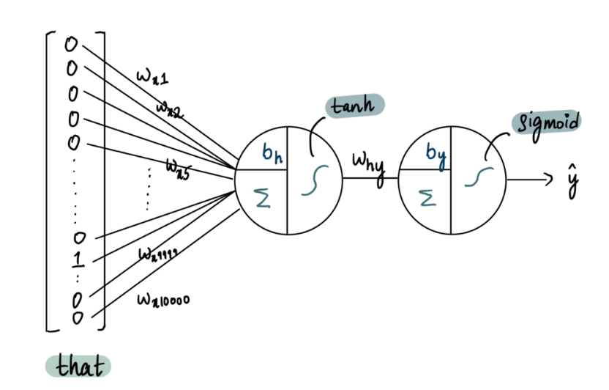
Consider network has 10,000 inputs (= 1 word)
a single hidden layer composed of one neuron
and one output neuron.

Slide 10
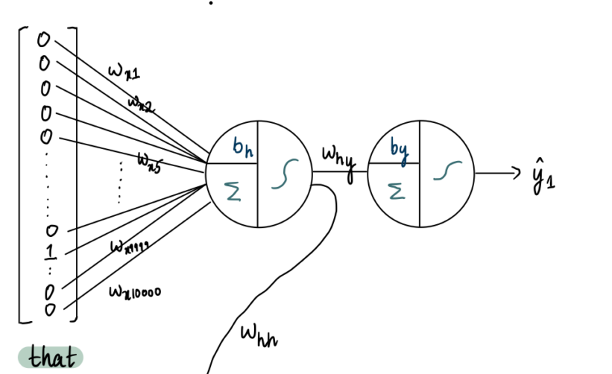
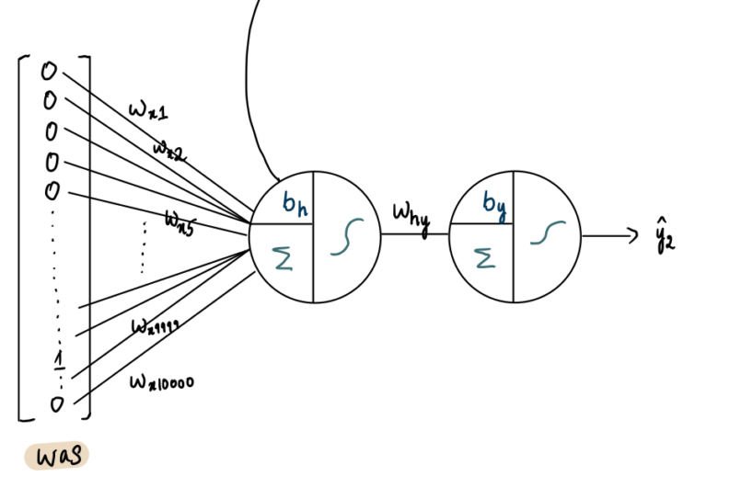
Take the output from the hidden layer
of the previous neural network
and pass it into the hidden layer
of the current network:

Slide 11
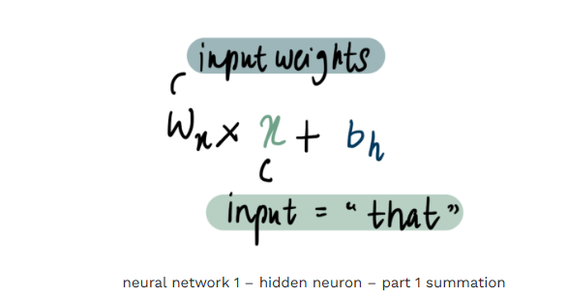
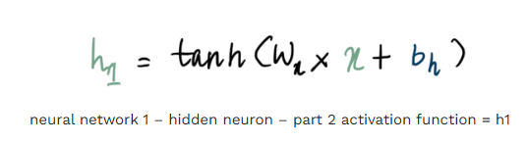
In the hidden layer neuron of the first neural network, the first step is summation:
Tanh acivation
where wₓ represents the input weights and x represents the input

Slide 12
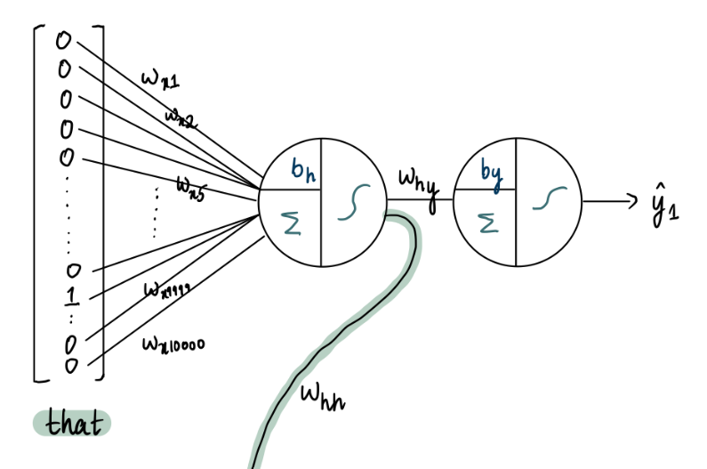
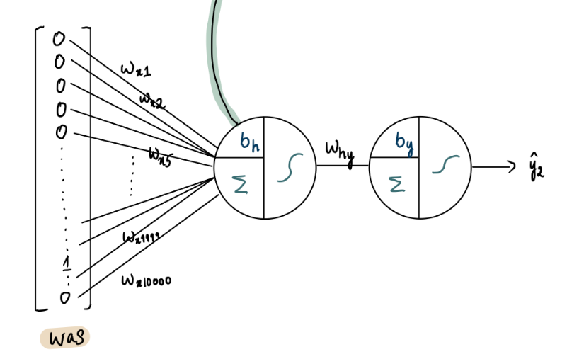
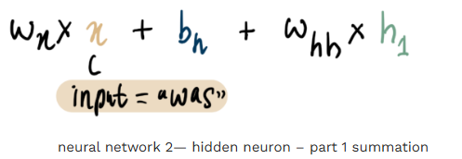
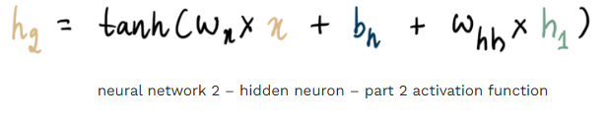
pass h1 to the hidden neuron in the
second neural network

Slide 13
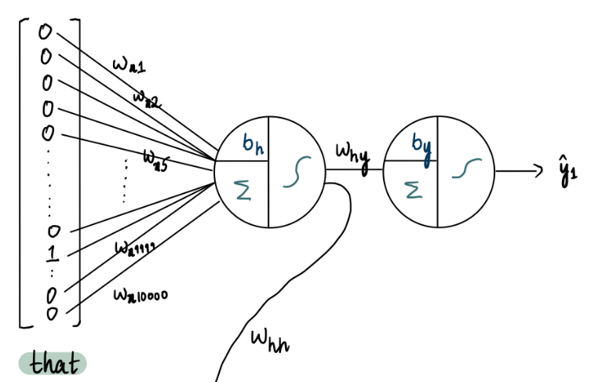
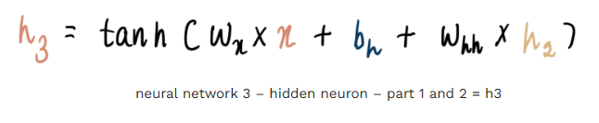
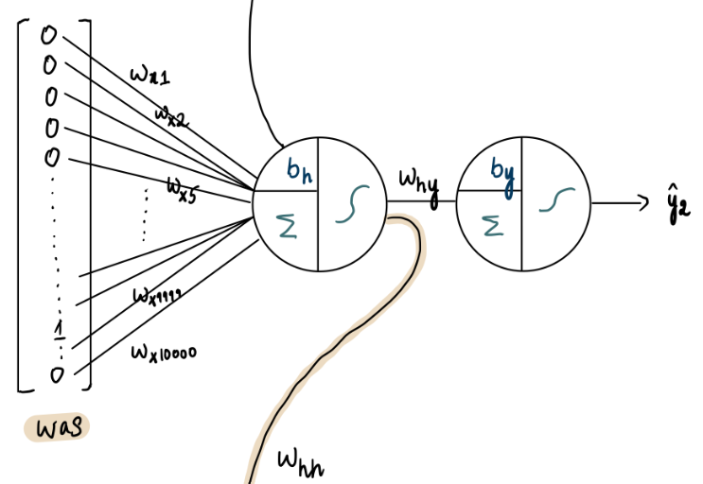
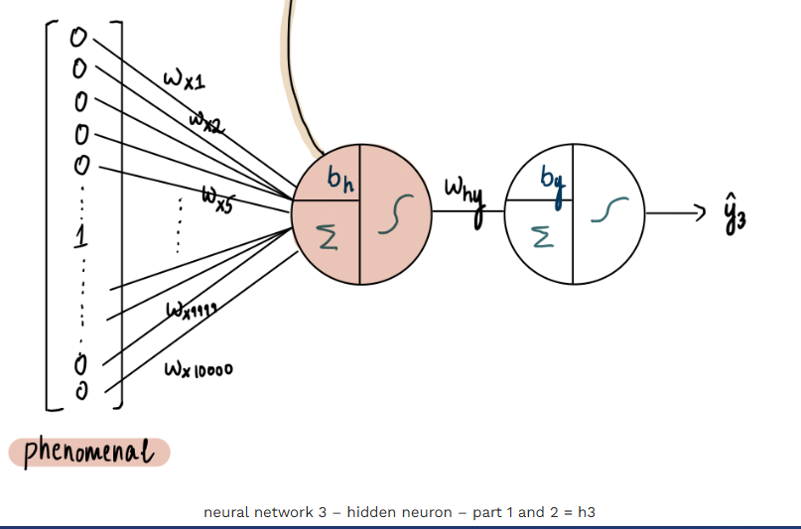
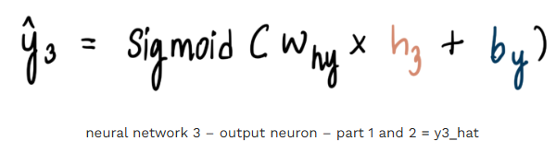
this is the last word in the review and consequently the final input, we pass this data to the outer neuron

Slide 14


Full linear transformation in hidden layer
Transformation happening in the output layer
x_{t}​: Input at time t
h_{t−1}​: Memory from previous step
h_{t}: Updated hidden state
Same weights shared at all time steps

Slide 15
Activation Functions
tanh:
Output range (-1, 1)
Repeated multiplication through time
Keeps values stable (prevents explosion)
Simple RNN
ReLU:
Faster learning
May forget negative
For deep or stacked RNNs

Slide 16
Notes:
Rolled RNN(Compact) is represented as a single block with a loop inside it showing the recurrent nature of the RNN. At all the time steps weights of the recurrent neuron would be the same since its a single neuron now. So a recurrent neuron stores the state of a previous input and combines with the current input thereby preserving some relationship of the current input with the previous input.
Unrolled RNN: how network processes sequential data by stretching out the loop across multiple time steps(t-1,t,t+1), showing each stage explicitly. It shows how the hidden state passes from one time step to the next, making it easier to understand training,

Slide 17
1.The training data(sequence) is split into time-based sequences(timesteps).If sentence has 4 words it will be unrolled into four layer, one layer for each word.
2.It is vector-encoded and passed into the RNN as inputs.
3.The RNN is initialized with random weights and biases which remain the same through all timesteps(difference with ANN).
4.The network iterates over the sequence to compute the output or hidden state for each timestep.
5.The current hidden state is computed by passing the input for the current time-step (xt), the previous hidden state(ht-1), and the weights and biases for the sequence into a layer with an activation function of choice.
6.The hidden state is then returned as an output and passed to the next timestep.
7.Above steps(5 and 6) are repeated
8. The final output can either be returned as a single vector or can be a combination of output vectors returned in each timestep.

Slide 18
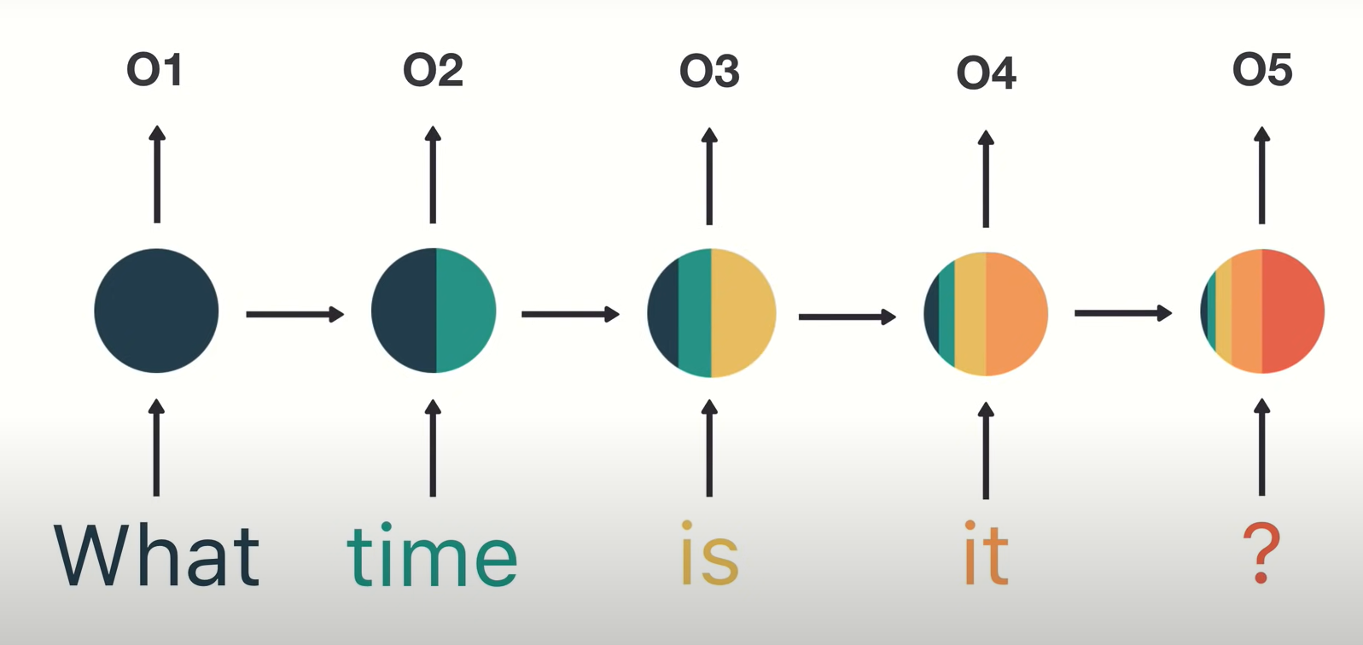

Slide 19
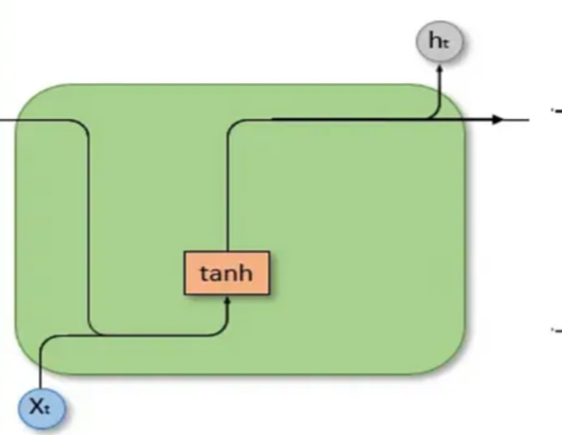
Standard RNNs

Slide 20
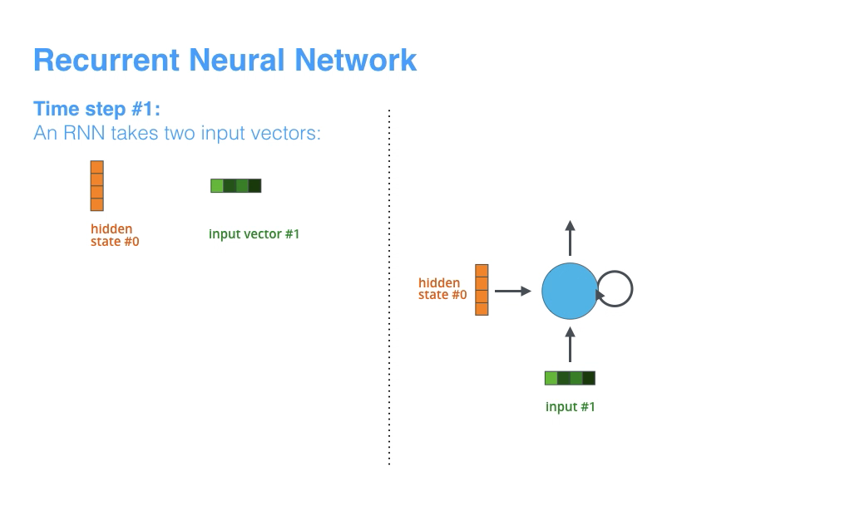

Slide 21
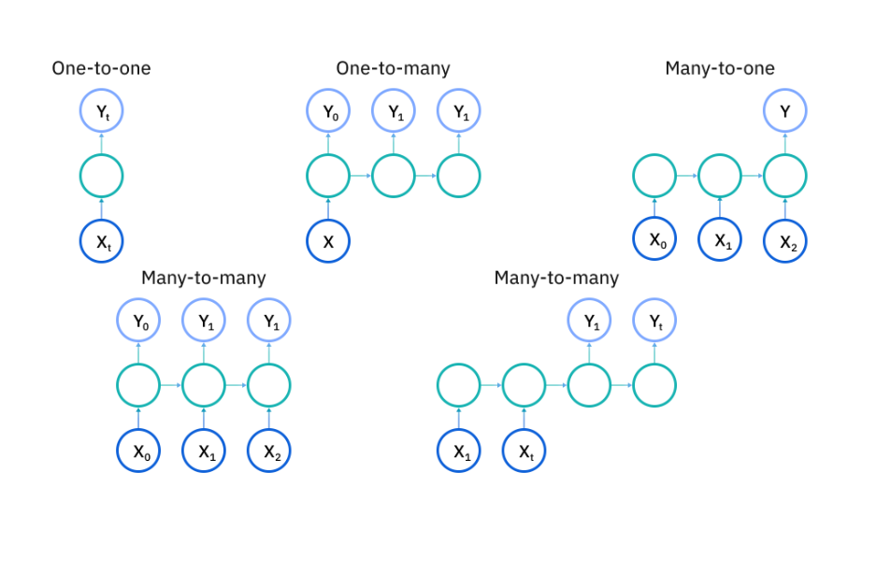
Types of RNN’s

Slide 22
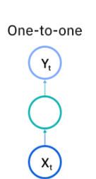
One-to-One RNN
Description: A standard neural network (not strictly an RNN)
.
Application: Used for problems with fixed-size input and output.
Example Use Cases: Image classification.

Slide 23
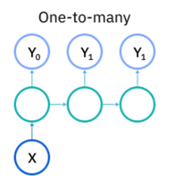
One-to-Many RNN
Description: Produces a sequence of outputs from a single input.
Application: Suitable for tasks where a single event generates a series of related outputs.
Example Use Cases:
Image captioning: An image input generates a sequence of words.

Slide 24
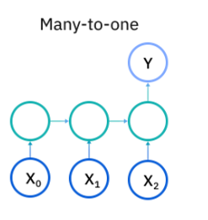
Many-to-one RNN
Description: Maps a sequence of inputs to a single output.
Application: Common for tasks where a sequence determines a single prediction.
Example Use Cases:
Sentiment analysis: Positive,Negative,Neutral
Spam detection: Spam,Not spam
Movie rating prediction
Next word prediction

Slide 25
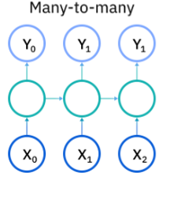
Many-to many RNN
Many-to-Many RNN (with Equal Input and Output Lengths)
Description: Maps a sequence of inputs to a sequence of outputs with the same length.
Application: Used when each input has a corresponding output.
Example Use Cases:
Video frame classification: Each frame in a video sequence is labeled.
Named entity recognition
Part of speech recognition

Slide 26
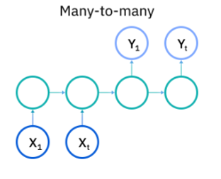
Many-to-Many RNN (with Unequal Input and Output Lengths)
Description: Produces a sequence of outputs with a different length than the input sequence.
Application: Suitable for tasks where input and output lengths vary.
Example Use Cases:
Machine translation: An input sentence in one language is translated to a sequence of words in another language.
Speech-to-text: An audio input is converted into a text sequence.

