Slide 1

Preparing for your RGE-EDGE Review
Steve Hilburger and Mark Miller
RGE-EDGE Senior Scientists
Office of Science Quality and Integrity (OSQI)
2024 Winter Review Cycle (Nov 15 Submission)
RGE mailbox rge-edge@usgs.gov
RGE website www.usgs.gov/rge-edge
Notes:
This session is not being recorded
Slides are available online www.usgs.gov/rge-edge
Focus on scientists planning to submit in the upcoming November 2024 submission
All the documents you will need are on the program web site.
We will pause periodically for questions

Slide 2
RGE and EDGE Definitions
RGE: Research Grade Evaluation
Research Scientists
~1,000 RGE scientists
OPM RGE Guide (2006)
EDGE: Equipment Development Grade Evaluation
Development Scientists
~45 EDGE scientists
OPM EDGE Guide (1968)

Slide 3
RGE-EDGE Review
Mandatory and periodic classification review of Permanent scientists
Administered by OSQI in collaboration with the Office of Human Resources
Reviewed by panels of scientific peers who meet, discuss, and reach consensus
Sum of scores from factors 1–4 maps to a grade

Slide 4
Review Schedule and Frequency
Frequency varies with grade
GS-9 (EDGE) or GS-11 (RGE) to GS-13: every 4 years
GS-14: 6 years
GS-15: 7 years
Early reviews scheduled with center director approval
Delayed reviews possible, typically limited to:
Personal / health issues, or
Temporary assignments away from research
Require center director approval

Slide 5
Annual Calendar (as of late 2022)
Two RGE-EDGE “cycles” per year, each with
~100+ scientists reviewed; ~15+ panels held
Summer Cycle
April 15 Intent to Submit Deadline (for ALL additions to May schedule – including early reviews and conversions)
May 15 submission date
Panels meet ~July through ~November
Winter Cycle
October 15 Intent to Submit Deadline (for ALL additions to Nov schedule – including early reviews and conversions)
November 15 submission date
Panels meet ~February through ~May

Slide 6
What is in an RGE-EDGE package?
Research or Development Scientist Record
List of references, including supervisor and center director
Three significant contributions (as attachments)
Approval Sheet signed by CD, supervisor, and scientist
Supervisory letter of support (Optional)
External Impact Statements (Optional)
CD Reclassification Letter (Required for reclassifications)
Templates and guidance on www.usgs.gov/rge-edge

Slide 7
Planning for your RGE-EDGE review
Review Planning for your Submission document
Read carefully the criteria used for scoring
OPM RGE Guide (all)
OPM EDGE Guide (pages 42–60) and EDGE checklist
If you’re a GS-15, the Degree G Criteria
Give yourself time
Write clearly and concisely; use plain language
Have colleagues, supervisor, Center Director review

Slide 8
Scientist Record – Outline
Scientist Background
Written Narratives (length limits)
Research Environment
Four Factor Narratives
Three Significant Contributions
Supporting Information
Bibliography, Presentations, Service, Awards, etc.
Reference List
Please don’t change the headings

Slide 9
Scientist Background
Name (pronouns, optional)
Classification Title, Series, and Grade
Center Name
Duty Station
Date of Entrance to Federal Service
Date of Last Promotion
Review Cycle Submitted
Up to 5 descriptive phrases that characterize your research and specialties
(e.g., aquatic trophic interactions, heavy metal isotopes, earthquake wave propagation…Avoid general terms such as hydrology, ecology, and geology.)

Slide 10
Research or Development Environment
An abstract to your position
Very high-level summary
Scope of research/development
Primary collaborators
Major sources of funding
Do not include:
A lot of detail
Lengthy lists of:
Projects
Accomplishments or impacts
Awards or recognition
Amounts of funding

Slide 11
Factor Narratives - Overview
Allows you to directly address each of the four factors.
Focus factors 1, 2, and 3 on current and recent work (see guidance document).
Factor 4 can cover full career, but focus on recent.
Focus on clear descriptions of your work and your role.
Claims made in the narrative must be substantiated in the record.
Tips:
Become familiar with OPM Guide criteria but avoid focusing on aspirational phrases from the Guide.
Describe specific evidence; avoid making a general statement followed by numerous citations.
Do not include images, diagrams, pictures, or illustrations.

Slide 12
Factor I: Research Assignment
Focus on:
Scope and complexity
General types of methods used
Importance of expected results
Scientific leadership – team, supervisory, and administrative responsibilities
Discuss your specific role
Tips:
Keep to current assignment: last ~4, ~6, or ~7 years; or since last promotion if shorter
Discuss the norm of the assignments rather than atypical projects
Don’t include specific accomplishments

Slide 13
Factor II: Supervisory Controls
Focus on:
Degree of personal responsibility
Authority to act independently
Level of approval required
Technical supervision required
Tips:
Keep to current assignment: last ~4, ~6, or ~7 years; or since last promotion if shorter
Don’t include supervision that you provide
Supervision can come from sources other than direct supervisor
At higher levels, the scientist has the autonomy to influence high-level (DOI) scientific directions

Slide 14
Factor III: Guidelines and Originality
Focus on:
Preexisting knowledge available
How you demonstrated originality
Methods and approaches rather than products and impacts
Tips:
Keep to current assignment: last ~4, ~6, or ~7 years; or since last promotion if shorter
Explain how your work is original
Specific examples are highly useful to panels

Slide 15
Factor IV: Contributions, Impact, Stature
Focus on:
Scientific contributions – publications, datasets, tools, code, presentations, testimony, strategic planning, special assignments…
Impact to society, agency, or science
Stature and standing – invitations, elected positions, awards, recognitions, selection to lead teams…
Tips:
Includes your entire career; recency is important to receive full credit
Discuss how your work is:
Changing the way people think or act
Advancing scientific understanding
Advancing the USGS and DOI Mission
Protecting and advancing the health, safety, economic vitality, or ecological integrity of society

Slide 16
Focus on Impacts
Former tendency for panels to over-rely on numbers of publications and reputation of outlets
Panels consider all scoring criteria, not just publications
Panels consider both impact and outputs

Slide 17
Three Significant Contributions
Should help panel assess your recent impact and major career achievements
May be publications, datasets, scientific tools, patent, code, presentations, testimony, strategic planning, and special assignments.
Avoid in-press publications (impact is uncertain)
Background, Role, Results, Impact
Use concise, plain language
Pre-USGS publications OK

Slide 18
Length Limits for Narratives
Including spaces
These are LIMITS, not targets
RSR/DSR Section | Characters Allowed | Page Length
Res./Dev. Env.: | 2,500 | (~3/4 page)
Factor 1: | 7,000 | (~2 pages)
Factor 2: | 3,500 | (~1 page)
Factor 3: | 7,000 | (~2 pages)
Factor 4: | 14,000 | (~4 pages)
Contributions: | 10,500 | (~3 pages)
Total: | 44,500 | (~12–13 pages)

Slide 19
Supporting Information (slide 1)
A. Current and Recent Projects (brief descriptions)
B. Bibliography
Published products
Products approved for publication (have BAO approval)
Unpublished technical reports
Submitted manuscripts
include data releases; see Guidance
include relative % contributions for Concept, Data, Interpretation, Writing; see Guidance
C. Presentations
Invited or noteworthy (entire career)
Contributed presentations (last 10 years)
D. Professional and Scientific Service
E. Academic Service

Slide 20
Supporting Information (slide 2)
F. Technical Training Provided
G. Awards and Recognition (research- or development-related awards)
H. Special Assignments
I. Inventions and Patents**
J. Outreach and Media Coverage
K. Previous Professional Positions
L. Education**
External Impact Statements (optional; see specific guidance)
** these sections differ between RGE and EDGE

Slide 21
References
Supervisor & Center Director (required)
Panelists will contact at least 4
CD, Supervisor, and 2+
List at least 6 references and their specific professional relationship to you.
“Collaborator on wormhole project”
“End user of SPYDER model”
Supervisor / CD turnover?
Feel free to list both current and former with notes
Consider including a range of collaborators, cooperators, partners and people who have been impacted by your science.
Recommend that you contact references prior to listing them. Consider sharing your documentation with them.
Panelists may contact people other than your references in certain situations.

Slide 22
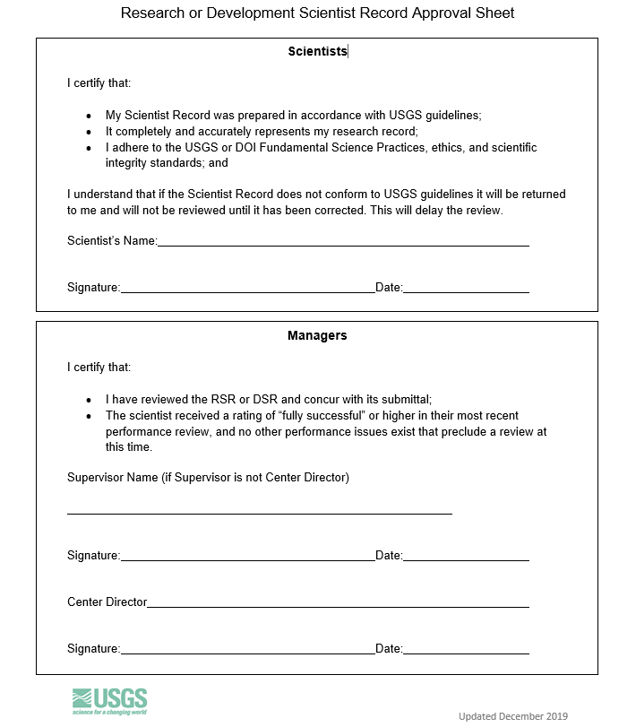
Approval Sheet and Signature
Your supervisor AND Center Director will review and verify
Accuracy
Use of clear language
Section length limits
Use of IPDS numbers
BAO approval dates
Electronic/pen signatures OK
Multiple copies OK

Slide 23
Ready to submit?
Refer to Planning for your Submission document
When package is complete
Email to submit_rge-edge@usgs.gov
You will receive confirmation of receipt
Submit all files by email, if possible
Break into multiple emails if needed
Contact us for extreme file size issues
If prompted, decline Outlook’s suggestion to submit OneDrive “links” instead; please actually attach the files
Use rge-edge@usgs.gov for general questions

Slide 24
Dynamic Peer Groups
Scientists do not pre-select peer group
Panels formed based on expertise of the scientists to be reviewed in each cycle
Use program to cluster packages into groups with similar expertise, followed by human curation
Result in better panel composition
More efficient panel development

Slide 25
Panel Findings
Written description of the score (typically 3-5 pages)
How each factor score was determined
Framed in terms of OPM Guide criteria
Why the higher score was not awarded
“The panel did not see evidence of [guide criteria]”
“The factor fully meets but does not exceed level C”
Goal to be more explicit, less subtle
No prescription ("you should focus more on....")

Slide 26
For example…
Aldo’s research requires subdivision into separate phases, including some that are themselves considerably broad and complex. In one example, he measured the response of laughing gull populations to rapid changes in parking lot extent and French fry availability, including publications by Leopold and others (2019, 2020, and 2021). Aldo’s paper on the relative influences of environmental and anthropogenic stressors on the regional distribution of Canada geese utilized unconventional and novel approaches by combining biological and golf course data sets. The problems that he addresses, such as linking avian population trends to a range of variables, including land use change and the availability of nutritional subsidies, are difficult to define. Aldo’s work on sandhill cranes resulted in a series of products that are definitive of the field (see Leopold 2022 and Leopold 2023).
The panel found that Aldo’s research assignment exceeds the level C criteria, but does not fully meet level E. The panel did not find evidence of the current assignment being exceptionally difficult and unyielding to investigation, or that research products are expected to result in major advances consistent with level E. Therefore, level D applies, and 8 points are credited for factor 1.

Slide 27
When will you receive your results?
It varies!
Planning to evaluate 100+ scientists over 15+ panels.
Panels held ~February through ~May.
Individual results send to Center Directors after each panel.
Specific timing depends on the overall schedule of panels.

Slide 28
Disagree with your results?
You have options.
Discuss with your supervisor / Center Director
Engage with RGE-EDGE Coordinators at OSQI
Early review (before next required review)
Classification review by Human Resources

Slide 29

Resources – www.usgs.gov/rge-edge
Planning for your Submission document
OPM’s RGE Guide and EDGE Guide
EDGE checklist and Degree G criteria
Training materials (these slides)
Current Scientist Record templates (Mar 2023) and associated guidance (June 2024)
External Impact Statement guidance
Approval Sheet

Slide 30
Contacts
RGE-EDGE Coordinators
Cara Campbell ccampbell@usgs.gov
Steve Hilburger shilburger@usgs.gov
Mark Miller mpmiller@usgs.gov
Alfredo Aretxabaleta aaretxabaleta@usgs.gov
Shared RGE-EDGE mailbox rge-edge@usgs.gov
Human Resources related to RGE-EDGE
Servicing Personnel Office

