Slide 1


CHEMISTRY 2e
Chapter 16 Thermodynamics
PowerPoint Image Slideshow

Slide 2
Chapter Outline
16.1 Spontaneity
16.2 Entropy
16.3 The Second and Third Laws of Thermodynamics
16.4 Free Energy

Slide 3
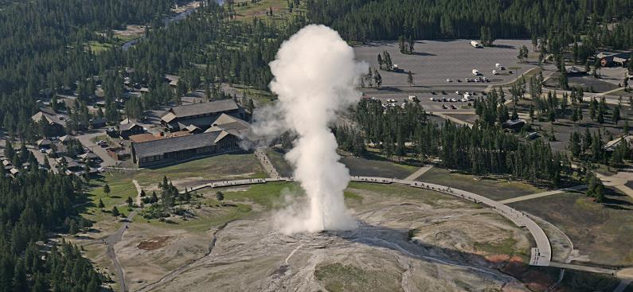
Figure 16.1
Geysers are a dramatic display of thermodynamic principles in nature. As water inside the earth heats up, it rises to the surface through small channels. Pressure builds up until the water turns to steam, and steam is expelled forcefully through a hole at the surface. (credit: modification of work by Yellowstone National Park)

Slide 4
Learning Objectives
16.1 Spontaneity
Distinguish between spontaneous and nonspontaneous processes
Describe the dispersal of matter and energy that accompanies certain spontaneous processes
We would expect spontaneous processes to from stronger bonds and break weaker bonds.
Such processes would be exothermic. ΔH would be -

Slide 5
Spontaneous Process
Will a reaction occur “naturally” at a given temperature and pressure, without the exertion of any outside force?
In other words, is a reaction spontaneous?
A process that does occur naturally under a specific set of conditions is called a spontaneous process.
A process that does not occur naturally under a specific set of conditions is called nonspontaneous.

Slide 6
Spontaneous Process
A spontaneous process will “just happen.”
A spontaneous process occurs naturally at a given set of conditions, without outside forces.
Example: A mixture of hydrogen and oxygen will react in the presence of a spark.
2H₂(g) + O₂(g) + spark → 2H₂O(g)

Slide 7
Spontaneity
It is important to not confuse spontaneous with fast.
The rate of a reaction (Chapter 12) and spontaneity are not necessarily connected.

Slide 8
Spontaneity
If a reaction is spontaneous in one direction, it will be nonspontaneous in the reverse direction under the same conditions.
2H₂(g) + O₂(g) → 2H₂O(l) Spontaneous
2H₂O(l) → 2H₂(g) + O₂(g) Nonspontaneous
A nonspontaneous reaction is still possible with the continual input of energy.
Example - Electrolysis.

Slide 9
Energy and Spontaneity
Many spontaneous processes proceed with a decrease in energy.
Recall that exothermic reactions also proceed with a decrease in energy.
Spontaneous reactions are often exothermic, but not always.
2H₂(g) + O₂(g) + spark → 2H₂O(g)
Since exothermic reactions form stronger bonds, and break weaker bonds, why are they not ALWAYS spontaneous?

Slide 10
Exceptions
Which is spontaneous at room temperature and a pressure of 1 atm?
H₂O(s) → H₂O(l) ΔH = +6.01 kJ/mol
H₂O(l) → H₂O(s) ΔH = –6.01 kJ/mol
Ice melting is ENDOTHERMIC, but under certain conditions, it IS spontaneous.

Slide 11
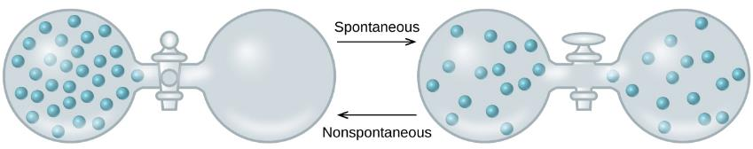
Figure 16.4
An isolated system consists of an ideal gas in one flask that is connected by a closed valve to a second flask containing a vacuum. Once the valve is opened, the gas spontaneously becomes evenly distributed between the flasks.

Slide 12
Dispersal of Matter
When the valve opens, the gas spontaneously expands to fill both containers.
With an ideal gas, this process results in no change in energy.

Slide 13
Dispersal of Energy
Two objects at different temperature are placed in contact.
Heat spontaneously flows from the hotter object to the colder object.
But overall, there is no change in energy.

Slide 14
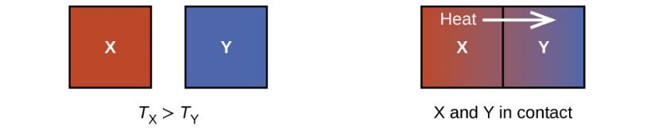
Figure 16.5
When two objects at different temperatures come in contact, heat spontaneously flows from the hotter to the colder object.

Slide 15
Some Other Factor
Some factor other than energy is important to the spontaneity of a process.
It appears that greater, more uniform dispersal of matter and energy can also be the driving force of a spontaneous process.
This other factor is entropy.

Slide 16
Learning Objectives
16.2 Entropy
Define entropy
Explain the relationship between entropy and the number of microstates
Predict the sign of the entropy change for chemical and physical processes

Slide 17
Entropy
Entropy (S) is a term coined by Rudolph Clausius in the nineteenth century.
Clausius was convinced of the significance of the ratio of heat delivered and the temperature at which it is delivered, .
q
T
© 2012 Pearson Education, Inc.

Slide 18
Entropy
Entropy can be thought of as a measure of the randomness of a system.
It is related to the various modes of motion in molecules.
© 2012 Pearson Education, Inc.

Slide 19
Entropy
Spontaneity is favored by an increase in entropy (S).
One equation for entropy is S = k ln W
k is the Boltzmann constant (1.38 × 10^{–23} J/K).
W is the number of microstates possible
We will not do problems using this equation.
Microstate: A specific configuration of the locations and energies of the particles in a system.

Slide 20
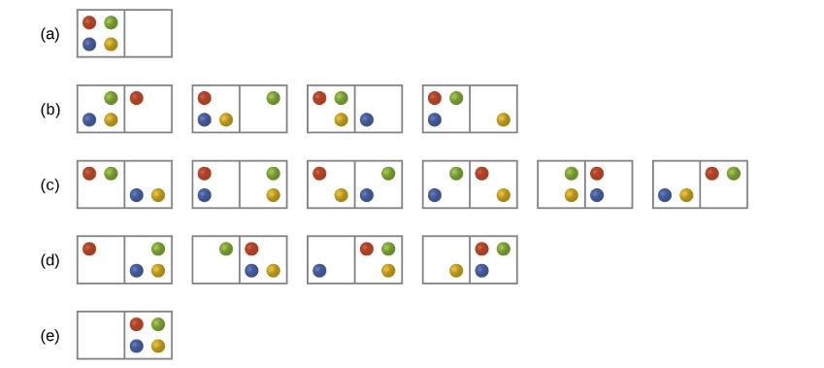
Figure 16.8
The sixteen microstates associated with placing four particles in two boxes are shown. The microstates are collected into five distributions—(a), (b), (c), (d), and (e)—based on the numbers of particles in each box.

Slide 21
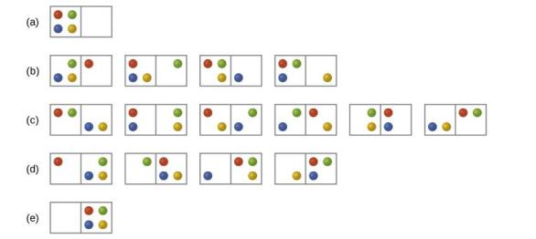
Entropy and Microstates
There are five possible distributions for this system.
Which distribution is most probable?

Slide 22
Entropy and Microstates
The most probable distribution has the largest number of microstates.
The most probable distribution, therefore, is the one of greatest entropy.
S = k ln W
States of high entropy are favored because they are the most probable.

Slide 23
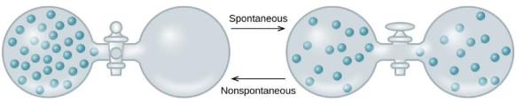
Entropy and Microstates
The most probable distribution has the largest number of microstates.
This same principle applies to all systems, including those with larger numbers of particles.
The most probable state will be the one in which the particles are divided evenly throughout the container.

Slide 24
Entropy Changes
Entropy is another state function.
The change in entropy for a process is the difference in entropy between the final state and the initial state.
ΔS_{sys} = S_{final} – S_{initial}

Slide 25
Factors That Influence Entropy
The phase of the substance. Gases have higher entropy than liquids, and liquids higher than solids (neglecting other variables).
The temperature of the substance.
Temperature is proportional to the average kinetic energy of the particles.
With higher temperature, the particles have greater freedom to move around.
Entropy increases with increases in temperature.

Slide 26
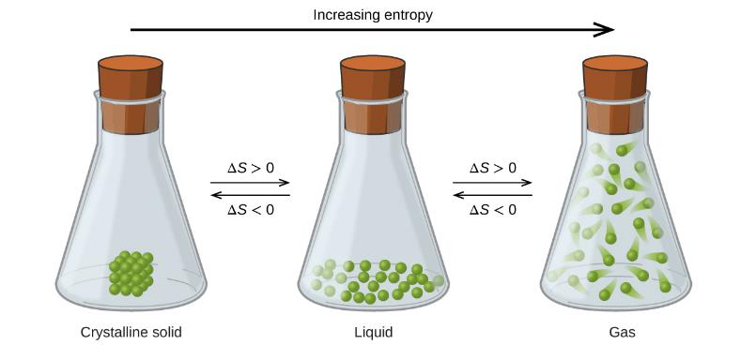
Figure 16.10
The entropy of a substance increases (ΔS > 0) as it transforms from a relatively ordered solid, to a less-ordered liquid, and then to a still less-ordered gas. The entropy decreases (ΔS < 0) as the substance transforms from a gas to a liquid and then to a solid.

Slide 27
Entropy vs. Temperature
The effect of temperature on entropy is due mostly to phase changes.

Slide 28
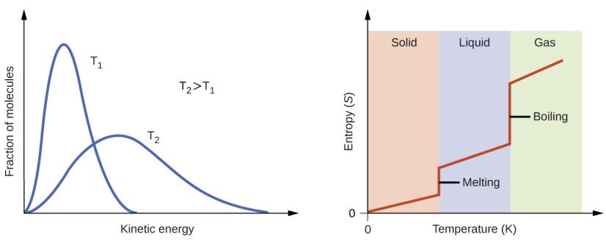
Figure 16.11
Entropy increases as the temperature of a substance is raised, which corresponds to the greater spread of kinetic energies. When a substance melts or vaporizes, it experiences a significant increase in entropy.

Slide 29
Factors that Influence Entropy
The type and number of particles that make up the substance.
Substances containing a larger number of atoms generally have greater entropy than those with fewer atoms..
4) Mixtures tend to have greater entropy than pure compounds.
Dissolving a solid in a liquid almost always leads to an increase in entropy.
Be sure to check out example 16.3 in the text, page 870 to 871

Slide 30
Learning Objectives
16.3 The Second and Third Laws of Thermodynamics
State and explain the second and third laws of thermodynamics
Calculate entropy changes for phase transitions and chemical reactions under standard conditions

Slide 31
The Second and Third Laws of Thermodynamics
The system is the part of the universe that is of specific interest.
The surroundings constitute the rest of the universe outside the system. Generally, chemists just focus on the immediate surroundings.
Correctly predicting the spontaneity of a process requires us to consider entropy changes in both the system and the surroundings.

Slide 32
Change in Entropy of the Surroundings, ΔS_{surr}
The change in entropy of the surroundings (ΔS_{surr}) is directly proportional to the change in enthalpy of the system.
ΔS_{surr} is also inversely proportional to temperature.

Slide 33
The Second Law of Thermodynamics
The entropy change of the universe is the sum of the entropy changes for the system and surroundings.
The second law of thermodynamics states that all spontaneous changes cause an increase in the entropy of the universe.
For a spontaneous process, ΔS_{universe} must be positive.
A process with –ΔS_{system} can still be spontaneous if …
ΔS_{surroundings} is + and larger. It would have to be an exothermic process, which transfers heat to the surroundings.

Slide 34
The Second Law of Thermodynamics
ΔS_{universe} > 0 for a spontaneous process
ΔS_{universe} < 0 for a nonspontaneous process (spontaneous in the reverse direction).
ΔS_{universe} = 0 for a process at equilibrium

Slide 35
The Third Law of Thermodynamics
Third law of thermodynamics: The entropy of a pure perfect crystalline substance at zero Kelvin is zero.
Zero Kelvin is called absolute zero.
There is no lower temperature than zero Kelvin.
At zero Kelvin, all molecular movement completely stops.
There is only one possible way to arrange the molecules.

Slide 36
Standard Entropies
It is possible to determine the absolute entropy of a substance.
Standard Entropies, S°
These values are for 1 mole of a substance at a pressure of 1 bar and a temperature of 298 K.
Aqueous species at 1 M concentration.
Standard entropy values can be used to calculate the standard entropy change (ΔS°) for a process.

Slide 37
Table 16.2
Substance | S°₂₉₈ (J mol^{–1} K^{–1}) | Substance | S°₂₉₈ (J mol^{–1} K^{–1})
carbon |  | hydrogen
C(s, graphite) | 5.740 | H₂(g) | 130.57
C(s, diamond) | 2.38 | H(g) | 114.6
CO(g) | 197.7 | H₂O(g) | 188.71
CO₂(g) | 213.8 | H₂O(l) | 69.91
CH₄(g) | 186.3 | HCl(g) | 186.8
C₂H₄(g) | 219.5 | H₂S(g) | 205.7
C₂H₆(g) | 229.5 | oxygen
CH₃OH(I) | 126.8 | O₂(g) | 205.03
C₂H₅OH(I) | 160.7
Standard entropies for selected substances measured at 1 atm and 298.15 K. (Values are approximately equal to those measured at 1 bar, the currently accepted standard state pressure.)

Slide 38
Calculate the standard entropy change for the combustion of methanol, 2 CH₃OH(l) + 3 O₂(g) → 6 CO₂(g) + 4 H₂O(l)
CH₃OH(I)
126.8
O₂(g) | 205.03
CO₂(g) | 213.8
H₂O(l) | 69.91
How would the value of ΔS change if we were forming gaseous H₂O ?

Slide 39
ΔS° for Reactions
The equation for calculating ΔS° is similar to that for ΔH°:
When calculating ΔS° and ΔH°, remember to multiply the standard entropies and standard enthalpies of formation by the coefficients of the balanced equation.

Slide 40
Learning Objectives
16.4 Free Energy
Define Gibbs free energy, and describe its relation to spontaneity
Calculate free energy change for a process using free energies of formation for its reactants and products
Calculate free energy change for a process using enthalpies of formation and the entropies for its reactants and products
Explain how temperature affects the spontaneity of some processes
Relate standard free energy changes to equilibrium constants

Slide 41
Free Energy, G
The second law of thermodynamics can be used to predict spontaneity.
But measurements on the surroundings are seldom made.
This limits the use of the second law of thermodynamics.
It is convenient to have a thermodynamic function that focuses on just the system and predicts spontaneity.

Slide 42
Gibbs Free Energy Change, ΔG
Second Law of Thermodynamics:

Slide 43
Gibbs Free Energy Change, ΔI
The changes in Gibbs free energy (ΔG) or simply change in free energy allow us to predict spontaneity by focusing on the system only.
ΔG = ΔH – TΔS

Slide 44
ΔG and Spontaneity
ΔG = ΔH – TΔS
The sign of ΔG indicates if a reaction will be spontaneous or not.
If ΔG < 0, the reaction is spontaneous in the forward direction.
If ΔG > 0, the reaction is nonspontaneous in the forward direction
If ΔG = 0, the system is at equilibrium

Slide 45
Relationship among ΔG, ΔH, and ΔS
ΔG = ΔH – TΔS
Spontaneous reactions, those with –ΔG, generally have
ΔH < 0
Exothermic reaction.
A negative ΔH will contribute to a negative ΔG.
ΔS > 0
A positive ΔS will contribute to a negative ΔG.
Note that a reaction can still be spontaneous (have a –ΔG) when ΔH is positive or ΔS is negative, but not both.
Also note that there is a temperature dependence.

Slide 46
ΔG = ΔH – TΔS
ΔH | ΔS | ΔG | Spontaneous?
– | +
+ | –
– | –
+ +

Slide 47
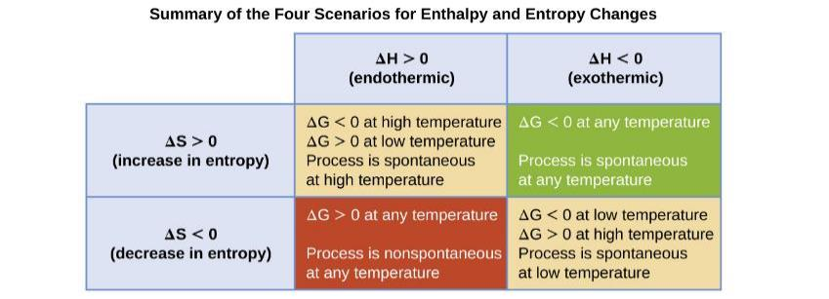
Figure 16.12
There are four possibilities regarding the signs of enthalpy and entropy changes.

Slide 48
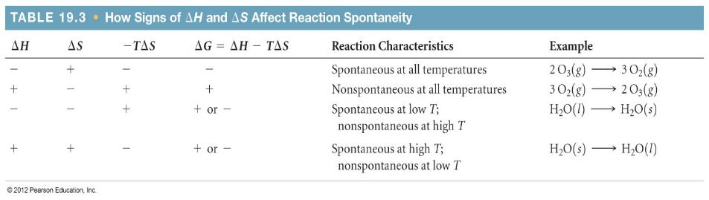
Free Energy and Temperature
© 2012 Pearson Education, Inc.

Slide 49
Direction of Spontaneity Change
To calculate the temperature at which the spontaneity of a reaction changes from …
Spontaneous to nonspontaneous
Or nonspontaneous to spontaneous
… find the temperature at which ΔG = 0
ΔG = 0 = ΔH – TΔS
T = ΔH / ΔS
This is the temperature at which ΔG = 0 and, by definition, the system is at equilibrium.

Slide 50
The Standard Free Energy Change, ΔG°
Although the Change in Gibbs Free Energy equation is valid under all conditions, we will most often apply it at standard conditions.
Standard conditions:
Under standard conditions, ΔG° = ΔH° – TΔS°
Pay attention to J vs. kJ in calculations!

Slide 51
Sample Exercise 19.6 Calculating Free–Energy Change from ΔH°, T, and ΔS°
Continued
Practice Exercise
Calculate ΔG° for a reaction for which ΔH° = 24.6 kJ and ΔS° = 132 J/K at 298 K. Is the reaction spontaneous under these conditions?
Answer: ΔG° = –14.7 kJ; the reaction is spontaneous.
Below what temperature would the reaction no longer be spontaneous? ( note that when ΔS and ΔH° are both positive, reaction is spontaneous at HIGH temperatures, and not at sufficiently low temperatures.)
Find T where ΔG° = 0. Then ΔHº = T ΔS° T = 186 K. So below 186 K, reaction is NOT spont. and ΔG°=+
Notes:
51

Slide 52
Substance | ΔHof kJ/mol) | ΔGof (kJ/mol) | So (J/mol K)
C6H6 (l) | 49.0 | 124.5 | 172.8
C6H6(g) | 82.9 | 129.7 | 269.2
C2H4(g) | 52.30 | 68.11 | 219.4
C2H5OH(l) | -277.7 | -174.76 | 160.7
H2(g) | 0 | 0 | 130.58
NH3(g) | -46.19 | -16.66 | 192.8
CO2(g) | –393.5 | – 394.4 | 213.6
C2H6(g) | –84.68 | –32.89 | 229.5
HCl(g) |  | – 95.27
H2O(l) | -285.85 | -236.81 | 69.96
Thermodynamic quantities are often listed in tables like this one. Note that the entropy is in a different unit!! That must be corrected when using equations that contain delta H and/or delta G as well!!

Slide 53
Standard Free Energy of Formation, ∆G°_{f}
The standard free energy of formation (∆G°_{f}) for a compound is defined as the free energy change for the formation of one mole of a substance from its elements in their standard state at 1 bar and 25 °C.
Analogous to the ∆H°_{f} discussed in Chapter 5.
Example:
H₂(g) + ½O₂(g) → H₂O(l) ∆G°_{f} = –237.2 kJ/mol

Slide 54
∆G°_{f} Values Can Be Used to Calculate ΔG°
For a chemical reaction:
mA + nB → xC + yD
ΔG° = [xΔG° _{f} (C) + yΔG° _{f} (D)] – [mΔG° _{f}(A) + nΔG° _{f} (B)]
ΔG° = ΣnΔG° _{f}(products) – ΣnΔG° _{f}(reactants)

Slide 55
∆G°_{f} Values Can Be Used to Calculate ΔG°
ΔG° = ΣnΔG° _{f} (products) – ΣnΔG° _{f} (reactants)
This equation only works for calculating ∆G° of a reaction at the temperature for which the values of ∆G°_{f} are tabulated, which is 298 K.
ΔG°_{f} for any element in its most stable form at standard conditions is defined as zero. ( Just as is the case for ΔH_{f} )
But Sº for an element is NOT zero!!!

Slide 56
Pressure and Concentration Effects
Most of our discussion on free energy to this point has involved the standard free energy change ΔG°.
All species are at 1 bar of partial pressure or 1 M concentration.
There is a general equation that enables you to calculate ΔG under non-standard conditions.
T is temperature in K
R = 0.008314 kJ/mol . K
Q is the reaction quotient

Slide 57

Sample Exercise 19.11 Calculating the Free–Energy Change under Nonstandard Conditions
Calculate at 298 K for a mixture of 1.0 atm N₂, 3.0 atm H₂, and 0.50 atm NH₃ being used in the Haber process:
ΔGº= -33.3 kJ
Solution
Note that Q is less than 1. That should make ΔG more NEGATIVE.
-44.9 kJ
Notes:
57

Slide 58
ΔG and the Equilibrium Constant
Thus far in this chapter, we have focused heavily on the relationship between the free energy change and the spontaneity of a reaction.
For a reaction to be spontaneous, ΔG° must be negative.
Another measure of reaction spontaneity is the equilibrium constant, K.
For a reaction to be spontaneous, K must be greater than 1. But “spontaneous” here means that the products are favored when ALL components are 1 M or 1 atm. For this reason I prefer the term “Thermodynamically feasible.”
This should make sense because we have discussed that if K is greater than 1, then the reaction is product favored.
It should be clear that if K>1, (favored) then ΔG° must be -

Slide 59
ΔG and the Equilibrium Constant
The relationship between ΔG° and K can be found starting with this general equation.
Remember that at equilibrium, ΔG = 0 and Q = K. So,
Therefore,
We can see that if K>1, then delta Go is NEGATIVE.

Slide 60
The Kp for the formation of ammonia,
N_{2(g)} + 3 H_{2(g)} ⇄ 2 NH₃ at 298 K is 6.7 x 10⁵
Find the value of the standard free energy change,
ΔGº, for the reaction at 298 K.
Remember, that if you want your answer to come out in kilojoules, use the value of R in kJ/molK, which is 0.00831
ΔGº = (-0.00831 kJ/molK)(298K)(Ln(6.7x10⁵)
= - 33.2 kJ.
Look back at slide 52. It lists the ΔGº f of NH₃(g) as
-16.66 kJ/mol. Is that consistent with our answer?

Slide 61
ΔG and the Equilibrium Constant
This relationship between ΔG° and K holds for all equilibrium constants we have discussed in this course.
K_{c}, K_{p}, K_{a}, K_{b}, K_{w}, K_{sp}, K_{f}, K_{d}
We can now relate the standard free energy change of a reaction to the extent of a reaction.

Slide 62
Additivity of ΔG; Coupled Reactions
As with enthalpy, free energy changes for reactions are additive if
Reaction 3 = Reaction 1 + Reaction 2
Then, ΔG₃ = ΔG₁ + ΔG₂
Also keep in mind that if a reaction is reversed, then the sign on ΔG is also reversed.
If a reaction is multiplied by a factor of “n,” then ΔG is also multiplied by a factor of “n.”

Slide 63
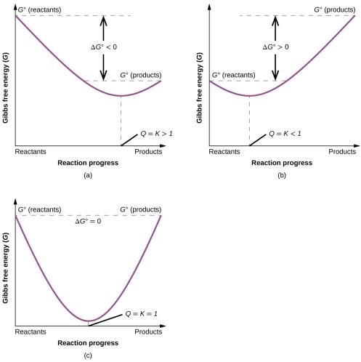
Figure 16.14
These plots show the free energy versus reaction progress for systems whose standard free changes are (a) negative, (b) positive, and (c) zero. Nonequilibrium systems will proceed spontaneously in whatever direction is necessary to minimize free energy and establish equilibrium.

Slide 64

Exercise 55

Slide 65
This OpenStax ancillary resource is © Rice University under a CC-BY 4.0 International license; it may be reproduced or modified but must be attributed to OpenStax, Rice University and any changes must be noted.

