Slide 1

The Course of Fundamentals of Thermodynamics
MUSTANSIRIYAH UNIVERSITY
COLLEGE OF SCIENCES
ATMOSPHERIC SCIENCES DEPARTMENT
2019-2020
Dr. Sama Khalid Mohammed
SECOND STAGE

Slide 2

Welcome Students In The Fifth Lecture ☺

Slide 3
This lecture including the following items
The ideal gases.
Form of Ideal Gas Law Most Used by Meteorologists.
Useful Relations for Comparing Two States of an Ideal Gas.
Internal Energy of an Ideal Gas.
Exercises and Riddles.

Slide 4
IDEAL GASES
An ideal gas is a gas with the following properties:
There are no intermolecular forces, except during collisions.
All collisions are elastic.
The individual gas molecules have no volume (they behave like point masses).
The equation of state for ideal gasses is known as the ideal gas law.
The ideal gas law was discovered empirically, but can also be derived theoretically. The form we are most familiar with,
pV = n RT Ideal Gas Law (1)
R has a value of 8.3145 J-mol⁻¹-K⁻¹, and n is the number of moles (not molecules).
Notes:
A molecule, for example of water, contains 2 hydrogen atoms and 1 oxygen atom chemically bounded together and is the smallest building block of the chemical water. The molecules are then held together by intermolecular forces, in this case by strong hydrogen bonds.
A mole is a certain quantity of molecules, namely the Avagadro number of molecules NA=6.023×1023. So for example if you take 6.023×1023 water molecules then that makes up 1 mole of water.

Slide 5
IDEAL GASES
A true ideal gas would be monatomic, meaning each molecule is comprised of a single atom.
Real gasses in the atmosphere, such as O₂ and N₂, are diatomic, and some gasses such as CO₂ and O₃ are triatomic.
Real atmospheric gasses have rotational and vibrational kinetic energy, in addition to translational kinetic energy (Energy due to linear motion of a rigid body).
Even though the gasses that make up the atmosphere aren’t monatomic, they still closely obey the ideal gas law at the pressures and temperatures encountered in the atmosphere, so we can still use the ideal gas law.

Slide 6
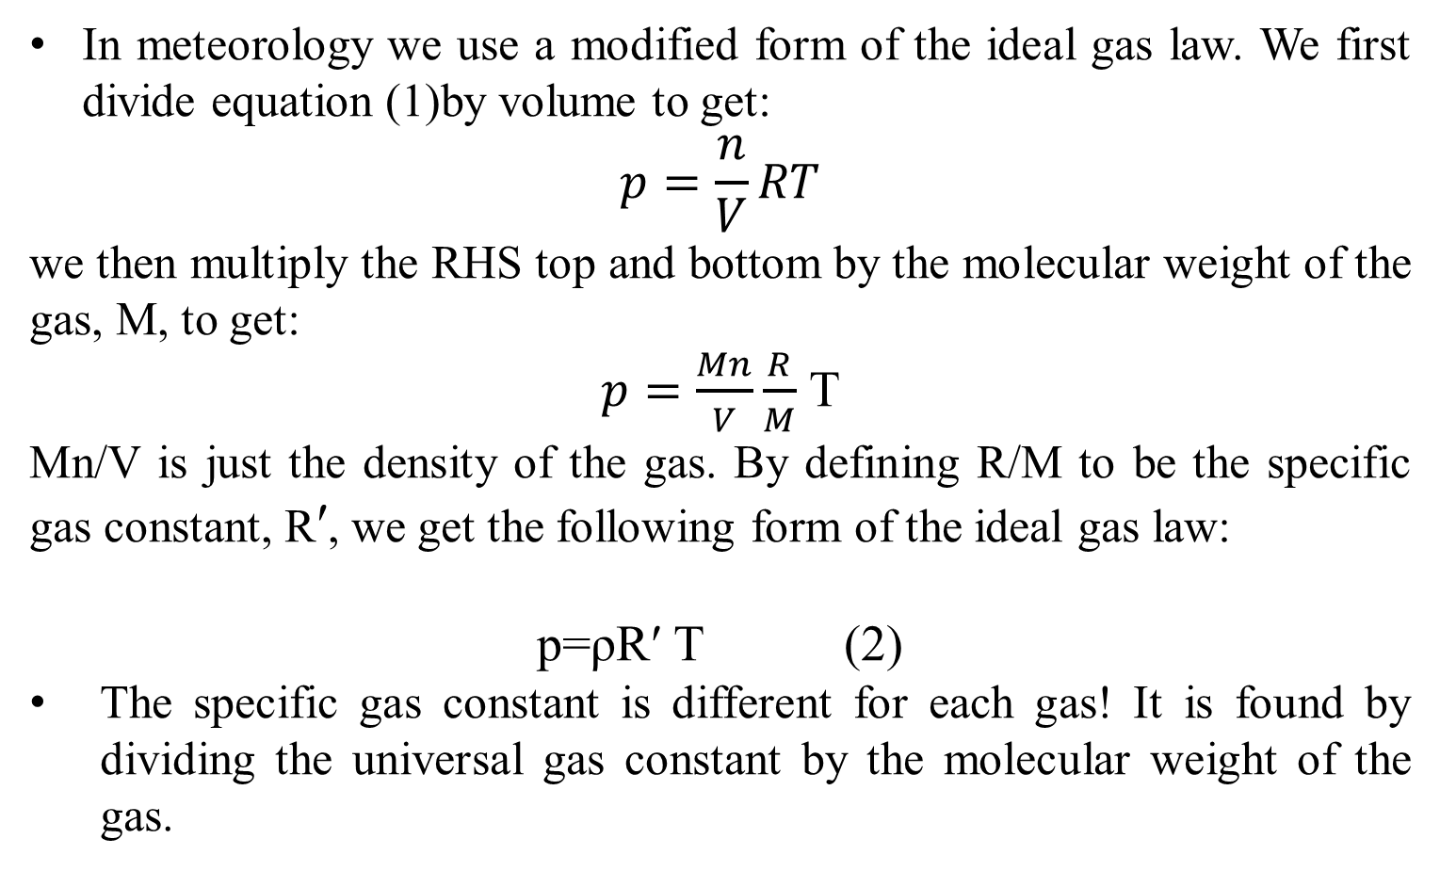
Form of Ideal Gas Law Most Used by Meteorologists
In meteorology we use a modified form of the ideal gas law. We first divide equation (1)by volume to get:
$$p=\frac{n}{V}RT$$
we then multiply the RHS top and bottom by the molecular weight of the gas, M, to get:
$p=\frac{Mn}{V}\frac{R}{M}$ T
Mn/V is just the density of the gas. By defining R/M to be the specific gas constant, Rʹ, we get the following form of the ideal gas law:
p=ρRʹ T (2)
The specific gas constant is different for each gas! It is found by dividing the universal gas constant by the molecular weight of the gas.

Slide 7
Form of Ideal Gas Law Most Used by Meteorologists
Dry air has a molecular weight of 28.964 g/mol. The specific gas constant for dry air is then 287.1 J kg⁻¹ K⁻¹, and is given the symbol R_{d}. The ideal gas law for dry air is then
p=ρ R_{d} T (3)
or equivalently, in terms of specific volume,
pα= R_{d} T (4)

Slide 8

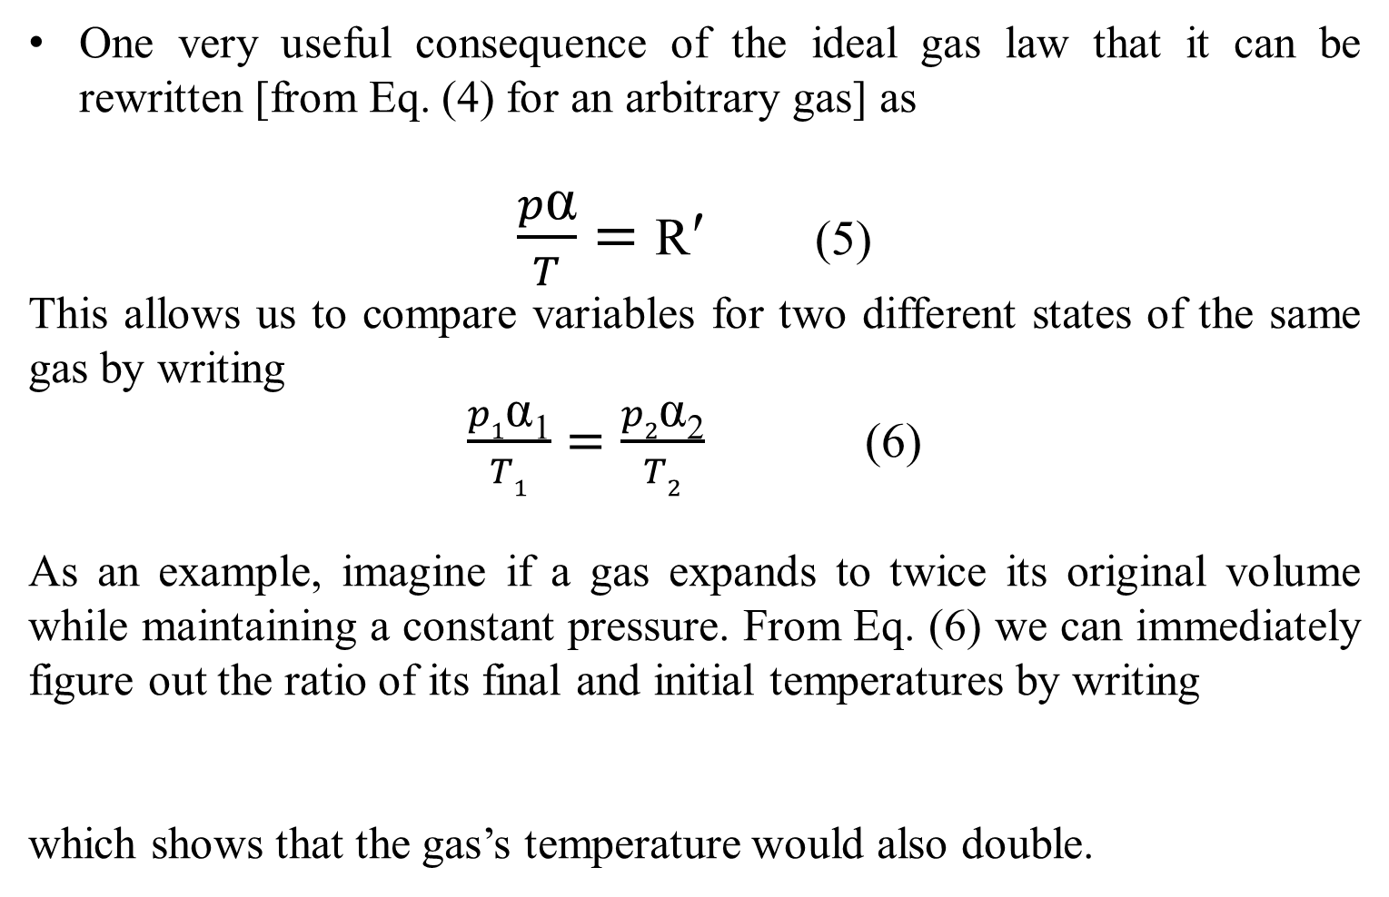
Useful Relations for Comparing Two States of an Ideal Gas
One very useful consequence of the ideal gas law that it can be rewritten [from Eq. (4) for an arbitrary gas] as
$\frac{p\text{α}}{T}=\text{R}\text{ʹ}$ (5)
This allows us to compare variables for two different states of the same gas by writing
$\frac{p1\text{α}\text{1}}{T1}=\frac{p2\text{α}\text{2}}{T2}$ (6)
As an example, imagine if a gas expands to twice its original volume while maintaining a constant pressure. From Eq. (6) we can immediately figure out the ratio of its final and initial temperatures by writing
which shows that the gas’s temperature would also double.

Slide 9


Useful Relations for Comparing Two States of an Ideal Gas
As another example, imagine if a gas’s pressure increases to four times its original value while keeping a constant temperature. Manipulating Eq. (6) shows that its volume would decrease to one-fourth its original size,
As a final example, imagine if a gas’s pressure increases to six times its original value while the volume decreases to one-fourth its original size. Manipulating Eq. (6) shows that the temperature increase by 150%,

Slide 10

Kinetic theory of heat
Let us consider a system at a temperature T, consisting of N point masses (molecules). According to the kinetic theory of heat, these molecules move randomly at all directions (Brownian motion), and due to this randomness, the internal energies of the point-masses are not equal to each other, but they change in time. However, if we calculate the mean internal energy, we will find that it remains constant in time.
Thus, the mean internal energy of each point-mass, U, is proportional to the absolute temperature of the system T
Ū = A × T , A is a universal constant (A=k/2 where k is Boltzmann’s constant (k = 1.38×10⁻²³ JK⁻¹)
Assume that N = 1, Then the point has only three degrees of freedom which here are called thermodynamic degrees of freedom and are equal to the number of independent variables needed to completely define the energy of the point, then the total internal energy is equal to its kinetic energy. Thus,

Slide 11

Kinetic theory of heat
The mean kinetic energy of a point with three degrees of freedom is equal to
Note: you will need to the following relations to reach to the next equation:
R=k N_{A} and Rʹ = R/M and M=n N_{A} m
R is the universal gas constant
m is the individual mass of a gas
M is the Molecular weight
Rʹ is the specific gas constant
n is the no. of moles

Slide 12

Internal Energy of an Ideal Gas
Since there are no intermolecular forces in an ideal gas, there is no internal potential energy. The internal energy of a monatomic gas is therefore due solely to the translational kinetic energy of the molecules (Recall from Lec.2 : Internal energy – The sum of the thermal energy and any potential energy due to the forces between the molecules of a substance).
If the molecules have more than one atom, then there is also kinetic energy due to rotation and vibration.
Though technically not an ideal gas, at normal temperatures and pressures the main atmospheric gasses closely follow the ideal gas law, so we can still speak of air as an ideal gas.
The translational kinetic energy has a value of

Slide 13
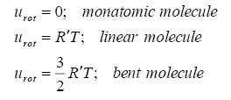
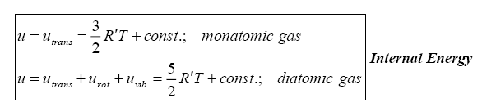
Internal Energy of an Ideal Gas
The rotational kinetic energy depends on whether the molecule is monatomic or multi-atomic, and whether it is linear or bent. It is
The vibrational kinetic energy is a complicated function of temperature. For light diatomic molecules (such as N₂ and O₂) it can be considered a constant except at extremely high temperatures.
Thus, the internal energies for most monatomic and diatomic molecules are:

Slide 14
Internal Energy of an Ideal Gas
Note that when temperature is 0K, there is still some kinetic energy. Motion does not cease at absolute zero.
An important point to notice is that, for an ideal gas, the internal energy is a function of temperature only.

Slide 15
Riddles
Using the ideal gas law, prove that P,V,T are state functions of a system .
Using the ideal gas law, prove that the work is not a state functions of a system .
Prove that the work depends on the path using partial derivatives.

