Slide 1

Clinic System
Group25
Sundin.N
Chris.G
Bruce.L

Slide 2
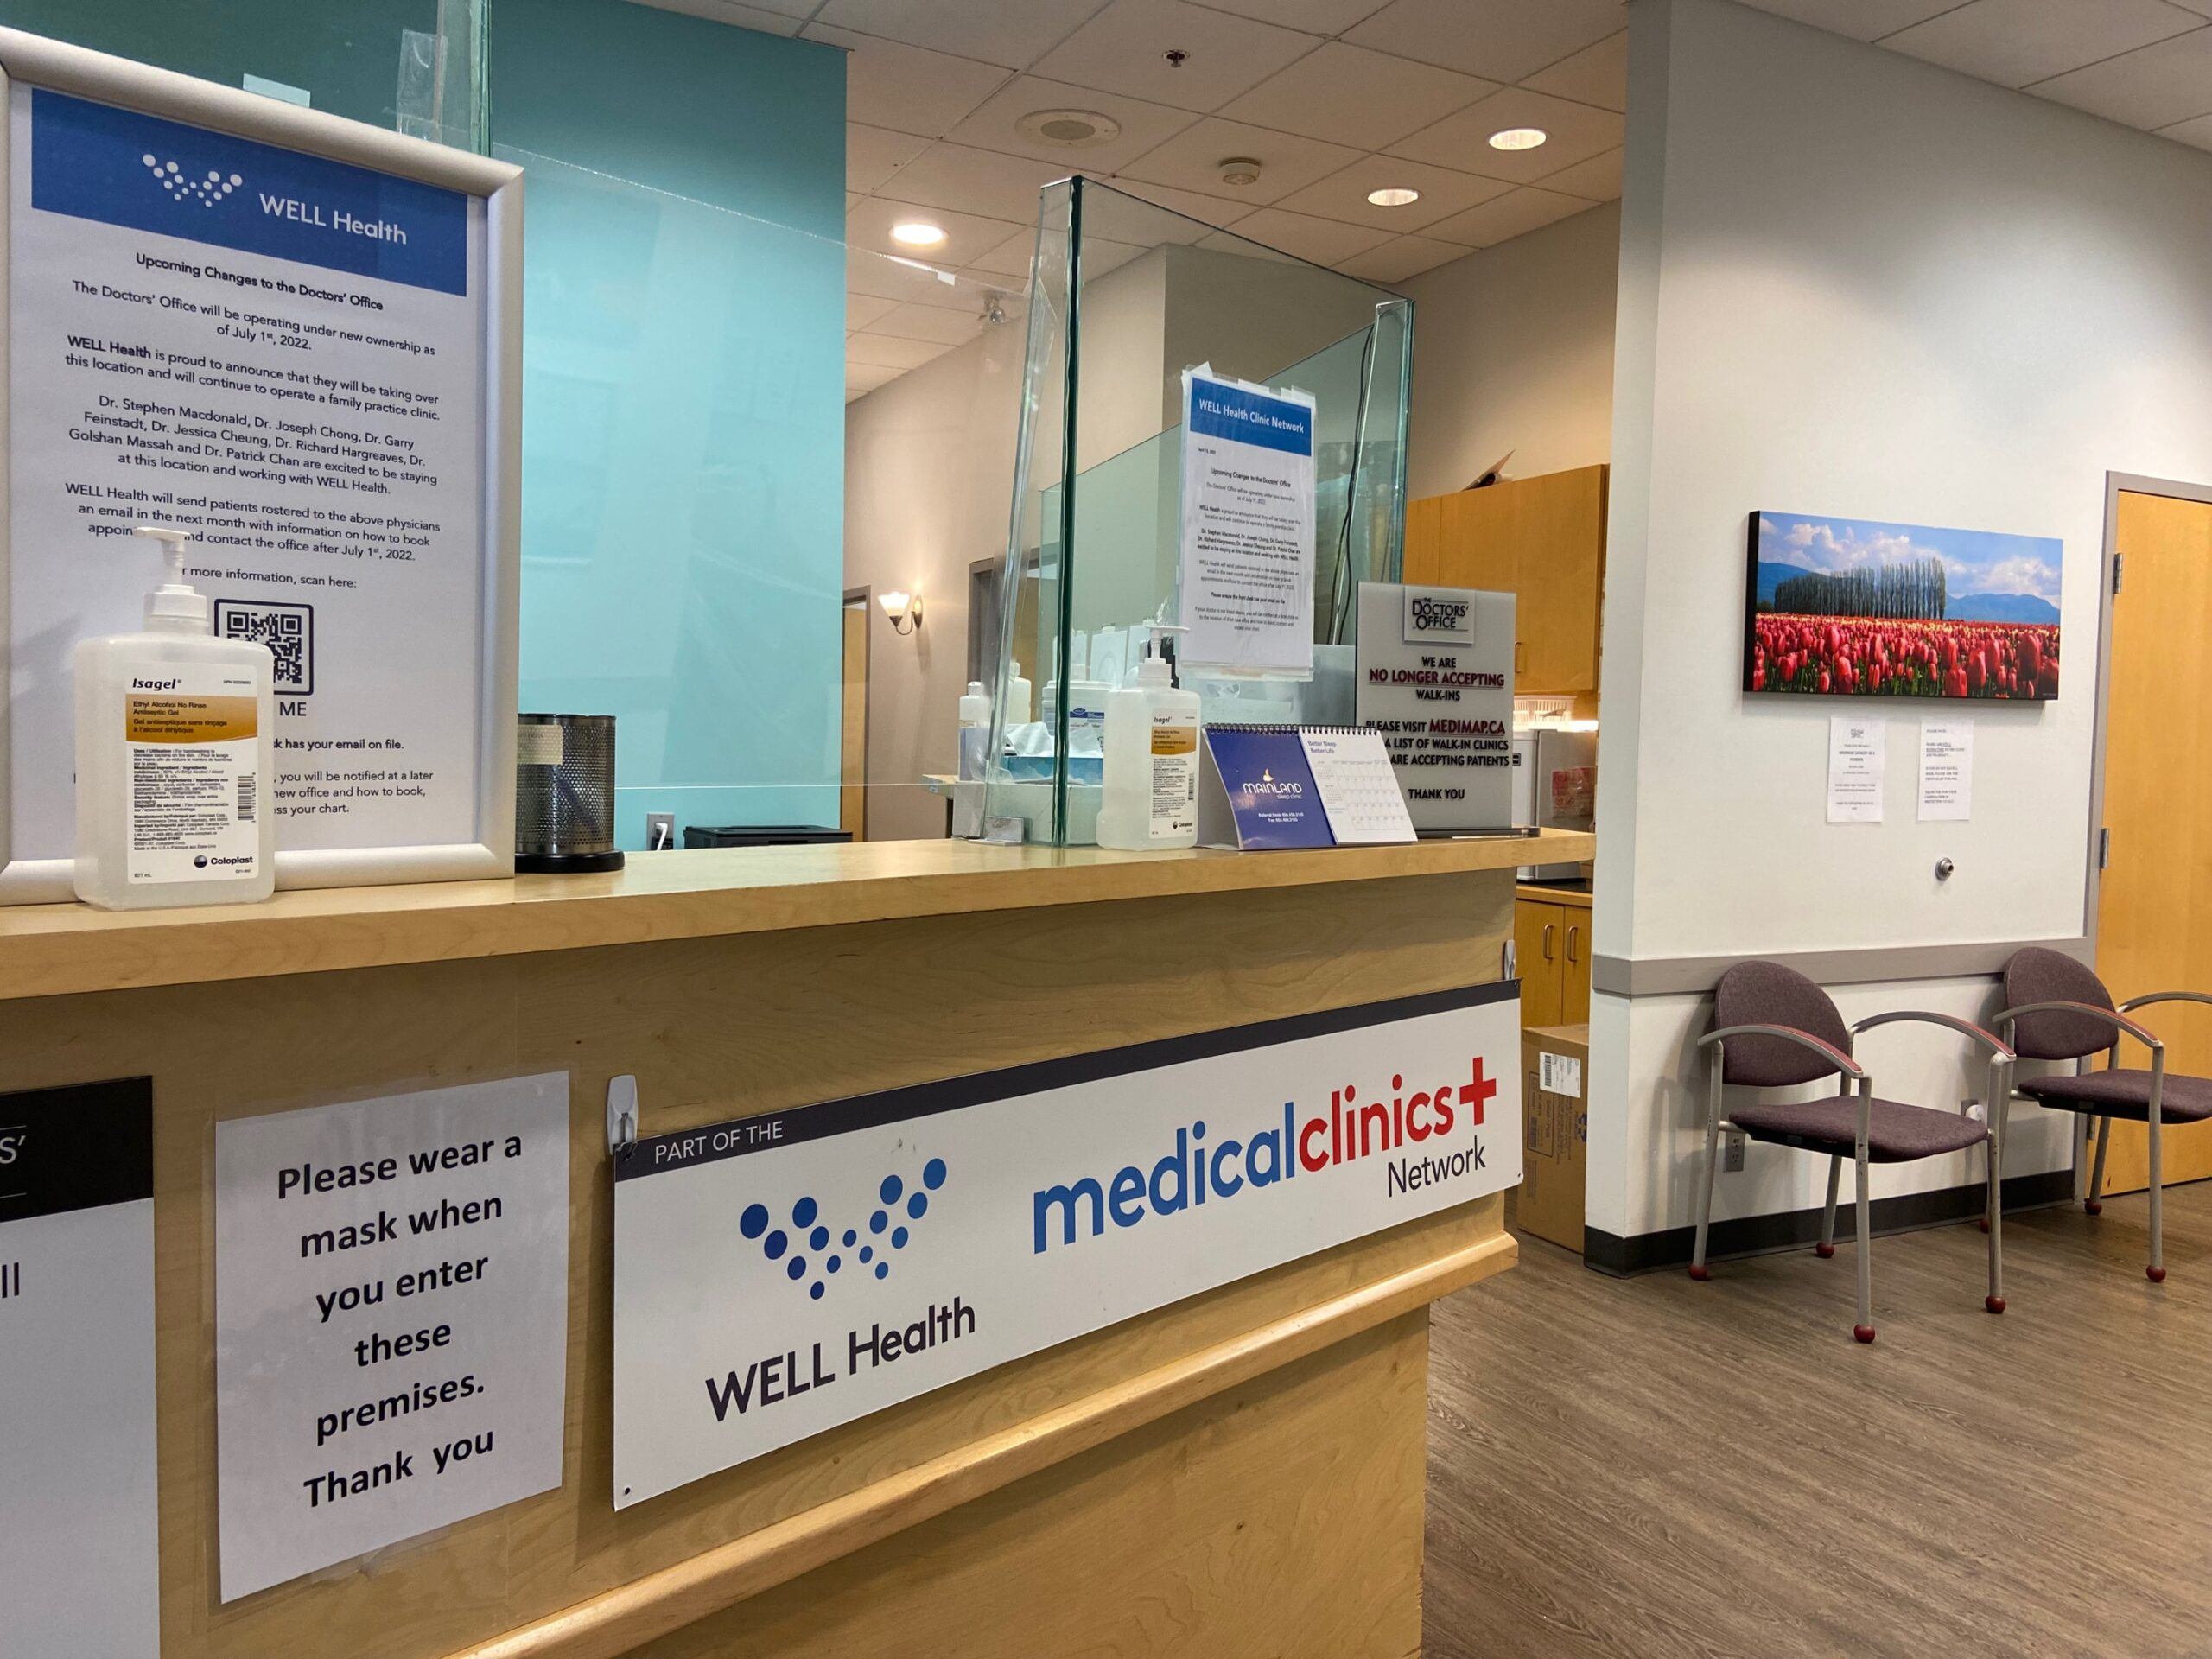
Problem Definition
The aim of this project is to implement a system that allows for small hospitals or clinics to easily be able to manage their patient information. We need a system that enables staff to organize this information and help staff to provide various services to patients

Slide 3
Problem Objective
Hospital or clinic staff can login, and manage patient records to their desire and help patients create a ticket to schedule an appointment, give patients prescription or bill.

Slide 4
Success Criteria
·Receptionist:
Add, delete or edit patient records about patient's personal information.
Create a new appointment from Phone or e-mail for patients.
Create and edit receipts for patients.
· Doctor:
Generate a report for a patient so that they can read what is wrong with them.
View a medical record from a specific patient to review the details of that patient.
· Administrator:
Be able to add, delete or edit patient records, doctor records and receptionist records from the system.

Slide 5
Development Process
01
02
03
04
05
07
Requirements
Analysis
Design Selection
Detailed
Design
Implementation
Testing
Report
We are here :)
·Schedule weekly meeting through Discord Hub to check progress.
·Immediate exchange of views on implementation details.

Slide 6


Tech Stack
Coding: Java
Database: mySQL

Slide 7

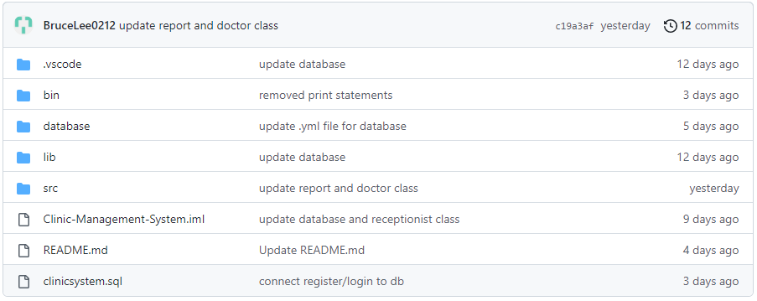

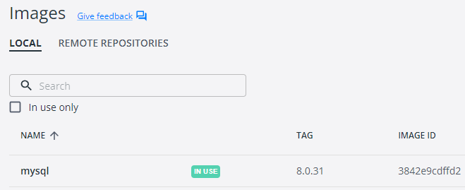
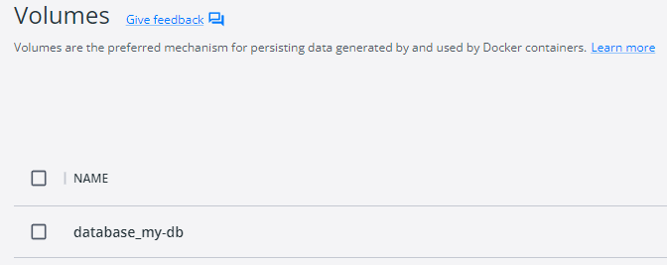
Project Management and Version Control
Github+Docker
Github: Push our whole project to Github Repository to make it easy to manage.
Docker: Create a MySql Instance with Docker Compose.

Slide 8
Architecture
We use Layered Architecture to organize the whole project
Presentation Layer
User Interface Layer
Core Business Logic Layer
Database Layer

Slide 9
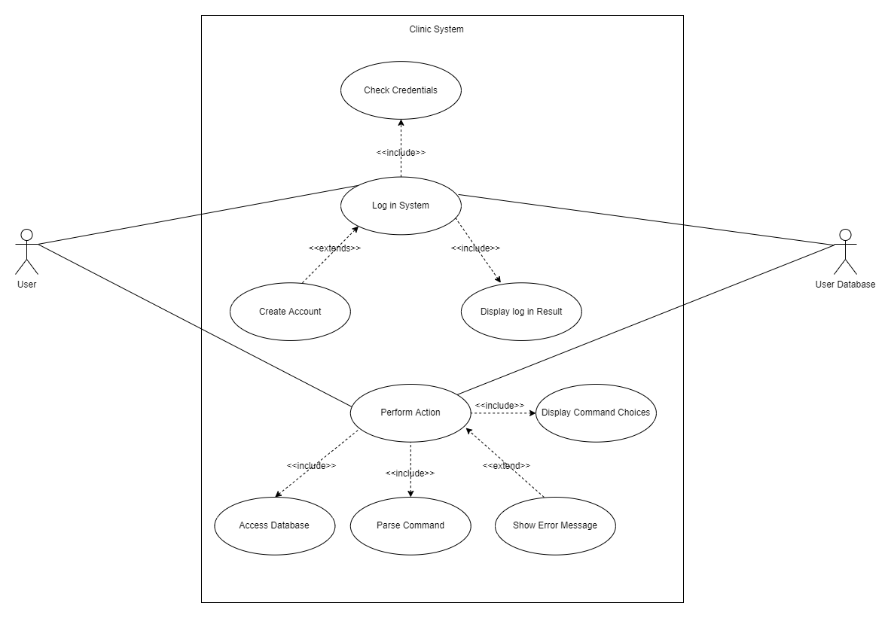
Usecase Diagram

Slide 10
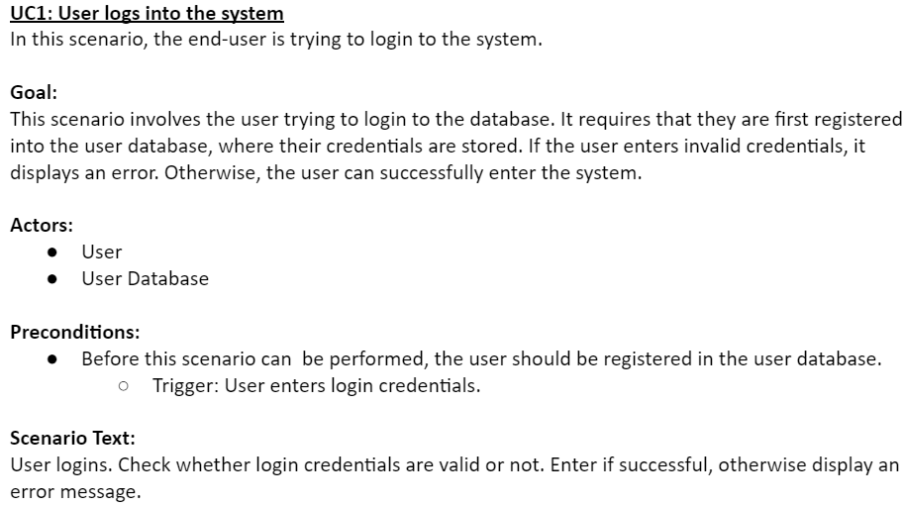
Usecase Description

Slide 11
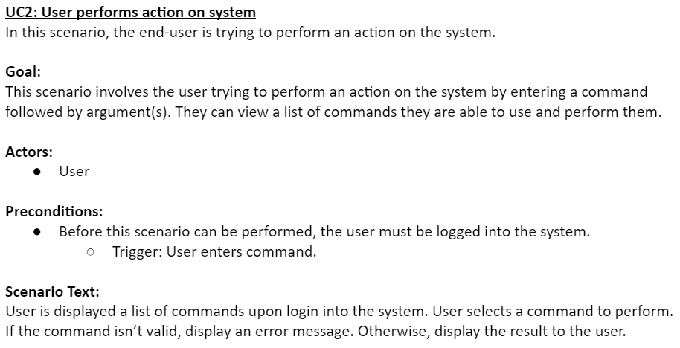
Usecase Description(Conj.)

Slide 12
Activity Diagram

Slide 13
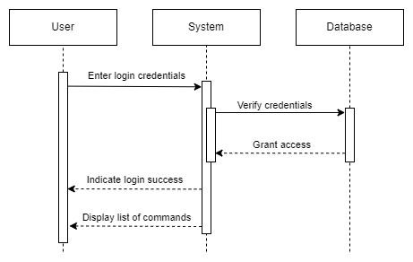
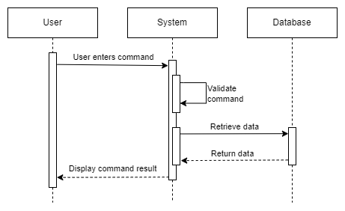
Sequence Diagram

Slide 14
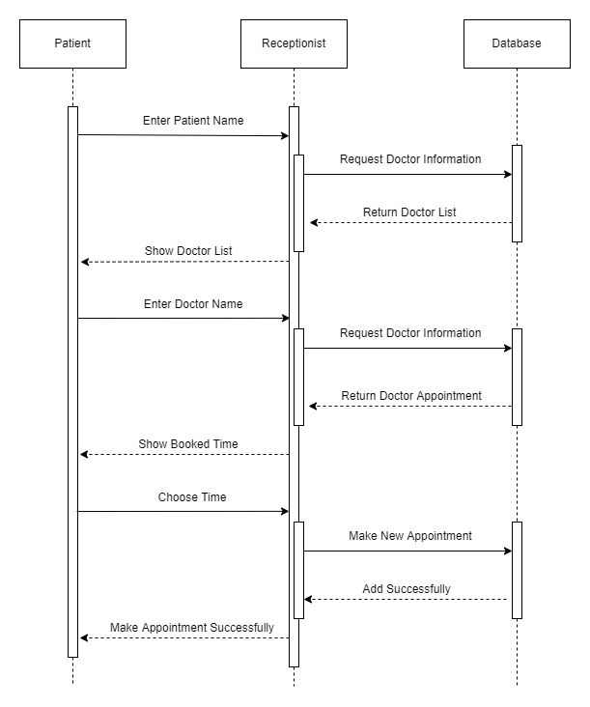
Sequence Diagram(Conj.)

Slide 15
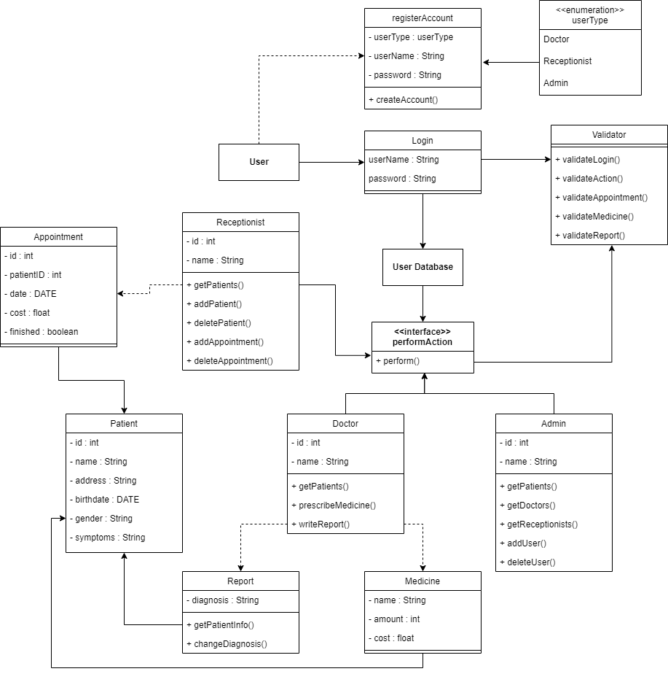
Class Diagram

Slide 16
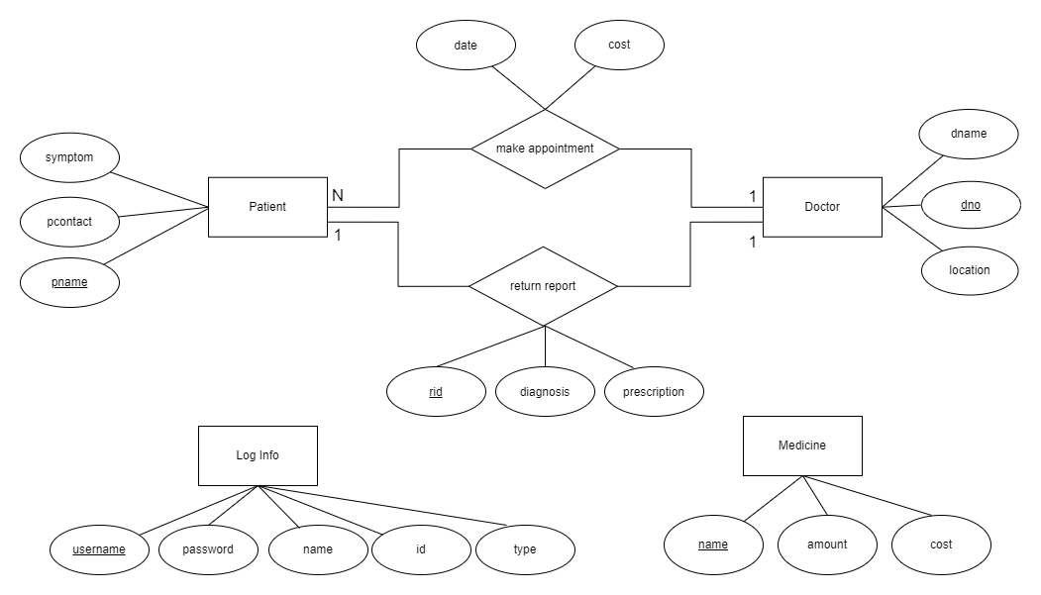
ER diagram

Slide 17
Testing

Slide 18
Deploying

Slide 19
Thank you for listening!

