Slide 1

Let's Get Happier: Happiness Level By Country
Group 3: Lance Hinds, Godfred Asamoah, Dariyon Goodnight, Jayda Gray, Philippe R. Nguendang

Slide 2
Agenda
Background: Motivation, Data selection, Description of Variable
Variable Distribution
Comparison of GDP and the Countries with a High Happiness Rank
How Region, Health, and GDP relate to one another

Slide 3
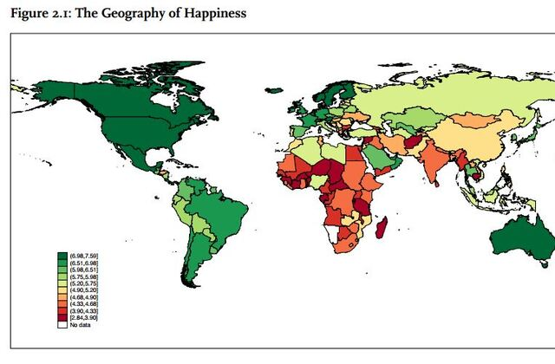
Background – dataset from Kaggle
World Happiness Report
Created because of a growing interest in happiness research in thanks to Bhutan
First created in 2012, we chose the year 2015
Data is collected through the Gallup World Poll every year
Question: Please imagine a ladder with steps numbered from 0 at the bottom to 10 at the top. The top of the ladder represents the best possible life for you and the bottom of the ladder represents the worst possible life for you. On which step of the ladder would you say you personally feel you stand at this time?

Slide 4
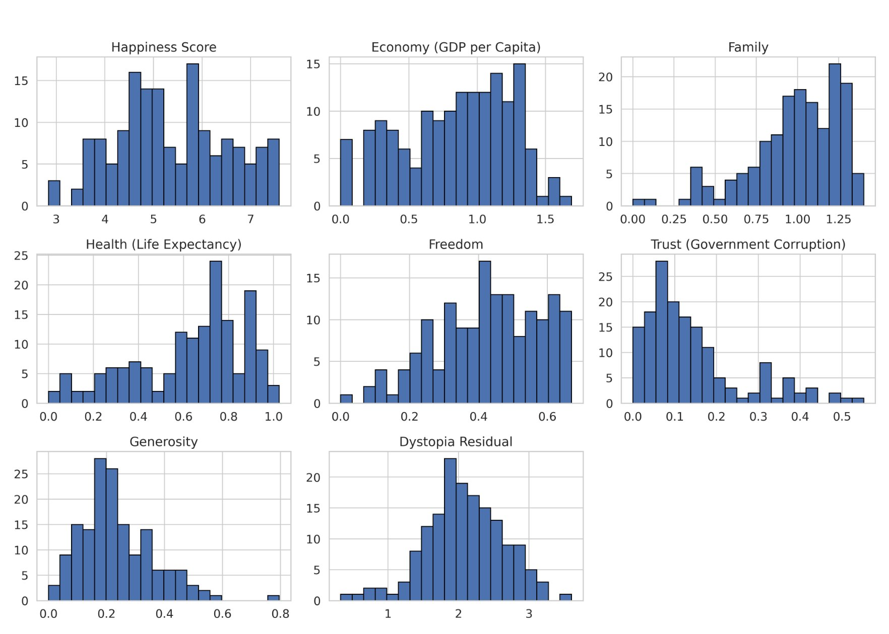
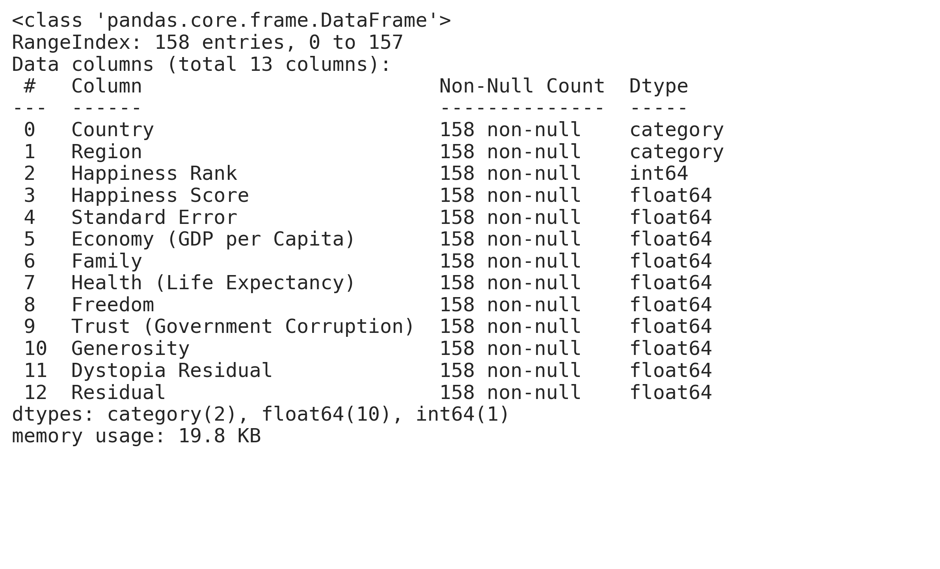
Variables & Data types

Slide 5
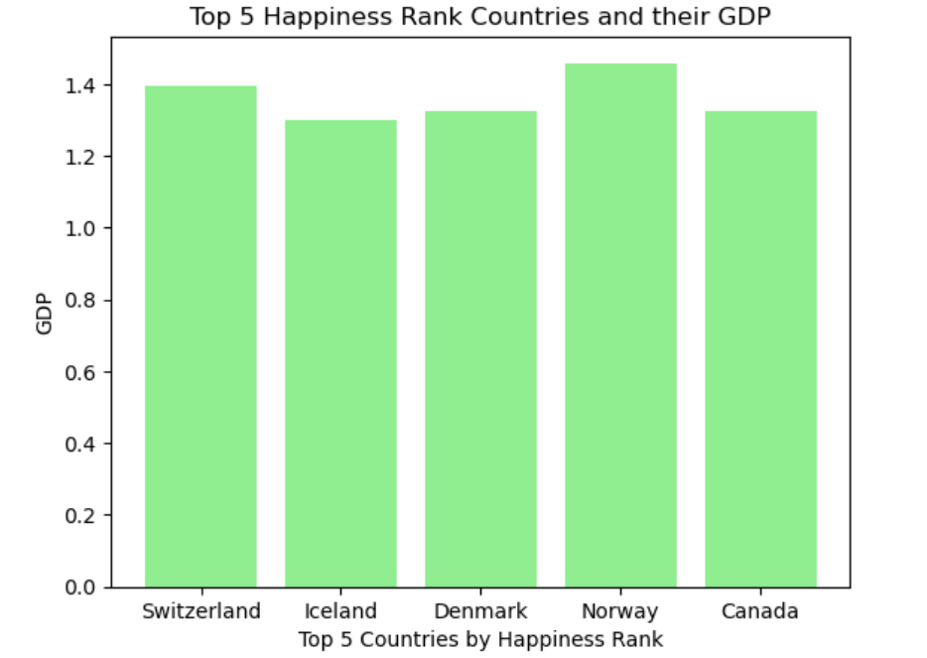
Comparison of GDP and the Countries with a High Happiness Rank
The country ranked 4th in happiness rank (Norway) has the highest GDP
Takeaways:
GDP is large factor in the overall happiness of a country
There are other subjects that influence happiness rank (Norway is not ranked first despite having the largest GDP

Slide 6
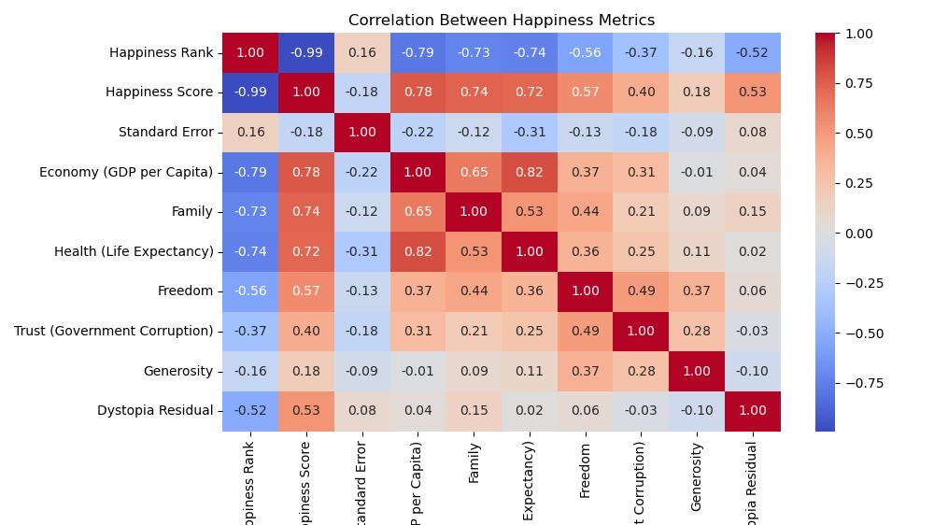

Slide 7
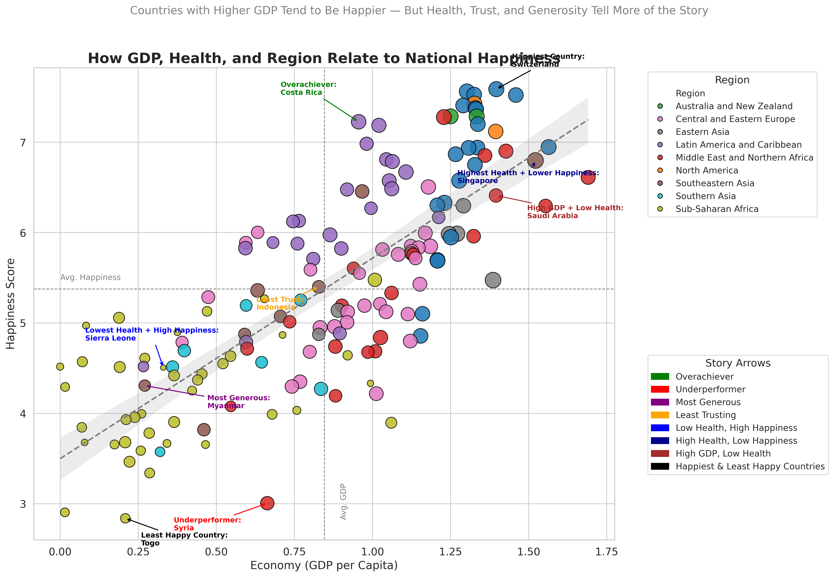

Slide 8
References
World Happiness - Kaggle: https://www.kaggle.com/datasets/ashwinigabbur/world-happiness
https://worldhappiness.report/ed/2025/executive-summary/

Slide 9
Thank you!

