Slide 1
by Godfred Asamoah
Final Project
Global Social Media Virality
29 April, 2025

Slide 2
Introduction
Every second, around 3.4 million swipes shape what the world sees next. This project dives into that global scroll — examining platforms, formats, hashtags, and regions — to uncover the repeatable patterns that drive true social media virality.

Slide 3
Hacking Virality
Every second, around 3.4 million swipes shape what the world sees next. This project dives into that global scroll — examining platforms, formats, hashtags, and regions — to uncover the repeatable patterns that drive true social media virality.
The goal being to turn data into actionable insight that creators & brand managers can use to drive virality for their content

Slide 4
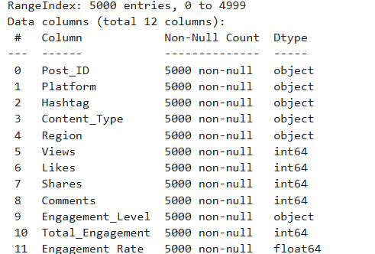
Data Cleaning
Lowercased all categorical columns for consistency
Removed 98 rows with null values or duplicates
Calculated engagement rate as a percentage
No null values in final dataset, making the cleaning process faster

Slide 5
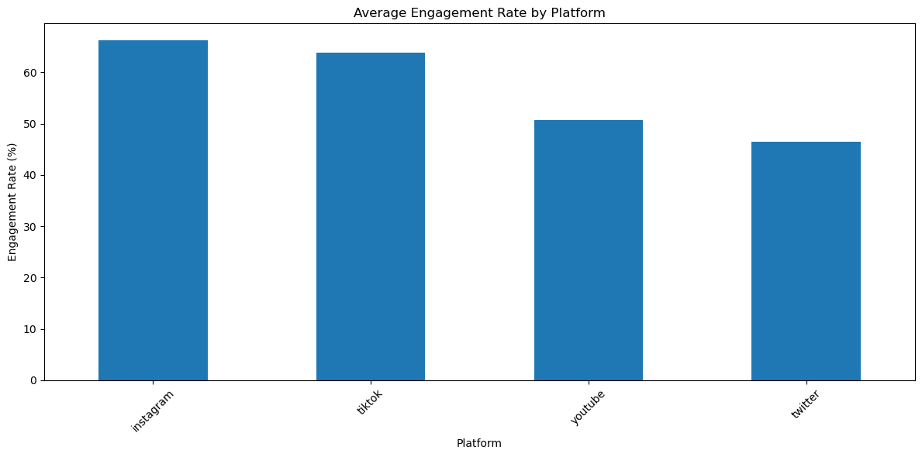
Who owns the feed?
Post volume is fairly even across platforms
YouTube uploads lead by approximately 8%
TikTok and Instagram closely follow

Slide 6
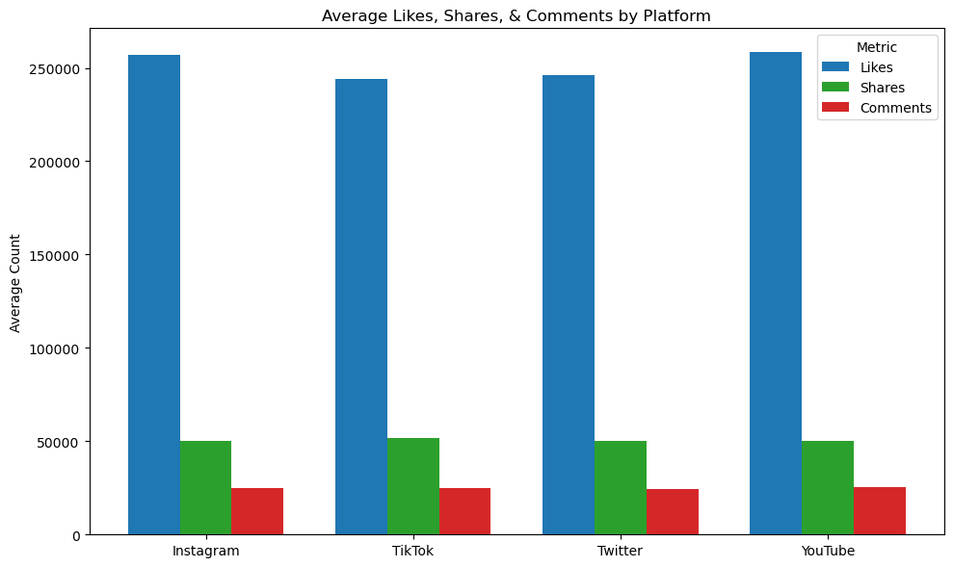
Engagement Breakdown
YouTube has the highest average engagement (257K)
Likes make up the majority of engagement metrics
Comments are the least common form of engagement across platforms

Slide 7
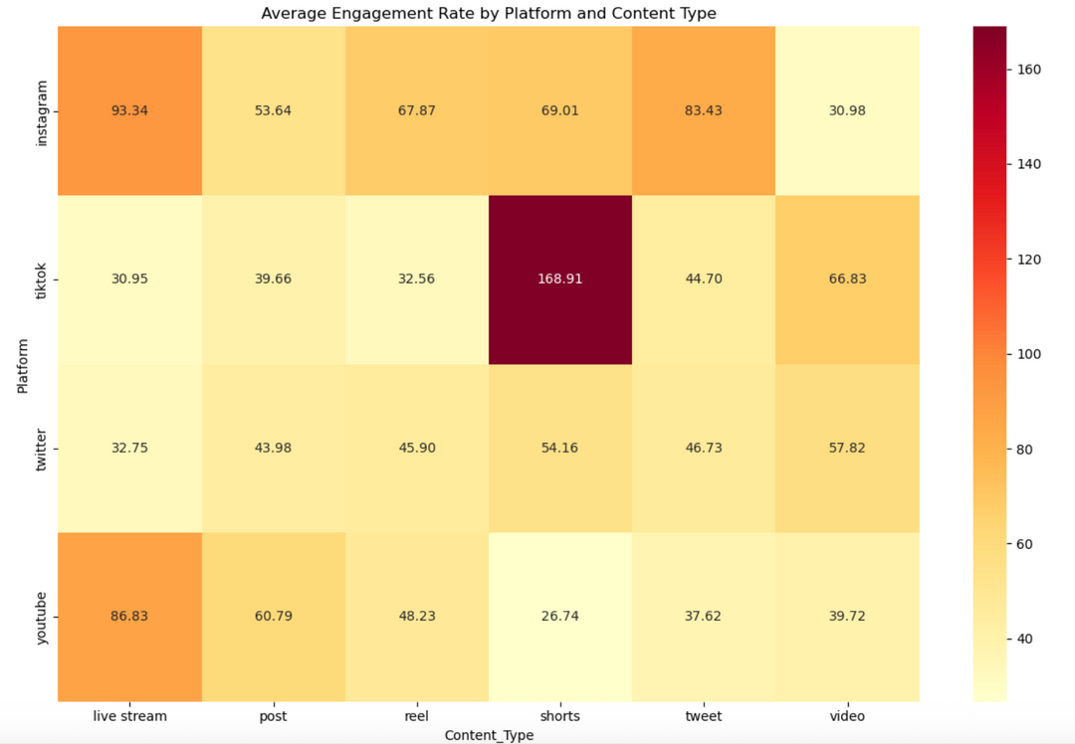
Engagement Heatmap
Short vertical clips drive higher interactions on TikTok
Real-time content encourages more comment threads
Traditional posts underperform across all platforms

Slide 8
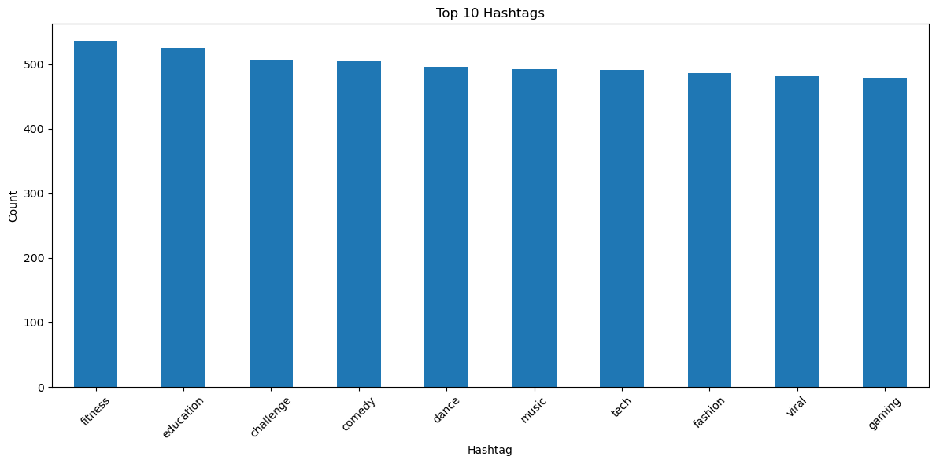
Consistently Viral Hashtags
#fitness, #education are the top hashtags to boost posts
#fitness, #education appear in about 41% of the posts that go viral
#gaming performs the worst in hashtag category

Slide 9
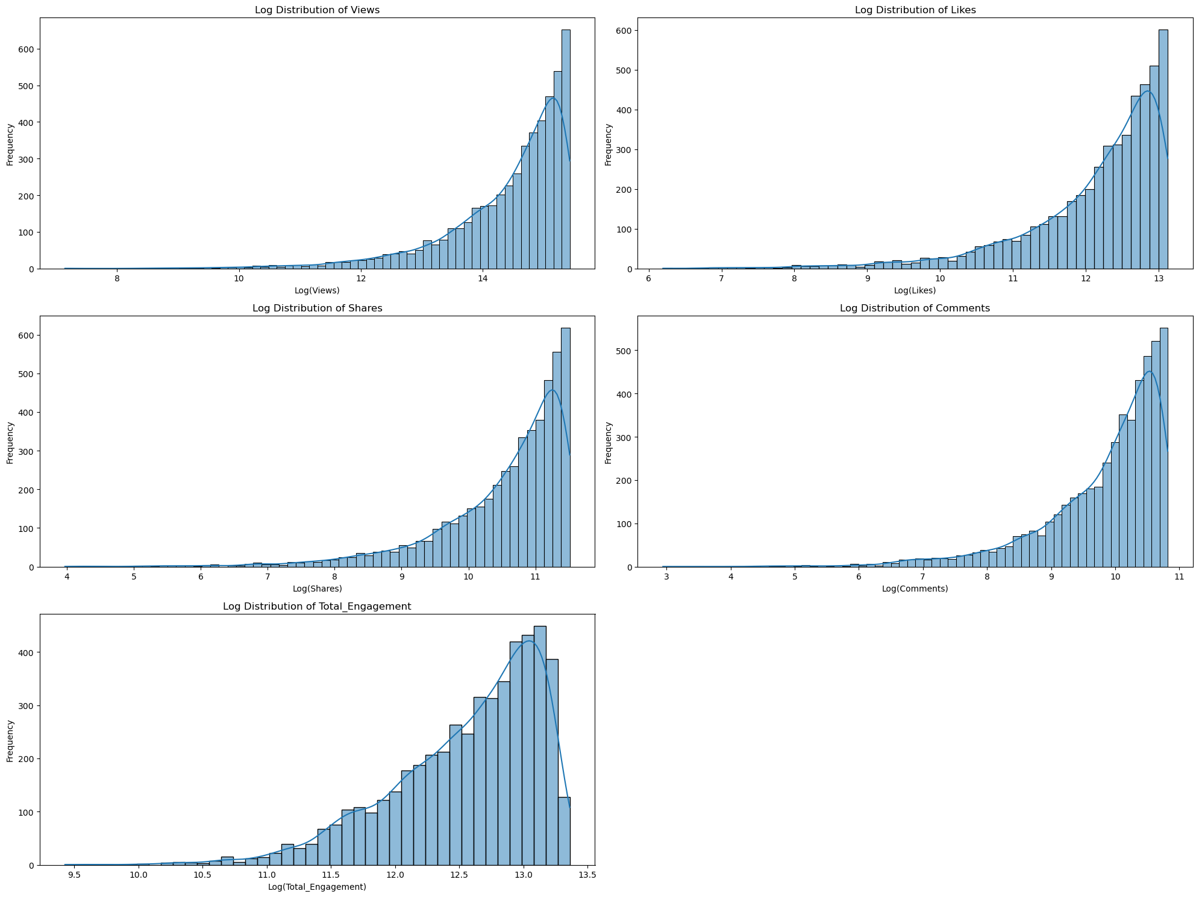
Format Matters
Short-form vertical videos average 265K in engagement
Outperform full-length videos across all metrics
Virality follows a power law — few videos go extremely viral

Slide 10
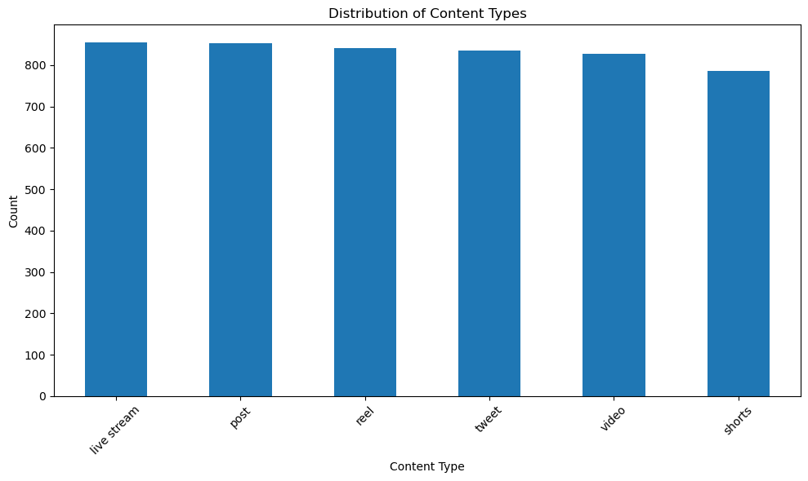
Why Short-Form Wins
Thumb-friendly, auto-play videos deliver quick dopamine hits
Algorithms prioritize "time watched per pixel"
Shorter watch times increase the chances of content being watched

Slide 11
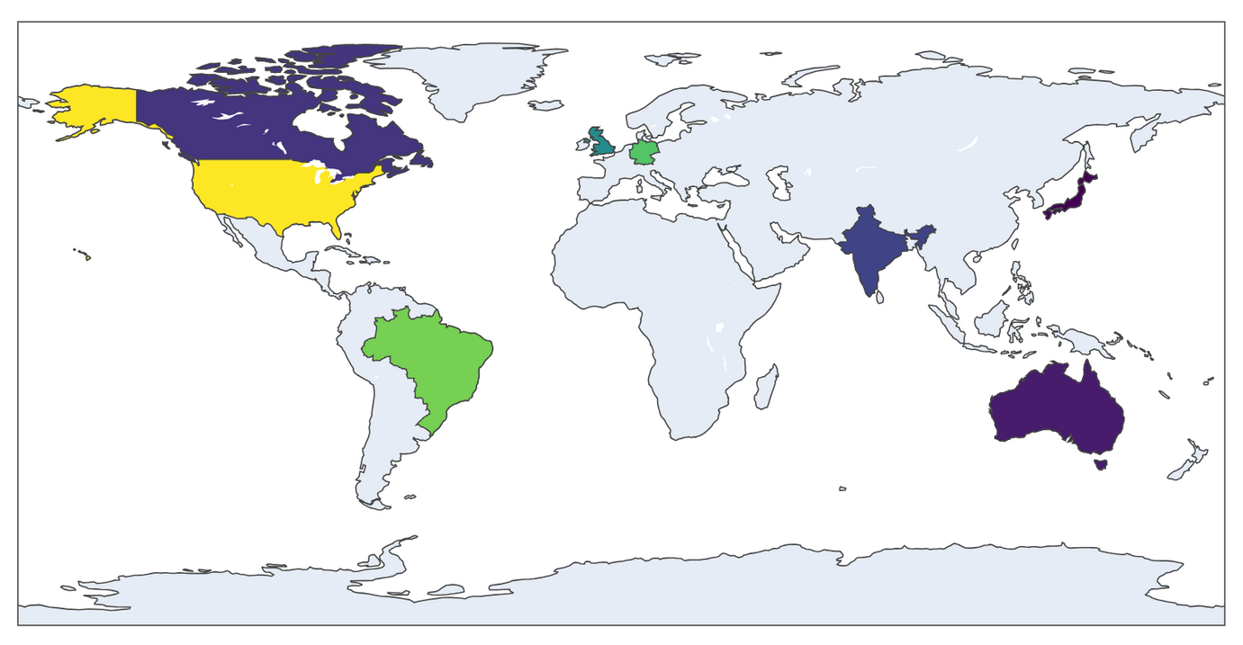
Average View Globally
U.S. content has the highest average views
India leads in video post comment interactions
Short-form videos dominate viewership in the U.S.

Slide 12
Key Insights
YouTube consistently outperforms other platforms in engagement by 5–8%
A small group of five hashtags fuels most viral content
Short-form video formats like Shorts and Reels show the highest success rates
Indian audiences generate the highest levels of interaction in this dataset

Slide 13
Strategy Recommendations
Focus on short-form video formats across platforms
Leverage top-performing hashtags like #Fitness and #Education
Optimize posting times to align with peak Indian audience activity
Drive engagement by prompting viewers with specific questions

Slide 14
Limitations
Lacks deeper audience insights like session duration and user retention
No measurement of viewer sentiment (positive, negative, neutral reactions)
Limited by a one-year snapshot; may not reflect long-term trends
Potential platform and region-specific biases not fully captured

Slide 15
Thank you

