Slide 1
Git
Version Control
Jessica Bonnie & Pete Nagraj

Slide 2
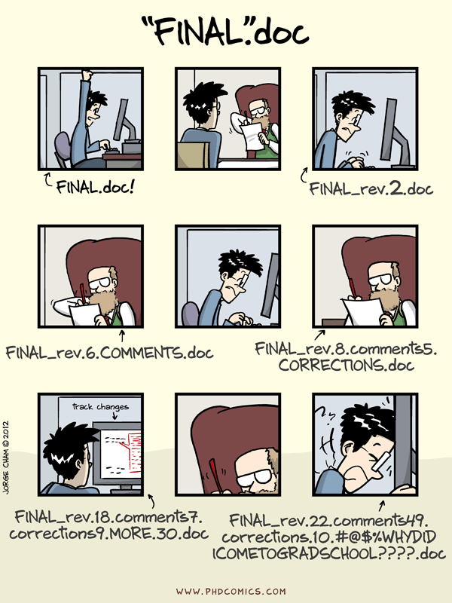
We've all been there...

Slide 3
Whiteboard Concept Illustration

Slide 4
Setting Up the First Time

Slide 5
Git in Real Time

Slide 6
Exercise
Add another fact about the planet Venus to venus.txt. Stage the change (with `add`) and then commit it.
(If you don’t know any other facts, you can google it or make one up -- dealer’s choice!)

Slide 7
GitHub

Slide 8
Offer from GitHub for Students:
https://education.github.com/pack
Only real question: How do you plan to use GitHub?

Slide 9
Hands On
https://try.github.io
http://bioconnector.org/learngit/

Slide 10
Have a great semester!

Slide 11
Extra Exercise
Create a new Git repository on your computer called bio. Write a three-line biography for yourself in a file called me.txt, commit your changes, then modify one line, add a fourth line, and display the differences between its updated state and its original state.

