Slide 1

Using Q-Learning to Control Optimization Hyperparameters
Samantha Hansen
Optimizing the Optimizers

Slide 2

Using Q-Learning to Control Optimization Hyperparameters
Raimo Bakis, Ewout van den Berg, Bhuvana Ramabhadran, Kartik Audhkhasi, Jia Cui, Brian Kingsbury, Geroge Saon, Michael Picheny, Raul Fernandez, Tom Sercu, Markus Nussbaum-Thom, Abhinav Sethy

Slide 3
Outline
Show how Q-learning can be used for optimization
Motivation
Background
Reinforcement learning for optimization
Toy Problem

Slide 4
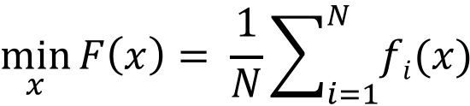
Motivation
Large-scale non-convex optimization
$$\min_{x}{F\left(x\right)= \frac{1}{N}\sum_{i=1}^{N}{fi(x)}}$$
f = loss a function
N = size of training set
i = one instance of a training example

Slide 5
Gradient Based Optimization
Updates
g is the gradient, stochastic gradient, gradient estimate
⍺ is the learning rate
Choosing the learning rate
Line search method (batch)
Annealing strategy (stochastic)
Use objective information (e.g. current loss, gradient norm, current learning rate)
Notes:
Both approaches use objective infromation in determining how to adjust the learning rate

Slide 6
Form a Feature Vector
Idea: Train a DQN to learn to control the learning rate
Snapshot of the F(x_{t}) progress and state
Feature Vector
DQN
Increase/Decrease or Maintain the learning rate

Slide 7
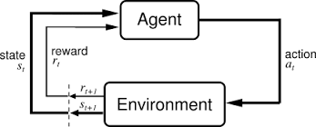
Reinforcement Learning Framework
Reinforcement Learning: An Introduction
Sutton & Barto

Slide 8
Reinforcement Learning Framework
Agent gets a state representation of the environment

Slide 9
Reinforcement Learning Framework
Based on the state the agent will choose some to take some action

Slide 10
Reinforcement Learning Framework
As a result of taking some action the environment moves to a new state and the agent receives a reward

Slide 11
Reinforcement Learning Framework
Agent wants to take the action that will result in maximal discounted return of rewards

Slide 12
Reinforcement Learning Framework

Slide 13
Reinforcement Learning Framework
Define the Q-function to help us find the action that results in the maximal rewards

Slide 14
Reinforcement Learning Framework

Slide 15
Bellman Equations
The optimal Q-function satisfies the Bellman Equation
Natural update rule (Q-learning):

Slide 16
Function Approximation
Finite state and actions Q-function is a look-up table
For infinite number of states approximate table with a function
Deep Q-Network (DQN) refers to when a Neural Network is used to approximate Q
Last layer is the q-value (expected discounted return of reward) for each action given state s

Slide 17


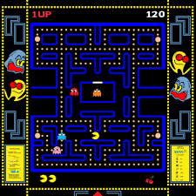

Background
“Human Level Control Through Deep Reinforcement Learning”
Task: train a DQN to play Atari video games

Slide 18

Background
“Using Deep Q-Learning to Control Optimization Hyperparameters”
Task: train a DQN to minimize a function*
$$\min_{x}{F\left(x\right)}$$
* By controlling the learning rate of a gradient based update

Slide 19
RL for Optimization
Agent Environment State Actions Reward

Slide 20
RL for Optimization
Agent Environment State Actions Reward
Train the agent to accomplish some task

Slide 21
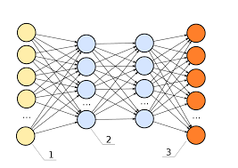

RL for Optimization
Agent Environment State Actions Reward
Task is to control learning rate in a gradient-based update routine
Train the agent to accomplish some task

Slide 22



RL for Optimization
Agent Environment State Actions Reward
Agent interacts in with an objective function
$$f(x)$$

Slide 23
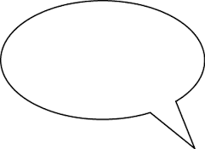
RL for Optimization
Agent Environment State Actions Reward
Agent sequentially receives a state representation of the environment
My current learning rate is..
My past M objective values are…
My gradient norm is…

Slide 24
RL for Optimization
Agent Environment State Actions Reward
Based on the state, the agent chooses to take an action
Half learning
Double learning rate
Maintain learning rate

Slide 25

RL for Optimization
Agent Environment State Actions Reward
As a result of taking an action, the environment moves to a new state and the agent receives some reward from the environment
$$x_{t+1}←x_{t}−α_{t} g_{t}$$
Time t, f(X_{t})
Time t+1, f(X_{t+1})

Slide 26
Closer look at the DQN
Output is the expected discounted return of rewards for each action
Input s is the state vector of the objective function f(x)

Slide 27
Will this work?
Formally describe setup
State Definition
Reward Function
Results

Slide 28

Game Rules
Task: Agent has T time steps to find the lowest objective value of a function f through gradient-based updates of the form
$$x_{t+1}←\overline{x}−α_{t}∇f(\overline{x})$$
Actions:
Half/Double learning rate
Maintain learning rate
Update accepted iterate x̄
Calculate new gradient

Slide 29
DQN in Practice
Assume we have a trained our DQN to control the learning rate of an objective function f
Q-GD = Trained DQN + Gradient Based Update

Slide 30
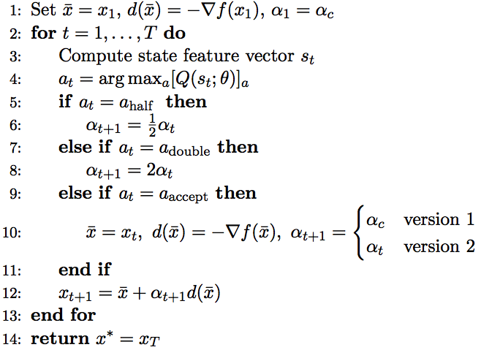
Input initial objective iterate, calculate gradient, and initialize learning rate

Slide 31
For each time step

Slide 33
Select the action

Slide 34
Select the action

Slide 35
Select the action

Slide 36
Select the action

Slide 37
Update candidate iterate

Slide 38
Return final solution

Slide 39
State Feature Vector
Motivation: Line Search Condition
Max objective value from past M iterates
Current objective value
Current learning rate
Gradient norm

Slide 40
State Feature Vector
Additional features
Current time t
Alignment measure consecutive gradients (search direction)
Encoding of current objective being higher/lower than M previous objective values

Slide 41
Reward Function
Must reflect our optimization goal of finding the lowest objective value in the fewest number of steps
Three candidates:
Inverse distance from objective lower bound
Objective change
Sufficient decrease condition

Slide 42
Evaluating Reward Functions
Generate a sequences of function values using a gradient based update
…
For each reward function and each function sequence:
Compute reward at each time step
Compute discounted return of rewards at each time step
Plot versus
Want lowest f_{T} values at highest R_{max} values

Slide 43
Reward Function Results
Inverse distance from
objective lower bound
Objective Change
Sufficient Decrease
Condition
Strictly positive
Based on degree of difficulty in decreasing objective

Slide 44
Training the DQN
Q-learning + Experience Replay
For details see “Using Deep Q-learning to Control Optimization Hyperparameters”
Agent
reward
r_{t}
state
s_{t}
action
a_{t}
r_{t+1}
s_{t+1}
Environment

Slide 45
Q-Learning
At each time step t get a state representation of the environment
Agent
reward
r_{t}
state
s_{t}
action
a_{t}
r_{t+1}
s_{t+1}
Environment

Slide 46
Q-Learning
Choose action based on a ε-greedy policy.
Let r ~ U[0,1]
Agent
reward
r_{t}
state
s_{t}
action
a_{t}
r_{t+1}
s_{t+1}
Environment

Slide 47
Q-Learning
Compute the predicted q-value for action a_{t}
Agent
reward
r_{t}
state
s_{t}
action
a_{t}
r_{t+1}
s_{t+1}
Environment

Slide 48

Q-Learning
Take action a_{t} and move to new state s_{t+1}
$$x_{t+1}←\overline{x}−α_{t}∇f(\overline{x})$$
My new state features are..
Agent
reward
r_{t}
state
s_{t}
action
a_{t}
r_{t+1}
s_{t+1}
Environment

Slide 49
Q-Learning
Calculate reward r_{t+1}
Agent
reward
r_{t}
state
s_{t}
action
a_{t}
r_{t+1}
s_{t+1}
Environment

Slide 50
Q-Learning
Compute the target q-value
s_{t+1}
Agent
reward
r_{t}
state
s_{t}
action
a_{t}
r_{t+1}
s_{t+1}
Environment

Slide 51
Q-Learning
Update DQN
Agent
reward
r_{t}
state
s_{t}
action
a_{t}
r_{t+1}
s_{t+1}
Environment

Slide 52
Q-Learning
Update DQN
Agent
reward
r_{t}
state
s_{t}
action
a_{t}
r_{t+1}
s_{t+1}
Environment

Slide 53
Q-Learning
Stop once an absorbing state has been reached (t=T)
Set x_{T} to x₀

Slide 54
Q-Learning
Stop once an absorbing state has been reached (t=T)
Set x_{T} to x₀
- Set α_{T} to α₀
AND REPEAT!
- Set t to 0

Slide 55
Evaluating the DQNs
Three questions
1. Does the Q-GD do better than GD with an Armijo or nonmonotone line search on minimizing the objective function?
2. Did the DQN Q-values converge to the true discounted return of rewards?
3. Will the Q-GD algorithm still work if the objective function is changed?
f_{train} =
f_{test} =

Slide 56
Input Parameters
Q-GD Versions 1 & 2
Additional Details:
Q-GD v1, GD + Armijo or
Nonmontone LS use α_{c}= 4
Q-GD v2 uses α_{c}= 2

Slide 57
Comparison against Line Search
- Q-GD v2 increases α to 8 then decreases it during final time steps
- Q-GD v1 only decreases α during last quarter of the optimization phase

Slide 58








Convergence of Q-values
Record Q-values associated with optimal action
$$q_{T−1},a_{T−1}$$
$$q_{2},a_{2}$$
$$q_{1},a_{1}$$
$$…$$
$$r_{1}$$
$$r_{2}$$
$$r_{T−1}$$
$$r_{T}$$
Calculate discounted return of rewards for each time step t
Plot R_{t} vs t and q_{t} vs t

Slide 59
Convergence of Q-values
Six state features contain enough information to capture distinct environment states

Slide 60
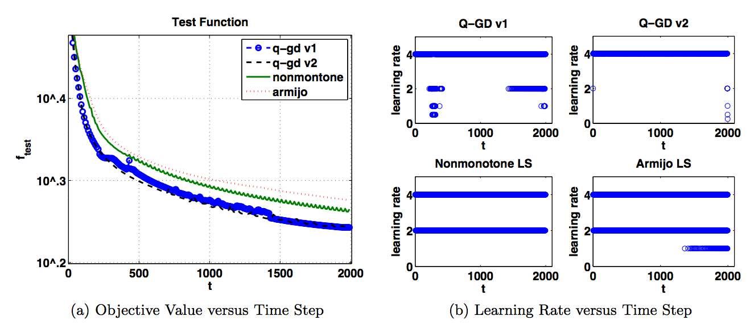
Results on Test Function
It didn’t break

Slide 61
Main Takeaway
Idea: Train a DQN to learn to control the learning rate
Snapshot of the F(x_{t}) progress and state
Feature Vector
DQN
Increase/Decrease or Maintain the learning rate

Slide 62
Future Work
Current state: fun idea, but not yet practical for large scale optimization
Extend to the stochastic regime
Framework for learning about successful optimization strategies
- Add more states
- Add more actions (hyperparameters)
Who care about q-values converging, just use for exploring hyperparameter space

Slide 63
Questions

