Slide 1
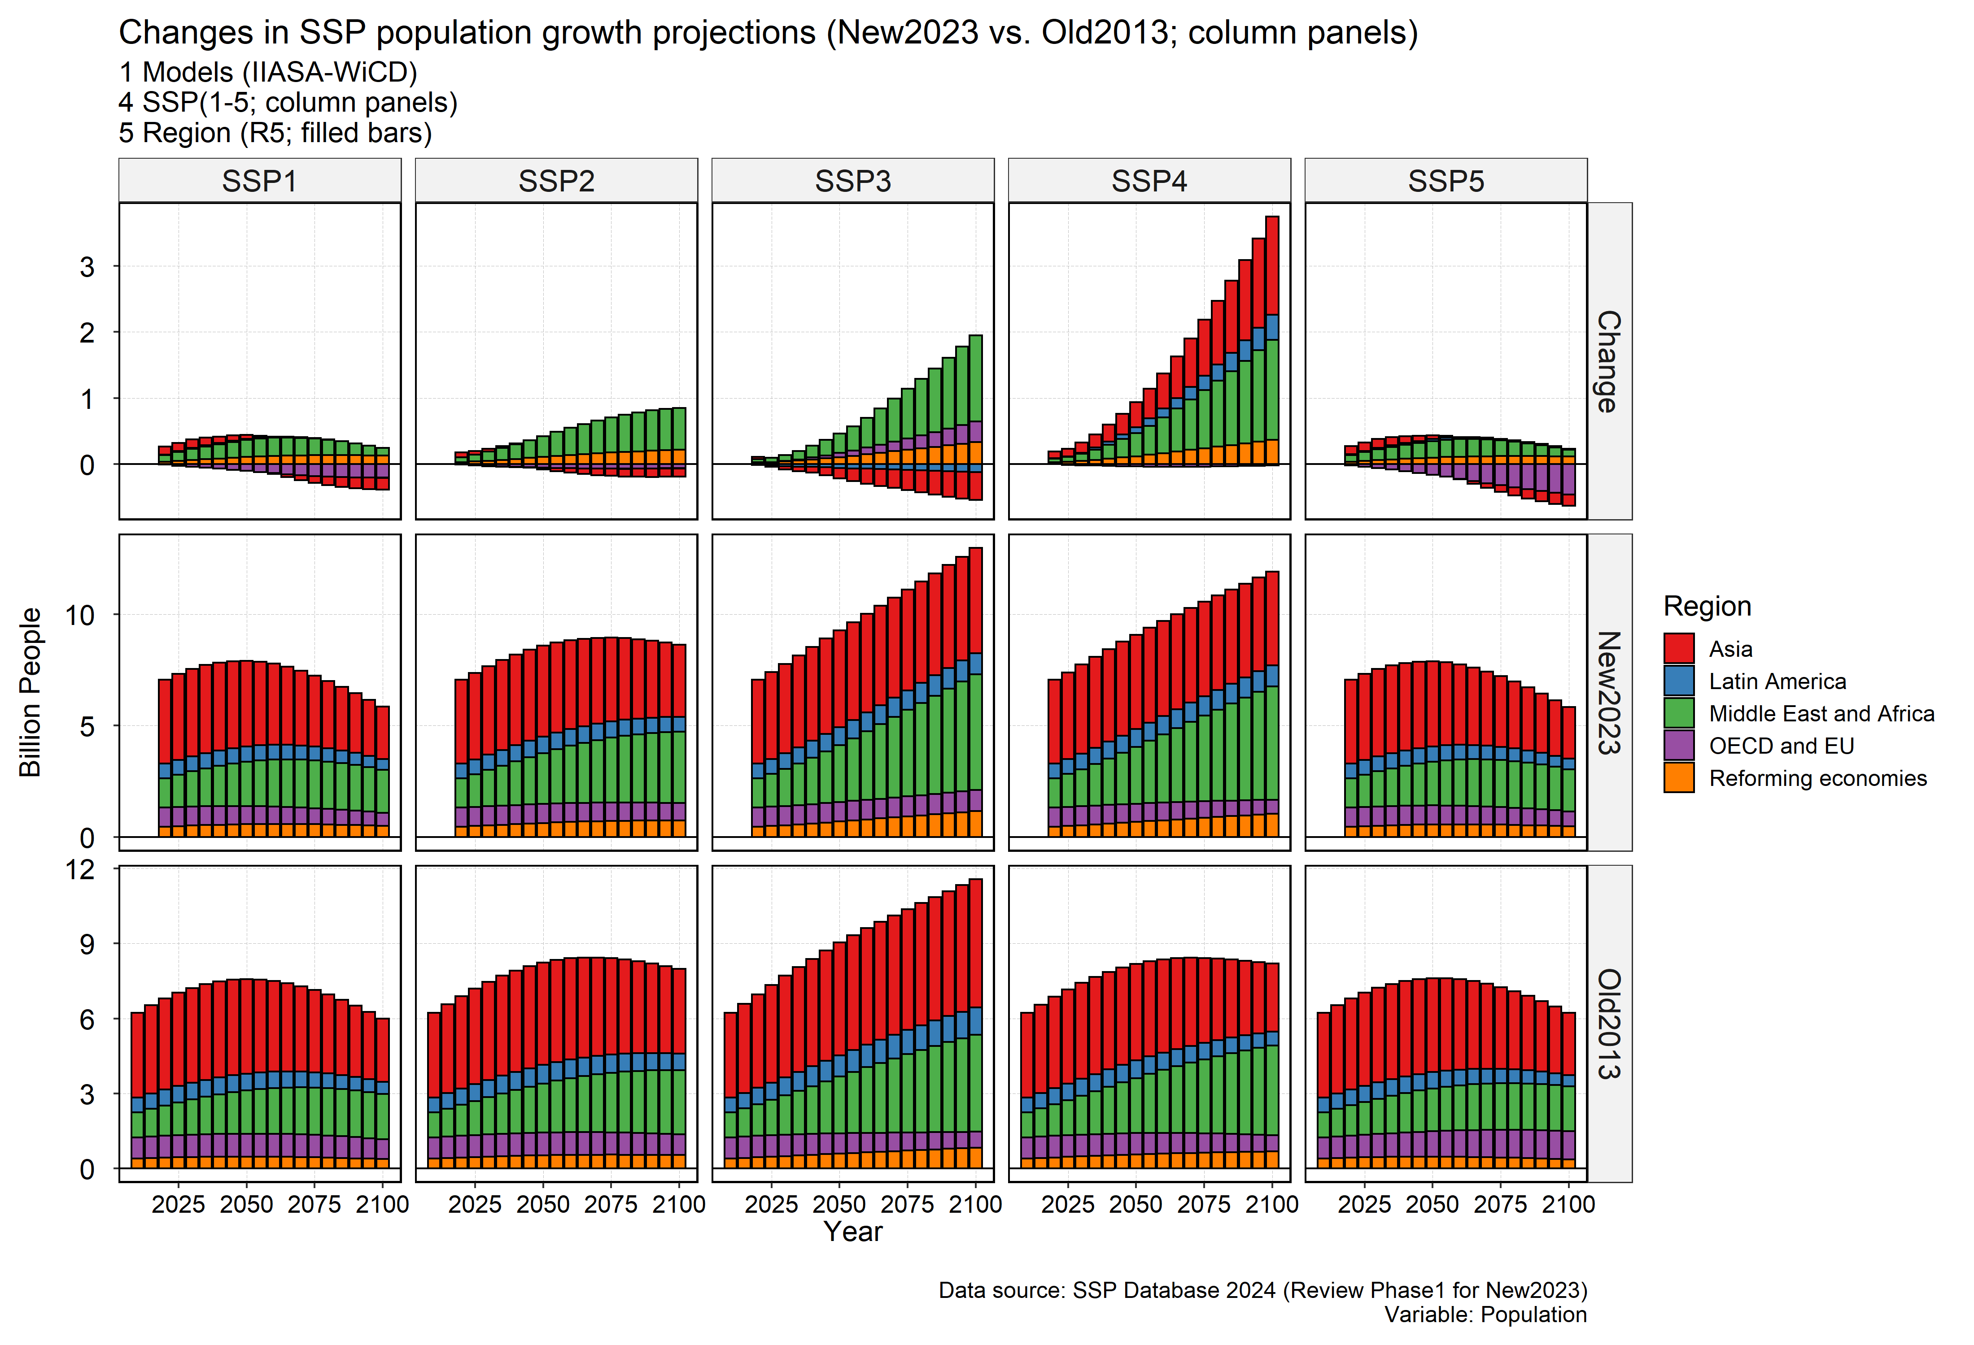
SSP2024 Population: IIASA-WiC POP 2020 - 2100

Slide 2
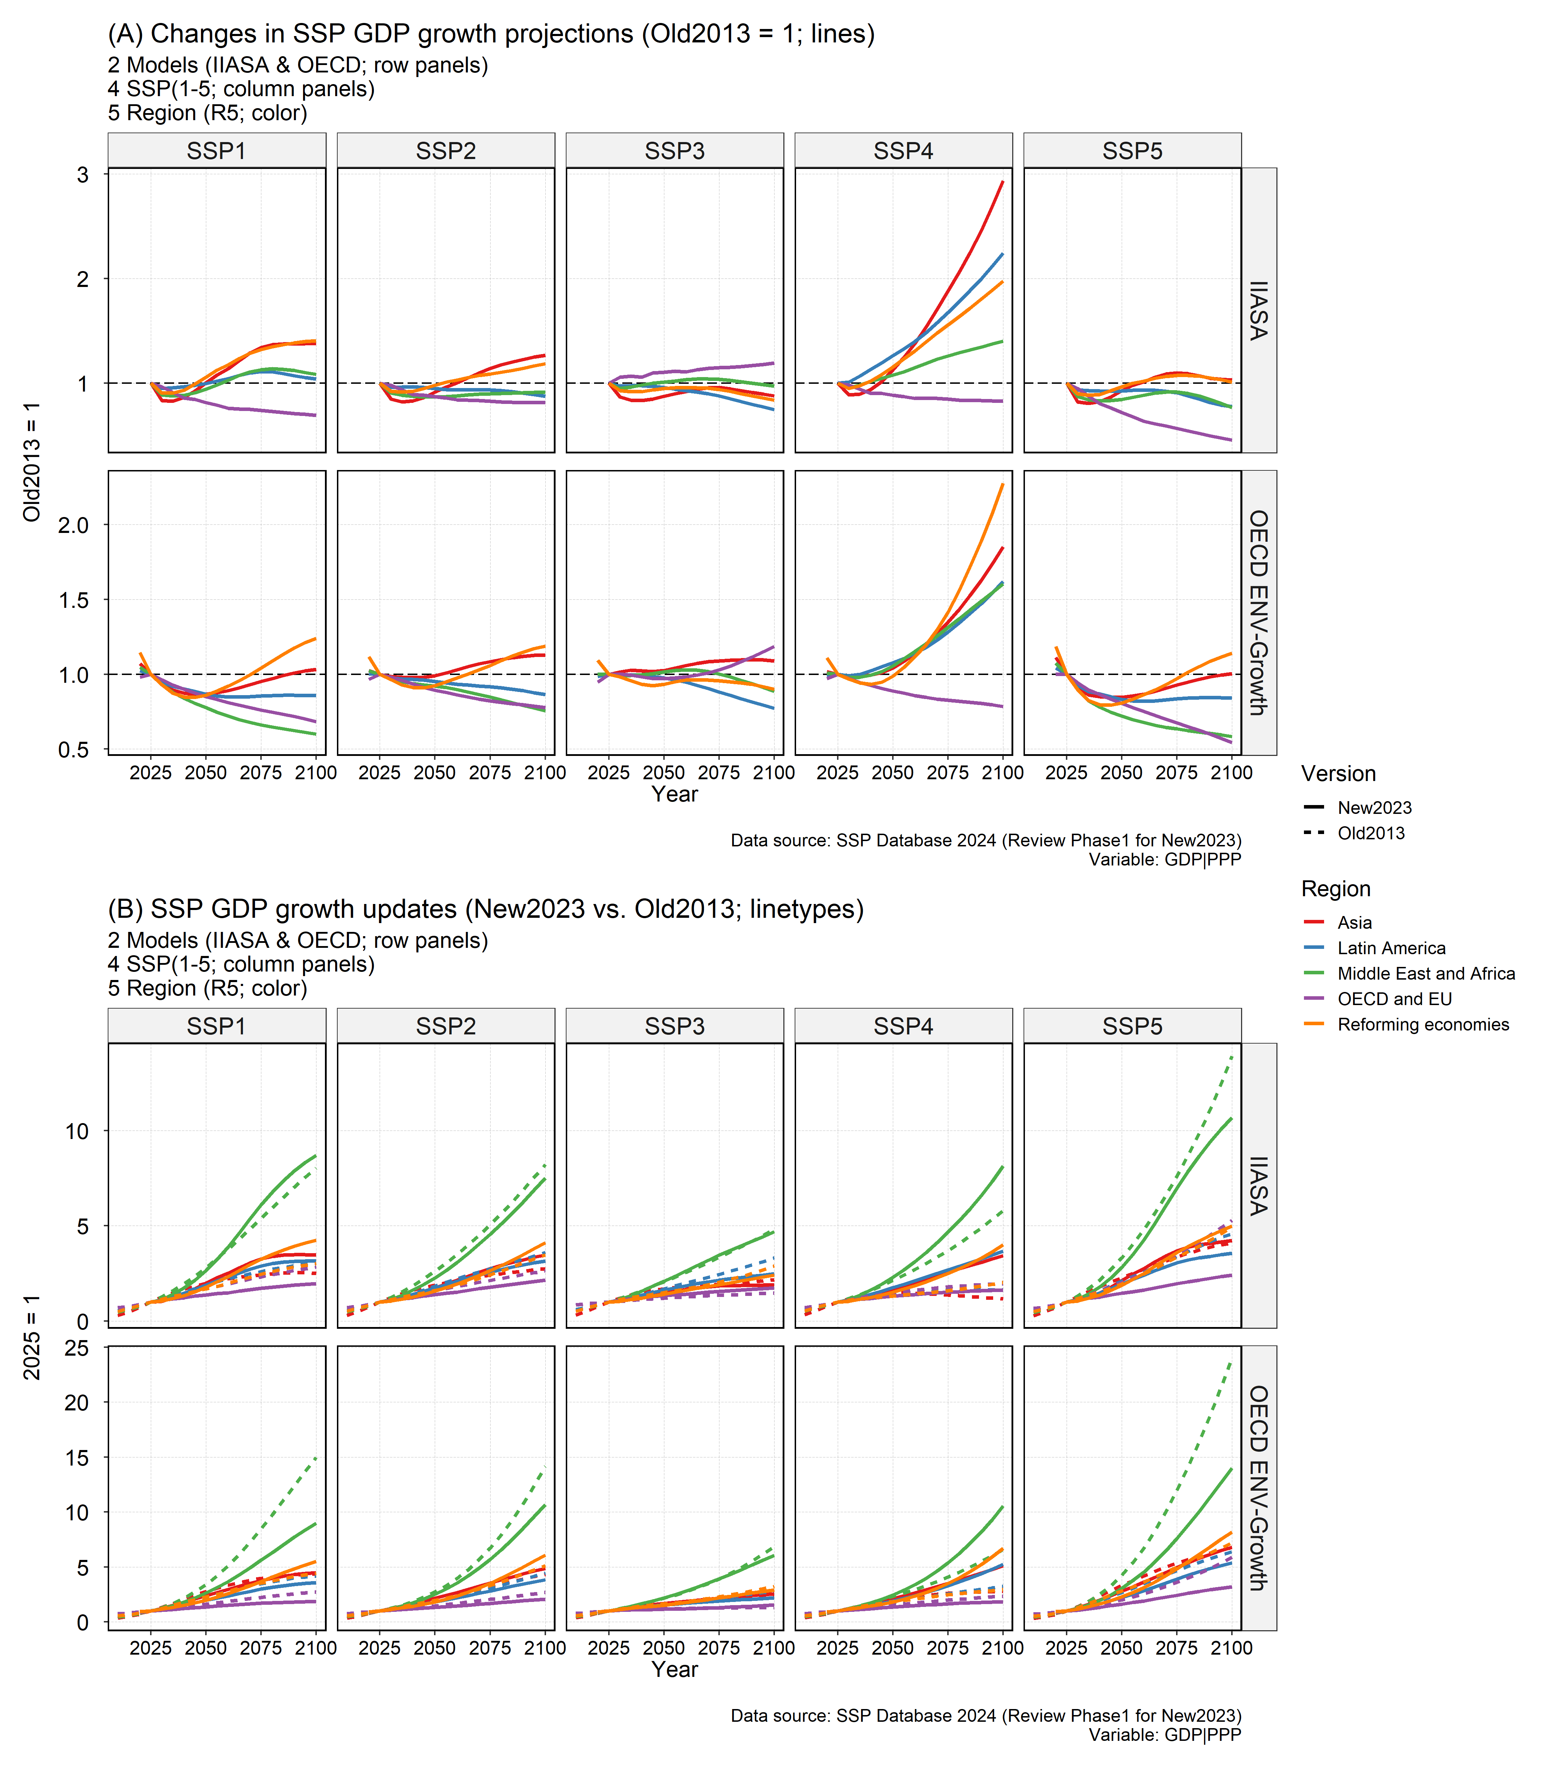
SSP 2024 GDP: 2 models: IIASA and OECD Future 2020 – 2100 History: 1980 – 2020 (OECD)

Slide 3
SSP data use in gcamdata
Two input files
"socioeconomics/socioeconomics_ctry“ (mapping)
"socioeconomics/SSP_database_v9“ (data)
info("socioeconomics/SSP_database_v9")
No precursors
Dependent: L100.Pop_thous_SSP_ctry_Yfut
Dependent: L102.gdp_mil90usd_Scen_R_Y
Dependent: L102.pcgdp_thous90USD_Scen_R_Y
Dependent: L102.PPP_MER_R
Dependent: L102.gdp_mil90usd_GCAM3_R_Y
Dependent: L102.gdp_mil90usd_GCAM3_ctry_Y
Dependent: L102.pcgdp_thous90USD_GCAM3_R_Y
Dependent: L102.pcgdp_thous90USD_GCAM3_ctry_Y
Dependent: L180.laborForceSSP
Three modules will be affected

Slide 4
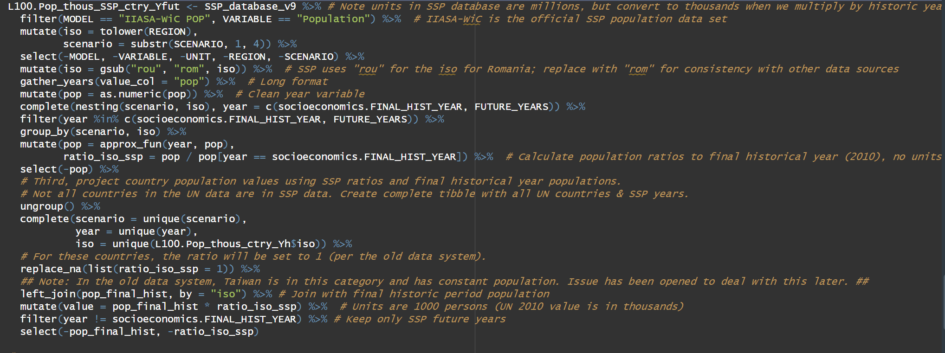
module_socio_L100.Population_downscale_ctry
model == "IIASA-WiC POP"
generate ratios of future population to base year (2010) for all SSPs. The ratios will be applied to the historical year populations so there are no jumps/inconsistencies.

Slide 5
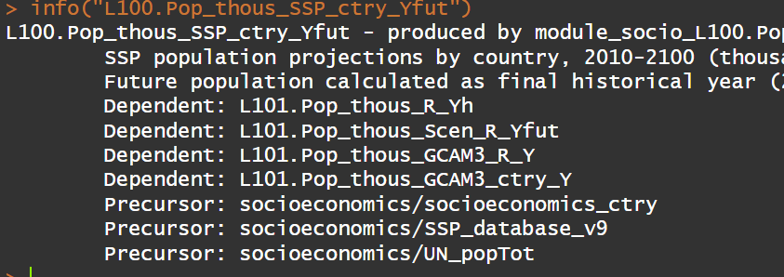
L100.Pop_thous_SSP_ctry_Yfut
Population is the same in gSSP and SSP

Slide 6
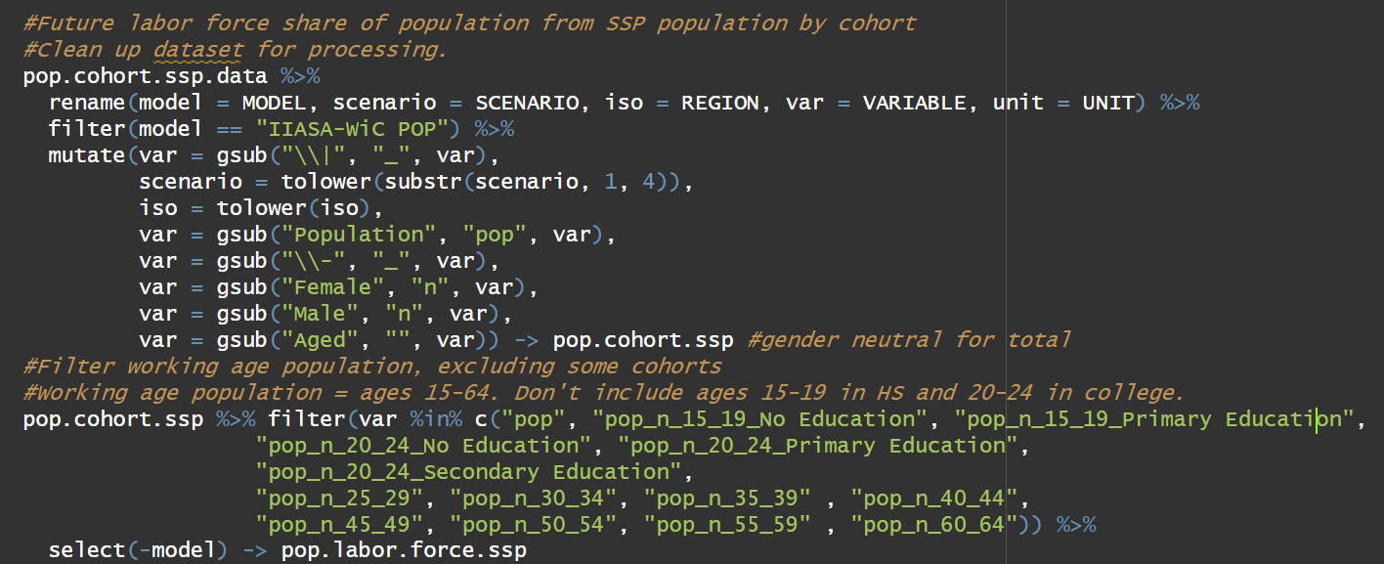
module_socio_L180.GDP_macro
Only for deriving labor force
model == "IIASA-WiC POP"

Slide 7
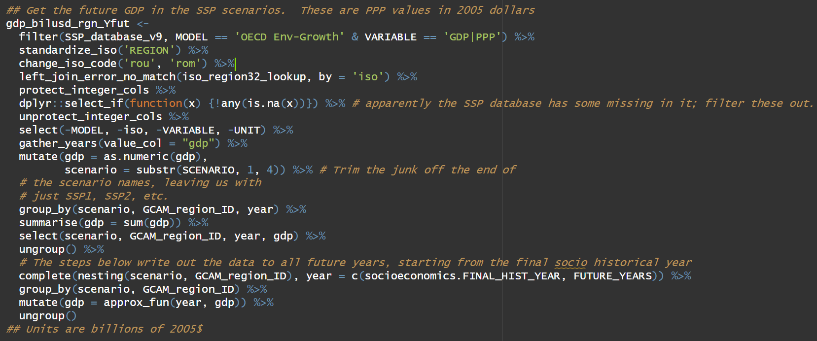
module_socio_L102.GDP
MODEL == 'OECD Env-Growth' & VARIABLE == 'GDP|PPP’
Clean and aggregate

Slide 8
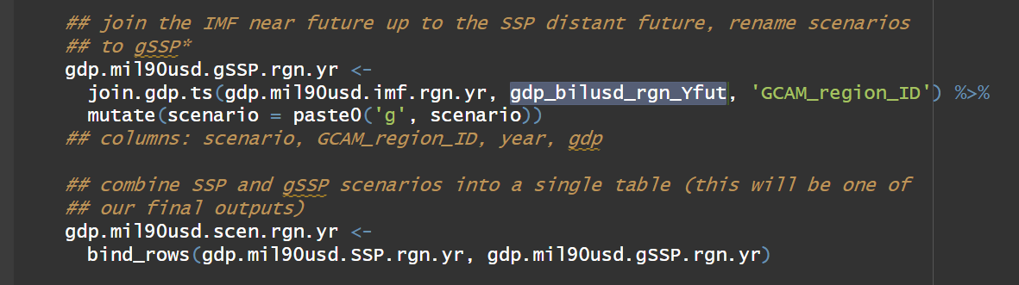
Using IMF near term projection up to 2024 to generate gSSP

Slide 10
Some goals
Generate POP and GDP in 1975 – 2100
Consistent with base year observations!
Need good data in the base year for calibration (e.g., per capita demand).

Slide 11
Restarting the work for both master and KLEAM
Step1:
Update the two input files with the latest data
"socioeconomics/socioeconomics_ctry“ (mapping)
"socioeconomics/SSP_database_v9“ (data)
Start with Master (xz/project/SSPUpdate)
Run 3 modules
Quick validation runs
Cherry-pick to KLEAM (xz/project/

