Slide 1
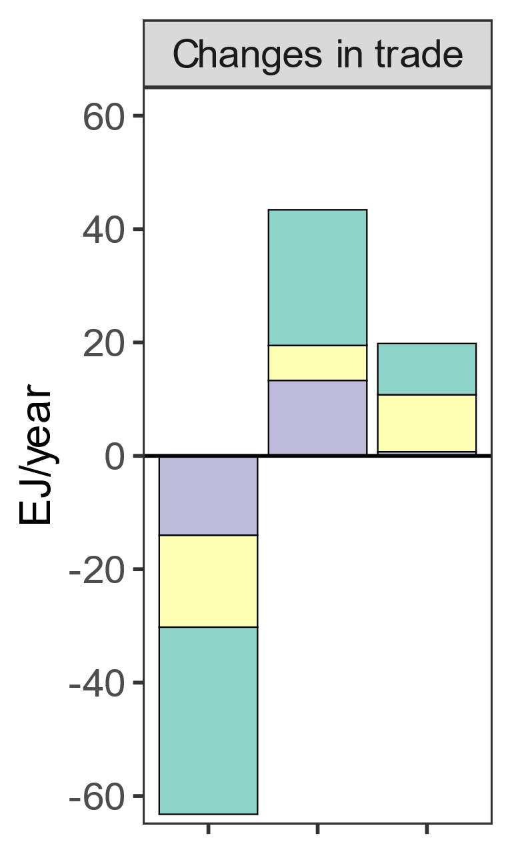
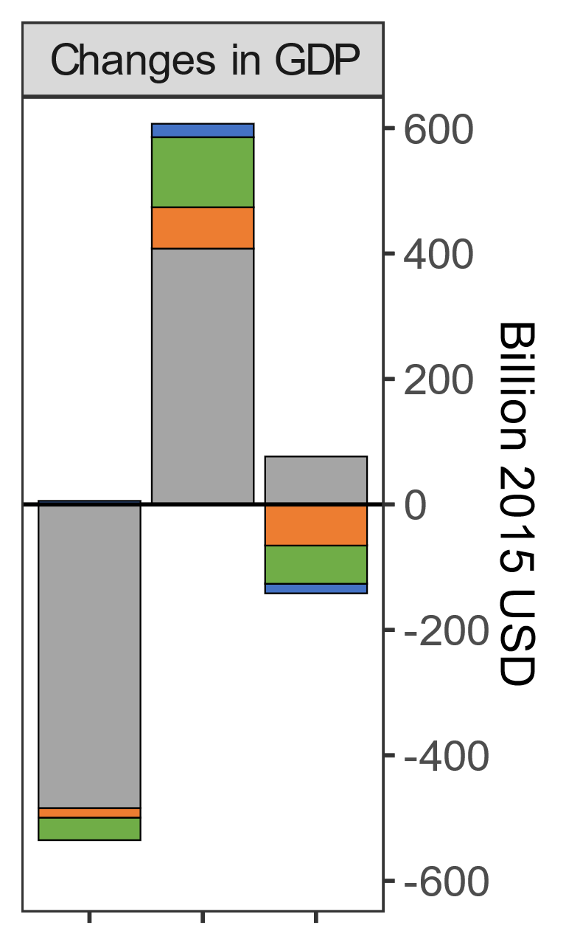
Changes in global energy trade patterns affect GDPs. We showcase how a cession of Russian exports shifts GDP around the world (SSP2; 2050).
Capital
Labor
Energy
Coal
Net Energy Export
Gas
Oil
Exporters
Exporters
Importers
Importers
Russia
Russia

