Slide 1
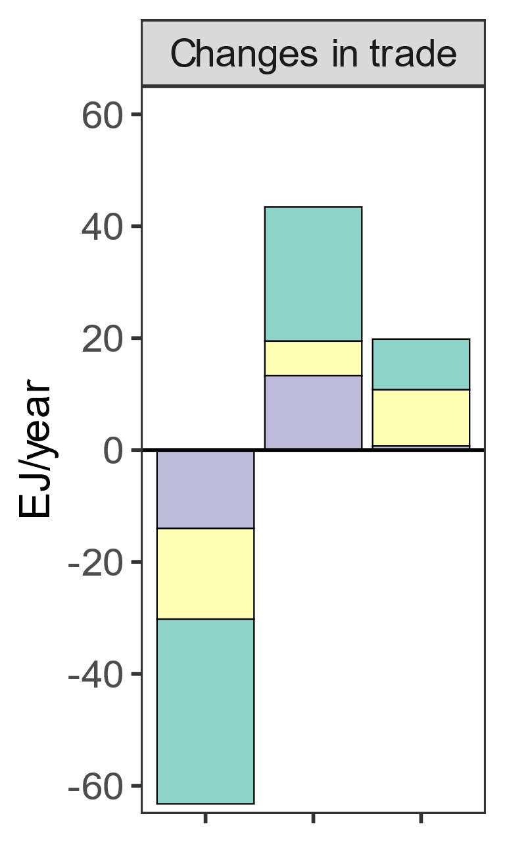
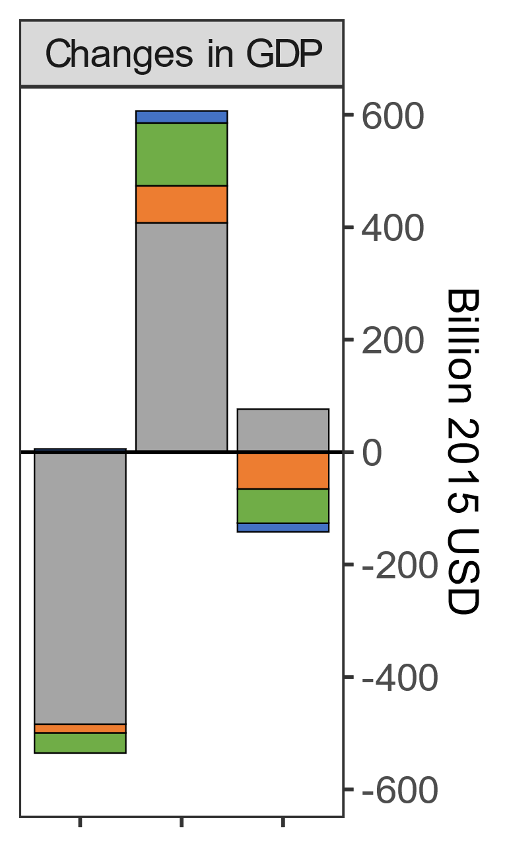
Changes in global energy trade patterns affect GDPs. We showcase how a cession of Russian exports shifts GDP around the world (SSP2; 2050).
Capital
Labor
Energy
Coal
Net Energy Export
Gas
Oil
Exporters
Exporters
Importers
Importers
Russia
Russia

Slide 2
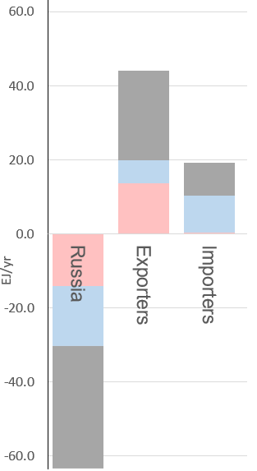
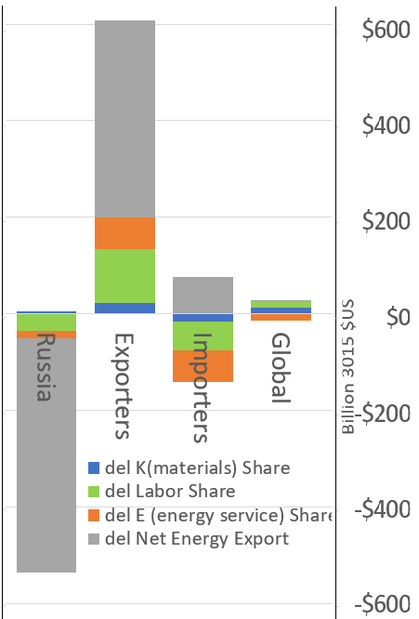

Changes in global energy trade patterns lead to changes in GDPs, e.g., cession of Russian exports shifts GDP around the world, 2050, SSP2
Changes in trade
Changes in GDP

