Slide 1
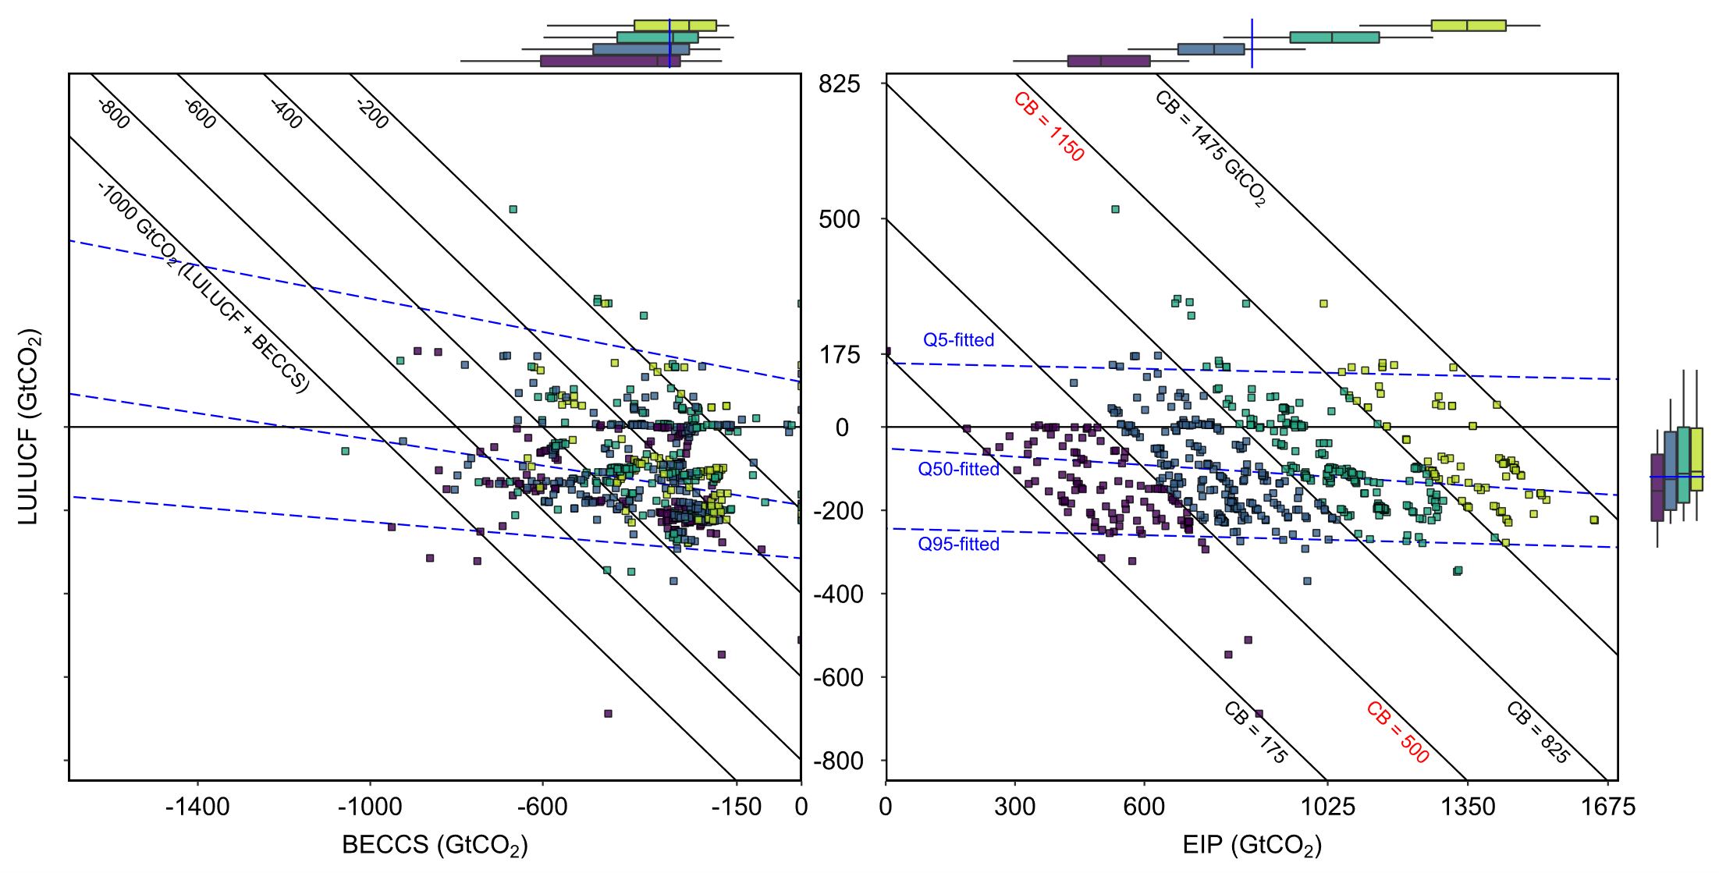
No-LCP
10%-LCP
50%-LCP
No-LCP
10%-LCP
50%-LCP
100%-LCP
1.5 °C
100%-LCP
Main
100%-LCP
A/R-
Focused
Low-
Bioenergy
1.5 °C
100%-LCP
A/R-
Focused
Low-
Bioenergy
AR6 CB (Gt CO2)
This study (GCAM)
EIP and land system mitigation policy
 | 1150 – 1475
 | 825 – 1150
 | 500 – 825
 | 175 – 500
2 °C (Main) | Global EIP system-wide carbon pricing with an end-of-century CB of 1150 GtCO₂; credit all land for carbon storage.
2 °C A/R-Focused | Credit only forest land for carbon storage.
2 °C Low-Bioenergy | Limit primary bioenergy by a linear path to 100 EJ in 2100.
1.5 °C | End-of-century CB of 500 GtCO₂.
 | Land carbon is priced as a portion of carbon prices in Fossil Fuels and Industry, i.e., 0% (No-LCP), 10%, 50%, or 100% (100%-LCP).
No-LCP
10%-LCP
50%-LCP
100%-LCP
Land carbon pricing (LCP) strength

Slide 2
No-LCP
10%-LCP
50%-LCP
No-LCP
10%-LCP
50%-LCP
100%-LCP
1.5 °C
100%-LCP
Main
100%-LCP
A/R-
Focused
Low-
Bioenergy
1.5 °C
100%-LCP
A/R-
Focused
Low-
Bioenergy
AR6 CB (Gt CO2)
This study (GCAM)
EIP and land system mitigation policy
 | 1150 – 1475
 | 825 – 1150
 | 500 – 825
 | 175 – 500
2 °C (Main) | Global EIP system-wide carbon pricing with an end-of-century CB of 1150 GtCO₂; credit all land for carbon storage.
2 °C A/R-Focused | Credit only forest land for carbon storage.
2 °C Low-Bioenergy | Limit primary bioenergy by a linear path to 100 EJ in 2100.
1.5 °C | End-of-century CB of 500 GtCO₂.
 | Land carbon is priced as a portion of carbon prices in Fossil Fuels and Industry, i.e., 0% (No-LCP), 10%, 50%, or 100% (100%-LCP).
No-LCP
10%-LCP
50%-LCP
100%-LCP
Land carbon pricing (LCP) strength

Slide 3
No-LCP
10%-LCP
50%-LCP
No-LCP
10%-LCP
50%-LCP
100%-LCP
1.5 °C
100%-LCP
Main
100%-LCP
A/R-
Focused
Low-
Bioenergy
1.5 °C
100%-LCP
A/R-
Focused
Low-
Bioenergy
AR6 CB (Gt CO2)
This study (GCAM)
EIP and land system mitigation policy
 | 1150 – 1475
 | 825 – 1150
 | 500 – 825
 | 175 – 500
2 °C (Main) | Global EIP system-wide carbon pricing with an end-of-century CB of 1150 GtCO₂; credit all land for carbon storage.
2 °C A/R-Focused | Credit only forest land for carbon storage.
2 °C Low-Bioenergy | Limit primary bioenergy by a linear path to 100 EJ in 2100.
1.5 °C | End-of-century CB of 500 GtCO₂.
 | Land carbon is priced as a portion of carbon prices in Fossil Fuels and Industry, i.e., 0% (No-LCP), 10%, 50%, or 100% (100%-LCP).
No-LCP
10%-LCP
50%-LCP
100%-LCP
Land carbon pricing (LCP) strength

Slide 4
No-LCP
10%-LCP
50%-LCP
No-LCP
10%-LCP
50%-LCP
100%-LCP
1.5 °C
100%-LCP
Main
100%-LCP
A/R-
Focused
Low-
Bioenergy
1.5 °C
100%-LCP
A/R-
Focused
Low-
Bioenergy
AR6 CB (Gt CO2)
This study (GCAM)
EIP and land system mitigation policy
 | 1150 – 1475
 | 825 – 1150
 | 500 – 825
 | 175 – 500
2 °C (Main) | Global EIP system-wide carbon pricing with an end-of-century CB of 1150 GtCO₂; credit all land for carbon storage.
2 °C A/R-Focused | Credit only forest land for carbon storage.
2 °C Low-Bioenergy | Limit primary bioenergy by a linear path to 100 EJ in 2100.
1.5 °C | End-of-century CB of 500 GtCO₂.
 | Land carbon is priced as a portion of carbon prices in Fossil Fuels and Industry, i.e., 0% (No-LCP), 10%, 50%, or 100% (100%-LCP).
No-LCP
10%-LCP
50%-LCP
100%-LCP
Land carbon pricing (LCP) strength

Slide 5
No-LCP
10%-LCP
50%-LCP
100%-LCP
1.5 °C
100%-LCP
A/R-
Focused
Low-
Bioenergy
AR6 CB (Gt CO2)
This study (GCAM)
EIP and land system mitigation policy
 | 1150 – 1475
 | 825 – 1150
 | 500 – 825
 | 175 – 500
2 °C (Main) | Global EIP system-wide carbon pricing with an end-of-century CB of 1150 GtCO₂; credit all land for carbon storage.
2 °C A/R-Focused | Credit only forest land for carbon storage.
2 °C Low-Bioenergy | Limit primary bioenergy by a linear path to 100 EJ in 2100.
1.5 °C | End-of-century CB of 500 GtCO₂.
 | Land carbon is priced as a portion of carbon prices in Fossil Fuels and Industry, i.e., 0% (No-LCP), 10%, 50%, or 100% (100%-LCP).
No-LCP
10%-LCP
50%-LCP
100%-LCP
Land carbon pricing (LCP) strength

Slide 6
AR6 CB (Gt CO2)
This study (GCAM)
EIP and land system mitigation policy
 | 1150 – 1475
 | 825 – 1150
 | 500 – 825
 | 175 – 500
2 °C (Main) | Global EIP system-wide carbon pricing with an end-of-century CB of 1150 GtCO₂; credit all land for carbon storage.
2 °C A/R-Focused | Credit only forest land for carbon storage.
2 °C Low-Bioenergy | Limit primary bioenergy by a linear path to 100 EJ in 2100.
1.5 °C | End-of-century CB of 500 GtCO₂.
 | Land carbon is priced as a portion of carbon prices in Fossil Fuels and Industry, i.e., 0% (No-LCP), 10%, 50%, or 100% (100%-LCP).
No-LCP
10%-LCP
50%-LCP
100%-LCP
Land carbon pricing (LCP) strength

Slide 7
No-LCP
10%-LCP
50%-LCP
100%-LCP
1.5 °C
A/R-
Focused
Low-
Bioenergy
AR6 CB (Gt CO2)
This study (GCAM)
EIP and land system mitigation policy
 | 1150 – 1475
 | 825 – 1150
 | 500 – 825
 | 175 – 500
2 °C (Main) | Global EIP system-wide carbon pricing with an end-of-century CB of 1150 GtCO₂; credit all land for carbon storage.
2 °C A/R-Focused | Credit only forest land for carbon storage.
2 °C Low-Bioenergy | Limit primary bioenergy by a linear path to 100 EJ in 2100.
1.5 °C | End-of-century CB of 500 GtCO₂.
 | Land carbon is priced as a portion of carbon prices in Fossil Fuels and Industry, i.e., 0% (No-LCP), 10%, 50%, or 100% (100%-LCP).
No-LCP
10%-LCP
50%-LCP
100%-LCP
Land carbon pricing (LCP) strength

Slide 8
AR6 CB (Gt CO2)
This study (GCAM)
EIP and land system mitigation policy
 | 1150 – 1475
 | 825 – 1150
 | 500 – 825
 | 175 – 500
2 °C (Main) | Global EIP system-wide carbon pricing with an end-of-century CB of 1150 GtCO₂; credit all land for carbon storage.
2 °C A/R-Focused | Credit only forest land for carbon storage.
2 °C Low-Bioenergy | Limit primary bioenergy by a linear path to 100 EJ in 2100.
1.5 °C | End-of-century CB of 500 GtCO₂.
 | Land carbon is priced as a portion of carbon prices in Fossil Fuels and Industry, i.e., 0% (No-LCP), 10%, 50%, or 100% (100%-LCP).
No-LCP
10%-LCP
50%-LCP
100%-LCP
Land carbon pricing (LCP) strength

