Slide 1
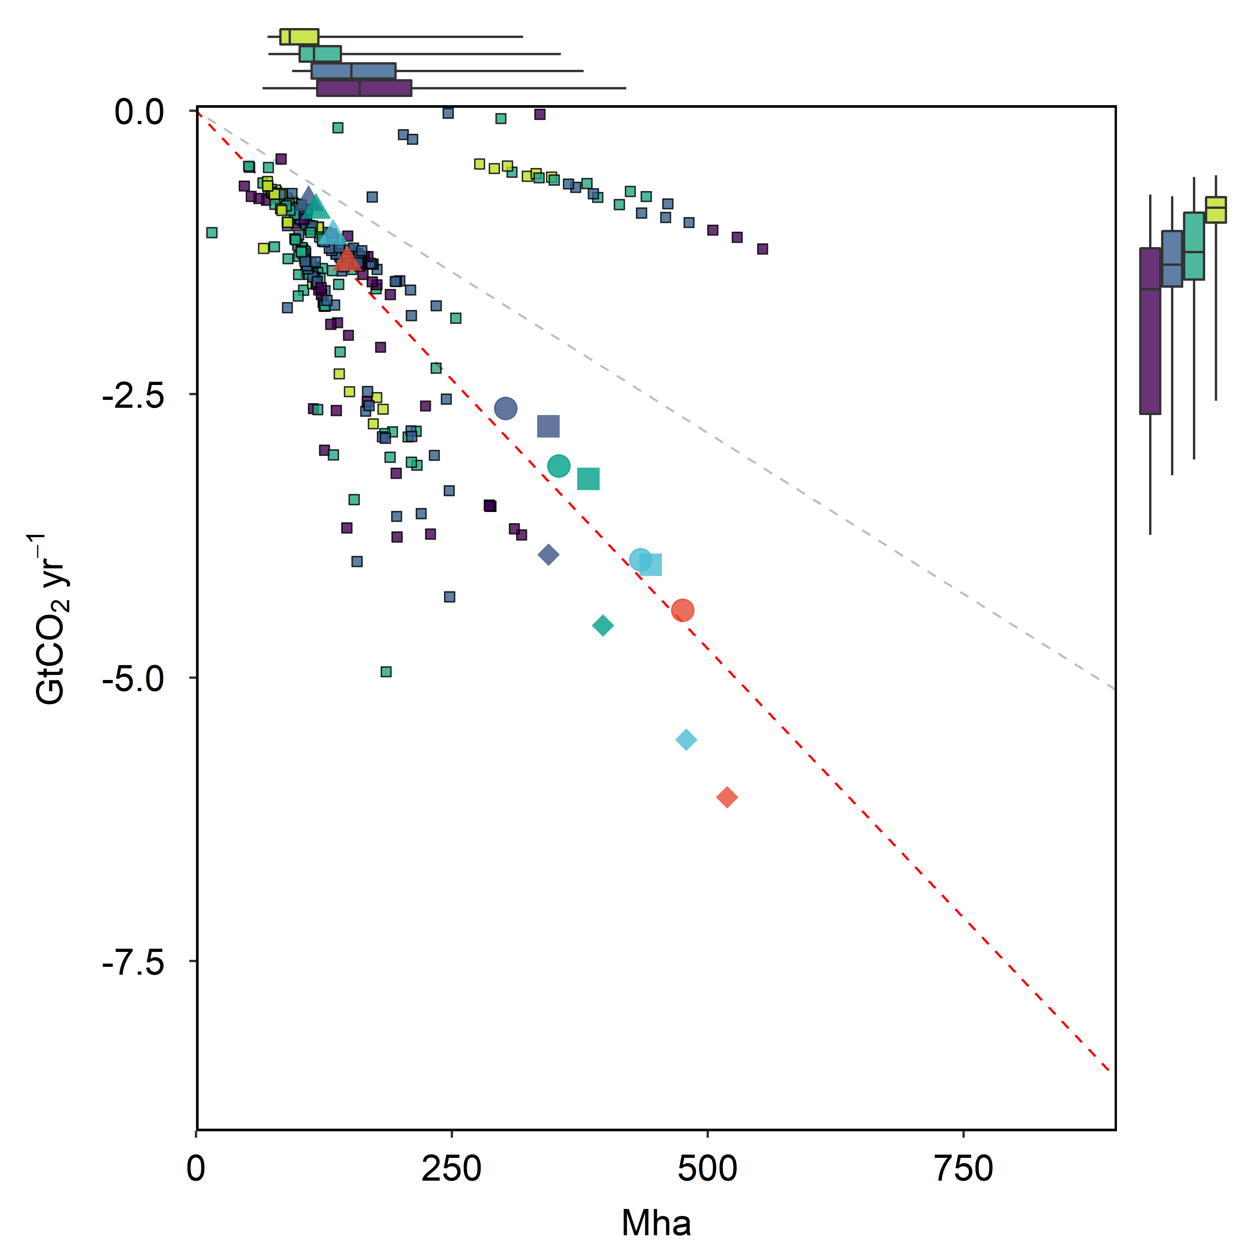
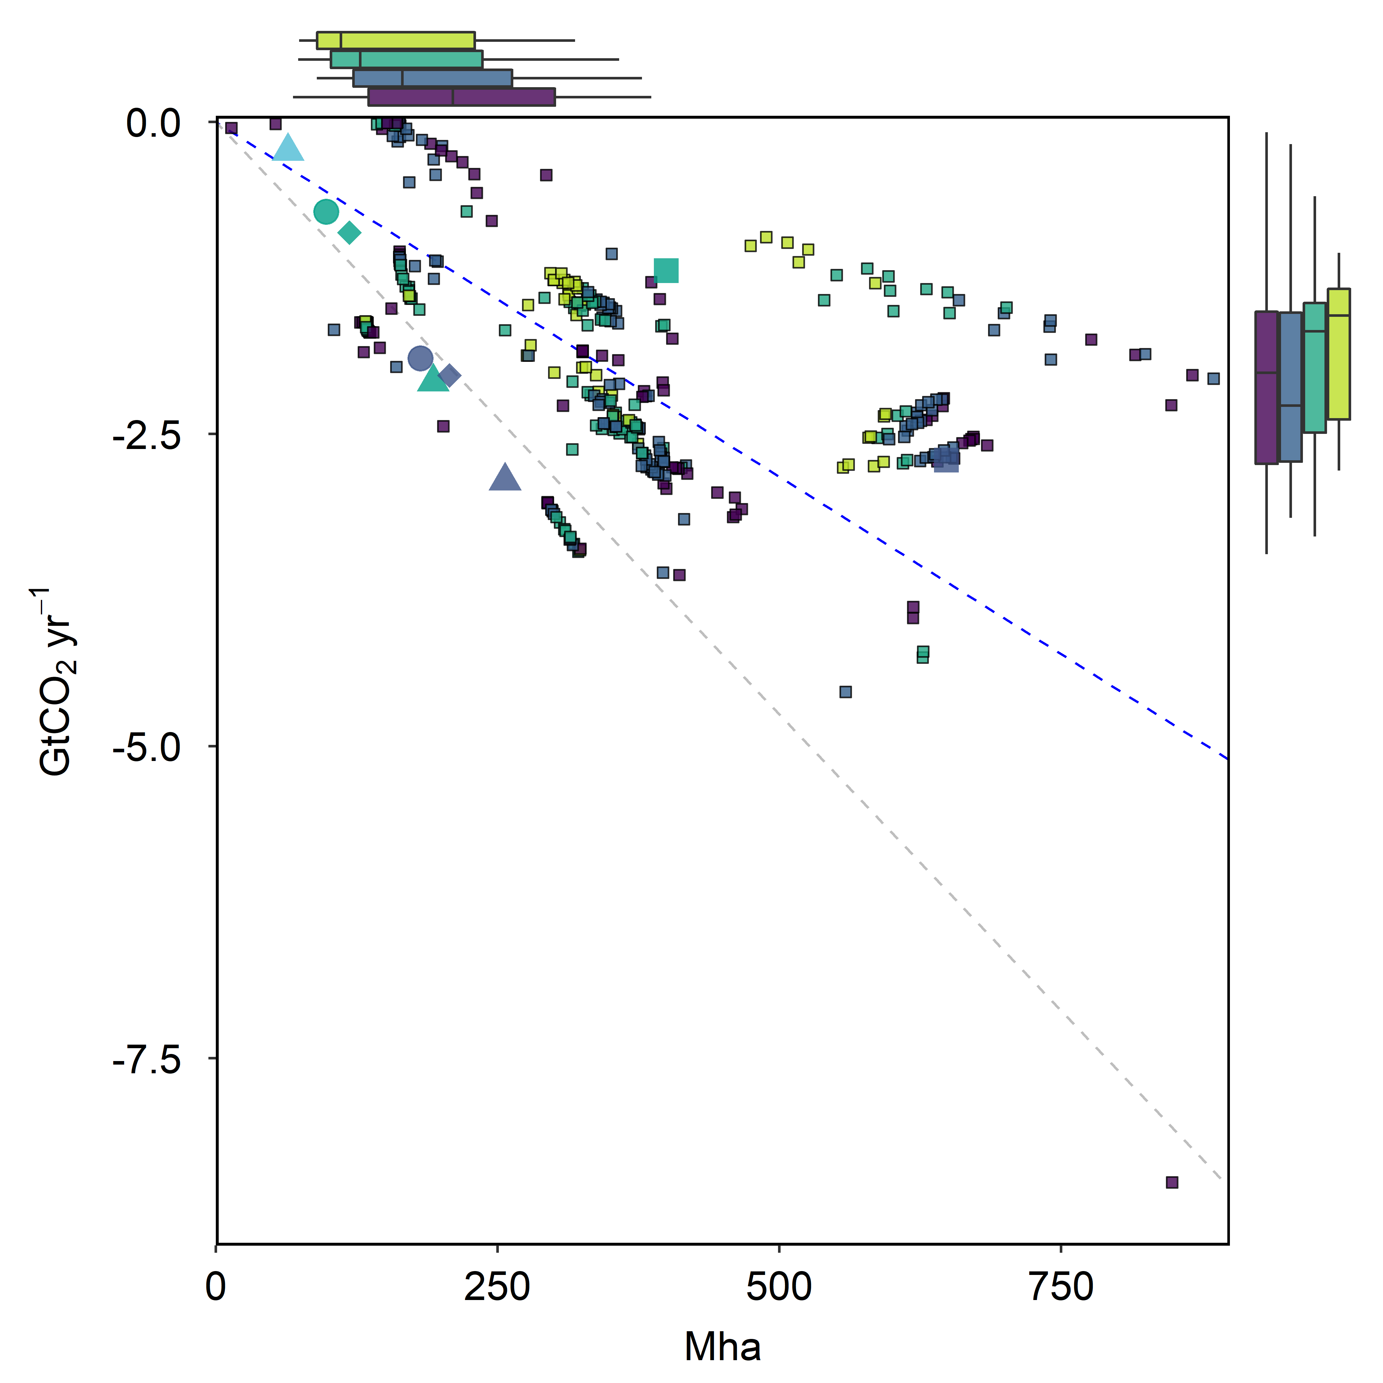
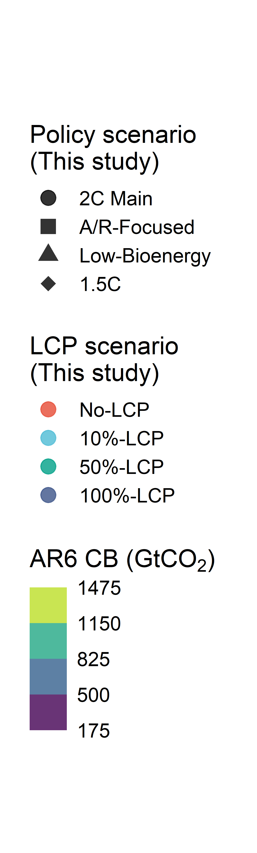
(A) BECCS vs. Energy cropland
(B) LULUCF vs. Forest
-5.7 tCO₂ ha⁻¹ yr⁻¹
-9.5 tCO₂ ha⁻¹ yr⁻¹

Slide 2
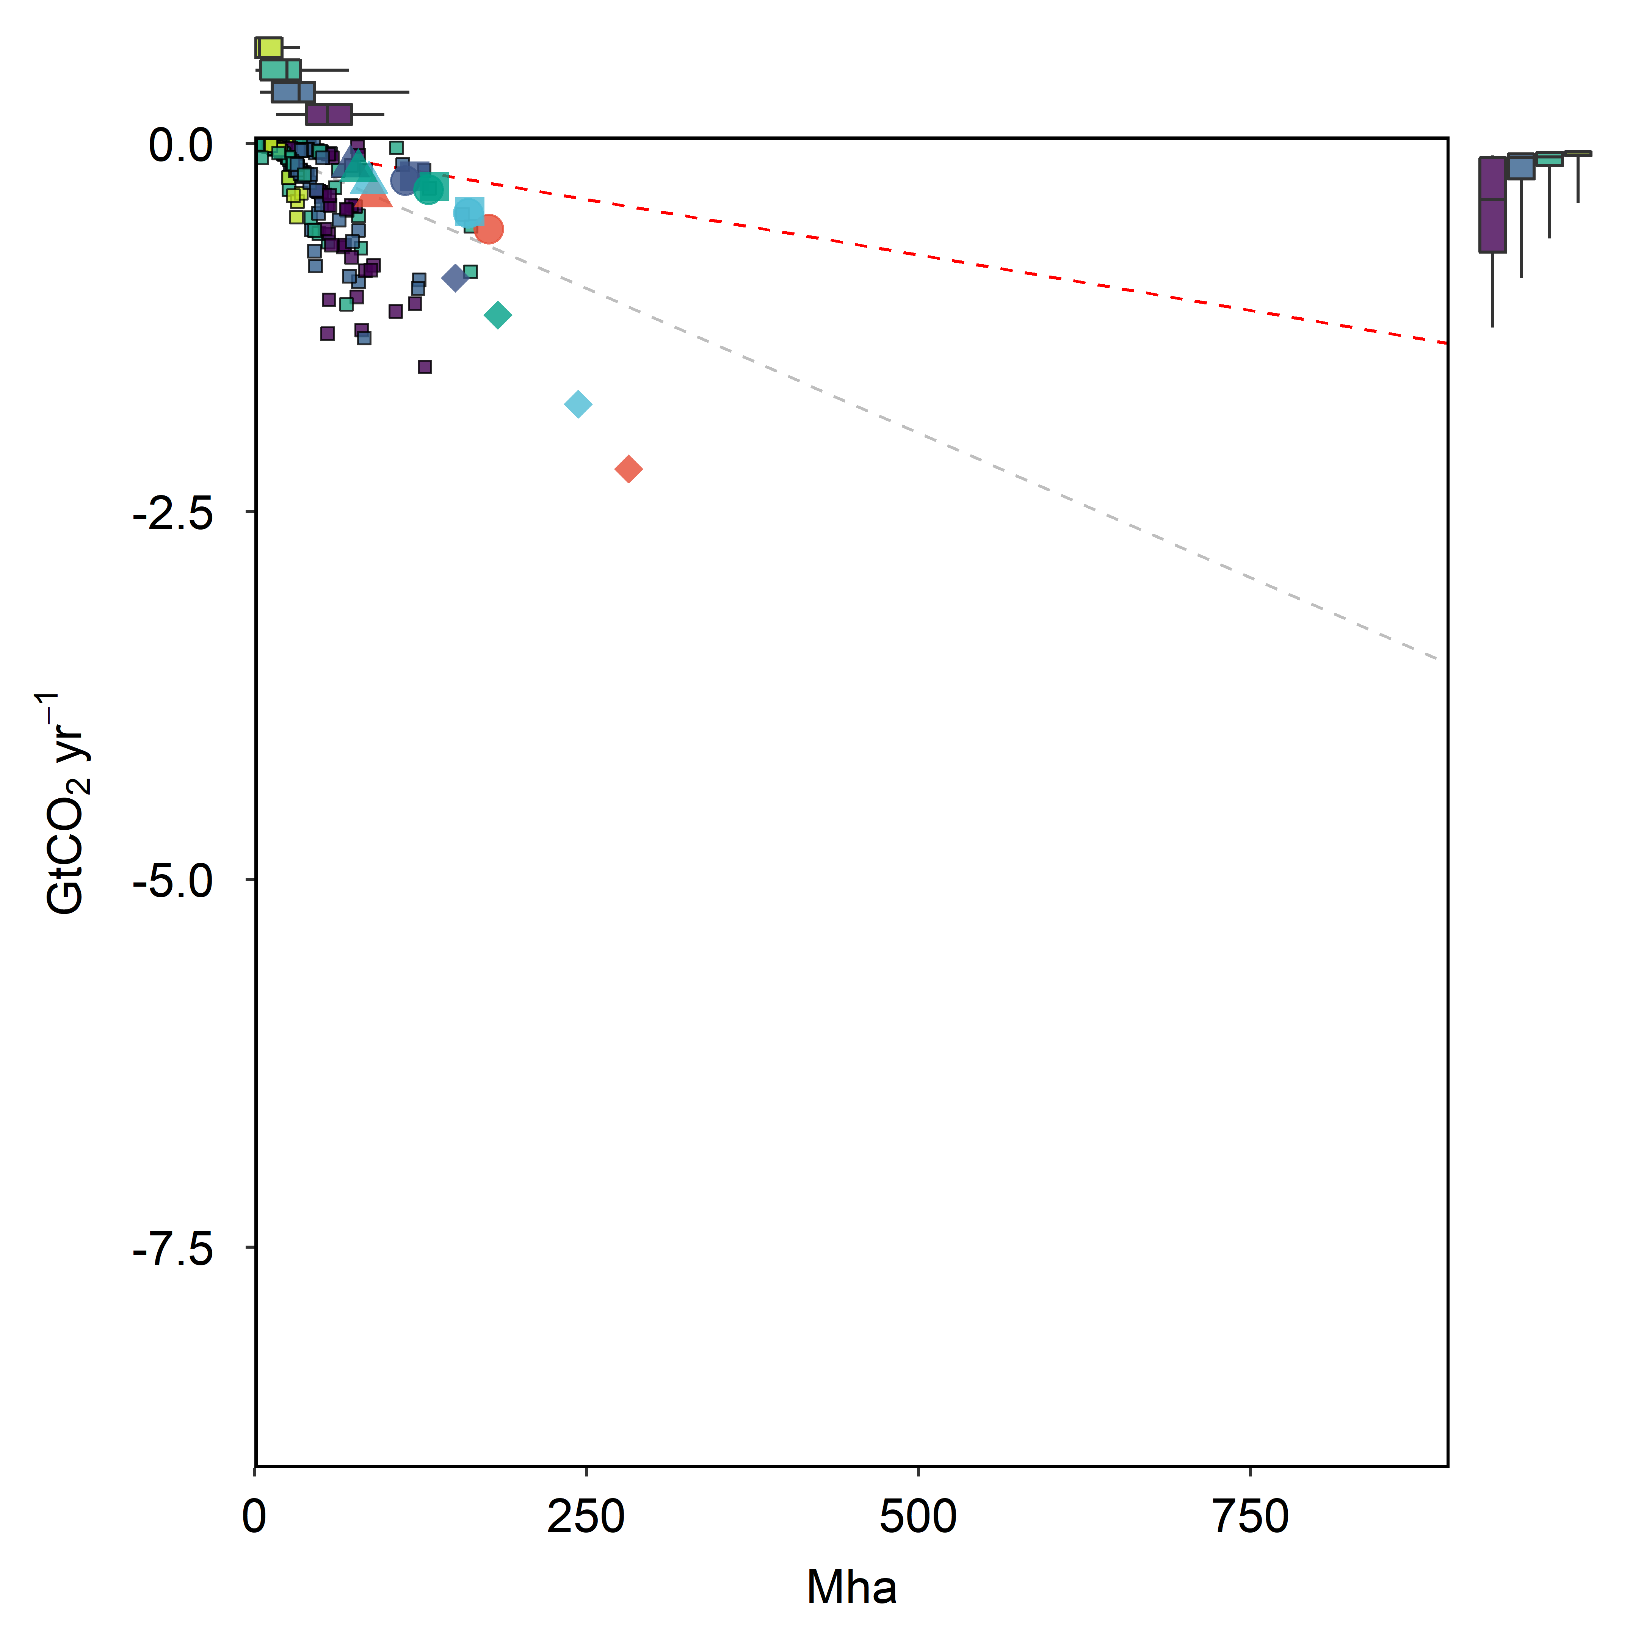
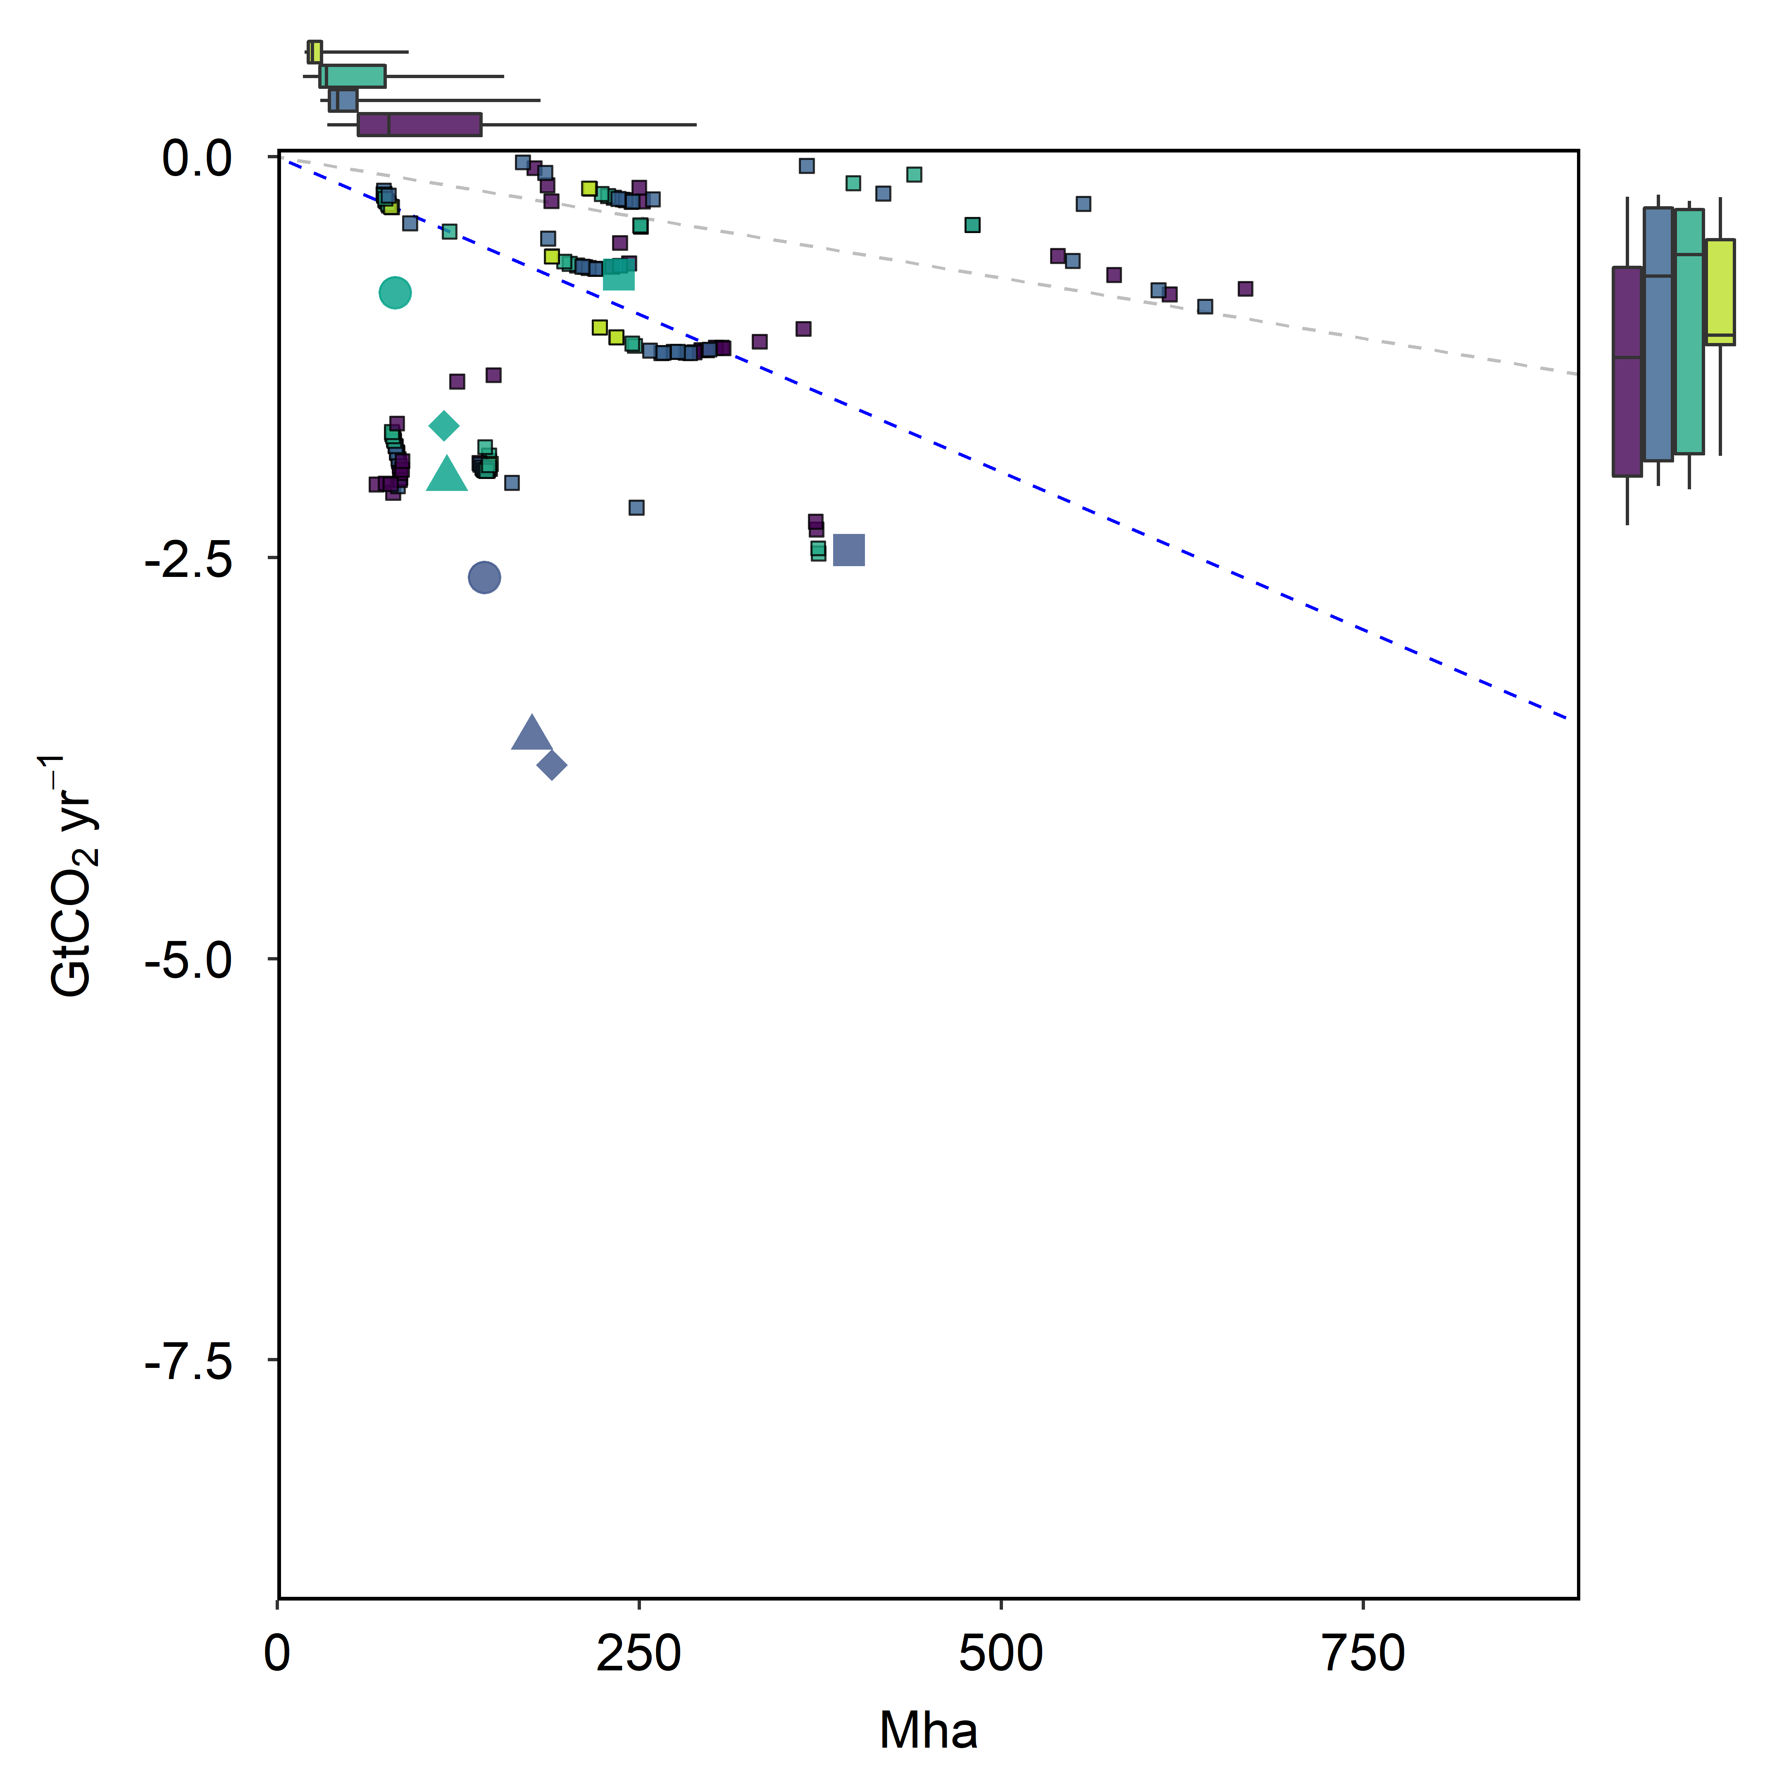
(A) BECCS vs. Energy cropland
(B) LULUCF vs. Forest
-1.5 tCO₂ ha⁻¹ yr⁻¹
-3.9 tCO₂ ha⁻¹ yr⁻¹

