Slide 1
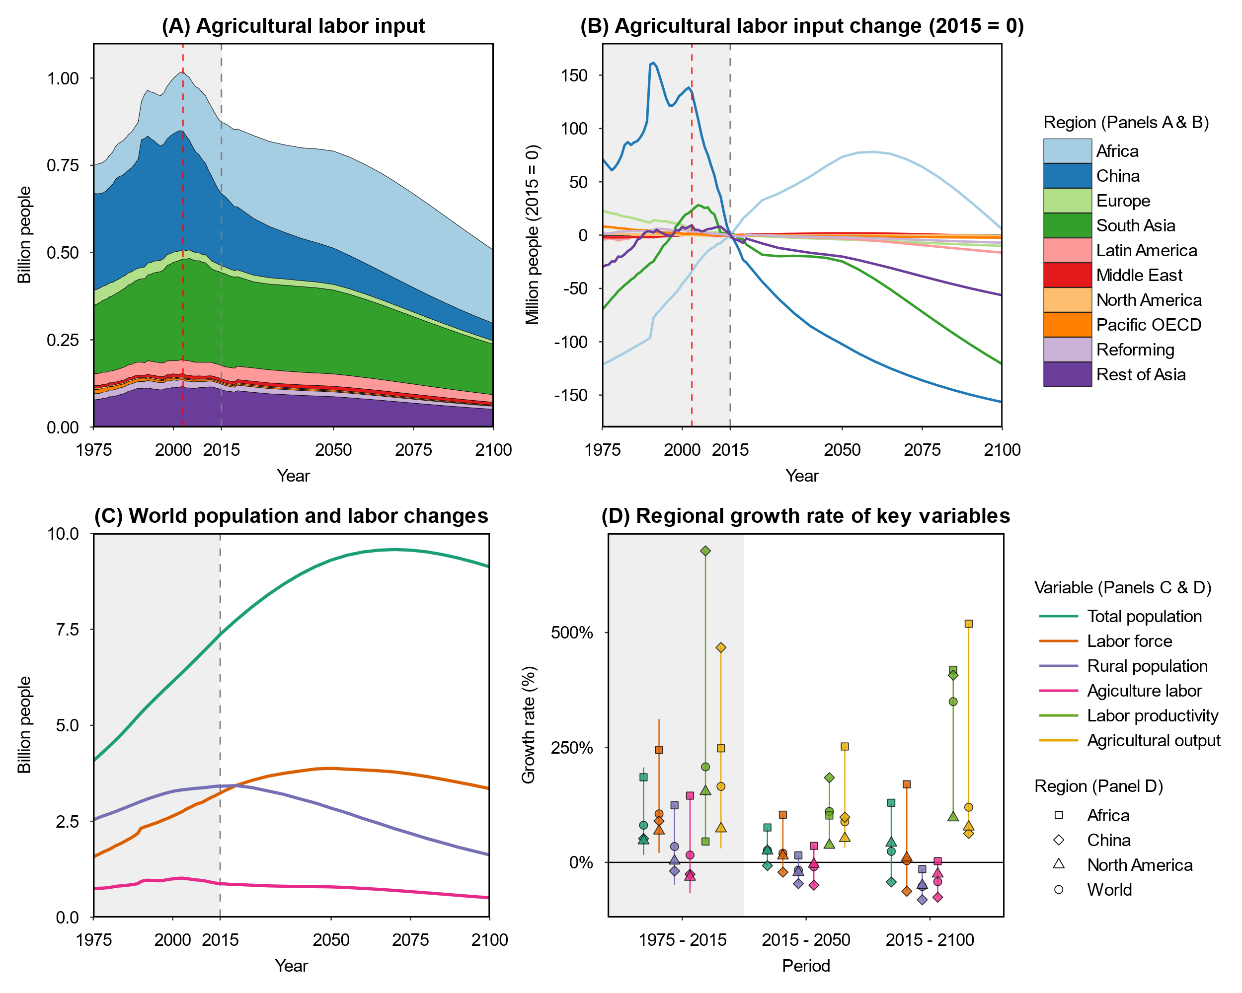
Africa
Europe
North America
Europe
Africa
Latin America
China
Rest of Asia
North America
South Asia
South Asia
Latin America
China
Pacific OECD
Rest of Asia
Ag.
output
Population
Labor
force
Labor force
Rural Population
Agricultural labor
Ag.
Labor

