Slide 1

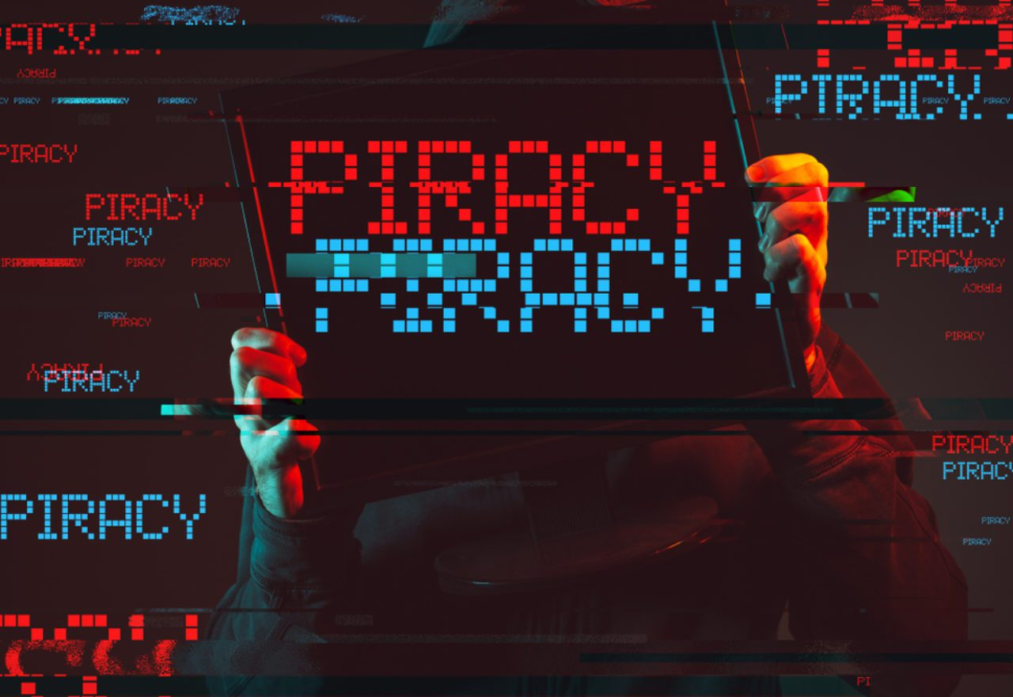
DIGITAL PIRaCY
GROUP 3

Slide 2

What is the definition of digital piracy?
Digital pirates are people who copy digital content that they do not have authorization to use. Copying digital content purchased by a friend, such as music, photographs, videos, movies, games, books, or software. Copying digital content from file sharing services or peer-to-peer networks.
The act of downloading and or sharing copyrighted material and intellectual property without paying for it is known as digital piracy. It is, without a doubt, a criminal act. Federal copyright rules make digital piracy illegal. It can lead to hefty fines and perhaps incarceration.
ALPANTE

Slide 3


The following are examples of common Internet pirate techniques:
Websites that provide software for free download or in return for anything else.
Counterfeit or out-of-channel software is sold on Internet auction sites.
Peer-to-peer networks that allow for the unlicensed distribution of copyrighted software.
CASTRO

Slide 4
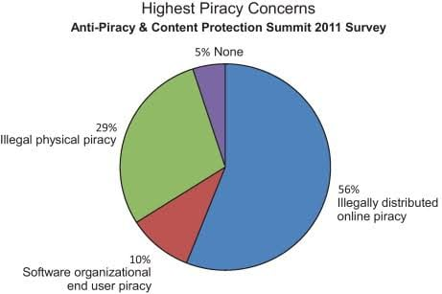
FRANCISCO

Slide 5
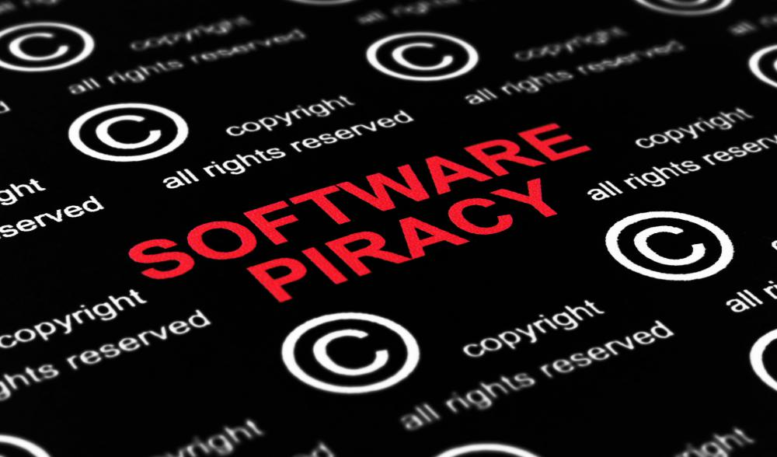
Four Main Types of digital Piracy :
GLIPONEO
Counterfeiting
The unauthorized replication, distribution, and/or sale of copyrighted content with the goal of duplicating the copyrighted product constitutes this sort of piracy. Counterfeit copies of compact discs containing software programs, as well as related packaging, manuals, license agreements, labels, registration cards, and security features, are widespread in the case of packaged software.

Slide 6
2. internet piracy
This happens when you download software from the internet. The same regulations apply to online software purchases as they do to software purchased on a CD.
GUEVARRA

Slide 7
3. Client Server Overuse
When too many users on a network use a central copy of a program at the same time, this sort of piracy happens. If you have a local-area network and want to install apps on the server for several users, make sure your licensing allows it. Overuse occurs when you have more users than the license allows.
MARABE

Slide 8
4. Hard-Disk Loading
This happens when a company sells new computers with unauthorized copies of software loaded into the hard disks to entice customers to buy the equipment.
OPENIO

Slide 9
Putting a stop to digital piracy
1. Get rid of the incentive Taking away the incentive for customers to hunt for stolen content is one of the most effective strategies to combat piracy. Effectively, this is defined as providing a good product and a pleasant user experience at a reasonable price.
REPOTENTE

Slide 10

2. Public Relations & Education
ALPANTE
There are various aspects to this, but the overall purpose is to make the consumer aware that piracy is a crime and must be prosecuted. This is evident to people in the industry; we recently wrote on the problem of password sharing and how up to 48% of US consumers share log-in credentials. This has become a normative crime, meaning that it is something that "everyone" does. As a result, the activity no longer appears to be illegal.

Slide 11

3. Entrance Barriers
CASTRO
You want to make it difficult for pirates, just as you want to make it easy for customers to choose legitimate alternatives. Unprotected information is a thing of the past. What this implies in practice is always evolving. Whereas card-based Conditional Access Systems were formerly the most sophisticated option available to operators, the shift to IP and OTT delivery has prompted a shift to software-based Digital Rights Management. The best practice today entails a multi-disciplinary approach that includes both preventative anti-piracy measures as well as the following two criteria for detection and enforcement.

Slide 12
4. Operations & Technology Monitoring
whether automated or human-led, is critical to success. There are some interesting developments in AI monitoring of video streams, both deployed and under development. In an ideal world, at least for the time being, a hybrid approach would be used. High-level agreements with the search engines and social media platforms that consumers use to find pirated content are essential for quick and real-time action.
FRANSISCO

Slide 13
5. Legal and Enforceability Operators
can identify consumers who are watching illicit streams and incentivise them to switch to lawful services using the right anti-piracy software. These steps range from mild to severe, with the more severe countermeasures involving the deployment of police enforcement. The key is to move quickly. While prosecution is usually a much slower process that occurs after the fact, removing the content from the internet as quickly as possible is the most effective strategy to deter pirates and direct consumers to legitimate alternatives.
GLIPONEO

Slide 14

6. Collaboration
While enterprises at all stages of the broadcast chain are used to competition, the losses caused by content theft are too large not to make strong efforts to collaborate. These must occur at all levels of the industry and at all stages of the production process, from production to on-set content security to transmission. The greater the number of corporations and organizations participating, the more effective the total solution will be.
GUEVARRA

Slide 15
Why Does Digital Piracy Exist?
The most common cause of digital piracy is a refusal to pay. People, understandably, want things for free.
People download illegally in many circumstances owing to financial problems. They simply do not have the financial means to purchase it.
Another typical factor is the notion that businesses already have enough cash. They may believe they have the right to freely distribute to those who are less wealthy and to allow everyone to enjoy or use it. - Some folks do it for the money. Hackers download illegal content with the hopes of reselling it for a profit. Pirated content is used by hackers and social engineers to distribute malware and infect a user's machine.
Some individuals may not consider digital piracy to be theft. They do not regard digital content in the same way that they do physical content.
MARABE

