Slide 1

PILOT PARTNERSHIP DECK
ONE CAMPAIGN
Creator Cash Flow
Brand
Campaign operations for agencies, brands and creators
Agency
Creator
A live product, a focused pilot and a path to trusted campaign reporting
Brief to payment status
September 2026
Notes:
Creator Cash Flow brings the campaign, the people, the proof and the payment status into one shared operating layer. This deck presents the live pilot experience and clearly labels planned capabilities.

Slide 2
02
MARKET CONTEXT
Creator marketing is becoming an operating challenge
$480B
Brand deals account for about 70% of creator revenue in the research cited by Goldman Sachs.
estimated creator economy by 2027
More campaign spend means more briefs, approvals, reporting requests and payment coordination.
$250B estimated in 2023
Source: Goldman Sachs Research, 19 April 2023
Notes:
Goldman Sachs Research estimated that the creator economy could grow from $250 billion in 2023 to $480 billion by 2027. The same article states that brand deals account for about 70% of creator revenue. Source: https://www.goldmansachs.com/insights/articles/the-creator-economy-could-approach-half-a-trillion-dollars-by-2027

Slide 3
03
THE OPERATING PROBLEM
Campaign operations are fragmented
01
02
03
04
Brief
Creator team
Approvals
Proof and payment
Scope and usage rights live in documents
Roster decisions happen in spreadsheets
Feedback moves through chat and email
Performance and invoices arrive later
No participant sees the same campaign state at the same time.
The cost shows up as follow-ups, slow approvals, disputed results and delayed payment decisions.
Notes:
Most teams already have messaging, spreadsheets and analytics. The missing layer is a shared campaign record that connects the work across those tools.

Slide 4

04
THE CCF MODEL
One campaign record with controlled views
Agency
SHARED CAMPAIGN
Creator
Roster, review queue and campaign budget
Brief
Deliverables
Milestones
Payment status
Own fee, tasks, content and invoice
Brand
Campaign spend, approvals and performance
Creator consent limits social data to the campaign. Personal income and unrelated work stay private.
Notes:
Creator Cash Flow gives each participant the information needed for the campaign without opening the creator's full business to an agency or brand. Social account access remains creator controlled. Phyllo currently runs in sandbox validation.

Slide 5
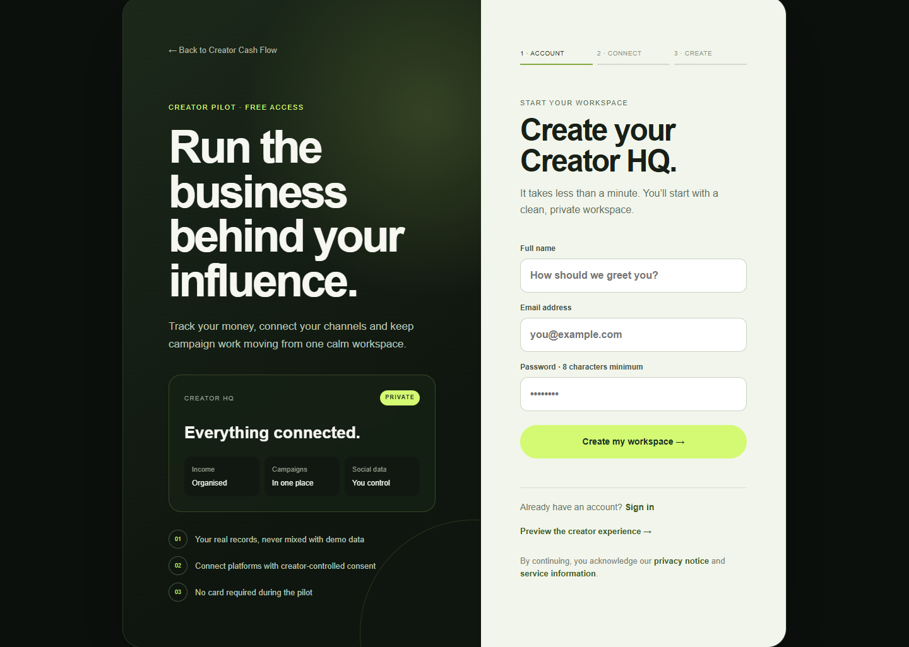
05
PILOT ENTRY
Creators know what they are joining
Creators enter a private workspace with a clear three-step path.
Real account records stay separate from sample campaign data.
The pilot requires no card and keeps social access under creator consent.
Notes:
The onboarding screen sets expectations before registration. Creator accounts are free during the current release. Agency and brand participation is handled through the pilot rather than self-service onboarding.

Slide 6
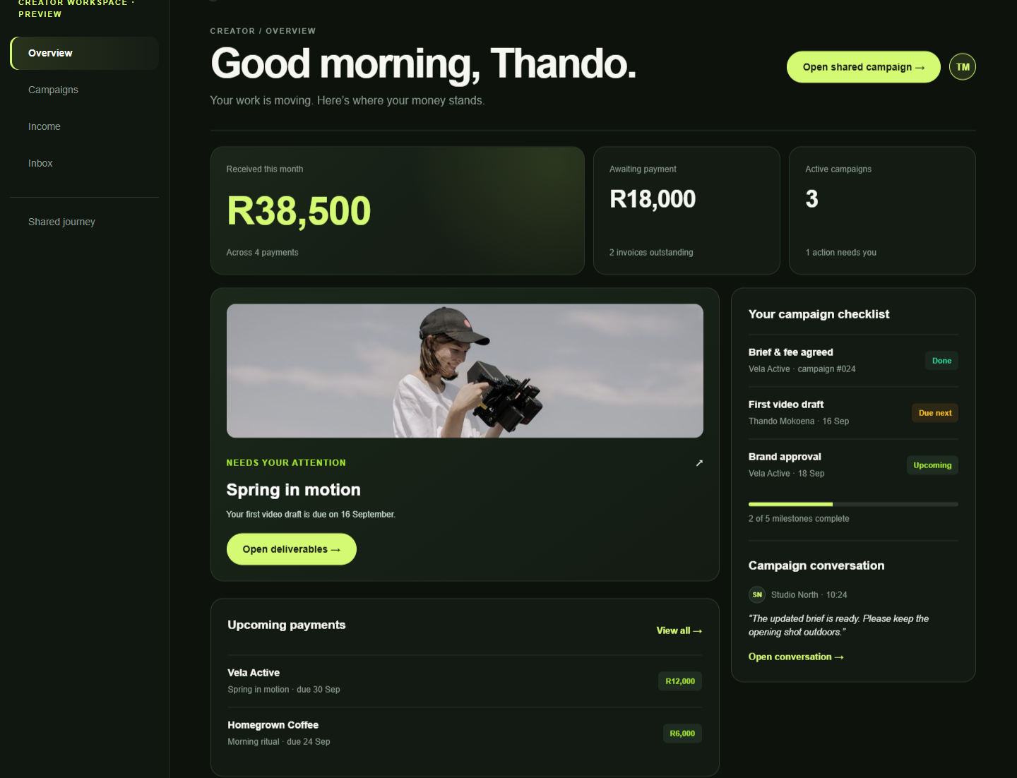
06
CREATOR WORKFLOW
Creators know what needs attention
The creator sees the fee, deliverable deadline, campaign conversation and upcoming payment in one view.
01
Accept the scope with the fee visible
02
Submit work inside the campaign
03
Track approval and invoice status
Notes:
The creator view removes the need to chase context across messages. The demo shows sample data. Live creator accounts currently support authentication and personal transaction records.

Slide 7
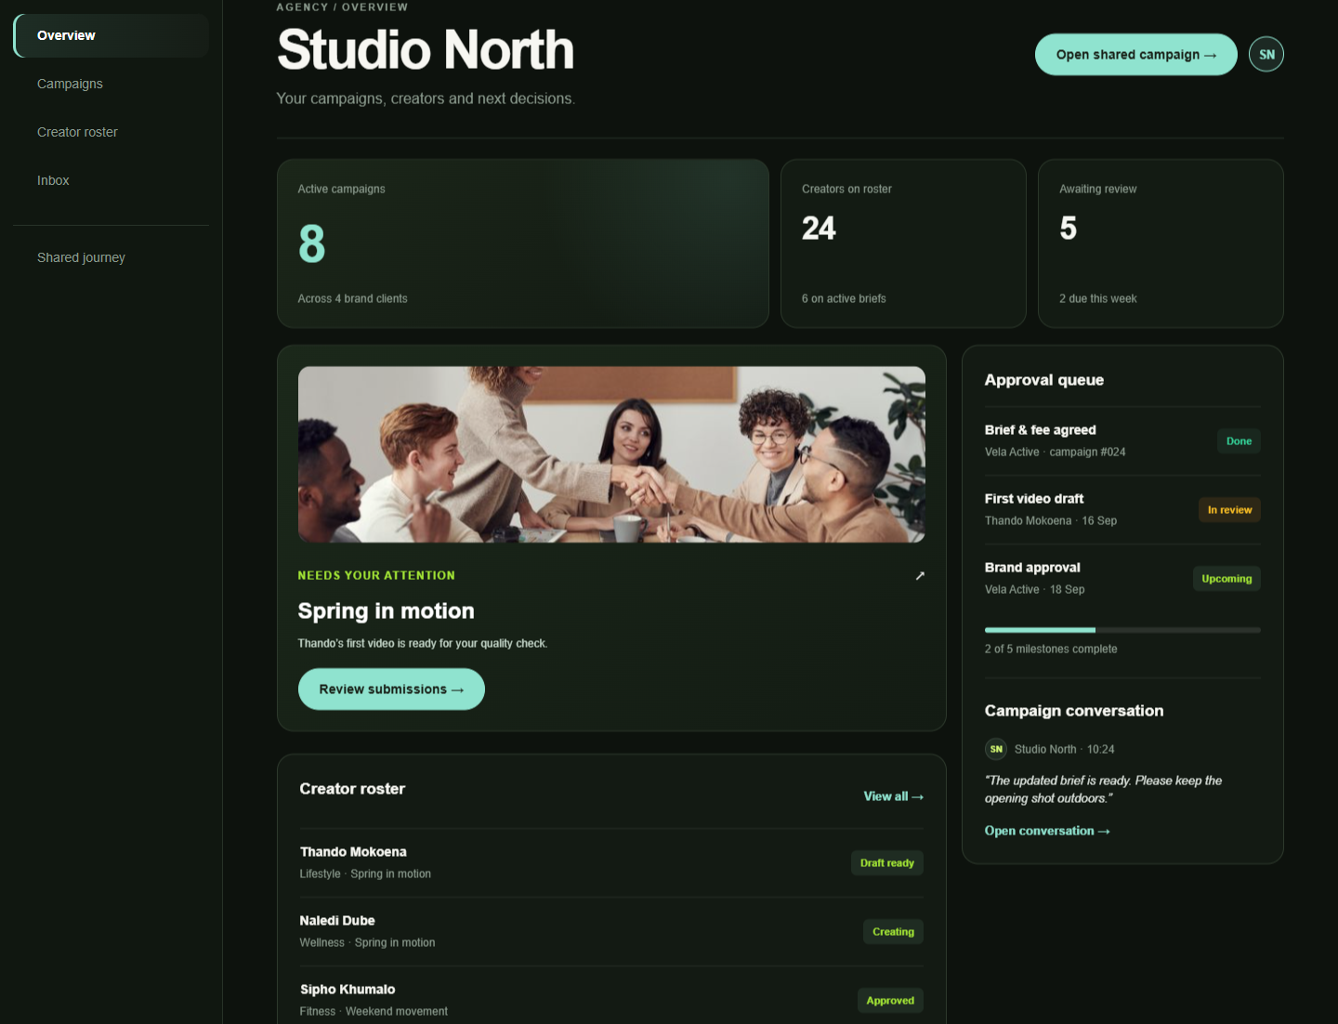
07
AGENCY WORKFLOW
Agencies run the handoffs
The manager sees the active portfolio, roster status and review queue before work reaches the brand.
01
Match creators to the agreed brief
02
Consolidate feedback before brand review
03
Monitor every campaign decision
Notes:
The agency becomes the operational centre of the campaign without owning the creator's private data. Agency access is currently an early access pilot rather than a self-service live account.

Slide 8
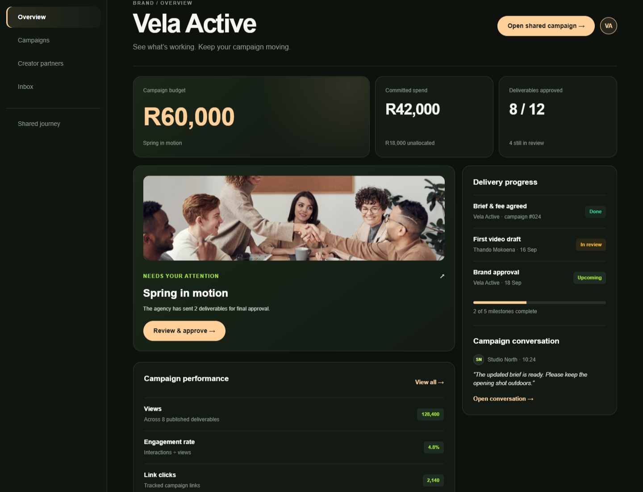
08
BRAND WORKFLOW
Brands see progress without chasing updates
The brand sees committed spend, final approvals and campaign performance inside the same record used by the agency.
01
Approve deliverables against the brief
02
See campaign-scoped performance
03
Confirm milestone and payment decisions
Notes:
The brand sees campaign evidence and approval state without access to a creator's unrelated income or campaigns. Brand access is currently part of the pilot.

Slide 9
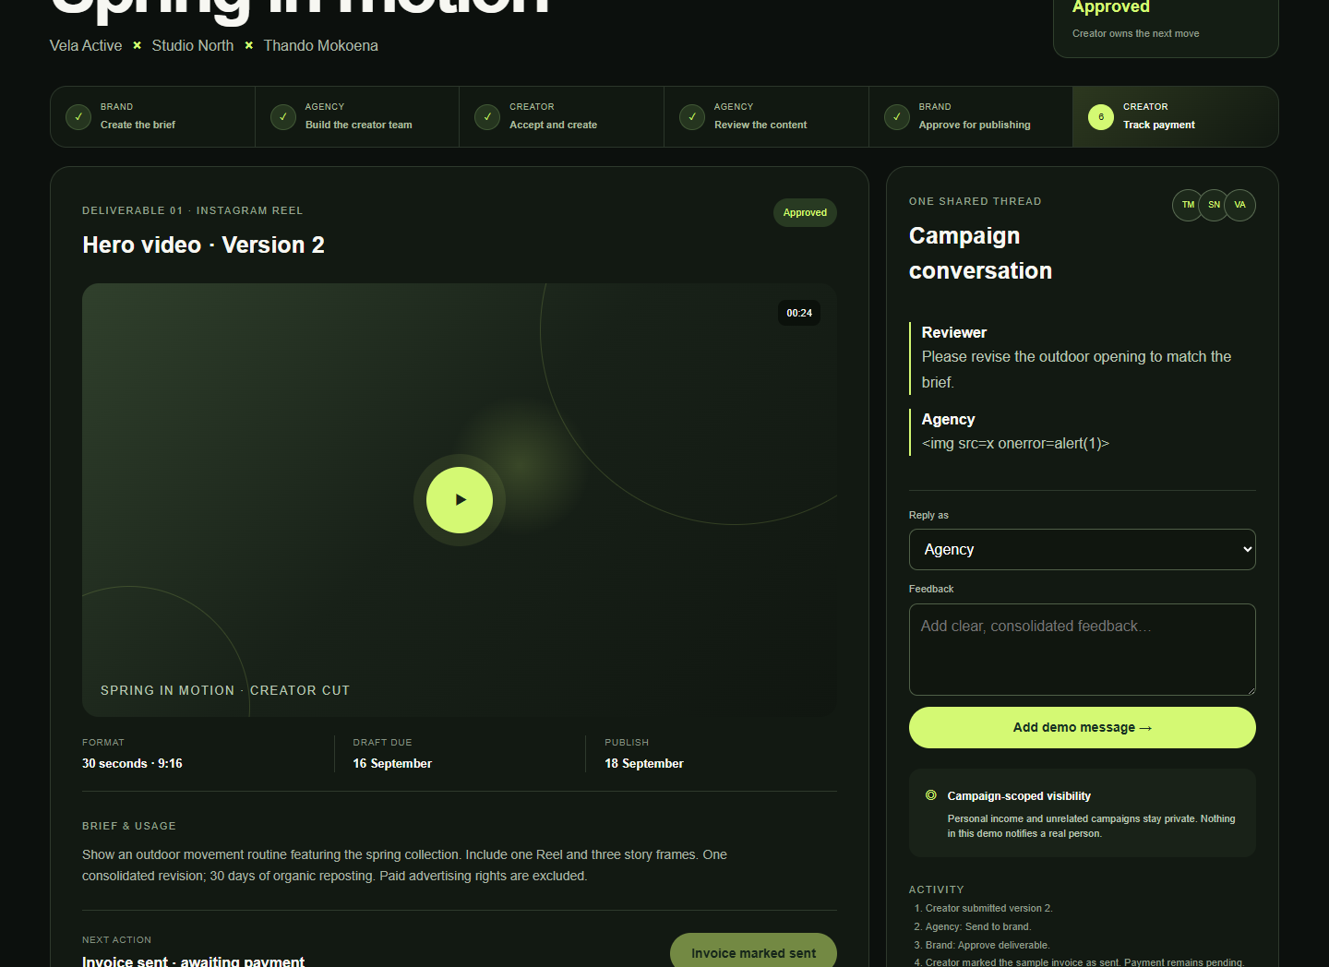
09
SHARED WORKFLOW
One decision trail for every role
Six handoffs connect the brief to payment status. Each role sees the same stage and owns a clear next action.
✓
✓
✓
✓
✓
6
Brief
Team
Create
Agency review
Brand approval
Payment status
The workflow keeps content approval separate from invoice payment.
That distinction gives agencies and brands a reliable decision trail without making financial claims the platform cannot verify.
Notes:
The shared campaign demo is interactive. A user can request a revision, submit a new version, send work to the brand, approve the deliverable and mark the sample invoice as sent. These actions remain in the browser and notify nobody.

Slide 10
10
PLANNED CAPABILITY
Campaign reports generated from the shared record
Illustrative concept for pilot validation
128.4K
illustrative verified views
01
Executive summary for the client
02
Deliverable performance by creator
03
Milestones, approvals and spend
04
Export to PDF and secure share link
Data shown here is illustrative. Report generation is not live in the current pilot.
Notes:
Planned report generation would turn the campaign record into a client-ready report. The example metrics are illustrative. The pilot should validate which report sections agencies and brands need before this feature is built.

Slide 11
11
PROPOSED PILOT
An eight-week test of real campaign operations
Weeks 1–2
Weeks 3–6
Weeks 7–8
Set up
Run the campaign
Review evidence
Choose one agency, one brand campaign and a small creator group.
Use CCF for the brief, assignments, feedback, approvals and milestone status.
Compare turnaround, follow-ups, data trust and reporting needs.
Pilot measures
Approval turnaround
Follow-up volume
Creator adoption
Report usefulness
This is a proposed pilot structure. Scope and success thresholds should be agreed with each partner.
Notes:
The proposed pilot starts narrow so CCF can learn from real campaign behaviour. Success thresholds should be agreed with the pilot agency and brand before launch.

Slide 12
12
COMMERCIAL HYPOTHESES
Revenue follows the teams that coordinate and report
Agency workspace
Brand participation
Premium capabilities
SUBSCRIPTION HYPOTHESIS
CAMPAIGN OR WORKSPACE HYPOTHESIS
EXPANSION HYPOTHESIS
Roster management, campaign workflow and team collaboration.
Approvals, performance visibility and client reporting.
Production data connections, generated reports and deeper financial operations.
Capital priorities
Phyllo production access
Security and privacy review
Reporting and exports
Pilot onboarding
Pricing and funding requirements remain hypotheses until the pilot produces usage and cost evidence.
Notes:
CCF has not set public agency or brand pricing. The pilot should test willingness to pay and identify the buyer. Capital would fund production social-data access, security and privacy work, report generation and operational onboarding.

Slide 13
PARTNERSHIP ASK
Help us prove the operating layer for creator campaigns
CURRENT STATUS
Creator accounts live
Multi-role pilot demo live
Phyllo sandbox configured
Agency partners
Run a live campaign and shape the manager workflow.
Brand partners
Test approvals, evidence and reporting access.
Capital partners
Fund the move from validated pilot to production infrastructure.
reamogetswemolefe@creatorcashflow.co.za
creator-cash-flow-ccf.onrender.com
Notes:
The immediate ask is for an agency willing to run a real pilot, a brand willing to use the campaign view and capital partners who understand the infrastructure needed to move from sandbox validation to production.

