Slide 1






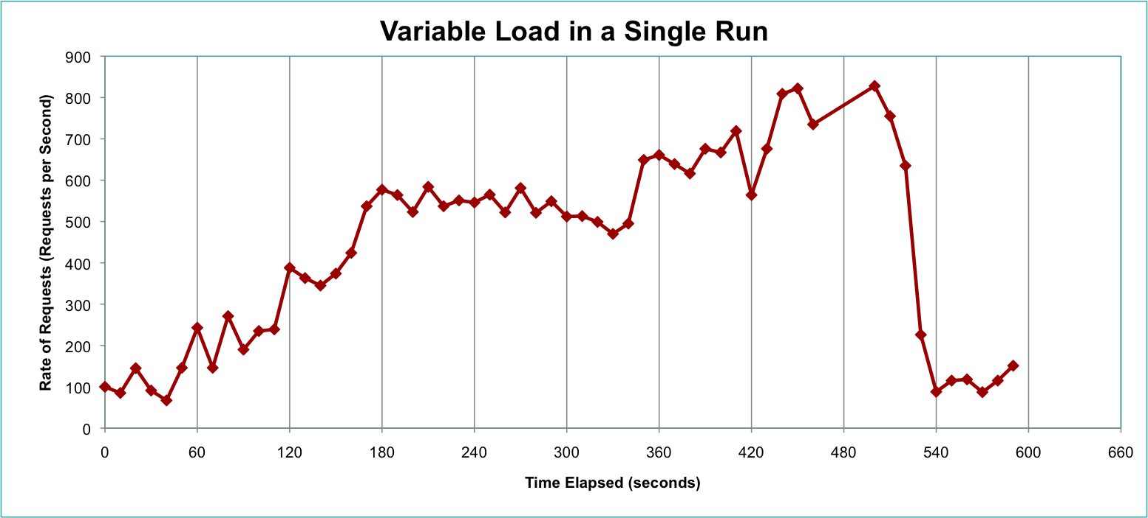


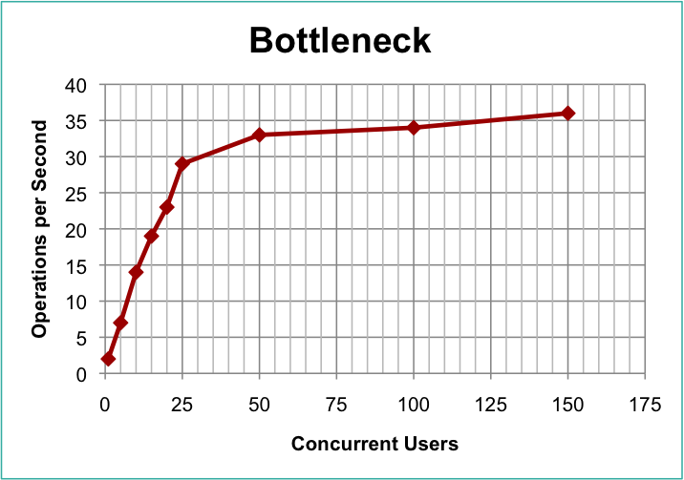
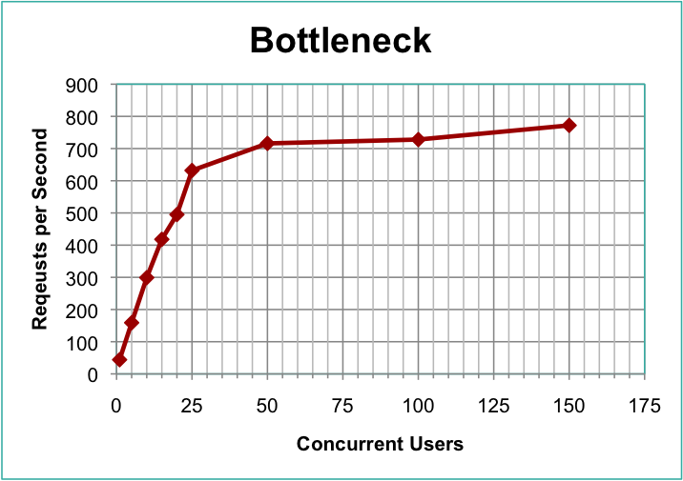
A Sophisticated Workload Generation Toolkit for Cloud Computing Applications
Aaron Beitch, Timothy Yung, Rean Griffith
Rain
Overview of workload generation
Managing workload variations is key to dynamic resource allocation in the Cloud.
We identify three classes of workload variation:
Load Amount (e.g. diurnal patterns, ramps, etc.)
Operation Mix (e.g. changes in feature-popularity or transitions between read- and write-heaviness)
Data popularity (e.g. hotspots)
Optimized dynamic resource allocation requires:
Scaling up/down to meet changes in load and avoid SLA penalties.
Reducing power consumption and costs.
Consolidating work to improve cluster utilization.
Benchmark architectural diagram
Preliminary Results
Implemented Rain prototype
~1813 lines of Java code
Created Cloudstone Workload Generator
Ported Olio UI Driver previously used in Faban
~2841 lines of Java code
Shared
Thread Pool
Dedicated
Load Threads
Asynchronous
Requests
Partly Open Loop
Load Generation
Synchronous
Requests
Scoreboard
Abstract Scenario
Abstract Generator
Abs. Generator
CloudstoneGenerator
Abs. Operation
CloudstoneOperation
HomePageOperation
LoginOperation
TagSearchOperation
EventDetailOperation
PersonDetailOperation
AddPersonOperation
AddEventOperation
Abstract Scenario
Load Profile
[ interval, # users, mix matrix, … ]
Load Scheduler
Rain workload generation toolkit
Rain is a statistics-based workload generation toolkit that uses parameterized and empirical distributions to model the different classes of workload variations.
*Olio is a Web 2.0 social-events application. The implementation used here is written in Ruby.
APIs of core classes
Experiments and results
Cluster Configuration (Amazon EC2):
1 Rails (c1.xlarge), 1 MySQL (c1.xlarge), 1 Rain (c1.xlarge)
1 Nginx/HAProxy (m1.small)
1 – 150 Users, Maximum Load (0 Think Time)
Scenario
getRampUp() getDuration() getRampDown()
getMaxUsers() getOpenLoopProbablity()
getCurrentLoadProfile()
User Threads
Request
Cloud Application
Generator
nextOperation(lastOp)
getThinkTime()
getCycleTime()
Used to initialize…
150
1 User Thread
5 User Threads
15 User Threads
Operation
prepare()
execute()
cleanup()
dumpTrace()
10 User Threads
20 User Threads
1 User Thread
25 User Threads
100 User Threads
Response
50 User Threads
Creates…
Problems with existing tools
Current workload generation tools fall short of allowing application developers to explore how these workload variations affect their systems and how they can improve their system’s reactions.
Features and design decisions
Modular design of the harness
  Generators can easily use parameterized or empirical probability distributions to characterize different variations in load
Supports closed, open, and partly open loop workload generation
  Separation of request generation and execution
  Use of the Command pattern to implement Operations (GoF)
≡
 | TPC-W | Rubis | Faban (1.0) | Rain
Variable load | No | No | Yes | Yes
Variable mix | No | No | No | Yes
Variable data | No | No | No | Yes
Future Work
Find traces to characterize interesting load variations.
Generate foreground and background workloads.
A Webrat-like library to create new workloads.
Integrate with SCADS and MapReduce request generators.

