Slide 1
IS 107
Applying DAX Fundamentals in Power BI
From Measures to Contextual Analysis
Rean Jay M. Camblinda

Slide 2
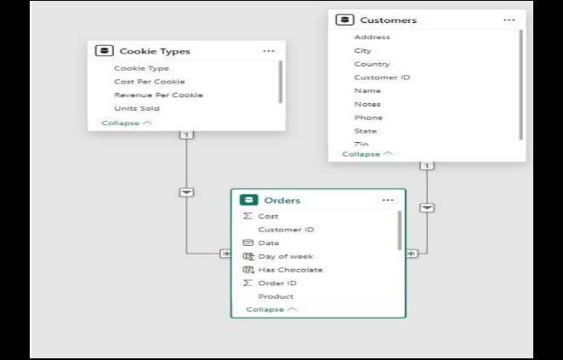
Data Model Structure
Customers Table
Customer ID, Name, Address/State, Phone, Zip, Notes
Orders Table
Order ID, Customer ID, Product, Units Sold, Date, Revenue, Cost, Profit, Day of week
Cookie Types Table
Cookie Type, Units Sold, Revenue Per Cookie, Cost Per Cookie, Has Chocolate
Relationships enable cross-table DAX measures and RELATED() lookups

Slide 3
How Does DAX Differ from Excel Formulas?
Key Difference: While Excel calculates a cell value, DAX calculates a context-aware result
Excel formulas are static — they compute one cell at a time and don't travel across related tables
DAX is a formula language built for relational data models
DAX understands table relationships and automatically aggregates across millions of rows
DAX reevaluates the moment a filter or slicer changes — something a plain Excel SUM formula simply cannot do

Slide 4
Why Do We Need DAX?
The Core Function: DAX bridges that gap by letting us define reusable logic (Measures) that respond to every visual and filter on the canvas.
Raw numbers alone can't answer questions like 'What is my profit margin per cookie type for orders above 500 units?'
The gap DAX fills is dynamic aggregation with context
The data in the Orders table is flat — it has Revenue and Cost per row, but no formula tells Power BI how to sum, filter, or relate them
Enables business intelligence that adapts to user interactions in real-time

Slide 5
Calculated Columns vs Measures
Aspect
Calculated Column
Measure
Storage
Stored in the model — increases .pbix file size
Computed on the fly — no extra storage
Evaluation
Row-by-row at refresh time
Evaluated per visual/filter context
Best for
Row-level flags (e.g. Has Chocolate)
Aggregations (Sum, Count, %)
Example
Day of week, Has Chocolate column
Total Profit, Count of orders, Profit Margin %
Key Insight: Measures are memory-efficient and dynamically responsive to filters

Slide 6
Filter Context in Action
700 Total Orders → 206 ACME Bites
With no filter active, 'Count of orders' shows 700 (total)
Clicking a customer row — say ACME Bites — narrows the filter context
The measure instantly returns 206 orders for that customer
DAX's CALCULATE function re-evaluates the measure inside a modified filter context
Makes every card, chart, and table automatically reactive to slicers and cross-highlights
This dynamic behavior is what makes Power BI dashboards interactive and powerful

Slide 7
Understanding the RELATED Function
Cookie Types (1)
RELATED is the bridge between tables
|
* (Many)
When building the 'Has Chocolate' calculated column inside Orders, it looks up whether the product belongs to a chocolate category in Cookie Types
Orders
RELATED follows the established relationship to fetch a value from the related table
In this model: Cookie Types (1) -> Orders (*) via Product enables this lookup
Critical Requirement: A model relationship must exist before RELATED() can be used

Slide 8
Anatomy of a DAX Measure
Total Sales = SUM( Sales[Sales Amount] )
Measure Name
Function
Table
Column
Total Sales
SUM()
Sales
[Sales Amount]
Descriptive, unique identifier for the KPI.
DAX aggregation function; iterates every row in scope.
Explicitly scopes the column lookup to avoid ambiguity.
The specific field being aggregated.
Best Practice: Always prefix with the table name (Table[Column]) so DAX can resolve columns unambiguously across multiple tables — especially critical in a 3-table model like ours.

Slide 9
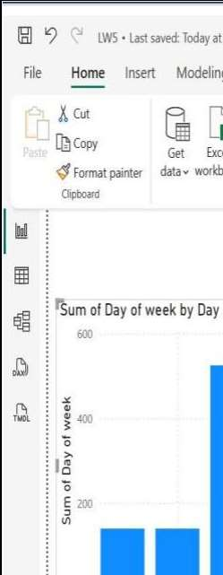
Advanced Filtering Results
Total Profit (Card)
$2,717,064.38
Revenue - Cost = Profit across all customers & all cookie types
Choc Chip Orders > 500 units
185
DAX CALCULATE used with FILTER condition: Units Sold > 500 on Chocolate Chip rows
Distinct Customers / Profit
5 total
Each customer: 1 unique buyer. Total Profit: $2,717,070.50

Slide 10
Negative Total Profit Analysis
Does a negative Total Profit mean the DAX formula is broken?
Verification Steps:
1. Cross-check Revenue and Cost columns in the raw Orders table for that category
NO
2. Confirm the Profit calculated column formula is correct: Profit = Revenue - Cost
A negative Total Profit figure does NOT mean the DAX formula is broken. It means the formula is working exactly as designed — it's telling you that for that specific category, costs exceeded revenue.
3. Check if there are data-entry errors (e.g. reversed Revenue/Cost values)
The data is the problem, not the logic.
In our results: All profits were positive. Total Profit 2 = $2,717,064.38

Slide 11
Profit Margin % Efficiency
Which is more efficient for Profit Margin % — Calculated Column or Measure?
A single Measure is far more efficient
Why Calculated Column is Inefficient:
Why Measure is Superior:
Would compute and store a value for every one of the 700 rows in Orders table
Profit Margin % = DIVIDE(SUM(Orders[Profit]), SUM(Orders[Revenue]))
Bloats file size and recalculates at every model refresh
Computes nothing until a visual requests it
Requires rebuilding entirely if sliced by new dimensions
Outputs only aggregated results
Adapts to filter contexts automatically
Memory-efficient and dynamically correct
If you slice by Cookie Type, the measure automatically reevaluates for just that subset, while a calculated column would require rebuilding entirely.

Slide 12
Key Takeaways
1. Context-Awareness
2. Storage Efficiency
DAX operates on relational models with context-awareness — not just static cell math
Calculated Columns store row-level data and grow the file; Measures are on-demand and storage-lean
3. Dynamic Filtering
4. Table Relationships
Filter Context is what makes a Measure dynamic — the same formula yields different results per visual
RELATED() requires established model relationships to bridge tables in column formulas
5. Best Practices
6. Data Validation
Profit Margin % is best built as a Measure for efficiency and dynamic filtering
Unexpected results (negatives) indicate business data issues — not broken DAX logic

Slide 13
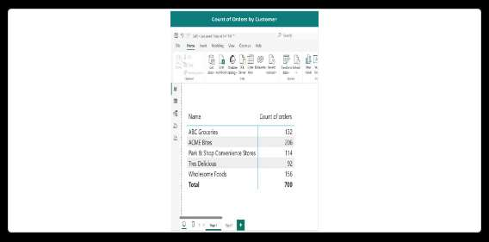
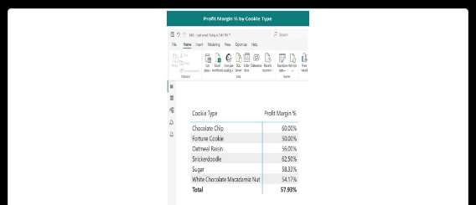
Appendix: Dashboard Visuals Part 1
Units Sold by Customer Visualization
Count of Orders by Customer Visualization

Slide 14
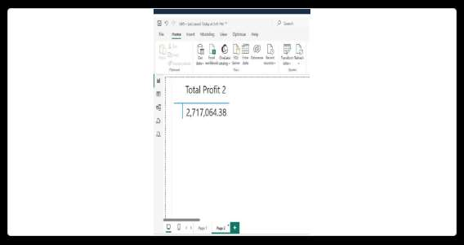
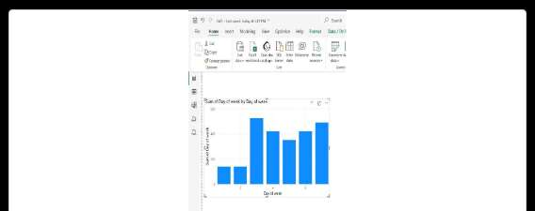
Appendix: Dashboard Visuals Part 2
Distinct Customers & Profit Metrics
Total Profit Card Visual

Slide 15
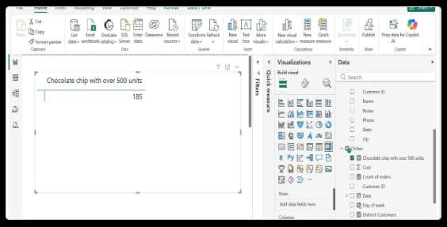
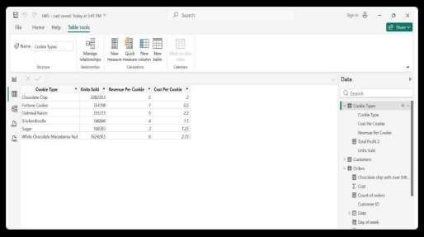
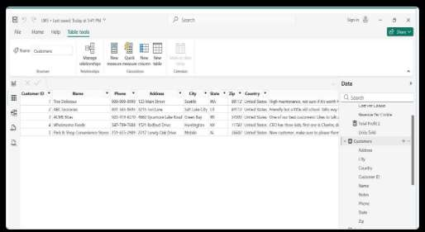
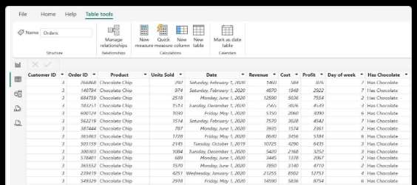
Appendix: Power BI Screenshots
Chocolate Chip Orders > 500 Units Filter
Power BI Interface Views
Orders Table (700 rows)

Slide 16
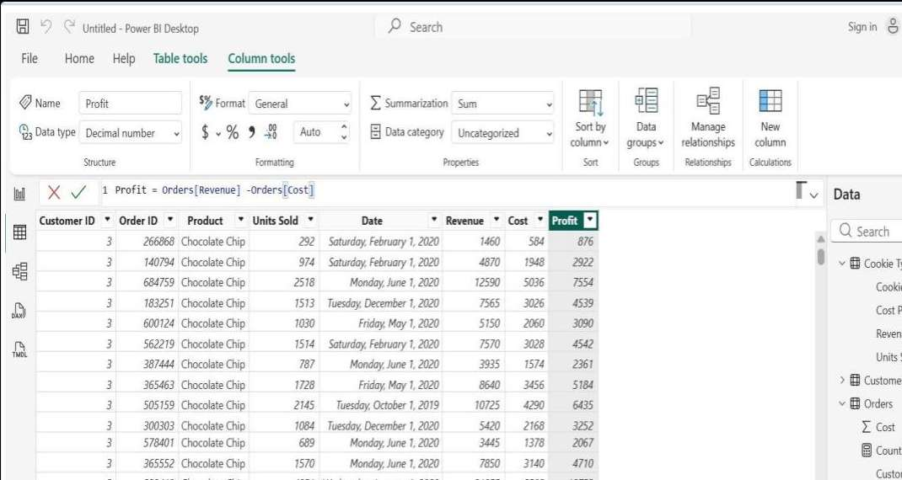
DAX Formulas: Calculated Columns
Profit Column:
Profit = Orders[Revenue] - Orders[Cost]
Result: 657 distinct values, Decimal number

Slide 17
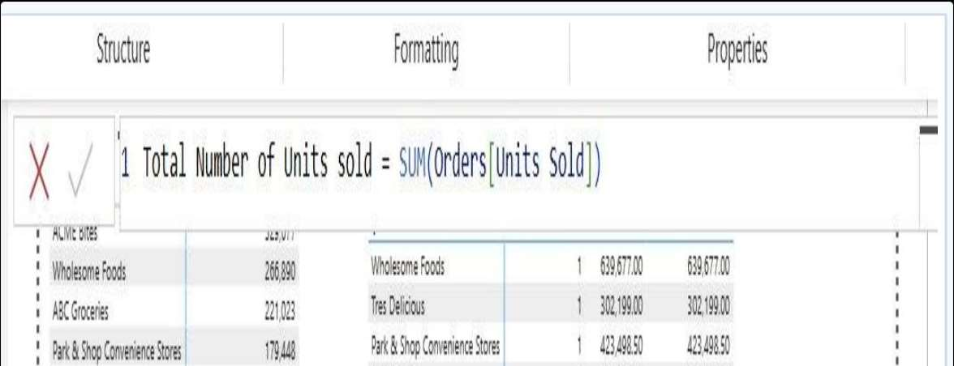
DAX Formulas: Measures
Total Number of Units Sold:
Total Number of Units Sold = SUM(Orders[Units Sold])
Result: 1,125,806 total units

Slide 18
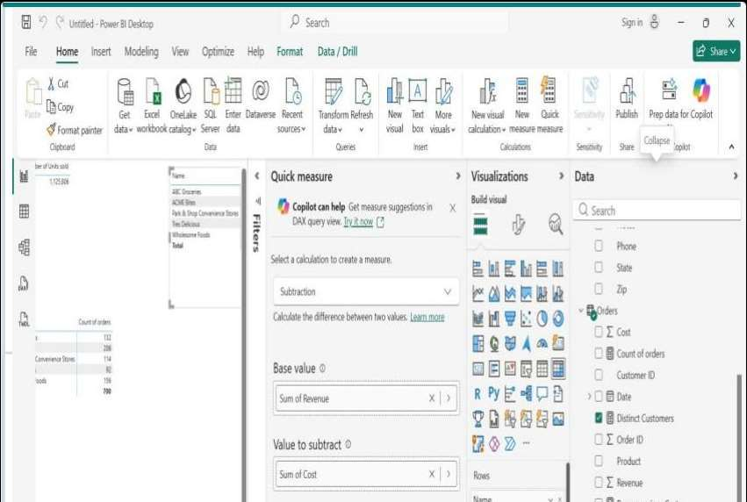
DAX Formulas: Advanced Measures
Total Profit 2 (SUMX):
Total Profit 2 = SUMX('Cookie Types', 'Cookie Types'[Units Sold] * ('Cookie Types'[Revenue Per Cookie] - 'Cookie Types'[Cost Per Cookie]))
Iterates Cookie Types table. SUMX is needed because row-level math must happen before aggregation.

Slide 19
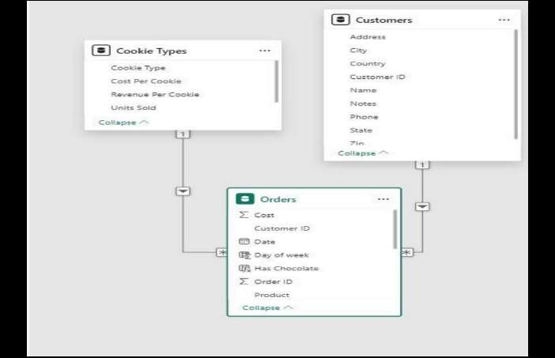
Data Model Relationships
Relationship Structure
The model establishes two 1-to-many relationships:
Cookie Types (1) -> Orders (*) via Product field
Customers (1) -> Orders (*) via Customer ID field
Why Relationships Matter
Enable RELATED() lookups in calculated columns
Allow cross-table DAX measures to aggregate correctly
Provide automatic filter propagation across tables
Create the foundation for context-aware calculations

