Slide 1
PUBG
Analysis
NAIQING CAI
YUCHEN ZENG
HAO PAN
QINTAO YING

Slide 2
Our Goal
1. Provide some advice to players to gain a higher rank
2. Try to detect some cheaters

Slide 3
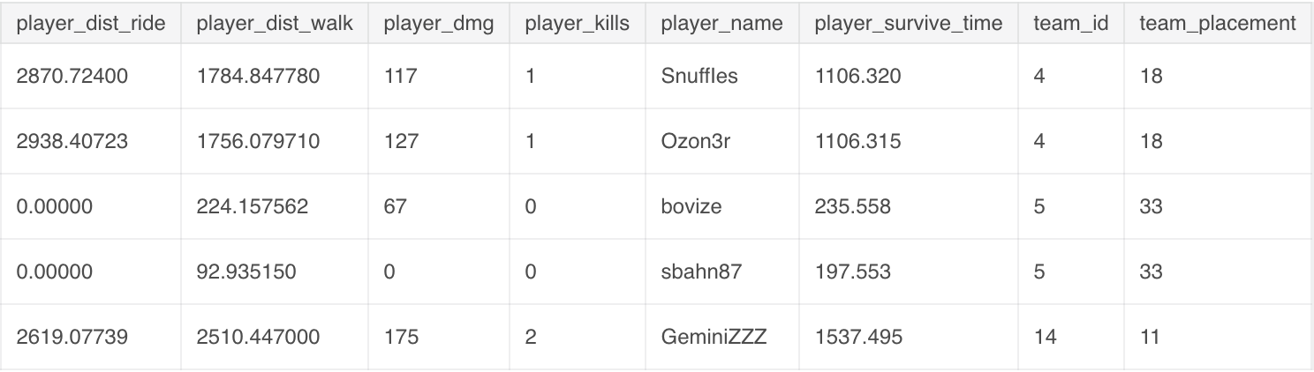
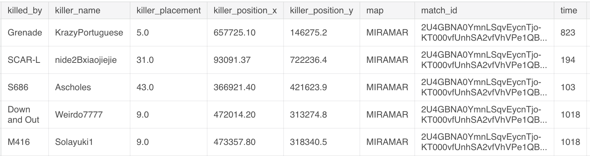
Dataset
Aggregate
Deaths

Slide 4
Death part

Slide 5
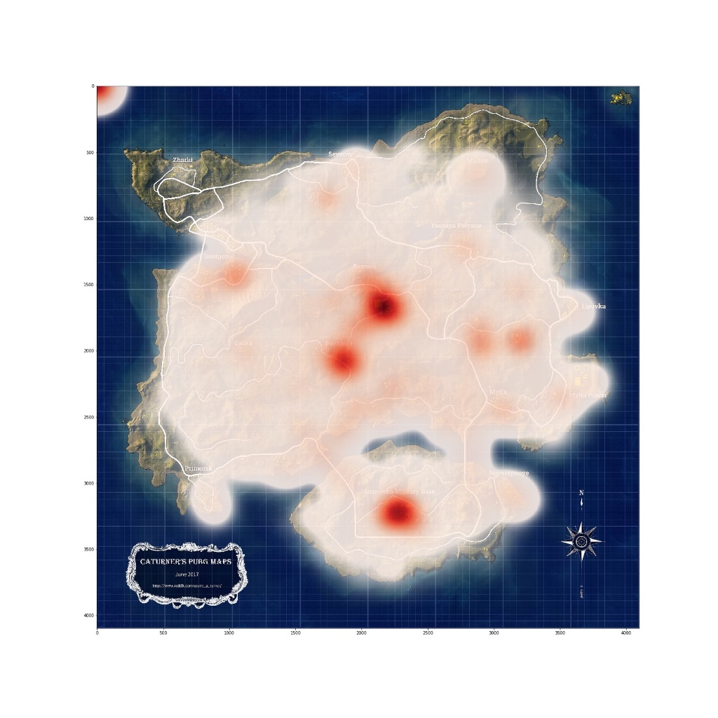
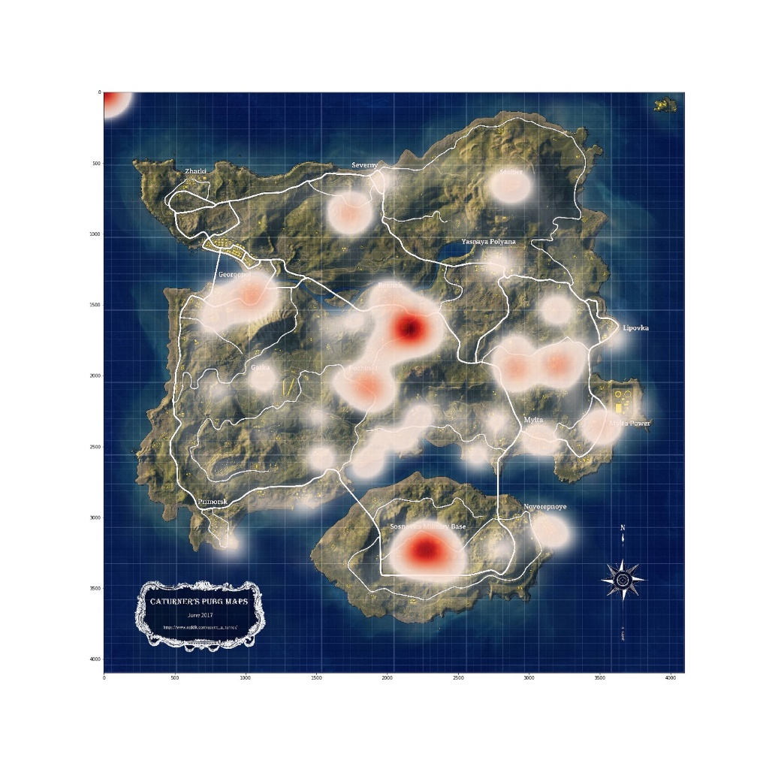
Death Place (Erangel)
Entire match
Four minutes

Slide 6
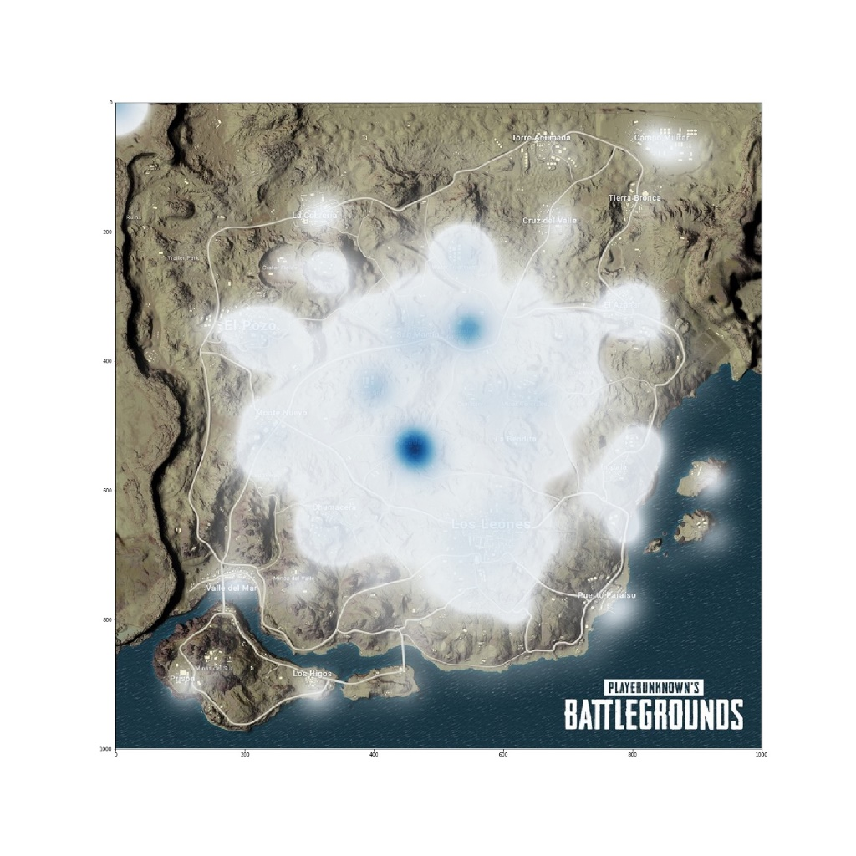
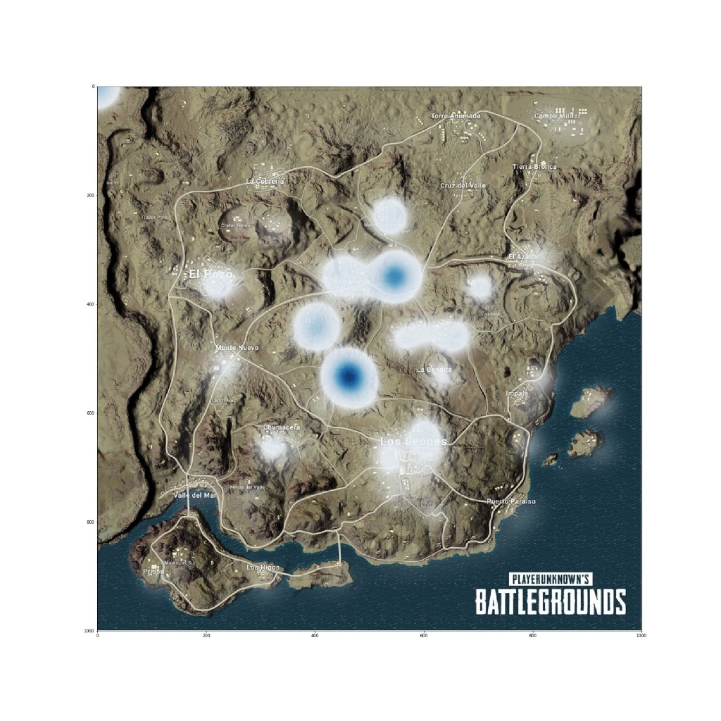
Death Place (Miramar)
Entire match
Four minutes

Slide 7
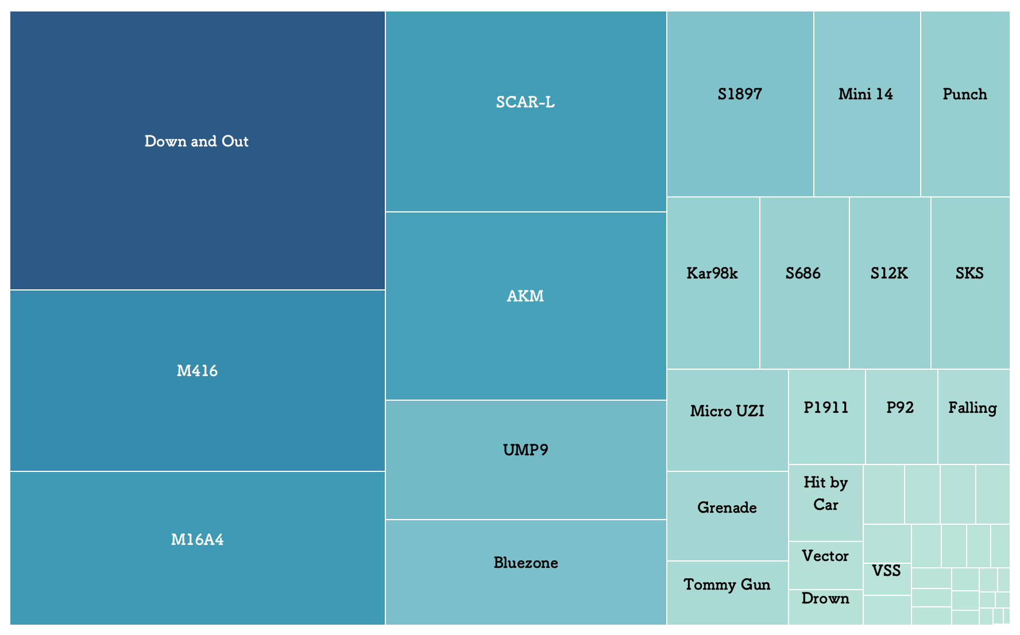
Death Reasons

Slide 8
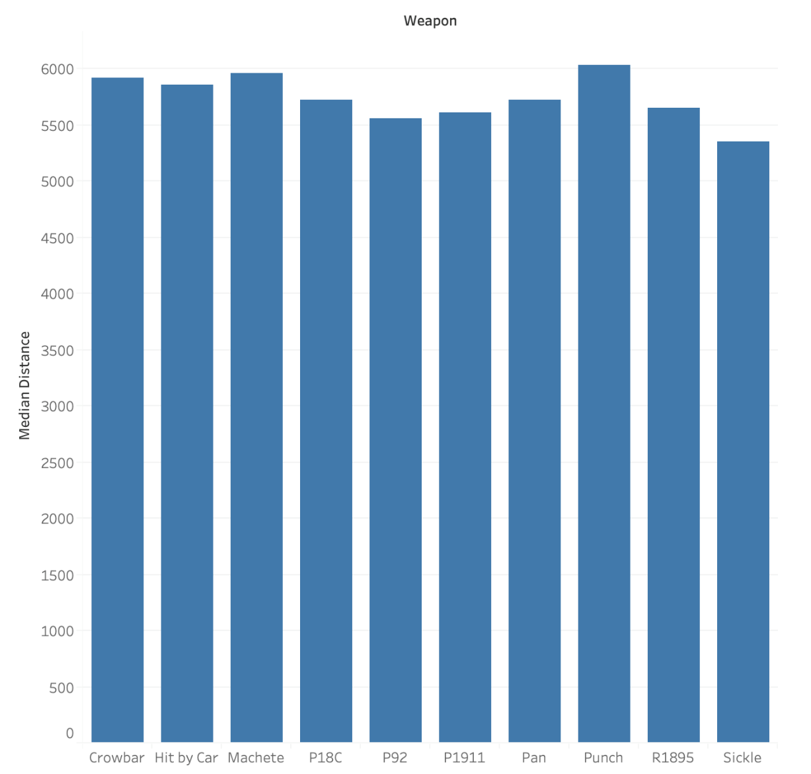
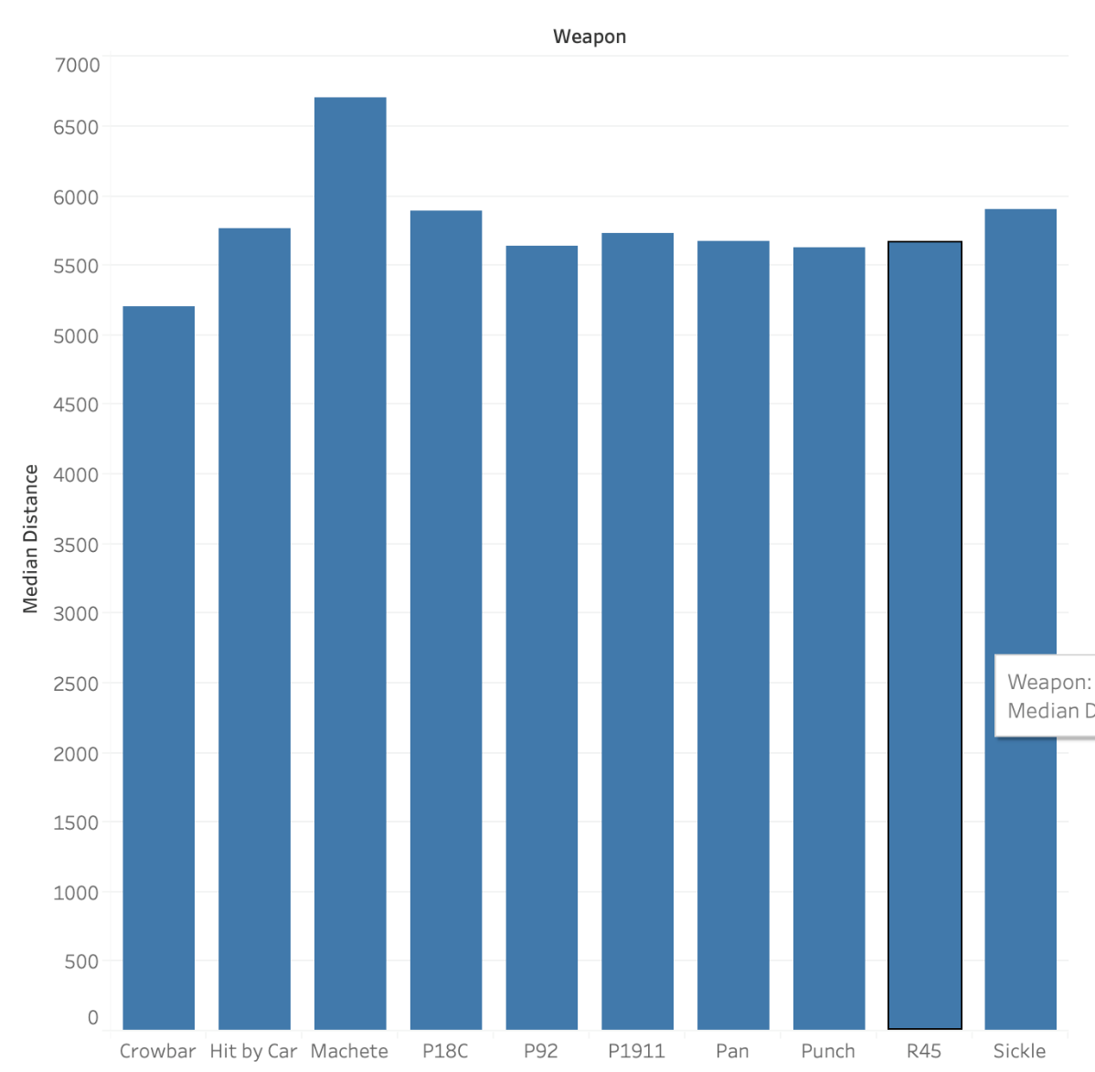
Mostly Used Weapons by Cheaters
Erangel
Miramar

Slide 9
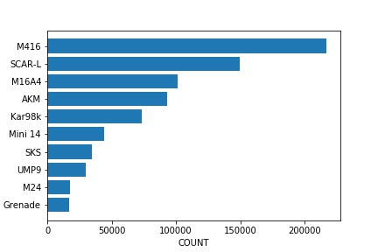
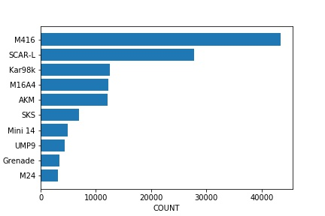
Top 10 Weapons
Erangel
Miramar

Slide 10
Aggregate part

Slide 11
Data Preprocessing
SMOTEEN
Too many classes?
1st, 2nd-10th, 11th-
Imbalanced?
Balanced data with 3 classes
Divide into 3 categories
Done

Slide 12
Aggregate——Prediction
 |  | Random Forest | KNN | Adaboost | Logistic Regression
party size 1 | Training | 97% | 98% | 100% | 77%
 | Testing | 97% | 97% | 96% | 77%
party size 2 | Training | 94% | 97% | 97% | 70%
 | Testing | 94% | 95% | 90% | 70%
party size 4 | Training | 92% | 96% | 98% | 75%
 | Testing | 93% | 93% | 90% | 75%

Slide 13
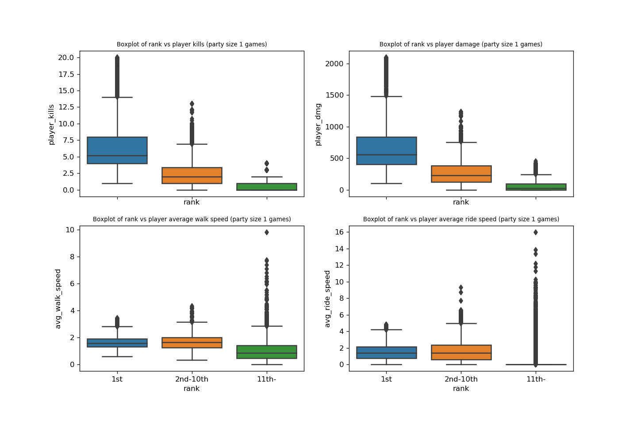
Aggregate——Party Size 1

Slide 14
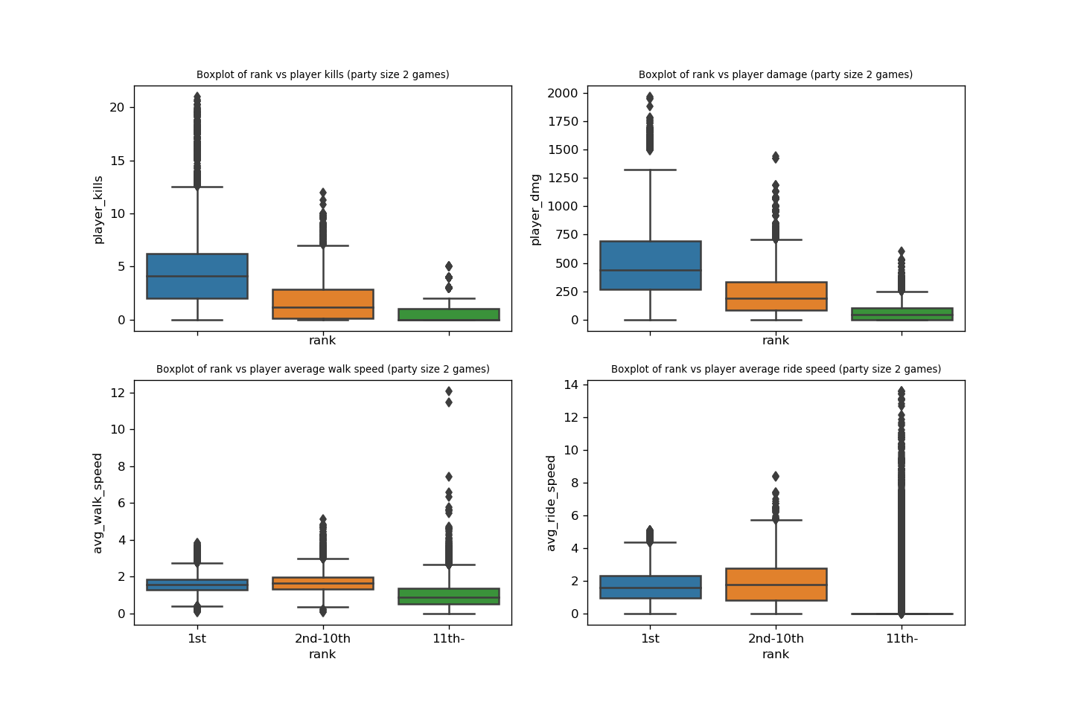
Aggregate——Party Size 2

Slide 15
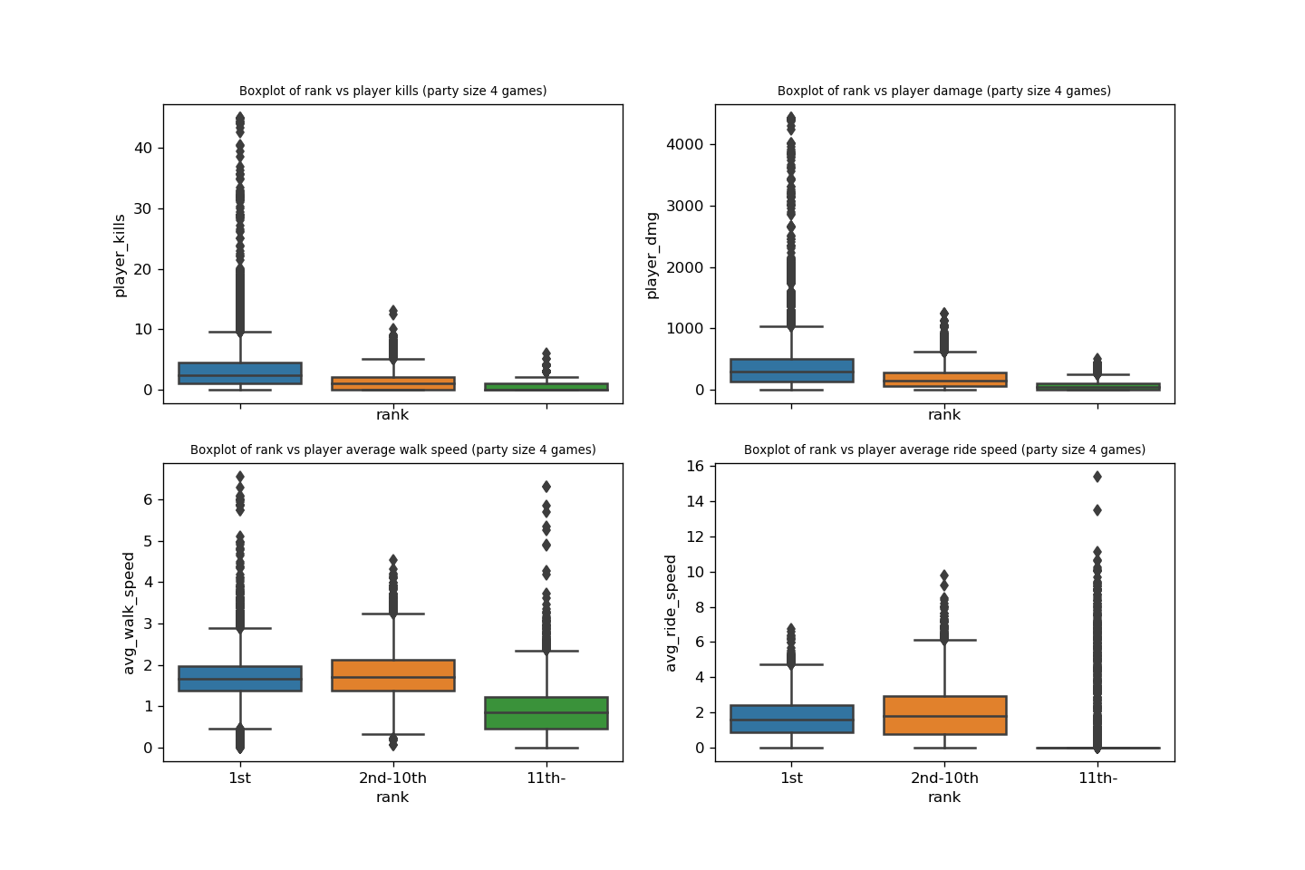
Aggregate——Party Size 4

Slide 16
Strategy Analysis
1
The most popular weapons are M416, followed by SCAR-L. And the best sniper is Kar98K
2
Perhaps you can avoid those areas that have high death rate in the first four minutes.
3
Kill more players, cause more damage, walk and drive faster

Slide 17
Specific Suggestion
1
It is player kills and player damage that count.
2
Average driving speed and player damage are most important.
3
Focus more on two average moving speed.

Slide 18
Thanks !

