Slide 1

relax-and-recover.org
Relax and Recover
(ReaR) Workshop
© 2016 Gratien D’haese, IT3 Consultants
© 2017 Schlomo Schapiro
This work is licensed under a
Creative Commons Attribution-ShareAlike 4.0 International License

Slide 2
Agenda
Introduction and Basics
Lab 1:
  Basic Usage
  Automated Disaster Recovery
Secure Disaster Recovery & Advanced Usage Scenarios
Architecture and Development
Lab 2:
  Debugging ReaR Issues
  Extending ReaR with Custom Code
  Contributing to ReaR
  Advanced Usage Example

Slide 3
Introduction and Basics

Slide 4
Ask Yourself: Mean Time to Restore Service
After deploying a bad software update or configuration?
After upgrading the Operating System to a faulty version?
  On 50 servers? On 500 servers?
After deleting the hard disk / SAN LUN of your main database?
  After deleting 20 LUNs?
After deleting the hard disk / SAN LUN of a Hypervisor?
  All the LUNs of a virtualization cluster?
After flooding the data center?

Slide 5

Business Continuity
Prevention
Risk Management
ReaR
Recovery
Recovery Plan
Rehearse,
maintain
and review
Preparedness
Business Impact
Analysis
Response
Incident Response
Notes:
Example for Business Impact Analysis:
https://www.heinlein-support.de/web/akademie/slac-2009/slac09-business-continuity-mal-ganz-pragmatisch/

Slide 6
Scope
Data Center
Data Center
Hypervisor
Hypervisor
Server
Server
Server
App
App
App
Server
Server
Server
Server

Slide 7
Scope of Relax and Recover
Data Center
Data Center
Hypervisor
Hypervisor
Server
Server
Server
App
App
App
Server
Server
Server
Server

Slide 8
Understanding Change Frequencies
Constantly changing
Very high cost per
time lost
Server
Configuration
OS
App
Regularly changing
OS
Files
App
Data
Seldomly changing
ReaR

Slide 9
Use the Best Tool for the Restore Job
Configuration
Management
or ReaR
Server
Software
Management
or ReaR
Configuration
OS
App
Provisioning
Automation
or ReaR
Specialized
Backup
Tooling
OS
Files
App
Data

Slide 10
Manual → Automated
Backup → Restore → Recovery
Relax and Recover

Slide 11
Why are backups not enough?
Backups of data are necessary!
Are not enough in case of losing the complete Operating System (OS)!
Reinstalling the OS from scratch takes hours
Restoring the backups a few more hours
Fine-tuning of configurations takes days
Even months later issues pop up!
It is absolute necessary to foresee an inventory of hard- and software

Slide 12
Disaster Recovery Plan (DRP)
DRP addresses need to recover from an emergency with minimum impact to the enterprise
Protects enterprise from major services failure
Minimizes risk to enterprise from delays in providing services
Guarantees reliability of standby systems by testing and simulation
Minimizes personnel decision-making required during disaster recovery

Slide 13
Relax and Recover as DR solution
Rear is a tool that implements a DR work-flow for Linux
Basically meaning:
  Modular framework written in Bash
  Easy to extend to own needs
  Easy to deploy (set up and forget)
  Integration for various Linux technologies
  Integration with various back-up solutions
  Attempts to make system recovery as easy as possible
Rear runs on-line (no downtime to create a DR image)

Slide 14
Introduction to Relax and Recover (rear)
Proven solution at large enterprise customers
Rear established as standard solution for Linux disaster recovery in data centers
Shipping with Fedora, openSUSE and RHEL 7.2 (and >)
Integrates with many “commercial” backup software solutions, e.g. TSM, DP, NBU, NSR, …
Integrates with OS backup software solutions as well, e.g. GNU tar, rsync, bacula, bareos, ...
Scales well with large amounts of servers

Slide 15
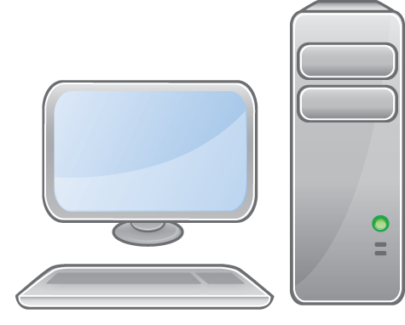

DR Flow – BACKUP and OUTPUT
OUTPUT
Rescue boot image
internal
external
BACKUP
Basic OS archive
(tar, rsync)
BACKUP
Basic OS archive
(external backup sw)

Slide 16
Decide on DR strategy
Which backup mechanism to use?
  Internal backup: GNU tar, rsync
  External backup: bacula, bareos, commercial backup solution
Where will the backups reside?
  NFS share, CIFS share, external USB disk, tape, local spare disk, cloud storage, DVD
  Remote network and/or storage location
How shall we boot the rescue image?
  Via DVD (ISO image), tape (OBDR), network (PXE), USB disk

Slide 17
Disaster Recovery - Media
Most important: External storage!
Bootable media: CD/DVD, USB key, LAN, tape ...
Media usually combination boot and backup media:
  Bootable CD/DVD, USB key with backup data on it
  LAN boot (PXE) with backup data via CIFS, NFS ...
  Bootable tapes - HP OBDR (CD emulation)
Separation between boot media and backup data
  Boot the system from a (small) USB key, CD/DVD or LAN
  Recover the system with backup software, tar, rsync ...

Slide 18
Disaster Recovery – How It Works
Store the disk layout
  Partitioning, LVM and RAID configuration
  File systems, file system labels ...
  Boot loader (GRUB, GRUB2, LILO, UEFI)
Store the files (tgz, rsync, through backup software ...)
Create bootable rescue media with system configuration (and backup data)
Can be done online
  No business interruption
  100% compatible with original systems hard- and software
  Works very reliably with Operating System files, not with databases …

Slide 19
Usage of rear
Shell scripts are stored under /usr/share/rear
Scripts are kept together according work-flows
  mkrescue (only make rescue image)
  mkbackup (including make rescue image)
  mkbackuponly (excluding make rescue image)
  recover (the actual recovery part)
Easy to incorporate new scripts, e.g. for information gathering of Hard- and Software, or other goodies

Slide 20
Backup Types
The major “backup types” available are
  NETFS: NFS, CIFS, USB, TAPE, ISO, SSHFS
  RSYNC: With rsync server
  REQUESTRESTORE, EXTERNAL (noop)
  BACULA, BAREOS, RBME, DUPLICITY (open source software)
  DP, NBU, TSM, NSR, GALAXY[7], SESAM (commercial software)

Slide 21
BACKUP and OUTPUT methods
BACKUP variable defines the “backup” method
  NETFS, RSYNC, DUPLICITY, ….
BACKUP_URL variable defines the location where to store the backup archive
OUTPUT variable defines the “output” method
  ISO, PXE, OBDR, USB
OUTPUT_URL variable defines the location where to store the output image (ISO image, pxe configuration, extlinux configuration)

Slide 22
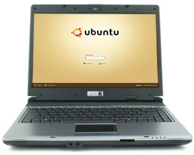
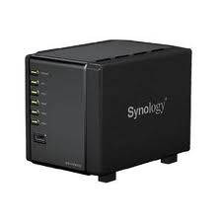

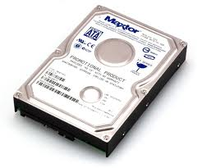
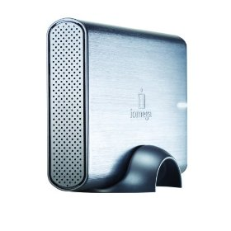
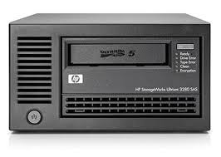
BACKUP type NETFS
OUTPUT=PXE
BACKUP=NETFS
isolinux
OUTPUT=ISO
pxelinux
network
(NFS|CIFS|local) disks
extlinux
External USB disks
Tape drive
OUTPUT=ISO
BACKUP=NETFS
OUTPUT=OBDR
BACKUP=NETFS
OUTPUT=USB
BACKUP=NETFS

Slide 23
Location BACKUP_URL
BACKUP=NETFS
BACKUP_URL can be
  File type: BACKUP_URL=file:///directory/
  NFS type: BACKUP_URL=nfs://nfs-server/directory/
  CIFS type: BACKUP_URL=cifs://samba/directory/
  USB type: BACKUP_URL=usb:///dev/disk/by-label/REAR-000
  ISO type: BACKUP_URL=iso://backup
  Tape type: BACKUP_URL=tape:///dev/nst0

Slide 24
Backup Program
BACKUP=NETFS
/usr/share/rear/conf/default.conf contains:
  Default: BACKUP_PROG=tar
  However, BACKUP_PROG=rsync is possible for local storage
  BACKUP_PROG_COMPRESS_OPTIONS="--gzip"
  BACKUP_PROG_COMPRESS_SUFFIX=".gz"
  BACKUP_PROG_EXCLUDE=( '/tmp/*' '/dev/shm/*' )

Slide 25
Relax and Recover
Lab 1:
Basic Usage

Slide 26

Lab Overview: Basic Setup
VM: client
192.168.33.10
VM: server
192.168.33.15
VM: recover
/isos/
Hypervisor Host: vagrant-host
192.168.33.1
./isos/

Slide 27
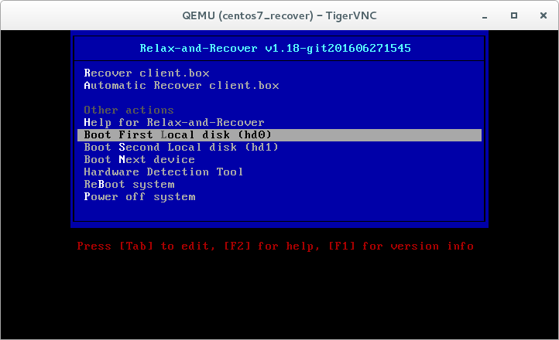

Lab Overview: Boot Media (CD)
VM: client
192.168.33.10
VM: server
192.168.33.15
VM: recover
rear mkrescue
/isos/
Hypervisor Host: vagrant-host
192.168.33.1
./isos/
ISO Image

Slide 28

Lab Overview: Backup & Restore
VM: client
192.168.33.10
VM: server
192.168.33.15
VM: recover
rear mkbackup
rear recover
/isos/
Hypervisor Host: vagrant-host
192.168.33.1
./isos/

Slide 29
Lab 1
Set up vagrant environment

Slide 30
Set up vagrant environment
Install / Download:
VirtualBox ≥ 5.0 https://www.virtualbox.org/wiki/Downloads
vagrant ≥ 1.9.4 https://www.vagrantup.com/
  For vagrant 1.9.4 (Fix https://github.com/mitchellh/vagrant/issues/8519):
  vagrant plugin install vagrant-share --plugin-version 1.1.8
Download workshop files:
https://github.com/rear/rear-workshop/archive/master.zip
(Should work on Linux, Mac, Windows, tested on Linux)

Slide 31
Set up vagrant environment (2)
Download workshop files:
https://github.com/rear/rear-workshop/archive/master.zip
Unzip workshop: unzip master.zip
Go into directory “rear-workshop-master/centos7”
Type “vagrant up”
Use “vagrant ssh client” to login on the client system
Use “vagrant ssh server” to login on the server system

Slide 32
Set up vagrant environment (3)
The last line of the vagrant up output should be:
==> client: Complete!
Account vagrant/vagrant (and root/vagrant)
Another way to login is via ssh:
  ssh root@192.168.33.10 (client root pw is vagrant)
  ssh root@192.168.33.15 (server root pw is vagrant)

Slide 33
Lab 2
Install Relax-and-Recover

Slide 34
Check NFS & SSH access on server
On client
  This should show the exported NFS share:
  showmount -e server
  Check that the following commands work without error:
  mount -v server:/export/nfs /mnt/
  touch /mnt/from-client
  umount -v /mnt
  ssh server touch /isos/from-client
Check that the file exists on host in centos7 directory:
  ls -l isos/
We confirmed write access from the client to the isos directory.

Slide 35
Install Relax-and-Recover
On client:
  yum search rear
  yum -y install rear
  yum -y install rear-workshop
  (for the configs)
  Install some extra tools:
    yum -y install net-tools
    (for netstat, route,...)
    yum -y install bind-utils
    (for nslookup, dig,...)

Slide 36
Install Relax-and-Recover
Explore ReaR on client:
  rear
  rear dump

Slide 37
Lab 3
Make a full backup with Bareos

Slide 38
Make a full backup with Bareos
Login on client
Start the “bconsole”
* run
Automatically selected Catalog: MyCatalog
The defined Job resources are:
1: client-backup
2: client-restore
3: client-backup-mysql
4: client-restore-mysql
Select Job resource (1-4): 1
Exit bconsole after the jobs starts
Check progress while still on client:
ssh server tail -f /var/log/bareos/bareos.log

Slide 39
Configure relax-and-recover
Configure /etc/rear/local.conf as follow:
OUTPUT=ISO
OUTPUT_URL=sshfs://server/isos
ISO_DEFAULT=manual
BACKUP=BAREOS
USE_STATIC_NETWORKING=y
KERNEL_CMDLINE="$KERNEL_CMDLINE net.ifnames=0 vga=791"
Or, copy the prepared configuration file:
cd /etc/rear
cp workshop/local-with-bareos.conf local.conf
Run rear -v dump

Slide 40
Lab 4
Create rear rescue image for
BACKUP=BAREOS topology

Slide 41
Create rear rescue image
On client
Run “rear -v mkrescue”
Fix any error shown (BAREOS_RESTORE_JOB)
Verify /var/log/rear/rear-client.log
Check destination (OUTPUT_URL) on host for ISO
Notes:
More about NFS on CentOS 7: http://www.server-world.info/en/note?os=CentOS_7&p=nfs&f=1

Slide 42
Create rear rescue image
# rear -v mkrescue
Relax-and-Recover 2.00 / Git
Using log file: /var/log/rear/rear-client.log
Creating disk layout
Creating root filesystem layout
Copying logfile /var/log/rear/rear-client.log into initramfs as'/tmp/rear-client-partial-2017-05-08T15:43:32+0200.log'
Copying files and directories
Copying binaries and libraries
Copying kernel modules
Creating initramfs
Making ISO image
Wrote ISO image: /var/lib/rear/output/rear-client.iso (132M)
Copying resulting files to sshfs location
Saving /var/log/rear/rear-client.log as rear-client.log to sshfs location

Slide 43
Recover with Bareos
Halt the client on vagant-host: vagrant halt client
Verify on the host that the isos/client directory contains the ISO image
Start the recovery: vagrant up recover
Choose “Recover client” in boot menu
Recover your 'client' system onto vm 'recover'
  Check network with 'ip a s'
  Recover with 'rear -v recover'

Slide 44
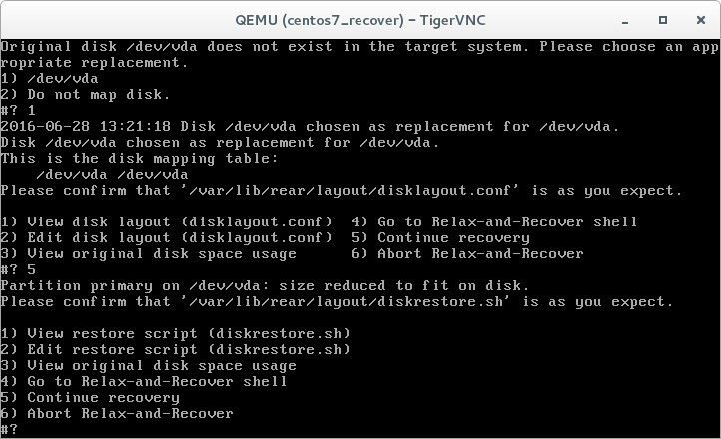
Recover with Bareos (2)

Slide 45
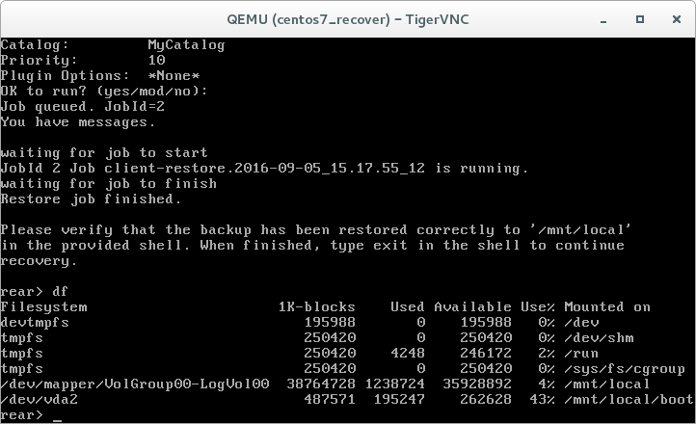
Recover with Bareos (3)

Slide 46
Recover with Bareos (4)
Reboot the VM and select now (2 times):

Slide 47
Recover with Bareos (5)
Check that the recovered VM is as the client was before, e.g. with:
yum install -y samba
Remove the recovery machine:
vagrant destroy recover -f
Start the client again:
vagrant up client

Slide 48
Lab 5
Troubleshoot the configuration files

Slide 49
Troubleshoot the configuration files
Go to directory /etc/rear/workshop
Type:
for f in ls *.conf ; do
bash -n $f
done
And now type:
for f in ls *.conf ; do
source $f
done

Slide 50
Lab 6
Using NFS as backup destination

Slide 51
Configure /etc/rear/local.conf
Replace the content of /etc/rear/local.conf with:
OUTPUT=ISO
OUTPUT_URL=sshfs://server/isos
ISO_DEFAULT=manual
BACKUP=NETFS
BACKUP_URL=nfs://server/export/nfs
USE_STATIC_NETWORKING=y
KERNEL_CMDLINE="$KERNEL_CMDLINE net.ifnames=0 vga=791"
Or, copy the prepared configuration file:
cd /etc/rear
cp workshop/local-with-nfs.conf local.conf

Slide 52
Using NFS as backup destination
Run a simulation and understand the difference
  rear -s mkrescue
  rear -s mkbackup
Run on client: rear -v mkbackup
Halt the client vm: vagrant halt client
Start the recover vm:
  vagrant up recover
  Select “Recover client” in boot menu
  Run: rear -v recover

Slide 53
Lab 7
Using sshfs as backup destination

Slide 54
Configure /etc/rear/local.conf
Install: yum -y install sshfs
Replace the content of /etc/rear/local.conf with
OUTPUT=ISO
OUTPUT_URL=sshfs://server/isos
ISO_DEFAULT=manual
BACKUP=NETFS
BACKUP_URL=sshfs://root@server/export/archives
USE_STATIC_NETWORKING=y
KERNEL_CMDLINE="$KERNEL_CMDLINE net.ifnames=0 vga=791"
Or, copy the prepared configuration file:
cd /etc/rear
cp workshop/local-with-sshfs.conf local.conf

Slide 55
Lab 8 with sshfs
Make a backup and ISO image (on client):
  rear -v mkbackup
  NETFS mounted via sshfs fuse module
Halt the client vm: vagrant halt client
Start the recover vm:
  vagrant up recover
  Choose “Recover client”
  Run: rear -v recover

Slide 56
Lab 8
Using CIFS as backup destination

Slide 57
Configure /etc/rear/local.conf
Install: yum -y install cifs-utils
Replace the content of /etc/rear/local.conf with
OUTPUT=ISO
OUTPUT_URL=sshfs://server/isos
ISO_DEFAULT=manual
BACKUP=NETFS
BACKUP_URL=cifs://server/homes
BACKUP_OPTIONS="cred=/etc/rear/.cifs"
USE_STATIC_NETWORKING=y
KERNEL_CMDLINE="$KERNEL_CMDLINE net.ifnames=0 vga=791"
Or, copy the prepared configuration file:
cd /etc/rear
cp workshop/local-with-cifs.conf local.conf

Slide 58
Configure CIFS credentials
Create or copy the credentials file:
cp /etc/rear/workshop/.cifs to /etc/rear/
Make a backup and ISO image (on client):
  rear -v mkbackup
  NETFS mounted via cifs
Halt the client vm: vagrant halt client
Start the recover vm:
  vagrant up recover
  Run: rear -v recover

Slide 59
Secure Disaster Recovery
&
Advanced Usage

Slide 60
Why is everything we did in the lab really bad security practice?
How will an attacker exploit our setup?

Slide 61
Potential Attack Vectors in Lab 1
Anybody on client can read your backup and secrets within
Backups (with secrets) of other clients can be also read
Use the secrets pulled from the backup archive
Modify the backup of other clients
SSH key of root: Run any program on “server”
Trigger Bareos backup/restore on other clients, modify Bareos
Attack plan:
  Modify backup of important server to include back door
  Make sysadmin recover the important server, e.g. via social engineering or DoS attack
  Use back door ☺

Slide 62





Top-Down Security Concept
No Trust
No Access
Don’t Believe
difficult / forbidden
easy / allowed

Slide 63
ReaR to the Rescue
Designed to be secure by default
Rescue image does not contain exploitable secrets,
as long as you don’t put them there.
Most BACKUP and OUTPUT methods are not secure!
Secure solutions are based on
  Pull from outside instead of push
  If push, then write-only access without overwriting existing data
  Triggering actions like file restore from outside
  Verifying that the data was not tampered with
ReaR is a tool box ⇒ build your own secure solution.

Slide 64
Security Best Practices
Don’t use BACKUP=NETFS, backup should be pulled from secure system. Some commercial backup software solves this better.
See also RSYNC BACKUP MADE EASY: https://github.com/schlomo/rbme
Pull rescue image or use drop protocols to push image:
FTP: OUTPUT_URL=ftp://server/
HTTP: OUTPUT_URL=http://server/
SMTP: RESULT_MAILTO=rear@domain
Orchestrate recovery from secure system:
  Provide access to rescue image only by need, not always
  Watch for suspicious behavior, e.g. many rescue images in short time

Slide 65

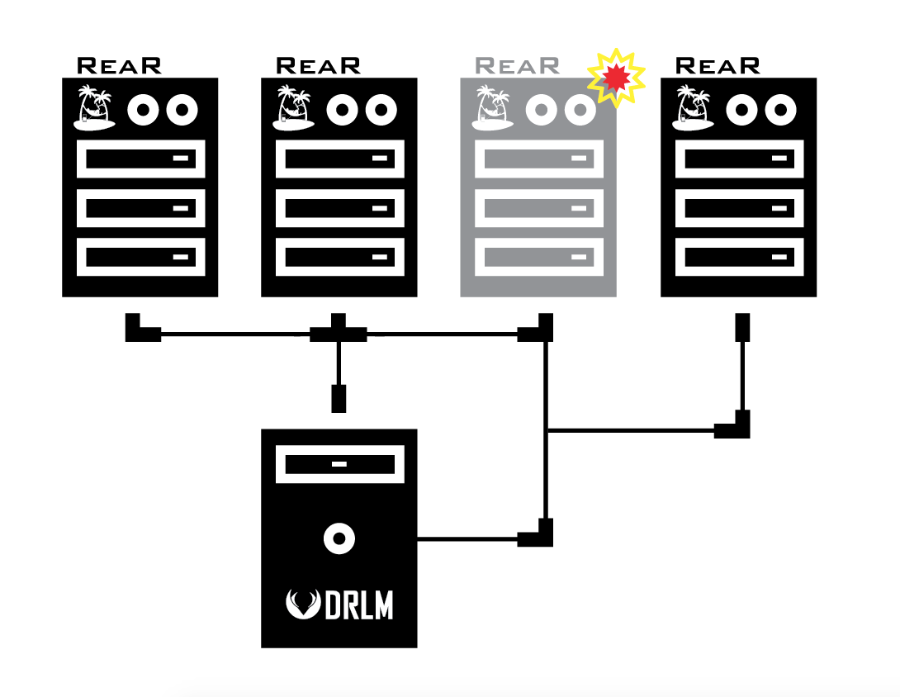
DISASTER RECOVERY LINUX MANAGER
About:
DRLM is a Centralized Management Open Source solution for small-to-large Disaster Recovery implementations using ReaR.
Is an easy-to-use software to manage your growing ReaR infrastructure. Is written in the bash language (like ReaR) and offers all needed tools to efficiently manage your GNU/Linux disaster recovery backups, reducing Disaster Recovery management costs.
ReaR is great solution, but when we're dealing with hundreds of systems, could be complex to manage well all ReaR deployments.
With DRLM you can, easily and centrally, deploy and manage ReaR installations for all your GNU/Linux systems in your DataCenter(s).
DRLM is able to manage all required services (TFTP, DHCP-PXE, NFS, ...) with no need of manual services configuration. Only with few easy commands, the users will be able to create, modify and delete ReaR clients and networks, providing an easy way to boot and recover your GNU/Linux systems through network with ReaR.
Furthermore DRLM acts as a central scheduling system for all ReaR installations. Is able to start rear backups remotely and store the rescue-boot/backup in DR images easily managed by DRLM.
You can easily enable or disable the last or any previous backups to restore any client with a single command line.
Currently DRLM supports PXE and NETFS(nfs) OUTPUT/BACKUP methods of ReaR, but the Development of DRLM non stops here, we are working on new 2.0 version with new features to improve performance, usability and more ReaR methods, in order to become, together with ReaR, the reference when talking about Disaster Recovery of GNU/Linux systems.
http://drlm.org/

Slide 66
Idea for rear-server
Use SMTP or HTTP as secure, easily available and cross-domain routable transport protocol
Version 1: Central dashboard
Version 2: Trigger DR via UI
Version 3: Integrate with system management solutions
See https://goo.gl/6K61Kb for more infos, looking for sponsor

Slide 67
Advanced Features 1
Use PROGS and COPY_AS_IS to add your own content
Add your own commands or scripts via
POST_RECOVERY_SCRIPT, PRE_RECOVERY_SCRIPT,
POST_BACKUP_SCRIPT, PRE_BACKUP_SCRIPT
Create bootable recovery media on USB storage:
  BACKUP=NETFS
  BACKUP_URL=usb:///dev/disk/by-label/REAR-000
  OUTPUT=USB
  UDEV_WORKFLOW=mkbackup
  rear format /dev/sdb
  Automatically trigger backup via udev rule:
  ACTION=="add", SUBSYSTEM=="block", ENV{ID_FS_LABEL}=="REAR-000", RUN+="/usr/sbin/rear udev"
Use rear -C CONFIG to configure different profiles
https://github.com/rear/rear/blob/master/doc/user-guide/11-multiple-backups.adoc

Slide 68
Advanced Features 2
Automate entire process via network boot OUTPUT=PXE
Set correct time on recovery TIMESYNC, TIMESYNC_SOURCE
Automate P2V, P2P, V2V migration by answering questions in mappings files:
  /etc/rear/mappings/disk_devices:
  /dev/cciss/c0d0 /dev/sda
  /etc/rear/mappings/ip_addresses:
  eth0 213.203.238.113/25
  eth1 dhcp
  /etc/rear/mappings/mac:
  00:11:85:c2:b8:d5 00:50:56:b3:75:ad eth0
  00:11:85:c2:b8:d7 00:50:56:b3:08:8c eth1
  /etc/rear/mappings/routes:
  default 213.203.238.1 eth0
  192.168.33.0/24 213.203.238.45 eth0
  Provide /etc/rear/disklayout.conf if you know better
  Provide /etc/rear/lun_wwid_mapping.conf for SAN migrations

Slide 69
Relax and Recover
Architecture & Development

Slide 70
Internals
Bash framework
Main program: /usr/sbin/rear
Configuration: /usr/share/rear/conf and /etc/rear
Functions: /usr/share/rear/lib/*-functions.sh
Workflows: /usr/share/rear/lib/*-workflow.sh
Stages: /usr/share/rear/*
Multi-dimensional script merging by ARCH, OS, OS_VERSION, BACKUP, OUTPUT, BACKUP/OUTPUT and more. Use rear -s to see how it works.

Slide 71
Coding
https://github.com/rear/rear/wiki/Coding-Style
Use Bash arrays and other advanced Bash features
Learn from the Advanced Bash-Scripting Guide http://tldp.org/LDP/abs/html/ and frequently consult man bash
Document all global variables in default.conf
Test on as many Linux distributions as you can

Slide 72
Relax and Recover
Lab 2
Development
Debugging
Advanced Usage

Slide 73
Development – Preparation
Please use Linux for development, we all do.
Use “client” VM with NFS configuration from Lab 1
Configure plain SSH access from host to client:
vagrant ssh-config client >>~/.ssh/config
Git clone ReaR sources:
git clone git@github.com:rear/rear.git
Install build dependencies:
ssh client sudo yum install -y rpm-build git
Create backup to restore:
ssh client sudo rear -v mkbackuponly

Slide 74
Development – Change Code and Test
Use the editor of your choice to work on ReaR.
Push ReaR sources to client
rsync -av --del rear/ client:rear/
Build & install RPM
ssh client "cd rear ; make rpm; sudo rpm -Uhv --force *.rpm ; sudo rear -v mkrescue"
vagrant up recover
vagrant ssh recover -- -t rear -v recover

Slide 75
Debugging
Read the logs – read the logs – read the logs!
See which scripts are called: rear -s mkrescue
Step-by-step, watch the data files: rear -S mkrescue
Enable debug mode -d or debugscript mode -D, read the log and inspect the work directory in /tmp/rear.*
Set a break point:
BREAKPOINT=layout/save/default/400_check_backup_special_files.sh rear -v checklayout
Add debug output to scripts or add a script that dumps stuff
Use rear shell to try out internals:
rear shell
# SourceStage layout

Slide 76
Contributing to ReaR
Follow the instructions in our development guide at http://relax-and-recover.org/development/ to contribute something to ReaR, e.g. fix a spelling mistake.
Read also the existing documentation, guides and links to blog articles in http://relax-and-recover.org/documentation/ for ideas.
Help (or sponsoring) wanted especially with
Testing and test automation, see also https://github.com/rear/rear-integration-tests
Documentation
Cleanup of legacy code paths

Slide 77
Try some advanced features
Create a disk mapping file to skip the question if /dev/sda should be recovered onto /dev/sda ☺
Configure vsftpd as drop-only FTP server, find out how to allow next upload without harming previous one?
Configure VirtualBox PXE booting and exercise PXE-based recovery.
See https://github.com/defunctzombie/virtualbox-pxe-boot
Create a backup of the Lab laptop onto USB thumb drive, erase it and recover it from the USB media

Slide 78
Feedback

Slide 79


Need Assistance?
Relax-and-Recover support options:
http://relax-and-recover.org/support/
Professional Support:
Gratien D'haese
IT3 Consultants
Heinlein Support GmbH
Schlomo Schapiro Open Source Consulting

