Slide 1
CMSC330.2xx Day 1- Ruby intro
Fall 2019 Eastman

Slide 2
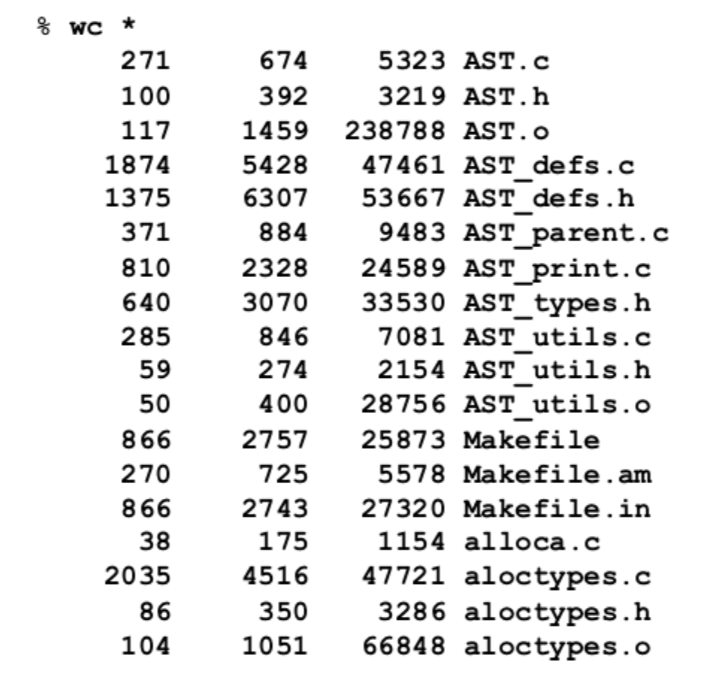
Problem
Large directory of data files
Find all with "AST" in name and more than 1000 words
Need this quickly

Slide 3
Scripting languages
Rapid prototyping languages for common tasks
Traditionally: text processing and system interaction
“Scripting” is a broad genre of languages
“Base” may be imperative, functional, OO…
Increasing use due to higher-layer abstractions
Originally for text processing; now, much more
sh (1971)
perl (1987)
Python (1991)
Ruby (1993)
#!/usr/bin/ruby
while line = gets do csvs = line.split /,/
if(csvs[0] == “330”) then ...

Slide 4
Ruby
An object-oriented, imperative, dynamically typed (scripting) language
Similar to other scripting languages (e.g., Python)
Notable in being fully object-oriented, and embracing higher-order programming style
Functions taking function(al code) as arguments
Created in 1993 by Yukihiro Matsumoto (Matz)
“Ruby is designed to make programmers happy”
Adopted by Ruby on Rails web programming framework in 2005 (a key to Ruby’s popularity)
Notes:
Added notes about higher-order programming. By this I am referring to the use of code blocks in paradigms like x.collect {|x| x+1} which are functions that take functions as arguments

Slide 5
Why Ruby?
Scripting language good to know
Imperative, OOP – similar to Java, good transition
Different from Java
Dynamic
Goes further
Purer OOP– se

Slide 6
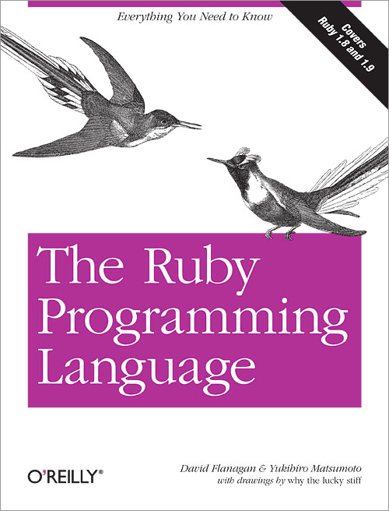
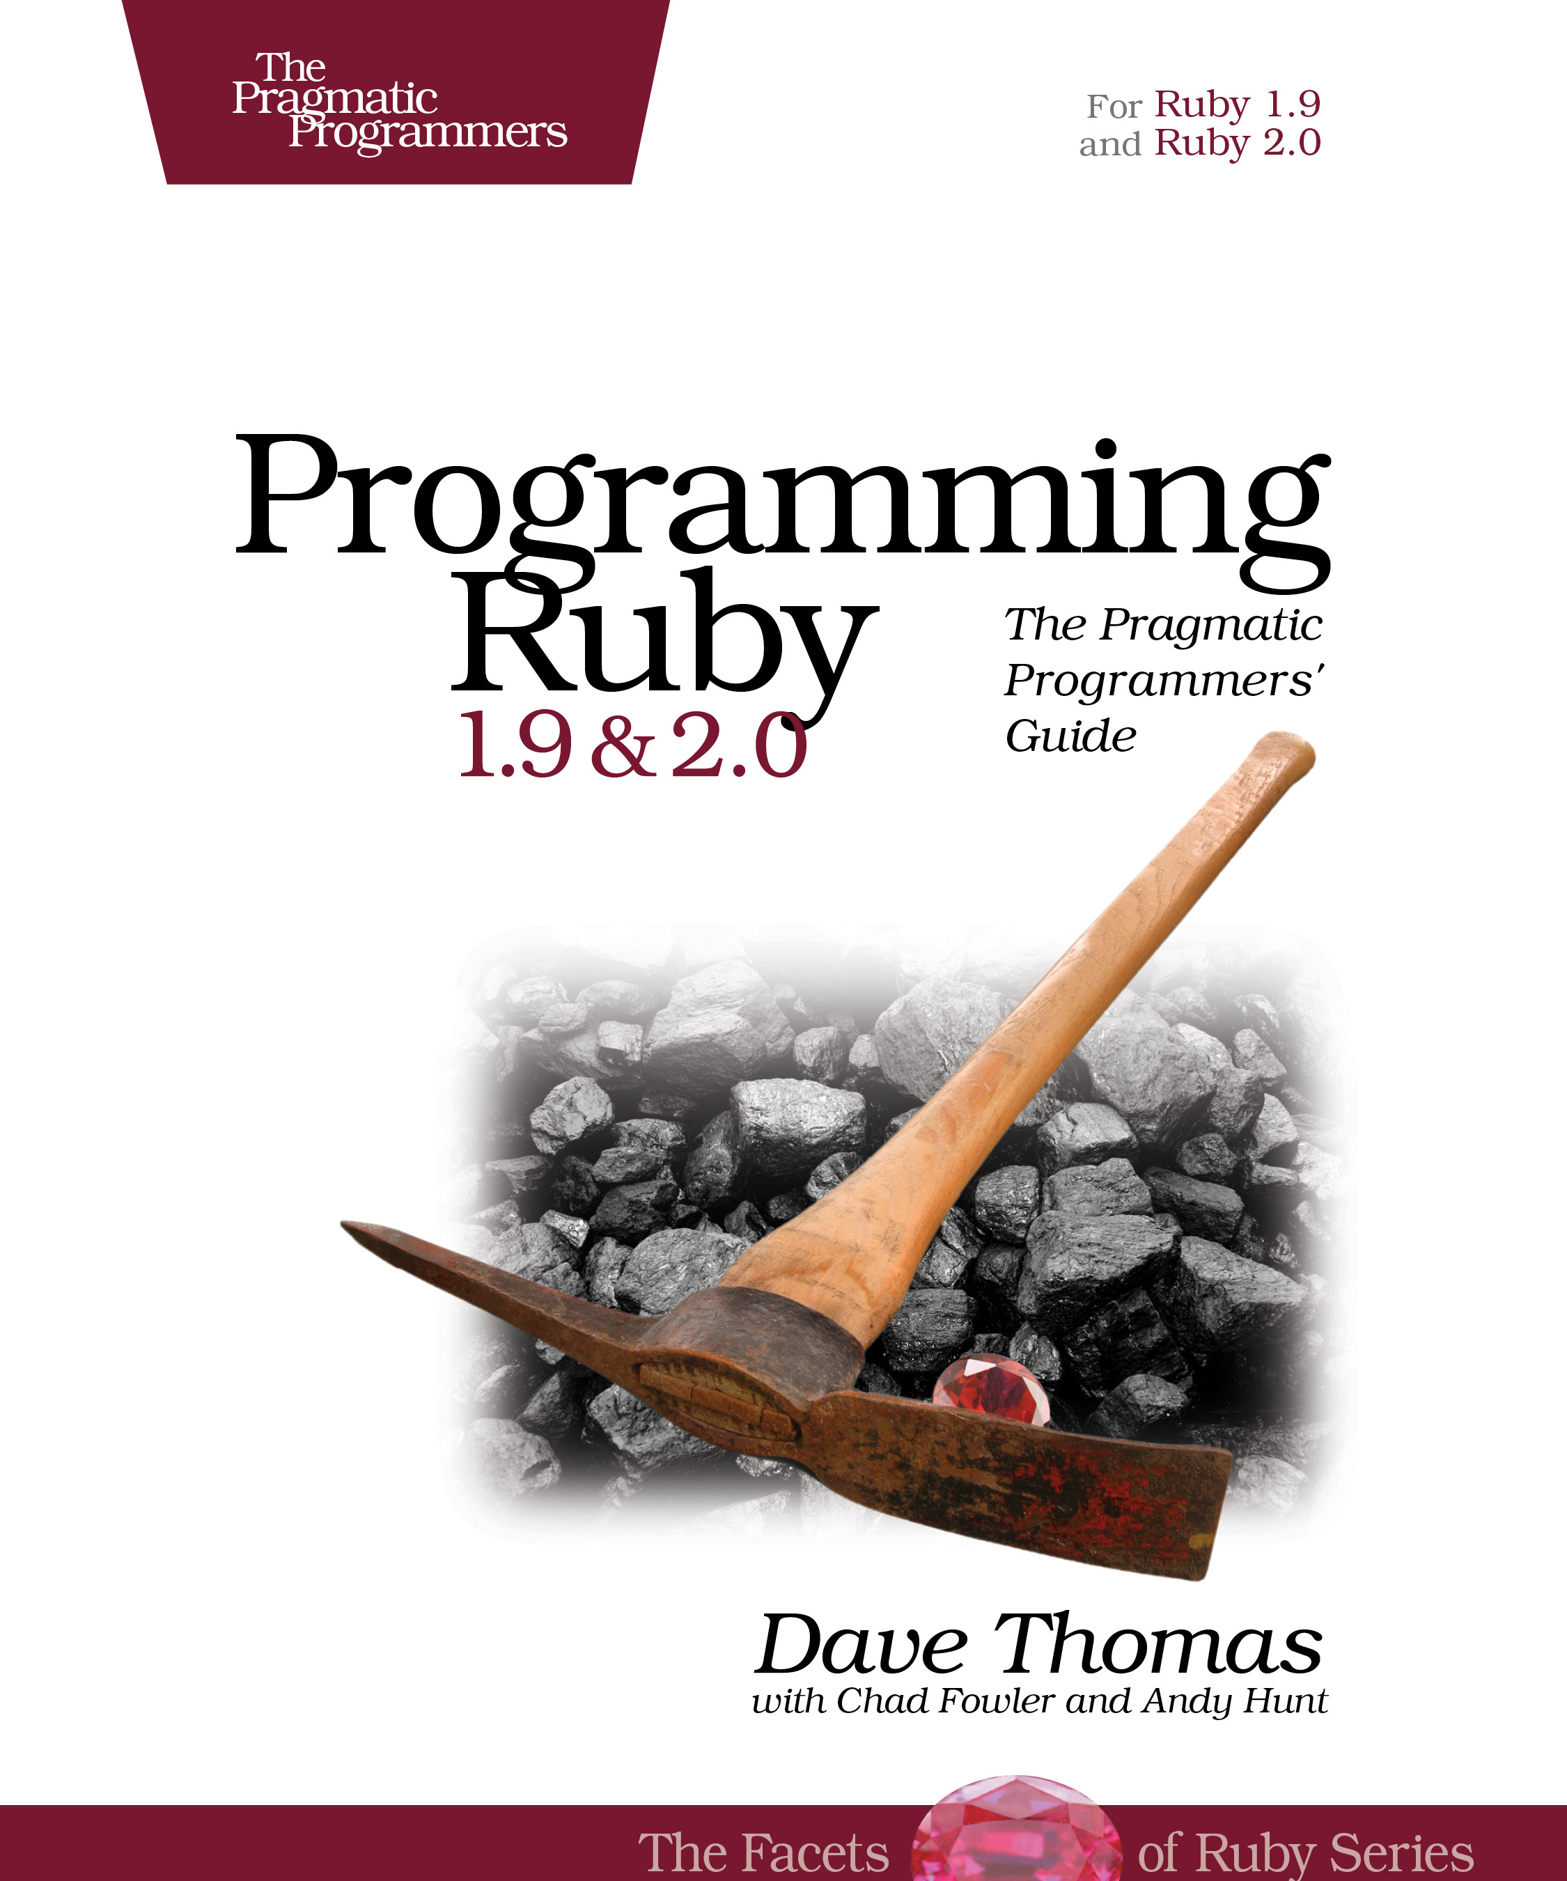
Books on Ruby
Earlier version of Thomas book available on web
See course web page
Notes:
Updated Thomas book photo

Slide 7
A Simple Example
Let’s start with a simple Ruby program
ruby1.rb:
# This is a ruby program
x = 1
n = 5
while n > 0
x = x * n
n = n - 1
end
print(x)
print("\n")
% ruby -w ruby1.rb
120
%

Slide 8
Language Basics
comments begin with #, go to end of line
# This is a ruby program
x = 1
n = 5
while n > 0
x = x * n
n = n - 1
end
print(x)
print("\n")
variables need not
be declared
line break separates
expressions
(can also use “;”)
no special main()
function or
method

Slide 9
Run Ruby, Run
There are two basic ways to run a Ruby program
ruby -w filename – execute script in filename
tip: the -w will cause Ruby to print a bit more if something bad happens
Ruby filenames should end with ‘.rb’ extension
irb – launch interactive Ruby shell
Can type in Ruby programs one line at a time, and watch as each line is executed
irb(main):001:0> 3+4
7
Can load Ruby programs via load command
Form: load string
String must be name of file containing Ruby program
E.g.: load ‘foo.rb’
Ruby is installed on Grace cluster

Slide 10
Implicit vs. Explicit Declarations
In Ruby, variables are implicitly declared
First use of a variable declares it and determines type
x = 37; // no declaration needed – created when assigned to
y = x + 5
x, y now exist, are integers
Java and C/C++ use explicit variable declarations
Variables are named and typed before they are used
int x, y; // declaration
x = 37; // use
y = x + 5; // use

Slide 11
Tradeoffs?
Explicit Declarations | Implicit Declarations
More text to type | Less text to type
Helps prevent typos | Easy to mistype variable name
var = 37
If (rare-condition)
y = vsr + 5
Typo!
Only caught when this line is actually run.
Bug could be latent for quite a while

Slide 12
Static Type Checking (Static Typing)
Before program is run
Types of all expressions are determined
Disallowed operations cause compile-time error
Cannot run the program
Static types are often explicit (aka manifest)
Specified in text (at variable declaration)
C, C++, Java, C#
But may also be inferred – compiler determines type based on usage
OCaml, C# and Go (limited)

Slide 13
Dynamic Type Checking
During program execution
Can determine type from run-time value
Type is checked before use
Disallowed operations cause run-time exception
Type errors may be latent in code for a long time
Dynamic types are not manifest
Variables are just introduced/used without types
Examples
Ruby, Python, Javascript, Lisp

Slide 14
Static and Dynamic Typing
Ruby is dynamically typed, C is statically typed
Notes
Can always run the Ruby program; may fail when run
C variables declared, with types
Ruby variables declared implicitly
Implicit declarations most natural with dynamic typing
# Ruby
x = 3
x = "foo" # gives x a
# new type
x.foo # NoMethodError
# at runtime
/* C */
int x;
x = 3;
x = "foo"; /* not allowed */
/* program doesn’t compile */

Slide 15
Tradeoffs?
Static type checking
More work for programmer (at first)
Catches more (and subtle) errors at compile time
Precludes some correct programs
May require a contorted rewrite
More efficient code (fewer run-time checks)
Dynamic type checking
Less work for programmer (at first)
Delays some errors to run time
Allows more programs
Including ones that will fail
Less efficient code (more run-time checks)

Slide 16
Java: Mostly Static Typing
In Java, types are mostly checked statically
Object x = new Object();
x.println(“hello”); // No such method error at compile time
But sometimes checks occur at run-time
Object o = new Object();
String s = (String) o; // No compiler warning, fails at run time
// (Some Java compilers may be smart enough to warn about above cast)

Slide 17
Quiz 1: Example clicker quiz
True or false: This program has a type error
# Ruby
x = 3
y = “foo”
x = y
True
False

Slide 18
Quiz 1: Get out your clickers!
True or false: This program has a type error
True or false: This program has a type error
# Ruby
x = 3
y = “foo”
x = y
True
False
/* C */
void foo() {
int x = 3;
char *y = “foo”;
x = y;
}
True
False

Slide 19
Quiz 1: Get out your clickers!
True or false: This program has a type error
True or false: This program has a type error
# Ruby
x = 3
y = “foo”
x = y
True
False
/* C */
void foo() {
int x = 3;
char *y = “foo”;
x = y;
}
True
False

Slide 20
Control Statements in Ruby
A control statement is one that affects which instruction is executed next
While loops
Conditionals
i = 0
while i < n
i = i + 1
end
if grade >= 90 then
puts "You got an A"
elsif grade >= 80 then
puts "You got a B"
elsif grade >= 70 then
puts "You got a C"
else
puts "You’re not doing so well"
end

Slide 21
Conditionals and Loops Must End!
All Ruby conditional and looping statements must be terminated with the end keyword.
Examples
if grade >= 90 then
puts "You got an A"
end
if grade >= 90 then
puts "You got an A"
else
puts “No A, sorry"
end
i = 0
while i < n
i = i + 1
end

Slide 22
What is True?
The guard of a conditional is the expression that determines which branch is taken
The true branch is taken if the guard evaluates to anything except
false
nil
Warning to C programmers: 0 is not false!
if grade >= 90 then
...
Guard

Slide 23
Yet More Control Statements in Ruby
unless cond then stmt-f else stmt-t end
Same as “if not cond then stmt-t else stmt-f end”
until cond body end
Same as “while not cond body end”
unless grade < 90 then
puts "You got an A"
else unless grade < 80 then
puts "You got a B”
end
until i >= n
puts message
i = i + 1
end

Slide 24
Using If and Unless as Modifiers
Can write if and unless after an expression
puts "You got an A" if grade >= 90
puts "You got an A" unless grade < 90
Why so many control statements?
Is this a good idea? Why or why not?
Good: can make program more readable, expressing programs more directly. In natural language, many ways to say the same thing, which supports brevity and adds style.
Bad: many ways to do the same thing may lead to confusion and hurt maintainability (if future programmers don’t understand all styles)

Slide 25
Quiz 2: What is the output?
x = 0
if x then
puts “true”
elsif x == 0 then
puts “== 0”
else
puts “false”
end
Nothing – there’s an error
“true”
“== 0”
“false”

Slide 26
Quiz 2: What is the output?
x = 0
if x then
puts “true”
elsif x == 0 then
puts “== 0”
else
puts “false”
end
Nothing – there’s an error
“true”
“== 0”
“false”
x is neither false nor nil so the first guard is satisfied

Slide 27
Other Useful Control Statements
for elt in [1, “math”, 3.4]
puts elt.to_s
end
while i>n
break
next
puts message
redo
end
generates a string; cf. to_i
for i in (1..3)
puts i
end
case x
when 1, 3..5
when 2, 6..8
end
(1..3).each {
|elt|
puts elt
}
IO.foreach(filename) { |x|
puts x
}
code block
(details later)
does not need break

