Slide 1
Beautiful-Open-Ended-INterior-Graphics
Stephen Reaves, Christopher Skeen, Christopher Bowling, Bobby Jones, Ian Finch

Slide 2
Workflow
Drag and Drop asset into Unity
Assign Metadata
Build

Slide 3
Metadata Annotation Window
After receiving spec sheets from suppliers, enter that info into the Metadata Annotation Window.
The Metadata Annotation Window will structure the Assembly Order, while maintaining other metadata.
Simple Unity extension that allows users to organize “order tree” and add other metadata.

Slide 4
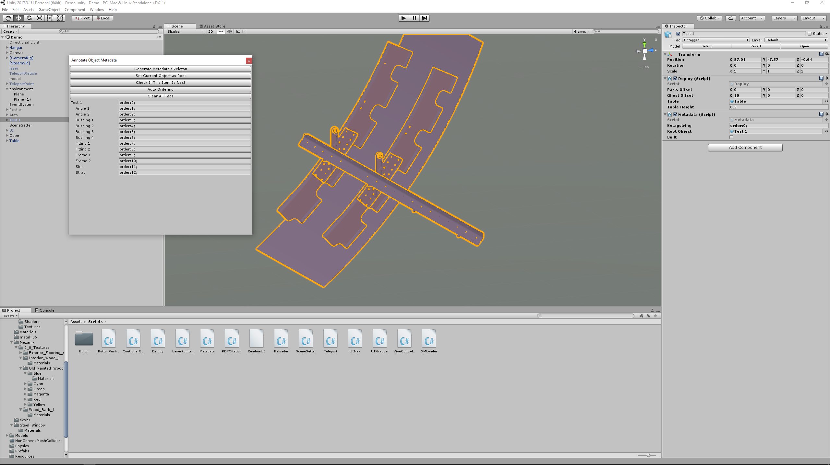
Metadata Annotation Window Screenshot

Slide 5
Virtual Reality
Use headset and controllers to assemble parts in VR
Parts will be on the table
Final location for all parts will be to the right and colored a transparent green
Next item in order will be red
Final location for part in hand will be transparent blue

Slide 6
Video Demo
Insert video here

