Slide 1
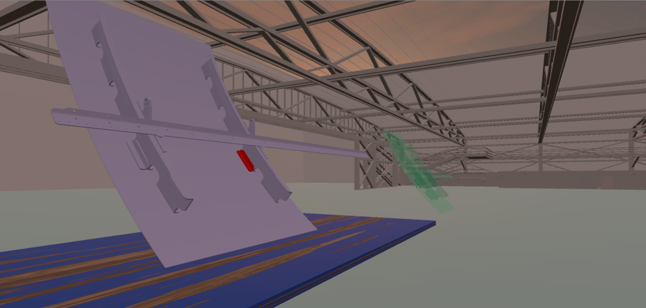
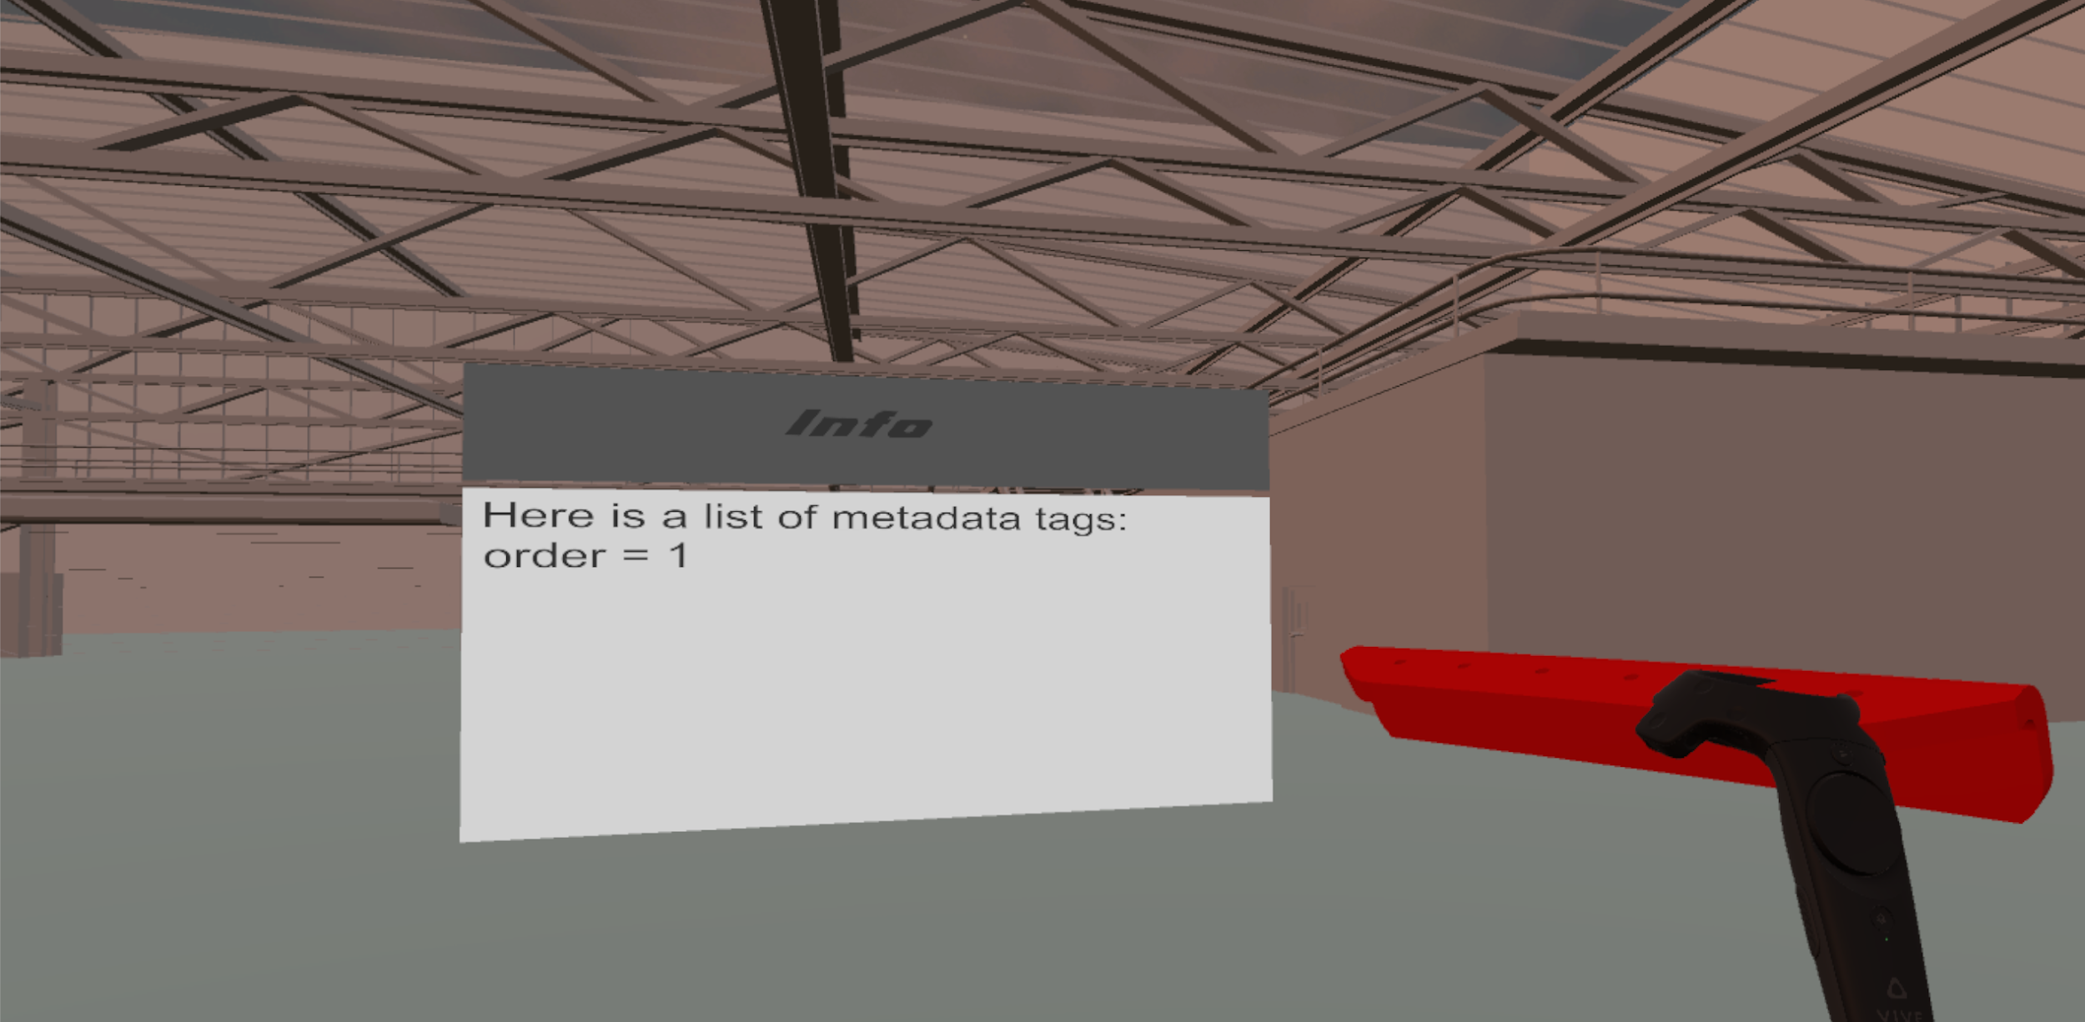
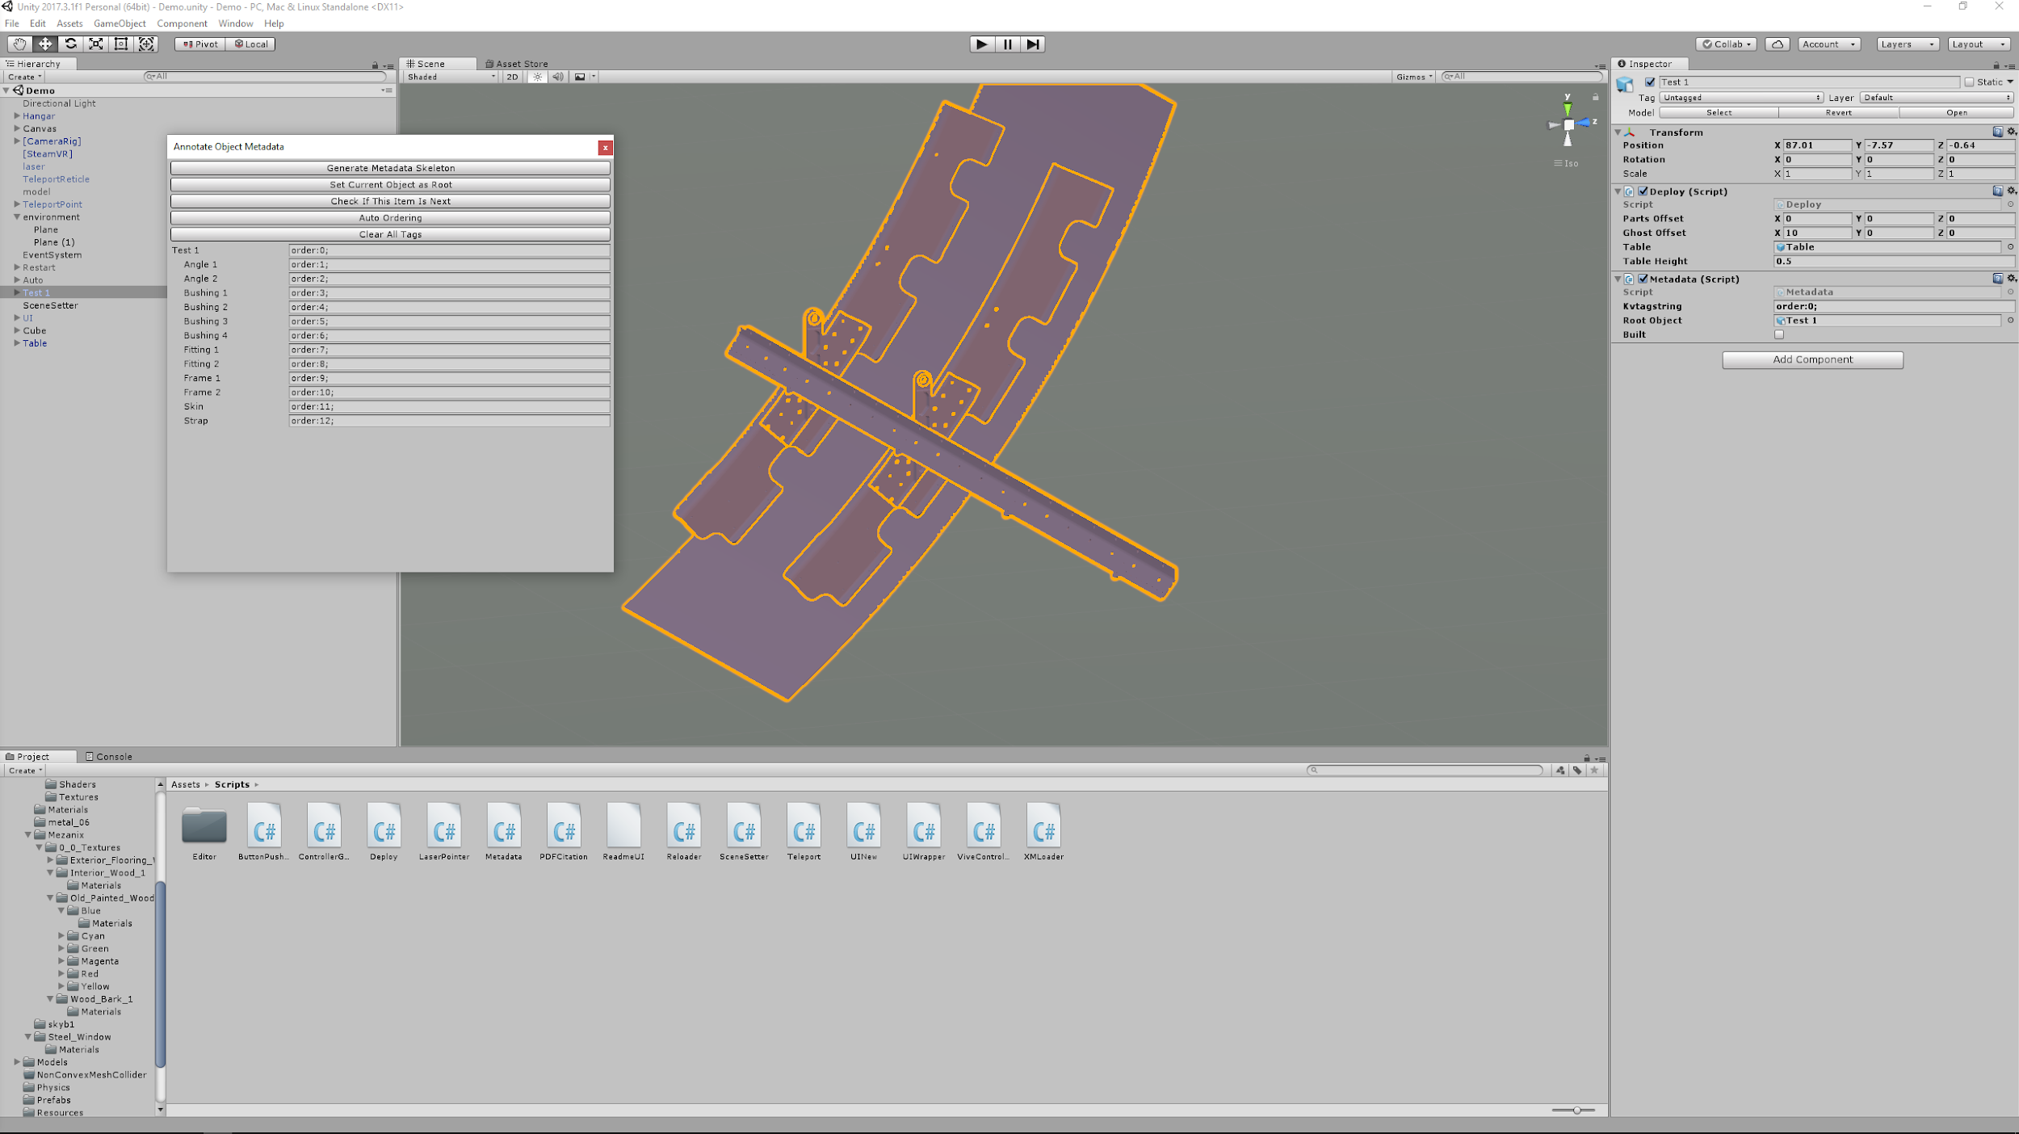
Beautiful-Open-Ended-INterior-Graphics
Robert Jones – Christopher Bowling – Ian Finch – Christopher Skeen – Stephen Reaves
Project Sponsor: Eric Hatch, Kyle Starck, Joe Clegg, Alex Starnes – Boeing
Instructors: Dr. Jose Vidal, Hongkai Yu (TA), Bridget Parsons (TA)
Computer Science / Computer Engineering Capstone Project – University of South Carolina
Problem Definition
Methodology
Current Status
Boeing is the world’s largest manufacturer of commercial and military aircraft in the world. They have several suppliers around the globe that manufacture peices of an aircraft. These pieces get sent to Charleston, SC and Seattle, WA for final assembly. Sometimes, these parts change and there is not enough time to teach the workers how the parts need to be assembled. The only thigns that Boeing recieves ahead of time are a 3D model of the parts and pages and pages of technical documentation. Boeing came to us to redesign their workflow in order to instruct workers on how to assemble parts, in a VR world, in under 30 minutes of time.
We will be using Unity to create a VR world where workers can interact with the parts. We will be utilizing an HTC Vive as well as Steam’s VRTK to implement the virtual reality portions. Users will drag and drop the 3D models into the Unity Editor. We created a Unity extension so you can quickly and easily add assembly order and other metadata to parts. From there, users will put on the Vive headset and begin building the assembly. The parts will fall onto a table and their final position will appear next to the table in a transparent color. The item that is next to be picked up will be highlighted red. If multiple items are highlighted, that means that they can be assembled in an arbitrary order, but both will need to be built before the next ones will highlight. Finally, after picking up an object, the final position for that individual item will highlight in blue. We also added a canvas that will read out the additional metadata for objects in your hand. We also implemented an auto-assembly feature so that the parts will build themselves.
The project is currently in a working state. A would-be engineer can take an FBX model provided by a vendor, import it into Unity, and attach a single script to “deploy” it in a virtual environment--including making every different part of the model interactable in the virtual space. In testing, this can be accomplished in well under the thirty minute time mark. A new assembly can be made deployable in a couple of minutes or less.
Proposed Solution
Boeing proposed the idea of using the commercially available HTC Vive VR headset as a way to help solve their assembly training problem. Our proposed solution to this problem is a set of Unity Editor extensions and components that an engineer can use to quickly create their own virtual assembly applications to suit whatever particular need they might encounter. The intention is to allow an engineer to go from a collection of FBX models to a complete interactable VR space within 30 minutes.
Future Goals
There is a wide variety of functional applications and future tools that this application could be used for. Some of the future goals fo this project could include:
Use of tools to help engineer associate proper assembly procedure
The separation and compression of parts for obtain different perspectives on the item
Making some parts only buildable when using a certain tool (i.e. need a screwdriver for screws)
Timing of user assembly for competitive interaction between users
Concise UI for entering data and generating order of assembly

