Slide 1

Introducing
Kinshuk Sunil / OSScamp Lucknow 11.03 / March 26, 2011 / v2.0

Slide 2
About Me
Kinshuk Sunil
Manager (Community & Relations), OSSCube
Band Member, Ctrl Alt Delhi
Founder, Indie GameDev India
Leads the LibreOffice Hindi Localization Initiatives
Contributes to Drupal, Mozilla Firefox, Ubuntu, phpBB, Wordpress, Wikipedia and some other projects.
Contact: kinshuk@osscube.com
Web: http://kinshuksunil.com

Slide 3
Reuse this Presentation
This presentation is licensed under the Creative Commons Attribution-Share Alike License.
Feel free to copy, share, and modify this presentation, given:
  You attribute the original work as “Based on the presentation 'Introducing LibreOffice' by Kinshuk Sunil”
  You share it further under the same license

Slide 4
What is LibreOffice?

Slide 5
a Free Open Source suite of office applications
available for
GNU/Linux,
Mac OS X, and
Microsoft Windows.

Slide 6
A fork of OpenOffice.org,
because the original is now controlled by Oracle

Slide 7
Developed & Supported by The Document Foundation
A meritocracy focused on delivering
the best possible document production software to a broad range of users

Slide 8
What Does it Include ?

Slide 9
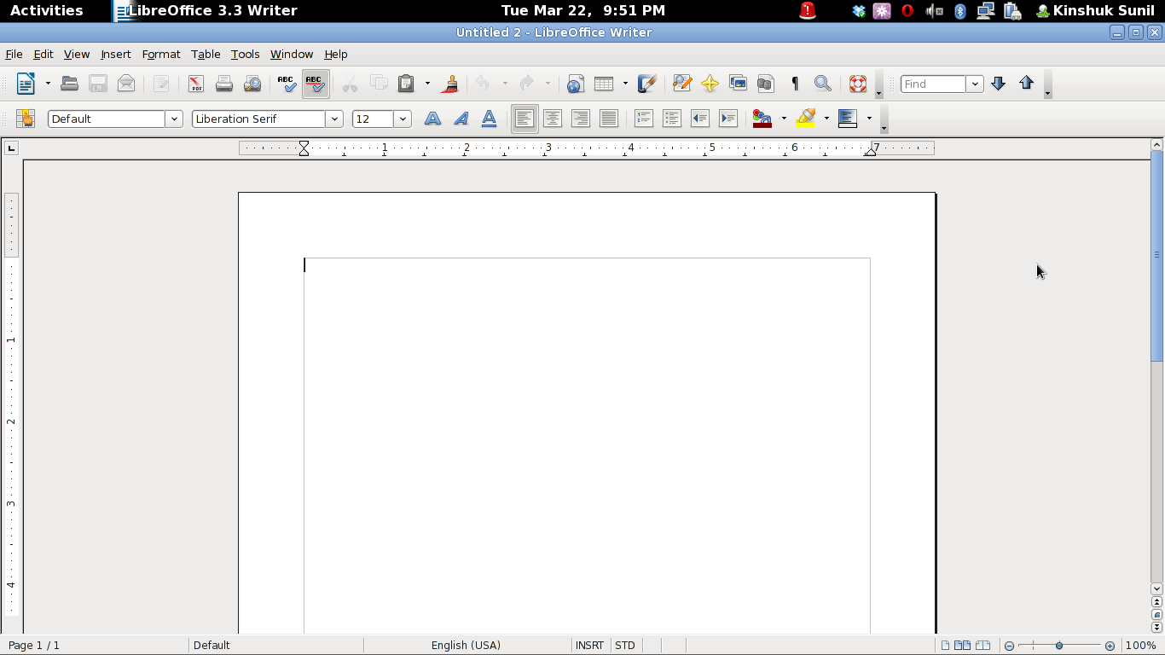
Writer

Slide 10
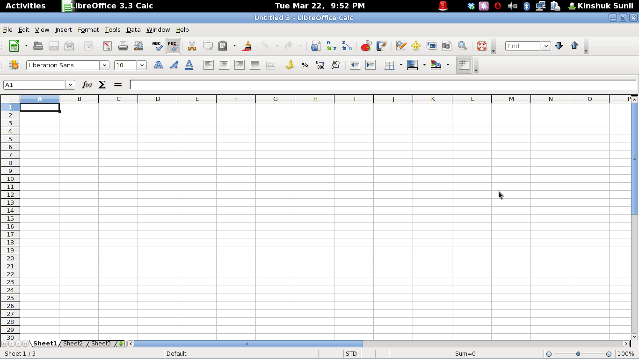
Calc

Slide 11
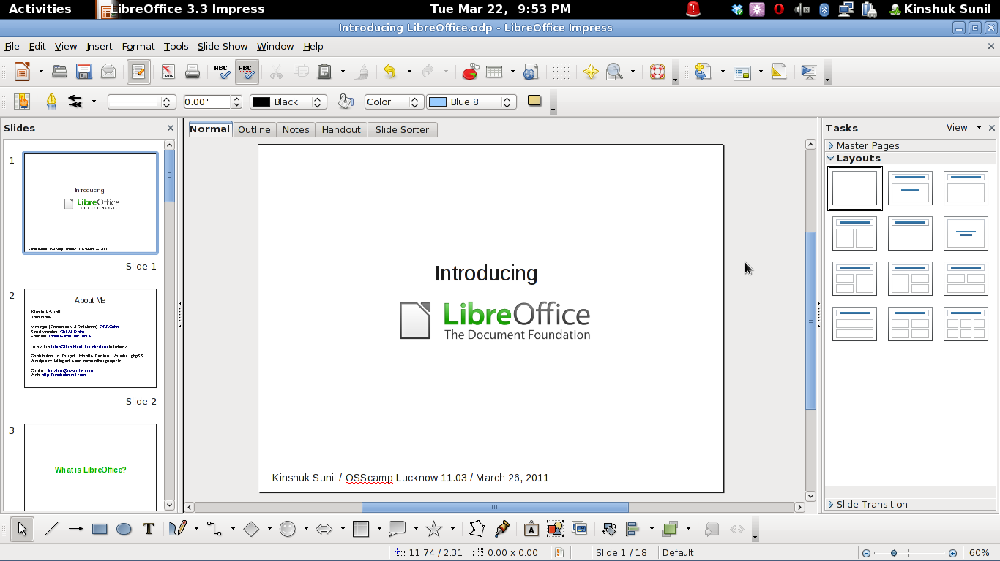
Impress

Slide 12
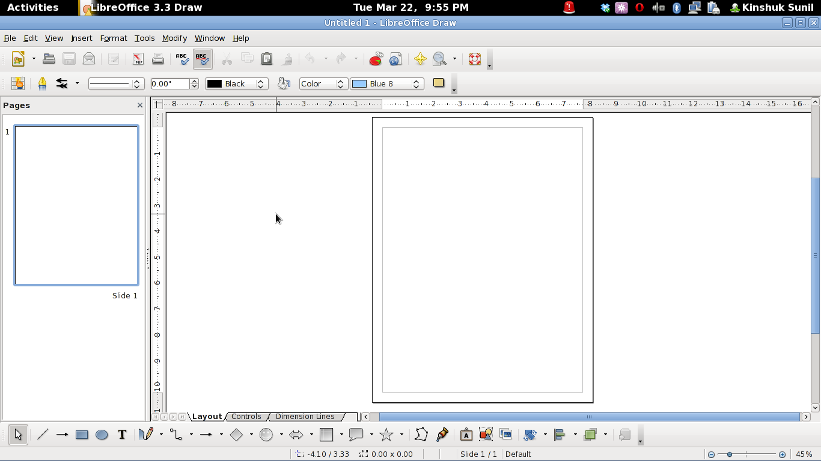
Draw

Slide 13
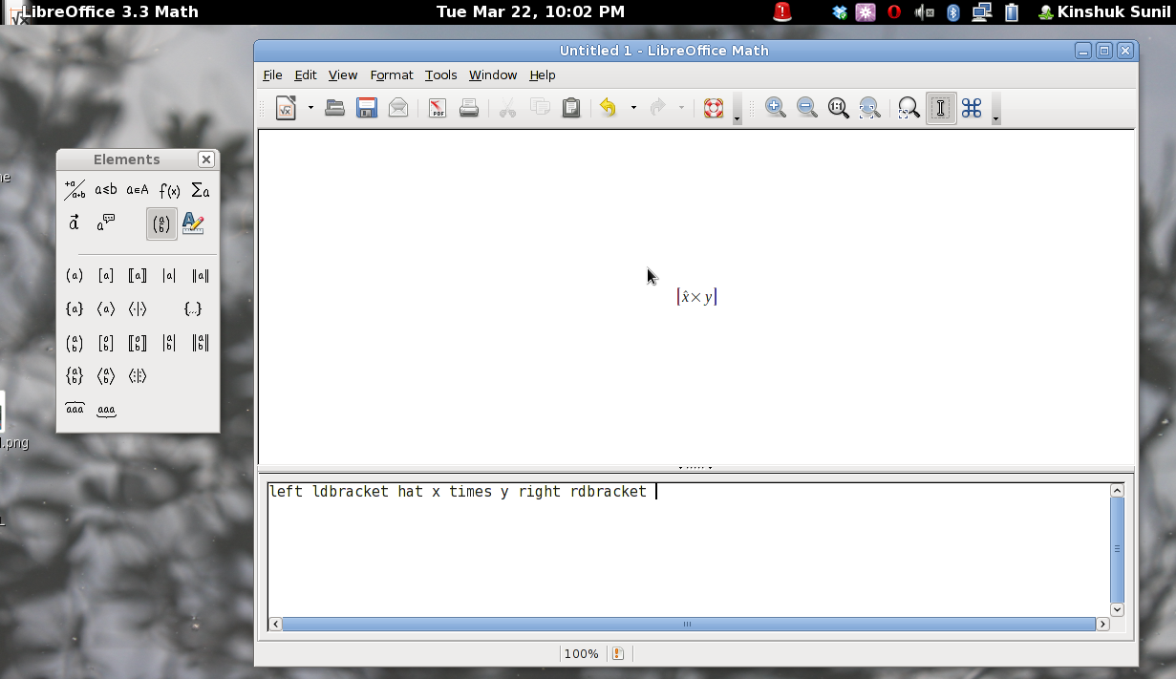
Math

Slide 14
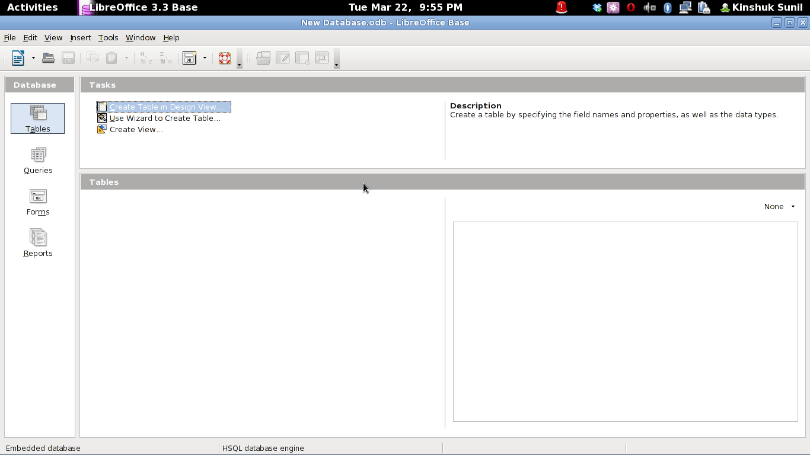
Base

Slide 15
History

Slide 16
July 19, 2000: Sun announces an open source StarOffice
October 13, 2000: OpenOffice.org Launched
May 1, 2002: OpenOffice.org 1.0 Released
September 2, 2005: Sun retires SISSL. OOo goes completely LGPL
October 4, 2005: Sun-Google Partnership for OOo
October 20, 2005: OpenOffice.org 2.0 Released
September 10, 2007: IBM Joins OOo Development

Slide 17
October 2, 2007: Go-oo announced
October 13, 2008: OpenOffice.org 3.0 Released
January 27, 2010: Oracle acquires Sun
September 28, 2010: The Document Foundation is formed. LibreOffice is announced
January 25, 2011: LibreOffice 3.3 released. First stable LibreOffice release
May 2011: LibreOffice 3.4 expected

Slide 18
Why LibreOffice?

Slide 19
When Oracle acquired Sun, it was unclear if OpenOffice.org will be discontinued like OpenSolaris

Slide 20
Oracle controls OpenOffice.org now
Oracle now releases Oracle Open Office, based on OOo, which is a proprietary software
Oracle has also announced Oracle Cloud Office, a proprietary derivative of OOo, on the cloud

Slide 21
To contribute to OpenOffice.org, you have to sign the Oracle Contributor Agreement, which hands over your copyrights to Oracle for creating proprietary versions of Oracle Open Office

Slide 22
LibreOffice was a temporary name. It was hoped, Oracle would contribute OpenOffice.org brand to the community.
Oracle refused

Slide 23
Oracle was invited to participate in the development of LibreOffice and be a contributor to The Document Foundation and the community.
Oracle refused

Slide 24
Oracle demanded that all members of the OpenOffice.org Community Council involved with The Document Foundation step down from the Council, citing a conflict of interest.

Slide 25
To ensure that the project remained independent of a single corporate sponsor
To drive the community Forward
To stay community-driven
To build a new ecosystem of contributions and benefits

Slide 26
Presently:
LibreOffice 3.3 has all features of OpenOffice.org 3.3 and some more

Slide 27
Features Unique to LibreOffice 3.3
SVG image import
Lotus Word Pro and MS Works import filters
Improved WordPerfect import
Dialog box for title pages
Navigator lets one heading be unfolded as usual in a tree view
"Experimental" mode that allows unfinished features to be tried by users
Some bundled extensions, including Presenter View in Impress
Colour-coded document icons.

Slide 28
Get it Now
http://www.libreoffice.org/download/

Slide 29
Getting Involved

Slide 30
Development & QA
Build LibreOffice
Find Tasks to be solved
Write code and patches that go into the software
Experiment with and implement Ideas
More: Wiki/Development
Perform Testing on the Software
Find and report Bugs
Review Patches
Help improve the quality of the software
More: Wiki/QA

Slide 31
Design & Website
Design Buttons and Icons
Design Web Banners
Design Badges and Stamps
Make it just work, and look great, too!
More: Wiki/Design
Write content for the website
Help test and maintain the Website and Features
More: Wiki/Website

Slide 32
Documentation & Localisation
Help write technical documentation for the project
Write technical How Tos for all the member applications
Write User Guides
More: Task Wishlist
Translate the project in your local language
Help the software reach out to a Non-English-Speaking audience too
More: Wiki/Localisation and Hindi Localisation

Slide 33
Marketing & Promotion
Use LibreOffice
Share with your Family and Friends
Organise community events
Spread the Word
More: Wiki

Slide 34
LibreOffice Hindi Localization Sprint
at
OSScamp Lucknow 11.03
http://translations.documentfoundation.org/hi/

Slide 35
The culture of an independent community brings out the best from all contributors.
Do Your Best!

Slide 36
Questions Please
(references follow)

Slide 37
The Document Foundation and LibreOffice by Florian Effenberger at openSUSE Conference, October 22nd 2010 in Nuremberg
LibreOffice Marketing at the LibreOffice Wiki
LibreOffice on Wikipedia
OpenOffice.org on Wikipedia

Slide 38
Reuse this Presentation
This presentation is licensed under the Creative Commons Attribution-Share Alike License.
Feel free to copy, share, and modify this presentation, given:
  You attribute the original work as “Based on the presentation 'Introducing LibreOffice' by Kinshuk Sunil”
  You share it further under the same license

