Slide 1

Note-Bridge 1
Sprint Review 4
Rebah Ozkoc
Anil Sen
Ilgin Simay Ozcan
Enescu Alex
Simeon Nikolov
Adham Ehab Magdy Selim

Slide 2
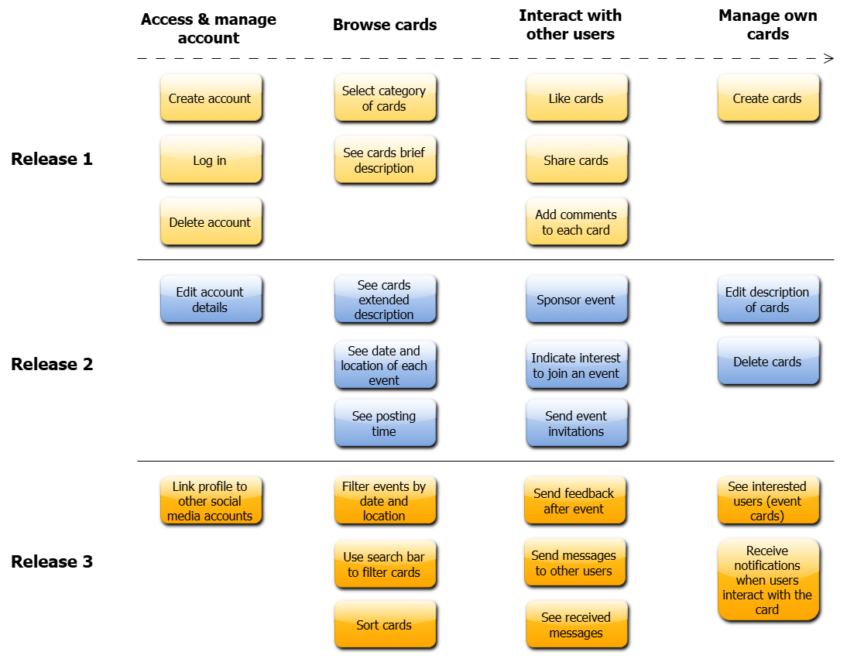




OUR
PLAN

Slide 3
DEMO TIME!

