Slide 1
Housing price Prediction

Slide 2
Table of Contents
Introduction
Business Problem Framing
Conceptual Background of Domain Knowledge
Motivation for the Problem Undertaken
Analytical Problem Framing
Data Sources and their formats
Data Preprocessing
Hardware and Software Requirements Tools used

Slide 3
Table Of contents
Exploratory Data Analysis
Visualizations
Scatterplots
DistPlots
Conclusion

Slide 4
Problem Statement:
Houses are one of the necessary need of each and every person around the globe and therefore housing and real estate market is one of the markets which is one of the major contributors in the world’s economy. It is a very large market and there are various companies working in the domain. Data science comes as a very important tool to solve problems in the domain to help the companies increase their overall revenue, profits, improving their marketing strategies and focusing on changing trends in house sales and purchases. Predictive modelling, Market mix modelling,
recommendation systems are some of the machine learning techniques used for achieving the business goals for housing companies. Our problem is related to one such housing company.

Slide 5
Conceptual Background of Domain Knowledge
A US-based housing company named Surprise Housing has decided to enter the Australian market. The company uses data analytics to purchase houses at a price below their actual values and flip them at a higher price. For the same purpose, the company has collected a data set from the sale of houses in Australia.

Slide 6
Motivation for the problem Undertaken
Housing and real estate market is one of the markets which is one of the major contributors in the world’s economy. It is a very large market and there are various companies working in the domain. Data science comes as a very important tool to solve problems in the domain to help the companies increase their overall revenue, profits, improving their marketing strategies and focusing on changing trends in house sales and purchases.

Slide 7
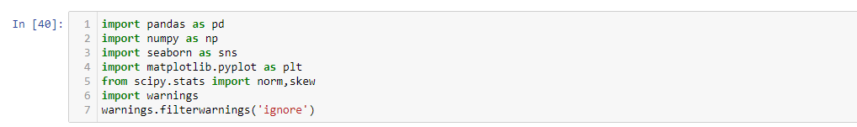
Analytical Problem Framing
DataSources and their formats
Our Data Source is FlipRobo Technologies, who provided the data in csv format during my internship program.
Before loading the dataset we imported some libraries
Now we are loading our dataset using pandas library

Slide 8
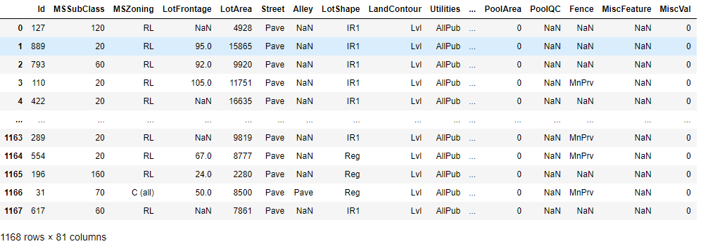
Lets Check our data

Slide 9
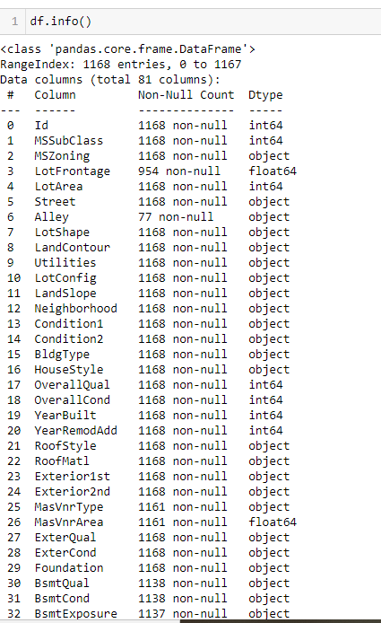
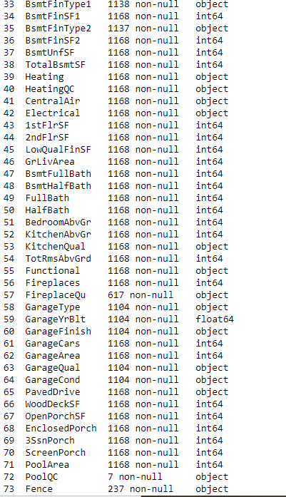
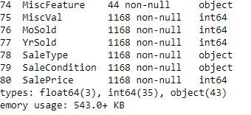

Slide 10
There are 1168 rows and 81 columns in the train data and 292 rows and 80 columns in present the test data
There are 35 intger type of data and 43 object type of data and 3 float type of data present in the dataset

Slide 11

Data Preprocessing
Before going to further steps, we do some data preprocessing. As it is necessary to clean our data before doing any analysis on it.
First we will check null values in dataset by using heatmap.
There are some null values present in the data.
We have to handle these null values.

Slide 12
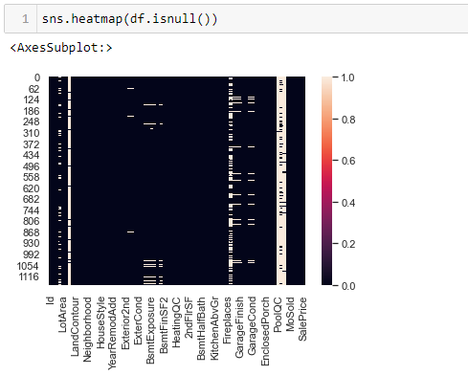
Let us check null values present or not using heatmap also

Slide 13
Harware and Software Requirements and Tools used
There is no such requirement for hardware,
Software: Jupyter Notebook(Anaconda),Microsoft word,Microsoft PowerPoint
Language: Python
Libraries used in project:
Pandas
Numpy
Matplotlib
Seaborn

Slide 14
Exploratory Data Analysis

Slide 15
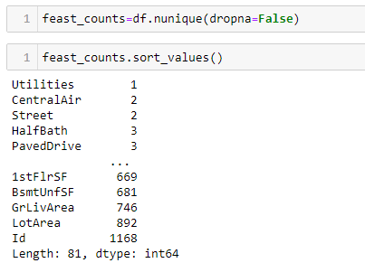

Slide 16
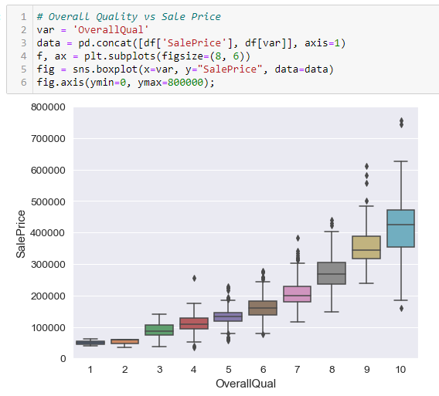
Data Visualization

Slide 17
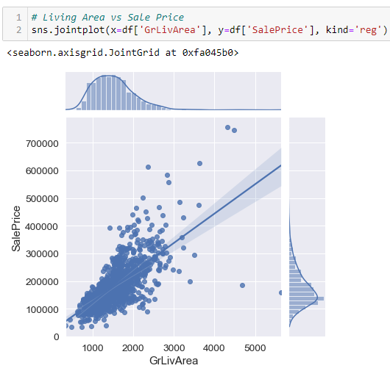
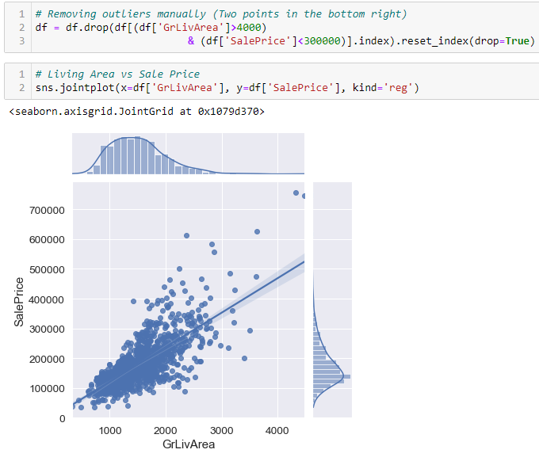

Slide 18
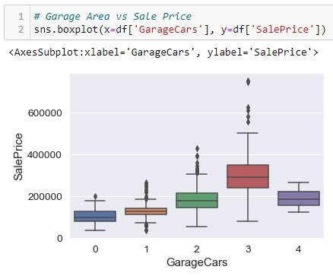
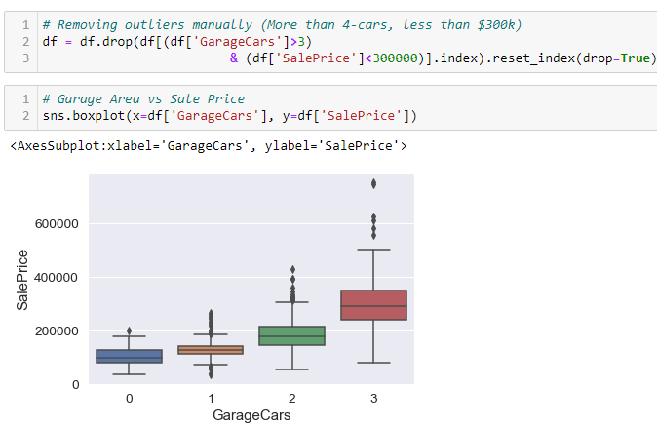

Slide 19
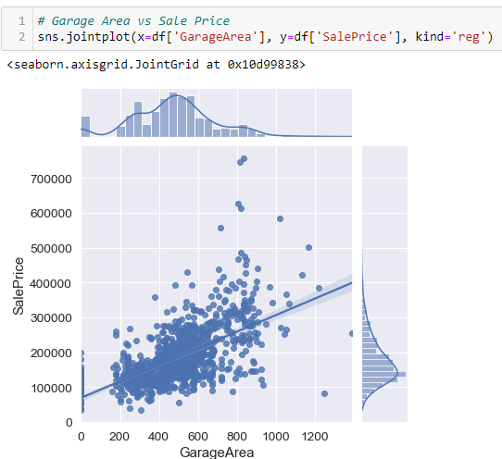

Slide 20
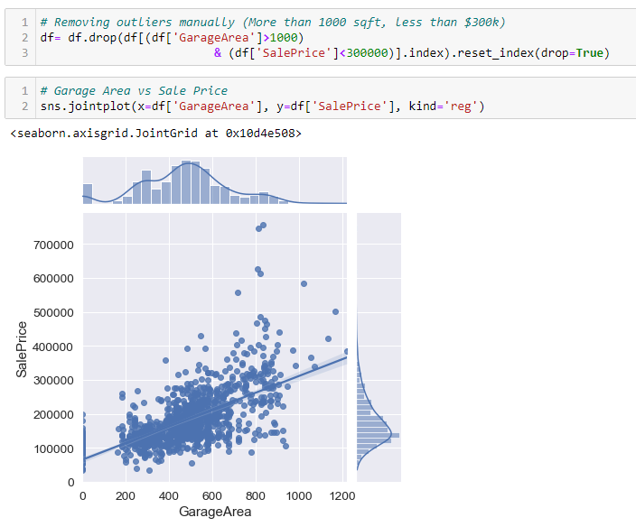
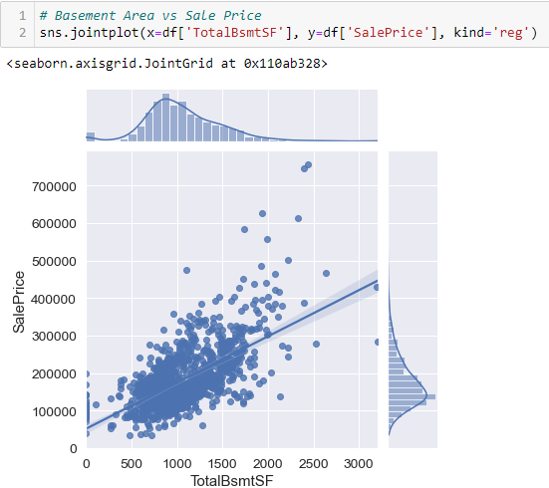

Slide 21
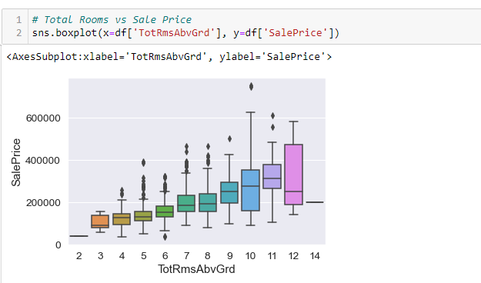

Slide 22
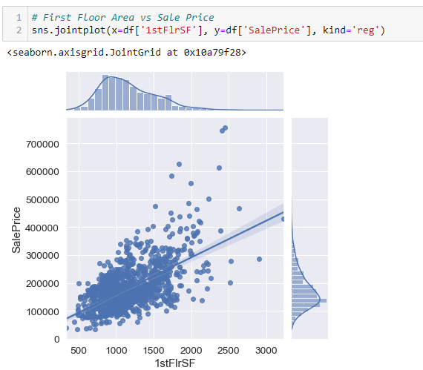

Slide 23
Observations from visualizations
People pay more for better quality? Nothing new here. Let's move on.
It makes sense that people would pay for the more living area. What doesn't make sense is the two datapoints in the bottom-right of the plot.
Nice! We got a 0.02 point increase in the Pearson-R Score.
4-car garages result in less Sale Price? That doesn't make much sense. Let's remove those outliers.
removal of data is totally discretionary and may or may not help in modeling. Use at your own preference.
Again with the bottom two data-points. Let's remove those outliers.
Only 0.01 point Pearson-R Score increase, but looks much better!
It seems like houses with more than 11 rooms come with a $100k off coupon. It looks like an outlier but I'll let it slide. Although it seems like house prices decrease with age, we can't be entirely sure. Is it because of inflation or stock market crashes? Let's leave the years alone.

Slide 24
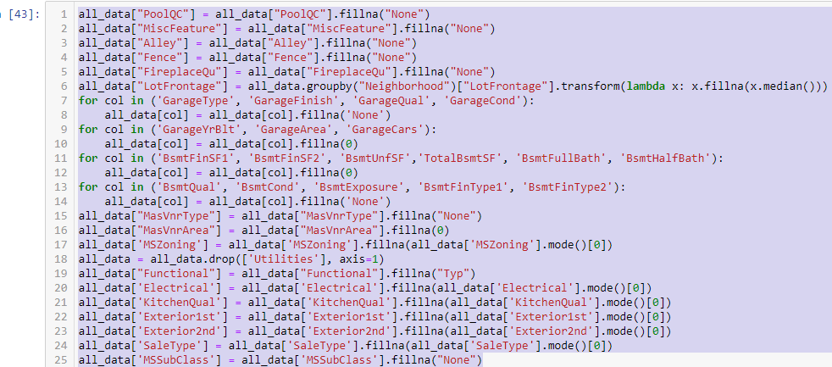

Slide 25
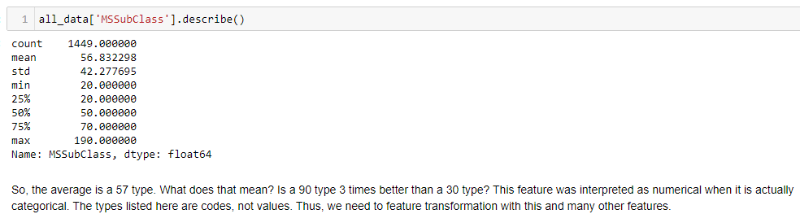
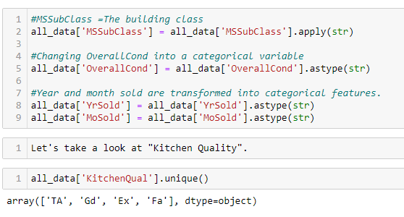
Feature Transformation/Engineering
Encoding

Slide 26
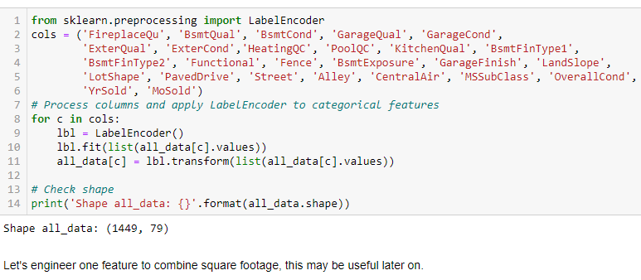

Slide 27
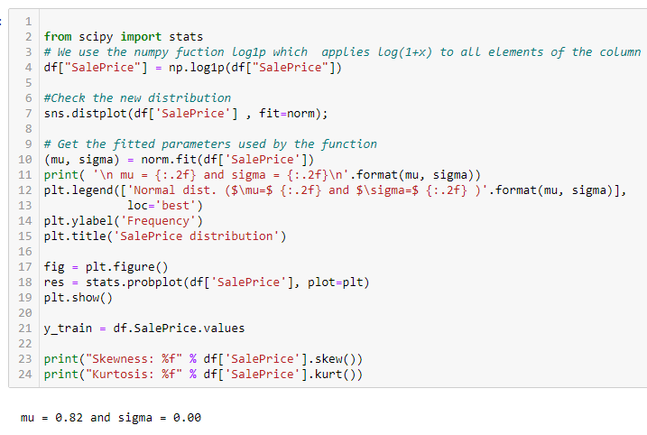
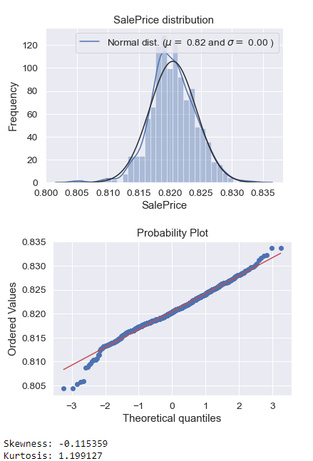

Slide 28
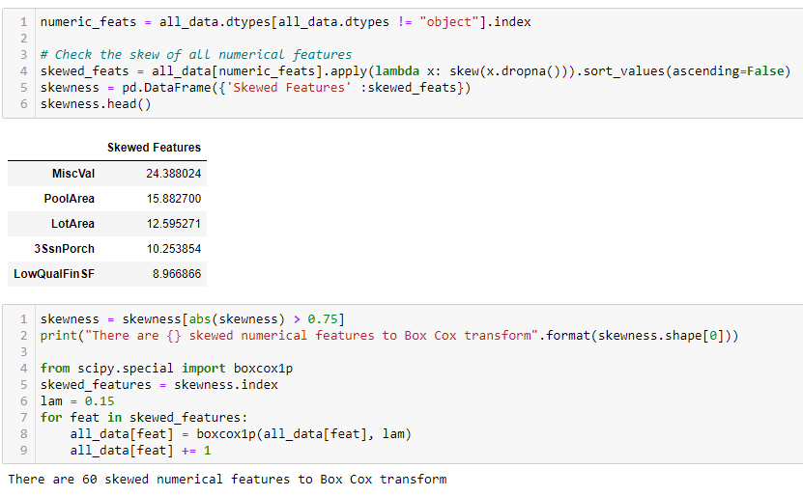
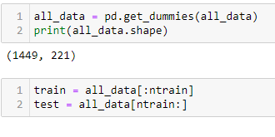

Slide 29
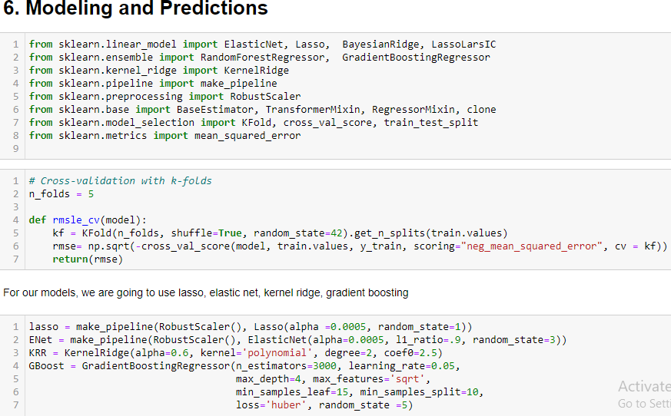

Slide 30
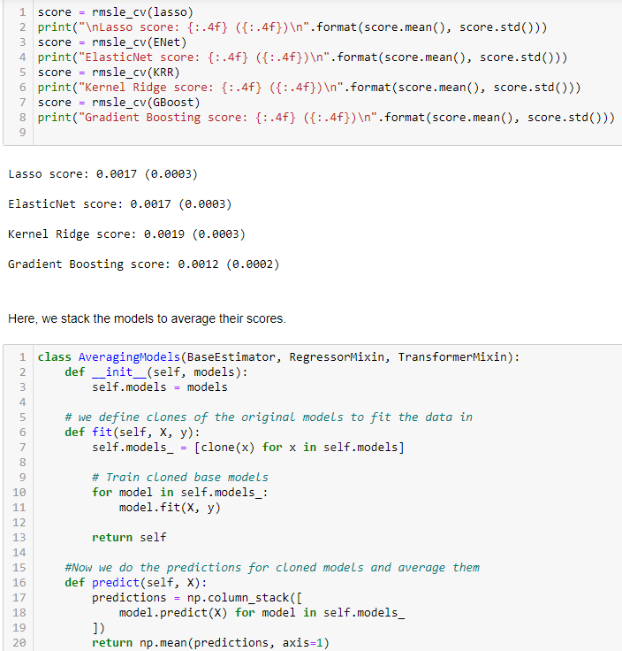

Slide 31
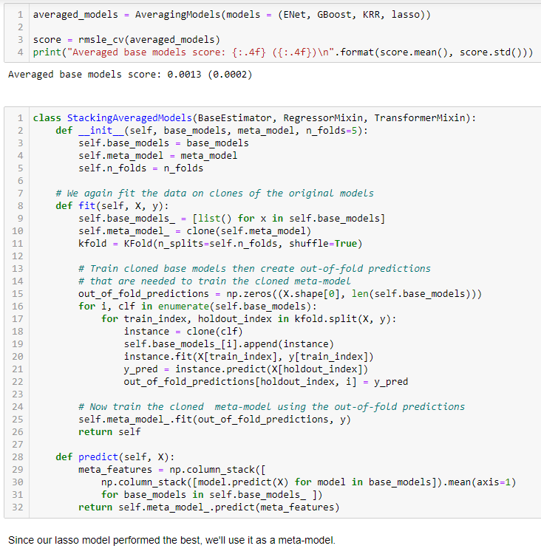

Slide 32
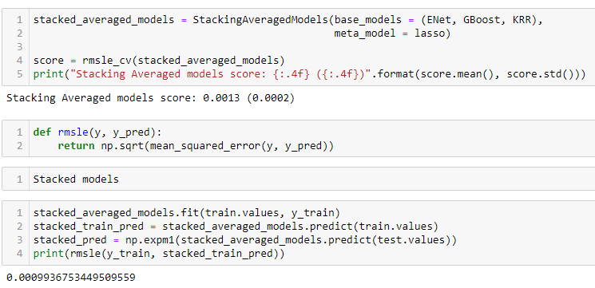
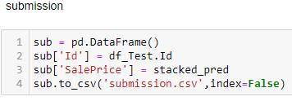

Slide 33
Conclusion: Since outr Lasso model performs well. We
accept this model

