Slide 1
Drawing and Coordinate Systems

Slide 2
Coordinate Systems
World Coordinate system
World window
Screen Coordinate system
Viewport
Window to viewport mapping

Slide 3
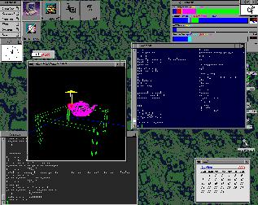
Screen Coordinate System
Glut
OpenGL
(0,0)

Slide 4
Screen Coordinate System
2D Regular Cartesian Grid
Origin (0,0) at lower left
corner (OpenGL convention)
Horizontal axis – x
Vertical axis – y
Pixels are defined at the grid
intersections
This coordinate system is defined
relative to the display window origin
(OpenGL: the lower left corner
of the window)
y
(0,0)
x
(2,2)

Slide 5
World Coordinate System
Application specific – difficult to work directly in screen coordinates
10 feet
20 feet

Slide 6
World Coordinate System
Another example:
plot a sinc function:
sinc(x) = sin(PI*x)/PI*x
x = -4 .. +4

Slide 7
World Coordinate System
It would be nice if we can use application specific coordinates –
world coordinate system
glBegin(GL_LINE_STRIP);
for (x = -4.0; x <4.0; x+=0.1){
GLfloat y = sin(3.14 * x) / (3.14 * x);
glVertex2f (x,y);
}
glEnd();

Slide 8
Define a world window

Slide 9
World Window
World window – a rectangular region in the world that is to be displayed
W_T
Define by
W_L, W_R, W_B, W_T
W_B
Use OpenGL command:
gluOrtho2D(left,right,bottom, top)
W_L
W_R

Slide 10
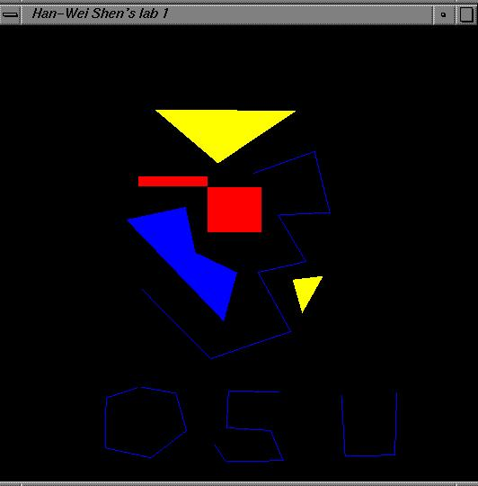
Viewport
The rectangular region in the screen for displaying the graphical objects defined in the world window
Defined in the screen coordinate system
glViewport(int left, int bottom,
int (right-left),
int (top-bottom));
call this function before drawing
(calling glBegin() and
glEnd() )
V_T
V_B
V_L
V_R

Slide 11
To draw in world coordinate system
Two tasks need to be done
  Define a rectangular world window
  (call an OpenGL function)
  Define a viewport (call an OpenGL function)
  Perform window to viewport mapping
  (OpenGL internals will do this for you)

Slide 12
A simple example
DrawQuad()
{
glViewport(0,0,300,200);
glMatrixMode(GL_PROJECTION);
glLoadIdentity();
gluOrtho2D(-1,1,-1,1);
glBegin(GL_QUADS);
glColor3f(1,1,0);
glVertex2f(-0.5,-0.5);
glVertex2f(+0.5,-0.5);
glVertex2f(+0.5,+0.5);
glVertex2f(-0.5,+0.5);
glEnd();
}
(300,200)
(0,0)
viewport
How big is the quad?

Slide 13
Window to viewport mapping
The objects in the world window will then be drawn onto the viewport
viewport
(x,y)
World window
(Sx, Sy)

Slide 14
Window to viewport mapping
How to calculate (sx, sy) from (x,y)?
(x,y)
(Sx, Sy)

Slide 15
Window to viewport mapping
First thing to remember – you don’t need to do it by yourself. OpenGL will do it for you
  You just need to define the viewport (with glViewport()), and the world window (with gluOrtho2D())
But we will look ‘under the hood’

Slide 16
Also, one thing to remember …
A practical OpenGL issue
  Before calling gluOrtho2D(), you need to have the following two lines of code –
    glMatrixMode(GL_PROJECTION);
    glLoadIdentity();
gluOrtho2D(Left, Right, Bottom, Top);

Slide 17
Window to viewport mapping
Things that are given:
  The world window (W_L, W_R, W_B, W_T)
  The viewport (V_L, V_R, V_B, V_T)
  A point (x,y) in the world coordinate system
Calculate the corresponding point (sx, sy) in the screen coordinate system

Slide 18
Window to viewport mapping
Basic principle: the mapping should be proportional
(x,y)
(sx,sy)
(x – W_L) / (W_R – W_L) = (sx – V_L) / (V_R – V_L)
(y - W_B) / (W_T – W_B) = (sy – V_B) / (V_T – V_B)

Slide 19
Window to viewport mapping
(x,y)
(sx,sy)
(x – W_L) / (W_R – W_L) = (sx – V_L) / (V_R – V_L)
(y - W_B) / (W_T – W_B) = (sy – V_B) / (V_T – V_B)
sx = x * (V_R-V_L)/(W_R-W_L) - W_L * (V_R – V_L)/(W_R-W_L) + V_L
sy = y * (V_T-V_B)/(W_T-W_B) – W_B * (V_T-V_B)/(W_T-W_B) + V_B

Slide 20
Some practical issues
How to set up an appropriate world window automatically?
How to zoom in the picture?
How to set up an appropriate viewport, so that the picture is not going to be distorted?

Slide 21
World window setup
The basic idea is to see all the objects in the world
  This can just be your initial view, and the user can change it later
How to achieve it?

Slide 22
World window set up
Find the world coordinates extent that will cover the entire scene
max Y
min Y
min X
max X

Slide 23
Zoom into the picture
Shrink your world window – call gluOrtho2D() with a new range
Viewport

Slide 24
Non-distorted viewport setup
Distortion happens when …
World window and display window have different aspect ratios
Aspect ratio?
R = W / H

Slide 25
Compare aspect ratios
H
W
World window
Aspect Ratio = R
Display window
Aspect Ratio = W / H
R > W / H

Slide 26
Match aspect ratios
H
R
?
W
World window
Aspect Ratio = R
Display window
Aspect Ratio = W / H
R > W / H

Slide 27
Match aspect ratios
H
R
W/R
W
World window
Aspect Ratio = R
Display window
Aspect Ratio = W / H
R > W / H
glViewport(0, 0, W, W/R)

Slide 28
Compare aspect ratios
H
W
World window
Aspect Ratio = R
Display window
Aspect Ratio = W / H
R < W / H

Slide 29
Match aspect ratios
?
H
W
World window
Aspect Ratio = R
Display window
Aspect Ratio = W / H
R < W / H

Slide 30
Match aspect ratios
H * R
H
W
World window
Aspect Ratio = R
Display window
Aspect Ratio = W / H
R < W / H
glViewport(0, 0, H*R, H)

Slide 31
When to call glViewport() ?
Two places:
Initialization
  Default: same as the window size
When the user resizes the display window

Slide 32
Resize (Reshape) window
Void main(int argc, char** argv)
{
…
glutDisplayFunc(display);
glutReshapeFunc(resize);
glutKeyboardFunc(key);
…
}
void resize () – a function
provided by you. It will be
called when the window
changes size.

Slide 33
Resize (reshape) window
Void resize(int W, int H)
{
glViewport(0,0,W, H);
}
This is done by default in GLUT
You can use the call to make
sure the aspect ratio is
fixed that we just discussed.

Slide 34
Put it all together
DrawQuad()
{
glViewport(0,0,300,200);
glMatrixMode(GL_PROJECTION);
glLoadIdentity();
gluOrtho2D(-1,1,-1,1);
glBegin(GL_QUADS);
glColor3f(1,1,0);
glVertex2f(-0.5,-0.5);
glVertex2f(+0.5,-0.5);
glVertex2f(+0.5,+0.5);
glVertex2f(-0.5,+0.5);
glEnd();
}
(300,200)
(0,0)
viewport
How big is the quad?

Slide 35
Well, this works too …
main()
{
…
glBegin(GL_QUADS);
glColor3f(1,1,0);
glVertex2f(-0.5,-0.5);
glVertex2f(+0.5,0);
glVertex2f(+0.5,+0.5);
glVertex2f(-0.5,+0.5);
glEnd();
}
Why?
OpenGL Default:
glViewport: as large as
you display window
gluOrtho2D:
gluOrtho2D(-1,1,-1,1);
Every time you learn a new OpenGL
function, always try to know its default
arguments

