Slide 1
Lemke’s Algorithm:
The Hammer in Your Math Toolbox?
Chris Hecker
definition six, inc.
checker@d6.com

Slide 2
First, a Word About Hammers
“If the only tool you have is a hammer, you tend to see every problem as a nail.”
Abraham Maslow
requirements for this to be a good idea
    a way of transforming problems into nails (MLCPs)
    a hammer (Lemke’s algorithm)
lots of advanced info + one hour = something has to give
    majority of lecture is motivating you to care about the hammer by showing you how useful nails can be
    make you hunger for more info post-lecture
    very little on how the hammer works in this hour

Slide 3
Hammers (cont.)
by definition, not the optimal way to solve problems, BUT
  computers are very fast these days
  often don’t care about optimality
    prepro, prototypes, tools, not a profile hotspot, etc.
  can always move to optimal solution after you verify it’s a problem you actually want to solve

Slide 4
What are “advanced game math problems”?
problems that are ammenable to mathematical modeling
    state the problem clearly
    state the desired solution clearly
    describe the problem with equations so a proposed solution’s quality is measurable
    figure out how to solve the equations
why not hack it?
    I believe better modeling is the future of game technology development (consistency, not reality)

Slide 5
Prerequisites
linear algebra
    vector, matrix symbol manipulation at least
calculus concepts
    what derivatives mean
comfortable with math notation and concepts

Slide 6
Overview of Lecture
random assortment of example problems breifly mentioned
5 specific example problems in some depth
    including one that I ran into recently and how I solved it
generalize the example models
transform them all to MLCPs
solve MLCPs with Lemke’s algorithm

Slide 7
A Look Forward
linear equations
Ax = b
linear inequalities
Ax >= b
linear programming
min c^{T}x
s.t. Ax >= b, etc.
quadratic programming
min ½ x^{T}Qx + c^{T}x
s.t. Ax >= b
Dx = e
linear complimentarity problem
a = Af + b
a >= 0, f >= 0
a_{i}f_{i} = 0

Slide 8
Applications to Games graphics, physics, ai, even ui
computational geometry
visibility
contact
curve fitting
constraints
integration
graph theory
network flow
economics
site allocation
game theory
IK
machine learning
image processing

Slide 9
Applications to Games (cont.)
don’t forget...
  The Elastohydrodynamic Lubrication Problem
  Solving Optimal Ownership Structures
    “The two parties establish a relationship in which they exchange feed ingredients, q, and manure, m.”

Slide 10
Specific Examples #1a:
Ease Cubic Fitting
warm up with an ease curve cubic
x(t)=at³+bt²+ct+d
x’(t)=3at²+2bt+c
4 unknowns a,b,c,d (DOFs) we get to set, we choose:
x(0) = 0, x(1) = 1
x’(0) = 0, x’(1) = 0
1
x
0
0
t
1

Slide 11
Specific Examples #1a:
Ease Cubic Fitting (cont.)
x(t)=at³+bt²+ct+d, x’(t)=3at²+2bt+c
x(0) = a0³+b0²+c0+d = d = 0
x(1) = a1³+b1²+c1+d = a+b+c+d = 1
x’(0) = 3a0²+2b0+c = c = 0
x’(1) = 3a1²+2b1+c = 3a + 2b + c = 0

Slide 12
Specific Examples #1a:
Ease Cubic Fitting (cont.)
d = 0, a+b+c+d = 1, c = 0, 3a + 2b + c = 0
a+b=1, 3a+2b=0
a=1-b => 3(1-b)+2b = 3-3b+2b = 3-b = 0
b=3, a=-2
x(t) = 3t² - 2t³

Slide 13
Specific Examples #1a:
Ease Cubic Fitting (cont.)
or,
x(0) = d = 0
x(1) = a + b + c + d = 1
x’(0) = c = 0
x’(1) = 3a + 2b + c = 0
x(0)
x(1)
x’(0)
x’(1)
0 0 0 1
1 1 1 1
0 0 1 0
3 2 1 0
a
b
c
d
0
1
0
0
=
=
(can solve for any rhs)
Ax = b, a system of linear equations

Slide 14
Specific Examples #1b:
Cubic Spline Fitting
same technique to fit higher order polynomials, but they “wiggle”
piecewise cubic is better
“natural cubic spline”
x_{i}(t_{i})=x_{i} x_{i}(t_{i+1})=x_{i+1}
x’_{i}(t_{i}) - x’_{i-1}(t_{i}) = 0
x’’_{i}(t_{i}) - x’’_{i-1}(t_{i}) = 0
there is coupling between the splines, must solve simultaneously
x₂
x₃
x₀
x₁
t₀
t₁
t₂
t₃
4 DOF per spline
  2 endpoint eqns per spline
  4 derivative eqns for inside points
  2 missing eqns = endpoint slopes

Slide 15
Specific Examples #1b:
Cubic Spline Fitting (cont.)
x_{i}(t_{i})=x_{i} x_{i}(t_{i+1})=x_{i+1}
x’_{i}(t_{i}) - x’_{i-1}(t_{i}) = 0
x’’_{i}(t_{i}) - x’’_{i-1}(t_{i}) = 0
a₀
b₀
c₀
d₀
a₁
b₁
c₁
d₁
.
.
.
x₀
x₁
0
0
x₁
x₂
0
0
.
.
.
Ax = b, a system of
linear equations
=
.
.
.

Slide 16
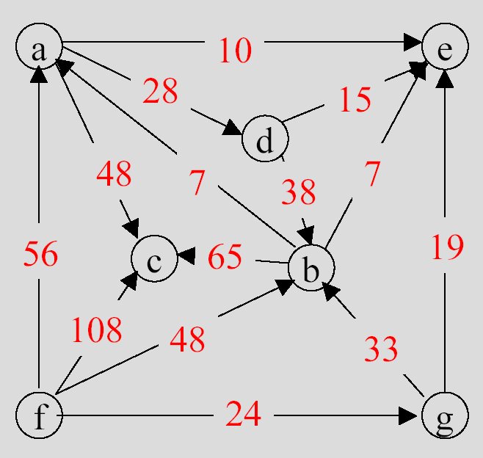
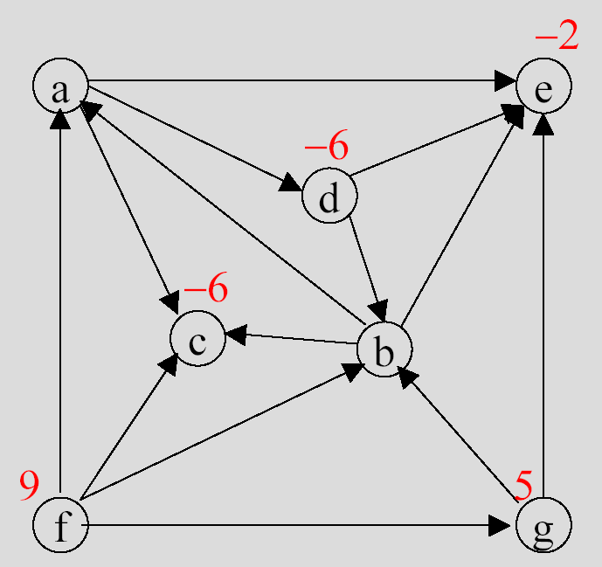
Specific Examples #2:
Minimum Cost Network Flow
what is the cheapest flow route(s) from sources to sinks?
model, want to minimize cost
c_{ij} = cost of i to j arc
b_{i} = i’s supply/demand, sum(b_{i})=0
x_{ij} = quantity shipped on i to j arc
x_{*k} = sum(x_{ik}) = flow into k
x_{k*} = sum(x_{ki}) = flow out of k
flow balance: x_{*k} - x_{k*} = -b_{k}
one-way streets: x_{ij} >= 0

Slide 17
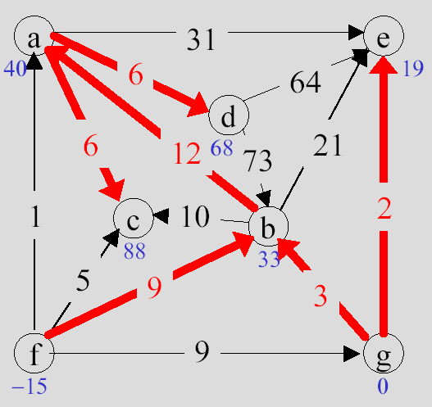
Specific Examples #2:
Minimum Cost Network Flow (cont.)
min cost: minimize c^{T}x
    the sum of the costs times the quantities shipped (c^{T}x = c ·x)
flow balance is coupling: matrix
x_{*k} - x_{k*} = -b_{k}
x_{ac}
x_{ad}
x_{ae}
x_{ba}
x_{bc}
x_{be}
x_{db}
.
.
.
b_{a}
b_{b}
b_{c}
b_{d}
.
.
.
minimize c^{T}x
subject to
Ax = -b
x >= 0
a linear programming problem
-1 -1 -1 1 0 0 0 0 1 0…
0 0 0 -1 -1 -1 1 …
...
= -

Slide 18
Specific Examples #3:
Points in Polys
point in convex poly defined by planes
n₁ · x >= d₁
n₂ · x >= d₂
n₃ · x >= d₃
farthest point in a direction in poly, c:
n₃
n₂
Ax >= b,
linear inequality
x
n₁
min -c^{T}x
s.t. Ax >= b
linear programming

Slide 19
Specific Examples #3:
Points in Polys (cont.)
closest point in two polys
min (x₂-x₁)²
s.t. A₁x₁ >= b₁
A₂x₂ >= b₂
stack ‘em in blocks, Ax >= b
n₃
n₂
x₁
n₁
x₁
x₂
b₁
b₂
x =
b =
A =
A₁ A₂
x₂
what about (x₂-x₁)², how do we stack it?

Slide 20
Specific Examples #3:
Points in Polys (cont.)
how do we stack x₁,x₂ into single x given
(x₂-x₁)² = x₂²-2x₂•x₁+x₁²
1 -1
-1 1
x₁
x₂
= x₂²-2x₂ • x₁+x₁² = x^{T}Qx
x₁^{T} x₂^{T}
x² = x^{T}x = x · x
1 = identity matrix
min x^{T}Qx
s.t. Ax >= b
a quadratic programming problem

Slide 21
Specific Examples #3:
Points in Polys (cont.)
more points, more polys!
min (x₂-x₁)² + (x₃-x₂)² + (x₃-x₁)²
x₁
x₂
x₃
2 -1 -1
-1 2 -1
-1 -1 2
x₁^{T} x₂^{T} x₃^{T}
= x^{T}Qx
min x^{T}Qx
s.t. Ax >= b
another quadratic programming problem
same form for all these poly problems
never specified 2d, 3d, 4d, nd!

Slide 22
Specific Examples #4:
Contact
model like IK constraints
a = Af + b
a >= 0, no penetrating
f >= 0, no pulling
a_{i}f_{i} = 0, complementarity
(can’t push if leaving)
a₁
a₂
f₁
f₂
a₁
a₂
linear complementarity problem
f₁
f₂
it’s a mixed LCP if some a_{i} = 0, f_{i} free, like for equality constraints

Slide 23
Specific Examples #5:
Joint Limits in CCD IK
a₁
how to do child-child constraints in CCD?
    parent-child are easy, but need a way to couple two children to limit them relative to each other
how to model this & handle all the cases?
define d_{n}= g_{n} - a_{n}
min (x₁ - d₁)² + (x₂ - d₂)²
s.t. c_{1min} <= a₁+x₁ - a₂-x₂ <= c_{1max}
parent-child are easy in this framework: c_{2min} <= a₁+x₁ <= c_{2max}
another quadratic program:
min x^{T}Qx
s.t. Ax >= b
g₁
a₂
a₁
g₂
g₁

Slide 24
What Unifies These Examples?
linear equations
Ax = b
linear inequalities
Ax >= b
linear programming
min c^{T}x
s.t. Ax >= b, etc.
quadratic programming
min ½ x^{T}Qx + c^{T}x
s.t. Ax >= b
Dx = e
linear complimentarity problem
a = Af + b
a >= 0, f >= 0
a_{i}f_{i} = 0

Slide 25
QP is a Superset of Most
quadratic programming
min ½x^{T}Qx + c^{T}x
s.t. Ax >= b
Dx = e
linear equations
    Ax = b
    Q, c, A, b = 0
linear inequalities
    Ax >= b
    Q, c, D, e = 0
linear programming
    min c^{T}x
    s.t. Ax >= b, etc.
    Q, etc. = 0
but MLCP is a superset of convex QP!

Slide 26
Karush-Kuhn-Tucker Optimality Conditions get us to MLCP
min ½ x^{T}Qx + c^{T}x
s.t. Ax - b >= 0
Dx - e = 0
for QP
form “Lagrangian”
L(x,u,v) = ½ x^{T}Qx + c^{T}x - u^{T}(Ax - b) - v^{T}(Dx - e)
for optimality (if convex):
∂L/ ∂x = 0
Ax - b >= 0
Dx - e = 0
u >= 0 u_{i}(Ax-b)_{i} = 0
  this is related to basic calculus min/max f’(x) = 0 solve

Slide 27
Karush-Kuhn-Tucker Optimality Conditions (cont.)
L(x,u,v) = ½ x^{T}Qx + c^{T}x - u^{T}(Ax - b) - v^{T}(Dx - e)
y = ∂L/ ∂x = Qx + c - A^{T}u - D^{T}v = 0, x free
w = Ax - b >= 0, u >= 0, w_{i}u_{i} = 0
s = Dx - e = 0, v free
y
s
w
x
v
u
c
-e
-b
y, s = 0
x, v free
w, u >= 0
w_{i}u_{i} = 0
Q -D^{T} -A^{T}
D 0 0
A 0 0
=
+

Slide 28
This is an MLCP
y
s
w
x
v
u
c
-e
-b
y, s = 0
x, v free
w, u >= 0
w_{i}u_{i} = 0
Q -D^{T} -A^{T}
D 0 0
A 0 0
=
+
a
=
A
f
+
b
a_{i}f_{i} = 0
some a >= 0, some = 0
some f >= 0, some free
(but they correspond so complementarity holds)

Slide 29
Modeling Summary
a lot of interesting problems can be formulated as MLCPs
  model the problem mathematically
  transform it to an MLCP
      on paper or in code with wrappers
  but what about solving MLCPs?

Slide 30
Solving MLCPs
(where I hope I made you hungry enough for homework)
Lemke’s Algorithm is only about 2x as complicated as Gaussian Elimination
Lemke will solve LCPs, which some of these problems transform into
then, doing an “advanced start” to handle the free variables gives you an MLCP solver, which is just a bit more code over plain Lemke’s Algorithm

Slide 31
Playing Around With MLCPs
PATH, a MCP solver (superset of MLCP!)
    really stoked professional solver
    free version for “small” problems
    matlab or C
OMatrix (Matlab clone) free trial (omatrix.com)
    only LCPs, but Lemke source is in trial
        not a great version, but it’s really small (two pages of code) and quite useful for learning, with debug output
        good place to test out “advanced starts”
my Lemke’s + advanced start code
    not great, but I’m happy to share it
    it’s in Objective Caml :)

Slide 32
References for Lemke, etc.
free pdf book by Katta Murty on LCPs, etc.
free pdf book by Vanderbei on LPs
The LCP, Cottle, Pang, Stone
Practical Optimization, Fletcher
web has tons of material, papers, complete books, etc.
email to authors
    relatively new math means authors are still alive, bonus!

Slide 34
Specific Examples #5:
Constraints for IK
compute “forces” to keep bones together
a₁ = A₁₁ f₁ + b₁
a₁ : relative acceleration
at constraint
f₁ : force at constraint
b₁ : external forces converted to
accelerations at constraints
A₁₁ : force/acceleration relation matrix
f_{e}
f₁

Slide 35
Specific Examples #5:
Constraints for IK (cont.)
multiple bodies gives coupling...
a₁
a₂
A₁₁ A₁₂
A₂₁ A₂₂
f₁
f₂
b₁
b₂
=
+
a = Af + b
a = 0 for rigid constraints
Af = -b, linear equations
f_{e}
f₁
f₂

