Slide 1


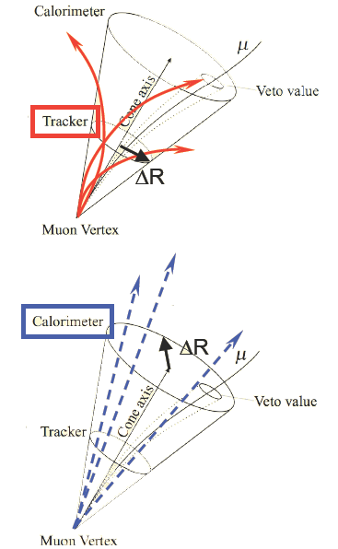
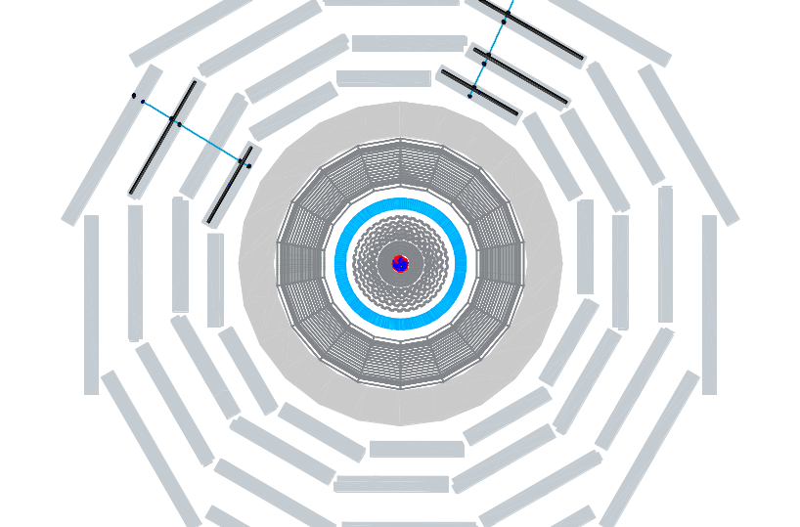
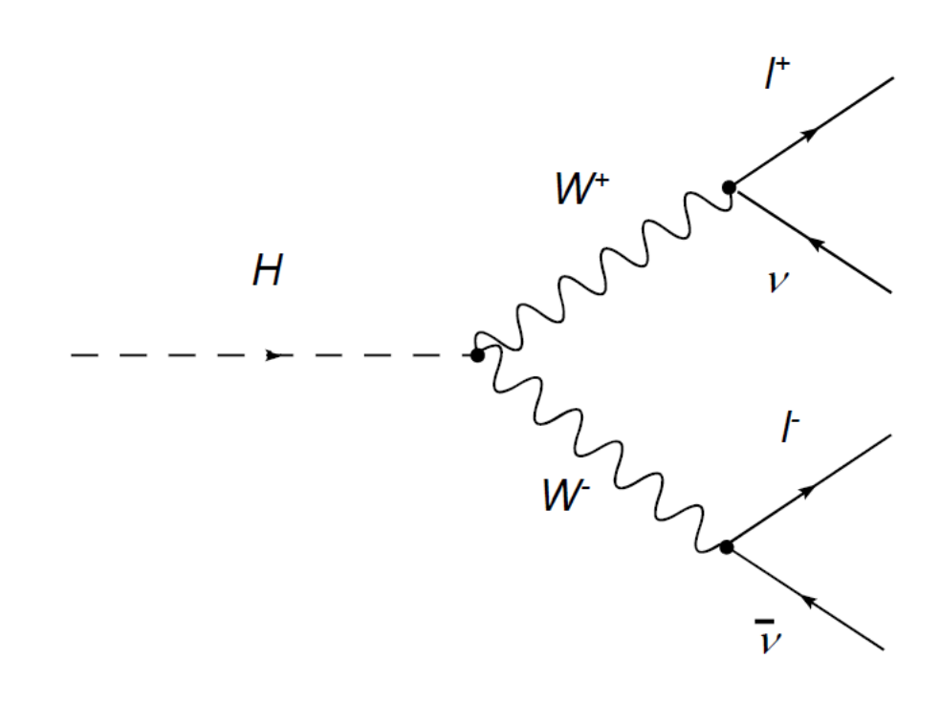
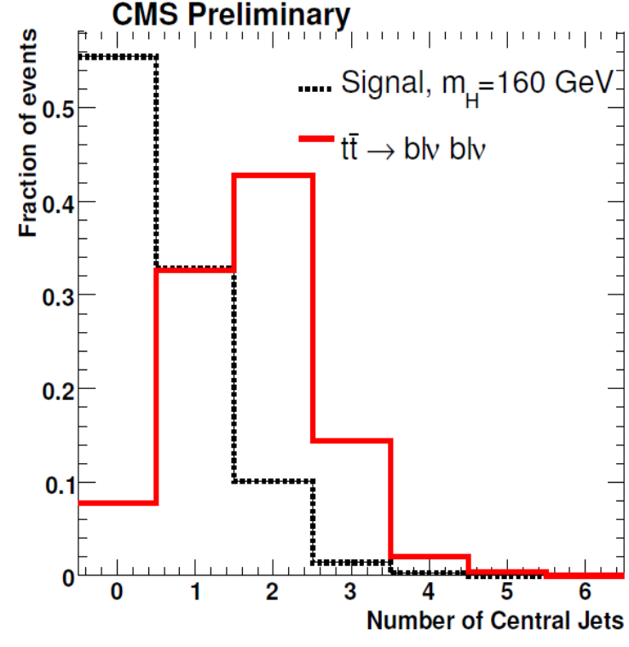
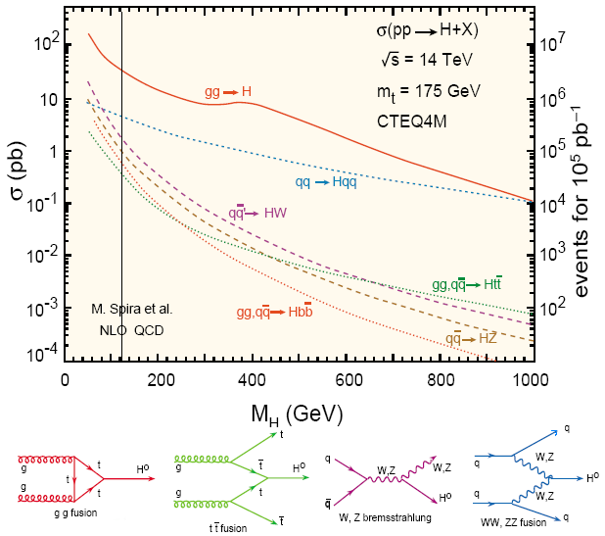
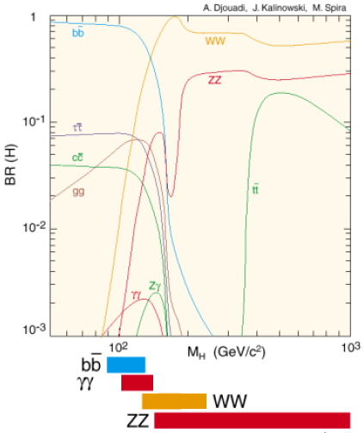
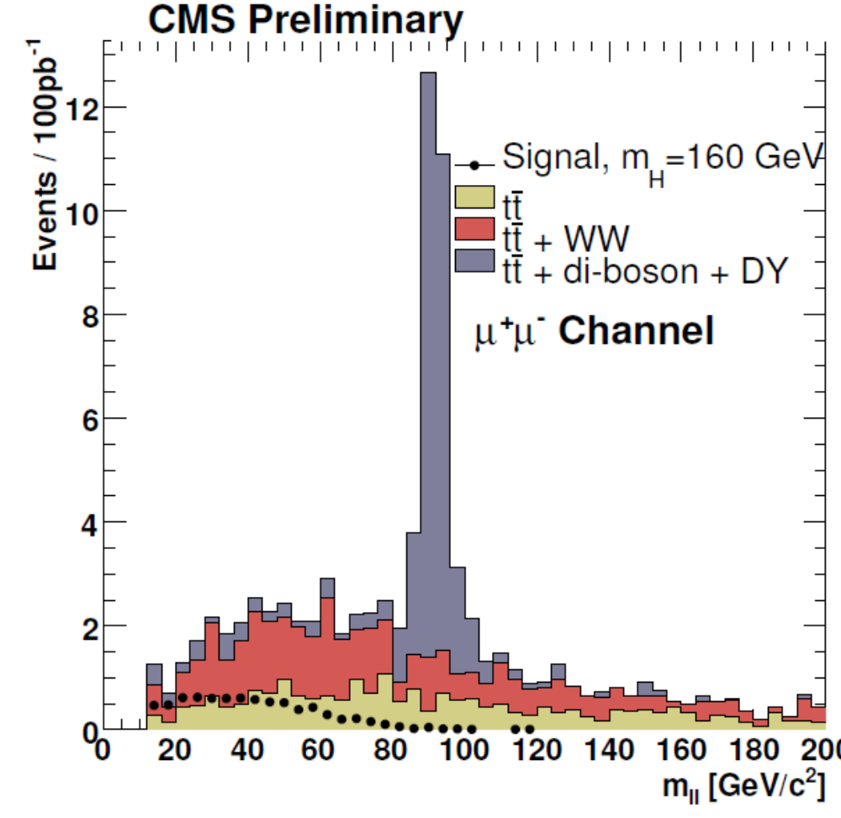
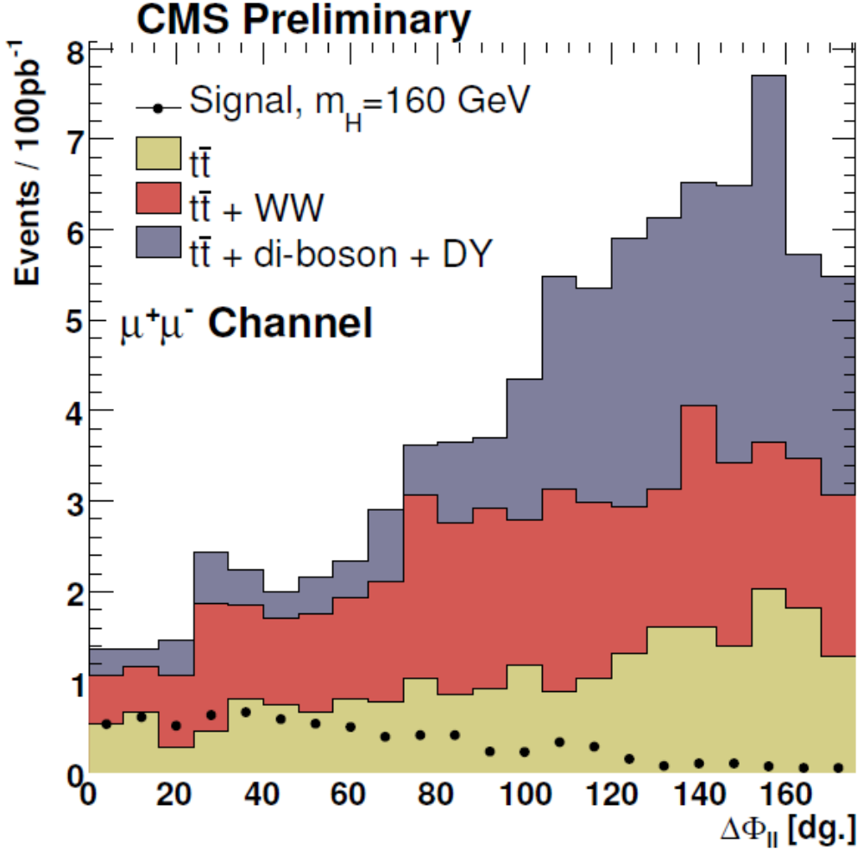
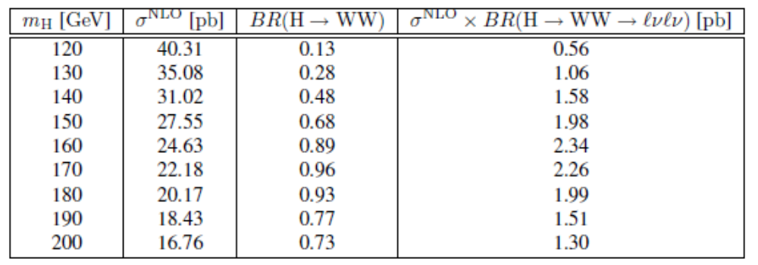

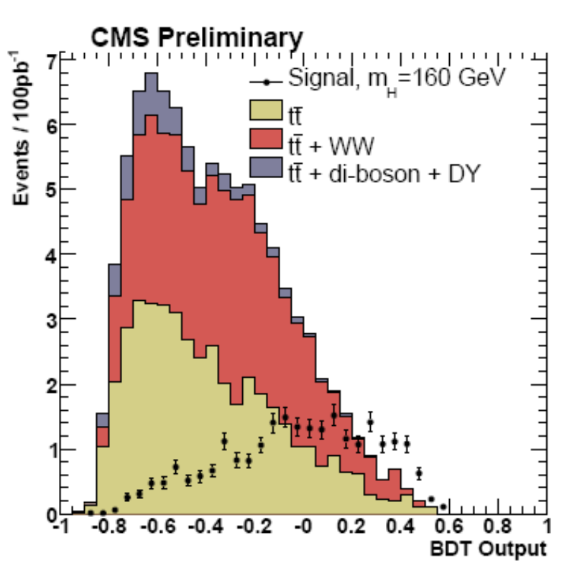
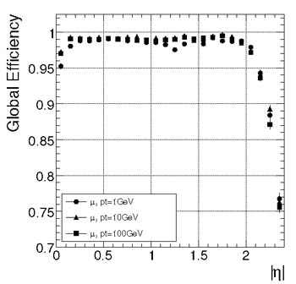
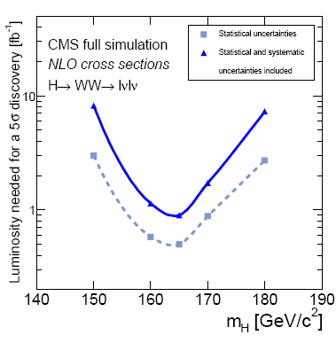


Discovery Potential for the SM Higgs Boson in
the H → WW* → 2l2ν channel at LHC
R. González Suárez ^{a)}
on behalf of the CMS Collaboration
CMS NOTE Hig_07_001
CMS Analysis Note 2007/037
1. Introduction
^{a)} U. de Cantabria,IFCA, Santander, Spain, rebeca@cern.ch
2.2 Lepton selection
Prospective search of the SM Higgs boson with the CMS detector. Establishing an analysis strategy for inclusive production of the Higgs boson decaying in WW* pairs in the context of the early LHC data.
Higgs mass region between 120-200 GeV, in which this signature was proposed as highly sensitive [2], has been studied.
W → ℓν are considered. Final states with ee, μμ, or eμ, significant MET and without the presence of jets.
This study uses MC events with full detector simulation, including limited calibration and alignment precision as expected at the startup.
Sets of sequential cuts are applied to each of the three topologies, in order to isolate a signal which exceeds the tt and continuum W⁺W⁻ backgrounds. Alternatively, an artificial neural network (ANN) multi-variate analysis technique is used.
Events are required to have exactly two leptons with:
- opposite electric charge sign
- |η| ≤ 2.5
- p_{T} ≥ 10, 20 GeV
- isolated with tracks
- isolated in the calorimeter
If more than two are found, the event is rejected (against WZ and ZZ backgrounds)
2.3 Jet Veto and Missing ET
No hard jet activity in the central region is expected for signal, which can be used against ttbar background.
Jets reconstructed using iterative cone algorithm with ΔR=0.5. If an event contains any jet with p_{T} >15 GeV and |η| < 2.5, it is rejected (also against: Wtb, QCD, Z+jets, W+jets).
1.1 Decay and production modes
A significant missing energy is expected due to the neutrinos in the final state, and is computed from the raw tower energies.
H → W W(*) is the dominant Higgs decay mode in a wide mass range, and for:
2m_{W} < my < 2m_{Z}
the Branching ratio is close to 1 (BR ~1)
The MET cut is specially useful against Drell-Yan background after mll cut
2.4 Kinematic variables
To optimize the signal event selection against the main backgrounds:
- angle between the leptons in the transverse plane ΔΦ_{ℓℓ}.
For WW events this angle is expected to be large (leptons back-to-back), for the scalar SM Higgs boson this angle tends to be small (spin correlations).
-invariant mass of the lepton pair m_{ℓℓ}.
An upper cut is applied in the case of e⁺e⁻, μ⁺μ⁻ final states to reduce the contamination by leptons coming from Z-boson decays.
- transverse momenta of the harder (p_{T}^{ℓ,max}) and the softer (p_{T}^{ℓ,min}) lepton
upper/lower limit applied in order to reduce the background further.
SM Higgs in this mass range is mainly produced via:
Gluon fusion (ggH): no hard jet activity
Vector-boson fusion (VBF) (qqH): 2 forward jets, opposite in rapidity, high mass
The leptonic final states of the W bosons give good signature of the Higgs boson
1.2 Signal and background topology
Topology of the signal: H → W W(*) → 2l 2ν
  2 leptons
  (with opposite charge, small opening angle)
  missing energy (undetected neutrinos)
No mass peak (Importance of background control)
Sources of background: multi-lepton final states + Missing ET
Main backgrounds:
Di-boson production, especially WW (but also WZ, ZZ) ,
ttbar (tW and bb also),
Drell-Yan, W + jets (jets faking electrons)…
Really big cross-sections
when compared with the signal !
3. Analysis
Split in three complementary topologies (e⁺e⁻, μ⁺μ⁻ and e±μ±)
Two approaches: Sequential cuts and multivariate.
Common for all the final states
Skimming
Reduce data volume
Select interenting events
2. Event Selection and Analysis
Pre-selection
Define common objects for the analysis/select events
2.1 Trigger and lepton identification
Final state cuts
ee, eμ, and μμ
- Experimental differences in the identification of e and µ
- Some bckg. processes do not equally affect all the final states
The amount of signal events recorded by the CMS experiment will depend on the trigger efficiency. We consider 9 lepton trigger paths which we plan to use to select pp → H → ℓℓ'νν with high efficiency at luminosities in the range 10³¹ to 10³³ cm⁻² s⁻¹.
Jet Veto
Cuts on sensible variables:
Missing E_{T}
ΔΦ
Inv. Mass
P_{T} leptons
HLT paths
μμ | ee | eμ
HLT1MuonIso | HLT1Electron
HLT1MuonNonIso | HLT1ElectronRelaxed
 | HLT2Electron | HLTXElectronMuon
HLT2MuonNonIso | HLT2ElectronRelaxed | HLTXElectronMuonRelaxed
Multivariate
Analysis
Sequential cuts
The combination of the analyses improves CMS discovery potential
4. Results
Physics TDR [1] conclusion:
SM Higgs boson could be discovered in the H → WW → lνlν channel with less than 1fb⁻¹ if its mass is around 165 GeV
Standard CMS lepton reconstruction techniques are used.
The effective selection of e and μ should show high efficiency for true isolated leptons from W boson decays, while at the same time effectively suppressing leptons from heavy quark decays or fake leptons produced by other objects.
The identification of electrons is tight (to reduce contamination by W+jets), based on the matching of a charged track reconstructed in the central tracker with a supercluster in the electromagnetic calorimeter [3][4].
Muon candidates are identified by matching a track reconstructed in the muon detectors with a track reconstructed in the central tracker[4][5].
Progress has been made toward a search for the Higgs boson in this channel. The selection of events with leptons, missing energy, and no central jets is a good starting point for this search.
5. References
[1] CMS Collaboration, "CMS Physics Technical Design Report (Vol II)," J. Phys. G:
Nucl. Part. Phys. 34,995-1579 (2007).
[2] M.Dittmar and H.K.Dreiner Phys. Rev. D 55 (1997) 167.
[3] S. Baffioni et al., "Electron reconstruction in CMS," CMS NOTE-2006/040, and Eur.Phys.J. C49 (2007) 1099-1116.
[4] CMS Collaboration, "The CMS experiment at the CERN LHC," To be published in JINST.
[5] G. Bellan et al. Nucl. Phys. Proc. Suppl.177-178:253-254 (2008).
ICHEP08: 34th International Conference on High Energy Physics
Philadelphia, PA, United States; 29 July-5 August 2008

