Slide 1


EW Symmetry Breaking at LHC
Rebeca González Suárez
IFCA
On behalf of the ATLAS and CMS Collaborations
7 July 2009
PASCOS 2009: 15th International Symposium on Particles, Strings and Cosmology, Hamburg, DESY (Germany)

Slide 2
Simplest mode of EW symmetry breaking…
Revealing the physical mechanism responsible for the breaking of electroweak symmetries is one of the most important open questions of contemporary particle physics; and therefore, is one of the main physics goals for the LHC.
A simple mechanism for the breaking of the EW symmetry can be incorporated to the Standard Model (SM) → Higgs Mechanism
The Higgs Mechanism:
Leaves the Standard Model mostly untouched
Adds a scalar, the Higgs boson, which we can search for.
→ Its mass is a free parameter of the theory
There are many proposed breaking mechanisms of the EW symmetry (multiple higgses, technicolor…), the LHC data will help to discriminate among them.
But in this talk, I will concentrate in some of the prospective searches that will take place at LHC’s experiments oriented to find a SM Higgs boson (and they are many…).

Slide 3
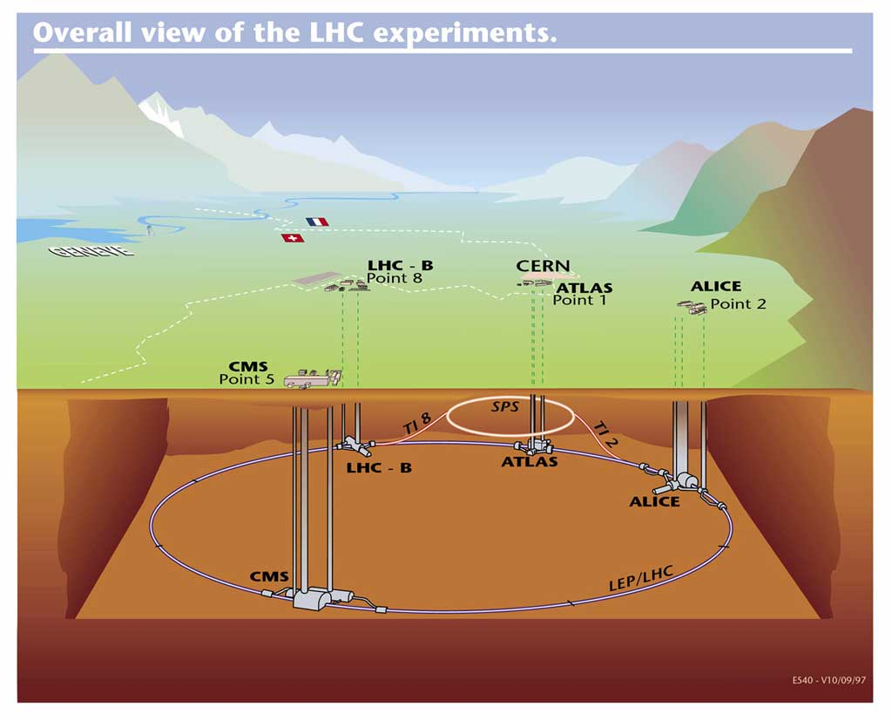
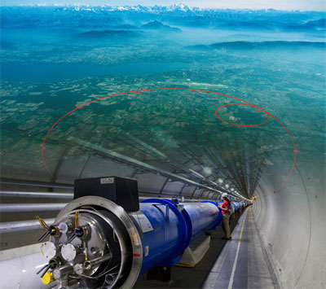
The Large Hadron Collider
The Large Hadron collider is a 26 Km long circular accelerator built at CERN, near Geneva, in Switzerland.
The magnetic field is created by 1232 superconducting dipole magnets (plus hundreds of focusing and correction magnets) arranged in a ring in the tunnel.
It has 4 big experiments (ALICE, ATLAS, CMS, LHCb), two of them (CMS and ATLAS) are intended for general purposes.
The design (proton-proton) collision energy is the highest ever: 14 TeV
(~10TeV intended for the first data)
It’s set up to re-start this fall! (cross-fingers)

Slide 4
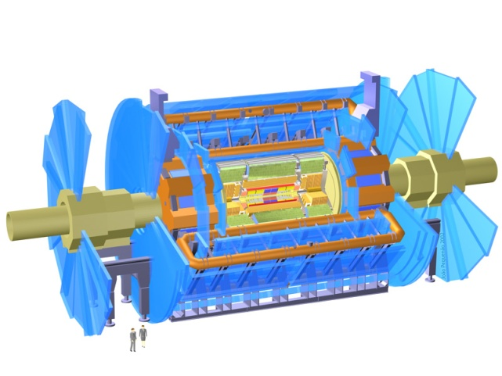
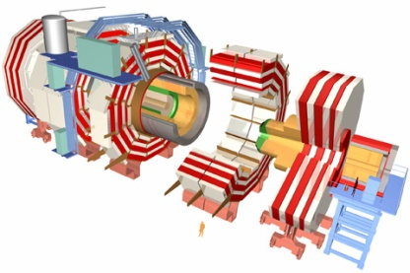
ATLAS Vs. CMS
 | ATLAS (A Toroidal LHC ApparatuS) | CMS (Compact Muon Solenoid)
Dimensions | Width: 44m Diameter: 22 m Weight: 7.000 t | Width: 22 m Diameter: 15 m Weight: 14.500 t
Magnetic Field | 2T solenoid + 3 toroid (0.5T barrel, 1T endcaps) | 4T solenoid + return yoke
Tracker | Si pixels, strips + TRT | Si pixels, strips
ECAL | Pb + LAr (Liquid Argon Calorimeter) (Optimized towards background rejection) | PbWO4 crystals (Crystal calorimeter) (optimized towards precise measurements)
HCAL | Fe + scint. / Cu + LAr (10λ) | Cu + scintillator (5.8λ + catcher)
Muon System | Air core spectrometer | Iron core spectrometer
Trigger | 3 – Level (region-of-interest 2-Level) | 2 - Level
Similar concepts, different execution, detector technologies, design emphasis…

Slide 5
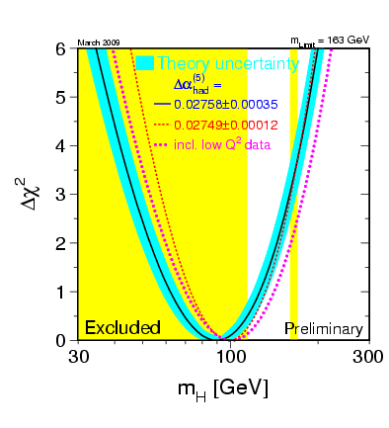
Searching for a SM Higgs: Direct searches
LEP experiments have set a 95% CL lower limit of m_{H} ≥ 114 GeV.
In addition to that, the precision electroweak measurements tell us that the mass of the Standard-Model Higgs boson is lower than ~163 GeV.
This limit increases to 191 GeV when including the LEP-2 data.
The Tevatron experiments CDF and DØ also search for the Standard-Model Higgs boson; the most recent combined result excludes the mass range of 160 GeV to 170 GeV at 95%CL.
Directly measured: m_{H} > 114 GeV and outside the [160, 170] interval
Indirect (precision fit): m_{H} < 163 GeV; including LEP2 m_{H} < 191 GeV
http://lepewwg.web.cern.ch/LEPEWWG/

Slide 6
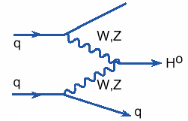

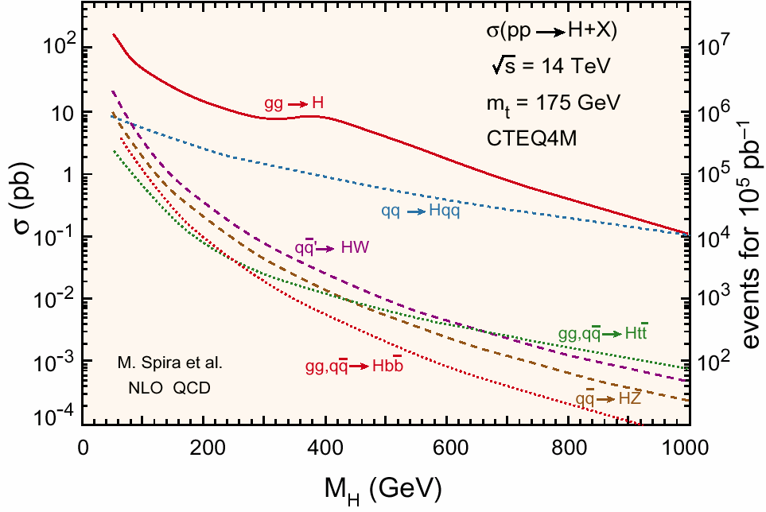

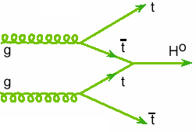
SM Higgs production at LHC
(VBF) W,Z fusion
< 10% unc. NLO
K ~ 1.1
increasingly important at high masses
gluon-gluon fusion
K ~ 2
Unc. NNLO 10-20%
Large backgrounds
at low mass
gg fusion dominates
< 5% unc. NNLO
K ~1.4
associated production in the low mass region
(‘easy’ triggering)
tt-fusion
~10% unc. NLO
K ~1.2

Slide 7
SM Higgs production at LHC
(VBF) W,Z fusion
< 10% unc. NLO
K ~ 1.1
increasingly important at high masses
gluon-gluon fusion
K ~ 2
Unc. NNLO 10-20%
Large backgrounds
at low mass
gg fusion dominates
Quite a Small Window!
< 5% unc. NNLO
K ~1.4
associated production in the low mass region
(‘easy’ triggering)
tt-fusion
~10% unc. NLO
K ~1.2

Slide 8
SM Higgs decays
Including quark mass uncertainties (t, b, c) and α_{s}(M_{Z})
At low mass (M_{H}< 2M_{Z})
Dominant bb; huge QCD background
H→ττ accessible through VBF
H→WW(*) accessible through gluon-gluon fusion and VBF
H→γγ decays through top and W loops
H →ZZ* also accessible
For higher masses
H→WW and H→ZZ
Decay branching ratios at NLO : Few % accuracy

Slide 9
SM Higgs decays
Including quark mass uncertainties (t, b, c) and α_{s}(M_{Z})
At low mass (M_{H}< 2M_{Z})
Dominant bb; huge QCD background
H→ττ accessible through VBF
H→WW(*) accessible through gluon-gluon fusion and VBF
H→γγ decays through top and W loops
H →ZZ* also accessible
For higher masses
H→WW and H→ZZ
The mass window may be small, but a wide range of Higgs decay channels can be studied.
Exciting times ahead!
Decay branching ratios at NLO : Few % accuracy

Slide 10
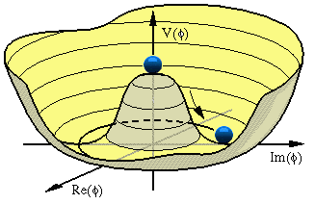
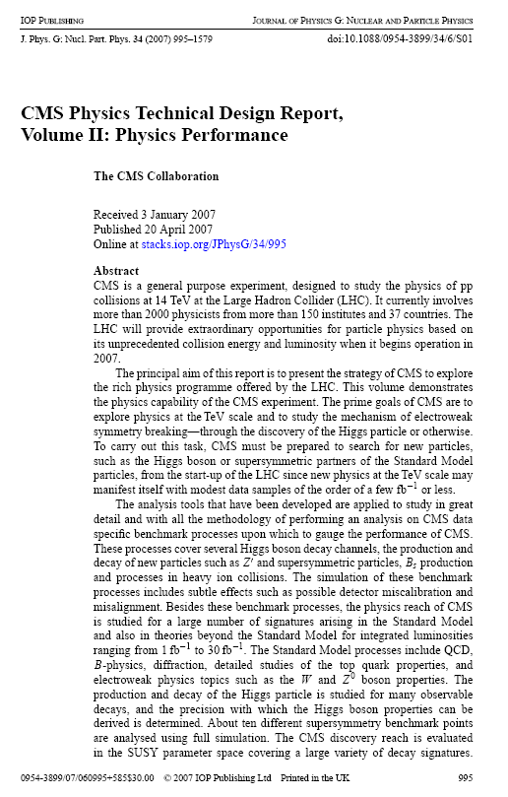
Prospective SM Higgs Searches ATLAS/CMS
ATLAS:
H → γγ
H → ZZ
H → WW
VBF H → ττ
ttH (H → bb)
ttH, H → WW*
WH, H → WW*
MSSM h/A/H → ττ
MSSM h/A/H →μμ
Invisible Higgs
Charged Higgs
…
CMS:
H → γγ
H → ZZ
H → WW
VBF H → WW/ZZ/invisible
H → ττ
Light charged Higgs
Heavy charged Higgs
Doubly charged Higgs
…
Both experiments work in a wide range of Higgs decay channels
ATLAS: CERN OPEN 2008-020
CMS: CERN / LHCC2006-021
(+ Updates!!)

Slide 11
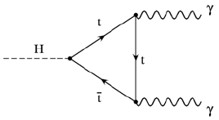
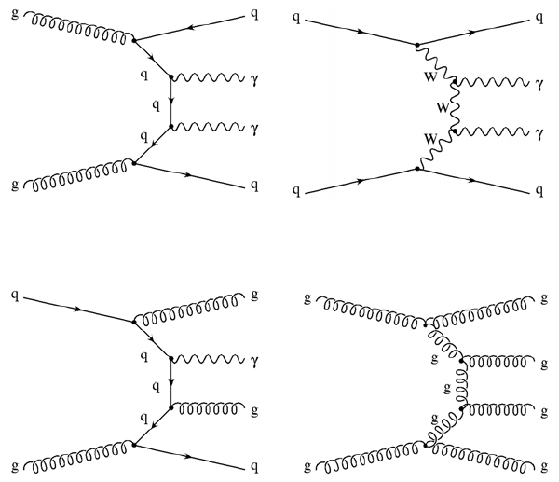
H → γγ
Promising channel for Higgs searches in the low mass range
(110 < m_{H} < 140 GeV)
Small branching ratio but clear signature:
2 high E_{T} isolated photons
Signal:
Direct production (inclusive) or in association with hadronich high P_{T} jets
Background:
Coming from the production of two isolated photons (IRREDUCIBLE)
Coming from events with at least one fake photon (REDUCIBLE)
Irreducible: γγ, γγ+jets
One of the benchmarks for the perfomance of the detectors.
Needs:
Photon reconstruction/calibration/identification
Photon/jet separation
Conversion reconstruction
Vertex reconstruction
Good mass resolution
And for the associated production channels
jet tagging
Reducible: γ+jets, jets, DY

Slide 12
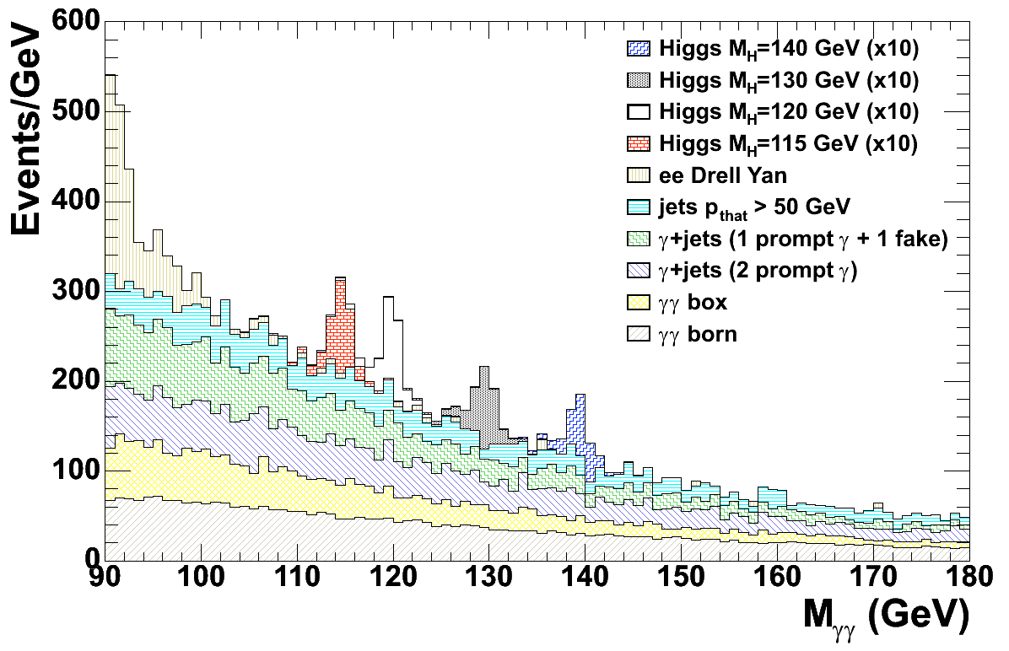
H → γγ
ATLAS
Vertex determined from extrapolation
using calorimeter samplings
Converted photons used to improve vertex determination: 57% Higgs events have ≥1 conversion
Signal divided into categories according to
η_{γ}, #jets, #converted photons
Search for H → γγ and H → γγ + jets
Unbinned maximum-likelihood fit
CMS
Cut-based analysis:
Signal categories according to η_{γ} and
lateral shower shape variable
Use of kinematics, isolation to reduce background
Reconstruction of the M_{γγ}-peak
Optimized analysis
Loose sorting
Kinematical cuts
Event-by-event kinematical Likelihood Ratio

Slide 13
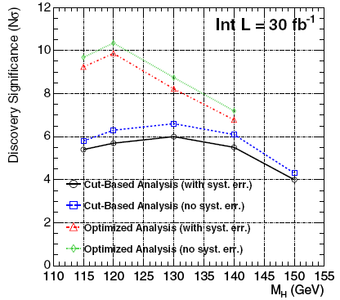
Results for H → γγ
ATLAS
For m_{H} = 120 GeV/c²:
Event Counting : σ= 2.6 (4.6) for 10fb⁻¹ (30fb⁻¹)
Fixed (floating) mass fit, combining 0j,1j,2j
analyses: σ = 3.6 (2.8) for 10fb⁻¹
2008
CMS TDR
CMS
5σ discovery between LEP lower limit and 140 GeV/c² with less than 30 fb⁻¹ of integrated luminosity
5σ discovery with event by event estimation of the S/B ratio possible at m_{H}=120GeV/c² with 7-8fb⁻¹
CMS slightly higher sensitivity (older results)
Improvements possible by using more exclusive γγ + jet topologies

Slide 14
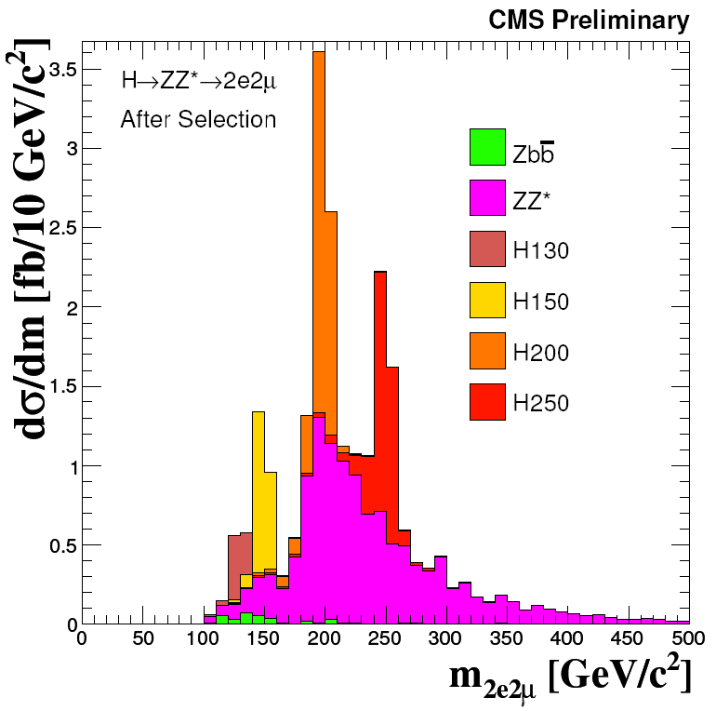
H→ZZ*→4l
‘Golden’ Higgs decay: experimentally cleanest signature for discovery.
Narrow 4-lepton (electrons or muons) invariant mass peak on top of a smooth background can be reconstructed.
Challenge: m_{H} between 120 and 150 (one of the Z’s on-shell)
Signal:
Very clean signal (4e, 4μ, 2e2μ) with high branching ratio except at m_{H} ≈ 2 m_{W}
Excellent mass resolution
(1.5 – 2 GeV/c² for M_{H}= 130 GeV/c²)
Powerful analysis in a wide mass range
Backgrounds:
Irreducible: ZZ* dominant
Reducible: Zbb, tt, ZW, Z + X
CSC 2008
The analysis rely on a good lepton identification and isolation (tracker and calorimeters)
Quality cuts to reject Zbb, tt: isolation, lepton track, impact parameter, vertex reconstruction…

Slide 15
Results for H→ZZ*→4l
3 independent (final state) channels + combined analysis with several levels of systematic uncertainties treatment
CSC 2008
CMS TDR 2006
Comparable significance
Highly sensitive in the high mass region (200 GeV/c² < m_{H} < 400 GeV/c²) and in the 150 GeV/c² region, where the Higgs boson could be discovered with 5 fb⁻¹
CMS update:
Cuts optimized for 1 fb⁻¹
Data driven methods for bckg. optimization control
Significance of about 3σ for m_{H} ~ 200 GeV at ∫Ldt = 1 fb⁻¹
SM Higgs can be excluded for m_{H} > 185 GeV with ∫Ldt = 1 fb⁻¹
-1σ
CMS PAS
HIG-08-003
"look-elsewhere" effect: in real search, significance to be de-rated by ~1σ

Slide 16
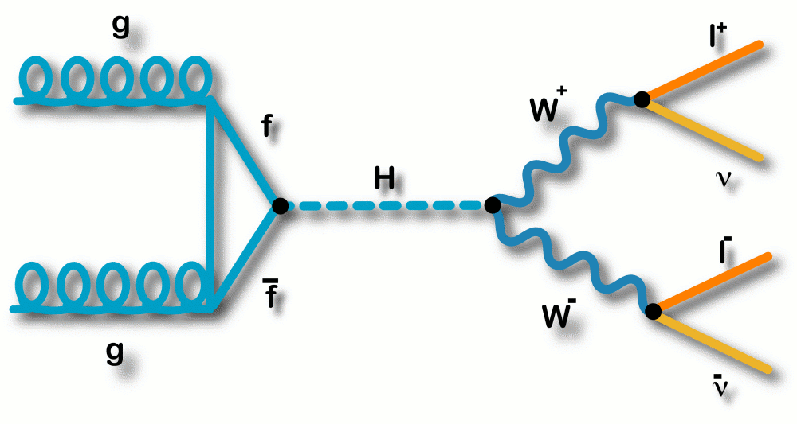
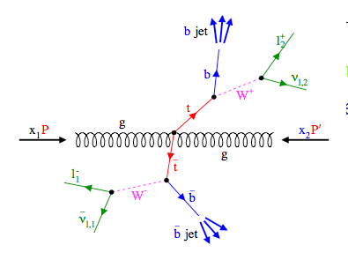
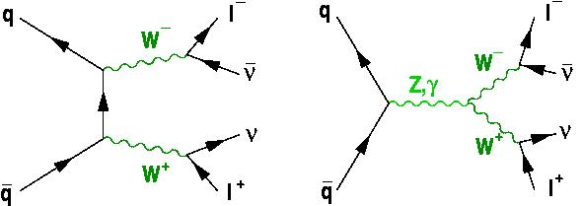
H→WW*→2l2ν
H→ WW is the discovery channel for a SM Higgs boson in the 2m_{W} < m_{H} < 2m_{Z} range in the LHC.
Branching ratio close to 1 in this region + clear signature, on the other hand, no mass peak can be reconstructed due to the undetected neutrinos.
Backgrounds:
All sources of real or fake multi-lepton final states + missing ET:
ttbar (tW), WW (WZ, ZZ), Drell-yan, W+jets…
WW It is the ‘Irreducible’ background
Signal:
Two isolated leptons
No central jet activity
Significant missing E_{T}
ttbar
W⁺
WW
Drell-Yan
H
l⁺
W⁻
W⁺
ν
Δφ_{ll} (angle between the leptons in the transverse plane):
Small for Higgs (spin correlations)
Large for WW
W⁻
l⁻
_
ν

Slide 17
H→WW*→2l2ν
ATLAS (eμ final states; H+0j, H+2j)
2 isolated leptons
Cuts on the transverse mass,e/μ kinematics, MET
Two main discriminants:
Angular correlation between lep. (WW)
Veto on additional jets (ttbar)
Final selection: 2D fit on transverse mass and Higgs candidate p_{T} in 2 bins of di-lepton azimuthal angle Δφ_{ll} to extract S/B ratio in signal region
CMS PAS HIG-08-006
CMS (ee, μμ, eμ final states; H+0j)
2 opposite-sign isolated and
identified leptons
Kinematical and MET cuts
No central jets
Final requirements:
cut based & multivariate techniques
Data driven techniques for background estimation: control regions, fake leptons study

Slide 18
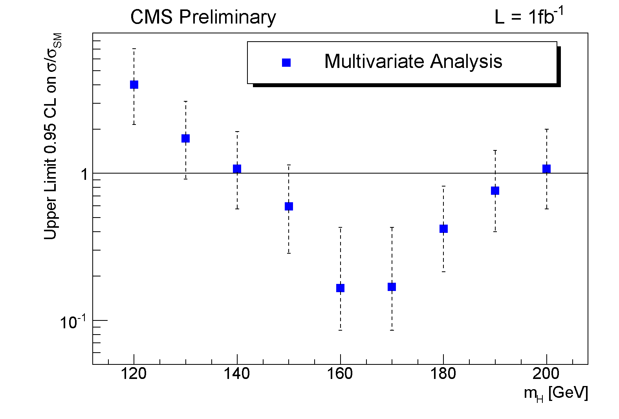
Results for H→WW*→2l2ν
ATLAS
Main search channel for range: ~140GeV < m_{H} < 2m_{Z}
Significance above 5σ for m_{H} >140 GeV/c² (10fb⁻¹)
*Results to be scaled by √2 and to 1 fb⁻¹
Updated CMS result:
Using a mass-dependent multivariate approach:
5σ around m_{H} = 160 GeV for 1 fb⁻¹
Analysis extended to other masses (mass dependent optimization) by multivariate approach
Improved lepton ID, mass dependent cuts, data driven methods
Cuts optimized separately for 1fb⁻¹ maximizing the expected statistical significance
CMS PAS HIG-08-006

Slide 19
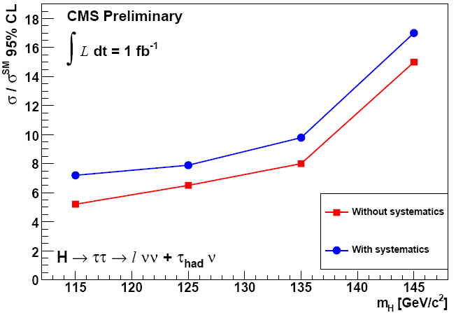
VBF H→ττ
ATLAS: 5σ achieved for 115-120 GeV for 30fb⁻¹
Significant channel for low masses (115-145 GeV)
Important for studying the coupling of Higgs to leptons
CSC 2008
Three final states considered:
lepton-lepton
lepton-hadron (just CMS)
hadron-hadron
Backgrounds: Zjj, tt, Z/γ → ττ
Invariant mass of the τ pair reconstructed via the collinear approximation (breaks down when the two taus are back-to-back)
CMS PAS HIG-08-008
Tau tagging (Likelihood, NN methods)
Z+jets background (especially for low masses)
tt rejection (b-jet ID and veto for lepton-lepton)

Slide 20
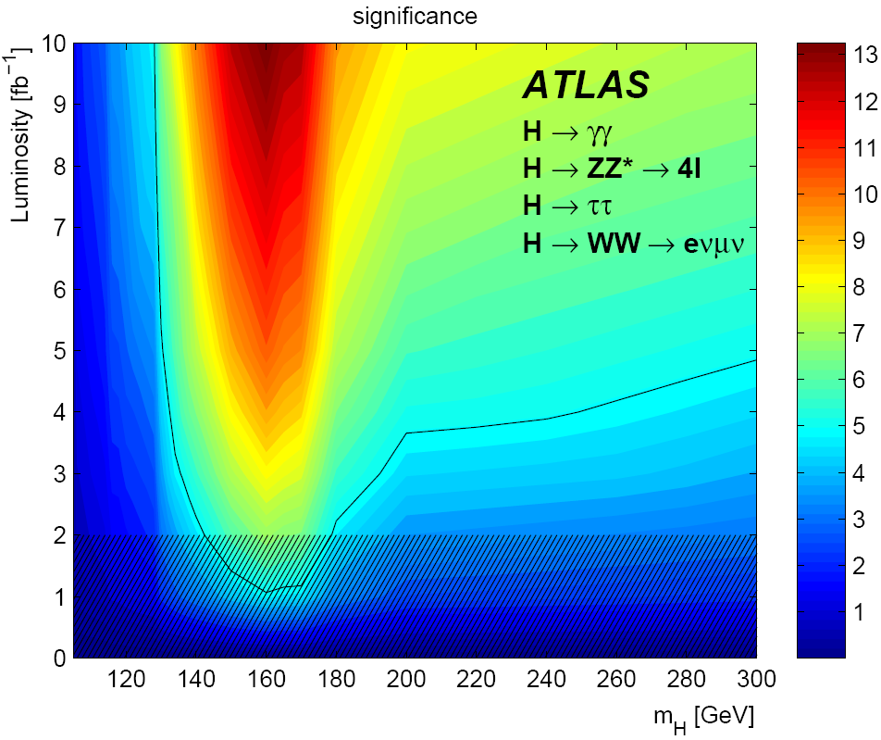
SM channel combination
5fb⁻¹
5fb⁻¹
With 10 fb⁻¹ (~ one LHC year at low luminosity)
5σ discovery for m_{H} in [~120, ~500] GeV
With 5 fb⁻¹: 5σ discovery for m_{H} in [~130, ~450] GeV/c²
With 1-2 fb⁻¹: something can be said first with the H→ WW channel
Combining results from both experiments, around half of this luminosity
Notes:
The hatched area below 2 fb-1 indicates the region where the approximations used in the combination are not accurate, although they are expected to be conservative.

Slide 21
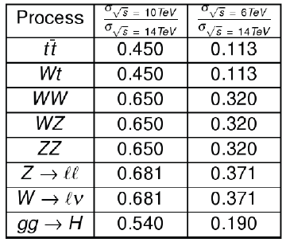
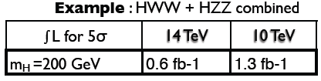
SM Higgs searches at √s<14TeV
LHC will start working with center of mass energy lower than 14 TeV, around 10 TeV
Main Effect: cross section changes
Different energy of LHC has two effects:
- Cross section for signals and backgrounds
goes down
- Signal (Higgs production) goes down faster:
(Higgs is mainly produced from gg and
backgrounds from qq)
Efficiency and Acceptance:
- Higgs becomes relatively “heavier”,
i.e. decay products become relatively more central for smaller LHC energies
- Therefore, the corresponding second order correction is larger than 1 (scaling factor)

Slide 22
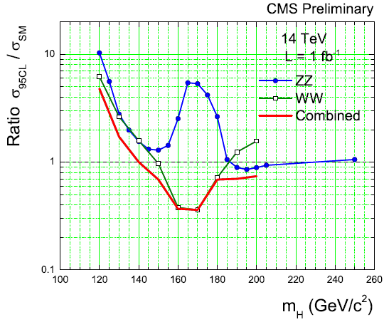
CMS projection for LHC@10TeV
LHC 2009 - 2010 luminosity performance – estimate: ~200pb⁻¹ of “good data”
Strategy:
First understand detectors,
do SM measurements,
→ then search for the Higgs…
Is that possible in the early running?
CMS: 10 TeV projection using the combination of HWW and HZZ results @ 14 TeV
Signal and bkgd yields re-scaled 14→10 TeV: loss of a factor of 1.5 in sensitivity, or a factor of ~2 in luminosity
With roughly ~200 pb⁻¹, reach sensitivity for a SM Higgs with m_{H}~160-170 GeV/c² (comparable to the current Tevatron sensitivity)
☹ region just excluded by Tevatron!!!
CMS AN-2009/020
Notes:
r~0.4 at 1 fb-1 and 10 TeV implies that one should expect r~1 at L~(0.4/1)2~0.2 fb-1. The exclusion scales aproximately as r~1/sqrt(L).

Slide 23
Conclusions
EW Symmetry breaking is puzzling; but the Large Hadron Collider is in a very good position to shed light on this.
All the machinery is getting ready to start again this late fall
Not pushing (low energy, low luminosity).
With the first collision data we’ll try to understand our detectors, but even in the early running, we’ll be able to start doing some Higgs physics!
ATLAS and CMS are more than ready to start looking for the Higgs Boson.
For a SM Higgs, combining ATLAS & CMS @14TeV, between ~1 and 5 fb⁻¹ are needed depending on mass value.
~0.1 fb⁻¹: exclusion limits will start carving into SM Higgs cross section
~0.5 fb⁻¹: 5σ sensitivity for M_{H}~160-170 GeV/c²
~5 fb⁻¹: SM Higgs is discovered (or excluded) in full range (~110-500)
Something has to happen, maybe it’s a Higgs, maybe not, but at CERN, we’re willing to start the hunting…
Thanks for listening!

