Slide 1
Search for a SM Higgs in the H → WW → 2l2ν decay channel
Rebeca Gonzalez Suarez

Slide 2
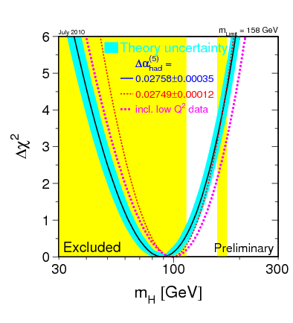
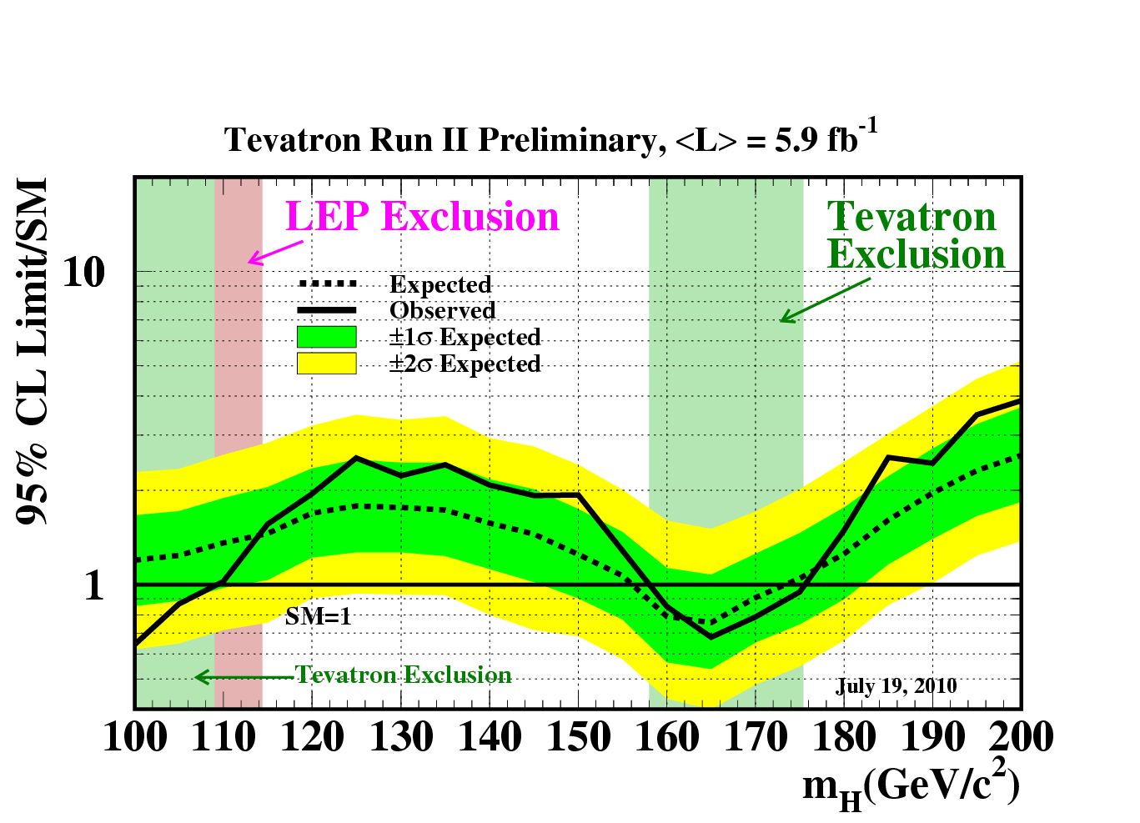
SM Higgs Searches Scenario
Direct measures at LEP set a 95% CL limit of m_{H} ≥ 114.4 GeV/c²
Precision electroweak measurements tell that m_{H} < ~158
(185 GeV/c² with LEP-2 data)
Most recent combined result from CDF and DØ, excludes the mass range between 158 and 175, and between 100 and 109 GeV/c² at 95% CL

Slide 3
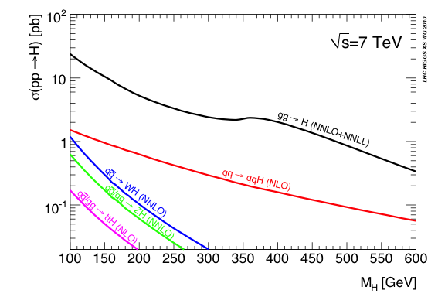
Higgs production at the LHC
The Search Strategy for a particular Higgs mass hypothesis:
determined by the production mode and decay channel
Gluon-gluon fusion (ggH):
Dominant production mode
Vector Boson Fusion, VBF (qqH):
Characteristic signature with two forward jets and rapidity gap, increasingly important for high masses
Associated production (WH, ZH, ttH): Relevant in the low mass region, allows for‘easy’ triggering

Slide 4
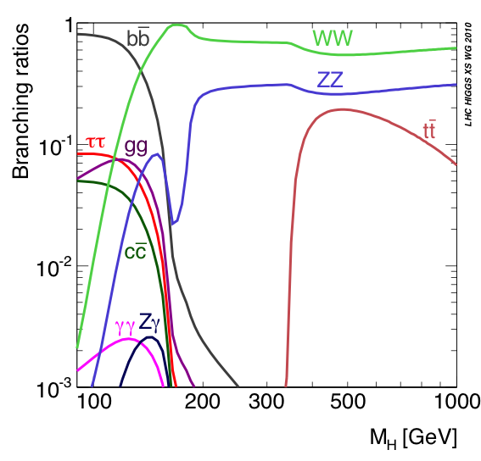
Higgs decay modes
Low mass (m_{H}< 2m_{Z})
H→bb: Highest BR for low masses. Challenging experimentally, huge QCD background
H→ττ: Collinear approx.→mass reco. Accesible through VBF
H→γγ: Mass-peak with good resolution
H→WW: Earliest sensitivity
H→ZZ: Very clean experimental signature with 4 leptons.
High mass (m_{H} > 2m_{Z})
H→tt: Difficult selection

Slide 5
Higgs Searches in CMS
CMS works in a wide range of Higgs decay channels, and is already producing results:
HIG-10-003 (pre-approved)
gluon-gluon fusion Higgs decaying to → γγ, ZZ, WW
VBF Higgs → WW/ZZ/invisible/ττ
MSSM Higgs → ττ, Light/heavy/double charged Higgs
+ more to come!
Public results with Monte Carlo for different center of mass energies (14-10)
Projections for the current √s 7 and 8 TeV scenarios: Bayesian Exclusion Limits (95%CL) and Significance

Slide 6
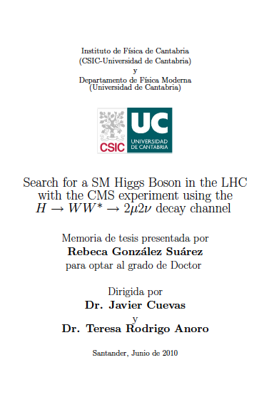
My work within the Higgs group
4 years working in the Higgs to WW to 2μ2ν channel
Link to my thesis in CDS:
http://cdsweb.cern.ch/record/1296019
Also work done in the EWK group within the WW analysis
Currently:
Higgs PAS HIG-10-003 in parallel with the WW observation EWK-10-009

Slide 7
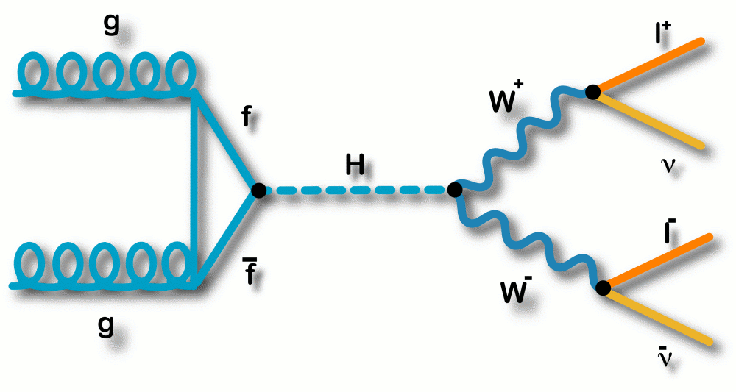
Higgs to WW*
H → WW* → 2l2ν considered the discovery channel for a SM Higgs boson in the mass range: 2m_{W} < m_{H} < 2m_{Z}
+ Branching Ratio for H → WW is close to 1 in this region (~2M_{W})
+ Leptonic final state has a clear signature
- No clear Higgs mass peak can be reconstructed
The signal is characterizad by:
Two isolated leptons (e/µ) with opposite charge and small opening angle
Missing Transverse Energy (ν)
No central jet activity
gg → H → WW* → 2µ2ν
120 ≤ mH ≤ 200 GeV/c²

Slide 8
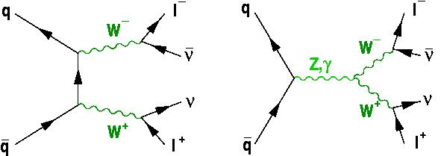
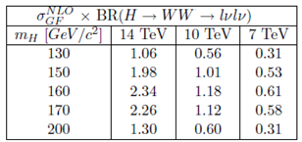
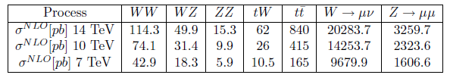
Signal and Backgrounds
Backgrounds:
All sources of real or fake multi-lepton final states + missing ET
→ ttbar (tW), WW (WZ, ZZ), W+jets, Drell-yan…
WW
Absence of the mass peak and cross-sections, orders of magnitude smaller for signal than for backgrounds → Understanding and control of the backgrounds mandatory
QCD, W+jets and Drell-Yan: easy to identify / very high cross-sections
tt can represent a problem when the hadronic content is not properly reconstructed
WW irreducible background
Signal and Background cross-sections (pb) NLO

Slide 9
Trigger
Up to now, the analysis makes use of Leptonic trigger paths to select events with leptons in the final state → very similar to EWK or top analysis
There is an effort going on within the Higgs group concerning trigger See yesterday’s Higgs PAG meeting slides:
http://indico.cern.ch/conferenceDisplay.py?confId=116271
Working with the Muon, Tau and Egamma POG, the idea is to develop a few key modes (HWW, γγ, ZZ) quickly and use them as starting point for further studies

Slide 10
Leptons, Jets and MET
The lepton ID for HWW follows the same path as any Analysis in CMS with high Pt isolated leptons in the final state:
- The most generic lepton the better (Muon/Egamma POGs)
Ideal scenario: use the same lepton than in EWK/Top/SUSY
- To discuss: The P_{T} threshold (important at low masses)
Right now is 20/20 (in the past 10/20 or 15/20)
Extensive work has been done in the past in the the lepton identification, selection and isolation against QCD and W+jets events.
Improvements in the analysis can be done, if the lepton selection is optimized allowing to go down in P_{T} without background contamination

Slide 11
Leptons, Jets and MET (II)
The Jets are used for the Central Jet Veto, anti ttbar measure, where events with central jets are vetoed
There is room for improvement in this subject:
- Not many analysis in the 0-jet bin (different systematics etc)
- Threshold optimization (P_{T}/η)
- Study of the 1-jet bin (2-jet bin for VBF)
The Jet choice has changed with time (Calo, PF, JPT, Track Jets)
RAW and corrected energies have been used (now, L2+L3)
There are additional strategies to further suppres ttbar

Slide 12
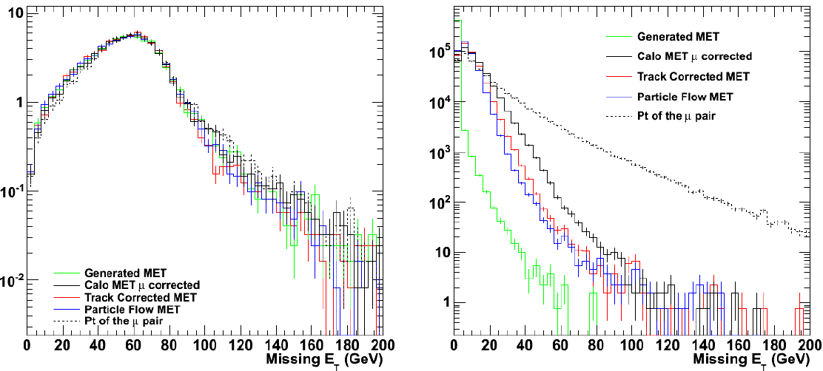
Leptons, Jets and MET (III)
The Missing E_{T} is one of the key ingredients in the analysis, as we deal with final states with neutrinos
It is important to have a good MET estimator, in particular for events with no genuine MET, like Z+jets, that can be mistaken as the signal and which tails could be dangerous
The analysis could benefit from dedicated MET studies (0-jet bin)
Higgs to WW to 2 muons and 2 neutrinos (signal) and Z+jets going to 2 muons (background) using different MET algorithms

Slide 13
Analysis Flow
Trigger
HLT paths/inital Dataset
Select potentially interesting events
Select events with two leptons coming from the decay of a W boson
Skimming / Pre-selection
To reduce the size of the dataset
Veto events with jets
+ Additional jet requirements (e.g. track info, b-tagging)
Advanced
techniques
Final analysis with sequential cuts
Counting Experiment
Multidimensional methods (NN, BDT)

Slide 14
Additional Strategies
After the Jet Veto, some b-quarks remain in tt events (Monte-Carlo truth) It is possible to improve the Calorimetric Jets performance using info from the rest of detectors
The use of the Track content of the event, like Track Jets/Number of tracks, Instead of the CaloJets or additionally was considered
Right now, the analysis has an additional Top Tagging applied in two steps:
soft muon veto: rejecting events with soft muons that are likely to come from a b-decay
b-tagging: rejecting events with Calo Jets that have a TrkCountingHighEff discriminating value greater than 2.1

Slide 15
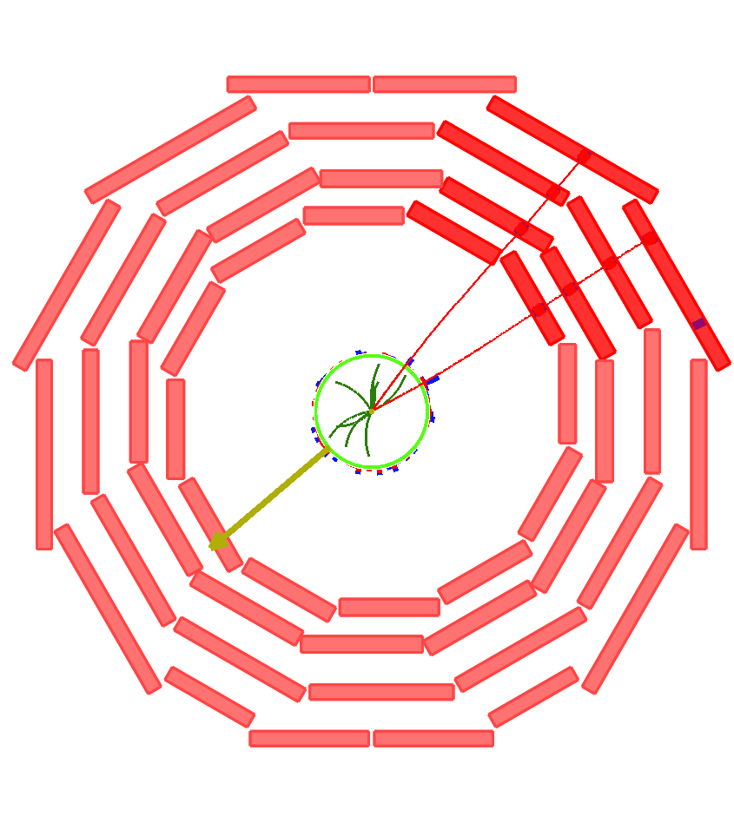
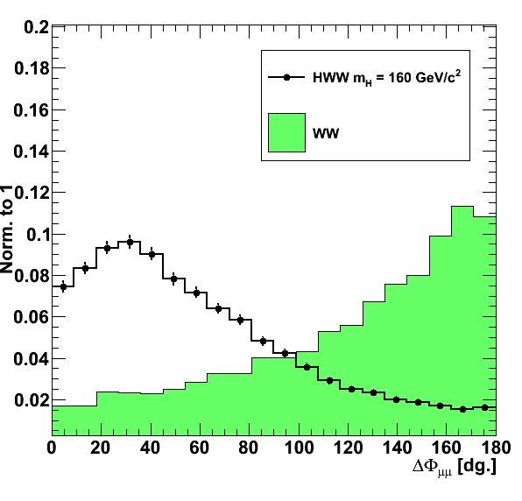

Kinematical properties used in the final selection (I)
- Angle between the leptons in the transverse plane to the beam, ΔΦll
→ Against every background, and the only way to get rid of WW
For Higgs to WW, ΔΦ tends to be small due to spin correlations, while WW produces back-to-back leptons with large ΔΦµµ

Slide 16
Kinematical properties used in the final selection (II)
Invariant mass of the lepton pair mll
→ Against background coming from Z
Missing E_{T}
→ Against backgrounds with no genuine Missing ET (Z+jets)
P_{T} of the leptons
→ different kinematics for signal and backgrounds
NOTE: In the current version of the analysis, no MET cut is applied, the Projected Missing ET is used instead
Projected MET = MET*sin(min(ΔΦ_{MET-closest lepton}, π/2))

Slide 17
Cut-based and Multivariate Analysis
Two ways to perform the analysis:
Applying sequential cuts
Multivariate approach
For the cut-based analysis, three final states are considered (ee, eμ, μμ):
- differences in the lepton identification and reconstruction
- affected by different backgrounds (Z+jets negligible for eμ)
- each final state: different set of cuts
For the Multivariate analysis, all the final states are considered at the same time (originally it started with only μμ), also additional variables are included here to maximize the discriminating power

Slide 18
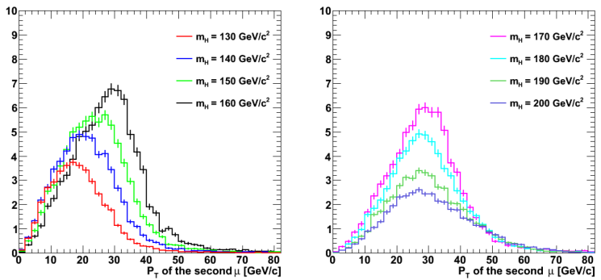
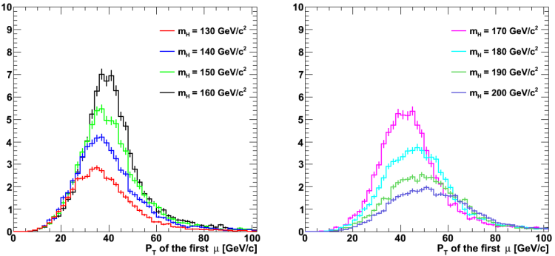

Optimization of the cuts
Starting with one set of cuts (using the 5 variables) for the whole mass range
The kinematics of the event change significantly as a function of the mass
(and the CM energy)
A mass-dependent optimization maximizing the statistical significance was made (in three mass regions) and in each final state (ee, eμ and μμ)
35%

Slide 19

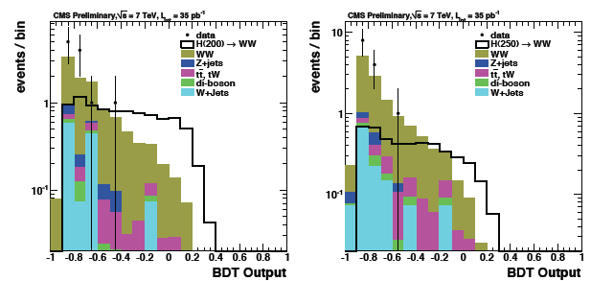
Currently…
In the cut-based analysis, each final state applies the same cuts, that have been optimized for each mass (20 masses from 120 to 500) maximizing the significance
MET cut not applied: not optimized
(Projected MET not optimized either)
35%
For the Multivariate analysis, the classifier of choice is a BDT
6 additional variables used:
- ΔR between leptons
- angle between leptons/MET
- final state id (ee/eμ/μμ)
- m_{T} leptons-MET

Slide 20
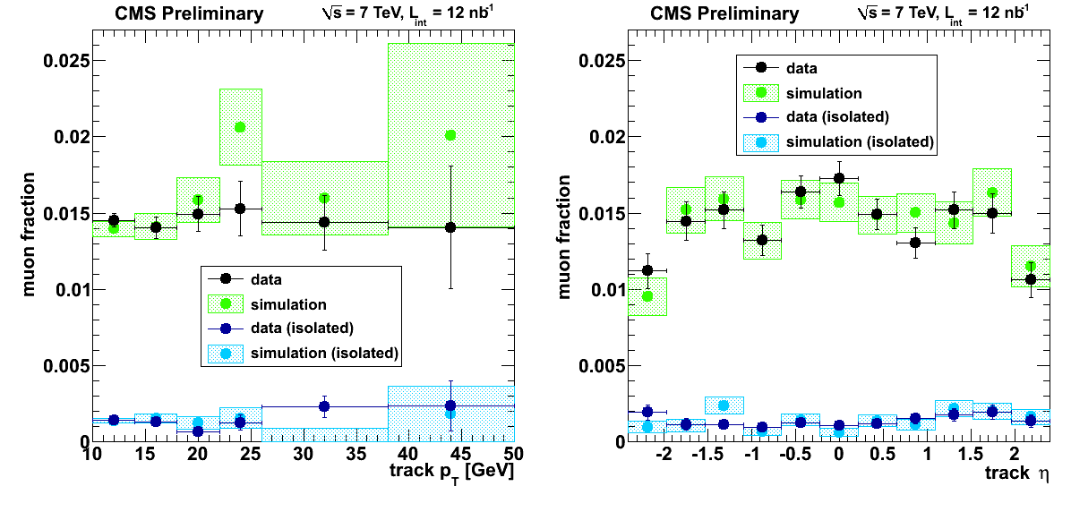
Background estimation
Main backgrounds require dedicated studies,:
- QCD/ W+jets: Fake leptons, other data-driven methods
- tt: Reconstruction of the hadronic content, control regions…
- Z+jets: Data driven methods already applied
+ Control of the irreducible background: WW (detailed study required)
Fake leptons: mainly for W+jets (also QCD) when a second lepton is misidentified. Several studies through the years, one designed specifically for di-leptons still not performed in data
MUO-10-002

Slide 21
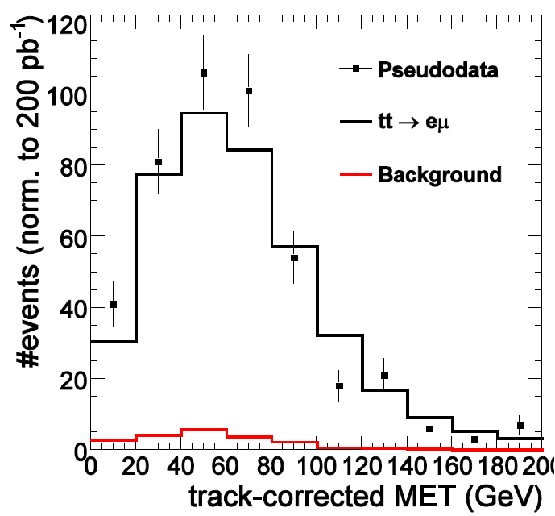
Systematic uncertainties
Many possibilities at each step of the analysis:
- Trigger/lepton ID/isolation
- Reconstruction of the hadronic content and everything jet
related like JES etc (Jet Veto)
- Missing ET related
- Monte Carlo Generators, PDFs etc
In collaboration with top di-lepton we made several systematic studies concerning the JES (0-jet/2-jet comparisons) and related to the MET in the tt decay to eμ

Slide 22
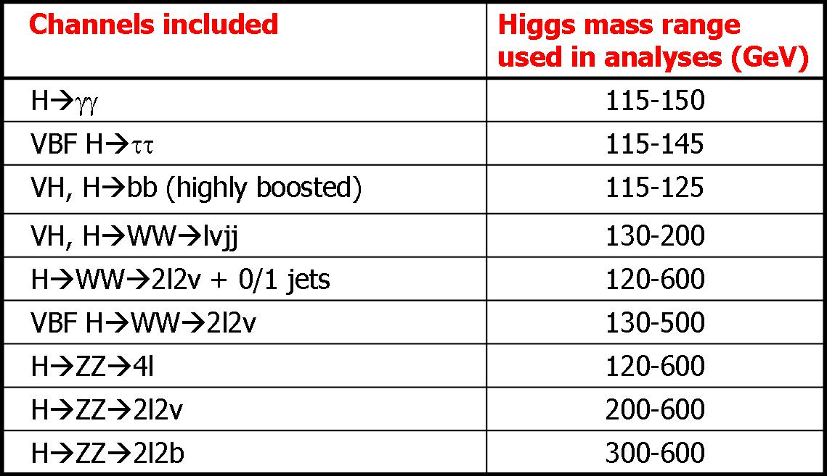
Work for the next months
SM Higgs combination:
Considering the expected 2011 scenario
Projections are obtained using an expanded list of SM Higgs signatures that are already under study or will be studied as soon as possible in CMS considering 7 and 8 TeV as collision energy
Several integrated luminosities: 1-5 fb⁻¹

Slide 23
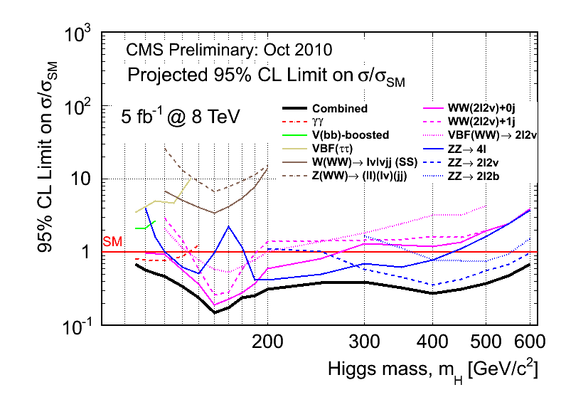
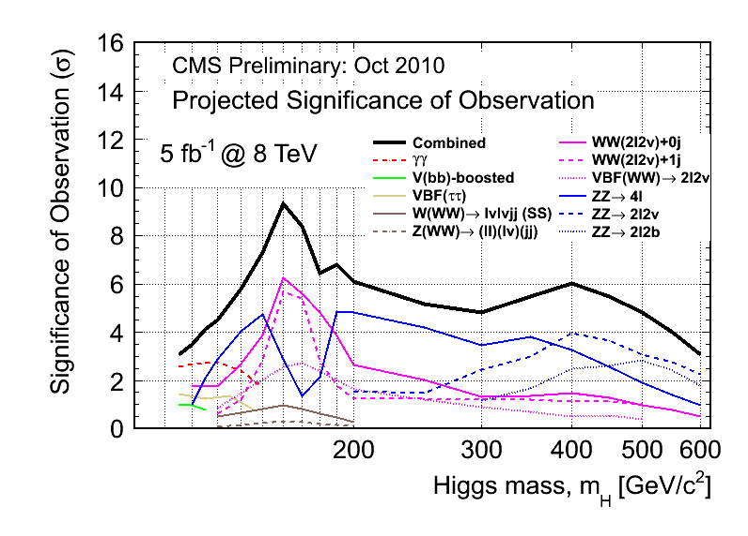
Limits and Significance
Projected exclusion limits and expected observation significance for a SM Higgs search at √S = 8 TeV with L = 5 fb⁻¹
CMS is expected to reach an exclusion sensitivity in the mass range from the LEP limits (114 GeV) to 600 GeV and the observation sensitivity in the same mass range of 114-600 GeV is expected to be 3σ or higher, depending on the Higgs mass

Slide 24
References
HIG-10-003: Search for Higgs Boson Decaying to Two W Bosons in the Fully Leptonic Final State at sqrt{s} = 7 TeV (CMS AN-2010/411)
EWK-10-009: Observation of WW final state (CMS AN-2010/344)
CMS NOTE-2010/008: The CMS physics reach for searches at 7 TeV
CMS AN-2009/020: Projected exclusion limits on the SM Higgs boson cross sections obtained by combining the H -> WW* and ZZ* decay channels
HIG-08-006: Search for the Higgs boson in the WW decay channel
(CMS AN-2008/039)
HIG-07-001: Search for the Higgs boson in the WW decay channel
(CMS AN-2007/037)
2006-2007 CMS Physics TDR, vol II
The original:
1996 - How to find a Higgs Boson with a Mass between 155--180 GeV at the LHC
(M. Dittmar, H. Dreiner) http://xxx.lanl.gov/abs/hep-ph/9608317

