Slide 1


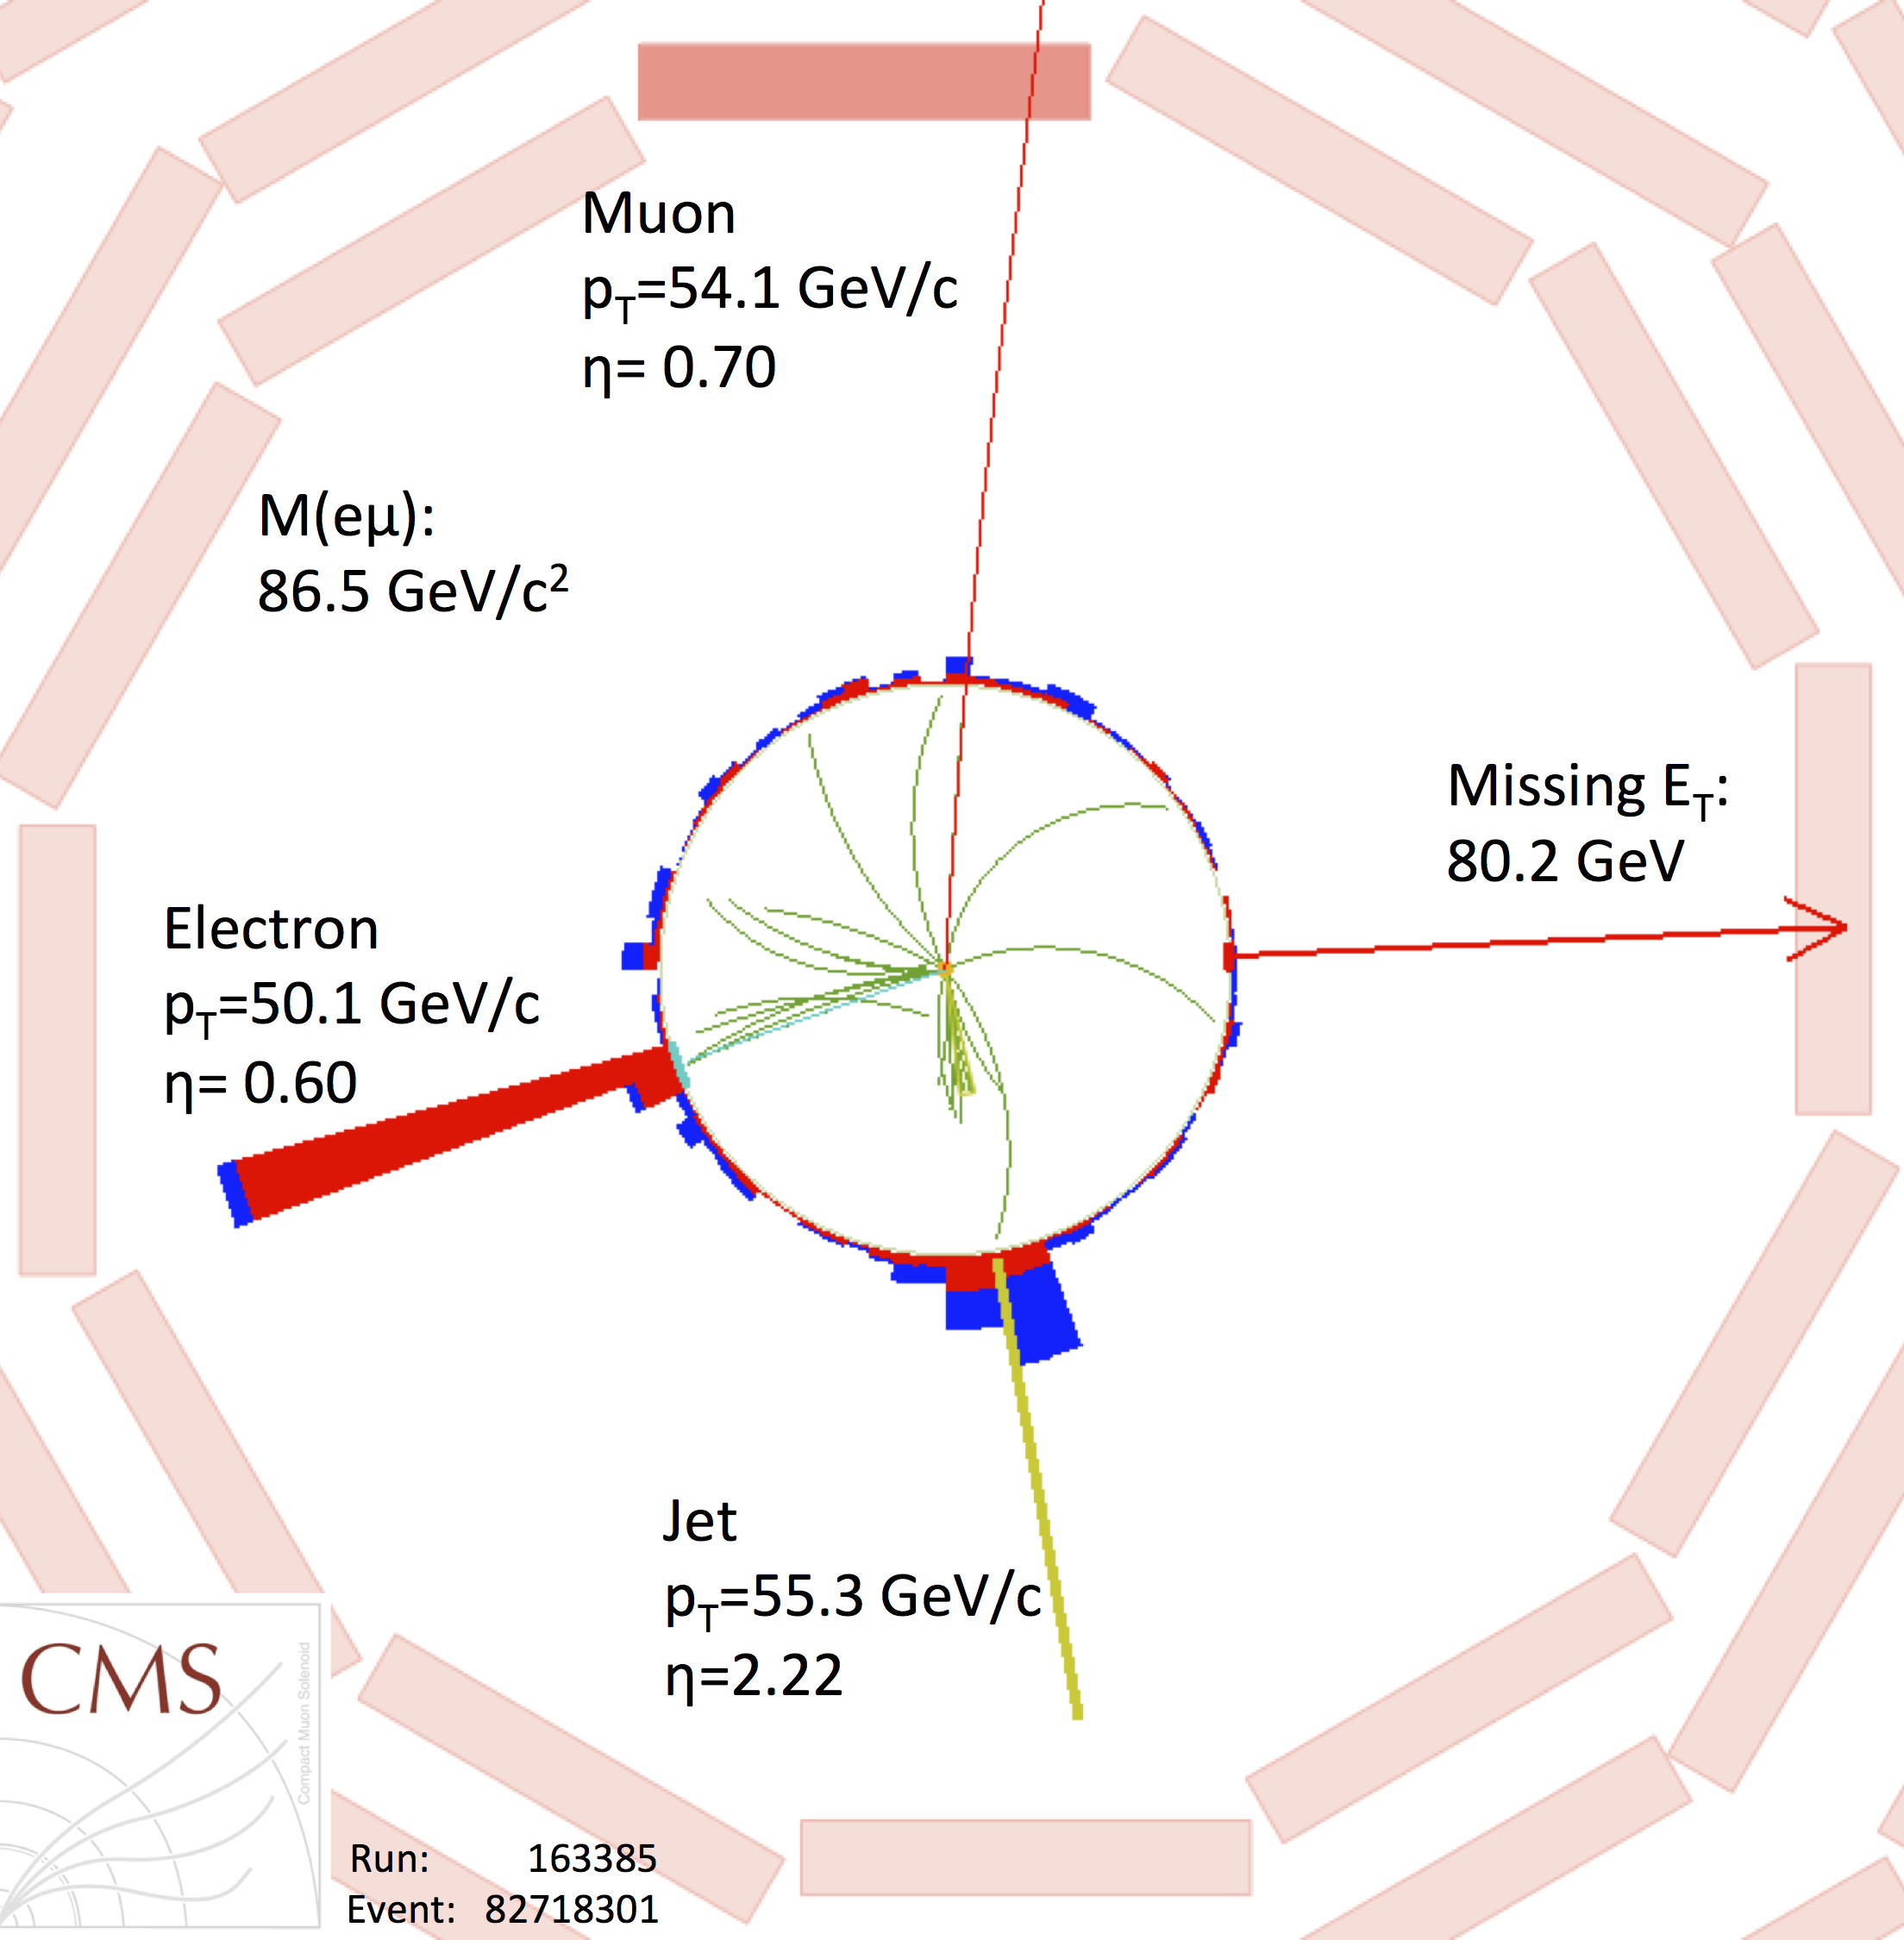
tW production at CMS
4th generation and single-top:
Workshop on fourth fermion generation and on single-top production
26-28 Mar 2012
Rebeca Gonzalez Suarez
on behalf of the CMS collaboration

Slide 2
Intro
CMS’s first public results for tW with 7 TeV data (September 2011):
CMS PAS TOP-11-022
First experimental study of the Single Top Associated tW in CMS:
Too difficult at the Tevatron, with no results from CDF and D0
At the LHC, ATLAS had already public results
Very interesting signature:
important background to Higgs searches (H → WW, particularly 1jet bin)
Not yet observed
After the observation of the process, a lot of physics to do:
Wtb interaction vertex study in a complementary region to the ones of the s- or t-channel production
direct measurement of the |V_{tb}| CKM matrix element without assumptions about the number of quark generations

Slide 3
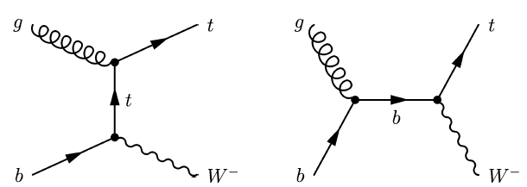
tW dilepton topology
Three final states (ee/eµ/µµ) are studied:
All the processes able to produce similar signatures will be background sources:
ttbar (dominant background), Z+jets (ee/µµ), EWK di-boson production (WW, WZ, ZZ), W+jets, other single top processes (t and s channel) and QCD
Signal signature
2 isolated opposite charged leptons
Missing E_{T} (2 neutrinos)
1 jet (coming from a b-decay)
Process | Cross-section
tW | 15.6±0.4+1.0-1.2 pb (app. NNLO)
tt | 163±14 pb (app. NNLO)
Z+jets | 3048±132 pb (NNLO)

Slide 4
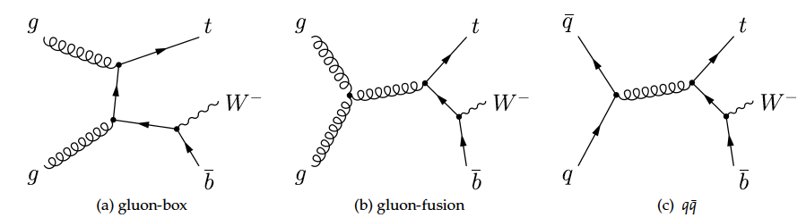
Diagram Removal and Subtraction
The definition of the tW process in perturbative QCD mixes with top-pair production (tt) at NLO, and poses conceptual problems
NLO
Two possible solutions:
The “diagram removal” approach (DR): all ambiguous diagrams at NLO are excluded from the definition of signal (chosen as default in the analysis)
The “diagram subtraction” approach (DS): subtracts a gauge-invariant term, cancelling locally the contribution of tt diagrams
The differences of using one or another Monte Carlo are small at the end of the analysis chain and taken as a systematic uncertainty

Slide 5
Datasets and Trigger
2.1fb⁻¹ of data considered, corresponding to 2011 data taken before September
CMS has 4.98 ± 0.11 fb⁻¹ of 7TeV proton-proton collisions available, being currently analyzed
Dilepton final states studied:
dilepton data streams, dilepton HLT paths:
1e1µ, pt > 17/8 (8/17)
2µ, pt > 17/8 (13/8) (7/7)
2e, pt > 17/8
The efficiency is extracted from data and emulated in MC. Scale factors from data/simulation comparison applied
Monte Carlo:
Single-top events in all channels simulated with POWHEG (full NLO)
MADGRAPH is used for tt, Z+jets, W+jets, PYTHIA for the rest
CTEQ 6.6 PDF sets
Scale factors for the trigger (PAS TOP-11-005):
0.961±0.01 (µµ) / 0.977±0.025 (ee) / 0.987±0.020 (eµ)

Slide 6
Physics objects: Leptons
Muons:
Reconstructed using information from the Tracker and Muon Chambers
p_{T} > 20 GeV
|η| < 2.4
Standard CMS requirements involving the quality of the reconstructed track, number of hits and impact parameter
Isolation variable (sum of the transverse
momentum of charged and neutral particles divided by the lepton P_{T}) in ΔR ≤ 0.3 < 0.15
Electrons:
Reconstructed from clusters of energy deposits in the ECAL matched to hits in the silicon tracker
E_{T} > 20 GeV
|η| < 2.5
Cut-based selection cuts using shower shape and track-cluster matching to reject fakes maintaining at least 70% efficiency for electrons from the decay of W (WP70)
Quality cuts on the impact parameter, distance to the PV, as well as cuts against photon conversions
Isolation (same as muons) < 0.15
Loose Muons:
p_{T} > 10 GeV, |η| < 2.5, iso. < 0.2
Loose Electrons:
E_{T} > 15 GeV, |η| < 2.5, WP95, iso. < 0.2
Data-driven scale factors for the lepton identification and isolation (PAS TOP-11-005):
0.947±0.002 µµ /0.968±0.003 eµ /0.990±0.001 ee

Slide 7
Physics objects: Jets and Missing E_{T}
Jets:
Anti-kt jets (0.5)
Corrected P_{T} > 30 (20 for loose jets) GeV
|η| < 2.4
standard Jet identification criteria applied
ΔR_{jet-lepton} > 0.3
B-tagging:
Algorithm reconstructs decay vertex and requires a minimum number of associated tracks: Simple Secondary Vertex
The working point is High efficiency Medium (SSVHEM, disc. > 1.74)
b-tagging efficiency of 62% with a
mistag rate of 1.43%
Missing ET:
Standard Particle Flow Missing E_{T}
Data-driven scale factor b-tagging
(PAS BTV-11-001):
0.95±0.01(stat)±0.10(sys)
Leptons, jets and missing E_{T} are reconstructed by the Particle Flow (PF) algorithm, which performs a global event reconstruction providing the full list of particles identified as electrons, muons, photons, charged and neutral hadrons

Slide 8
Analysis Flow

Slide 9
Analysis Flow (II)
Cleaning: (data) Events with very high energy noise in the HCAL are rejected; events with 10 tracks or more, should have at least 25% of them passing a tight selection
Primary Vertex cut: At least one primary vertex with 4 tracks or more, with longitudinal (radial) distance of less than 24 (2) cm from the center of the detector
Lepton Selection: exactly two isolated leptons (electrons or muons) with opposite charge, events with other leptons (loose) are vetoed
Invariant Mass and MET cuts:
At pre-selection level, all final states: m_{ll} > 20 GeV
ee/µµ final states:
Events with invariant mass m_{ll} inside the Z mass window [81, 101] are rejected
Missing E_{T} > 30 GeV
Mostly against Drell-Yan background
(also other Z processes and QCD)

Slide 10
Analysis Flow (III)
Jet selection: To define the Signal Region, events are required to have exactly 1 jet, following the requirements presented previously, with p_{T} > 30 GeV
B-tagging: The jet in the event has to be b-tagged, and no extra b-tagged jets are allowed (p_{T} > 20 GeV)
Extra kinematical cuts: chosen maximizing the signal significance after b-tagging (against tt), in the p_{T} of the system (leptons + jet + MET) and, only in the eµ channel, to compensate for the lack of MET and m_{ll} cuts, in H_{T}
Other Jet multiplicities are also used to constrain tt background
Variable | cut
p_{T} of the system | < 60 GeV
Ht | > 160 GeV (eµ only)

Slide 11
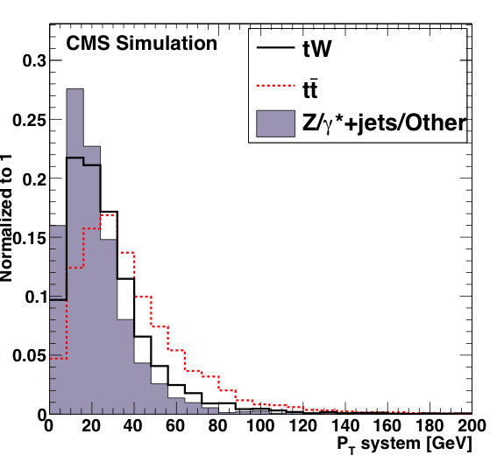
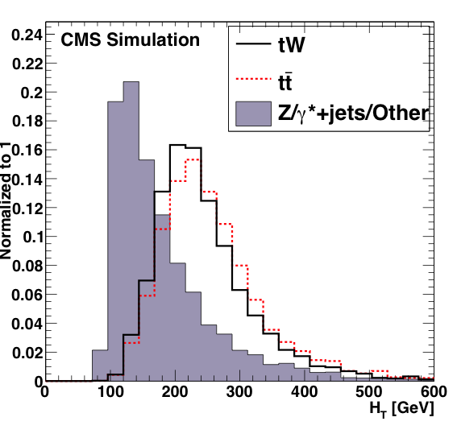
p_{T} of the system and H_{T}
Kinematic distributions normalized to the same area in the eµ final state for simulated tW signal, tt background and the sum of other backgrounds after lepton selection and lepton veto, in events with exactly one jet.

Slide 12
Summary of the selection
Cut | ee | eµ | µµ
HLT | yes | yes | yes
Primary Vertex (standard cleaning cuts) | yes | yes | yes
Opposite charge 2 leptons selection p_{T} > 20 GeV | yes | yes | yes
Loose lepton veto (no extra loose leptons) | yes | yes | yes
m_{ll} > 20 GeV | yes | yes | yes
m_{ll} outside [81,101] GeV | yes | no | yes
MET > 30 GeV | yes | no | yes
1 jet selection (p_{T} > 30 GeV) | yes | yes | yes
B-tagging requirements (SSHVEM > 1.74, veto extra b-tagged p_{T} > 20 GeV) | yes | yes | yes
p_{T} of the system < 60 GeV | yes | yes | yes
H_{T} > 160 GeV | no | yes | no
In Data: Event cleaning
In Monte Carlo: Pile Up re-weighting to match the data
HLT and lepton ID and isolation scale factors applied per event
B-tagging scale factor applied per jet

Slide 13
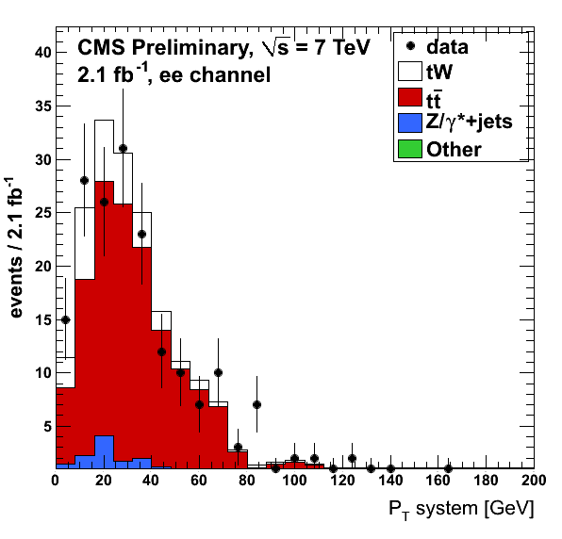
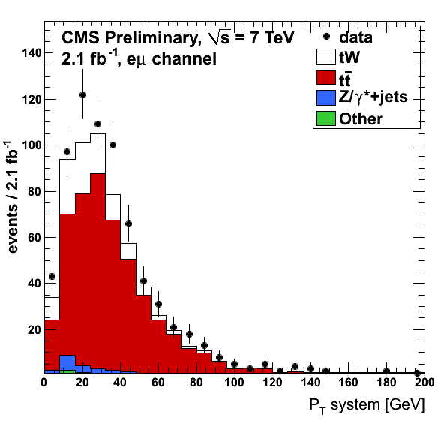
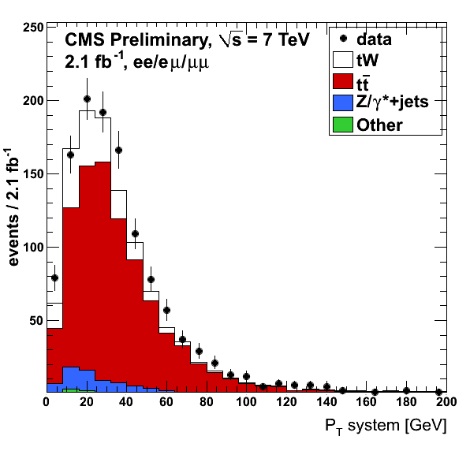
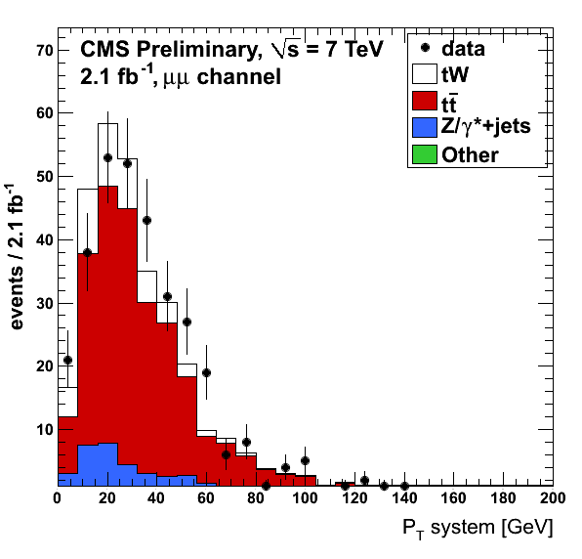
Final MC/data distributions: P_{T} system
data and simulation after b-tagging in the ee, eµ and µµ final states separately and all together

Slide 14
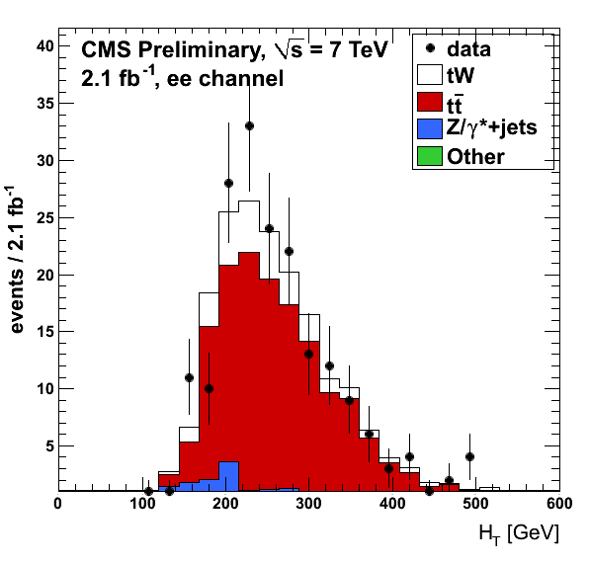
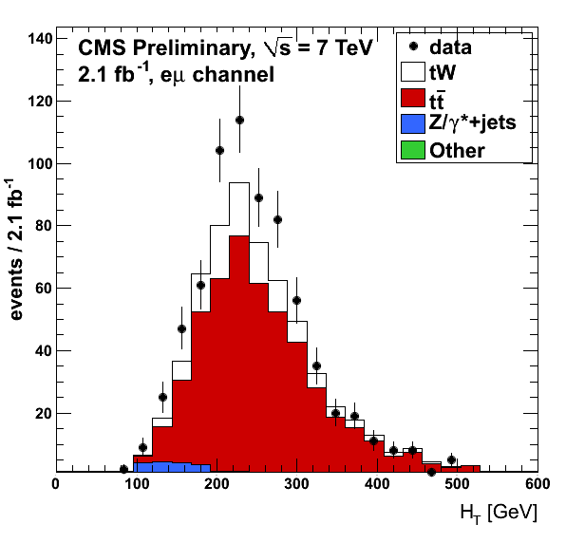
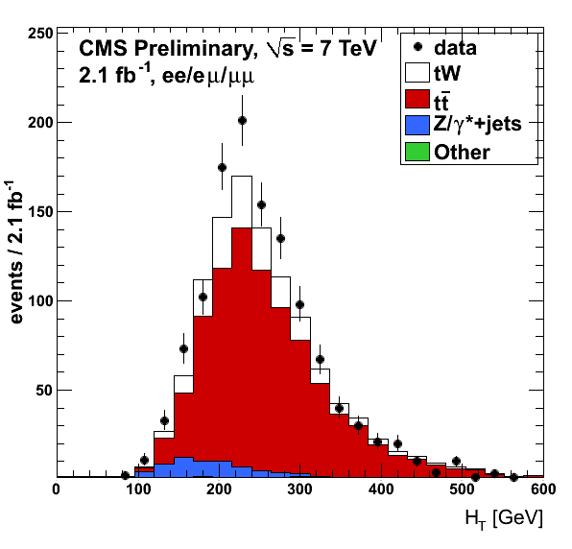
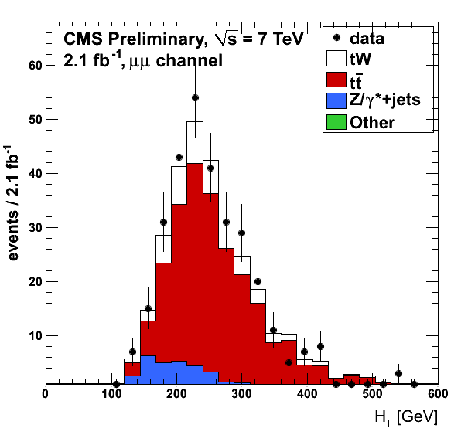
Final MC/data distributions: H_{T}
data and simulation after b-tagging in the ee, eµ and µµ final states separately and all together

Slide 15

DY Background estimation
WW, WZ, ZZ, W+jets, QCD and other single top processes contribute very little to the final number of events, and their contributions are taken from Monte Carlo
In the signal region, Drell-Yan is a main background (ee/µµ), and it is estimated in a data-driven way (events in/out the Z window):
For the eµ final state (less important contribution), the simulation yield is also scaled to match the data by a factor 1.73, derived from the ee and µµ final states: 10.4±2.2 events (6.01.3 in simulation
The number of observed eµ events is used to correct for the presence of non-peaking backgrounds, the factor 1/2 comes from the branching ratio and k corrects for the differences in acceptance and reconstruction between electrons and muons
Uncertainty associated
50% (conservative)

Slide 16
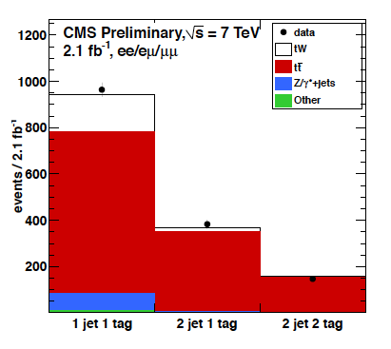
TT control regions
Two tt enriched control regions: 2jets1tag and 2jets 2tag are considered in the significance calculation to constrain tt contamination and b-tagging efficiency
Event yields in data and simulation in the signal region (1 jet, 1 b-tag) and the two tt-enriched control regions for the three final states together
Drell-Yan in ee/µµ comes from the data-driven estimation, and the tt contribution is scaled to the outcome of the statistical fit

Slide 17
Systematics (I)
Luminosity: Luminosity measurement at CMS (4.5%)
Pile Up multiplicity: Official Pile-up reweighting applied to the Monte Carlo, shifted by ±0.6 to estimate the systematic
Trigger Efficiency/Lepton reconstruction and identification efficiency: Systematic taken directly from other dilepton analysis with similar selections (TOP-11-005/HIG-11-003)
MET modeling: Scaling ±10% the un-clustered components of the MET
Jet multiplicity and jet energy scale (JES): Shifting the jet energy correction (JEC) one standard deviation up/down, including the MET
Jet energy resolution (JER): The JER is worse in data, everything is corrected by 10%, and to estimate the uncertainty, 0% for JER- and 20% for JER+
B-tagging: Varying the b-tagging scale factor 0.95 by ±10%

Slide 18
Systematics (II)
Background Normalization: Depends on the background, for DY, 50% comes from the data-driven estimation, for the rest backgrounds come from theory (uncertainty in the cross-section)
PDF uncertainties: alternate weights for each event are produced using different pdf sets (CTEQ6.6 and MRST2006)
Factorization/Normalization Scale (Q2)
ME/PS matching thresholds
Initial and final state radiation (ISR/FSR)
DS/DR scheme: Difference between the DR (default) and DS signal samples
Monte Carlo statistics: Related to the size of the samples
Dedicated MC samples with variations of the parameters up/down, doubled/halved... For tt and tW signal

Slide 19
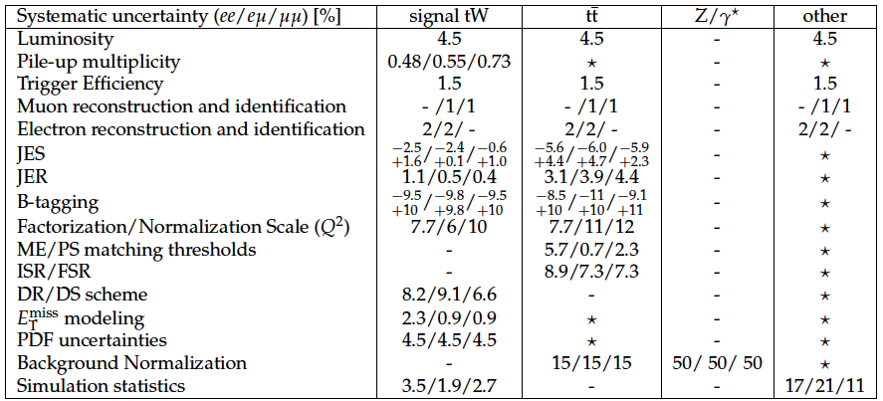
Systematics (III)
Rate systematic uncertainties for the three final states in the signal region, presented in
percentage
“-” means it doesn’t apply, and “★” for negligible contributions

Slide 20
Statistical Interpretation and Results
The evaluation uses a statistical model of Poisson event counts in the three final states (ee, eµ, µµ)
Systematic uncertainties are included in the model one by one as nuisance parameters (same treatment as in other multi-channel counting experiments such as Higgs searches)
To estimate the tt contribution simultaneously, events from tt enriched regions are included in the model
The significance is calculated with the background-only distribution of the likelihood ratio, and the 68% confidence level interval is evaluated using the profile likelihood method
Observed significance: 2.7σ
Expected significance 1.8±0.9σ
Cross section value and 68% C.L. interval: 22 +9-7 (stat + syst) pb
(to compare with 15.6 ± 0.4 +1.0 -1.2 pb)

Slide 21
Summary
First indications of the tW production in CMS in the dilepton channel (three final states, ee, eµ and µµ) using 2.1fb⁻¹
Main background: tt
Also important Drell-Yan (data-driven method)
Smaller backgrounds (WW/WZ/ZZ, single top, W+jets, QCD) from simulation
All the sources of systematic uncertainties addressed
Signal region defined, and significance calculated using the tt sidebands (2jets1tag and 2jets2tag)
Cross-section measured at the same time, value and 68% C.L. interval:
22 +9-7 (stat + syst) pb
Coming up next:
Analyze the full 2011 dataset
Introduce Multivariate Methods to gain sensitivity
Observed (expected) significance: 2.7σ (1.8±0.9σ)

