Slide 1



Single Top Production at √s=7 TeV
Moriond QCD and High Energy Interactions
March 10th - March 17th 2012
Rebeca Gonzalez Suarez
on behalf of the CMS and ATLAS collaborations

Slide 2
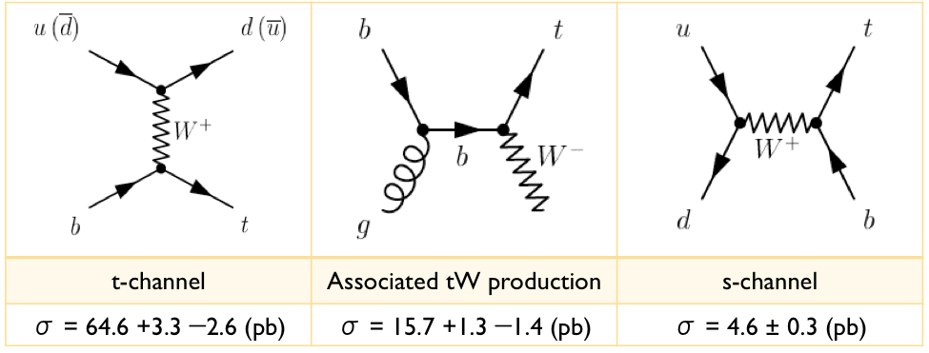
Intro
Top quarks (Tevatron, 1995) in hadron colliders are mostly produced in pairs, via strong interaction
Alternative production: via the weak interaction, involving a Wtb vertex, leading to a single top quark final state:
First observed at the Tevatron (2009), in a combination of t/s-channel
Already observed by the LHC experiments with 2010-2011 data
Single top-quark processes:
  are sensitive to many models of new physics
  allow for a measure of V_{tb} without assumptions about the number of quark generations
  can be used to measure the b-quark parton distribution function (PDF)
Cross-sections by N. Kidonakis approximate NNLO, √s = 7 TeV
(σ_{tt} = 164.6 pb )

Slide 3
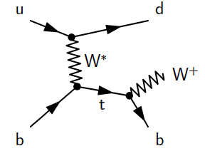
t-channel
Dominating process with the highest cross section at the Tevatron and the LHC
ATLAS and CMS have public results with 2011 data:
The final state studied is a lepton + jets signature
Signal events are characterized by:
  One isolated muon or electron and missing transverse energy (E_{T}^{miss}) (leptonic decay of the W)
  A central b-jet and an additional light-quark jet from the hard scattering process (often forward)
  Additionally, a second b-jet produced in association to the top quark can be present as well (softer p_{T} spectrum with respect to the b-jet from top decay)
New!
ATLAS-CONF-2011-101
July 2011; L = 0.7fb⁻¹
CMS PAS TOP-11-021
March 2012; L = 1.1/1.5fb⁻¹
Updates previous result with 36pb⁻¹ Phys. Rev. Lett. 107 (2011) 091802
arxiv:1106.305

Slide 4
Selection criteria
CMS:
  Exactly 1 isolated lepton (e,µ)
  2 jets in the event, 1 b-tagged
  Muon channel: m_{T}(W) > 40 GeV
  Electron channel: E_{T}^{miss} > 35 GeV
  Invariant mass of the reconstructed top quark within (130,220) GeV
ATLAS:
  Exactly 1 isolated lepton (e,µ)
  2 or 3 jets in the event (NN only 2), 1 b-tagged
  E_{T}^{miss} > 25 GeV
  m_{T} (W) > 60 GeV − E_{T}^{miss}
Other jet (1-2-3 jets) and b-tagging multiplicities (0-1-2) used in background estimations and control regions
Main backgrounds:
- W boson production in association with jets (W+jets)
- top pair (tt) production
- Multijets (QCD) events
tt and smaller backgrounds from Z+jets, other single-top processes, and diboson production are estimated from simulation and normalized to their theoretical cross-sections.

Slide 5
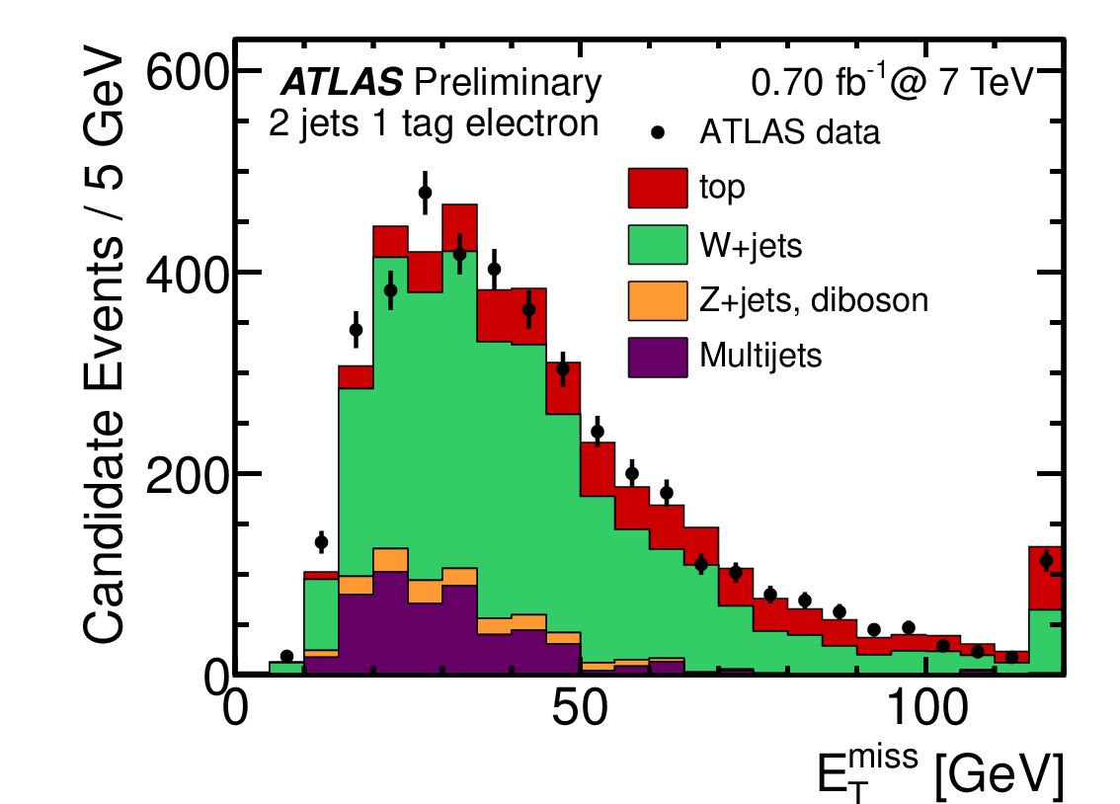
Background estimation
The multijet QCD contribution is estimated via maximum likelihood Fit to MET (e,µ ATLAS, e CMS) / m_{T} (µ CMS)
  Template for QCD obtained in data by inverting the isolation on muons and either requiring the electrons to fail some of the quality requirements (CMS), or replacing the electron by a jet passing similar requirements as the electrons (jet-electron model, ATLAS).
  For all other processes (top, W/Z+jets, dibosons), Monte Carlo templates
W+jets
  ATLAS: distributions from Monte Carlo, overall normalization and flavor composition from data (data-driven scale factors)
  CMS: W+jets shapes and normalization extracted from the reconstructed top quark mass sideband –events that fail the cut-, subtracting other backgrounds

Slide 6
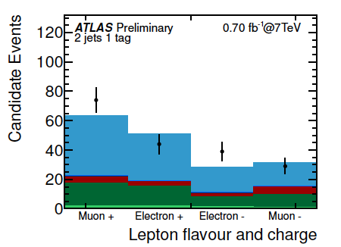
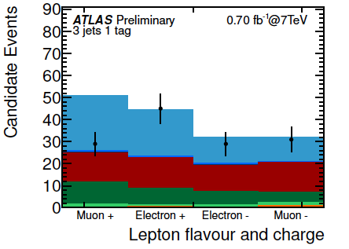
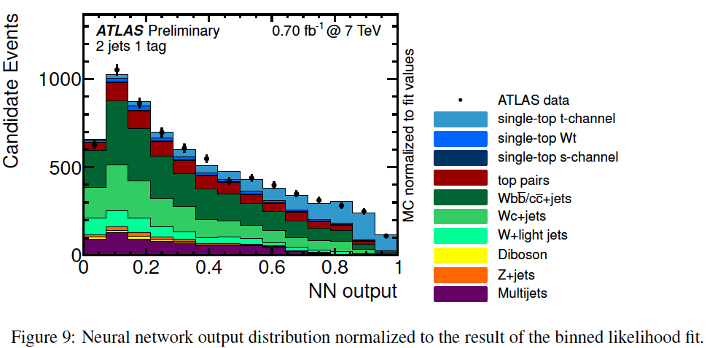
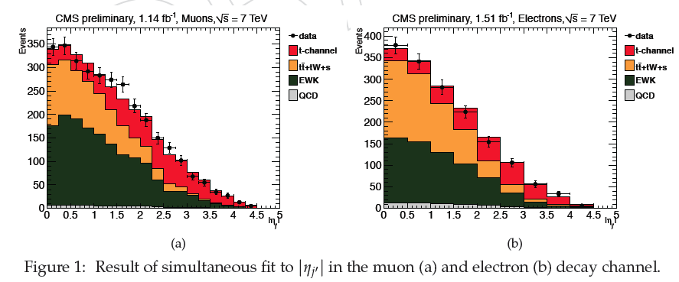
Signal extraction
ATLAS: set of discriminant variables
Cut based / Neural Network analysis
Main variables:
  reconstructed top quark mass
  pseudorapidity of the light (untagged) jet, |η_{j}’|
  transverse energy of the light (untagged) jet
Distributions after the cut-based selection, signal contribution normalized to the measured combined cut-based cross section.
CMS: maximum likelihood fit to the distribution of the pseudorapidity of the light (untagged) jet, |η_{j}’|
Result of simultaneous fit in the muon and electron decay channel

Slide 7
Systematics
ATLAS and CMS applied different definitions of theory systematic errors, the discussion is ongoing towards their harmonization
Several sources of systematic uncertainty considered, main ones quoted:
  Background normalization to data
  Detector simulation and object modeling
    - JES (~9% ALTAS,CMS), b-tagging, JER (18%, 6% ATLAS) (3%, 1% CMS)
  Theoretical uncertainties:
    CMS: renormalization and factorization scale Q² (7%)
    ATLAS: generator (11%), parton shower (10%), ISR/FSR (14%)
  Monte Carlo generators
  Statistics
  Luminosity
CMS | [%]
Total | ± 17
ATLAS | Cut-based [%] |  |  | NN [%]
 | 2-jet | 3-jet | combined
Total | +45/-31 | +57/-43 | +44/-30 | +45/-34
Full tables in the backup slides

Slide 8

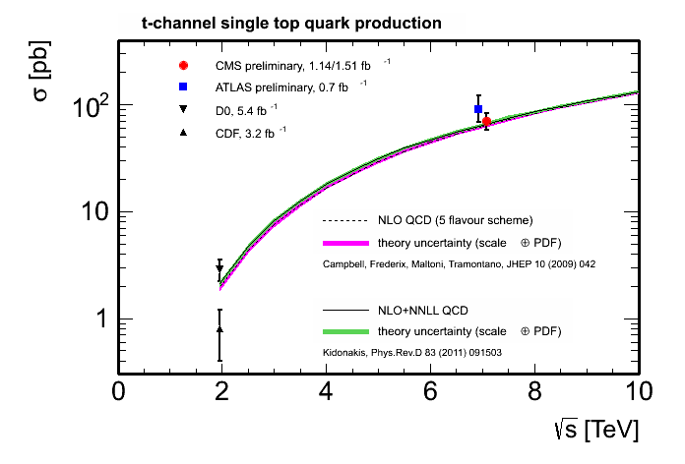


Results
ATLAS: As the cut-based method uses both 2- and 3-jet channels, and has a slightly smaller overall expected uncertainty, it is chosen as the baseline result.
CMS: Results for muon and electron
channels and combination
σ_{theoretical} = 64.6 +3.3 −2.6 (pb)

Slide 9
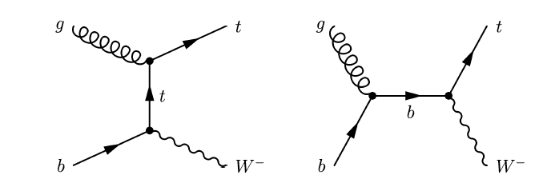
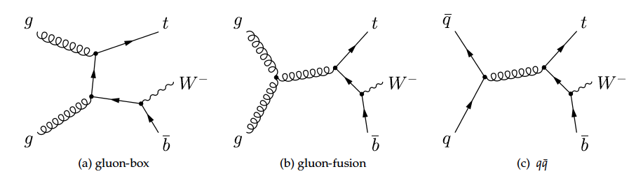
tW associated production
Interesting topology (background to H → WW searches), not yet observed
Mixes at NLO with tt production
Public results with 2011 data:
Dilepton final states:
  2 leptons, E_{T}^{miss} and a jet from a b-decay
Main backgrounds:
  tt production
  Z+jets
  Small contributions from dibosons, other single top channels, W+jets and QCD
LO
ATLAS-CONF-2011-104
July 2011; L = 0.7 fb⁻¹
NLO
CMS PAS-TOP-11-022
September 2011; L = 2.1 fb⁻¹

Slide 10
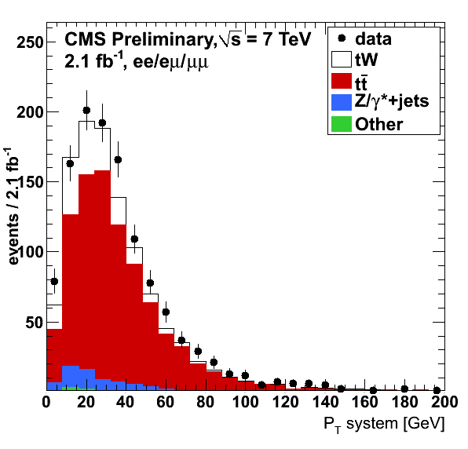
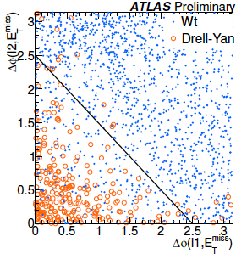

Event selection
ee, eµ and µµ final states (with no extra leptons)
Jet selection: exactly1 jet (ATLAS/CMS), b-tagged (CMS)
E_{T}^{miss} > 50 (ATLAS) 30 (CMS, ee/µµ)
Anti Z+jets: Remove events in the Z mass window 81 < mll < 101 GeV (ee/µµ)
CMS: Extra variables, p_{T} of the system formed by the leptons, the jet and the E_{T}^{miss} and H_{T} (scalar sum of the pt of the leptons, jet and MET)
ATLAS: dedicated anti Z→ττ cut in the selection
Same structure: Cut-based analysis

Slide 11
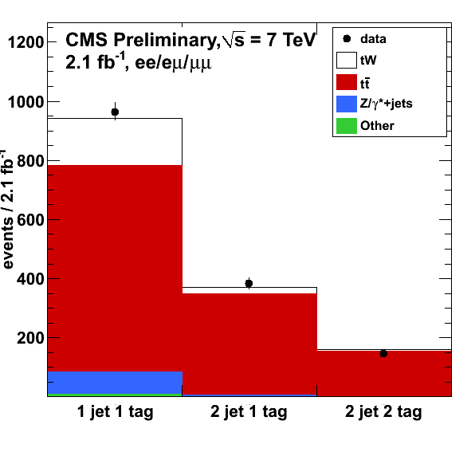
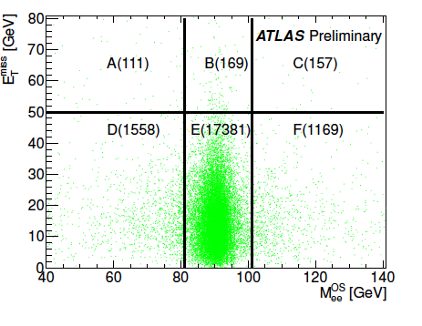

Background estimation
CMS:
  Data-driven estimation of the Z+jets background (in/out of the Z mass window)
  Two tt enriched control regions (2j1t, 2j2t) considered in the significance calculation to constrain tt contamination and b-tagging efficiency
ATLAS:
  Data-driven Drell-Yan, using ABCDEF method, orthogonal cuts on 2 variables (m_{ll} and E_{T}^{miss}) define signal and background enriched regions; used to determine background content in the signal region from data.
  Fake lepton estimation for W+jets (single) and Multijets (double-fake) with matrix method (< 1% effect)
  Data-driven estimation of Z→ττ
  Scale factor for tt obtained from 2j sample

Slide 12
Results
Main sources of systematics:
  CMS: B-tagging (10%) and Q² (~10%)
  ATLAS: JES (35%), JER(32%), and background normalization
Tables in the backup slides
ATLAS:
95% CL observed limit on tW production:σ_{tW} < 39.1(40.6) pb obs. (exp.)
Observed significance of 1.2σ
With a value of the cross-section:
σ_{tW} = 14 +5.3-5.1(stat.) +9.7-9.4(syst.) pb
CMS:
Observed (expected) significance of
2.7σ (1.8±0.9σ)
Measured value of the cross-section and 68% CL interval:
σ_{tW} = 22 +9-7 (stat+sys) pb

Slide 13
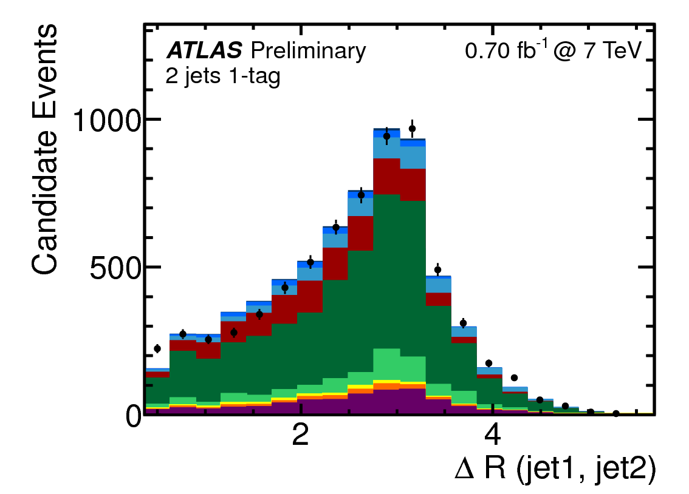
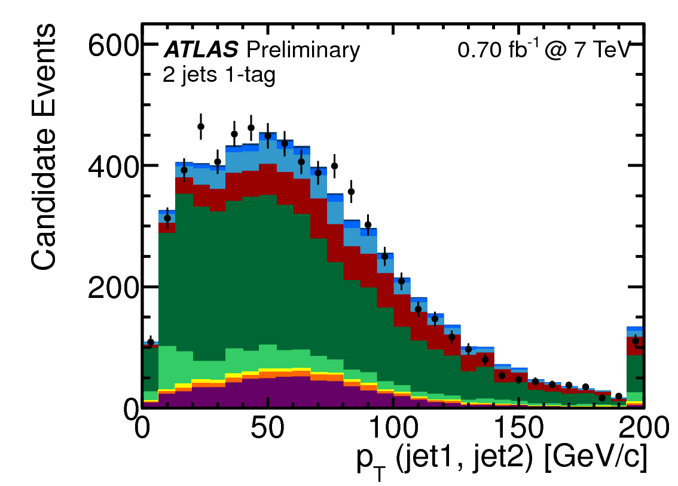
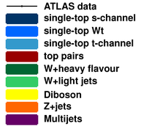

s-channel
ATLAS-CONF-2011-118
August 2011; L = 0.7 fb⁻¹
Sensitive to several models of new physics, like W’ bosons or charged Higgs bosons
Not yet observed
Signal signature: lepton + jets
  A lepton (e,µ) and E_{T}^{miss} from the leptonic decay of a W boson
  two hadronic jets with high transverse momentum, at least one of which is required to originate from a b-quark
Backgrounds: tt, W+jets , Multijet + small contributions from other processes
Very Challenging
Same objects and pre-selection as t-channel
Also same background estimations for Multijets and W+jets
After the final selection: signal purity of 6%
Upper limit on the observed production cross-section
Cut-based analysis

Slide 14
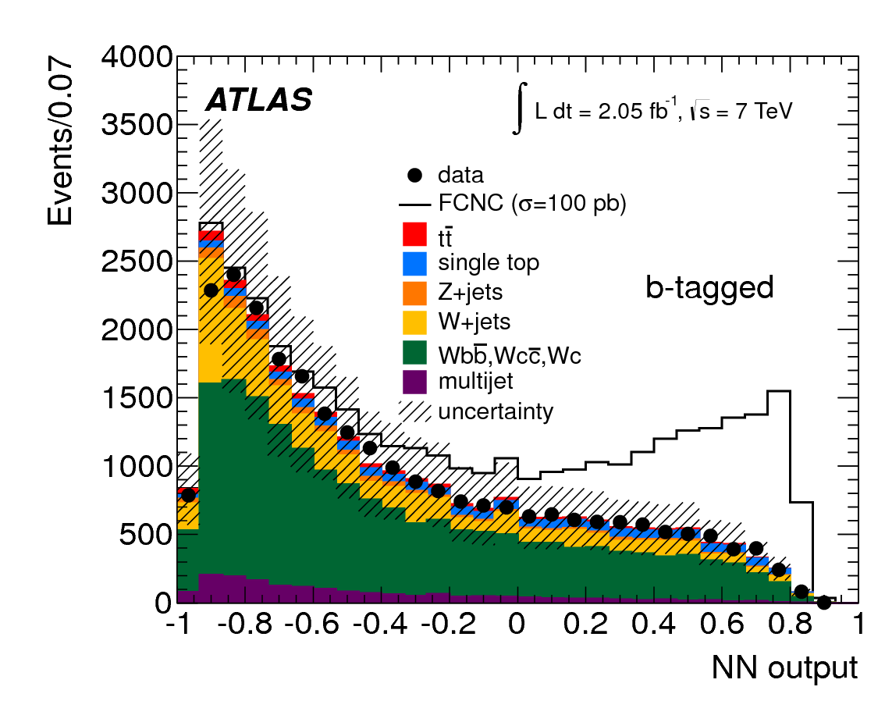
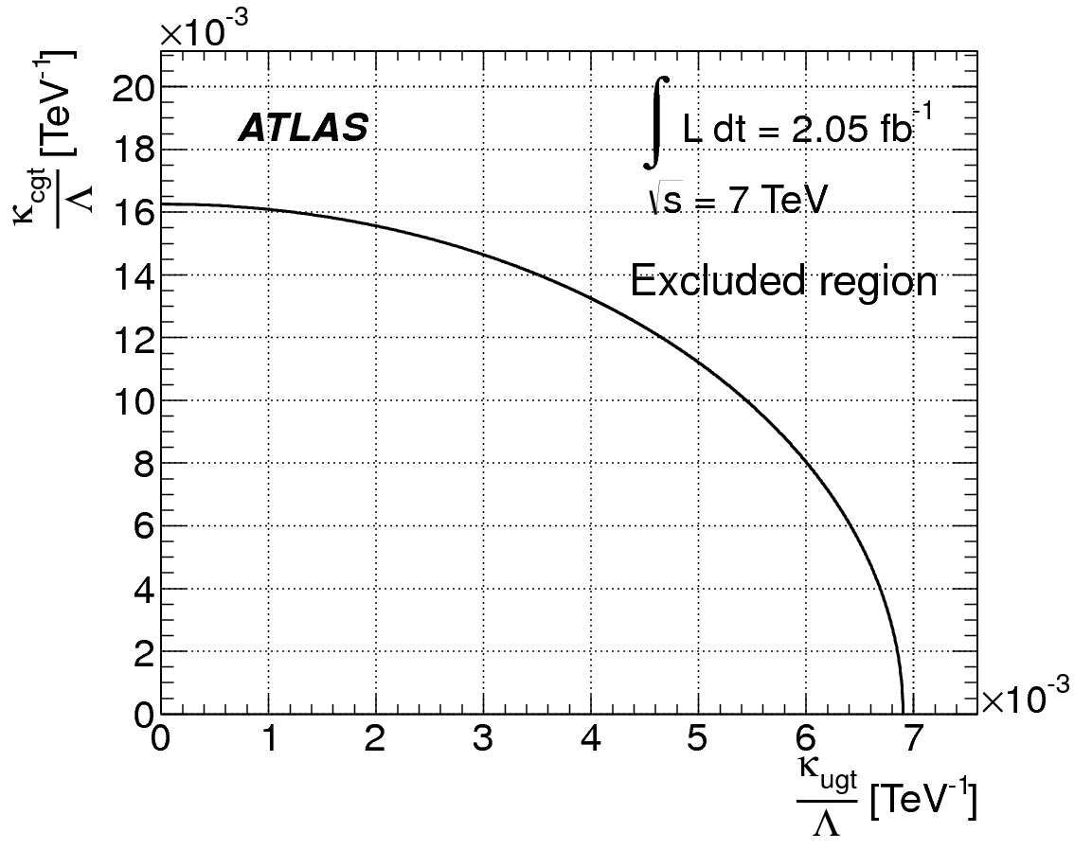
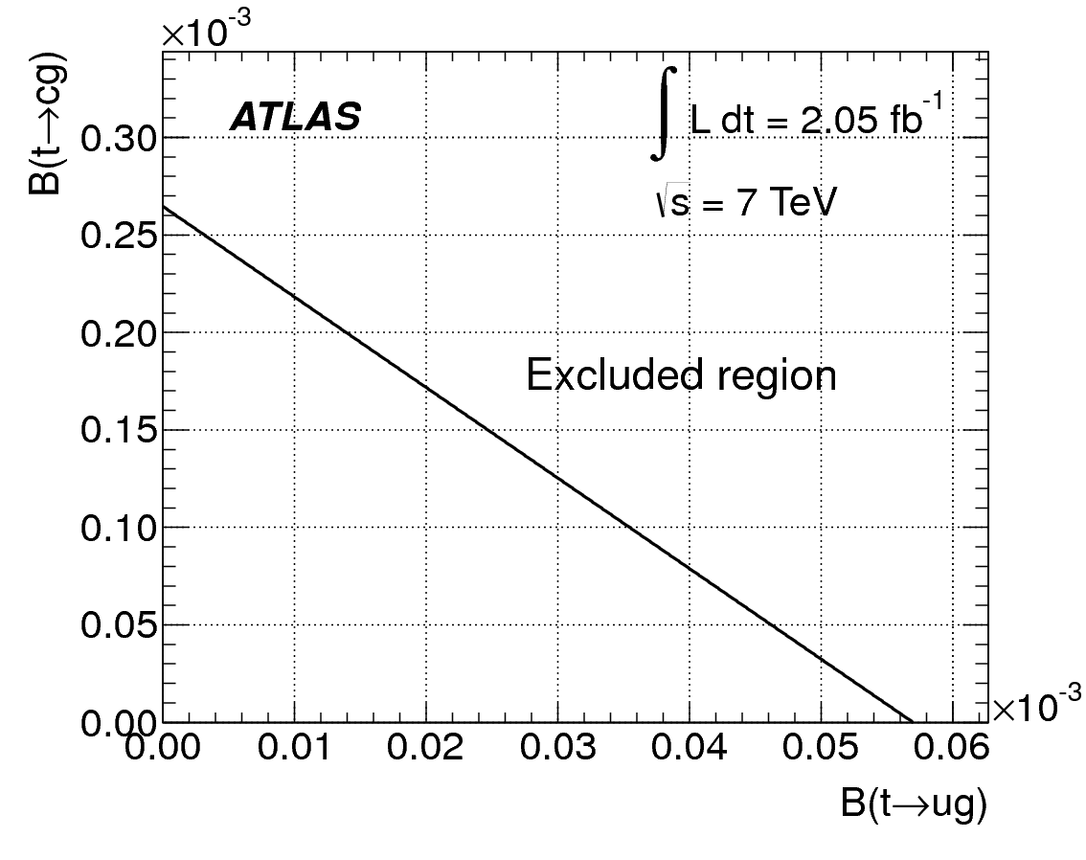

Other single top studies:
FCNC single top quark production
New!
Analysis strategy:
  use leptonic decays, 1 jet bin
  classify events using a neural network
  most signicant variables: W boson p_{T}, ΔR_{(b-jet,lepton)} and lepton charge
Results: no observed excess over SM, limits set:
Submitted to Phys. Lett. B
arXiv:1203.0529
Mar 2012; 2.05fb⁻¹
Upper limit on the coupling constants κ_{ugt}/Λ and κ_{cgt}/Λ.
Upper limit on the branching fractions t → ug and t → cg

Slide 15
Summary
ATLAS and CMS have a broad program of single top physics
Window to new physics, key to measurements of electroweak properties of the top quark, background to Higgs and other searches
Measurement of the cross-section of t-channel production with 2011 data
From t-channel cross section: CMS measures |V_{tb}| at the 10% level
First hints of tW associated production with upper limit on the cross-section (ATLAS) and significance close to 3σ (CMS) in cut based analysis
First upper limits on s-channel production (ATLAS), challenging final state
Other single top studies, latest result from ATLAS: FCNC single top quark production:
  The limits set on the coupling constants and the branching fractions are the most stringent to date on FCNC single top-quark production processes for qg→t and improve on the previous best limits set by the Tevatron by factors of 4 and 15, respectively.

Slide 16
Backup Slides

Slide 17
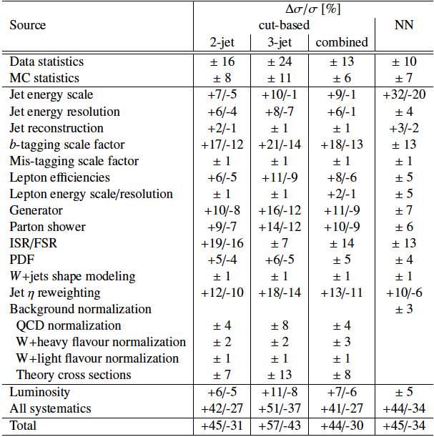
Systematic uncertainties: t-channel
ATLAS
CONF-2011-101

Slide 18
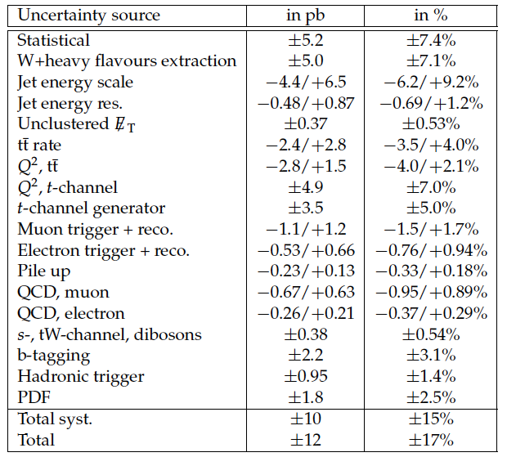
Systematic uncertainties: t-channel
CMS PAS
TOP-11-021

Slide 19
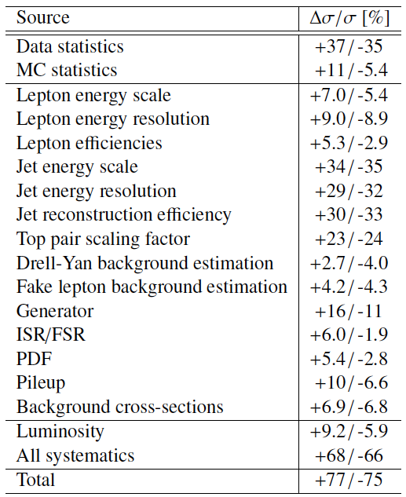
Systematic uncertainties: tW
ATLAS-CONF-2011-104

Slide 20
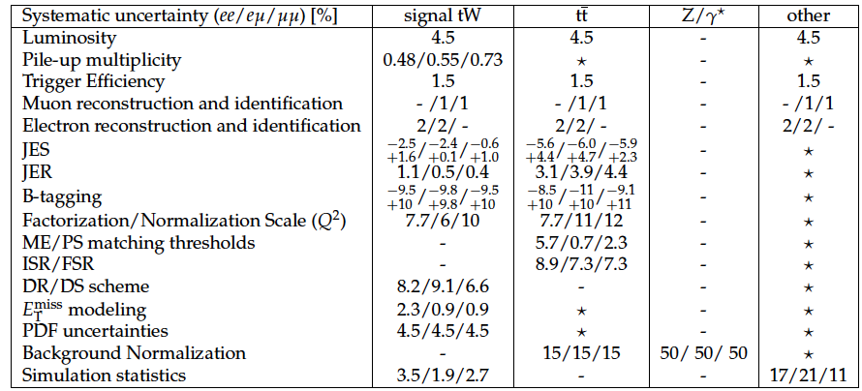
Systematic uncertainties: tW
CMS PAS TOP-11-022
“-” means it doesn’t apply, and “★” for negligible contributions

Slide 21
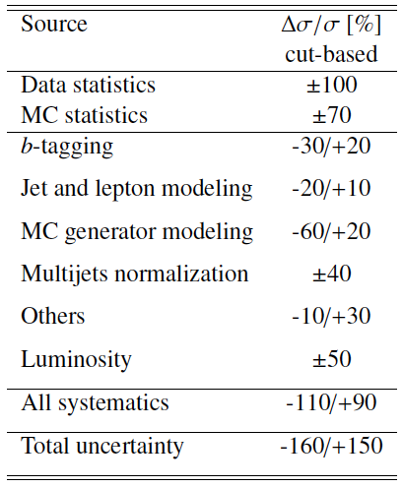
Systematic uncertainties: s-channel
ATLAS-CONF-2011-118

Slide 22
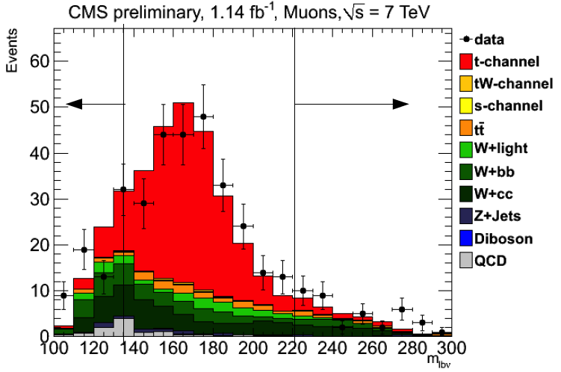
Background estimation in t-channel CMS
QCD multijets is controlled in the 2 jet 1 tag sample after fitting the low m_{T} region for the muon channel/low ET miss region for the electron channel
Check shape and normalization of |η_{j} | and m_{lvb} in 2 control regions:
  2 jets 0 tags: W+light
  3 jets 2 tags: ttbar
W+ heavy flavor production is the main background
  From EWK/ ttbar cross section measurement it is expected to be 1.2 (W+b) / 1.7x (W+c) larger with respect to MC prediction
  Control |η_{j} | in the m_{lvb} sidebands
  Subtract TTbar, single top-s, -tW and dibosons from prediction
  Derive the template for W+heavy flavor contribution to be fit in the signal region

