Slide 1




Inclusive single top cross section at the LHC
TOP2013
6th International Workshop on Top quark physics
14-16 September
Durbach, Germany
Rebeca Gonzalez Suarez (University of Nebraska, Lincoln)
On behalf of the ATLAS and CMS collaborations

Slide 2
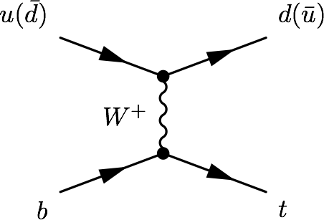
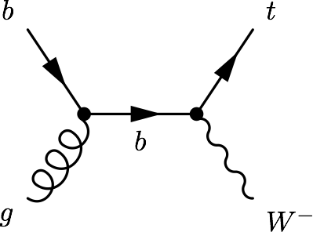
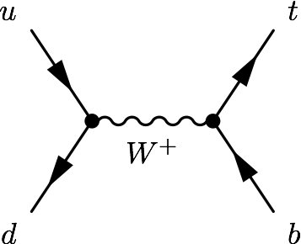
Intro, single top modes
LHC: top quarks produced mostly in pairs via strong interaction
Single top quark production: alternative mode via electroweak interaction, involving a Wtb vertex
Three process contribute:
t-channel, tW associated production, s-channel
Single top processes are sensitive to many models of new physics
FCNC, Anomalous couplings
New particles (W’, charged Higgs)
Provide a characteristic scenario to perform SM measurements:
Top polarization, W helicity, top mass, |V_{tb}|
Are a background to searches (Higgs, SUSY)
Just observed
Observed
Work in progress

Slide 3
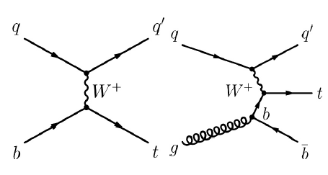
t-channel
Dominating process with the highest cross section at the Tevatron and the LHC
ATLAS and CMS have studied the process and measured its cross-section at 7 and 8 TeV
The final state studied is a lepton + jets signature
Signal events are characterized by:
One isolated muon or electron
Missing transverse energy (MET)
A central b jet and an additional light-quark jet from the hard scattering process (often forward)
Additionally, a second b jet produced in association to the top quark can be present as well (softer p_{T} spectrum with respect to the b jet from top decay)
Main backgrounds: W+jets, top pairs, multijet

Slide 4
t-channel at √s = 7 TeV
Phys.Lett.B 717(2012) 330-350
JHEP12(2012) 035
Objects (ATLAS/CMS):
Muons: p_{T} > 25/20 GeV, |η| < 2.5/2.1
Electrons: E_{T}/p_{T} > 25/30 GeV, |η| < 2.47/2.5
Jets: Anti-k_{t} (0.4/0.5) p_{T} > 25/30 GeV, |η| < 4.5
+ b-tagging
Event Selection:
Exactly 1 isolated lepton (µ or e)
At least 2 jets (ATLAS: exactly 2 or 3. CMS: several exclusive regions up to 4 jets)
Kinematic cuts:
ATLAS:
MET > 25 GeV; m_{T} (W) > (60 – MET)
CMS:
m_{T} (W) > 40 GeV (µ) ; MET > 25 GeV (e)
ATLAS: NN (+cut-based)
L = 1.04 fb⁻¹
CMS: NN, BDT, |η_{j’}| fit
L =1.17 (µ) / 1.56(e) fb⁻¹
CMS regions:
NN and BDT: 2jets1tag, 3jets1tag
(+ 4j1t, 2j2t, 3j2t, 4j2t to constrain nuisance parameters)
|η_{j’}|: 2j1t divided into:
SR (130 < m_{lνb} < 220 GeV) and SB
ATLAS: exactly 2/3 jets:
b-tagged sample (1 tag)
Pre-tagged sample
2/3jets 1tag: signal region
2/3jets 0tags: W+jets enriched
3jets 2tag, 4jets 0/1/2ttags: ttbar enriched

Slide 5
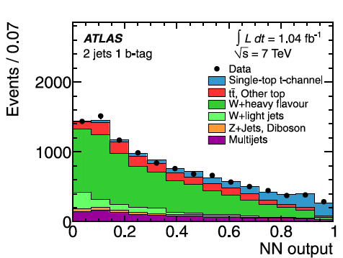
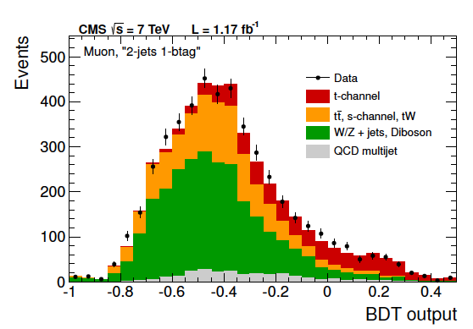
t-channel at √s = 7 TeV: Analysis
Phys.Lett.B 717(2012) 330-350
JHEP12(2012) 035
Background estimation:
QCD multijet: data-driven. Maximum likelihood fit to MET or m_{T}(W) (CMS µ channel). Templates from data: inverting isolation (CMS, µ), failing some conditions (CMS e), replacing the electron requirement by a jet requirement (jet-electron model, ATLAS)
W+jets: ATLAS distributions from MC, normalization from data. CMS checked in CR, estimated from SB to SR in |η_{j’}|
ATLAS:
NN: 12 variables (2 jet), 18 variables (3jet), most discriminant: m_{lbν}, m_{j1j2}
Cut-based: 5 variables (also used by the NN)
CMS:
NN: 37 variables (µ), 38 variables (e), |η_{j’}| highest rank
BDT: 11 variables
|η_{j’}| fit in the SR

Slide 6
t-channel at √s = 7 TeV: Results
Phys.Lett.B 717(2012) 330-350
JHEP12(2012) 035
ATLAS:
Maximum likelihood fit to the NN output
Cut-based: 4 channels (l⁺/l⁻, 2/3 jets treated separately)
Main systematics: ISR/FSR, b-tagging
Results:
NN: σ_{t-channel} = 83±4(stat) +20-19(syst) pb = 83 ± 20 pb
Cut-based: σ_{t-channel} = 92+29-26 pb
|V_{tb}| = 1.13+0.14-0.13, constrained (|V_{tb}| ≤ 1) |V_{tb}| > 0.75 at 95%CL
CMS:
Results:
|η_{j’}|: σ_{t-channel} = 70.0±6.0(stat)±6.5(syst)±3.6(th)±1.5(lumi) pb
NN: σ_{t-channel} = 68.1±4.1(stat)±3.4(syst)+3.3-4.3(th)±1.5(lumi) pb
BDT: σ_{t-channel} = 66.6±4.0(stat)±3.3(syst)+3.9-3.3(th)±1.5(lumi) pb
Combination:
σ_{t-channel} = 67.2±3.7(stat)±3.0(syst)±3.5(th)±1.5(lumi) pb = 67.2±6.1 pb
|V_{tb}| = 1.020 ± 0.046 ± 0.017, constrained |V_{tb}| > 0.92 at 95% CL
SM expectation
σ_{t-channel} = 65.9 (+2.1-0.7) (+1.5-1.7) pb
http://arxiv.org/abs/1210.7813v2

Slide 7
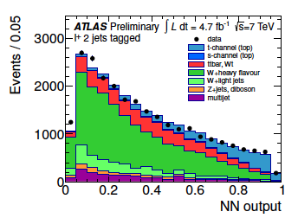
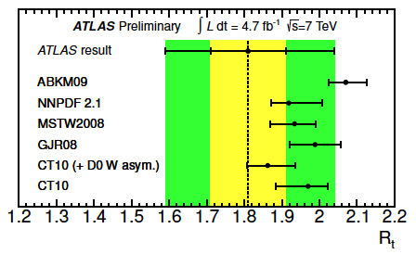
t-channel at √s = 7 TeV: Charge ratio
ATLAS-CONF-2012-056
ATLAS, L = 4.71fb⁻¹
Similar strategy, slightly different cuts:
MET > 30 GeV, m_{T}(W) > 30 GeV
p_{T} cut for (forward) jets > 30 GeV (50 GeV)
Background estimation:
Multijet: same method. W+jets: simulation, fractions scaled from data
Analysis:
NN: 15 variables 2j1t, 19 variables 3j1t
training done in 4 channels (2 regions, l⁺ or l⁻)
Main systematics: ISR/FSR, multijet normalization
Results:
Maximum likelihood fit to the NN output, l⁺/l⁻ independently:
σ_{top} = 53.2±1.7(stat)±10.6(syst) pb = 53.2±10.8 pb
σ_{anti-top}= 29.5±1.5(stat)±7.3(syst) pb = 29.5+7.4-7.5 pb
R = 1.81±0.10(stat)+0.21-0.20(syst) = 1.81+0.23-0.22
SM expectation
σ_{top}= 43.0 (+1.6-0.2) ±0.8 pb σ_{anti-top}= 22.9±0.5 (+0.7-0.9) pb
http://arxiv.org/abs/1210.7813v2

Slide 8
t-channel at √s = 8 TeV
ATLAS-CONF-2012-132
CMS-PAS-TOP-12-011
Objects (ATLAS/CMS):
Muons: p_{T} > 25/26 GeV, |η| < 2.5/2.1
Electrons: E_{T} > 25 GeV, |η| < 2.47
Jets: Anti-k_{t} (0.4/0.5) p_{T} > 30/60 GeV, |η| < 4.5 + b-tagging
Event Selection:
Exactly 1 isolated lepton
At least 2 jets
(ATLAS: exactly 2/3, CMS: several regions)
Kinematic cuts:
ATLAS: MET > 30 GeV, m_{T}(W) > 50 GeV
CMS: m_{T} (W) > 50 GeV
ATLAS: NN
L = 5.8 fb⁻¹
CMS: |η_{j’}| muon channel
L =5.0 fb⁻¹
ATLAS
Signal region: 1 tag
Control regions: loose b-tagging requirements, vetoing b-tagged events from signal region
CMS
2j1t divided into:
SR (130 < m_{lνb} < 220 GeV) and SB
+Several jet-tag regions as CR to check input variables

Slide 9
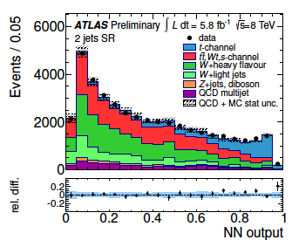
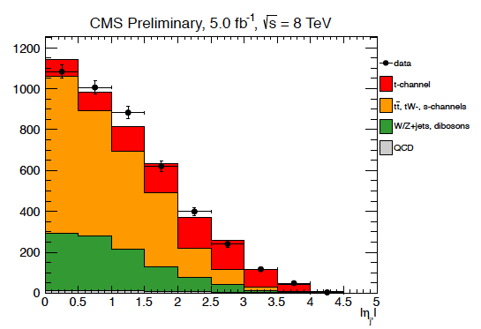
t-channel at √s = 8 TeV: Analysis
ATLAS-CONF-2012-132
CMS-PAS-TOP-12-011
Background estimation:
QCD multijet: data-driven. Maximum likelihood fit to MET (ATLAS) or m_{T}(W) (CMS) before cut. Template from data, inverting isolation (CMS). Template from PYTHIA jet-electron model (ATLAS)
W+jets: ATLAS simulation, fractions scaled from data. CMS from SB to SR
tt: CMS normalization from simulation, template from 3j2t
CMS:
Fit to |η_{j’}| in 2j1t, SR
ATLAS:
NN: 11 variables. Training independently 2j1t and 3j1t

Slide 10
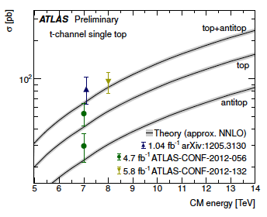
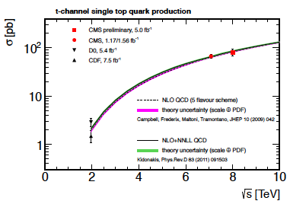
t-channel at √s = 8 TeV: Results
ATLAS-CONF-2012-132
CMS-PAS-TOP-12-011
ATLAS
Binned maximum likelihood fit to the NN in 2/3 jets samples
Main systematics: ISR/FSR, b-tag
σ_{t-channel} = 95.1±2.4(stat)±18.0(syst) pb= 95.1±18.1 pb
|V_{tb}| = 1.04+0.10-0.11, constrained |V_{tb}| > 0.80 at 95%CL
CMS
Maximum likelihood fit to |η_{j’}| in 2j1t in the SR
Larger systematic effect: JES
σ_{t-channel} = 80.1±5.7(stat)±11.0(syst)±4.0(lumi) pb
|V_{tb}|= 0.96±0.08(exp)±0.02(th)
constrained |V_{tb}| > 0.81 at 95%CL
SM expectation
σ_{t-channel} = 87.2 (+2.8-1.0) (+2.0-2.2) pb
http://arxiv.org/abs/1210.7813v2

Slide 11
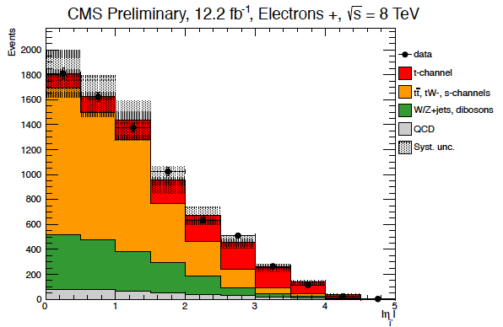
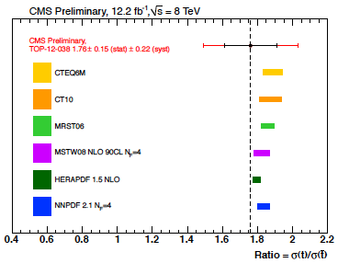
t-channel at √s = 8 TeV: Charge ratio
CMS, L = 12.2fb⁻¹
CMS-PAS-TOP-12-038
|η_{j’}| analysis with both muons and electrons
Electrons E_{T} > 30 GeV, |η|<2.5; Jet P_{T} > 40 GeV
Same event selection with MET > 45 GeV for electron channel (instead of m_{T}(W) cut)
Multijet background: same method, fit to MET for electron channel.
Analysis: Fit to |η_{j’}| in 2j1t, SR, for l⁺ and l⁻
Main systematics: pdf, background estimation
SM expectation
σ_{top}= 56.4 (+2.1-0.3) ±1.1 pb
σ_{anti-top}= 30.7±0.7 (+0.9-1.1) pb
http://arxiv.org/abs/1210.7813v2
Results:
σ_{top} = 49.9±1.9(stat)±8.9(syst) pb
σ_{anti-top}= 28.3±2.4(stat)±4.9(syst) pb
R = 1.76±0.15(stat)±0.22(syst)

Slide 12
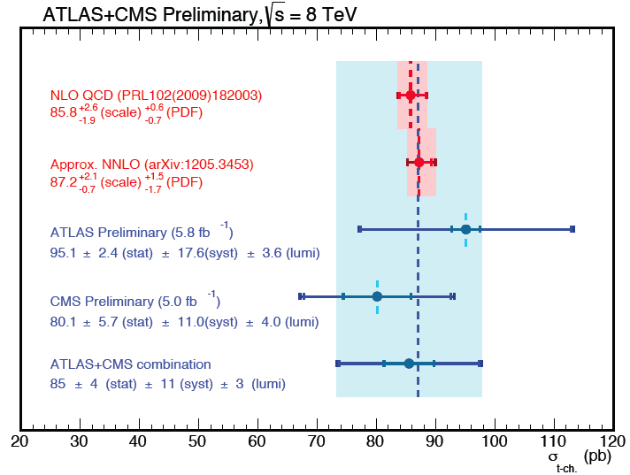

t-channel at √s = 8 TeV: Combination
ATLAS-CONF-2013-098
TOP-12-002
Technique: Iterative BLUE (Best Linear Unbiased Estimator)
Uncertainty contributions separated in categories
Correlation assumptions for the different systematics
Stability of the combination tested varying correlation factors
Systematics with the larger impact: simulation and modeling
For more information, check the poster by Luca Lista
SM expectation
σ_{t-channel} = 87.2 (+2.8-1.0) (+2.0-2.2) pb
http://arxiv.org/abs/1210.7813v2
Result: σ_{t-channel} = 85±4(stat)±11(syst)±3(lumi) pb = 85±12 pb

Slide 13
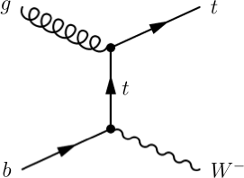
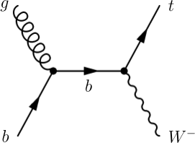
tW associated production
Single top process with the second largest cross-section at the LHC, negligible at the Tevatron
ATLAS and CMS showed evidence at 7 TeV, CMS has presented the first observation at 8TeV
The final state studied is a dilepton signature
Signal events are characterized by:
Two opposite-sign, isolated leptons
Missing transverse energy (2 neutrinos in the final state)
A jet coming from a b decay
Backgrounds: ttbar, DY

Slide 14
tW at √s = 7 TeV [First Evidence]
Phys.Lett.B 716 (2012) 142-159
Phys.Rev.Lett 110, 022003 (2013)
Objects (ATLAS/CMS):
Muons: p_{T} > 25/20 GeV, |η| < 2.5/2.1
Electrons: E_{T}/p_{T} > 25/20 GeV, |η| < 2.47/2.4
Jets: Anti-k_{t} (0.4/0.5) E_{T}/p_{T} > 30 GeV, |η| < 2.5/2.4
b-tagging (CMS)
Event Selection:
Exactly 2 opposite-charge isolated leptons
(µµ, eµ and ee)
ATLAS:
MET > 50 GeV
ee/µµ: veto events with 81 < m_{ll} < 101 GeV
ΔΦ_{(l1, MET)} + ΔΦ_{(l2, MET)} > 2.5 to reduce Z-> ττ
CMS:
m_{ll} > 20 GeV
ee/µµ: veto events with 81 < m_{ll} < 101 GeV
ee/µµ: min (MET, Tracker MET) > 30 GeV
ATLAS: BDT
L = 2.05 fb⁻¹
CMS: BDT (+cut-based)
L = 4.9 fb⁻¹
ATLAS uses events with at least 1 jet (signal region, exactly 1)
CMS
Signal Region: Exactly 1 jet, b-tagged (no additional b-tagged jets, p_{T} > 20)
Control Regions: Exactly 2 jets 1/2 tags (ttbar)

Slide 15
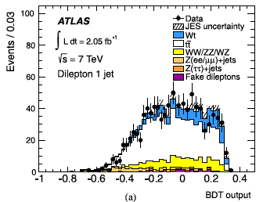
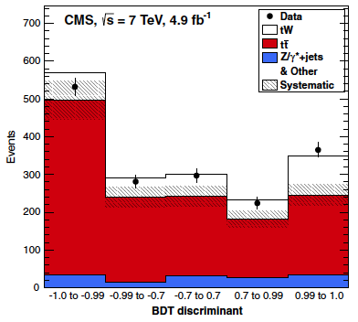
tW at √s = 7 TeV: Analysis
Phys.Lett.B 716 (2012) 142-159
Phys.Rev.Lett 110, 022003 (2013)
Background estimation:
tt: Dedicated control regions included in the fit. ATLAS: events with exactly 2 jets and with 3 or more. CMS: 2jet 1tag and 2jet 2tag regions
DY: data-driven scale factors. ATLAS: from control regions defined by MET and m_{ll} CMS: MET-dependent, from Z mass peak inverting the m_{ll} cut
Fakes: ATLAS matrix method (< 1%)
Z-> ττ: ATLAS control region inverting the cut
ATLAS:
BDT (training on 1jet events), 22 variables. Most powerful: p_{T} of the system (leptons, MET, jet)
CMS:
BDT (4 variables) + cut based (extra cut on eµ H_{T})

Slide 16
tW at √s = 7 TeV: Results
Phys.Lett.B 716 (2012) 142-159
Phys.Rev.Lett 110, 022003 (2013)
ATLAS:
Maximum likelihood fit over BDT distribution in signal and control regions
Main systematics JES, parton shower
Results:
Significance: 3.3σ observed (3.4σ expected)
σ_{tW} = 16.8 ± 2.9 (stat) ± 4.9 (syst) pb
|V_{tb}| = 1.03+0.16-0.19
CMS:
Binned likelihood fit on BDT distributions, separated by final state and regions
Dominating systematic: JES, matching thresholds
Results:
Significance: 4.0σ (3.6+0.8-0.9σ expected)
σ_{tW} =16+5-4 pb
|V_{tb}| = 1.01+0.16-0.13+0.03-0.04(th)
constrained |V_{tb}| > 0.79 at 90% CL
SM expectation
σ_{tW} = 15.6±0.4±1.1 pb
http://arxiv.org/abs/1210.7813v2
Cut-based:
3.5σ (3.2±0.9σ expected)
σ_{tW} =15±5 pb

Slide 17
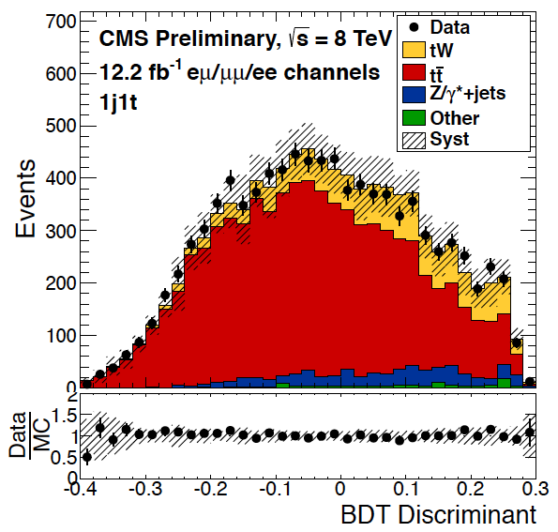
CMS: tW at √s = 8 TeV [Observation]
CMS L = 12.2fb⁻¹
CMS-PAS-TOP-12-040
Objects:
Muons (Electrons)
p_{T}> 20 GeV, |η| < 2.4(2.5), isolated
Jets:
Anti-k_{t} 0.5 p_{T} > 30 GeV, |η| <2.4 corrected
(+ loose jets: failing p_{T}/|η| ; p_{T} > 20 GeV, |η| < 4.9)
b-tag
Event selection:
Exactly 2 leptons, opposite charge
m_{ll} > 20 GeV
ee/µµ:
veto events with 81 < m_{ll} < 101 GeV
MET > 50 GeV
Analysis
BDT, 13 variables (variables related to loose jets most powerful)
Two cross-check analyses, additional cut in eµ H_{T} > 160: fit on shape of p_{T} of the system and event counting
Same regions and background estimations as in the 7TeV analysis

Slide 18
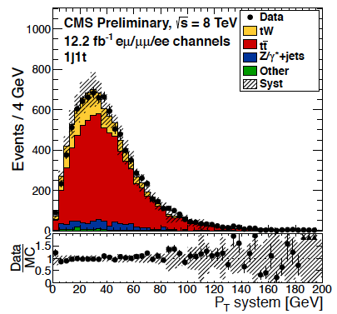
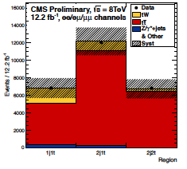
CMS: tW at √s = 8 TeV: Results
CMS-PAS-TOP-12-040
For more information, check the poster by Duncan Leggat
CMS:
Binned likelihood fit on the three final states in the three regions
Main systematics, theoretical: matching thresholds, Q²
Results:
Significance: 6.0σ (5.4+1.5-1.4σ expected)
σ_{tW} = 23.4+5.5-5.4 pb
|V_{tb}| = 1.03 ± 0.12(exp)±0.04(th), constrained |V_{tb}| > 0.78 at 95%CL
SM expectation
σ_{tW} = 22.2±0.6±1.4 pb
http://arxiv.org/abs/1210.7813v2
Cross-check (fit to the p_{T} of the system):
4.0σ (3.2+0.4-0.9)
σ_{tW} = 24.3+8.6-8.8 pb
Cross-check (cut based):
3.6σ (2.8+0.9-0.8σ)
σ_{tW} = 33.9+8.6-8.6 pb

Slide 19
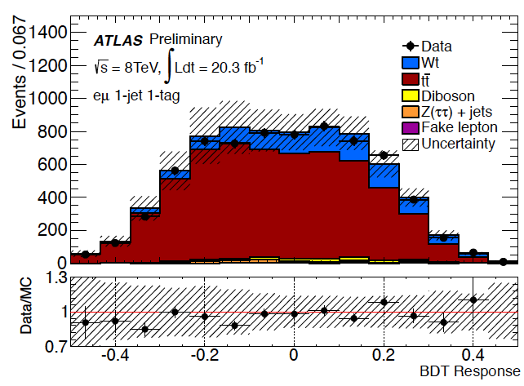
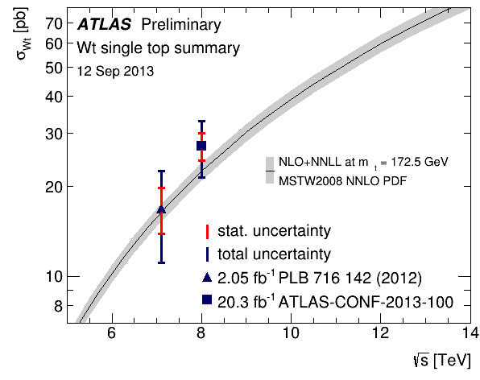
ATLAS: tW at √s = 8 TeV
ATLAS-CONF-2013-100
ATLAS L = 20.3fb⁻¹
eµ channel
Event selection:
eµ pair, opposite charge
Exactly 1/2 jets, at least one b-tagged
Fake leptons background: matrix method
Analysis:
BDT: 19 variables (1 jet), 20 variables (2 jet)
Maximum likelihood fit to the BDT output in both regions
Larger systematics: generators and flavor tagging
Result:
Significance: 4.2σ (4.0σ expected)
σ_{tW} = 27.2±2.8(stat)±5.4(syst) pb
|V_{tb}| = 1.10±0.12(exp)±0.03(th)
constrained |V_{tb}| > 0.72 at 95%CL
SM expectation
σ_{tW} = 22.2±0.6±1.4 pb
http://arxiv.org/abs/1210.7813v2

Slide 20
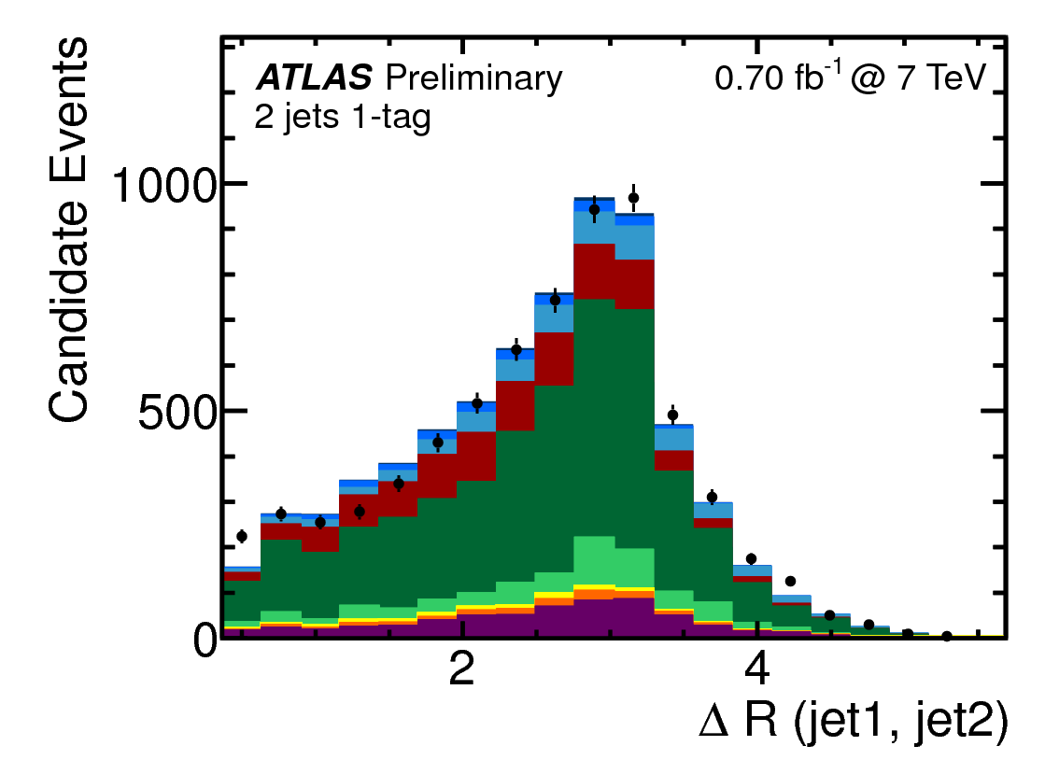
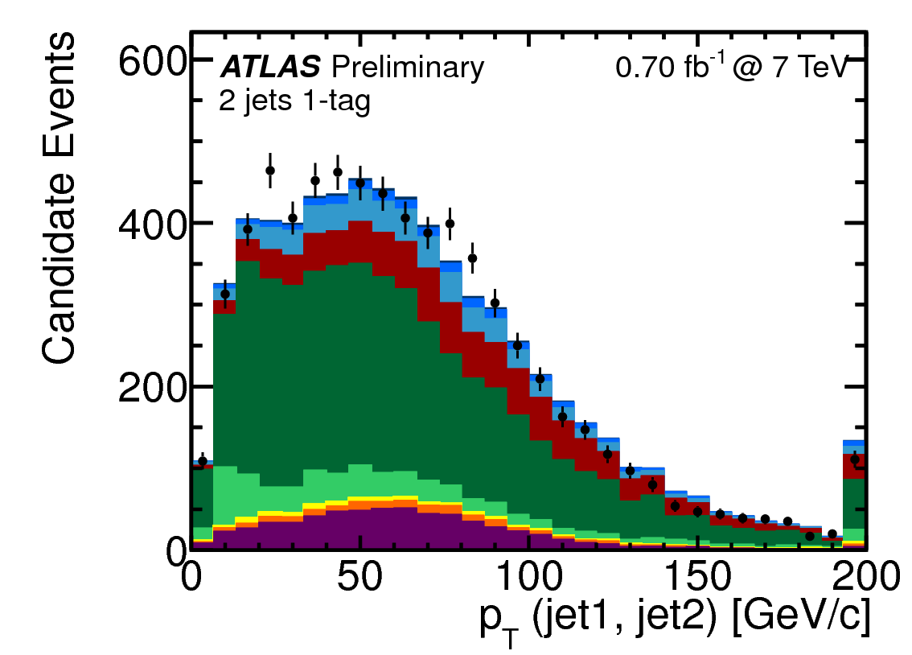
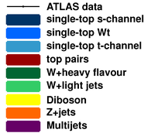
s-channel at √s = 7 TeV
ATLAS-CONF-2011-118
ATLAS, L = 0.70 fb⁻¹
Sensitive to new physics, W’ bosons, charged Higgs bosons
Signal signature: lepton + jets
A lepton (e,µ) and MET from the decay of a W boson
Two jets with high transverse momentum
at least one of which originating from a b-quark
Backgrounds: W+jets and ttbar (same final state), multijet
Cut-based analysis, cuts optimized Vs. S/√B, statistically limited
Same objects, event selection* and background estimation as t-channel 7TeV analysis
(*only central jets are used here)
SM expectation
σ_{s-channel} = 4.56±0.07 (+0.18-0.17)pb
http://arxiv.org/abs/1210.7813v2
Observed (expected) upper limit:
σ_{s-channel} < 26.5 (20.5) pb at 95%CL

Slide 21
Summary
ATLAS and CMS have a broad catalog of single-top analyses: t-channel and tW studies at 7 and 8TeV, s-channel studies ongoing (challenging final state)
t-channel rediscovered at the LHC with early 7TeV data, cross-section and charge ratio measured at 7 and 8TeV using various techniques
Evidence of the tW associated production reported by both experiments with 7TeV data, process observed by CMS at 8TeV
Work ongoing on the combination of results, first LHC common result:
t-channel combination at 8TeV
So far, everything in agreement with the Standard Model expectations
 | t-ch. (7TeV) | t-ch. (8TeV) | tW (7TeV) | tW (8TeV) | s-ch. (7TeV)
ATLAS | 83 ± 20 pb | 95.1±18.1 pb | 16.8 ± 5.7 pb | 23.4 +5.5-5.4 pb | < 26.5 pb
CMS | 67.2 ± 6.1 pb | 81.1±13.0 pb | 16 +5-4 pb | 27.2 ± 5.8 pb
LHC |  | 85 ± 12 pb
Th. 65.9 (+2.1-0.7) (+1.5-1.7) pb
Th. 15.6 ±0.4±1.1 pb
Th. 4.56 ±0.07 (+0.18-0.17) pb
Th. 87.2 (+2.8-1.0) (+2.0-2.2) pb
Th. 22.2 ±0.6±1.4 pb

Slide 22
Backup

Slide 23
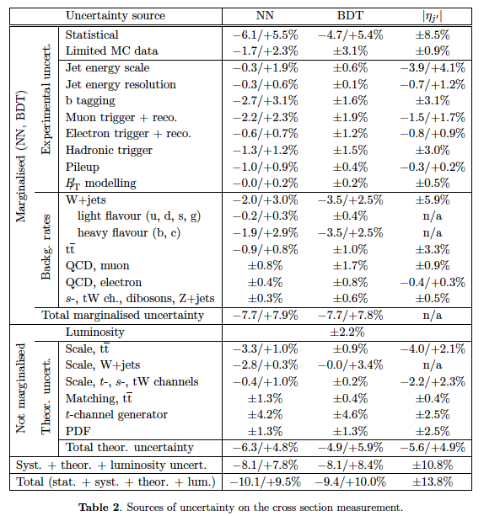
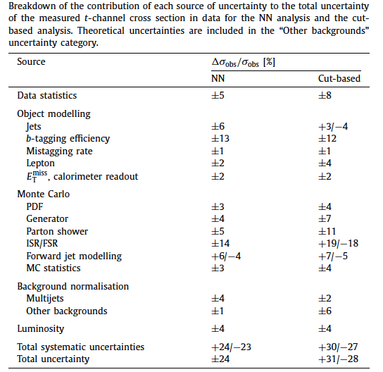
t-channel at √s = 7 TeV: Systematics
Phys.Lett.B 717(2012) 330-350
JHEP12(2012) 035

Slide 24




t-channel at √s = 7 TeV: Results
Phys.Lett.B 717(2012) 330-350
JHEP12(2012) 035
ATLAS
NN
Cut-based
CMS
|ηj’|
NN
BDT

Slide 25
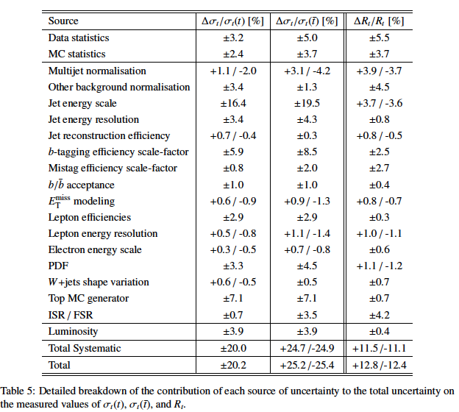

R at √s = 7 TeV: Systematics & Results
ATLAS-CONF-2012-056

Slide 26
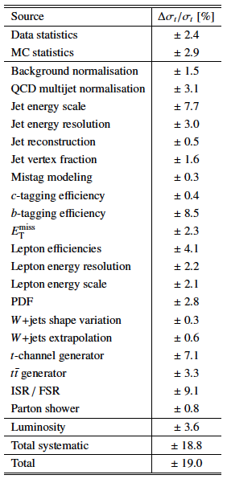
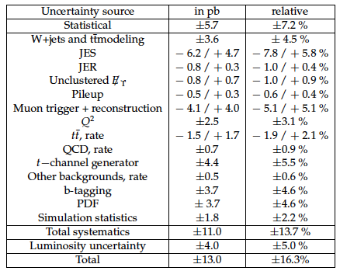
t-channel at √s = 8 TeV: Systematics
ATLAS-CONF-2012-132
CMS-PAS-TOP-12-011

Slide 27
t-channel at √s = 8 TeV: Results
ATLAS-CONF-2012-132
CMS-PAS-TOP-12-011

Slide 28
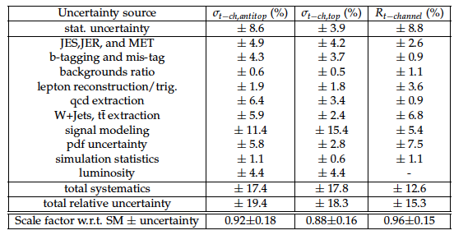

R at √s = 8 TeV: Syst. & Results
CMS-PAS-TOP-12-038

Slide 29
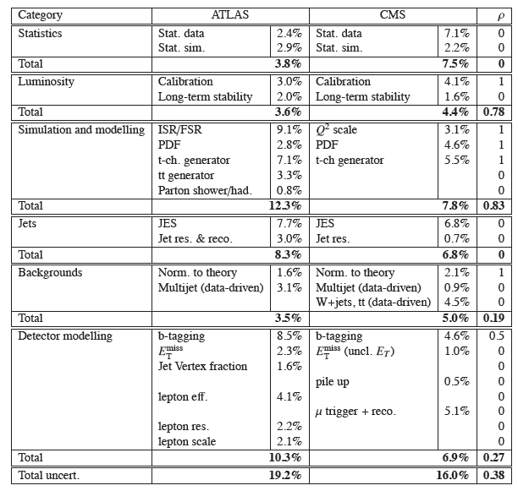
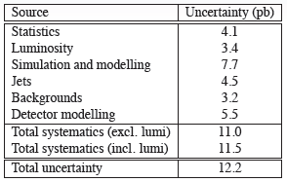
Combination at √s = 8 TeV
ATLAS-CONF-2013-098
REF. coming soon!

Slide 30
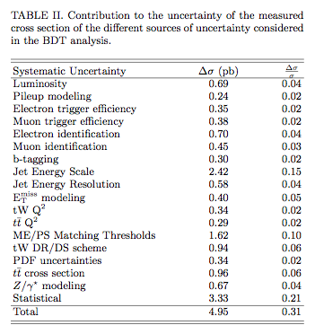
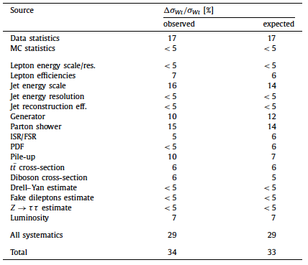


tW at √s = 7 TeV
Phys.Lett.B 716 (2012) 142-159
Phys.Rev.Lett 110, 022003 (2013)

Slide 31
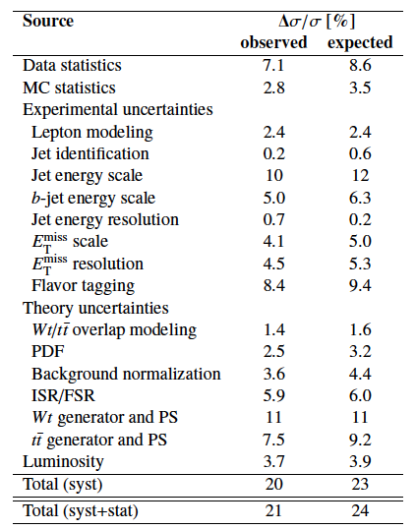
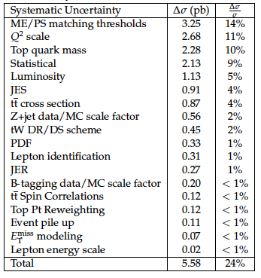
tW at √s = 8 TeV
ATLAS-CONF-2013-100
CMS-PAS-TOP-12-040

Slide 32
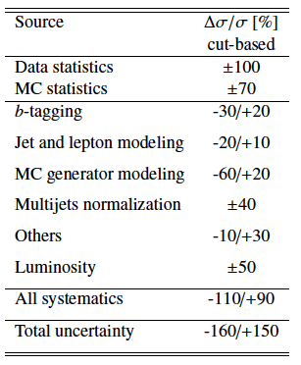
s-channel at √s = 7 TeV
ATLAS-CONF-2011-118

Slide 33
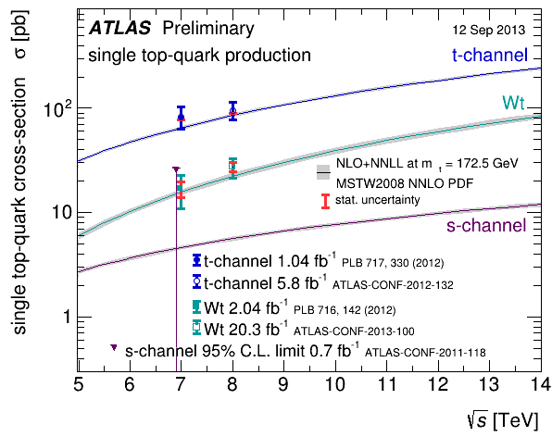
ATLAS: Summary

