Slide 1



Single top Summary and next steps
Rebeca Gonzalez Suarez
CMS Single top workshop
19-20 December 2013, Naples

Slide 2
Introduction
Single top quark production:
Alternative electroweak production mode to the strongly-produced, predominant, top pairs, that happens mainly via three processes (t-channel, tW associated production, and s-channel) at a lower rate
Important Standard Model (SM) check, top quark laboratory!
Sensitive to many new physics scenarios (FCNC, AC, new particles…)
Rare, still now
The study of single top physics did not start at the LHC
Most of the things we know about the top quark is thanks to the Tevatron legacy
The Tevatron started operation in 1986, and discovered the top quark (major milestone) in 1995
First single top evidence (2006) and finally observation (2009) by CDF and D0
When LHC started operation, only the t-channel observed (> 5σ), today not all the modes are established

Slide 3

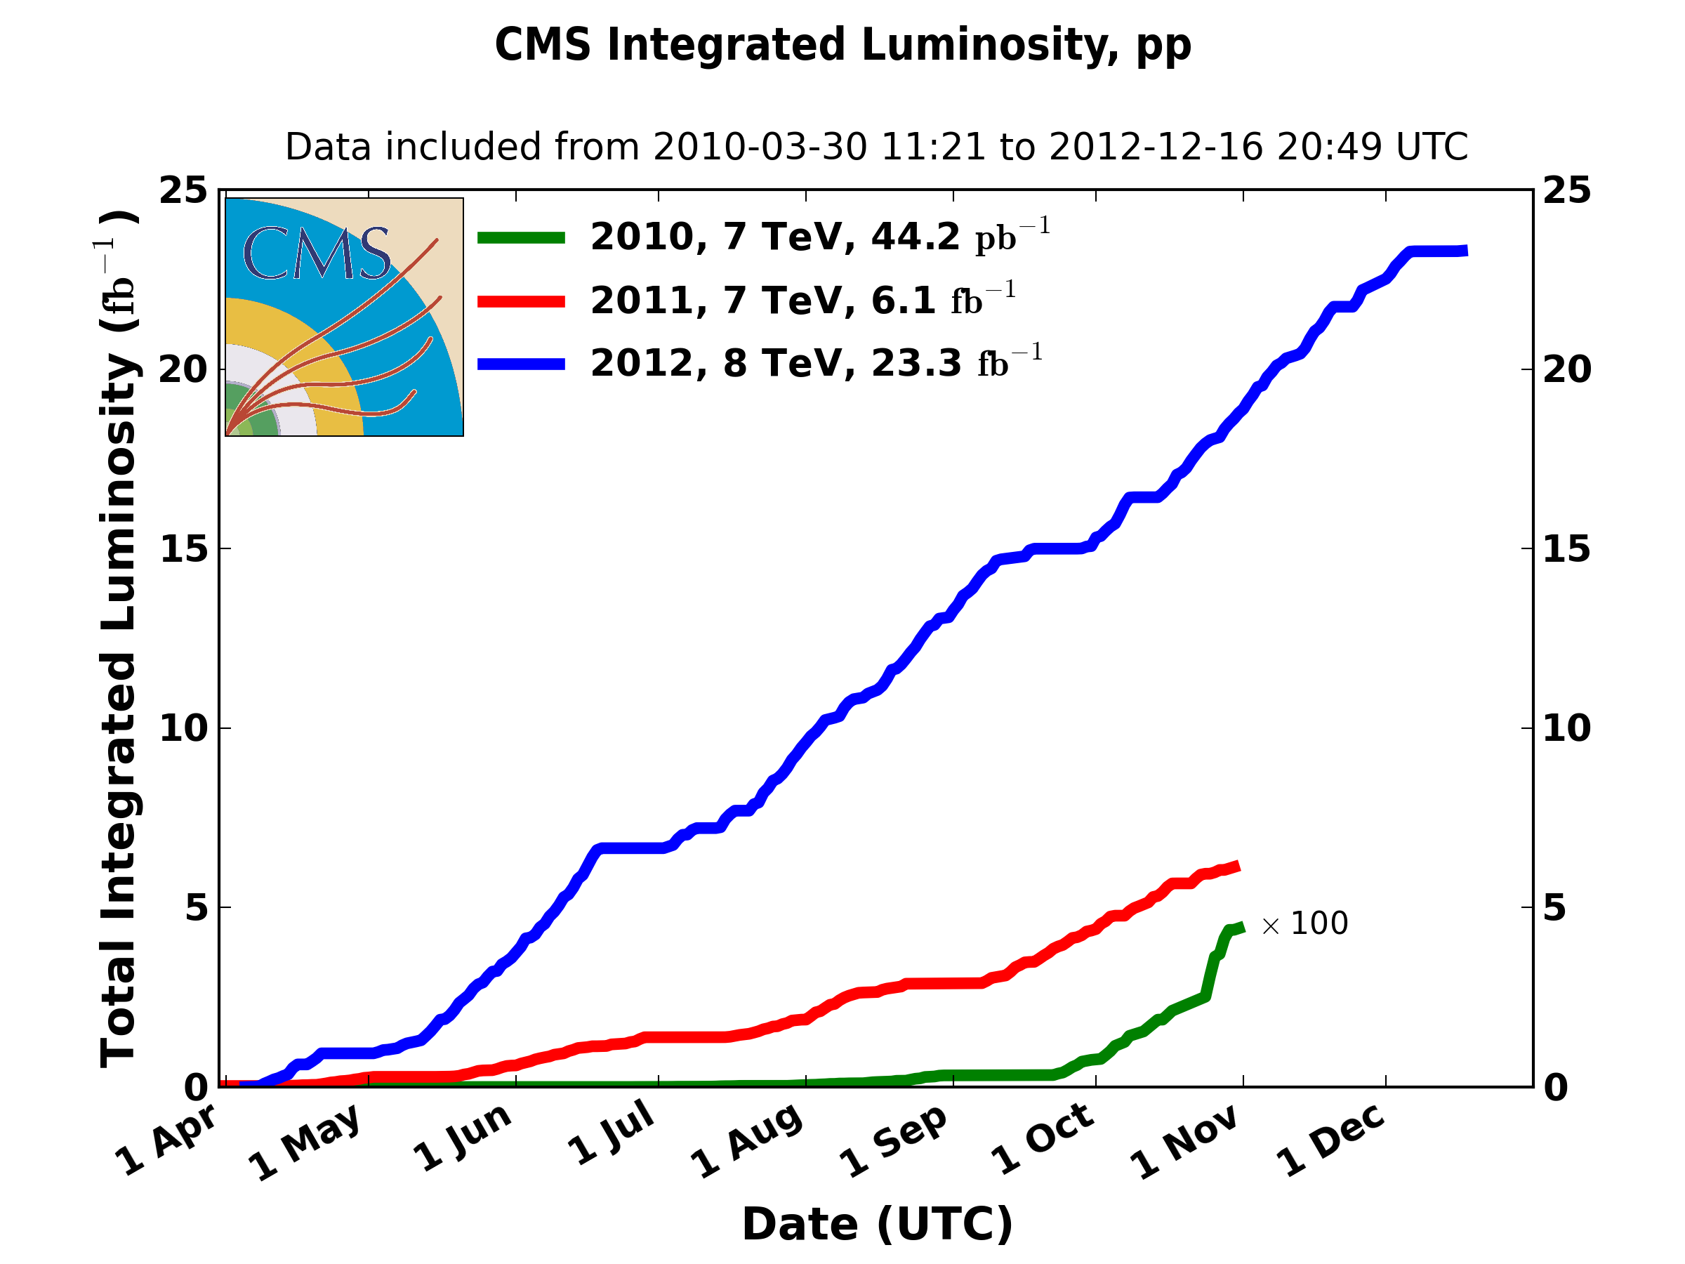
The road highway to single top at the LHC
At the LHC, tops are produced at a much higher rate
Collisions at the LHC started 2010, ATLAS and CMS were almost immediately competitive with respect to the Tevatron results in (single) top physics
σ [pb] | ttbar
Tevatron | 7.08
LHC @ 7TeV | 163
LHC @ 8TeV | 234
LHC = Top factory
CMS presented the first t-channel studies with 7TeV data early 2011
LHC = SINGLE Top factory!
Much more data since then…

Slide 4
Before and After
Before the LHC started operation
Today
σ [pb] | t-channel | tW | s-channel
Tevatron (1.96 TeV) | 2.08±0.12 | 0.22±0.08 | 1.046±0.058
LHC (7 TeV) | 64.6±2.1 pb | 15.6±1.2 | 4.59±0.19
LHC (8 TeV) | 87.1±2.8 pb | 22.2±1.5 | 5.55±0.22
Not accesible
Evidence
Established
Ongoing
Established
Evidence
… ATLAS
Established
Established
… CMS
t-channel is well established everywhere
Really interesting to make measurements
W-helicity, top polarization, top mass?
tW associated production observed for the first time (by CMS!)
More studies will follow, new channels, better precision
s-channel is still hard (low cross-section, difficult signature)
Tevatron has evidence, but neither ATLAS or CMS is close yet
Not yet observed!

Slide 5
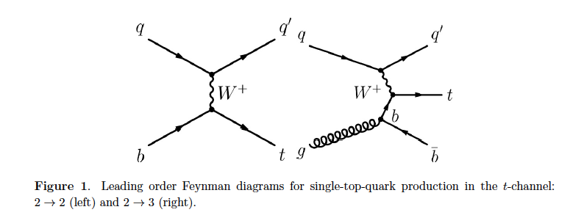
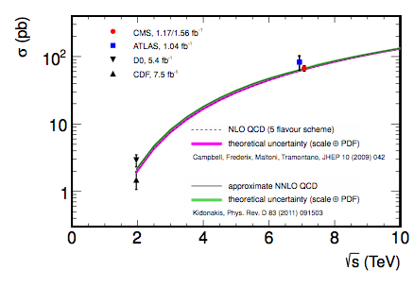
Single top t-channel
Dominating process with the highest cross section at the LHC (and Tevatron)
Lepton+jets signature studied (so far!)
Isolated lepton, MET, central b jet (top decay)
Light-quark jet from the hard scattering process (often forward)
additional second b jet produced in association to the top quark (softer p_{T} spectrum)
Main backgrounds: W+jets, top pairs, multijet
Cross-section at 7TeV published in JHEP
Three analyses: NN, BDT, |η_{j’}|
(1.17 (µ) / 1.56(e) fb⁻¹)
σ_{t-channel} = 67.2±3.7(stat)±3.0(syst)±3.5(th)±1.5(lumi) pb = 67.2±6.1 pb
|V_{tb}| = 1.020 ± 0.046 ± 0.017
|V_{tb}| > 0.92 at 95% CL
JHEP12(2012) 035
(December 2012)

Slide 6
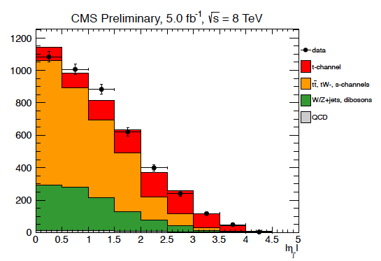
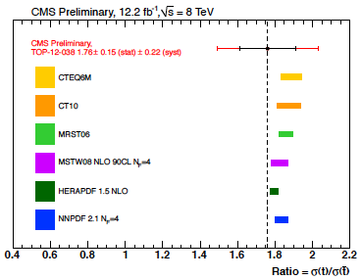
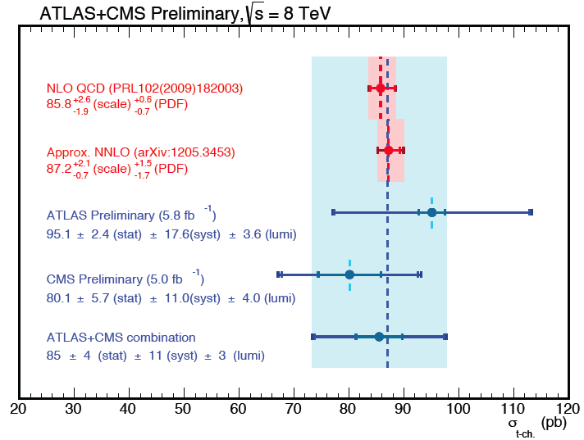
t-channel (8 TeV)
First 8TeV single top result
CMS-PAS-TOP-12-011
Inclusive cross-section at 8TeV
|η_{j’}| analysis, µ only 5.0 fb⁻¹
σ_{t-channel} = 80.1±5.7(stat)±11.0(syst)±4.0(lumi) pb
|V_{tb}|= 0.96±0.08(exp)±0.02(th), |V_{tb}| > 0.81 at 95%CL
Charge ratio (R = σ_{top}/σ_{antitop})
|η_{j’}| analysis, muons and electrons, 12.2fb⁻¹
σ_{top} = 49.9±1.9(stat)±8.9(syst) pb
σ_{anti-top}= 28.3±2.4(stat)±4.9(syst) pb
R = 1.76±0.15(stat)±0.22(syst)
ATLAS+CMS combination
Using Iterative BLUE
σ_{t-channel} = 85±4(stat)±11(syst)±3(lumi) pb = 85±12 pb
(September 2012)
Moriond 2013
CMS-PAS-TOP-12-038
(March 2013)
First LHC single top combination
(TOP2013)
CMS-PAS-TOP-12-002
(September 2013)

Slide 7
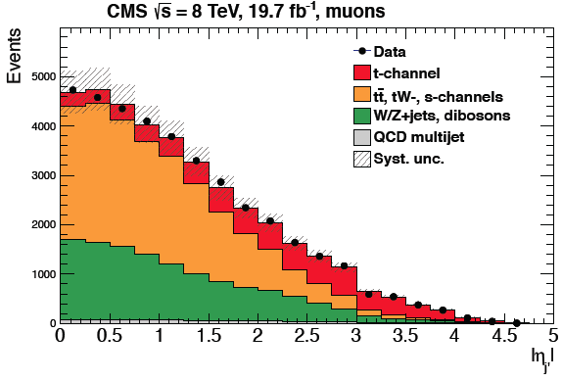
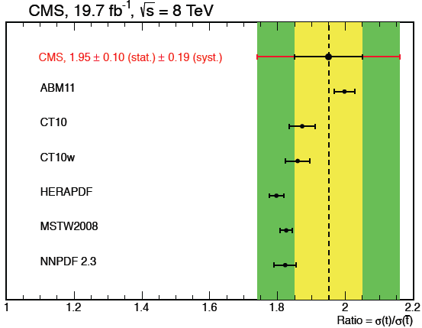
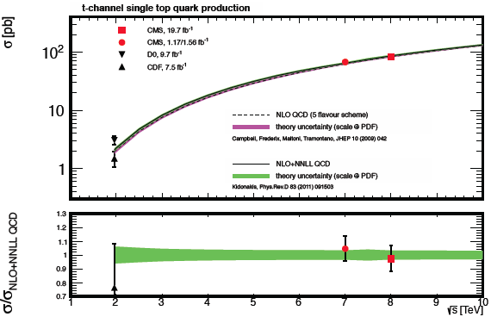
Single top t-channel: Coming up next
Paper reporting latest 8TeV inclusive cross-section and charge ratio measurements to enter CWR soon (paper version of TOP-12-038 –link-)
|η_{j’}| analysis, muons and electrons
Full dataset 19.7 fb⁻¹
σ_{t-channel} = 83.6±2.3(stat.)±7.4(syst.) pb
σ_{top} = 53.8±1.5(stat.)±4.4(syst.) pb
σ_{anti-top} = 27.6±1.3(stat.) ±3.7(syst.) pb
R = σ_{top}/σ_{anti-top} = 1.95±0.10(stat.)±0.19(syst.)

Slide 8
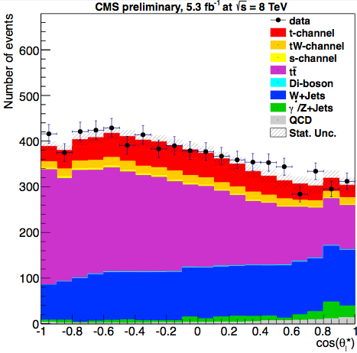
t-channel measurements: W-helicity fractions
CMS-PAS-TOP-12-020
7+8 TeV Public PAS:
Only muons, 1.14fb⁻¹(7TeV) and 5.3fb⁻¹(8TeV)
Standard t-channel |η_{j’}| selection
F_{L;R;0} extracted from the distribution of cosθ_{l}*
F_{L} = 0.293±0.069(stat.)±0.030(syst.)
F₀ = 0.731±0.114(stat.)±0.023(syst.)
F_{R} = -0.006±0.057(stat.)±0.027(syst.)
Indirect limits on anomalous tWb couplings
Next: Update at 8 TeV, full dataset 19.8fb⁻¹, with both e and µ
Paper version of TOP-12-020 under ARC review now –link
Beyond TOP-12-020 (13TeV):
Using advanced tools (MEM reweighting techniques using MadWeight)
Direct limits on anomalous couplings
(March 2013)
Moriond 2013

Slide 9
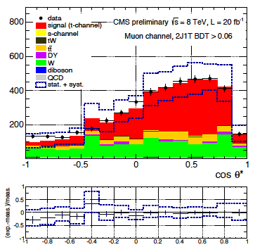


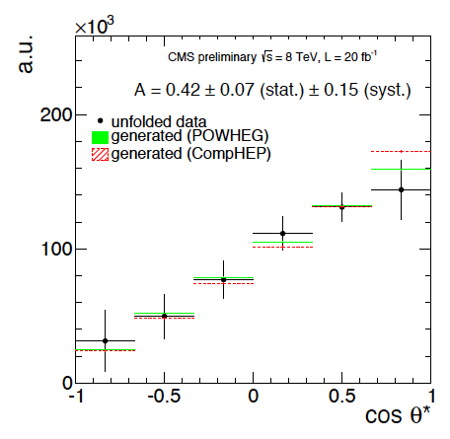
t-channel measurements: top polarization
CMS-PAS-TOP-13-001
(September 2013)
Analysis performed with 8TeV data BDT, e/µ, 20fb⁻¹
Top polarization related to spin asymmetry
Polarization measured using the slope of the unfolded distribution of cosθ*_{l}
A_{l} = 0.41±0.06(stat)±0.16(syst)
P_{t} = 0.82±0.12(stat.)±0.32(syst.)=0.82±0.34
Next:
Different tests ongoing towards the paper version of TOP-13-001 –link
Highlighted result
TOP 2013

Slide 10

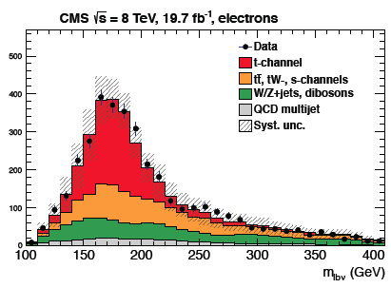
t-channel measurements: in the pipeline
+ Discussion ongoing on proper |V_{tb}| estimation (different assumptions, direct measurements, limits on |V_{td}|, |V_{ts}|?)
Top width
ttbar and single top analyses mature, combination ready
Next: PAS for winter conferences
Later on: Combine all single top cross sections to achieve better precision
Differential cross sections
p_{T}/η(top),p_{T}/η(light jet)
Selection and tools almost ready (same unfolding technique as in the top polarization)
Next: First results expected beginning next year
Later on: Work towards 2nd b differential cross sections
Top mass
working on fit, aiming to have PAS by winter
Next: Implement Ideogram method, improve precision
More manpower could be helpful here!
Michelangelo Mangano’s Christmas wish

Slide 11
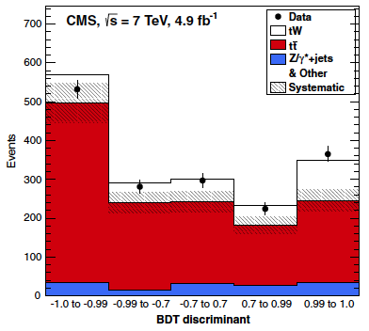
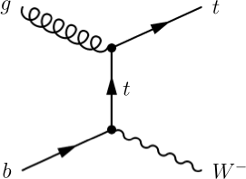
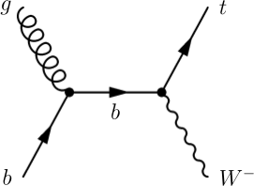
tW associated production
Second process at the LHC (negligible at the Tevatron)
Dilepton signature studied (so far!)
Two opposite-sign, isolated leptons
Missing transverse energy (2 neutrinos in the final state)
A jet coming from a b decay
Main backgrounds: top pairs, Drell-Yan
Evidence at 7TeV
Published in PRL, BDT and cut-based, 4.9 fb⁻¹
Significance: 4.0σ (3.6+0.8-0.9σ expected)
σ_{tW} =16+5-4 pb
|V_{tb}| = 1.01+0.16-0.13+0.03-0.04(th)
constrained |V_{tb}| > 0.79 at 90% CL
Phys.Rev.Lett 110, 022003 (2013)
(January 2013)

Slide 12
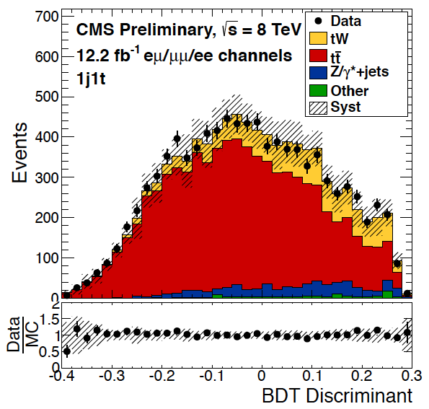
tW associated production: Observation
8TeV, 12.2fb⁻¹
BDT makeover increased the sensitivity
Variables based on the loose jet content
13 variables (before, 4 variables)
Robustness checked
two additional cross-check analyses
Tighter cut on MET thanks to the higher luminosity and center of mass energy → smaller DY contribution
Observation (> 5σ)
Significance: 6.0σ (5.4+1.5-1.4σ expected)
σ_{tW} = 23.4+5.5-5.4 pb
|V_{tb}| = 1.03 ± 0.12(exp)±0.04(th), |V_{tb}| > 0.78 at 95%CL
2013 Milestone for CMS
EPS 2013
CMS-PAS-TOP-12-040
(July 2013)

Slide 13
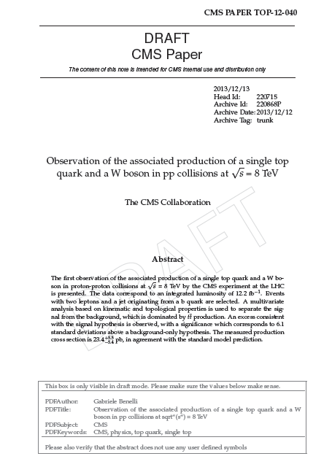
tW associated production: coming up next
“Fast paper” with tW observation FR next week (Monday 23) –link
Targeting PRL as first observation of the process
Minor alterations after PAS
6.1 σ (5.4+1.5-1.4 σ expected)
σ_{tW} = 23.4+5.5-5.4 pb
Next:
Combination with ATLAS (8TeV)
Harmonization of the ystematic treatment under discussion
Full 8TeV dataset
New final states: l+jets already starting
Adding new measurements: charge ratio R, top width
Improving precision

Slide 14
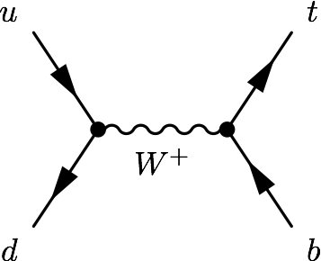
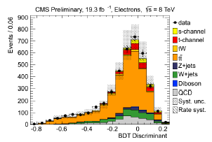
Single top s-channel
Third process at the LHC (a bit better at the Tevatron)
(challenging) l+jets signature studied
A lepton (e,µ) and MET from the decay of a W boson
Two b-jets with high transverse momentum
Main backgrounds: W+jets, top pairs
First CMS result in this channel
PASCOS 2013
Fresh result from CMS
BDT, e/µ, 8 TeV 19.3 fb⁻¹
σ_{s-channel} = 6.2±5.4(exp.)±5.9(th.) pb = 6.2±8.0 pb
σ_{s-channel} (FC) = 6.2+8.0-5.1 pb
Upper limit σ_{s-channel} < 2.1 × SM
Next: aiming to have evidence of the process, 13TeV can be hard, 7TeV offers best S/B (plus, 7+8 combination)
Exploring BSM links, W’, charged Higgs…
Combined t+s measurement
CMS-PAS-TOP-13-009
(November 2013)

Slide 15
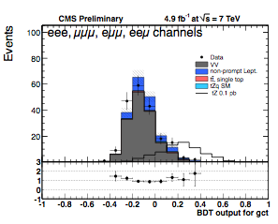
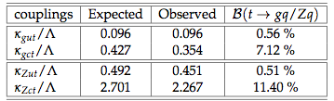
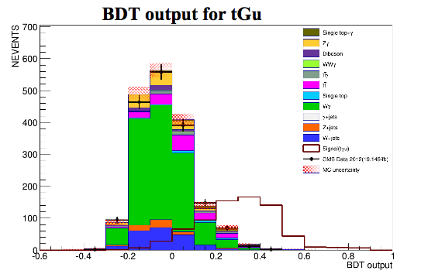
New physics in single top: FCNC
FCNC tZ
PAS at 7TeV, 4.9fb⁻¹
Trilepton signatures
BDT (gut, gct, Zut, Zct)
Limits on couplings and branching fractions
Next: 8TeV analysis, paper (-link to TOP-12-039)
currently busy with the simulation
FCNC tqγ
Ongoing, no CADI line yet –link to AN-2013/249
8TeV, 20 fb⁻¹, BDT, muon channel only
Next: PAS in the next weeks/couple of months
CMS-PAS-TOP-12-021
(July 2013)

Slide 16
New physics in single top: more
Planned:
BNN with t-channel signatures
Study BSM anomalous Wtb limits to (L_{V},R_{V}), (L_{V},L_{T}) and probably with (L_{V},R_{T})
BSM FCNC tcg and tug limits
+ Anomalous couplings studies (W-helicity, top polarization)
Also other single top-related new physics searches that fall under B2G/HIGG/EXO
W’
Charged Higgs bosons
Monotops
b*
…
+ Rare SM process, tZq studies also planned!
(8TeV, maybe 13TeV)

Slide 17
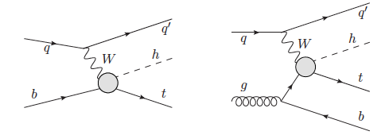
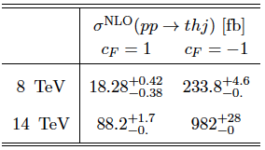
Single top + Higgs
Moriond 2014?
Ideal scenario to test the Higgs couplings -and look for new physics
single top + Higgs production is largely suppressed in the SM
However, nonstandard couplings of the Higgs to the W boson and/or to the top quark can produce an enhancement of the cross section
Interesting signatures: single top t-channel + Higgs decay
Different final states already under study:
H→ bb
H → γγ
H → WW
Next: first public results for this process!

Slide 18

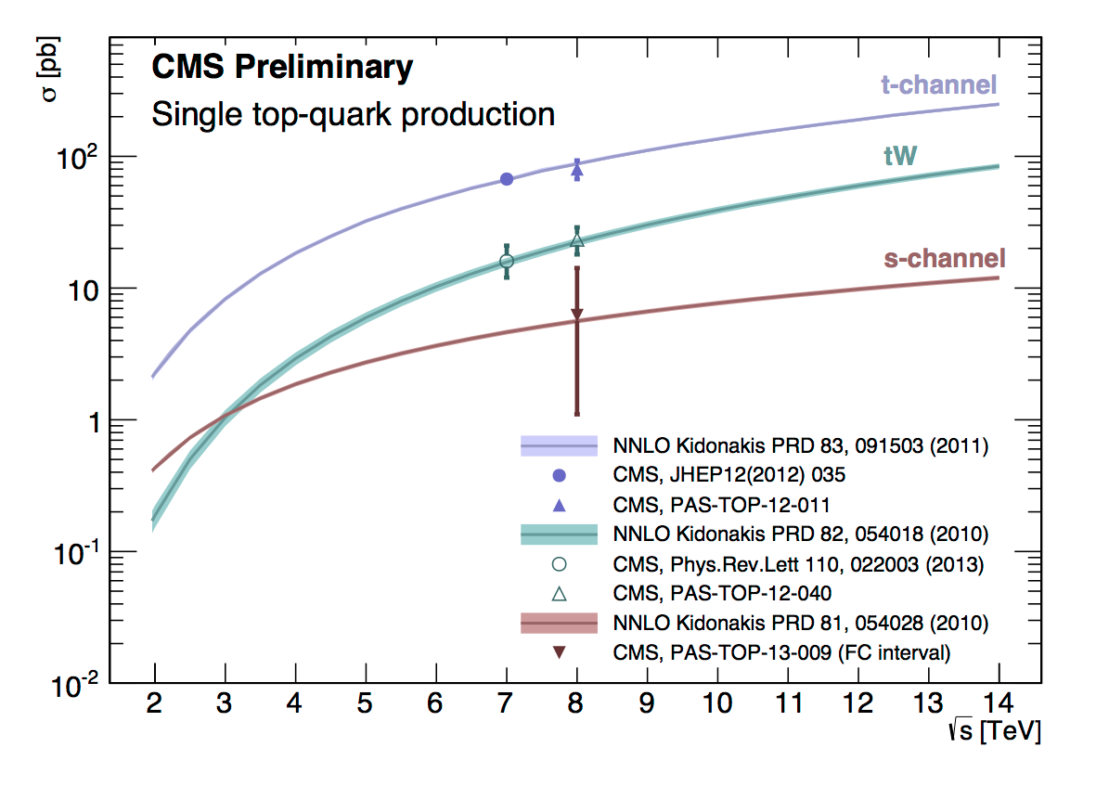
The last two years (Luca’s era)
5fb⁻¹ at 7TeV and 20fb⁻¹ at 8TeV of pp data
2 papers published (JHEP, PRL)
8 PASes public (all the modes covered)
1 evidence
1 first (and so far only) observation
First single top LHC combination
First CMS s-channel results
…
3 papers close to submission
2 papers in preparation
Good progress in several analysis
Everything in agreement with the SM expectations…

Slide 19

The future (Orso’s quest)
The Run-I LHC data still has some results on it
Ongoing analyses, also new ones
data will keep us busy for a while
Run-II is coming
2015: 13 TeV, 25ns, 42fb⁻¹/year
We have a year to prepare the simulation, design trigger, and define the objects to use (not an easy task, should be a priority); + understand the pileup!
What about physics potential?
σ [pb] | t-channel | tW | s-channel | ttbar
LHC (7 TeV) | 64.6±2.1 pb | 15.6±1.2 | 4.59±0.19 | 172.0±4.8
LHC (8 TeV) | 87.1±2.8 pb | 22.2±1.5 | 5.55±0.22 | 245.8±9.6
LHC (13TeV) | 219.4 | 71.70 | 10.89 | ~745
Life won’t be any easier!

Slide 20

Roadmap
Pre-data
Prepare for Run-II
Trigger
Object ID
MC simulation
0-10fb⁻¹
Rediscovery of the t-channel
Cross-section, R, |V_{tb}|, top width, m_{t}
Study top polarization and differential distributions
Check SM agreement
Look for SM deviations
Anomalous couplings, FCNC
> 10 fb⁻¹
Rediscovery of tW
different final states
Cross-section, R, |V_{tb}|, top width
Test top-Higgs coupling
Continue looking for deviations from the SM
~100fb⁻¹ and up
s-channel
rare processes (tZq, tγ?)
And then?
(b-tagging)

Slide 21
Summary
The first run of the LHC has been fruitful for single top physics, many achievements unlocked
The three modes of single top production have been studied in CMS
The t-channel has a cross-section large enough to allow us to perform different measurements (W-helicity, top polarization, differential cross sections, top mass…)
We have the first observation of tW associated production
New physics searches are already happening: anomalous couplings, FCNC (+ many others belonging to other PAG’s)
About to start testing the Higgs-top coupling
All the potential of Run-I has not been exploited yet but we have to prepare for Run-II already, where the S/B will be not optimal, but the luminosity and energies will allow us for many new studies

Slide 22

Thank you Luca for this two years as convener!
Welcome Orso!
And thanks to all of you for joining us in Naples!

