Slide 1
H→ WW Run-1 legacy
ATLAS and CMS experiments
ATLAS
October 2014
https://cds.cern.ch/record/1954714
To be submitted soon
CMS
January 2014
JHEP 01 (2014) 096
http://arxiv.org/abs/1312.1129

Slide 2
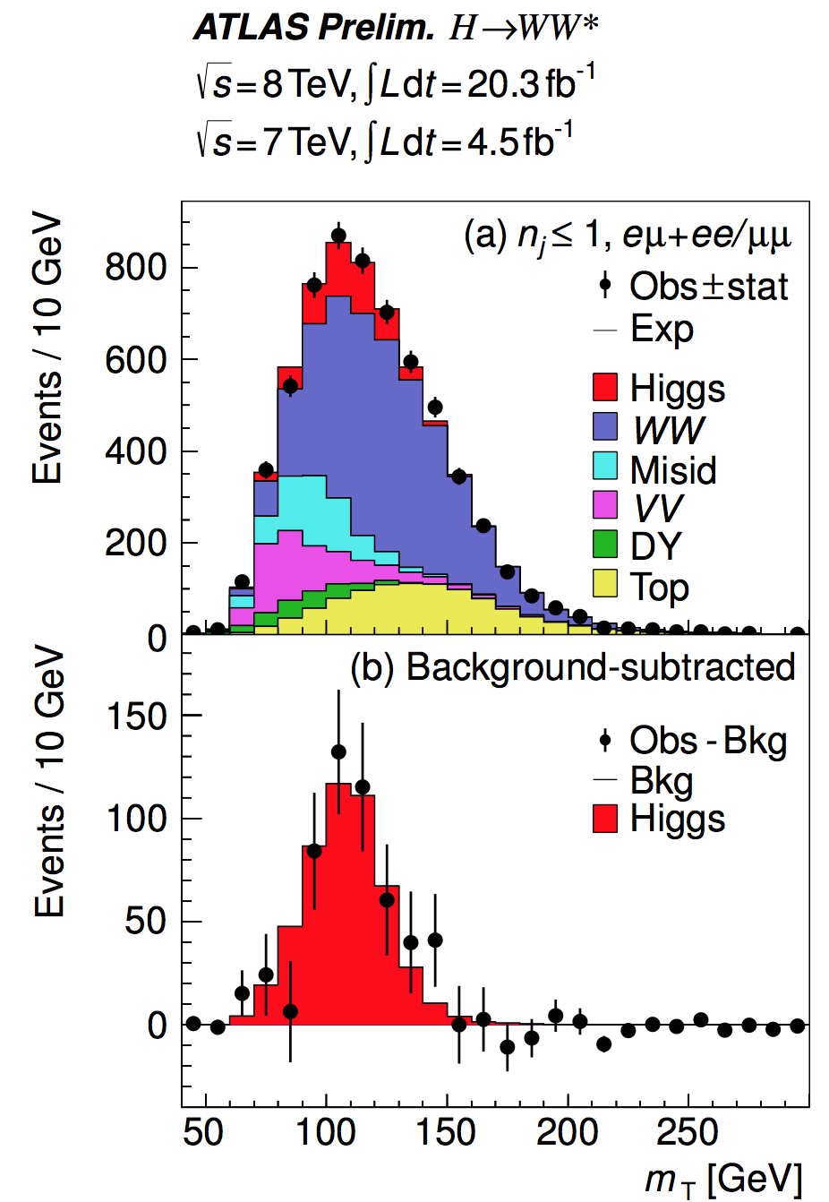
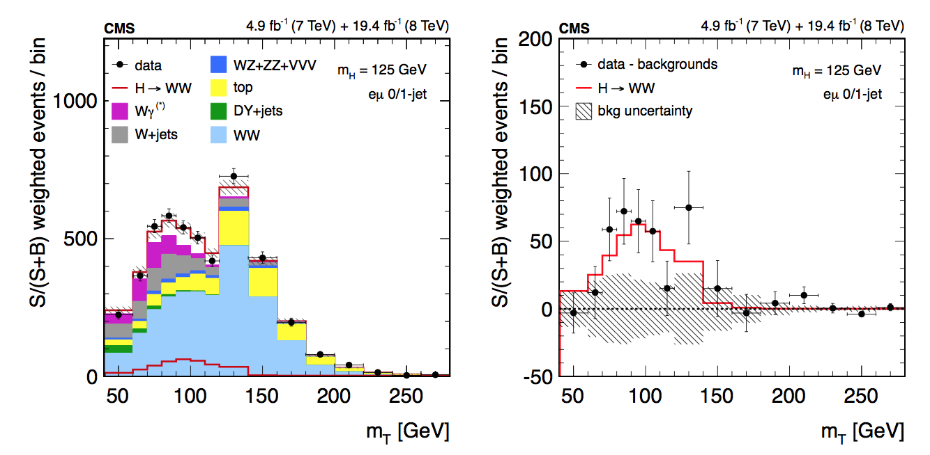
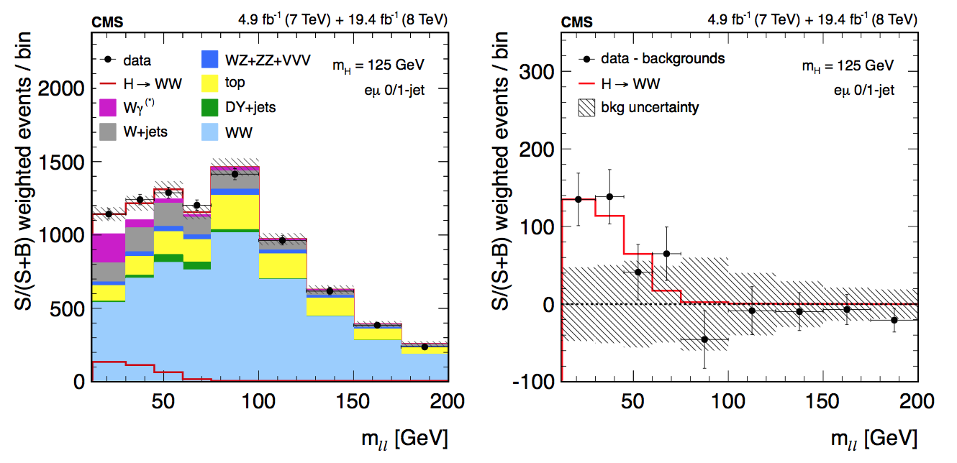

Slide 3
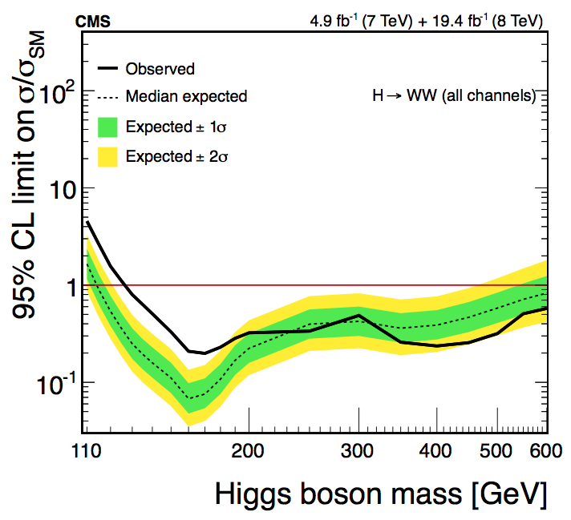
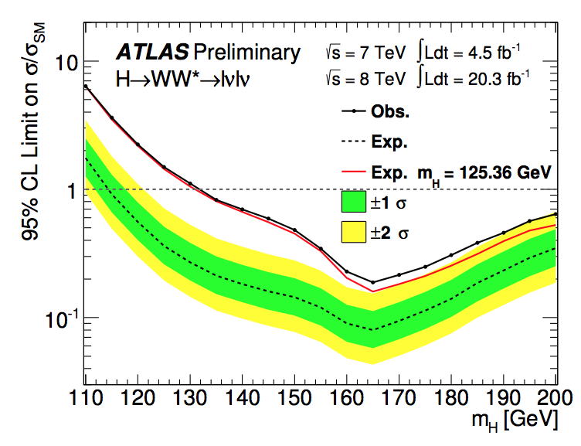

Slide 4
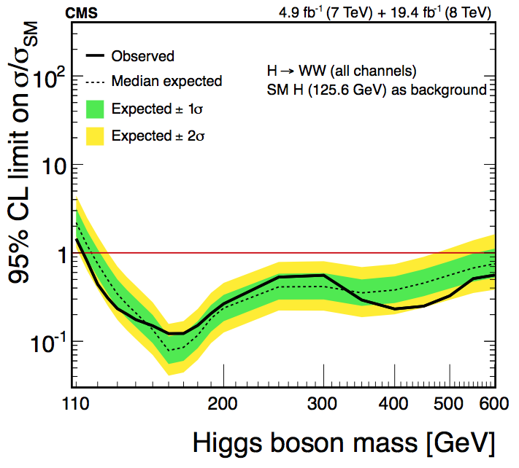
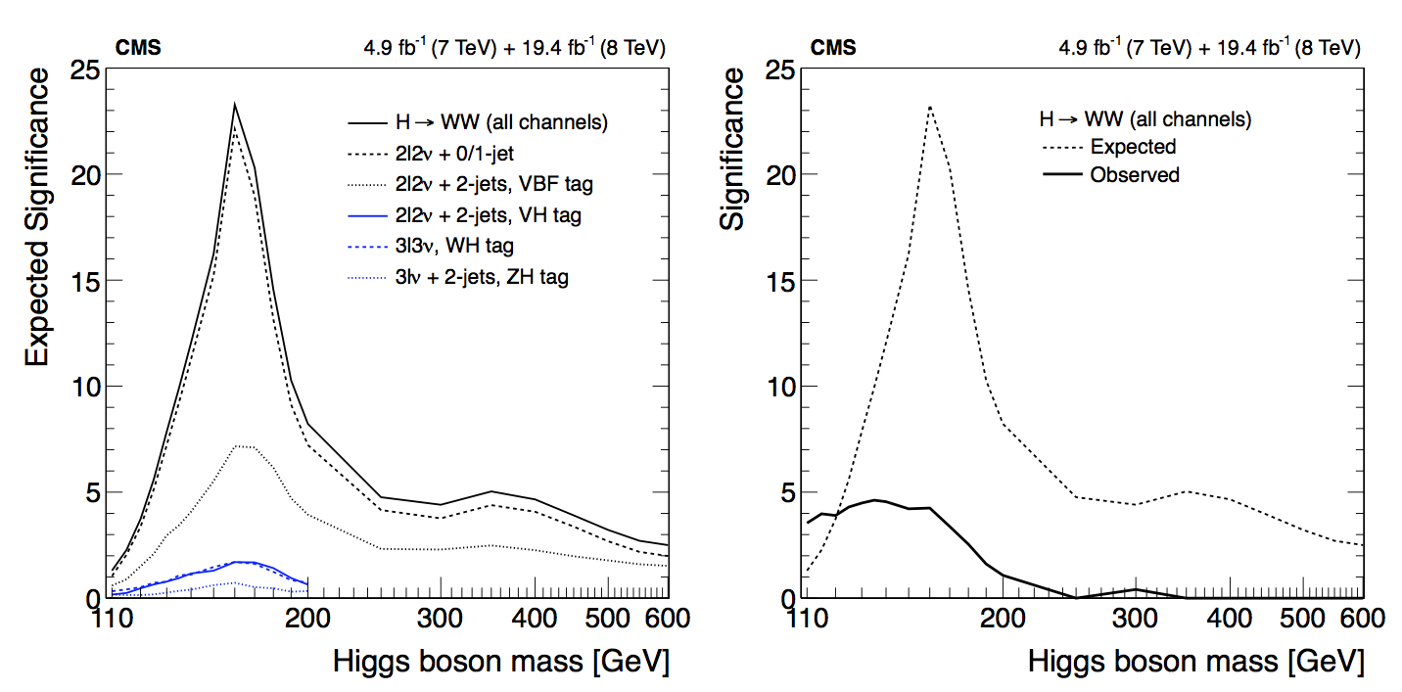

Slide 5
