Slide 1

Single top tW
Rebeca Gonzalez Suarez (UNL)

Slide 2
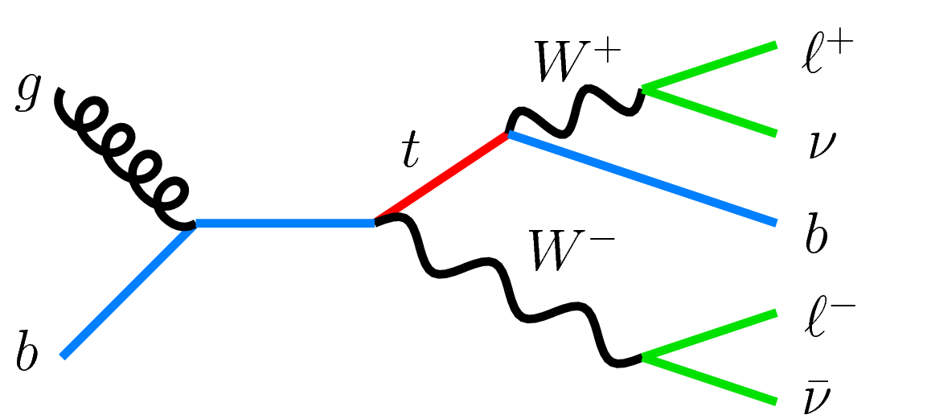
Why tW?
From the three main single top production modes (t-channel, tW, s-channel), the tW associated production is the one that could not be explored before the LHC
Like the other single top modes, it is sensitive to new physics, and provides an additional handle to study top properties
Dilepton signature:
2 opposite sign leptons (e,µ)
Substantial MET (2 neutrinos)
1 b-jet
Main backgrounds:
ttbar, DY (same flavor), VV…
σ [pb] | ttbar | t-channel | tW | s-channel
Tevatron (1.96TeV) | 7.08 | 2.08 | 0.22 | 1.046

Slide 3
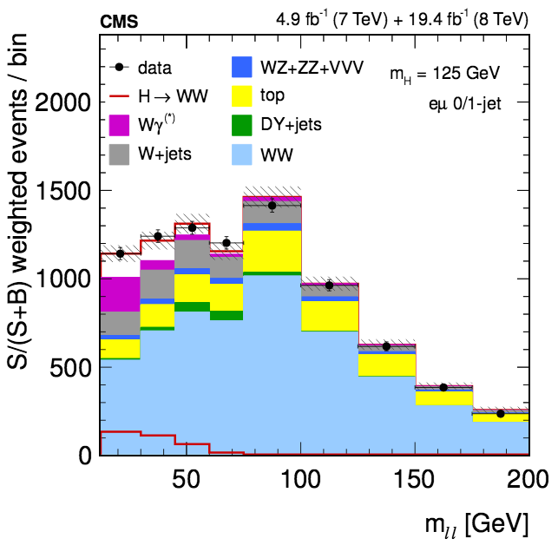
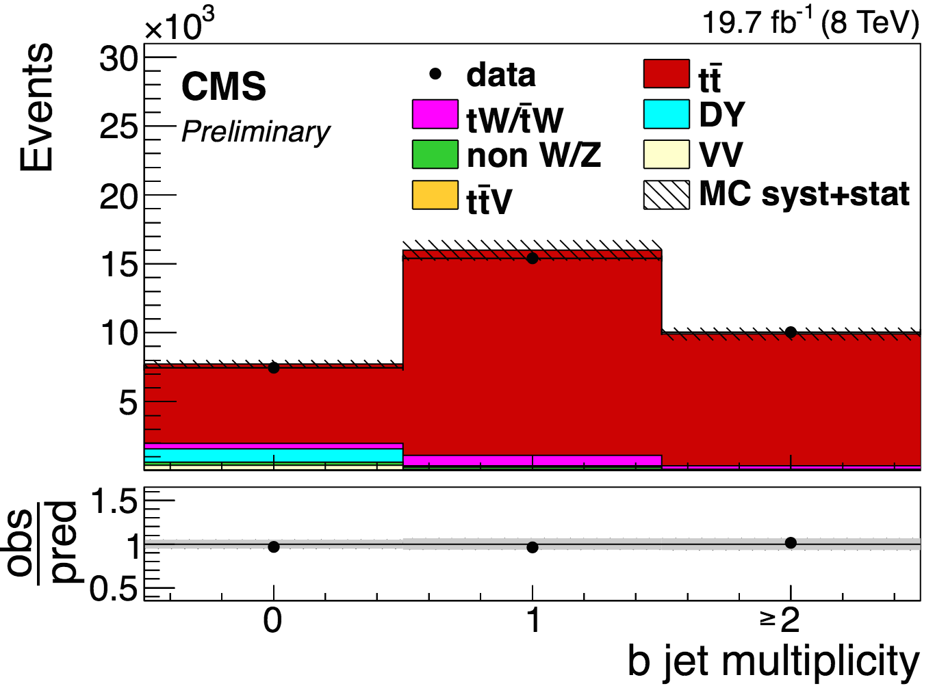
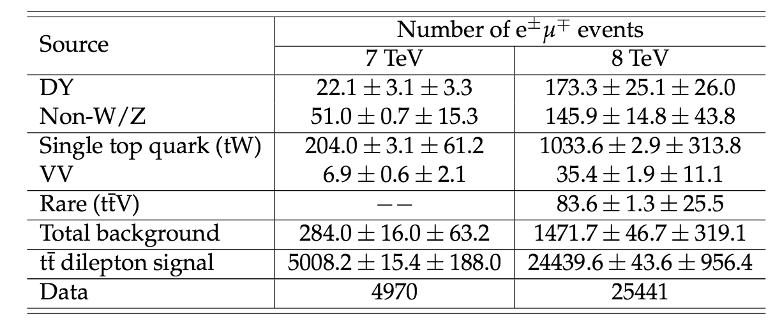
tW as background
H→WW→2l2nu
arXiv:1312.1129, JHEP 01 (2014) 096
Top background is a mixture of tt and tW
0-jet bin: 45% of top is tW
1-jet bin: 25%
tt dilepton (TOP-13-004)
tW → main background of the analysis

Slide 4






CMS teams involved in Run-1
l+jets
+ perpetual single top contributor

Slide 5
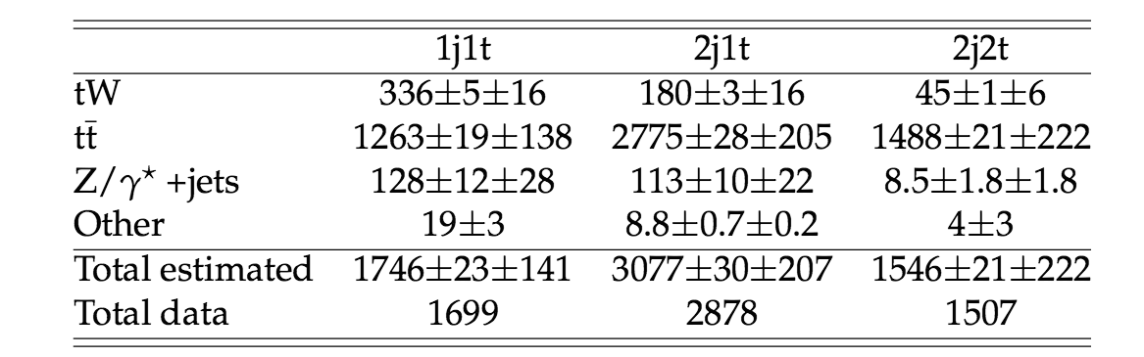
Run-I 7 TeV
At 7TeV we explored single top tW associated production using the full luminosity (4.9fb⁻¹)
First PAS, then paper
The analysis used three regions
1j1tag → signal region
2j1tag → ttbar control region
2j2tag → ttbar control region
σ [pb] | ttbar | t-channel | tW | s-channel
Tevatron (1.96TeV) | 7.08 | 2.08 | 0.22 | 1.046
LHC @ 7TeV | 177.31 | 63.89 | 15.74 | 4.29
September 2011
CMS PAS-TOP-11-022
September 2012
Phys. Rev. Lett. 110 (2013) 022003
arXiv:1209.3489

Slide 6
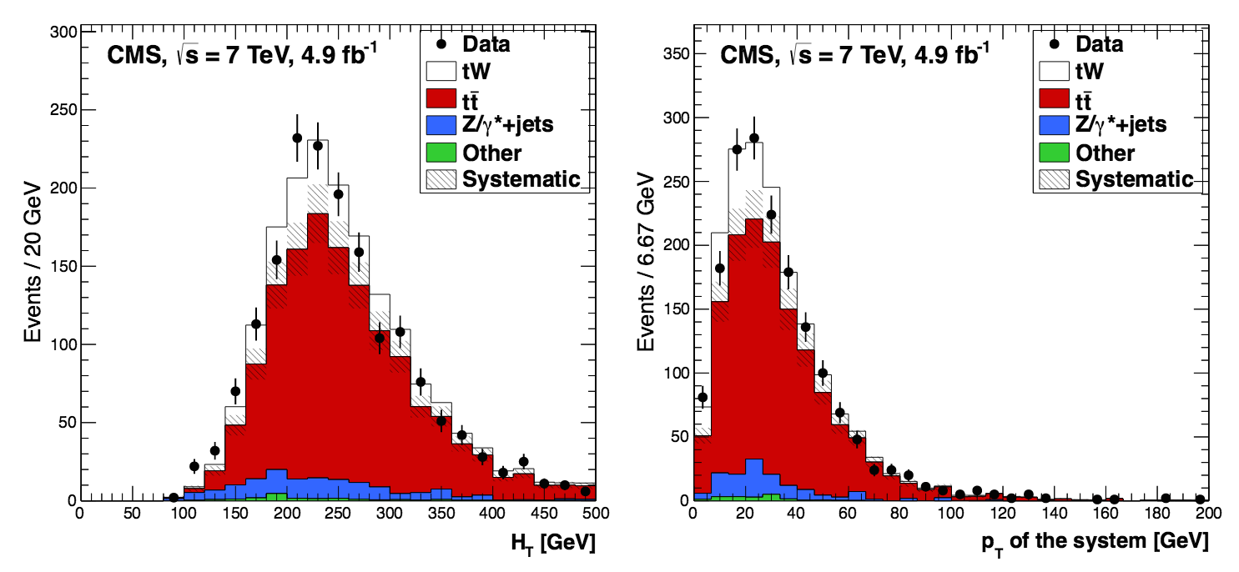
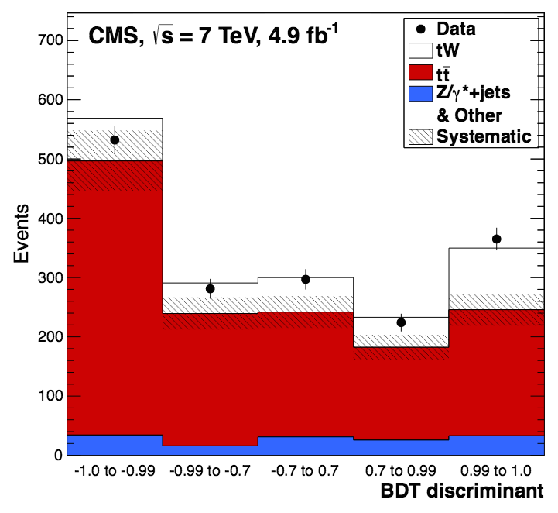
Analysis strategy
BDT and cut-based analysis as cross-check
4 main kinematic variables for separating tW from tt:
p_{T} of the system
H_{T}
p_{T} of the leading jet
ΔΦ_{MET-closest lepton}
Drell-Yan background estimated from the Z mass peak (events vetoed in the analysis)
→ reweight of the MET distribution

Slide 7
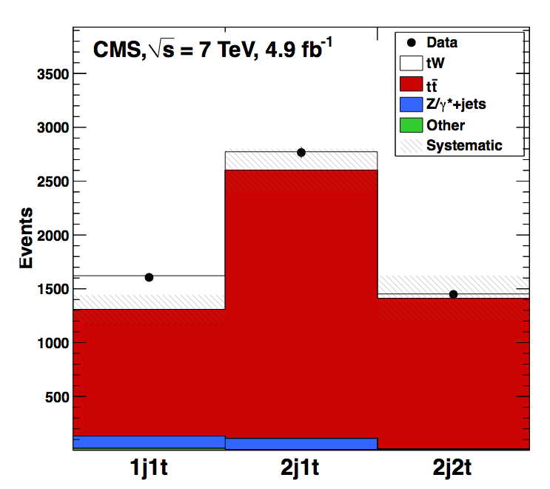
Results
Observed significance 4.0σ (3.6 expected)
Measured cross section: 16+5-4 pb
Main uncertainty: Statistical, with a 20% effect
followed by theory uncertainties on ttbar (10%) and JES (up to 7%)
Evidence > 3σ
Analysis statistically dominated

Slide 8
Run-I 8 TeV
Analysis repeated and improved
BDT → different discriminant, more variables
Additional cross-check → shape of the p_{T} of the system
Not statistically dominated anymore → not full lumi used 12.2fb⁻¹
PAS → then paper
January 2014
Phys. Rev. Lett. 112 (2014) 231802
arXiv:1401.2942
July 2013
CMS PAS-TOP-12-040
σ [pb] | ttbar | t-channel | tW | s-channel
Tevatron (1.96TeV) | 7.08 | 2.08 | 0.22 | 1.046
LHC @ 7TeV | 177.31 | 63.89 | 15.74 | 4.29
LHC @ 8TeV | 252.89 | 84.69 | 22.2 | 5.24

Slide 9
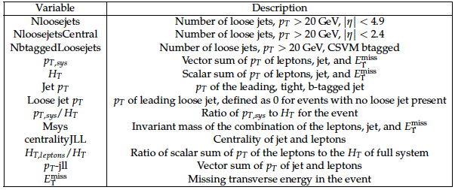
Analysis strategy
The main challenge (as at 7TeV), is the ttbar background
ttbar with 1 jet outside acceptance or miss-reconstructed → signal
We maintained the 2 ttbar control regions and improved the BDT
13 variables
Key upgrade: adding variables related to ‘loose jets’ → jets not fulfilling the main requirements for jets in the analysis but close to

Slide 10
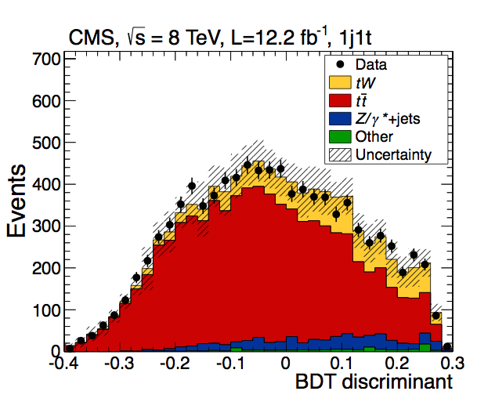
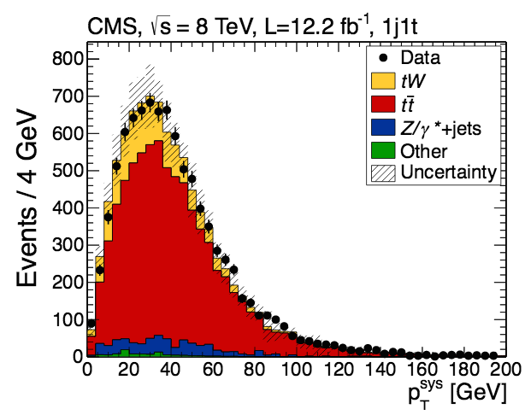
Distributions
As for 7 TeV, he analysis performs a binned likelihood fit on the shape of the BDT

Slide 11
Results
Excess of events above the expected background with a significance of 6.1σ (5.4 expected)
→ First observation of the process
The measured cross section is 23.4±5.4 pb
Main uncertainty:
choice of thresholds for the matrix element and parton showering (ME/PS) matching in simulation of ttbar and renormalization/factorization scales

Slide 12
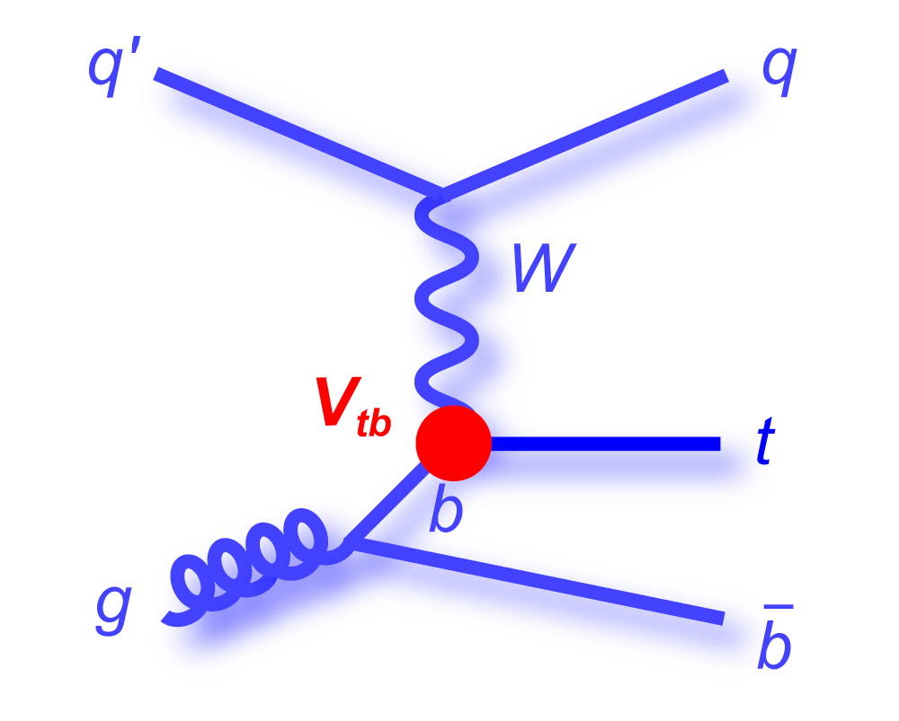
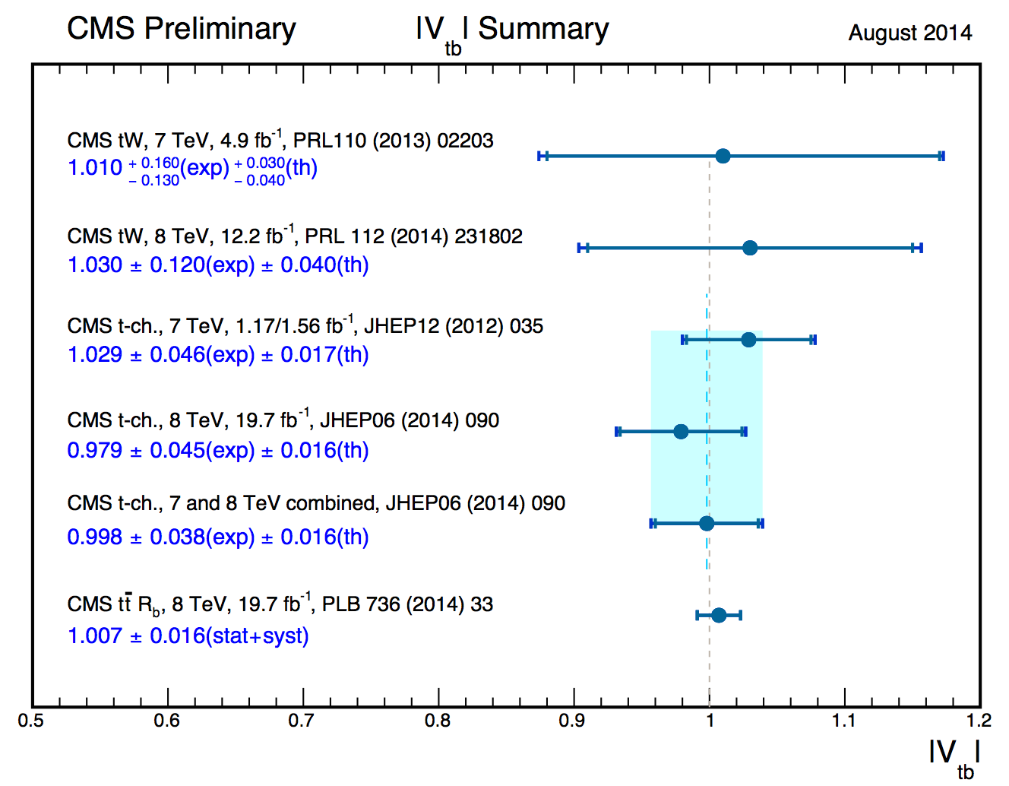
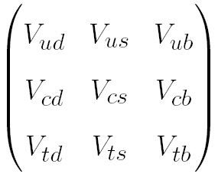
Cross-section and |V_{tb}|
From the inclusive production cross section of single top (t-channel, tW), a value of the CKM matrix element, |V_{tb}|, can be extracted
Considering |V_{td}|, |V_{ts}| << |V_{tb}|
Cross section ~ |V_{tb}|²
7 TeV | 8TeV
|V_{tb}| = 1.01 | |V_{tb}| = 1.03

Slide 13
ATLAS
Meanwhile ATLAS has been following a parallel route:
In may 2012 they submitted the (first) evidence at 7TeV
http://arxiv.org/abs/1205.5764
Last week they submitted the observation at 8TeV
http://arxiv.org/abs/1510.03752v2
Together, we made a combination a while ago (with an ATLAS CONF note)
Energy | Predicted | CMS | ATLAS | LHC
7TeV | 15.6±0.4±1.1 | 16+5-4 | 16.8±2.9±4.9 | nope
8TeV | 22.2±0.6±1.4 | 23.4±5.4 | 23.0±1.3+3.2−3.5±1.1 | 25.0±1.4±4.4±0.7

Slide 14
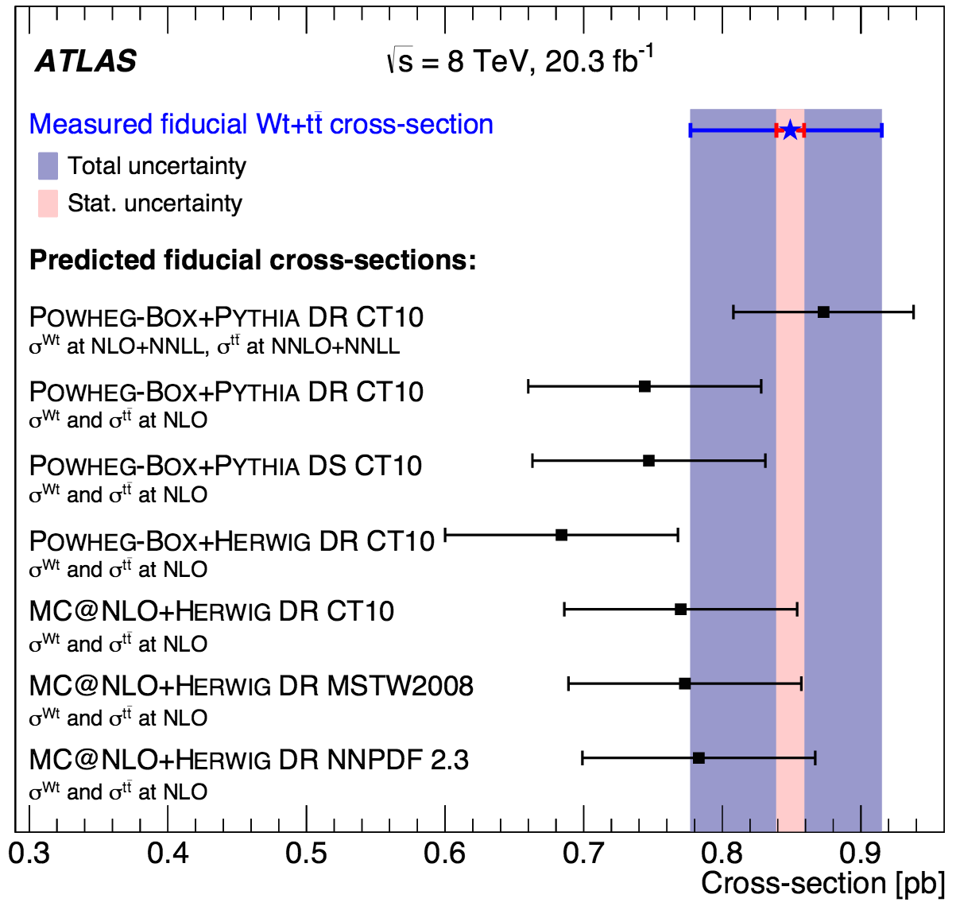
In the latest ATLAS paper
Something new was reported:
Fiducial cross section
1jet-1tag region → tW + ttbar
Fiducial measurements are interesting on their own:
more robust comparison to the theoretical prediction reducing the sensitivity to theory modeling uncertainties
But especially, the study of the tW-tt interplay is interesting

Slide 15
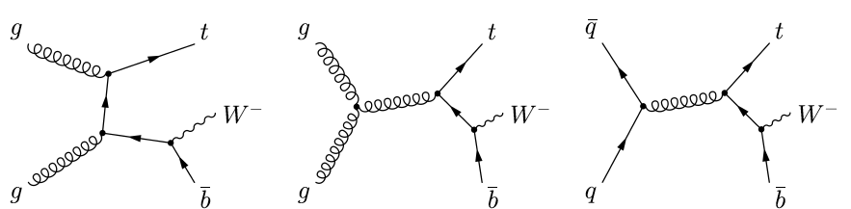
ttbar and tW
tt production is the main background for the tW analysis
~10X the cross-section (depending on the center of mass energy)
able to provide identical final states when one of the b-quarks is outside acceptance
But there is something more:
At NLO tW mixes with ttbar, sharing initial/final states → this causes theoretical problems in the signal definition
NLO

Slide 16
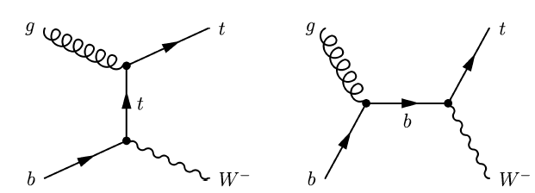
ttbar in tW
Two alternative solutions → none of them theoretically sound
diagram removal (DR): the problematic diagrams are removed
diagram subtraction (DS): resonant diagrams cancelled with the introduction of a gauge-invariant term
http://arxiv.org/abs/0908.0631
In practice this means:
tW is defined at LO → O(20%) accuracy
Traditional workarounds suffer from conceptual issues → systematic theoretical uncertainty that cannot be reduced
LO

Slide 17
tW+tt unified description
Recently (2013), several papers suggested an unified description at NLO, 4FS (massive b):
Frederix :
http://arxiv.org/abs/1311.4893
F. Cascioli, S. Kallweit, P. Maierhöfer, S. Pozzorini:
http://arxiv.org/abs/1312.0546
G. Heinrich, A. Maier, R. Nisius, J. Schlenk, J. Winter:
http://arxiv.org/abs/1312.6659
Topic discussed in the single top workshop:
2013 (Frederix): https://indico.cern.ch/event/275626/session/0/contribution/2/attachments/499458/689961/frederix.pdf
2014 (Caola): https://indico.cern.ch/event/331154/session/1/contribution/20/attachments/644959/887235/singletop_napoli.pdf

Slide 18
Going into more details
Frederix (for example) proposes the unified studied of the processes for a specific problem: top background to Higgs searches (1 jet bin)
This is relevant in the H→WW channel
It applies in the same way to the tt dilepton measurements
The idea is to achieve a unified description that does not separate tt and tW, keeping all their interference effects
Requires NLO calculation to the pp → 2l2nubb+X in the 4FS
5FS: the mass of the b is neglected, the process (pp → 2l2nubb+X) is not finite in fixed-order perturbation theory without requiring phase-space cuts on the final state b jets
→ cannot be used for tW
4FS: b massive with a finite value, includes:
double quark resonant production (tt)
single top-quark resonant contributions (tW)
non top-quark resonant contributions

Slide 19
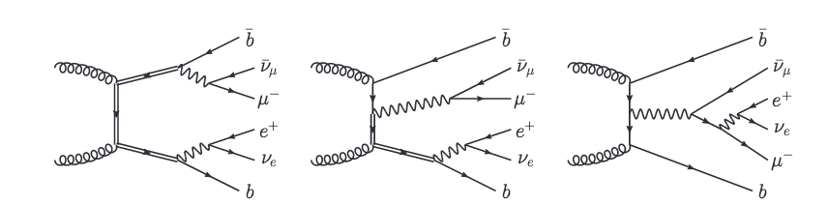
What does this mean?
Means that we could describe a set of processes accurately at NLO including ttbar and tW:
The fixed order NLO calculation of the combined pp → bb2l2nu+X is possible and has been done already (in Madgraph5_aMC@NLO)
For a more exclusive description of the final state, matching to the parton shower would be required
The parton shower is not yet available. It will take at least a couple of more months → Maybe sometime early next year?
b-quark associated
llνν production
tt
tW

Slide 20
Run-2
In terms of cross section, is the single top process that will grow the most (similar increase as ttbar)
The process has been already established
Still interesting to check it at 13TeV
In Run-2 the role of tW as background will become particularly relevant
For H→WW (obvious)
And especially for tt dilepton precision measurements
The study of ttbar and tW together will therefore be very important and should be done either like ATLAS, or directly with the appropriate full NLO simulation
σ [pb] | ttbar | t-channel | tW | s-channel
LHC @ 8TeV | 252.89 | 84.69 | 22.2 | 5.24
LHC @ 13TeV | 831.76 | 216.99 | 71.2 | 10.32
From 8 to 13TeV | 3.3 | 2.6 | 3.2 | 1.9

Slide 21
Measuring tt+tW
Common measurement of tW and tt:
1j1t (tW signal region), more could be explored
Fiducial (like in ATLAS) or not
Once the region to perform the analysis is defined:
If there is MC for the unified description → compare directly
If the MC is not available yet → make a simultaneous fit of tt and tW using separated samples (neglecting interference)
This can be done either within the tW or ttbar analyses, or by teams from both working together (depending on amount of people)
Use the same objects/selections from the start of the tW and tt analyses

Slide 22
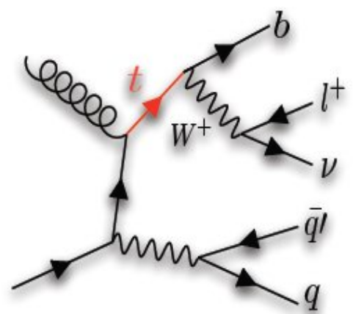
tW in the l+jets channel
There has been an effort with Run-1 data on exploring the l+jets signature that is ongoing
Signature:
1 lepton and MET from a W decay
1 b quark from the top
2 light quarks from a W decay
Not only ttbar background, also W+jets
Cons:
Smaller S/B
separation between ttbar and tW even more difficult
Pros:
Higher statistics, potential reconstruction of angular variables

Slide 23
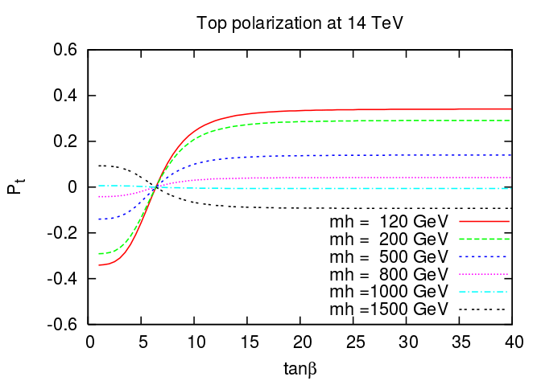
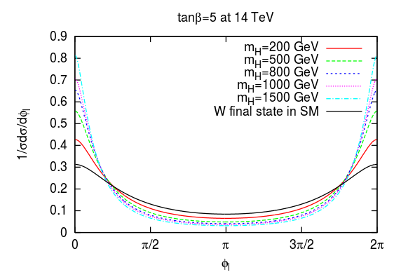
top polarization, angular distributions
Top polarization can also be measured in the tW channel:
sensitive to anomalous couplings
sensitive to charged Higgs pp → tH⁻
More challenging than in the t-channel:
The polarization is 0.25 (0.9 in the t-channel)
signal over background ratio worse in tW
Requires top quark reconstruction:
Maybe a study for the l+jets decay
Other options :
measure angular distributions in the lab frame :
ΔΦ_{ll}: (Is it worth it?)
Φ_{l}: lepton azimuthal angle. Need to determine the lepton from top.
arXiv:1012.0527

Slide 24
Summary
Run-1 was good for singlet top tW associated production
We achieved first evidence at 7 TeV, then observation at 8TeV, and measured the cross section
A key role for tW lays on its contribution to other analyses as background
Higgs is the classic case
ttbar dilepton is also important
The main issue when studying tW is the ttbar background
Large contribution, similar final states, mixing at NLO
A common description of tt and tW at NLO could be used → both processes studied together, that could have an immediate use case in H→WW

