Slide 1
H→WW
Overview of results

Slide 2
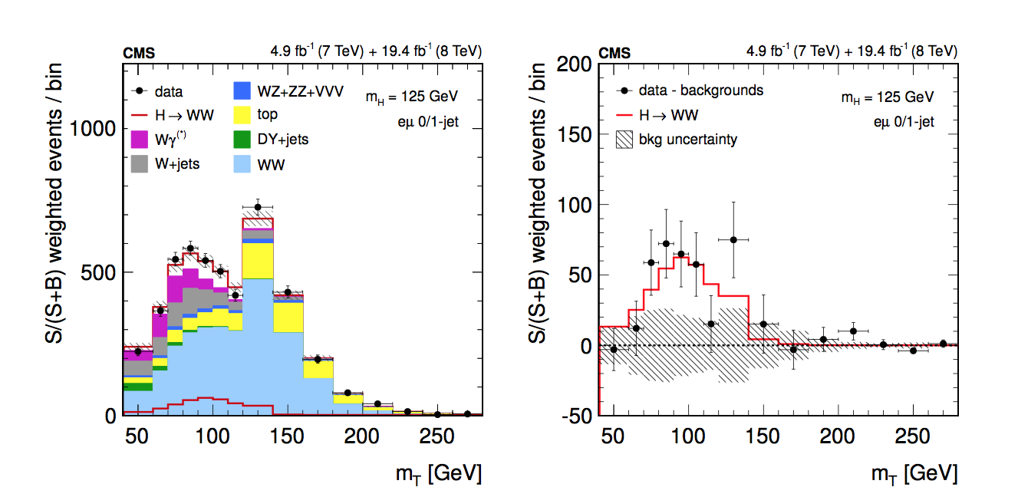
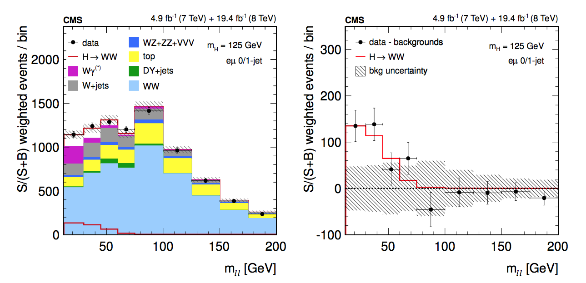
H→WW legacy paper
arXiv:1312.1129
JHEP 01 (2014) 096
2L 0/1j

Slide 3
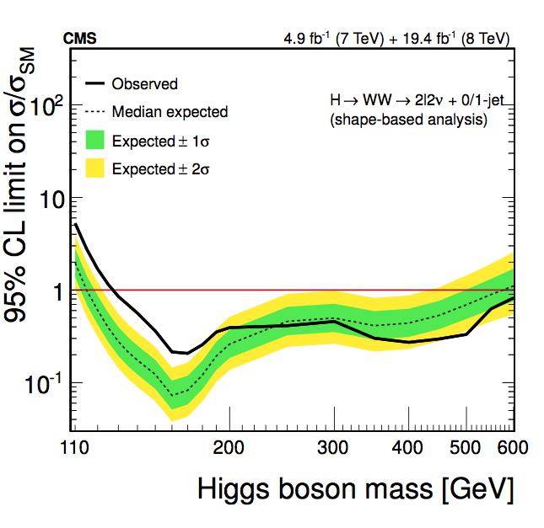
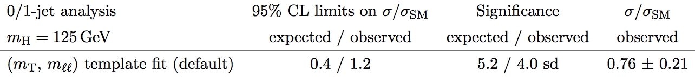
2L 0/1j
H→WW legacy paper
arXiv:1312.1129
JHEP 01 (2014) 096

Slide 4
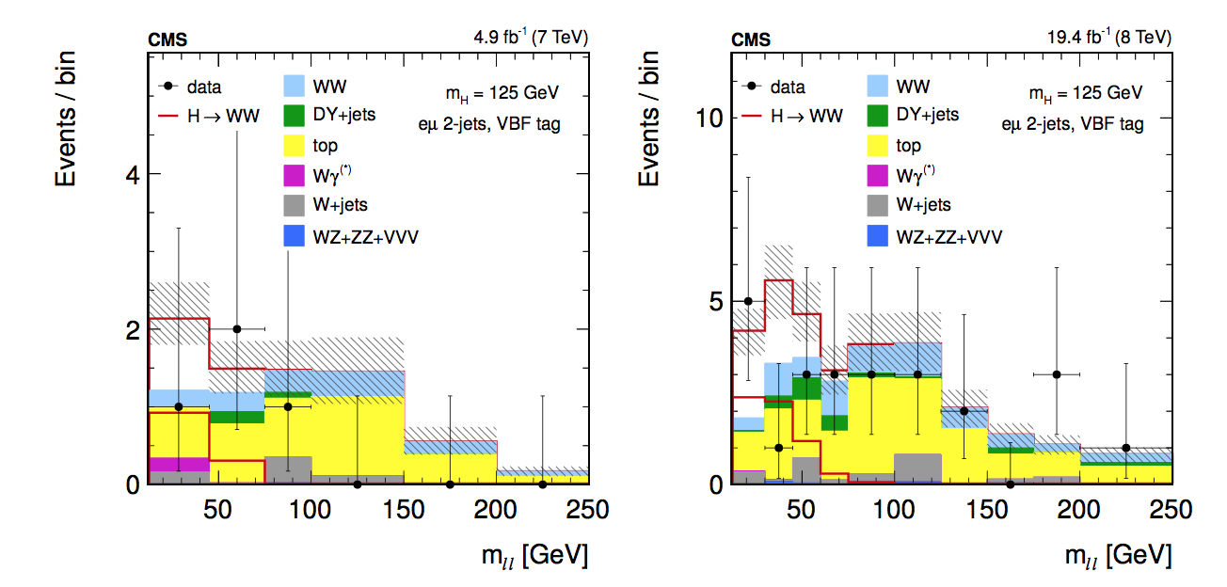
2L VBF
H→WW legacy paper
arXiv:1312.1129
JHEP 01 (2014) 096

Slide 5
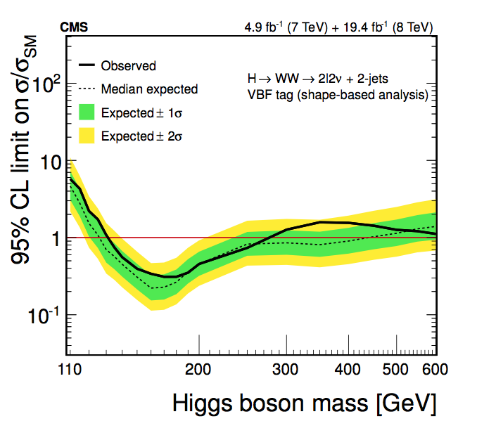
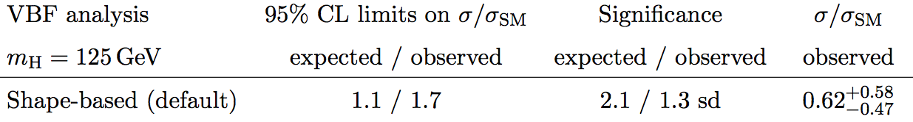
2L VBF
H→WW legacy paper
arXiv:1312.1129
JHEP 01 (2014) 096

Slide 6
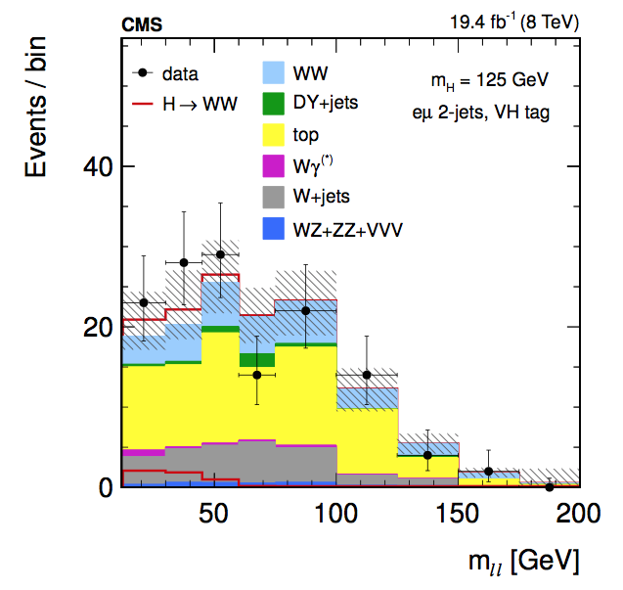
2L VH
H→WW legacy paper
arXiv:1312.1129
JHEP 01 (2014) 096

Slide 7
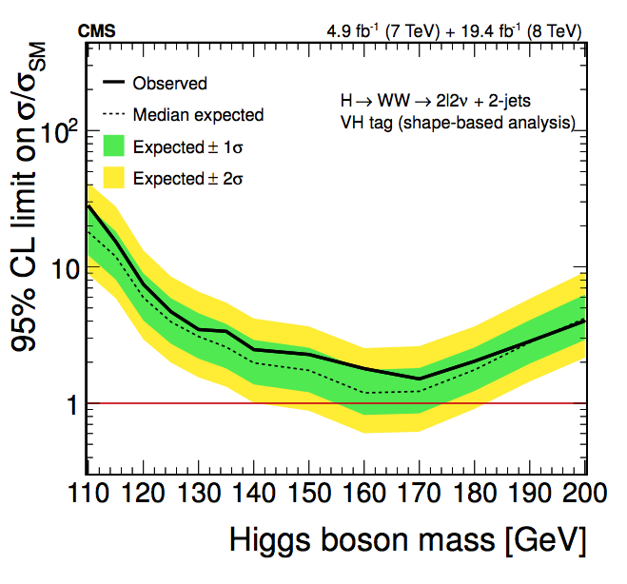
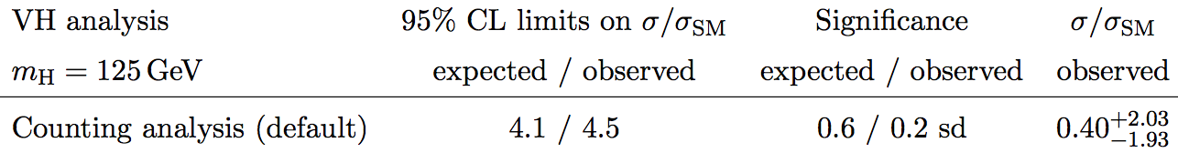
2L VH
H→WW legacy paper
arXiv:1312.1129
JHEP 01 (2014) 096

Slide 8
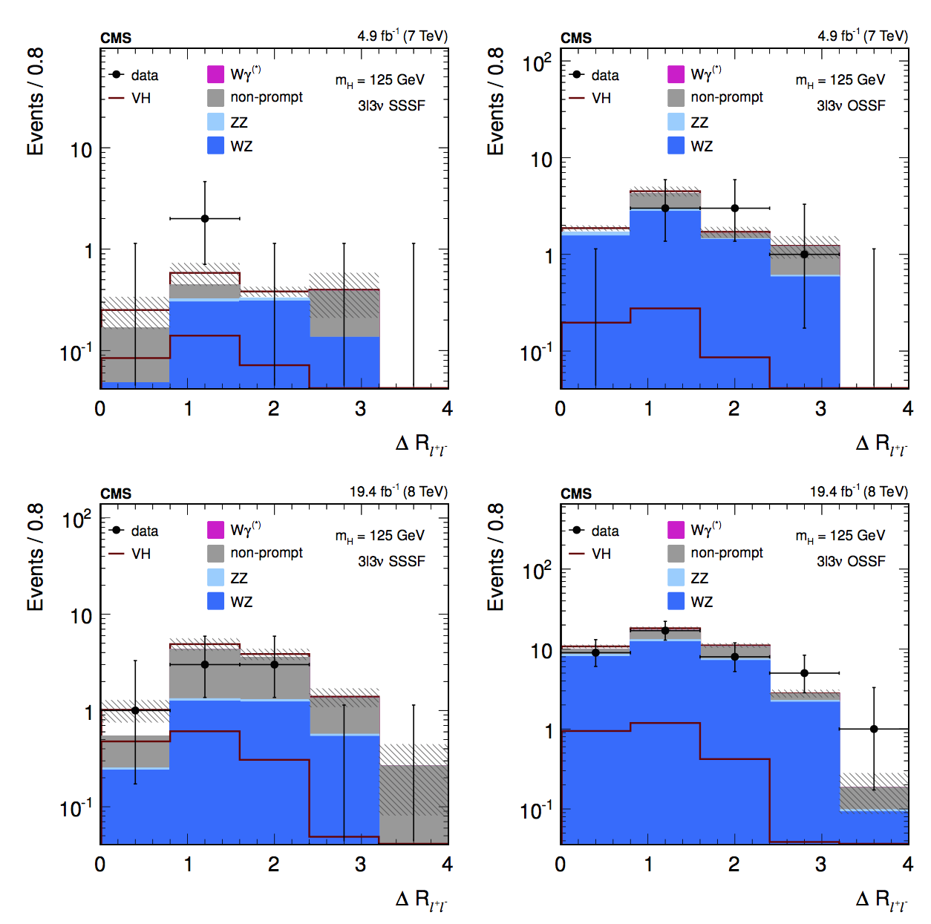
H→WW legacy paper
arXiv:1312.1129
JHEP 01 (2014) 096
3L WH

Slide 9
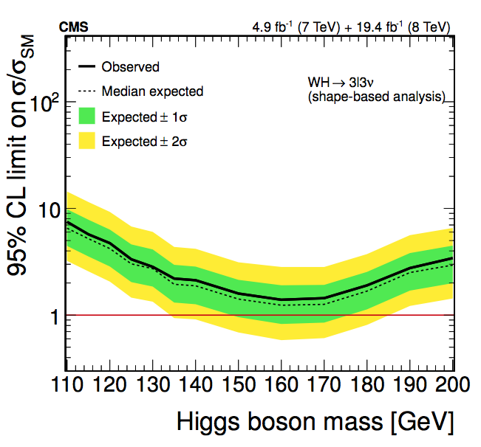
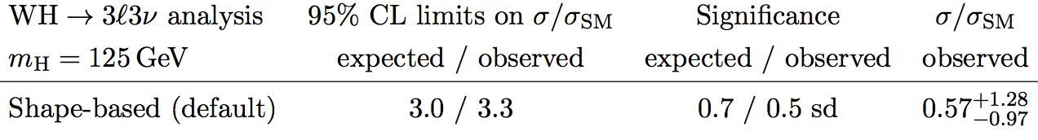
3L WH
H→WW legacy paper
arXiv:1312.1129
JHEP 01 (2014) 096

Slide 10
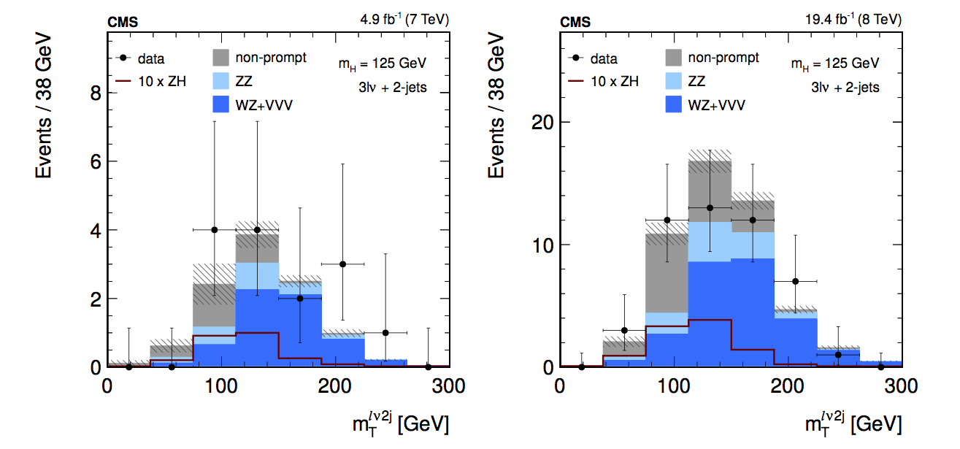
3L ZH
H→WW legacy paper
arXiv:1312.1129
JHEP 01 (2014) 096

Slide 11
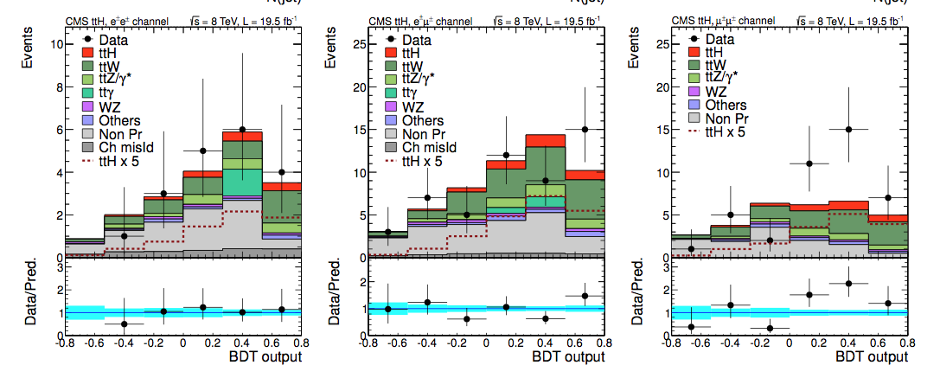
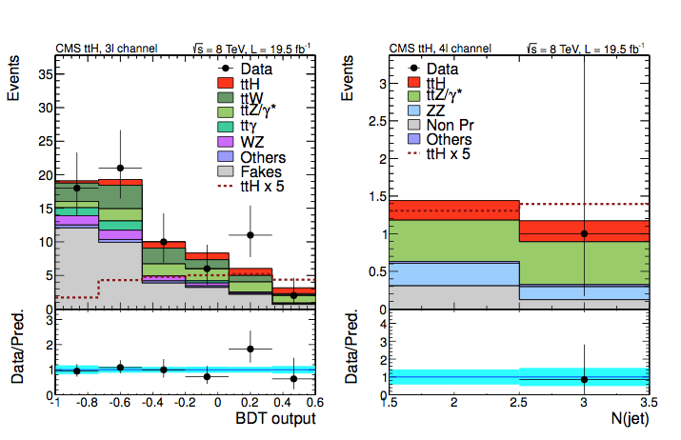
ttH paper
arXiv:1408.1682
JHEP 09 (2014) 087
ttH 2L-3L-4L

Slide 12
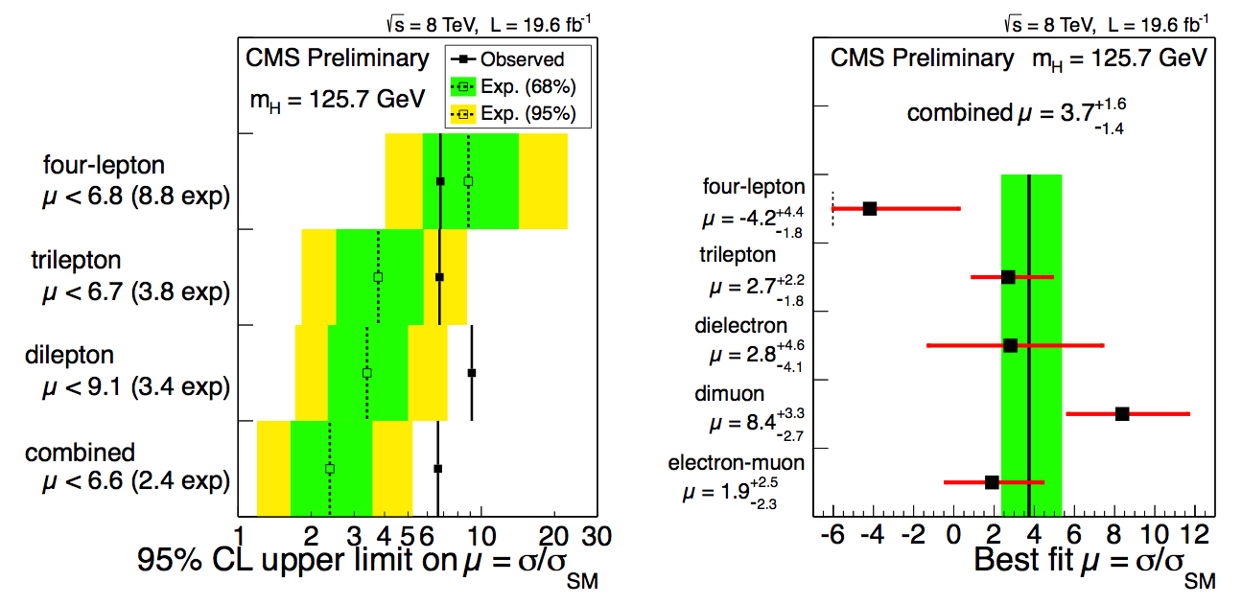
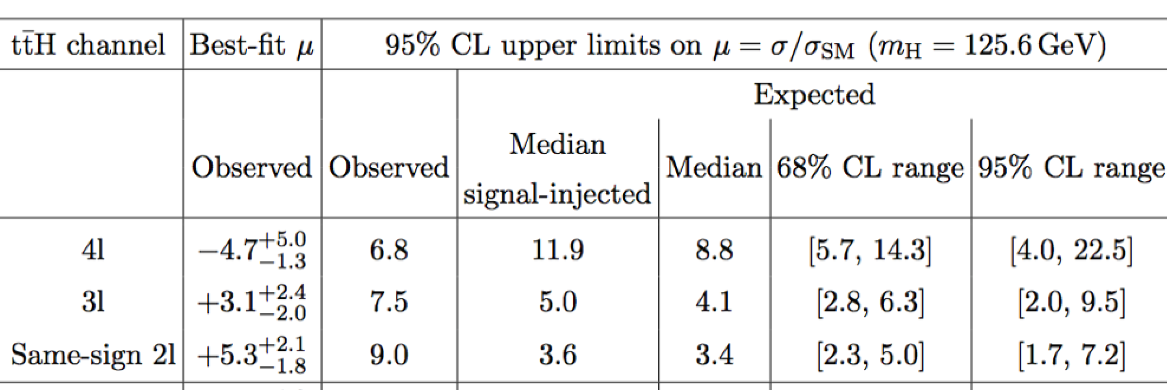
ttH paper
arXiv:1408.1682
JHEP 09 (2014) 087
ttH 2L-3L-4L

Slide 13
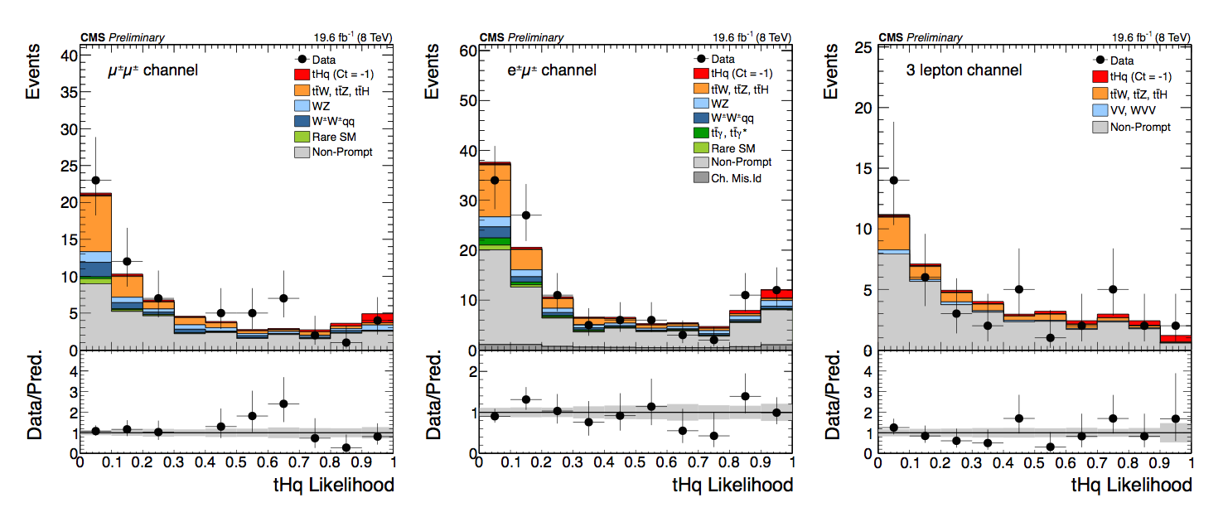
tHq 2L-3L
Signal assuming Ct =-1
tH paper
Coming soon (see Ken Bloom’s talk at DPF)
H→WW tHq PAS public
HIG-14-026

Slide 14
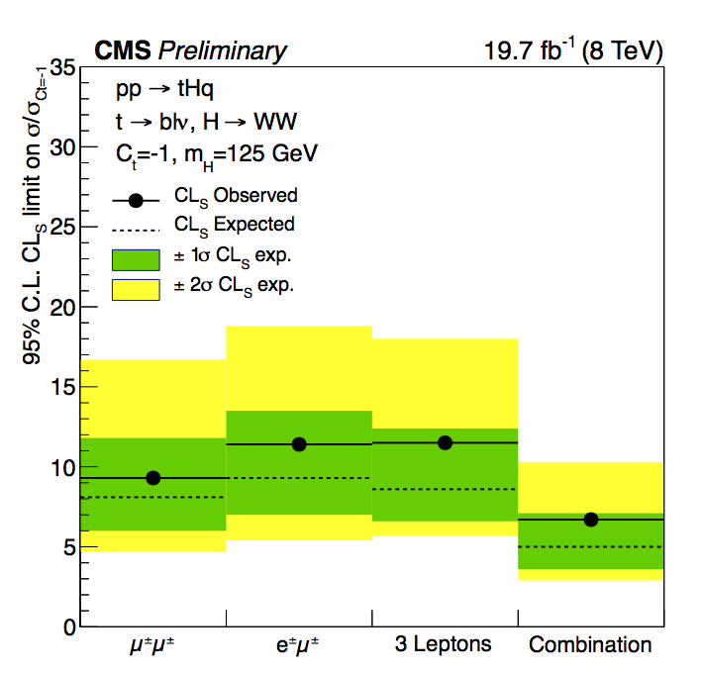
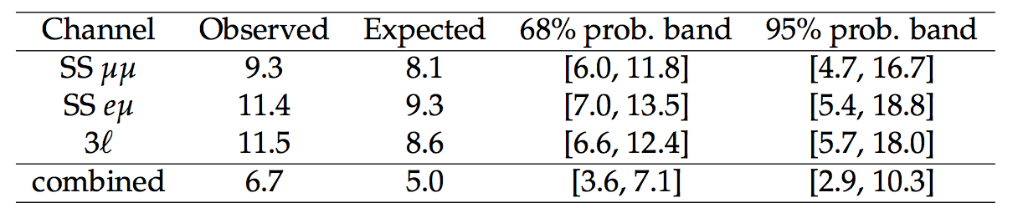
tHq 2L-3L
Signal assuming Ct =-1
tH paper
Coming soon (see Ken Bloom’s talk at DPF)
H→WW tHq PAS public
HIG-14-026

