Slide 1



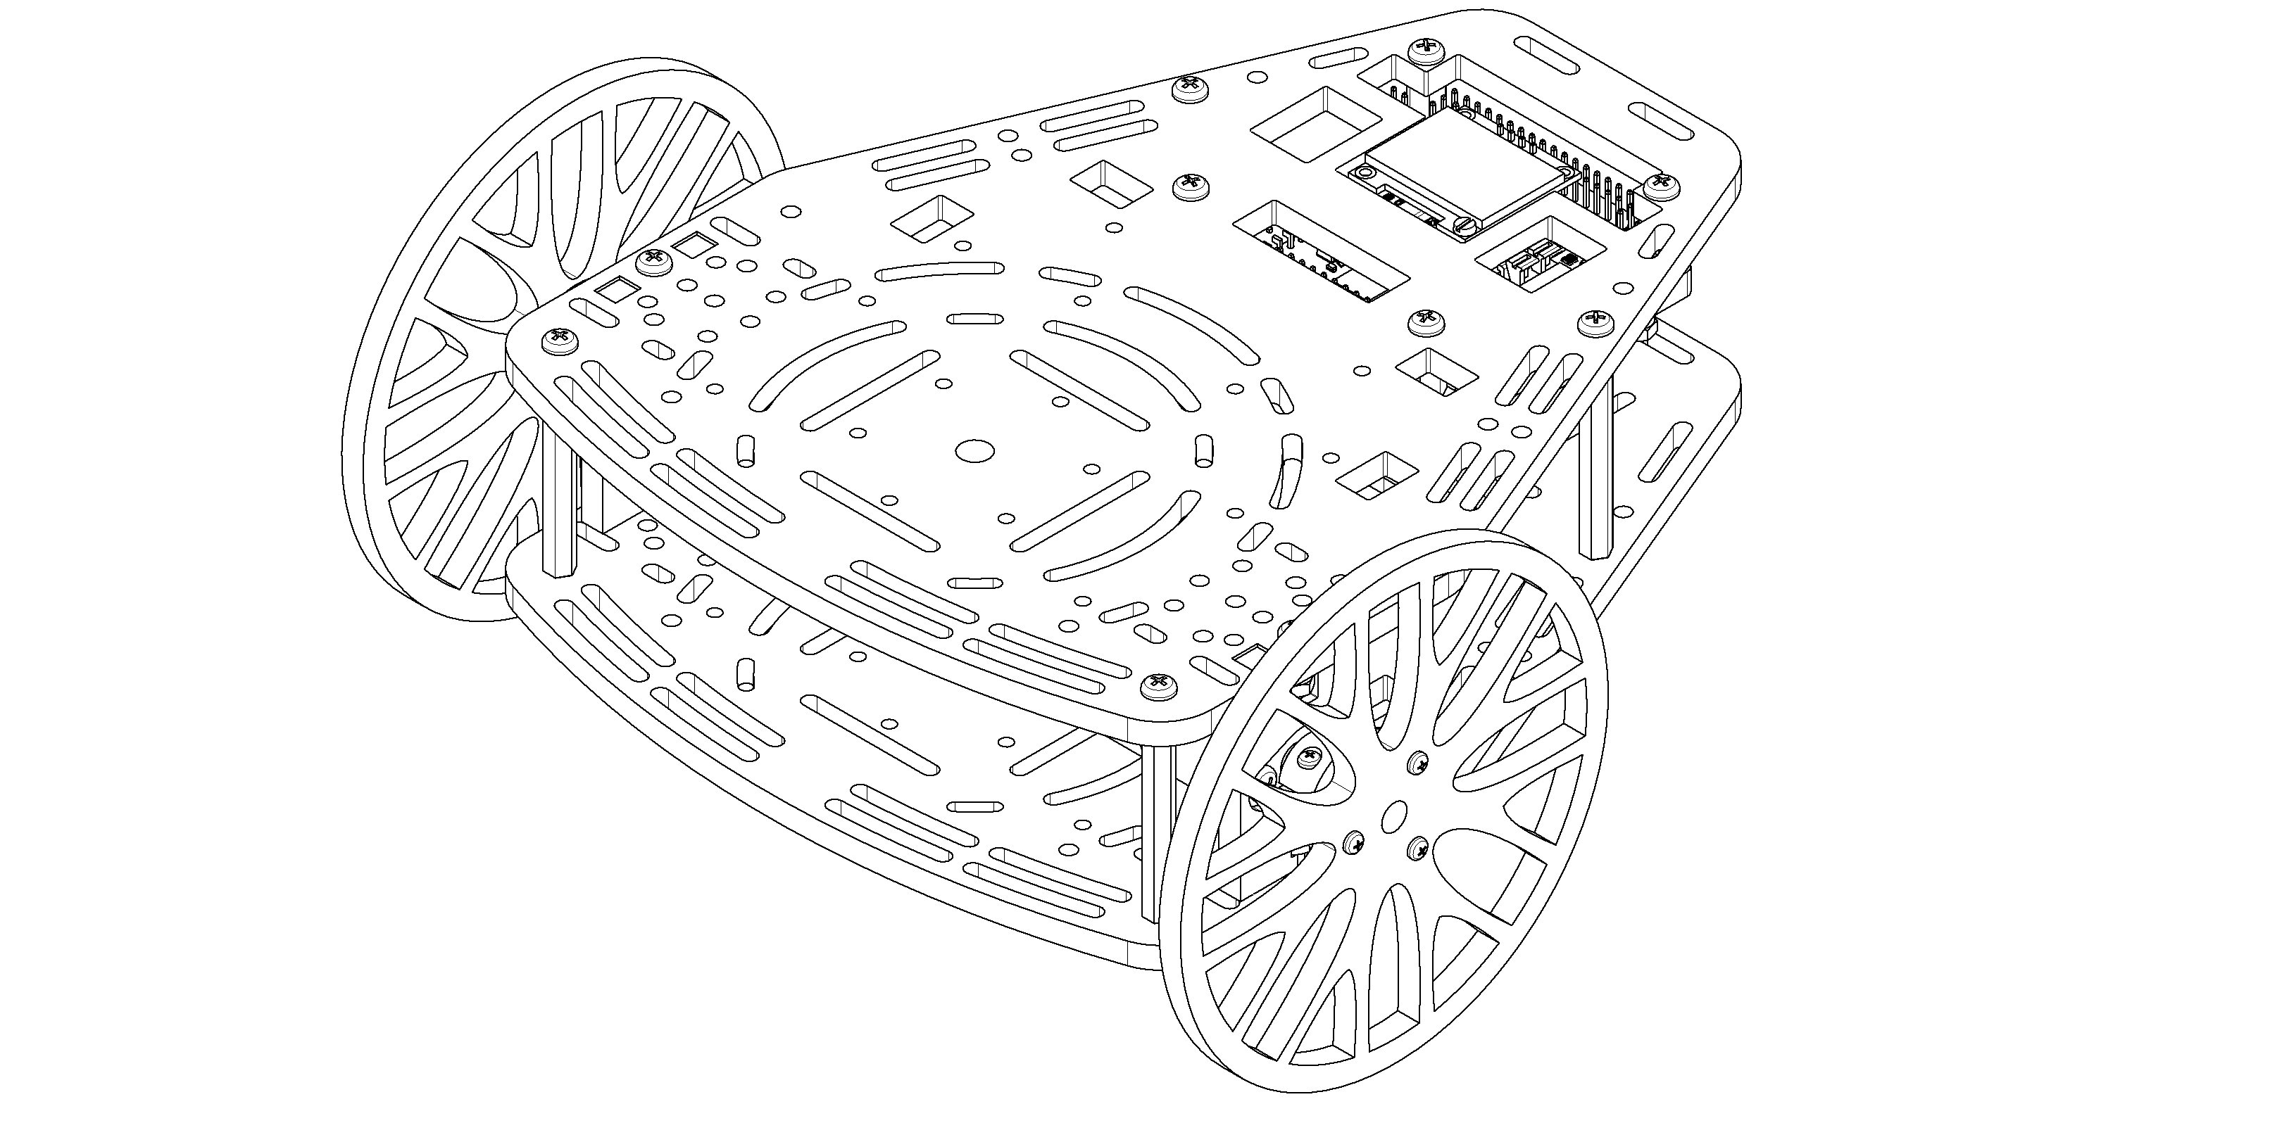
The PuzzleBot
Hardware, firmware, software, and simulation

Slide 2
In previous days …
Day 1: ROS basics
Day 2: ROS Manipulators
Modelling in ROS
Gazebo as a simulation environment
Spatial relationships
sRobot manipulation

Slide 3
Schedule
What is a PuzzleBot?
Puzzlebot setup and configuration
Adding Encoder data to the control loop
What is OpenCV?
Adding camera response to the control

Slide 4
Required HW/SW
Puzzlebot Jetson edition
Computer with ubuntu 18.04 and ros melodic installed
Start with the Jetson connected to a screen, keyboard and mouse, ideally with the wheels lifted off the ground

Slide 5
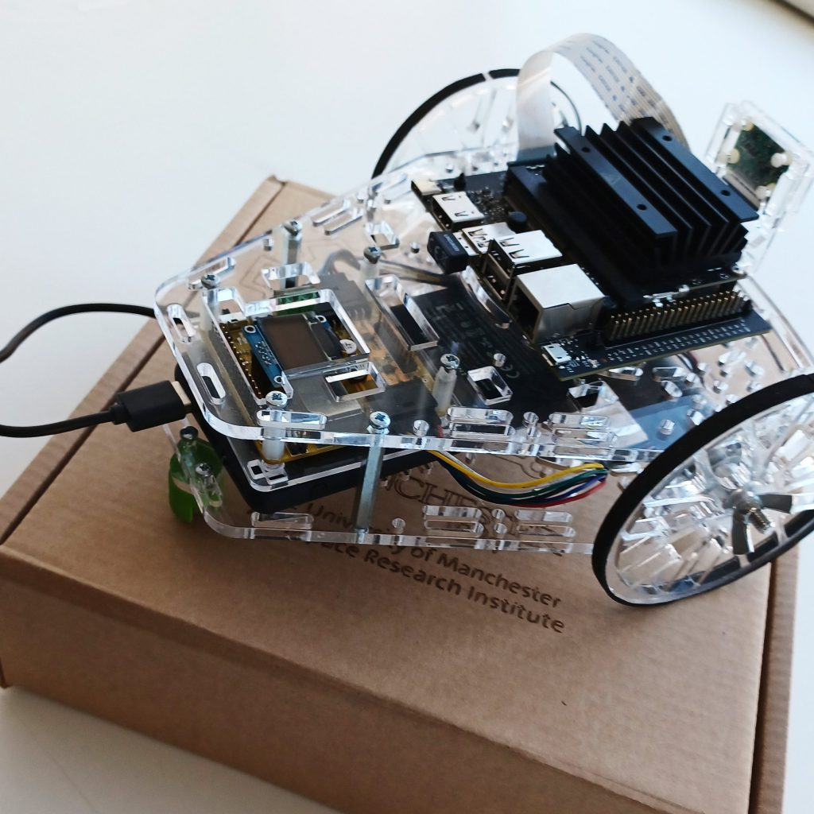
Puzzlebot: Jetson Edition
NVIDIA Jetson Nano
For AI and computer vision
Raspberry Pi Camera
GPIO Arrays
Expansion possible via the
Jetson or the Hacker Board
Hacker Board
For low-level control algorithms

Slide 6
The PuzzleBot
High Level Computing units (RPi, NVIDIA computing units, Laptop, …)
Servo Motors
GPIO
Sensors
Graphic Display
Serial
or Wi-Fi
Puzzle-Bot Control Unit
Left
Encoder
Right
Encoder
Key
Data Signals
Power
Motor Signals
Optional connection
External Power Supply (5 V, 3 A)
(not included)
Wi-Fi / Bluetooth Module (Built-in)
Motor driver
Left Motor
Right Motor
Notes:
Here is a basic block diagram of the puzzlebot
Power can be provided via a USB power bank or an external 5V power supply
High level control algorithms are programmed in the high level compute unit, and control signals can be communicated to the robot via WiFi or USB Serial
Low level – realtime – on the Hacker Board
High level – AI – Real-time not necessary

Slide 7
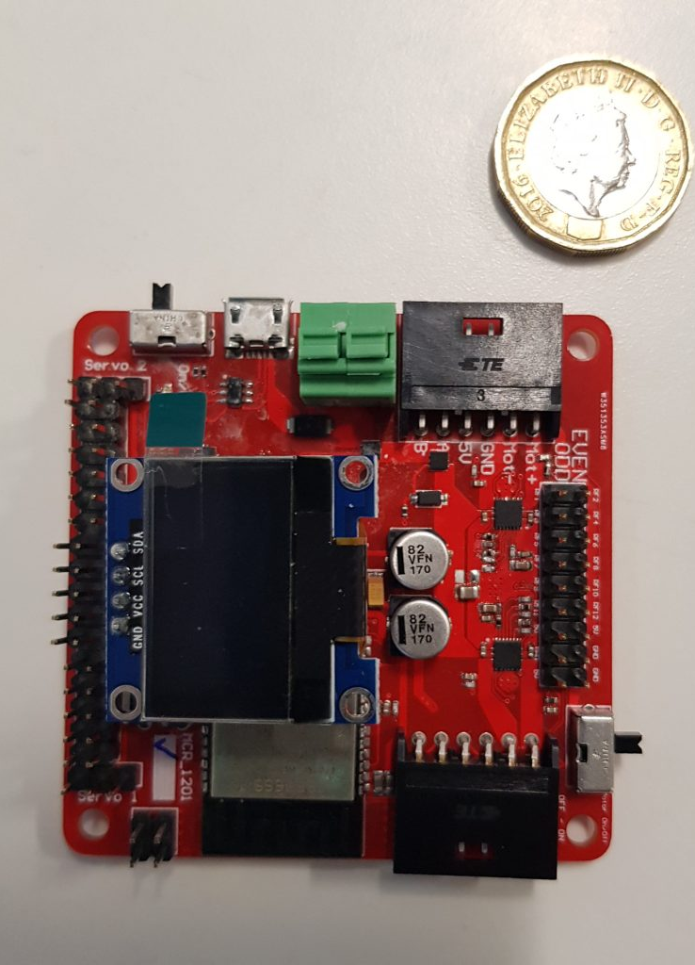
The Hacker Board
ESP32-based Microcontroller
Xtensa dual-core 32-bit LX6 microprocessor
520 KB of SRAM
WiFi & Bluetooth
DC-DC Converter
Motor Driver
0.96” I2C LCD Display
Notes:
Note: Mexico course has V1, but the new robots will be V2
For control of low level, low power components such as motors and encoders
DC-DC convertor provides the voltages necessary for all onboard components
Screen by default displays information such as motor speeds, sonar distance, and connection details

Slide 8
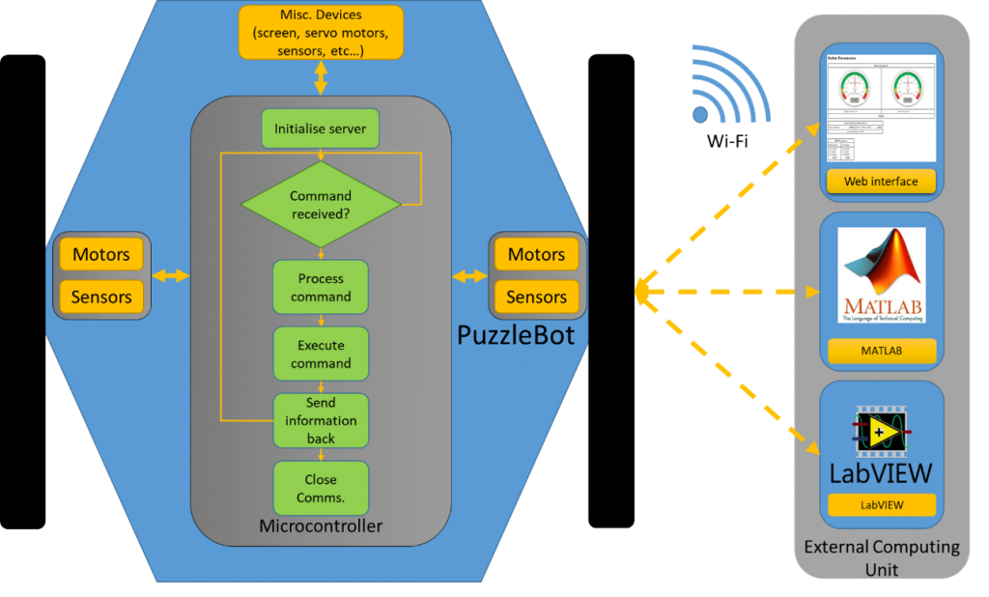
The Hacker Board
Preprogramed firmware including basic control, sensing, and communication libraries
Two programming configurations:
Standalone Configuration
External-Control Configuration
Notes:
Standalone Configuration:
The Hacker Board is programmed directly, making use of the provided libraries to interface with other hardware
This is done using Arduino because it is very popular, however other options (such as Espressif’s system)
External-control Configuration: Control is provided by an external computer, with communication achieved via WiFi or Serial.
All the low level interaction with peripherals is abstracted away
Control algorithms can therefore be tested and implemented with ease
Simple controls can be sent from a webpage, and more complex algorithms can be implemented in MATLAB or labView (python coming soon). MATLAB (and soon python) feature simulations of the puzzlebot, enabling algorithms to be tested before being implemented on the real robot.
In this course, the external compute unit will be the NVIDIA Jetson Nano. Combined with the raspberry pi camera, this setup enables basic control such as line following along with the use of AI for object recognition and identification.
As well as communicating with the hackerboard using ROS, the jetson can communicate with an external PC to receive commands, and could be configured to communicate with other robots for multi-agent control

Slide 9
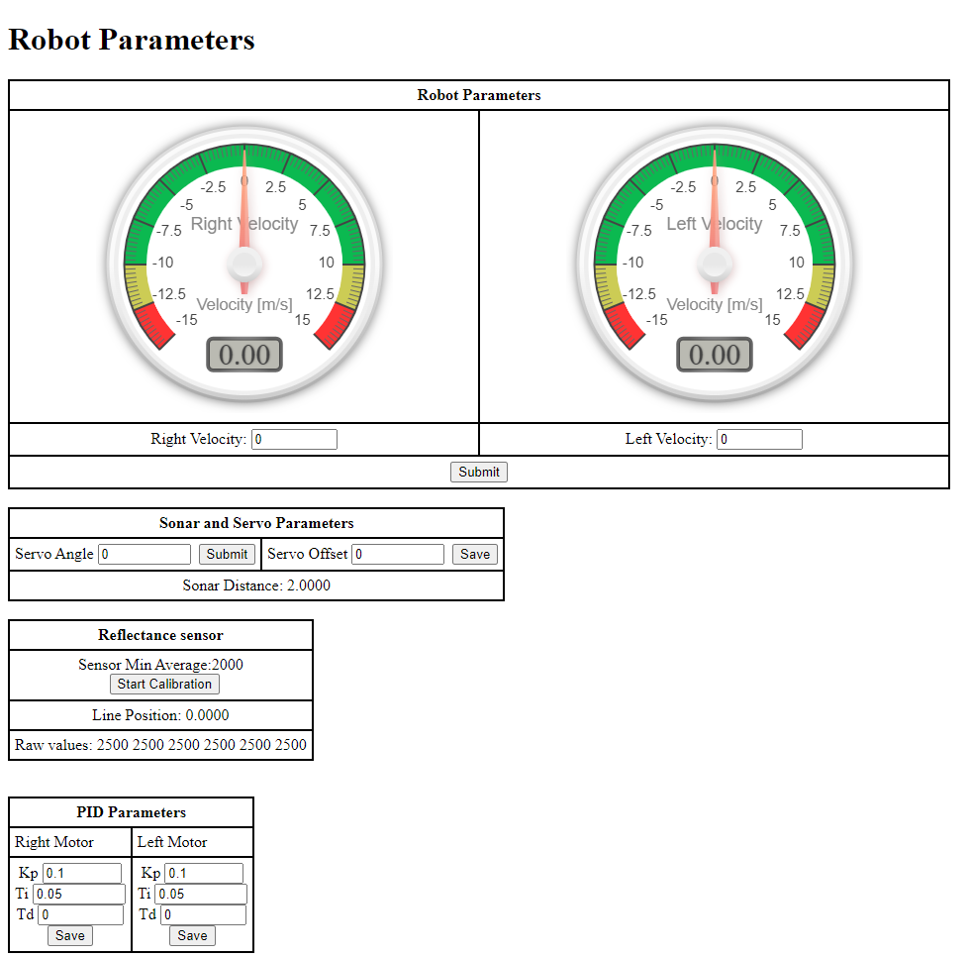
The Webpage
Connect to the WiFi Network displayed on the Hacker Board
Go to 192.168.1.1 in a browser
Notes:
Explain functionality of webpage, how to control wheels and read speed, that it can be used to test the hardware and debug problems
Mini Task
Navigate to the webpage
Read the speed of the wheels (by manually rotating them)
Set the speed of the wheels
Robot Should be lifted off the ground

Slide 10
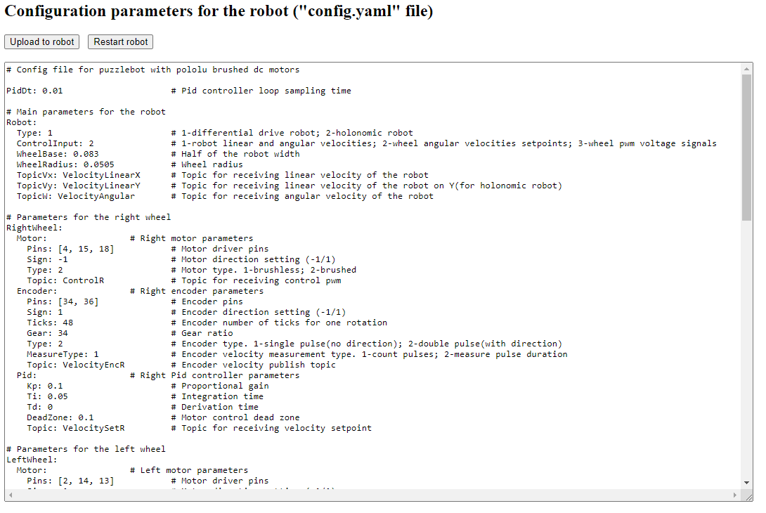
The Config
Now visit 192.168.1.1/config
Notes:
This file allows the parameters of the firmware to be set by the user.
3 Control modes
1 – Send v and ω, the linear and angular velocities of the whole robot
2 - Send ωr and ωl, the velocities of the left and right wheels
3 – Send pwmr and pwml, the pwm values for the left and right motors (between 0 and 1)
Other key Parameters:
Robot geometry
Pins for hardware (do not need changing except between hacker-board updates)
PID constants for the internal controllers (explain that control modes 1 and 2 use an internal PID controller to set the PWM sent to the motor)
Webpage parameters
Activation values for hardware and software features (such as ROS/sonar/Lidar/etc)
For the change to take effect, click “upload to robot”, and then “restart robot”
For today’s activity:
Ensure the control input is set to type 2
Return to the main webpage and check if the controllers are working correctly by commanding the wheels to move.
If the wheels immediately accelerate to full speed, there is a sign issue. Try changing the sign of the motor, encoder, or both.
Now set the control input to type 1
Ensure the wheelbase is set to 0.19
Ensure that ROS is turned on

Slide 11
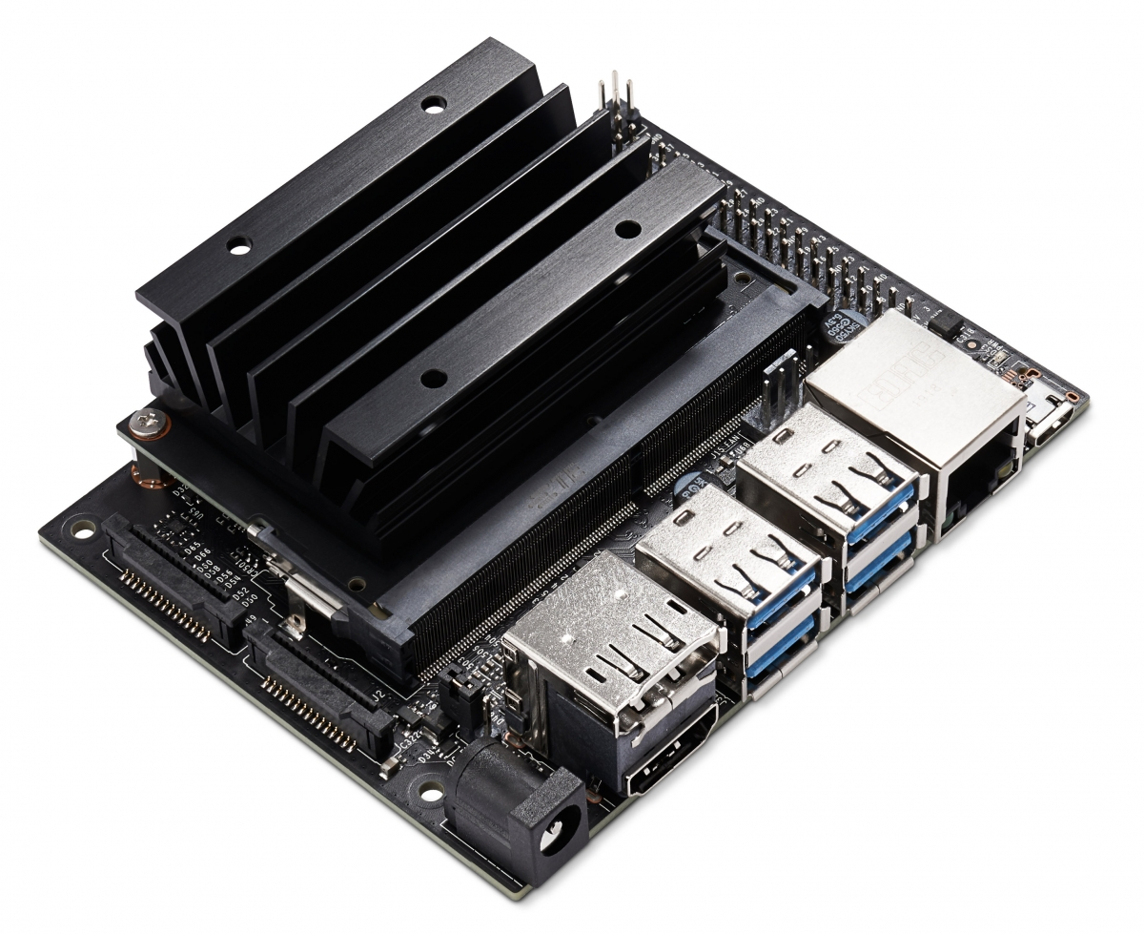
The Jetson Nano 2GB
128-core NVIDA Maxwell GPU
1.43 GHz Quad-core ARM A57 CPU
2 GB of 64-bit LPDDR4 Memory
SD card for storage
Ethernet & WiFi
CSI-2 Connector for Camera
Runs a modified version of Ubuntu 18.04
Notes:
Designed for AI applications, but also featuring hardware and software which enables easy communication with the puzzlebot
It can be interfaced with like a PC for the writing and debugging of code. Once the code is written, it commands to run the code can be sent remotely such that the robot can move freely
The operating system is an NVIDIA-modified version of ubuntu 18.04, which comes with a selection of useful tools for robotics and AI, such as OpenCV, pre-installed
The OS is loaded onto an SD card from an external computer, which is then inserted into the Jetson

Slide 12
The Jetson Nano 2GB
Communicates with the Hacker Board serially via ROS
Runs NVIDIA’s own version of Linux, similar to Ubuntu
The OS is flashed onto the SD card by a PC
Three options for setup
Use the provided image in place of the NVIDIA image (recommended)
Run a setup bash file
Manual installation
Notes:
The Rosserial package enables USB communication with the hacker board. When rosserial is activated, a set of topics appear to the Jetson which enable it to control the hacker board.
The jetson is setup by flashing an OS image to an SD card, and then inserting it. Full instructions linked here.
However, the Jetson does not come with ROS, so there are three methods to install it and configure it for use on the puzzlebot.
Firstly, a pre-created image is available. This can be flashed onto the jetson using the same method as the standard image.
The base image includes all the necessary programs (including ROS) for basic communication with the hacker board.
A second version of the image also sets up OpenCV and the Pi Camera for communication with ROS
Secondly, if the user already has a Jetson up and running, ROS and the required packages can be installed by running a bash script
Thirdly, detailed instructions for the manual configuration of ROS on the Jetson are provided in the Puzzlebot User Manual

Slide 13
The Jetson Nano with ROS
Ros Master
Jetson
Hacker Board
Sensor node(s)
User
Node(s)
Control
Node(s)
Actuator
Node(s)
ROS Implementation
Notes:
ROS Master running on the Nvidia Jetson
Control nodes can be built to run on the jetson or on an external PC
Pros of Jetson control nodes:
Jetson should have sufficient power to deal with most problems
Wifi transmission (e.g. of images) is slow
Pros of External compute unit control nodes:
Easier to debug without hooking the jetson up to peripherals
External computer can be very powerful, but still likely to be bottlenecked by wireless transmission speeds
Ideal for high level commands
Use of world-level vision

Slide 14
Multi-device Communication
Each device has its own ROS_IP and ROS_ MASTER_URI variables
The ROS_IP is always the local IP of the device
The ROS_MASTER_URI informs the devices where in the network the ROS master is
By default, both IP and URI are local to each device
External PC
Jetson
ROS IP – local IP with reference to Jetson Network
ROS Master URI – Points to master on the Jetson
ROS IP – local IP with reference to Jetson Network
ROS Master URI – Points to local master
Notes:
With Puzzlebot, the ROS Master runs on the puzzlebot, so the external PC must be directed to that master.
This enables remote control of the puzzlebot and debugging of the Jetson code, without needing to connect the jetson to a monitor/keyboard
Mention ROS_Hostname – with more devices, referring to each by IP can be confusing, so ROS hostname provides a way to give each device a name

Slide 15
Activity Teleoperation
Setup a PuzzleBot Jetson:
https://developer.nvidia.com/embedded/learn/get-started-jetson-nano-devkit#write
Install the ROS teleop twist keyboard package on an external PC
sudo apt install ros-melodic-teleop-twist-keyboard
Connect the external laptop/PC
The Jetson will create its own WiFi network that can be used to communicate with it
Name: PuzzlebotJetson
Password: Puzzlebot72
The WiFi details can be changed on the Jetson by selecting:
Networks->Edit Connections->Hotspot
Notes:
For the Mexico course, the PuzzleBot will already be setup. Suggested to guide them through the setup process anyway as this will not always be the case. Click on the link, show them the etcher software
The teleoperation package enables basic keyboard control by publishing messages to the rostopic package
NOTE: if multiple Jetsons are to be run in the same area, they will need to have unique Network names. Suggest demonstrating how to do this.
Puzzlebot72 is also the default password for the Jetson itself, so if sudo is required, that is the password

Slide 16
Activity: Teleoperation
Remotely connect to the PuzzleBot from the external device
Use ifconfig to get local IP. It will be of the form 10.42.0.XXX
export ROS_MASTER_URI=http://10.42.0.1:11311
export ROS_IP=<your_local_ip>
Once connected, use rostopic list to check if the connection has been successful
The topics /cmd_vel, /wr, and /wl should be displayed, along with a few others
Use the external device to remotely operate the puzzlebot
rosrun teleop_twist_keyboard teleop_twist_keyboard.py
Follow the instructions displayed in the command window
Notes:
Troubleshooting:
If we can see the master on the external PC but not the right topics (usually just 2 or 3 topics including /rosout), there is a problem with the hackerboard communication
The communication can be restarted with sudo systemctl restart puzzlebot.service
The status of the communication can be checked with sudo systemctl status puzzlebot.service

Slide 17
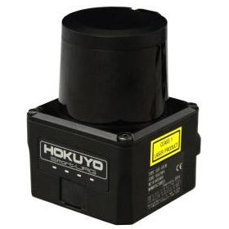
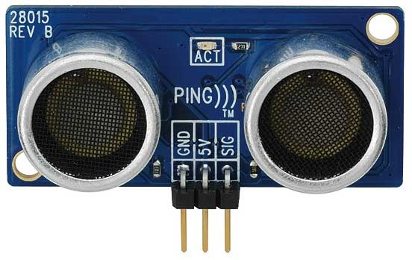
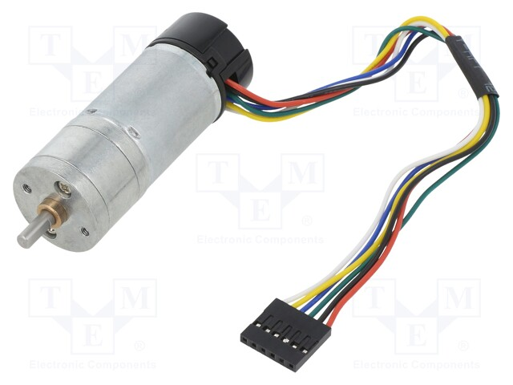
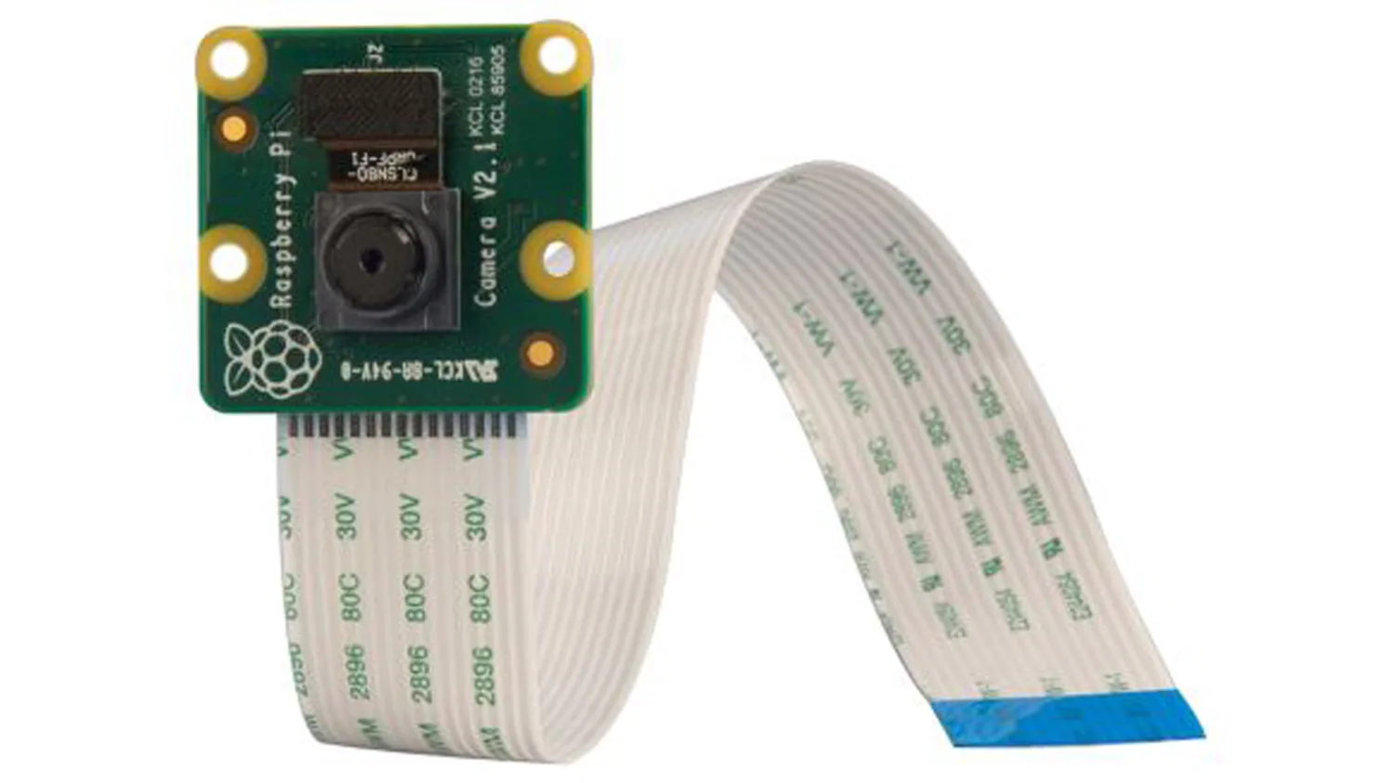
Sensors
Hacker Board | Jetson
Sonar | LIDAR
Encoder | Camera
Notes:
Simple sensors that require little processing power are typically connected to the hacker board, which supports sonar, line sensors, some LIDARs, and encoders out of the box. The data is then published to a ROS topic by the node which runs on the hacker board
More complex sensors, such as some LIDARs or camera, are to be connected to the jetson. ROS packages to support those devices are typically made available either by their manufacturers, or by NVIDIA

Slide 18
Closing the Loop
Robot
Node
+
Error
Controller
/cmd_vel
Robot
Velocity Set Point
Output
(Robot Motion)
-
/cmd_vel
/wl
/wr
Controller
Node
Encoders
/wr
/wl

Slide 19
Activity: Closing the Loop
First, use the code that drove the simulator in a square to drive the real robot
Next, attempt to improve the performance of the robot by making use of the encoders, implementing the PID loop shown on the previous slide.
There is no need to tune the PID constants at this stage
Subscribers
Integrators
Controller
Publisher
Encoder data on topics
/wr
/wl
ωr
ωl
d
θ
v
ω
Robot Velocity
to topic /cmd_vel
Notes:
Firstly, the robot should be made to drive in a square simply by sending commands on /cmd_vel for specific amounts of time, as was done with the simulator on day 1
Secondly, a pair of P/PI/PID controllers should be added to control the forward speed and angle. Integrate wr and wl, work out the distance and angle of the robot, and then use them as error inputs to the controllers
This figure shows the suggested structure of the controller node
A loop such as this could be implemented either on the jetson or a remote PC. However, here we shall be implementing it on the Jetson as future code will depend on this and will need to be on the Jetson
Now we should have a basic navigation algorithm, based on dead-reckoning localisation.

Slide 20
Activity: Launch and config files
Using the guidance given on day 1, create a config file which contains the tuning parameters for the PID controller
Create a launch file that sets the gains in the ROS parameter server and starts the controller node
Check that your launch file has worked
rosparam list
rosparam get <parameter_name>
Modify the controller code so it takes the PID gains from the parameter server
Notes:
This setup currently only has one node, however we may require multiple
Also, it is useful to be able to edit the PID parameters from a config file.
Easier to navigate on an external PC
When using c++, we have to call catkin_make every time we modify the source files, which is time-consuming when tuning things such as PID parameters. Storing these parameters in a config file removes this step
Multiple nodes can access the same shared parameters

Slide 21
Activity: Remote access
Since the config file is small and easy to edit, we can tune the parameters remotely
On the external PC, access the Jetson with ssh:
ssh puzzlebot@10.42.0.1
Password: Puzzlebot72
This command window is now equivalent to one running on the Jetson.
We can edit the PID constants with nano <path_to_config>.yaml
Launch ROS files using roslaunch <package> <file>.launch
Now tune the PID Loop using this remote access.
Notes:
- Now to tune the PID loop, the robot will need to be on the ground, so disconnect

