Slide 1
Progress Logbook
SP2022

Slide 2
Summary
Wrote classifier script on small PD dataset
Converted images into (BW) array for classification (completed KNN and CNN)
Combined all images, scrambled and split (both done randomly) into train data and validation data (20%)
Tweaked CNN to get best results (max accuracy achieved ~85%)
Things to still accomplish:
Research BME professors
Learn how to use server
Work on image classification example
Create a GitHub
Convert into JupyterNotebooks

Slide 3
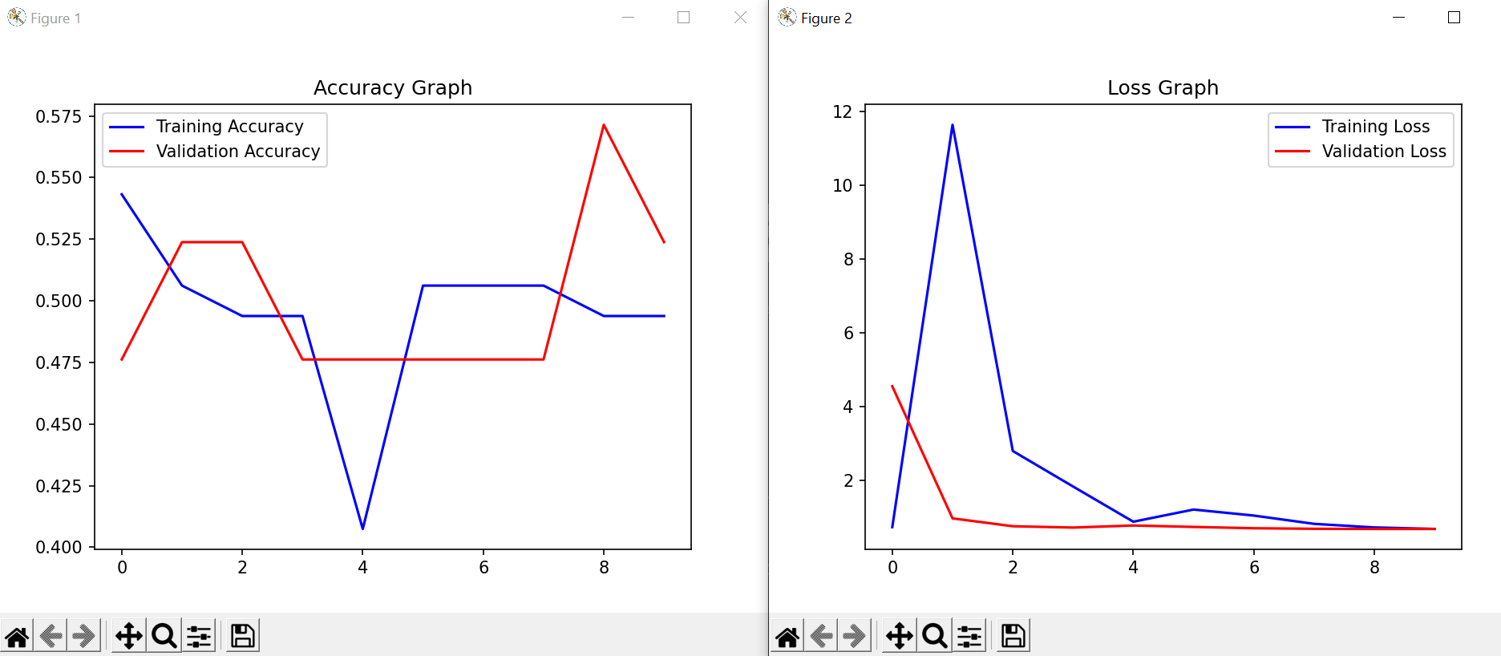
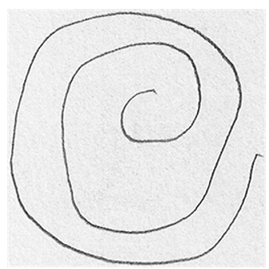
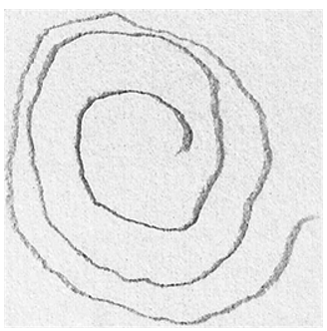
Original results from image cnn
This CNN used 4 layers, original images with minimal augmentation.
Results look awful

Slide 4
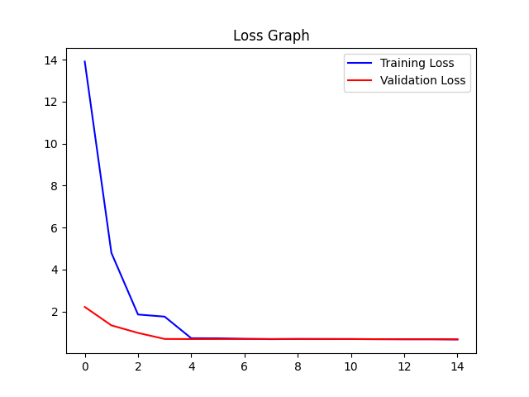
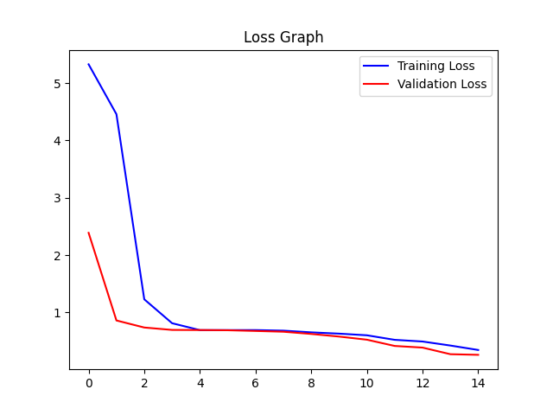
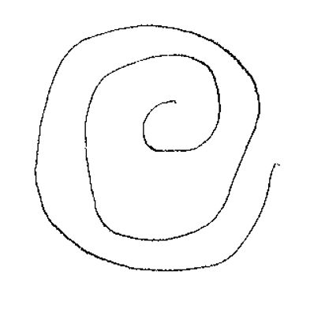
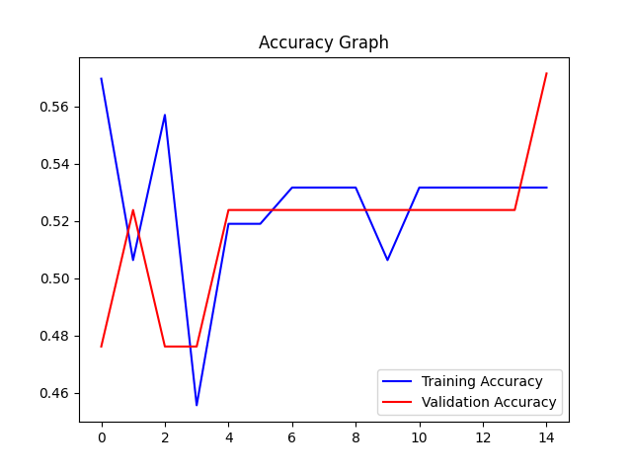
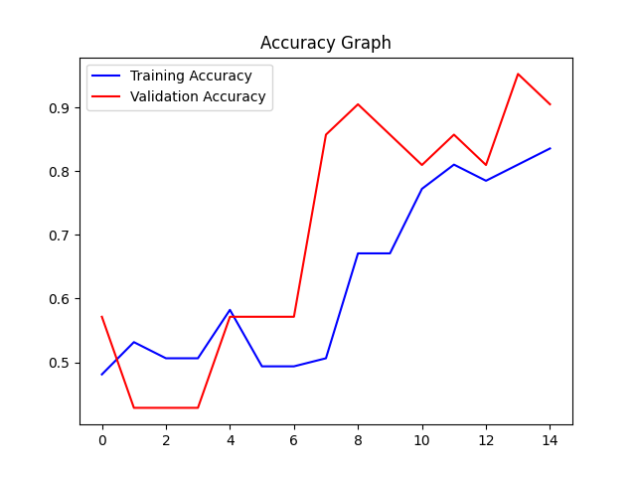
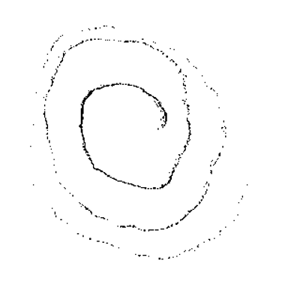
Results from array-based image cnn
Same CNN used from image classifier (on previous slide).
Very mixed results.
More often looked like bottom results.
128 threshold
150 threshold

Slide 5
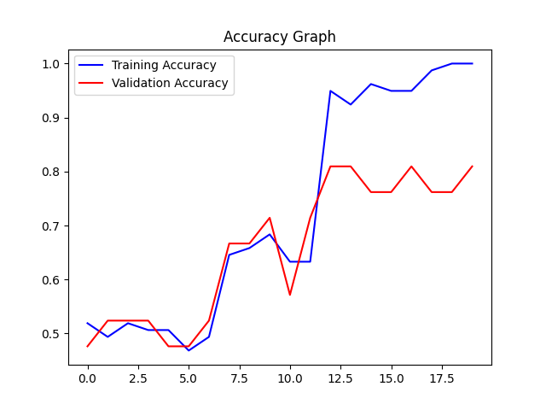
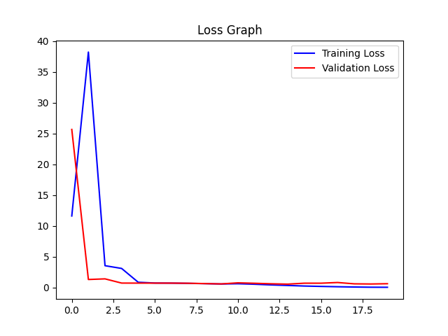
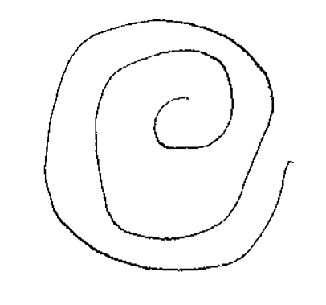
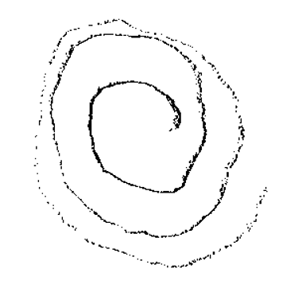
ARRAY-BASEd image cnn – 3 layers (150 BW threshold)
Results starting to look more promising
Ran numerous times, and more often got similar results to this than those of the original

Slide 6
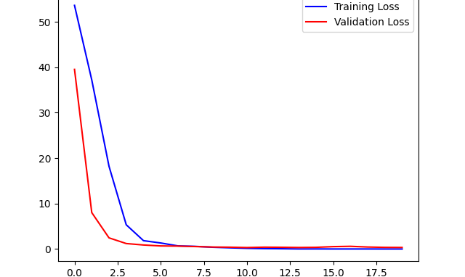
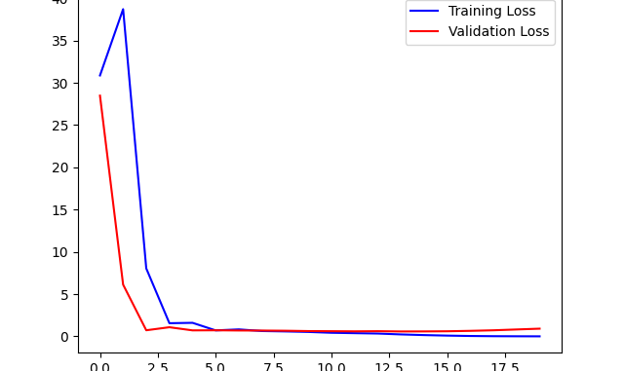
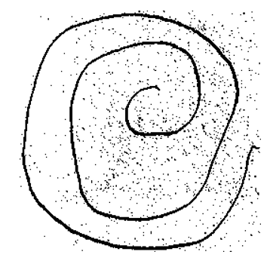
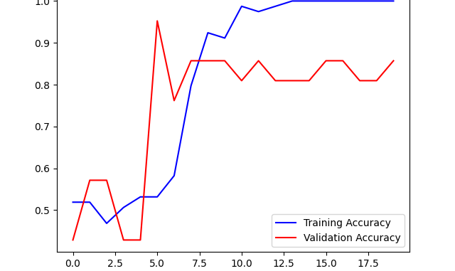
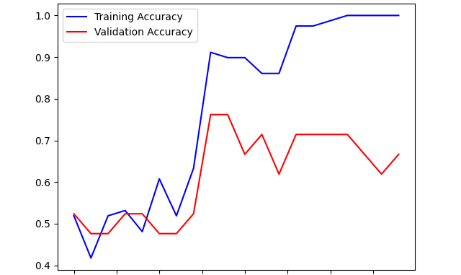
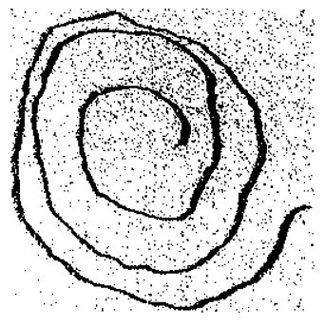
ARRAY-BASEd image cnn – 3 layers (225 BW threshold)
Started getting much better results, more consistently

Slide 7
KNN Results
128 threshold | k=1, accuracy=52.38% k=2, accuracy=52.38% k=3, accuracy=42.86% k=4, accuracy=57.14% k=5, accuracy=57.14% k=6, accuracy=57.14% k=7, accuracy=57.14% k=8, accuracy=57.14% k=9, accuracy=57.14% k=10, accuracy=57.14% | k=1, accuracy=42.86% k=2, accuracy=42.86% k=3, accuracy=42.86% k=4, accuracy=66.67% k=5, accuracy=66.67% k=6, accuracy=57.14% k=7, accuracy=57.14% k=8, accuracy=57.14% k=9, accuracy=57.14% k=10, accuracy=57.14% | k=1, accuracy=52.38% k=2, accuracy=52.38% k=3, accuracy=42.86% k=4, accuracy=57.14% k=5, accuracy=57.14% k=6, accuracy=57.14% k=7, accuracy=57.14% k=8, accuracy=57.14% k=9, accuracy=52.38% k=10, accuracy=52.38%
150 threshold | k=1, accuracy=66.67% k=2, accuracy=66.67% k=3, accuracy=66.67% k=4, accuracy=66.67% k=5, accuracy=66.67% k=6, accuracy=61.90% k=7, accuracy=66.67% k=8, accuracy=42.86% k=9, accuracy=42.86% k=10, accuracy=33.33% | k=1, accuracy=66.67% k=2, accuracy=57.14% k=3, accuracy=71.43% k=4, accuracy=47.62% k=5, accuracy=52.38% k=6, accuracy=42.86% k=7, accuracy=47.62% k=8, accuracy=42.86% k=9, accuracy=66.67% k=10, accuracy=57.14% | k=1, accuracy=47.62% k=2, accuracy=47.62% k=3, accuracy=38.10% k=4, accuracy=42.86% k=5, accuracy=38.10% k=6, accuracy=61.90% k=7, accuracy=33.33% k=8, accuracy=52.38% k=9, accuracy=42.86% k=10, accuracy=42.86%
128 -> expected not great results
150 -> started to improve

Slide 8
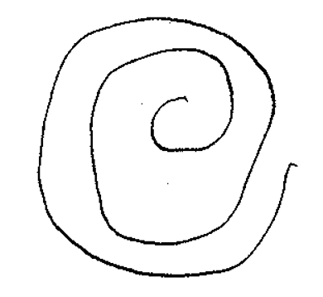
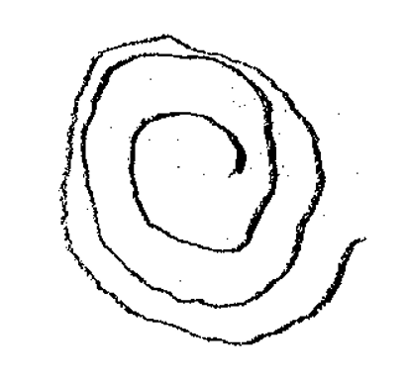
KNN Results (cont)
200 threshold | k=1, accuracy=66.67% k=2, accuracy=57.14% k=3, accuracy=80.95% k=4, accuracy=85.71% k=5, accuracy=66.67% k=6, accuracy=66.67% k=7, accuracy=66.67% k=8, accuracy=47.62% k=9, accuracy=57.14% k=10, accuracy=61.90% | k=1, accuracy=57.14% k=2, accuracy=52.38% k=3, accuracy=66.67% k=4, accuracy=61.90% k=5, accuracy=66.67% k=6, accuracy=71.43% k=7, accuracy=66.67% k=8, accuracy=57.14% k=9, accuracy=66.67% k=10, accuracy=61.90% | k=1, accuracy=61.90% k=2, accuracy=47.62% k=3, accuracy=66.67% k=4, accuracy=71.43% k=5, accuracy=71.43% k=6, accuracy=71.43% k=7, accuracy=66.67% k=8, accuracy=57.14% k=9, accuracy=66.67% k=10, accuracy=61.90%
225 threshold | k=1, accuracy=52.38% k=2, accuracy=47.62% k=3, accuracy=47.62% k=4, accuracy=38.10% k=5, accuracy=38.10% k=6, accuracy=38.10% k=7, accuracy=38.10% k=8, accuracy=42.86% k=9, accuracy=38.10% k=10, accuracy=38.10% | k=1, accuracy=71.43% k=2, accuracy=66.67% k=3, accuracy=71.43% k=4, accuracy=57.14% k=5, accuracy=47.62% k=6, accuracy=57.14% k=7, accuracy=57.14% k=8, accuracy=61.90% k=9, accuracy=66.67% k=10, accuracy=66.67% | k=1, accuracy=61.90% k=2, accuracy=57.14% k=3, accuracy=76.19% k=4, accuracy=52.38% k=5, accuracy=61.90% k=6, accuracy=52.38% k=7, accuracy=71.43% k=8, accuracy=52.38% k=9, accuracy=52.38% k=10, accuracy=38.10%
Based on how KNN works, we would expect to see not great results at 225, results were a bit all over the place
Much better results at 200

Slide 9
Conclusions / next steps
Conclusion
Results are starting to look more promising
Need to create a way to find the ideal threshold (currently just doing guess and check manually)
Next steps
Explore other classification methods (decision trees, RNN?)
Go back to the image classification and work to improve the results there

