Slide 1
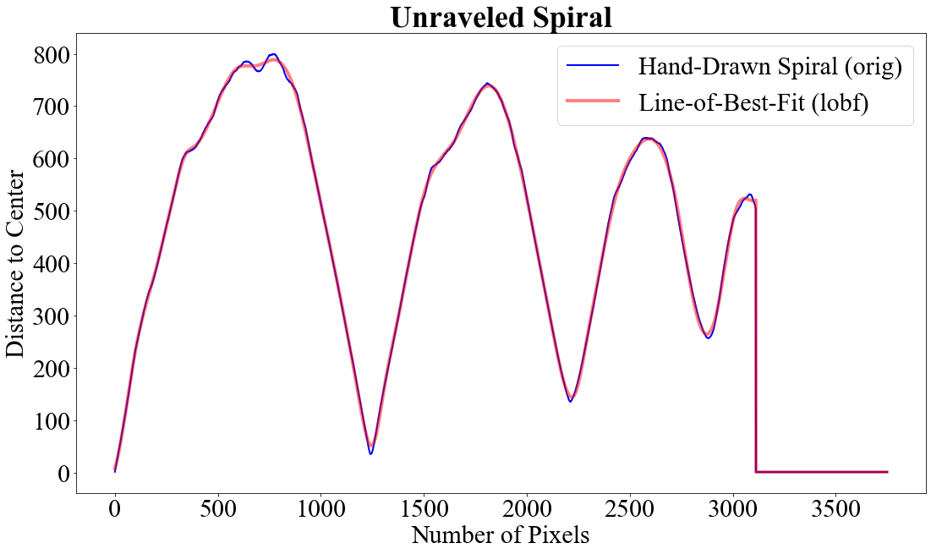
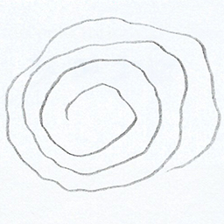
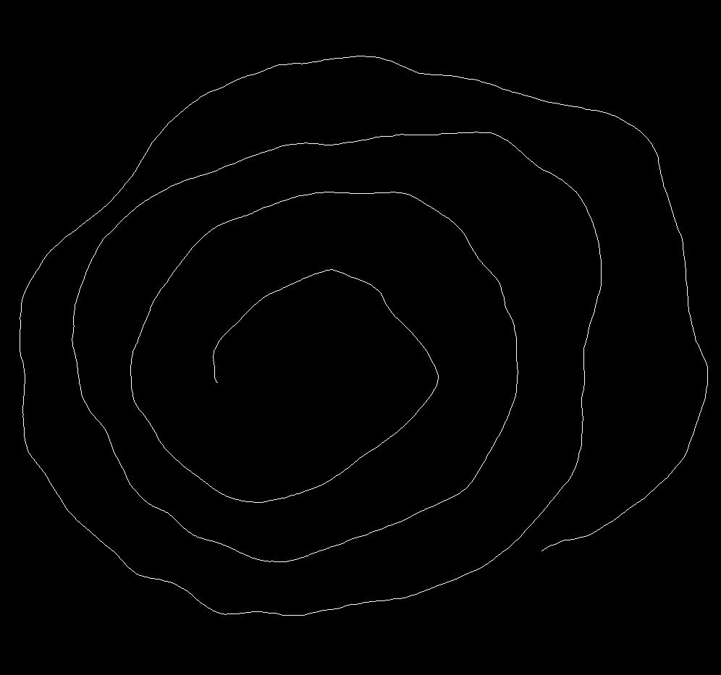
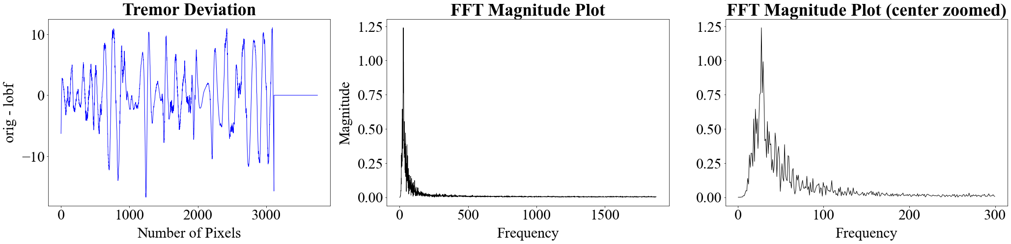
Spiral drawing
Perform morphological thinning. Obtain one-pixel-width image
1
2
3
(a)
(b)
Frequency Features
Peaks
Center Frequency
Variance
SNR
Bandwidth
Calculate histogram information
Histogram Features
Pencil Thickness
Pencil Pressure
Calculate frequency information

Slide 2
Peak
Signal
Noise Floor
Noise
Center

Slide 3
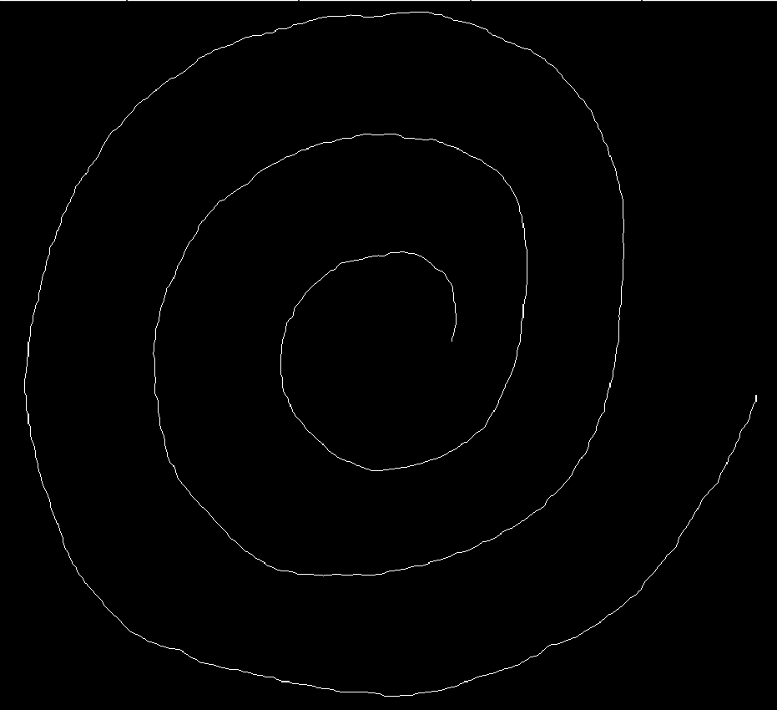
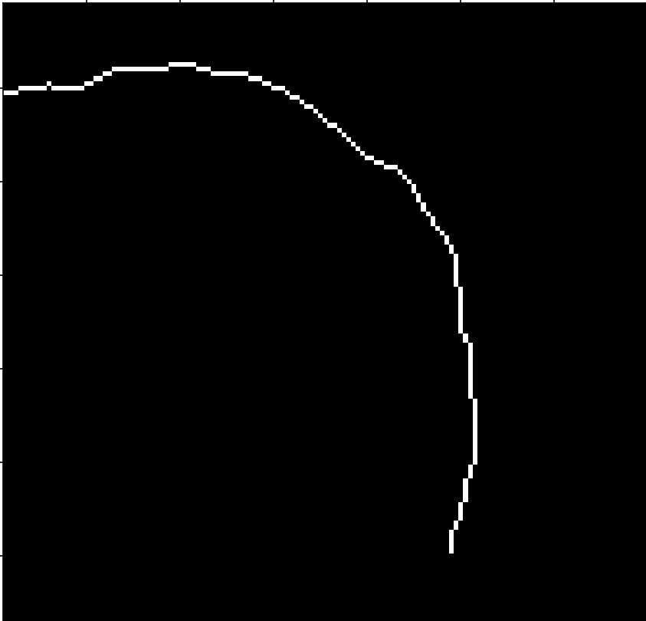
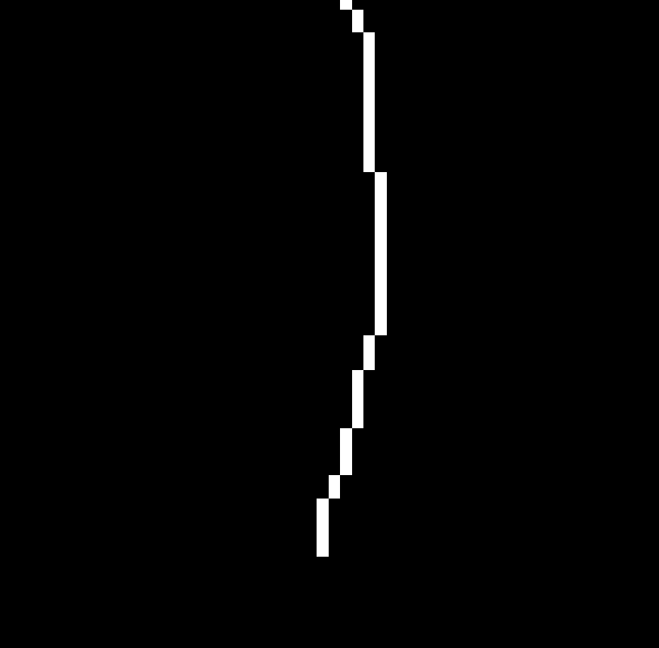
(x_{current pixel}, y_{current pixel})
STOP
Distance to Center
START
…
3
2
1
(x_{center}, y_{center})
(a)
(b)
(c)

Slide 4
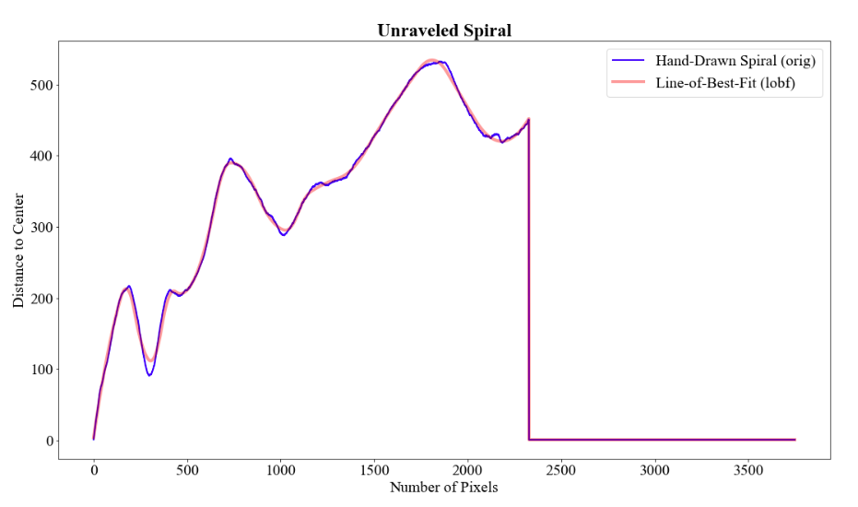
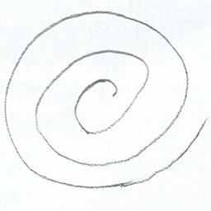
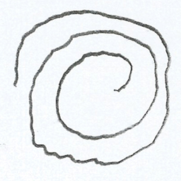
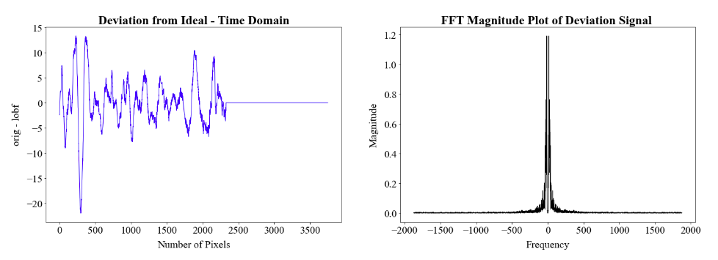
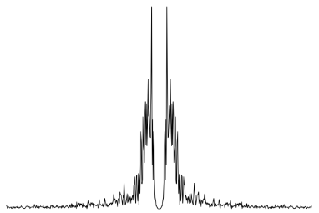
Healthy
PD
(a) Examples of hand-drawn spiral images.
(b) Unraveled spiral using Euclidean distance calculation to center.
(i)
(ii)
(iii)
(c) The left-most plot shows the tremor is present and was calculated as the difference between the original hand drawing and the spline fit (this is the time-domain representation), the center plot shows (i) converted to the frequency domain, and the right-most image is a zoomed-in plot around the center frequency of (ii).

Slide 5
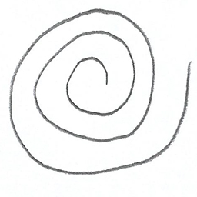
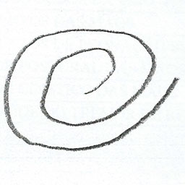
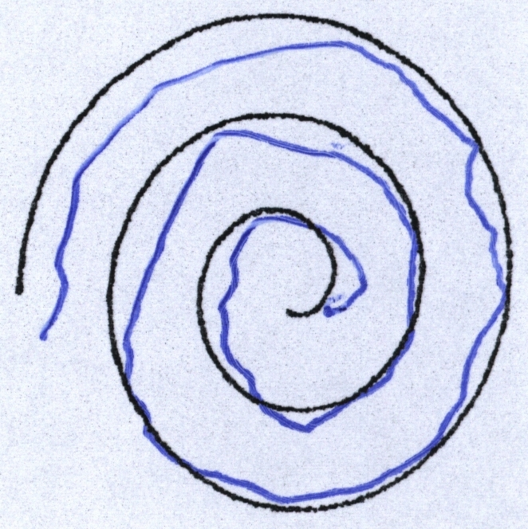
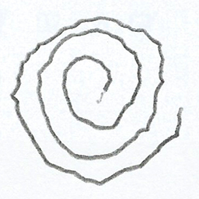
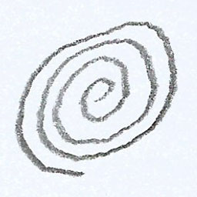
(a) Healthy spiral, contains three revolutions
(b) Healthy spiral, contains two revolutions
(e) Example image with a template provided for tracing.
(c) Parkinson’s spiral, contains three revolutions. Tremor is visibly present.
(d) Parkinson’s spiral, contains three and a half revolutions. Tightly bunched turns.

Slide 6
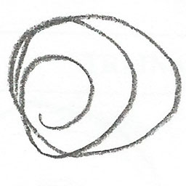
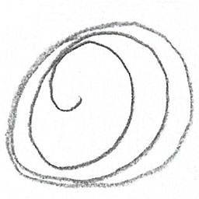
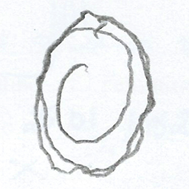
(a)
(b)
(c)

Slide 7
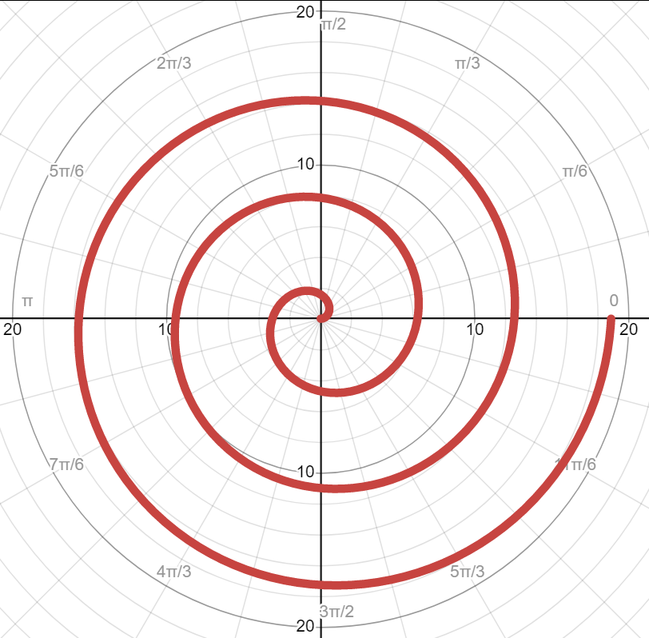
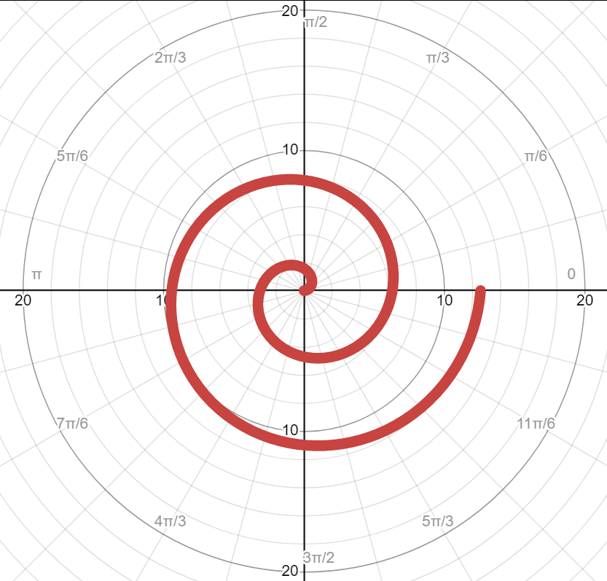
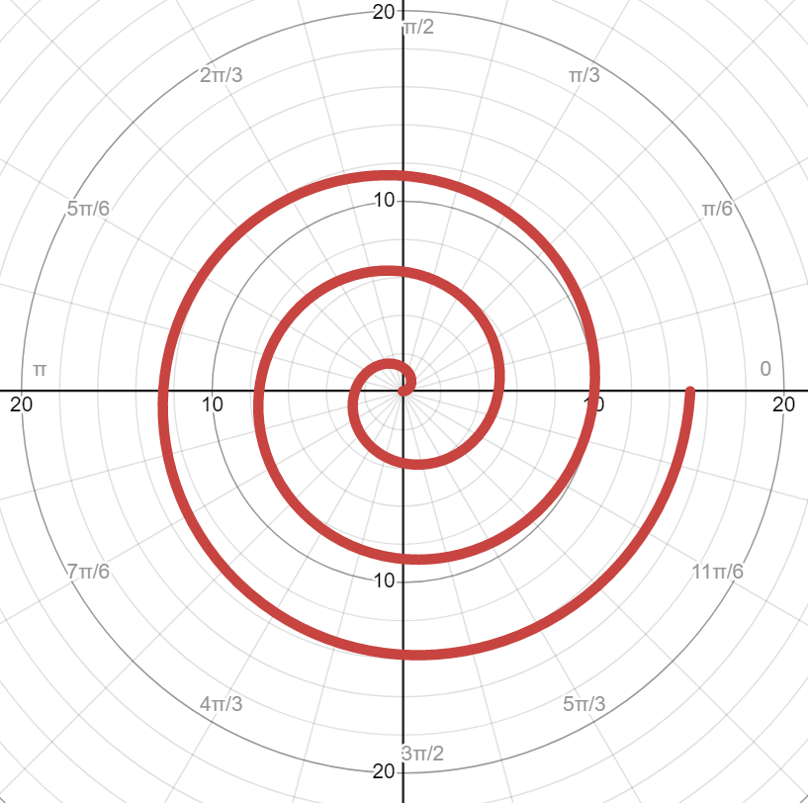
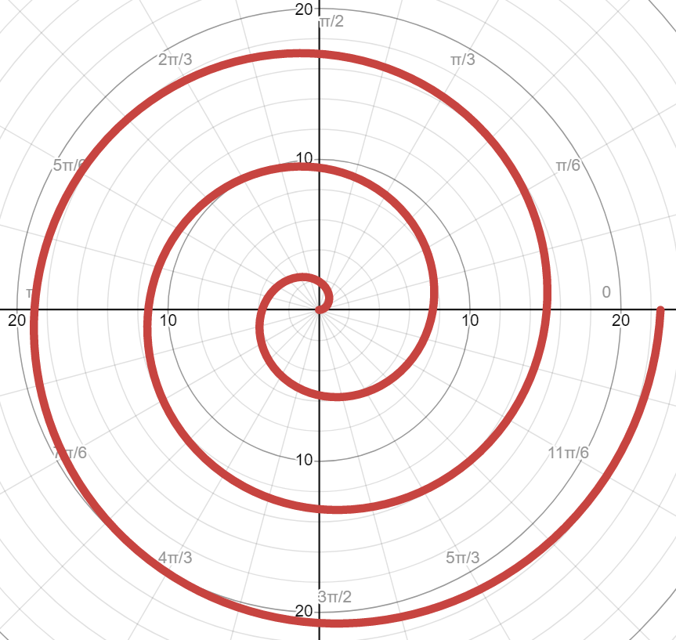




(a) $a=1, 0 ≤θ≤6π$
(b) $a=1, 0 ≤θ≤4π$
(c) $a=0.8, 0 ≤θ≤6π$
(d) $a=1.2, 0 ≤θ≤6π$

Slide 8
a
(a) Original image
(b) Morphologically thinning result
(c) Edge detection and curvature result

Slide 9
Input: (224x224x3)
CONV
Batch Norm
ResNet-50 Model Architecture without Fully Connect Layers
ReLU
Max Pool
Output:
Feature Maps
2048 7x7 maps per each image
Image Dataset
Conv Block
ID Block
Conv Block
ID Block
Conv Block
ID Block
Conv Block
ID Block

