Slide 1
Machine learning for cheminformatics
Rebecca Mackenzie

Slide 2
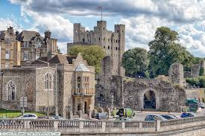
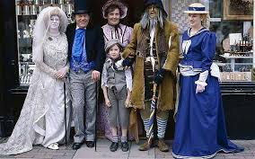
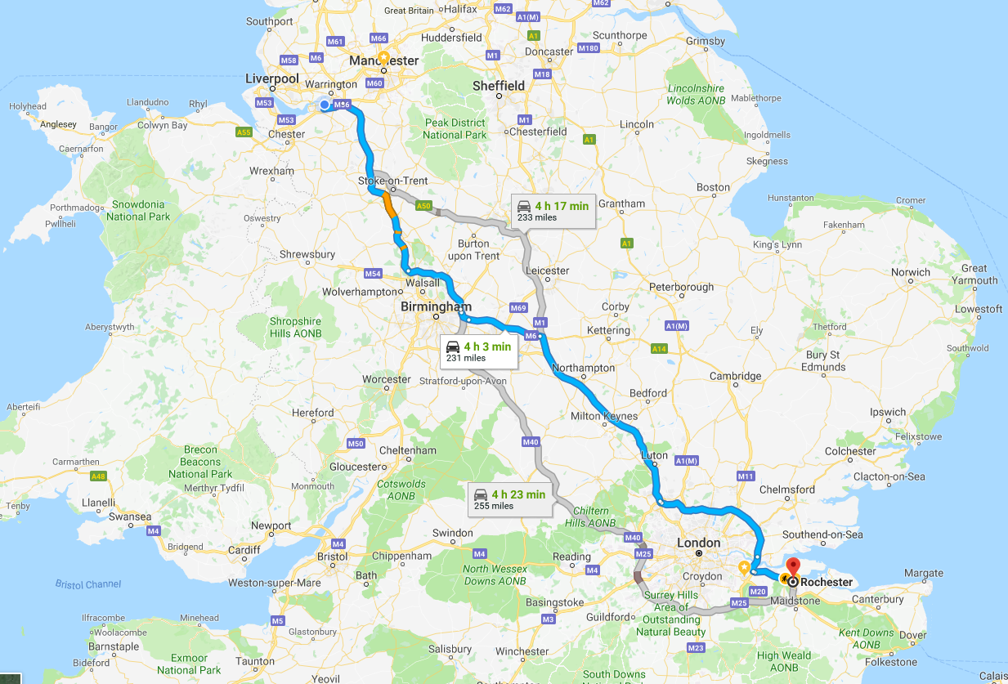
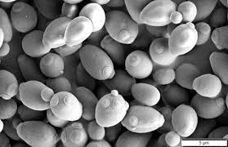
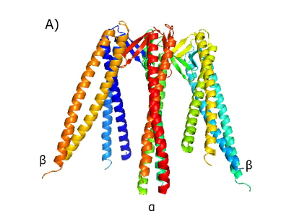

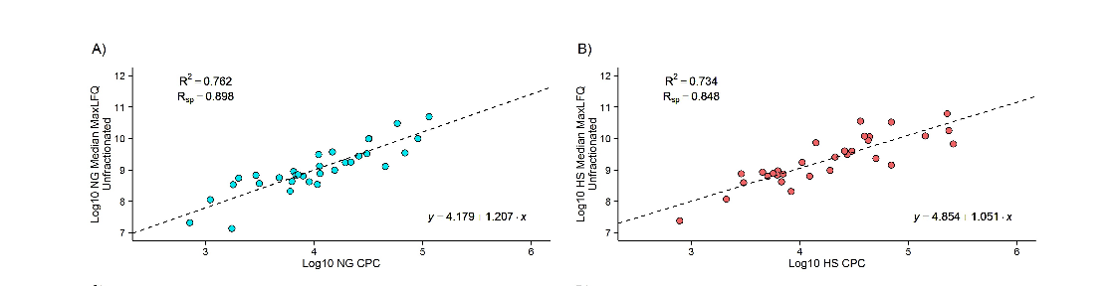

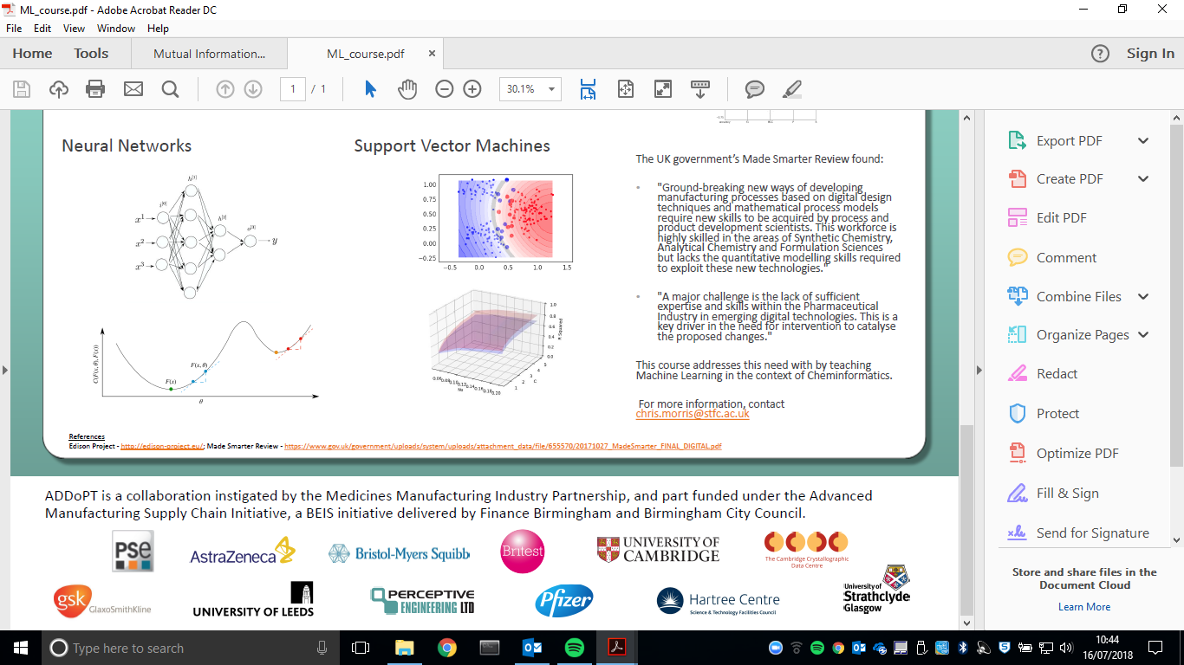
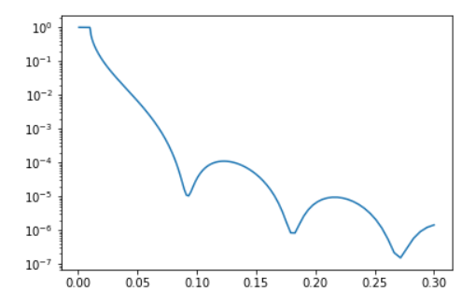
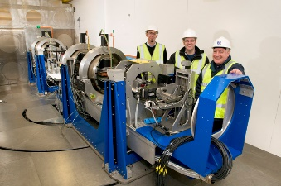
Early life
University
BSc (Hons) Biochemistry
PhD Biochemistry
ADDoPT
SciML
Career

Slide 3



Machine Learning (ML)
“A subset of artificial intelligence … uses statistical techniques to give computers the ability to learn without being explicitly programmed”
Often overlaps with computational statistics – prediction making through the use of computers
If supervised – the model is ‘trained’
If unsupervised – the model is given lots of data and must find patterns and relationships within

Slide 4
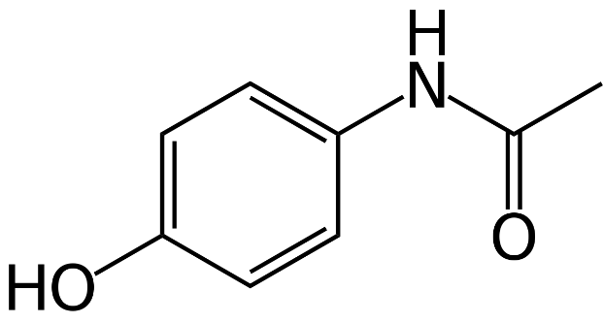

Cheminformatics (and ML)
The use of computer and informational techniques applied to a range of problems in the field of chemistry
Supervised learning – uses data to train model, then make new predictions for unknown
Predicted solubility = 6.09

Slide 5
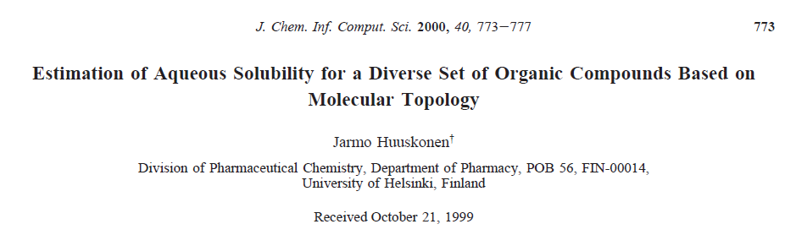
The Project
Predicting solubility from chemical structure information
If the API for a tablet isn’t soluble, it is useless.

Slide 6
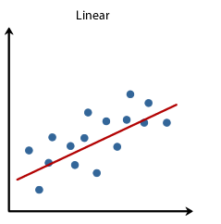
The Project
Base model is a multiple linear regression
(Linear regression, but multiple ‘x’ variables)
Project aims:
Replicate the model from the journal article
Can you find a better linear model?
Can you use other algorithms to find a better model? (Optional)

Slide 7
The work – suggested in pairs
Tutorials and exercises in python, covering relevant packages, followed by project work.
RDKit (for chemical structures and data)
Sklearn (for machine learning)
Pandas (for data)
Jupyter (interactive python kernel)
No time schedule, work at your own pace!
Optional extras if you get through it quickly.

Slide 8
I’ll be around @
 | Monday | Tuesday | Wednesday | Thursday | Friday
AM | - | 10:00 | 10:00 | 10:00 | 10:00
PM | 14:30 | 13:00 | - | 14:00 | Presentations
All files and instructions can be found in ‘student_ml_project’ folder.

